Slide 1


Slide 2
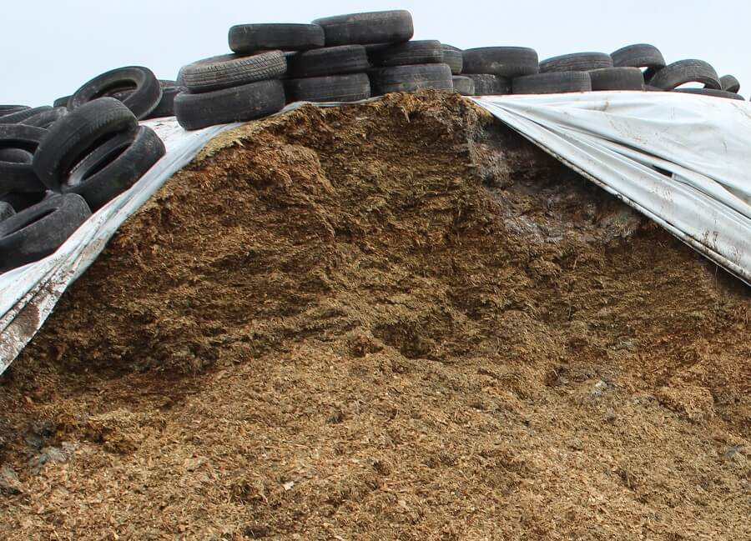
Pasture Silage

Slide 3
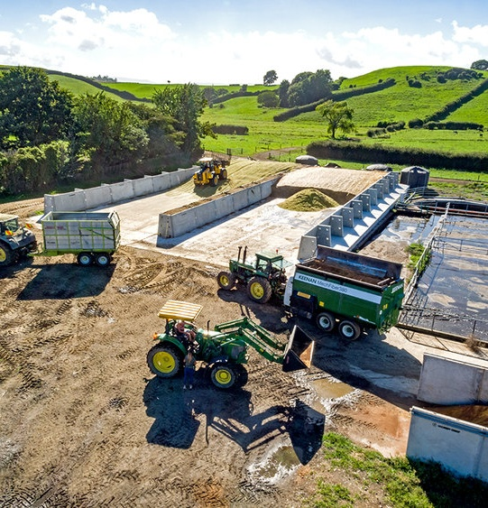
What is silage?
Pasture silage is pickled pasture, preserved through the conversion of its sugars into lactic acid by bacteria. This process extends the shelf life of the pasture beyond what it would have if exposed to open air.
Good quality pasture silage is a good source of energy and protein for a milking cow and can be used as a fibre source when feeding high sugar or starch feeds.

Slide 4
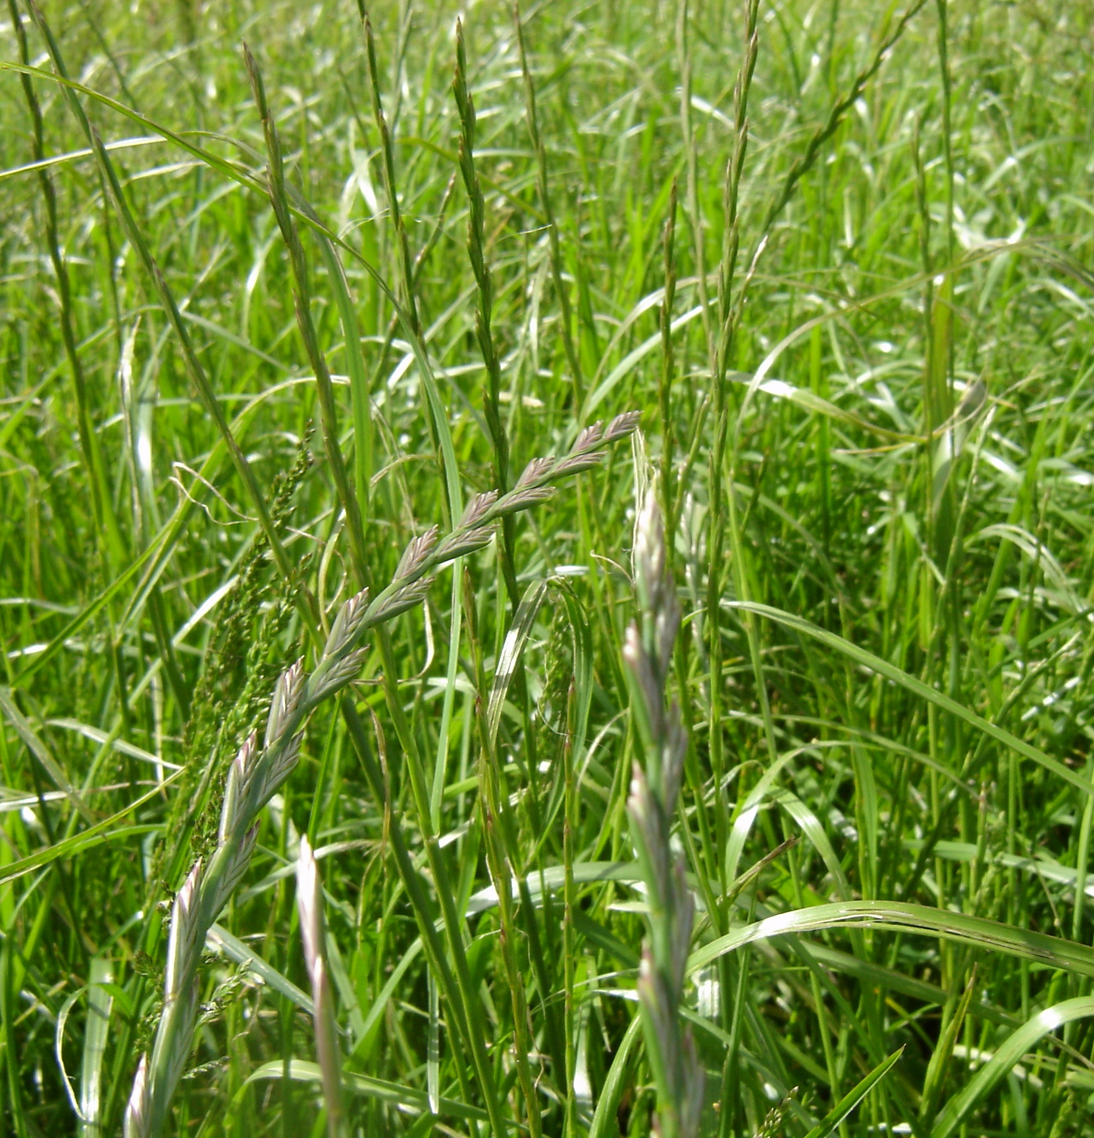
Mature pasture- Surplus
To get high quality silage with a high nutritive value of 10MJME then you need to start with high quality pasture. Pasture should be mature with not more than10% seed head emergence and free of weeds)
Quality not quantity is important therefore small, light crops rather than large heavy crops are recommended
Garbage in means worse garbage out.

Slide 5
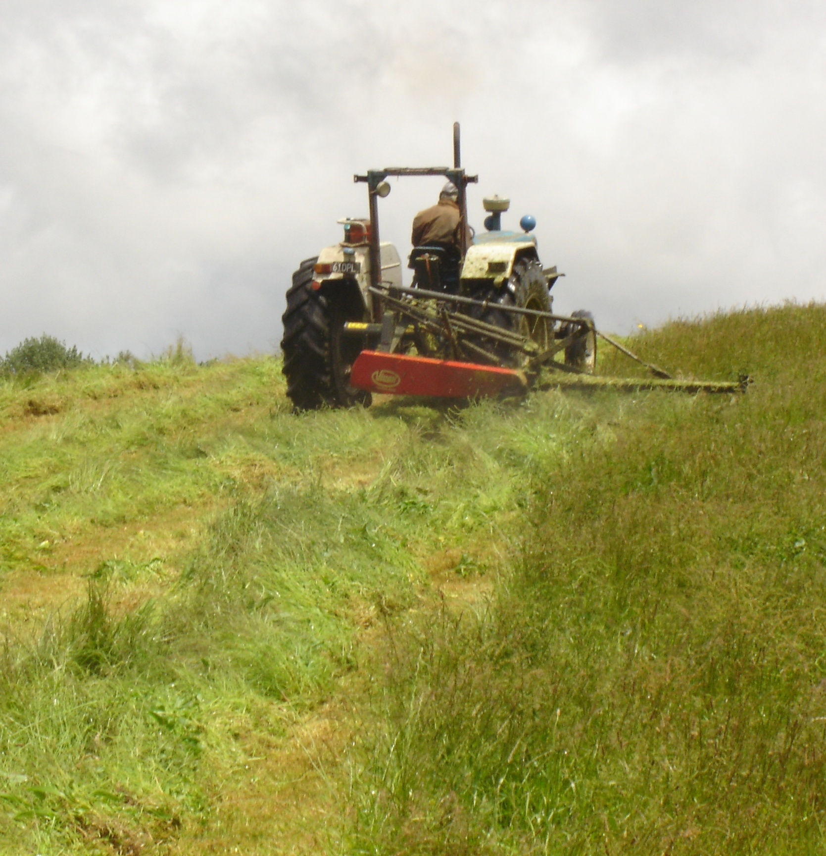
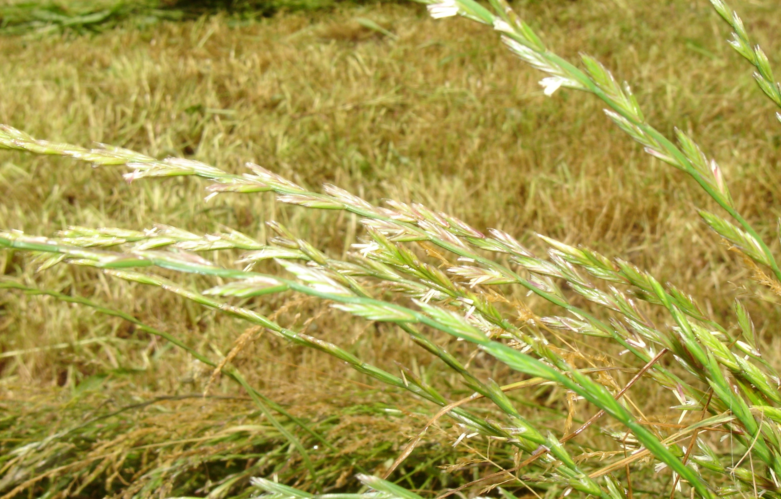
Mowing silage
Cut high quality pasture during a spell of fine weather.
Cut after midday as sugar levels in the pasture are high.
High sugar levels provide the “fuel” for the bacteria to produce a good fermentation

Slide 6
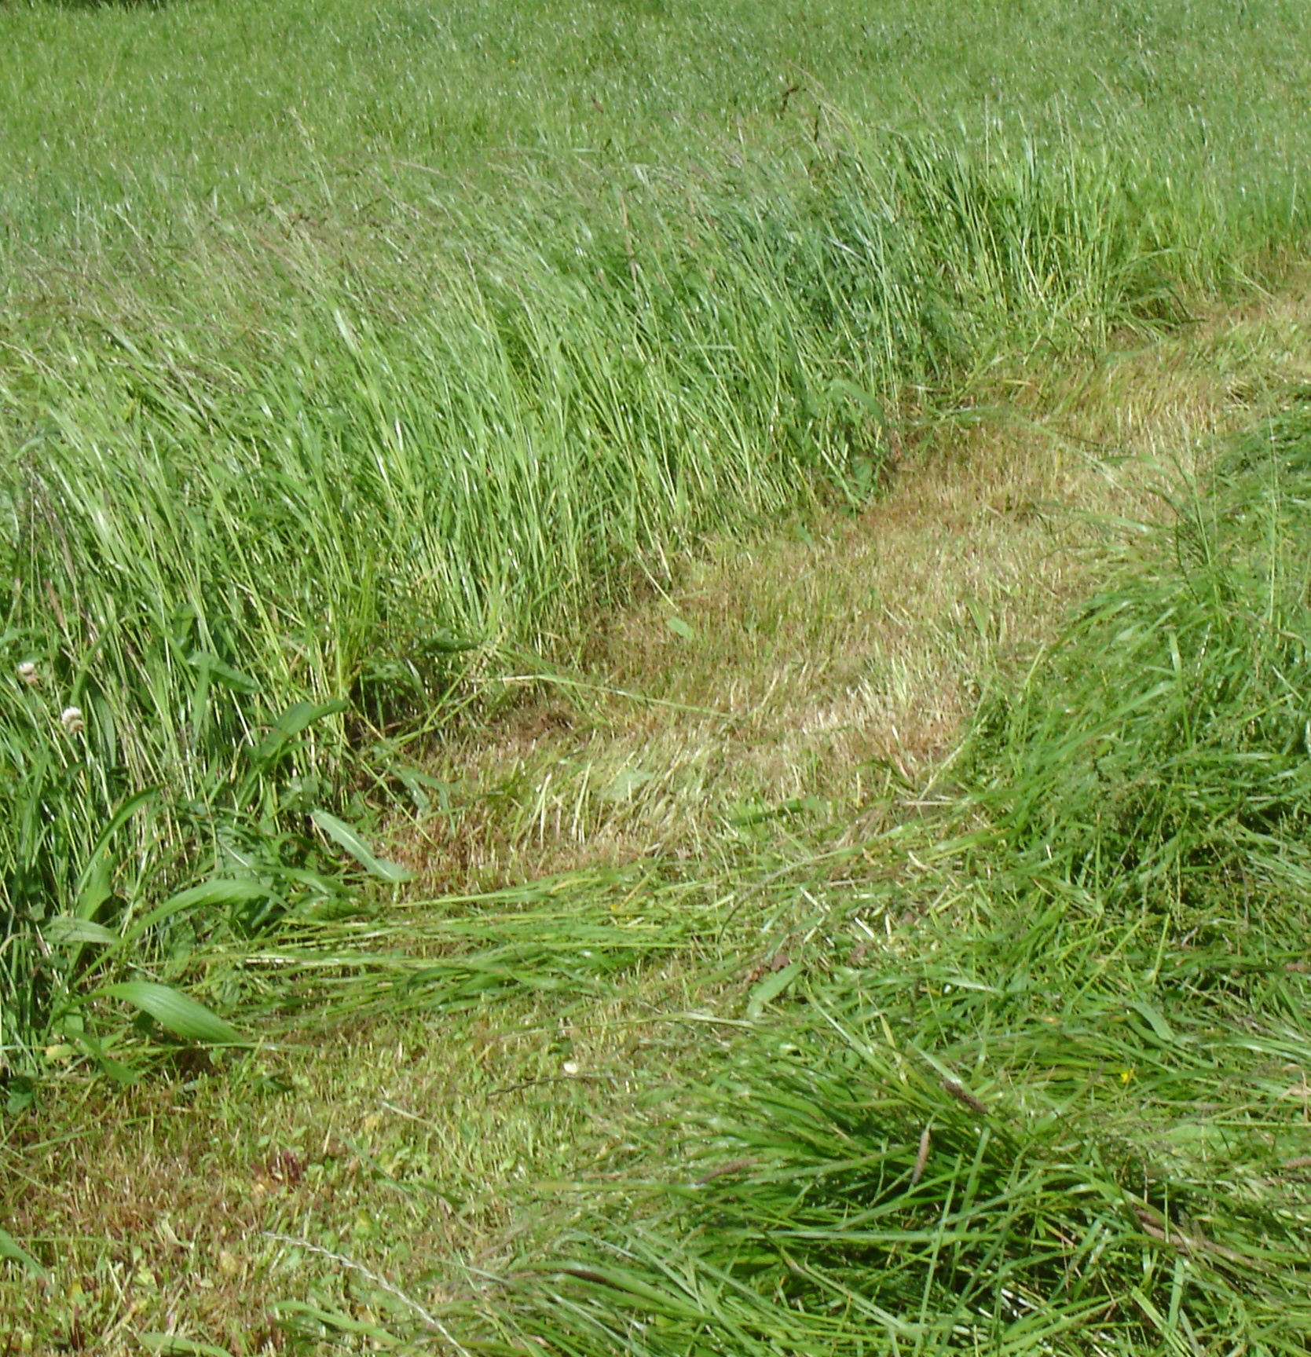
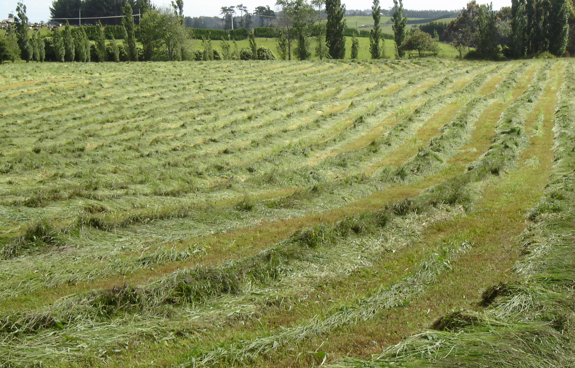
Wilting
Wilting reduces the moisture content and increases sugar levels but avoid wilting for any more than 24 hours.
High plant sugar concentrations improves the fermentation process.
Wilted pasture is easier to consolidate.
Fermentation is faster with wilted, chopped silage which improves palatability.

Slide 7
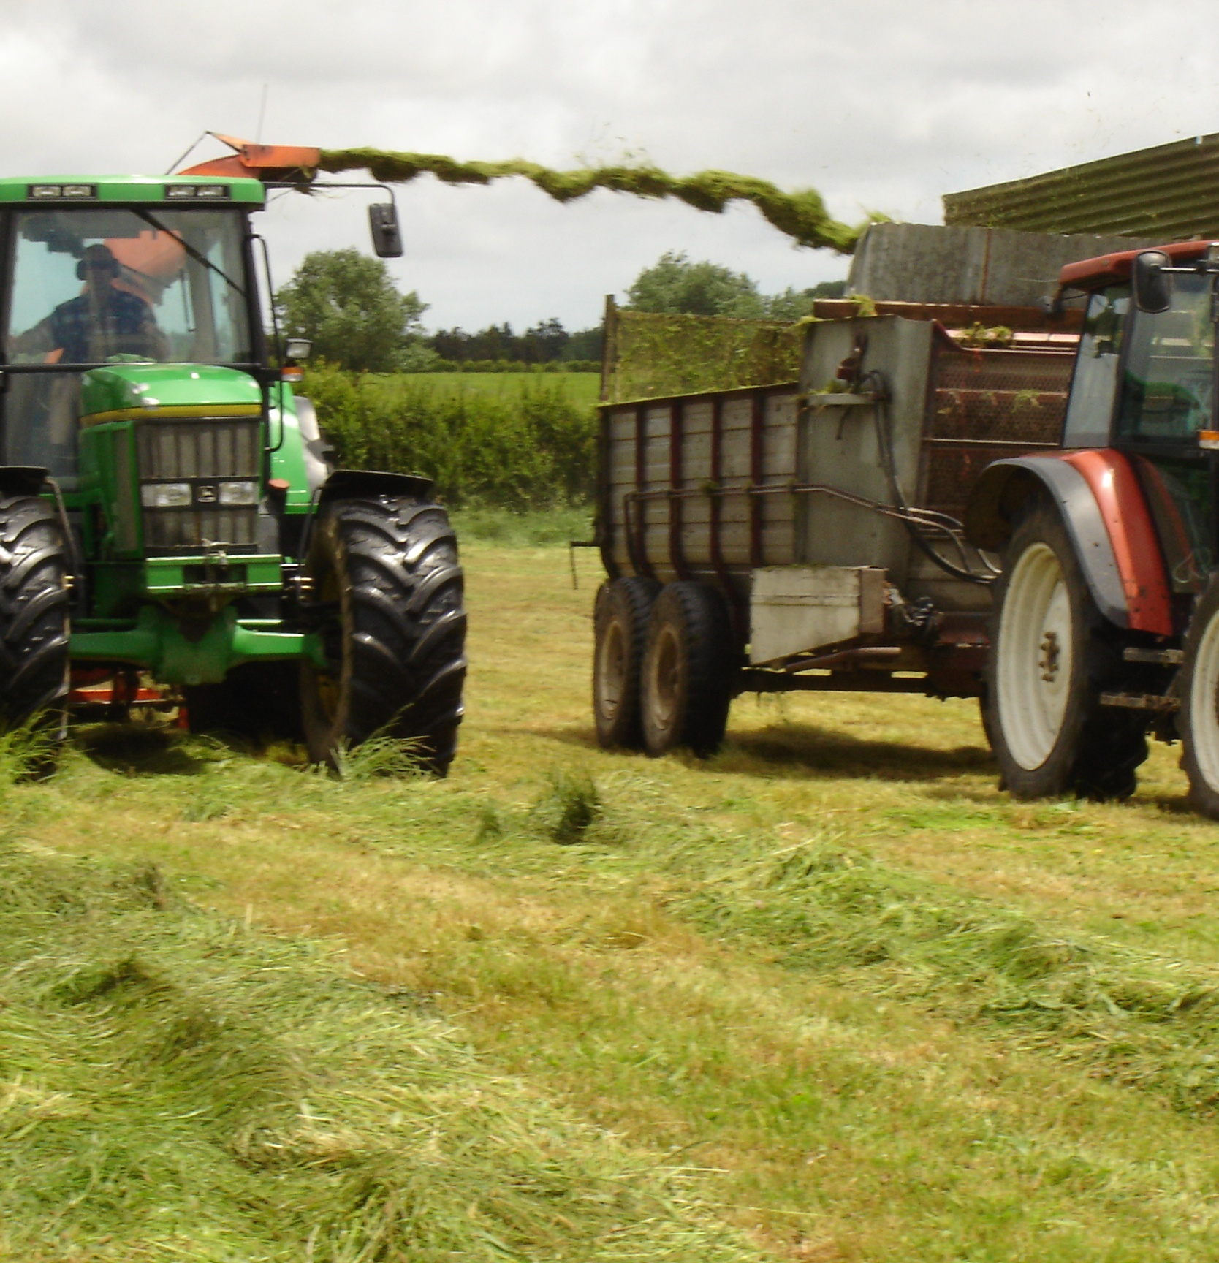
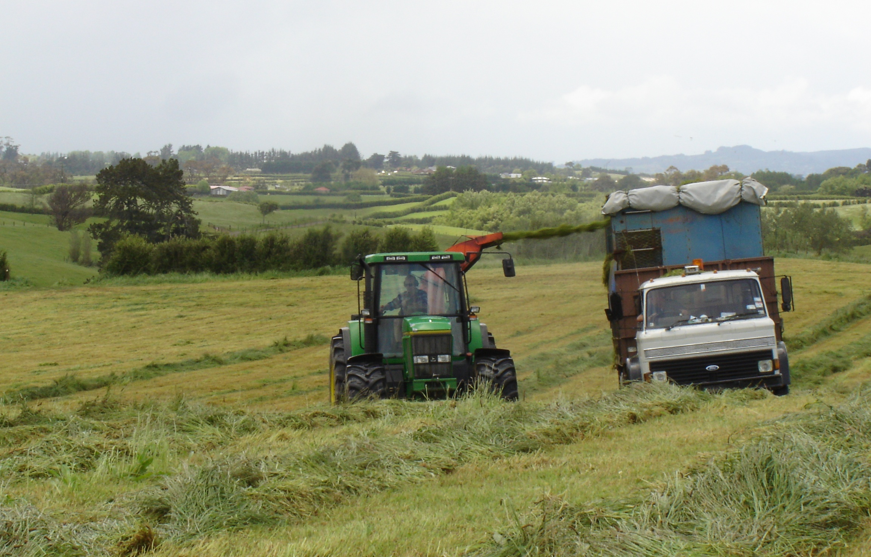
Harvesting silage
Harvest the silage crop when it reaches 25% drymatter.
Correct wilting, to 25% will eliminate effluent losses from the stack.
Chopping during harvest releases plant juices encouraging rapid lactic acid production and a good fermentation. Chopping also increases silage density and helps with consolidation which helps the exclusion of oxygen/air from the stack.
Chopping also assists removal from the stack.

Slide 8
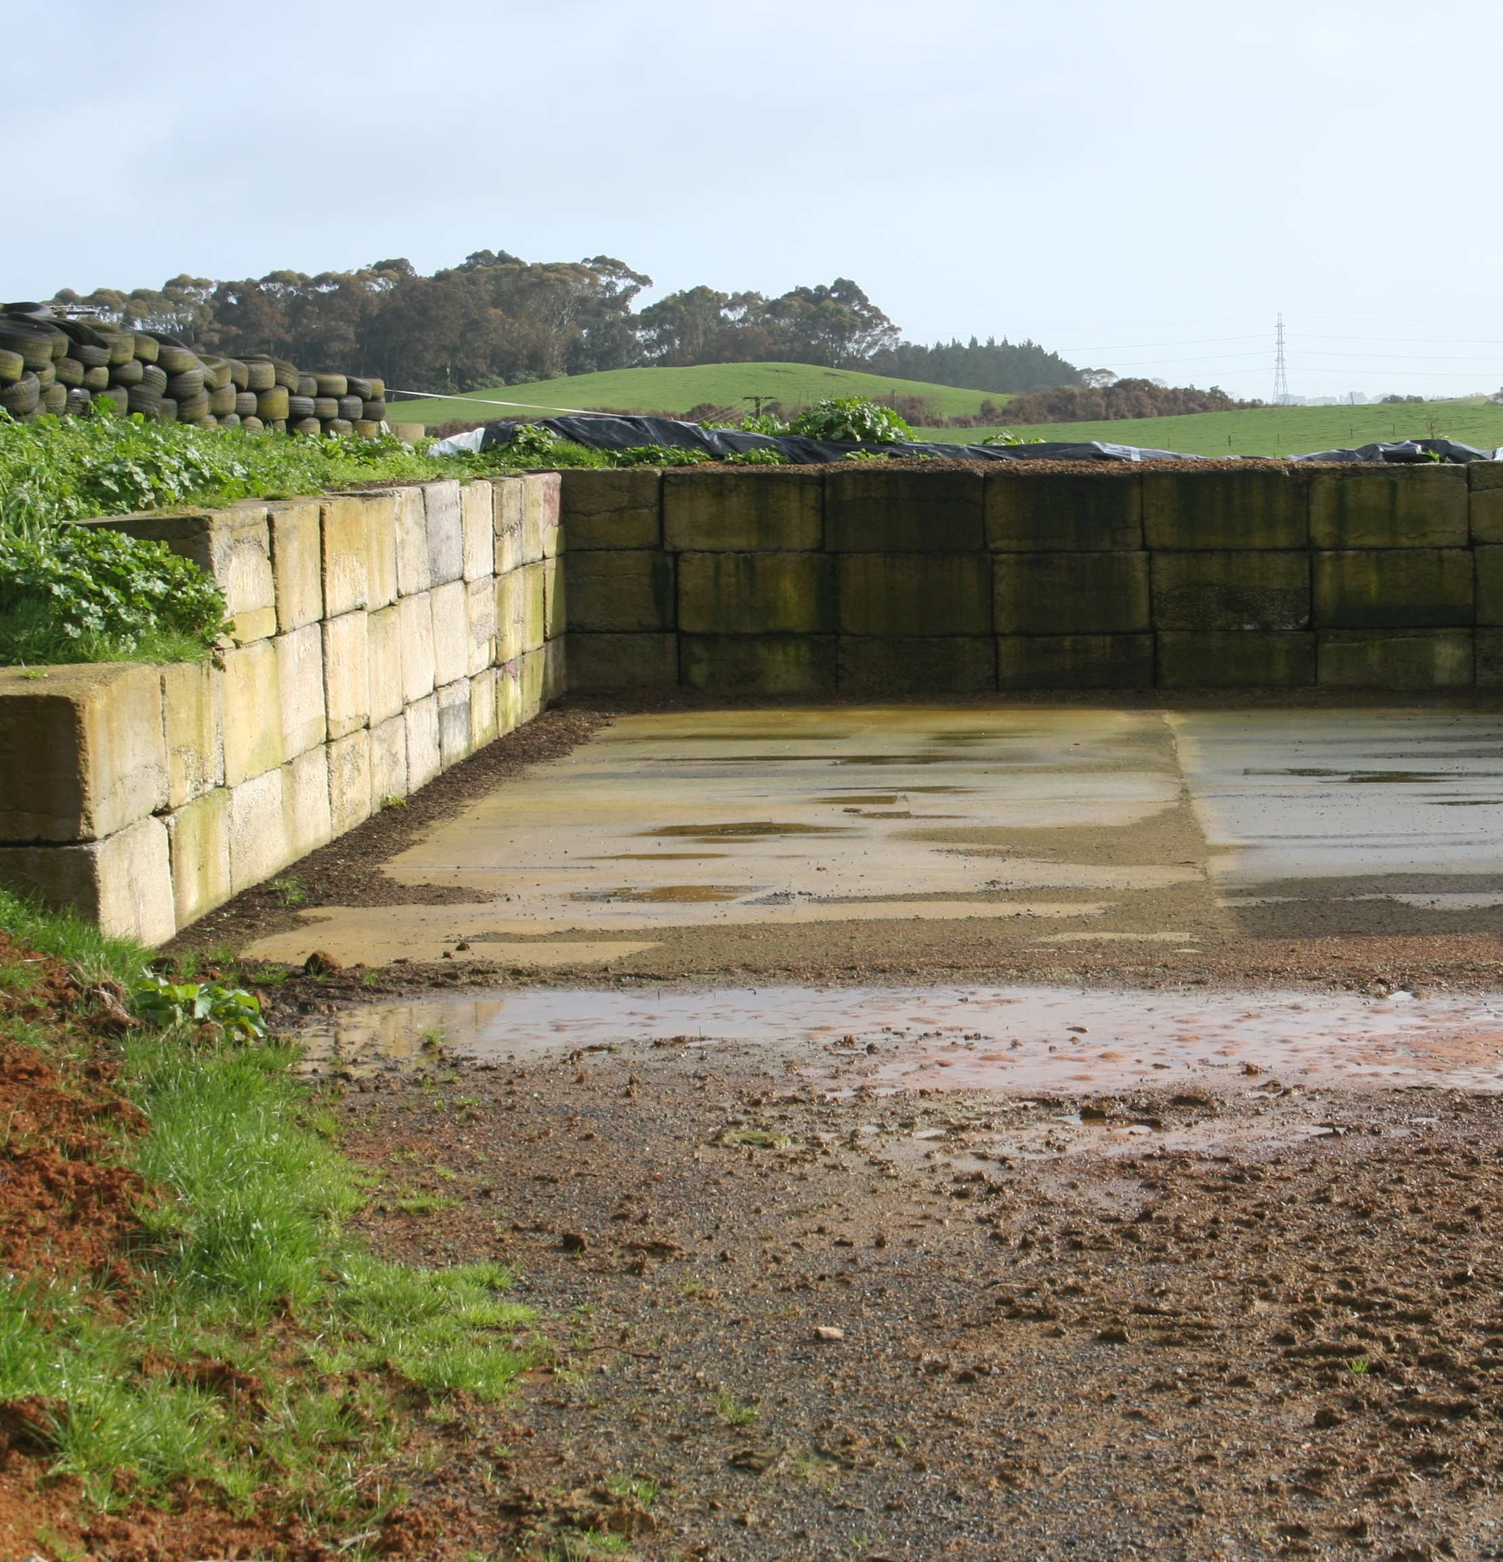
Silage storage
For long term silage storage, a silage bunker or pit is strongly recommended for ensuring quality, and minimising wastage.
An airtight heavy plastic lined concrete bunker will provide a secure barrier against oxygen and enable the silage to be compacted down effectively.
Ensure the chosen site for the stack is well back from any waterways, drains or tiles, and avoid wet or gravel areas.
Stacks should be easily accessible sit on a watertight base to prevent loss to groundwater.
Ensure any silage leachate/effluent produced is directed into an existing effluent management system.
Divert rainwater away from the stack

Slide 9
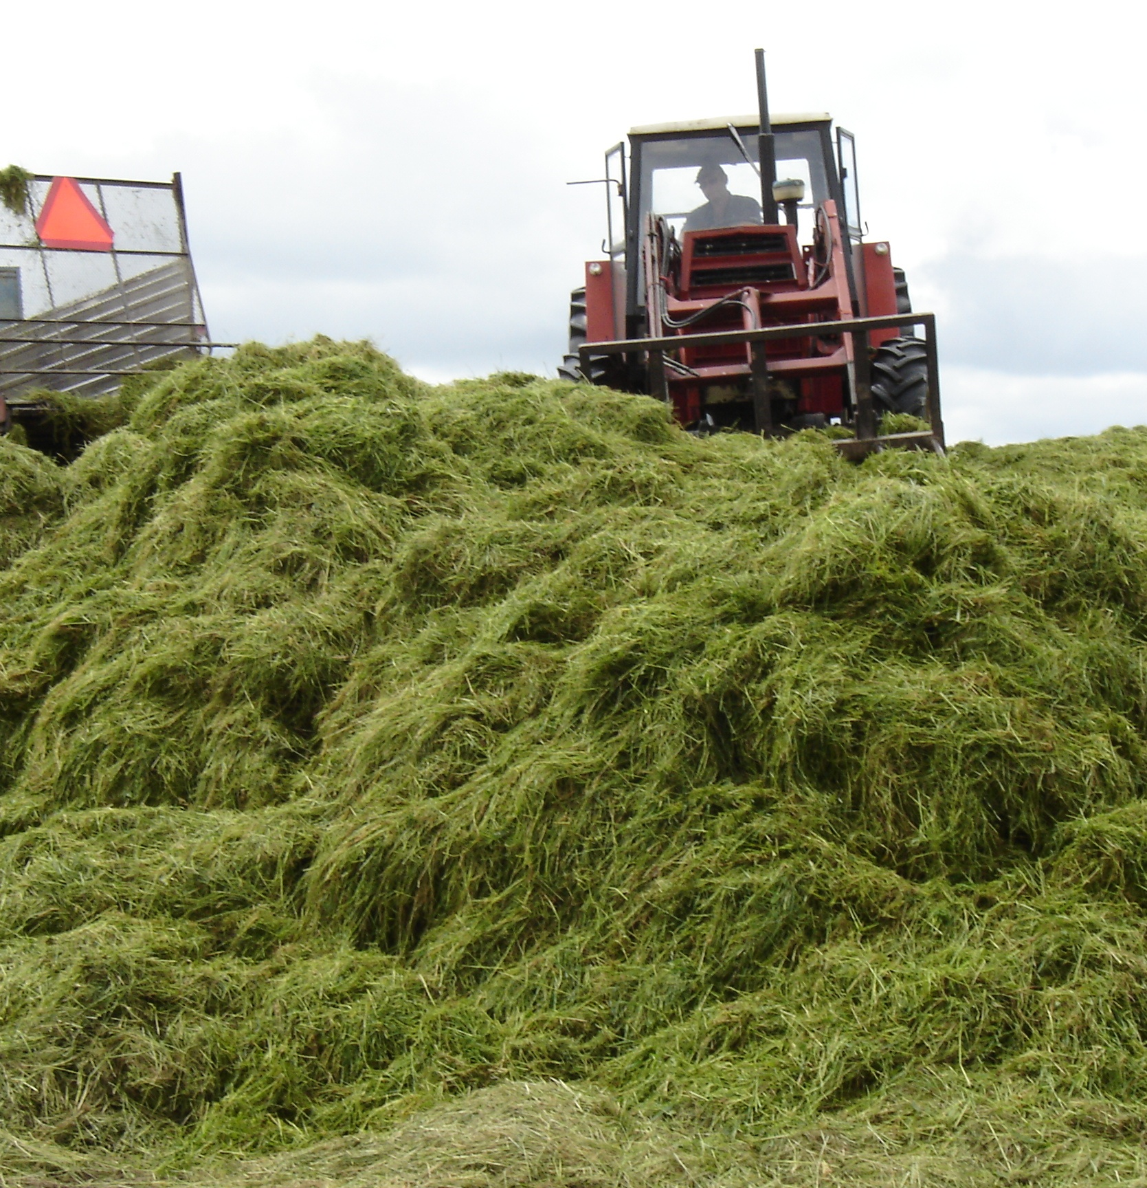
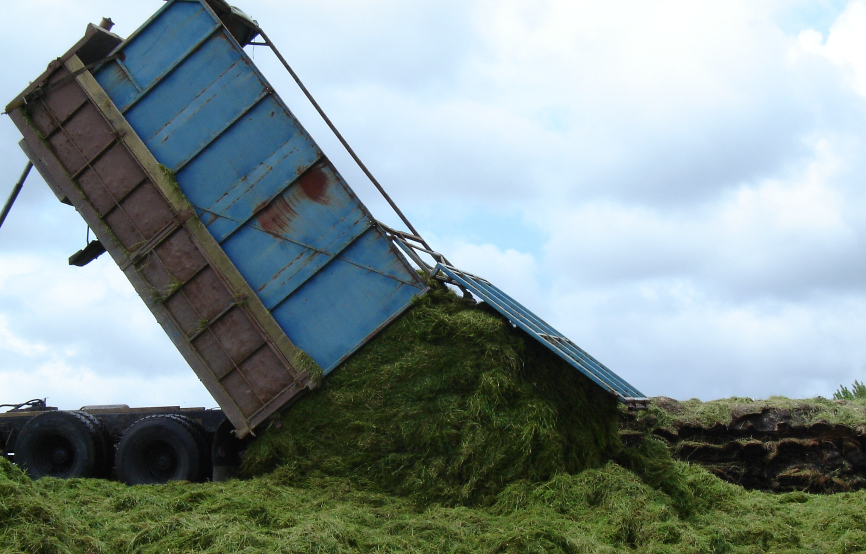
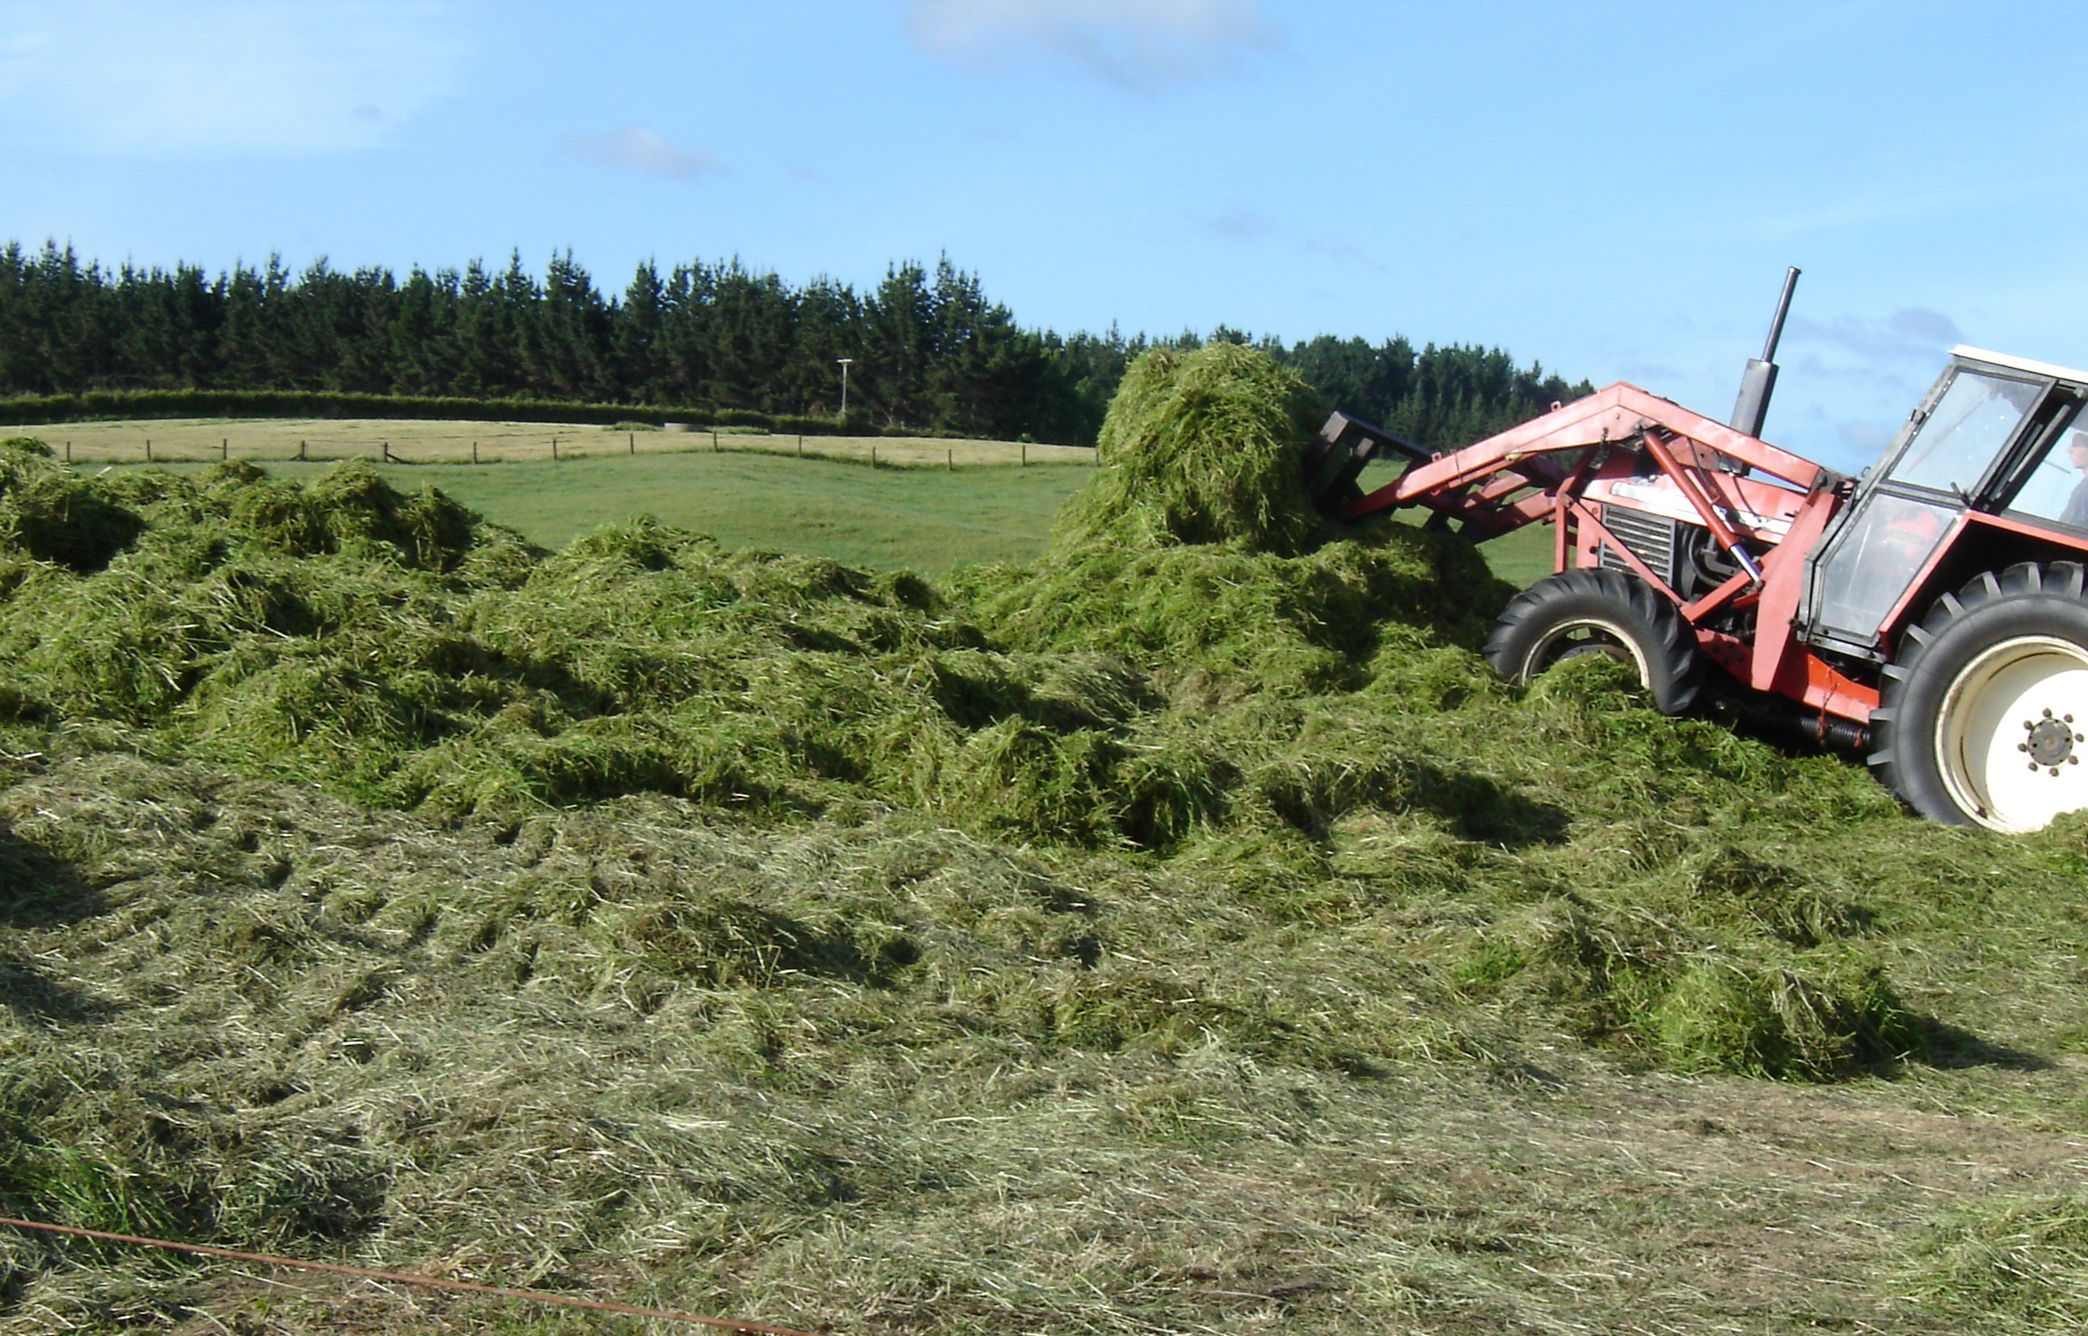
Consolidation
Oxygen removed which stops respiration maintaining nutritional value of pasture silage.
Fermentation starts, pH drops quickly to 4.2, lactic acid build up preserving the grass in a stable digestible state.

Slide 10
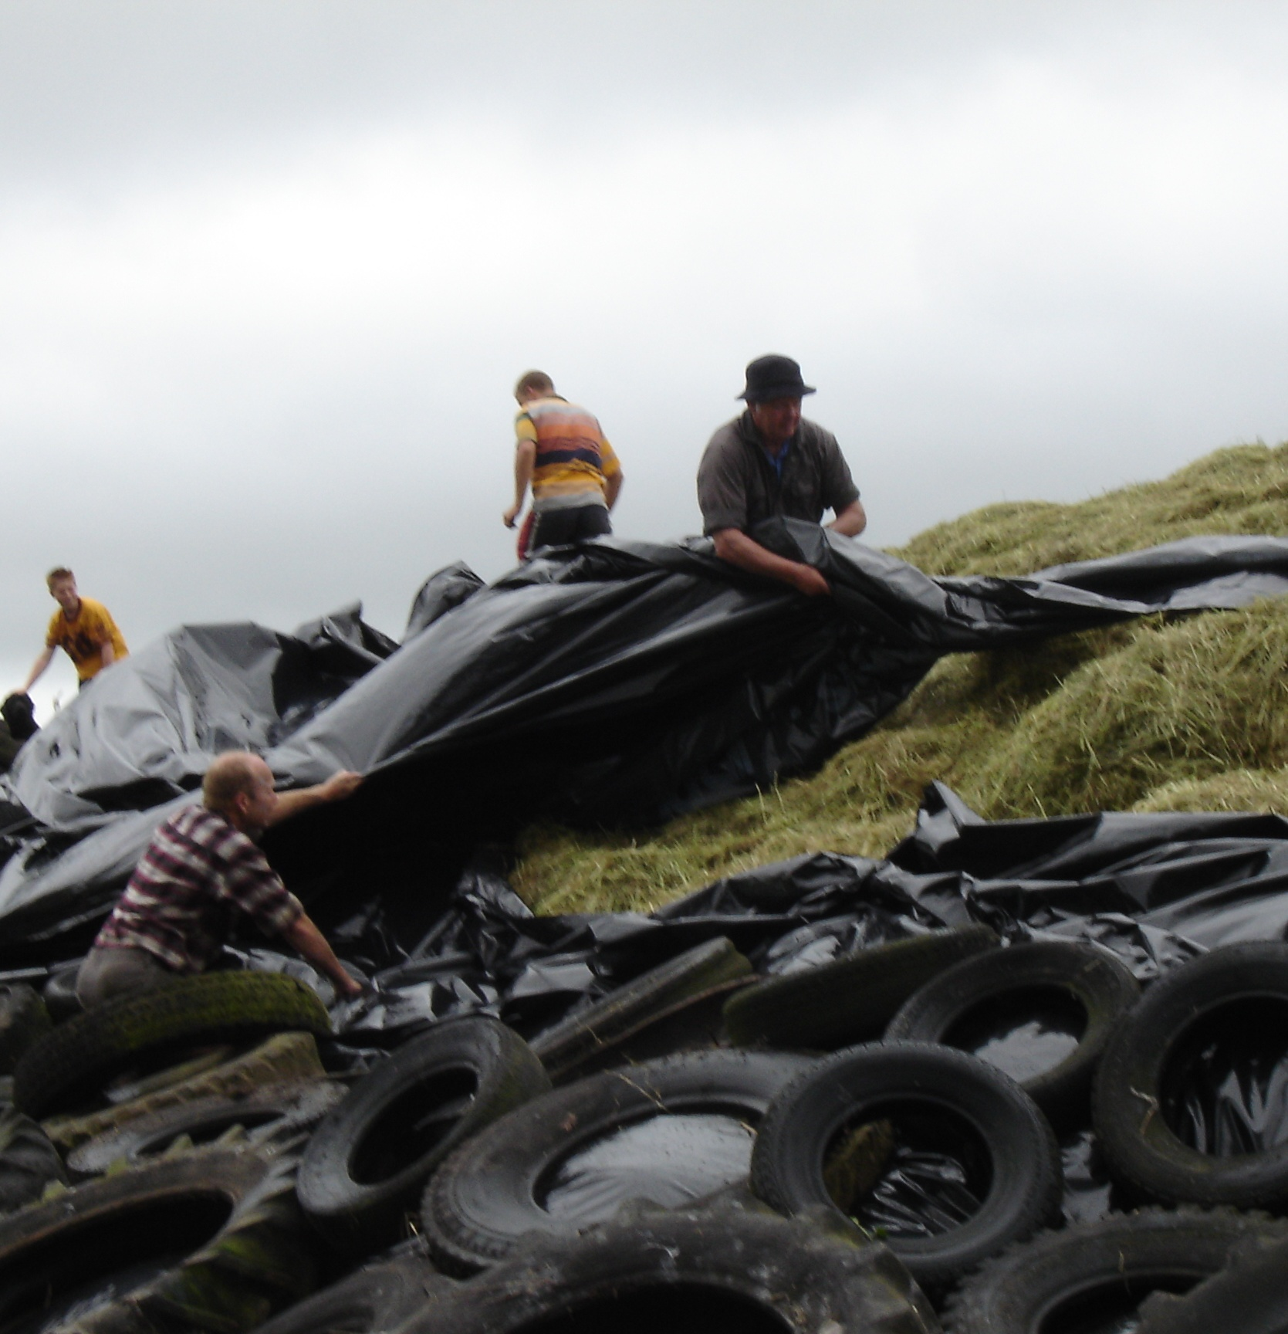
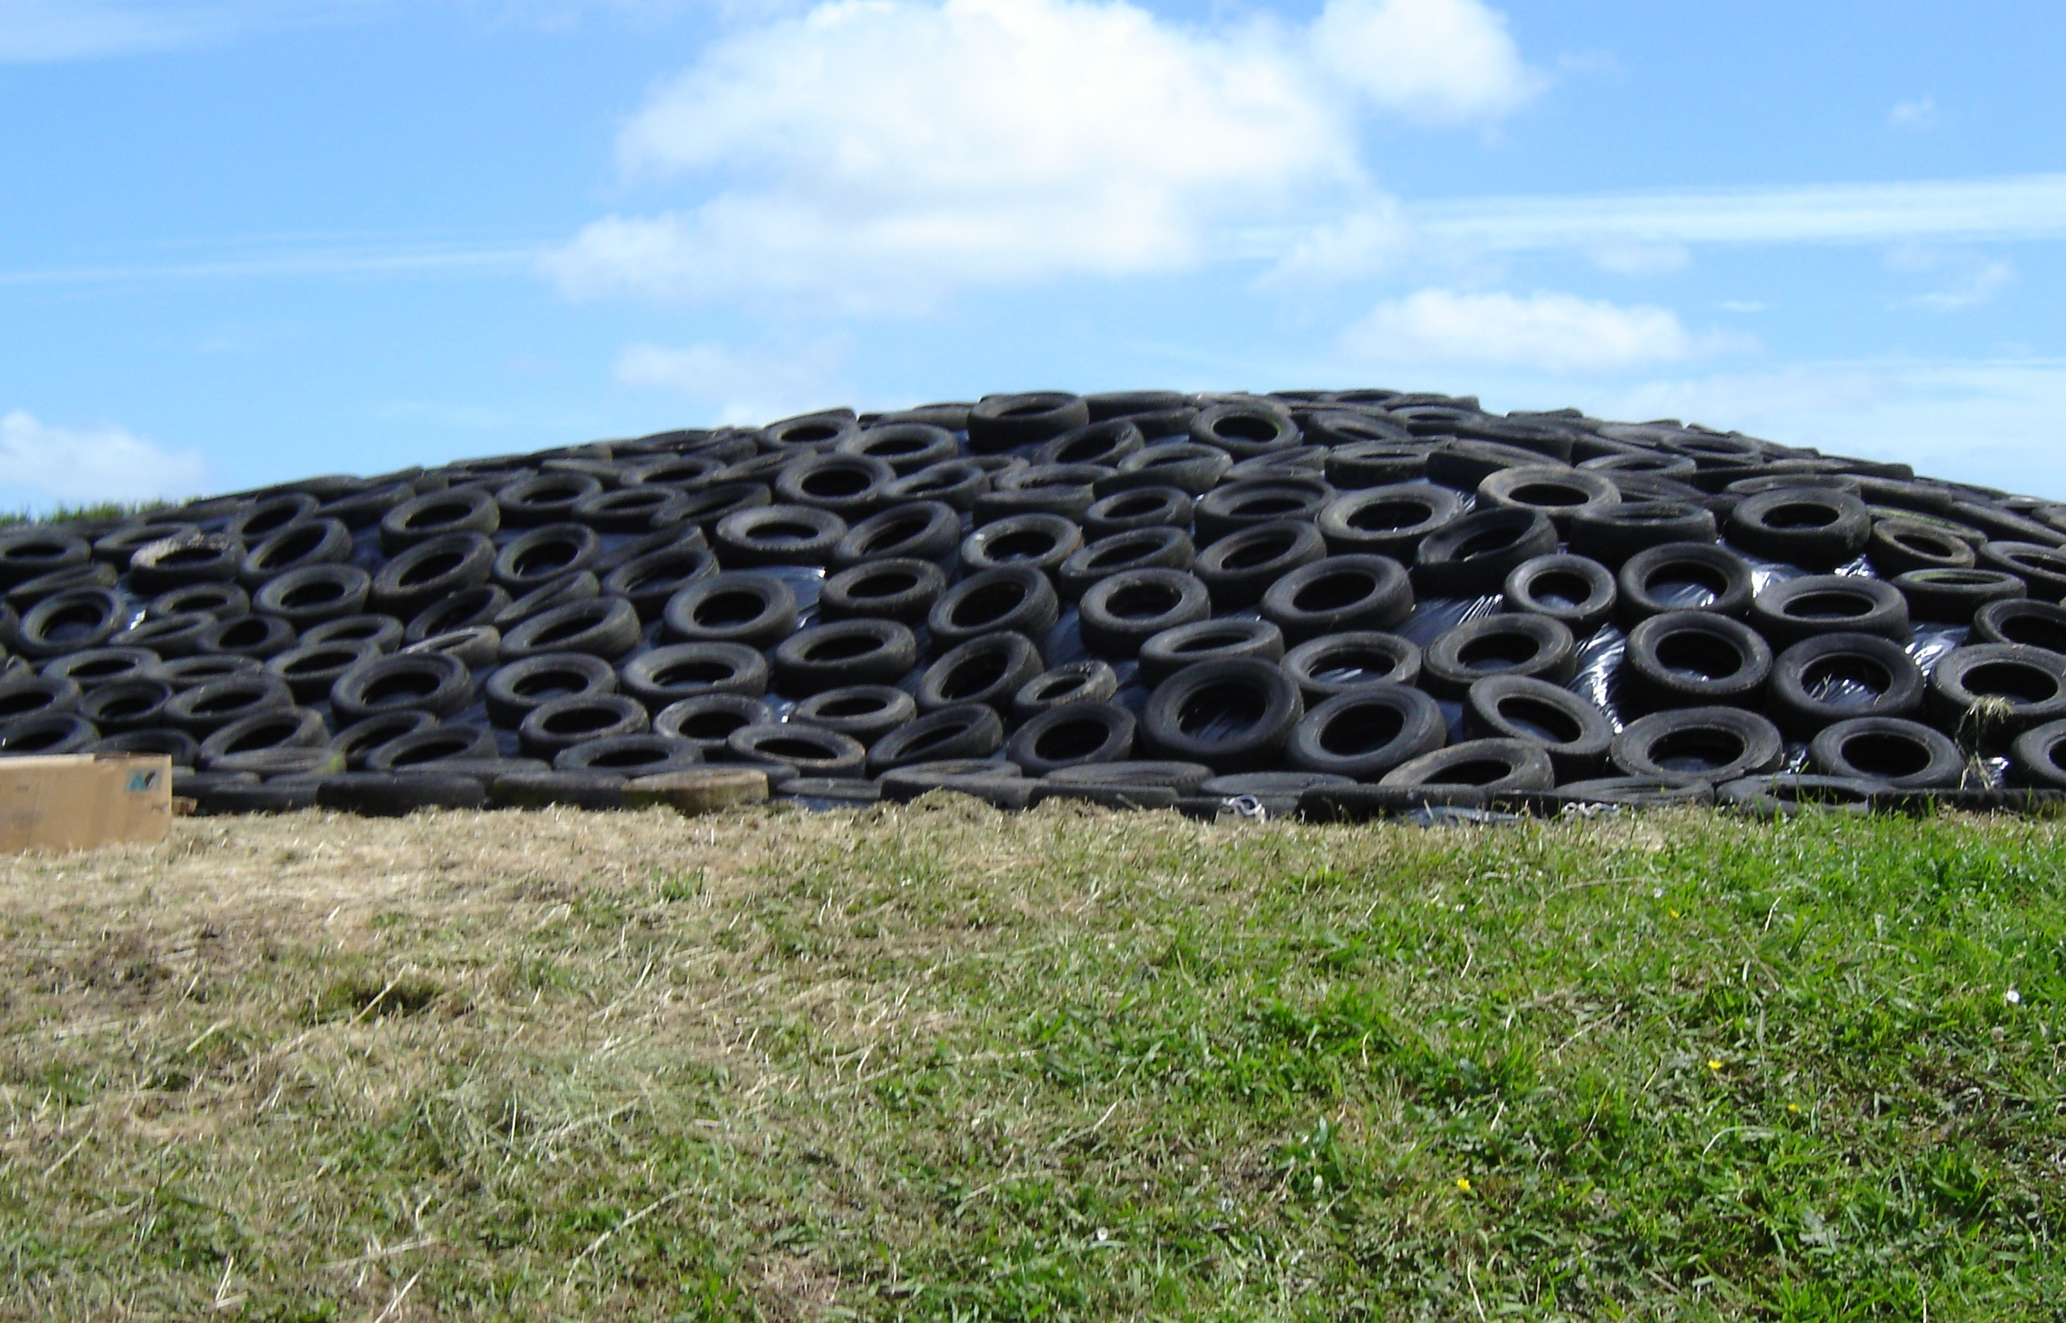
Covering the stack
Prevents oxygen and water getting into the stack maintaining the quality and nutritional value of the silage
Use quality plastics well weighted and sealed
sand
sand

Slide 11
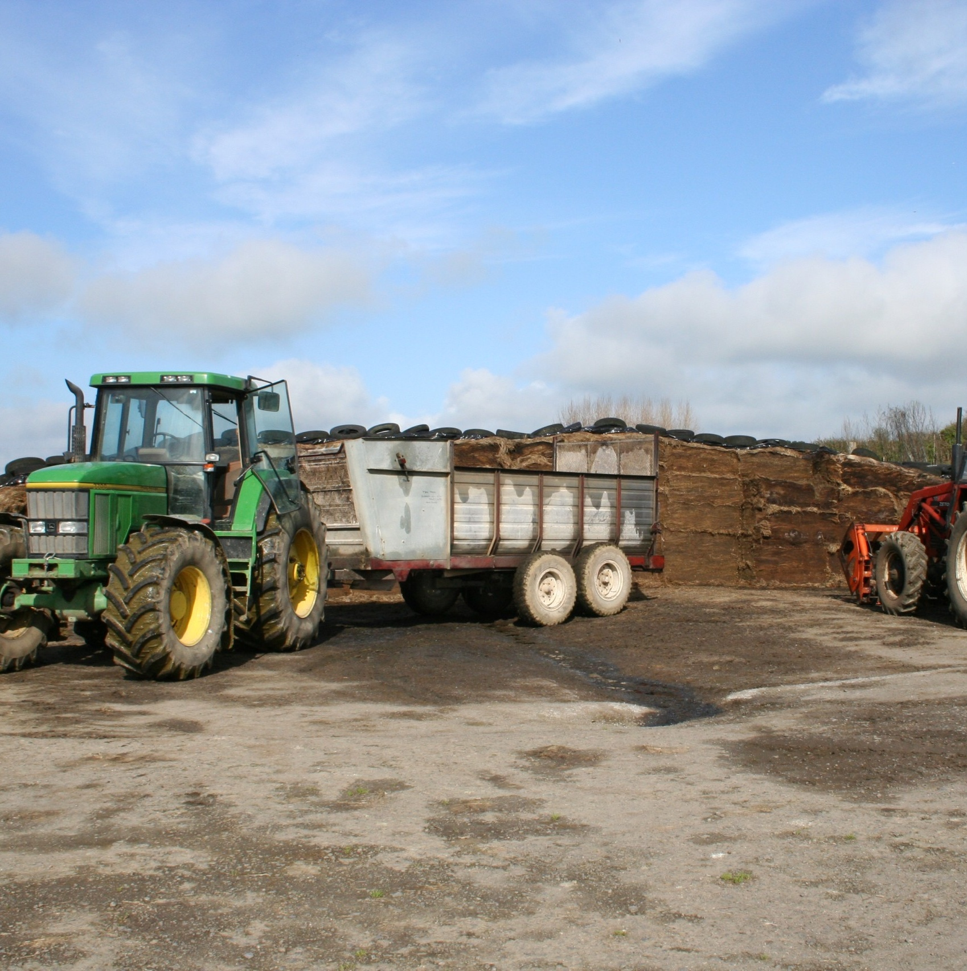
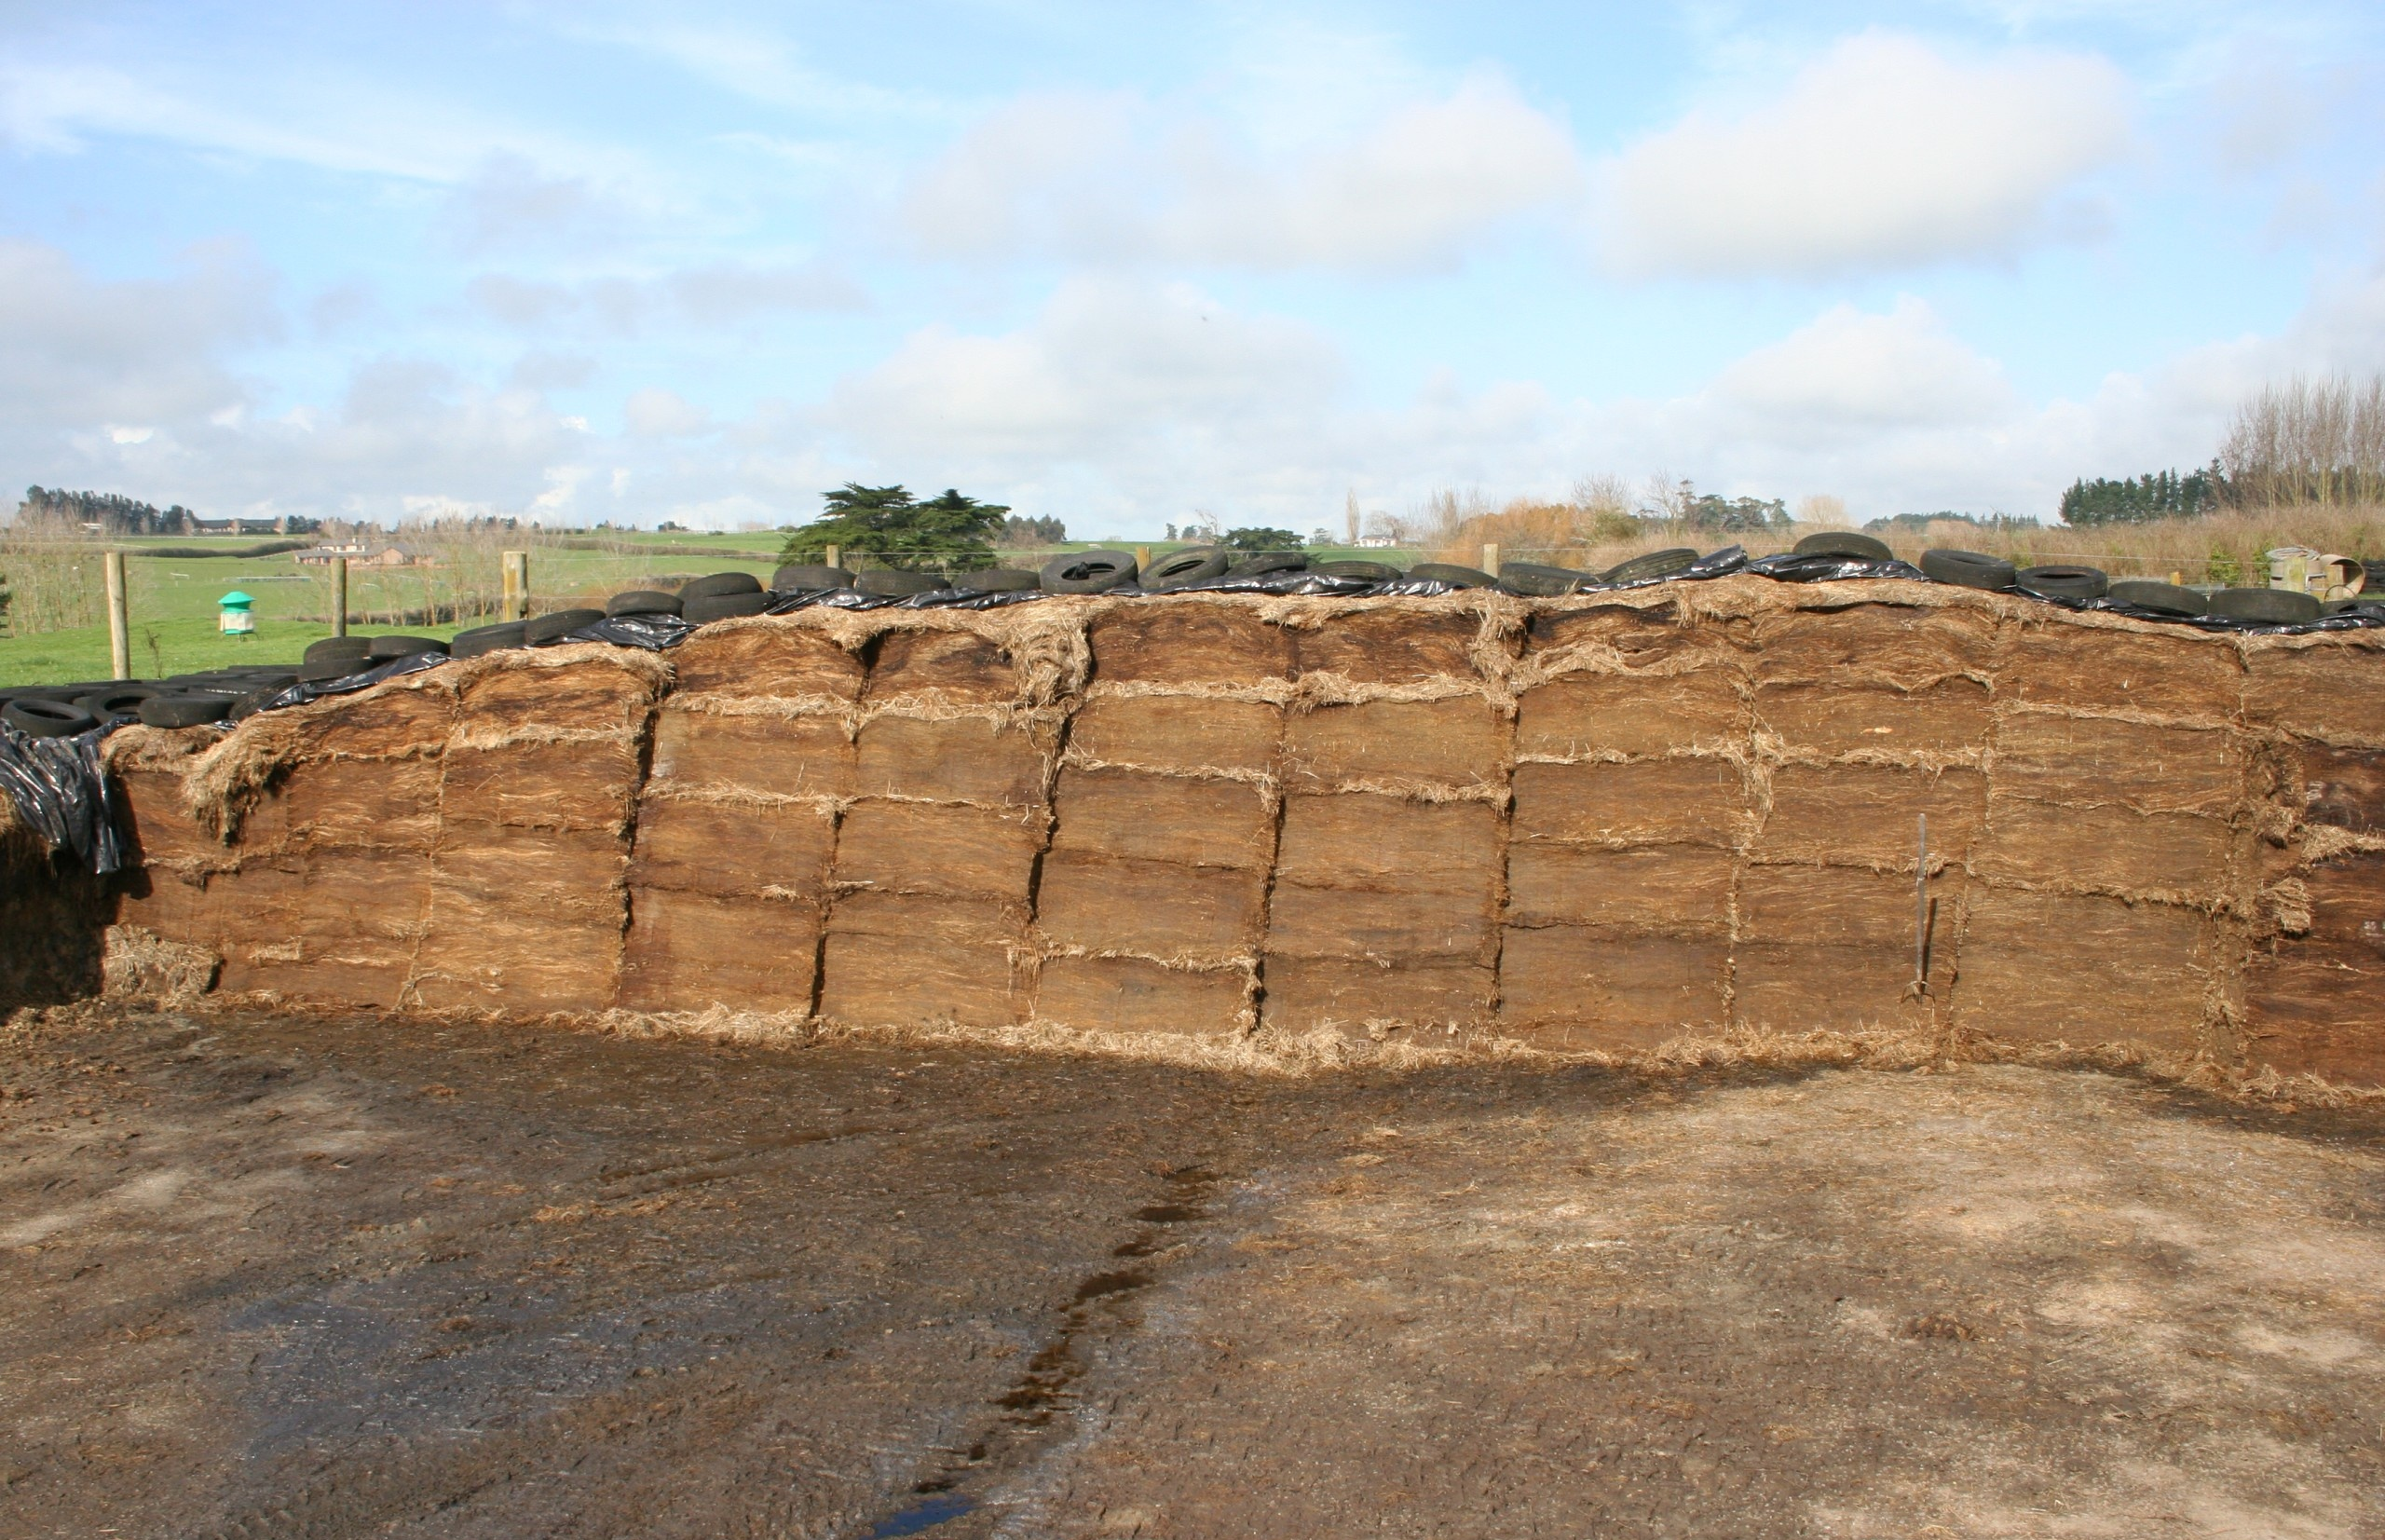
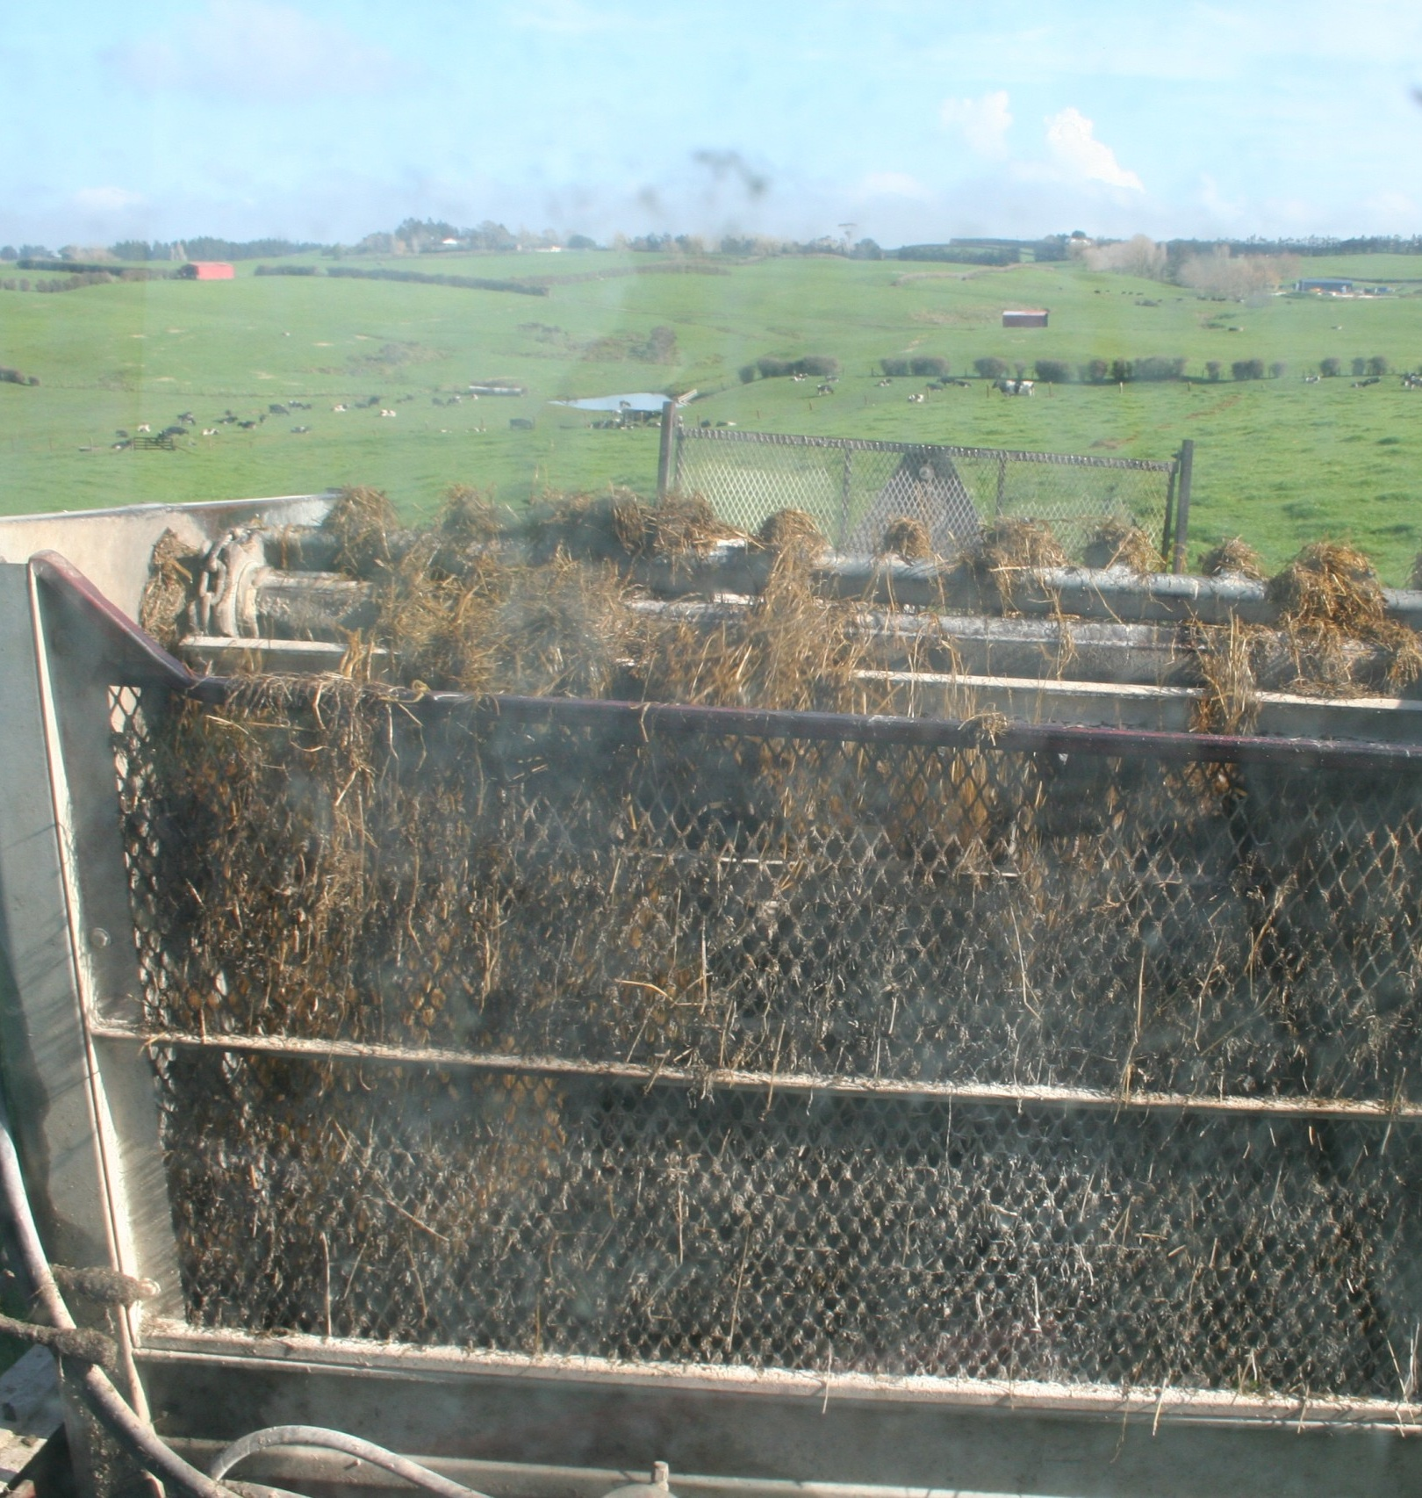
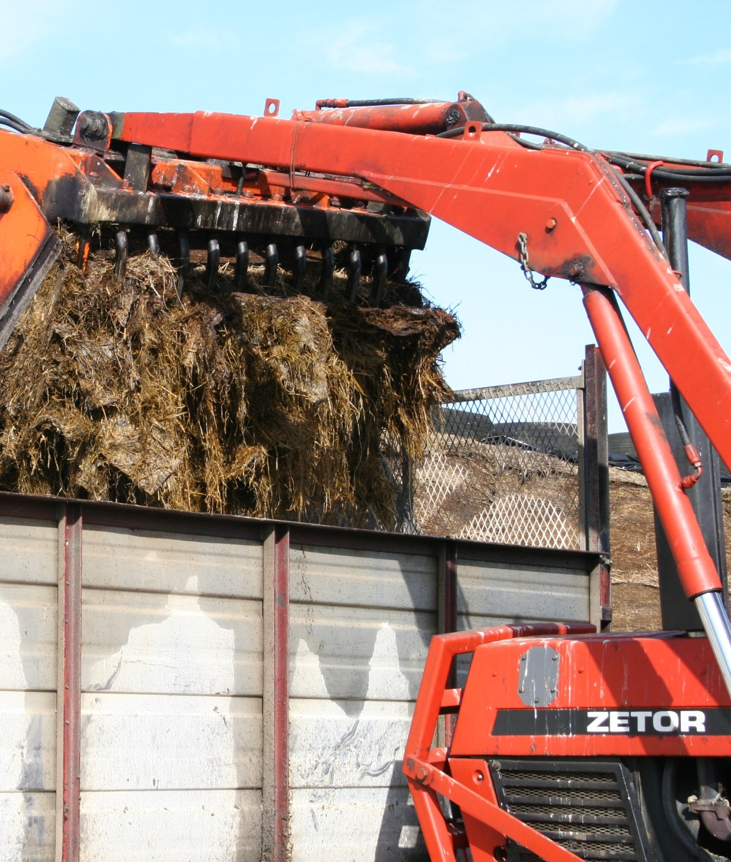
Feeding out
Cut silage off the face, rather than pulling it off. This keeps a smooth surface at the stack face, which reduces air penetration into the stack.
Leave the stack face open on dry days to avoid heat build-up under the polythene.
Do not feed out more than 1 day in advance, especially in summer.
Cows will be able to eat more of the silage they are offered if it is fed out on dry paddocks or feed out areas, along fence lines, or in feed bins or troughs.

Slide 12
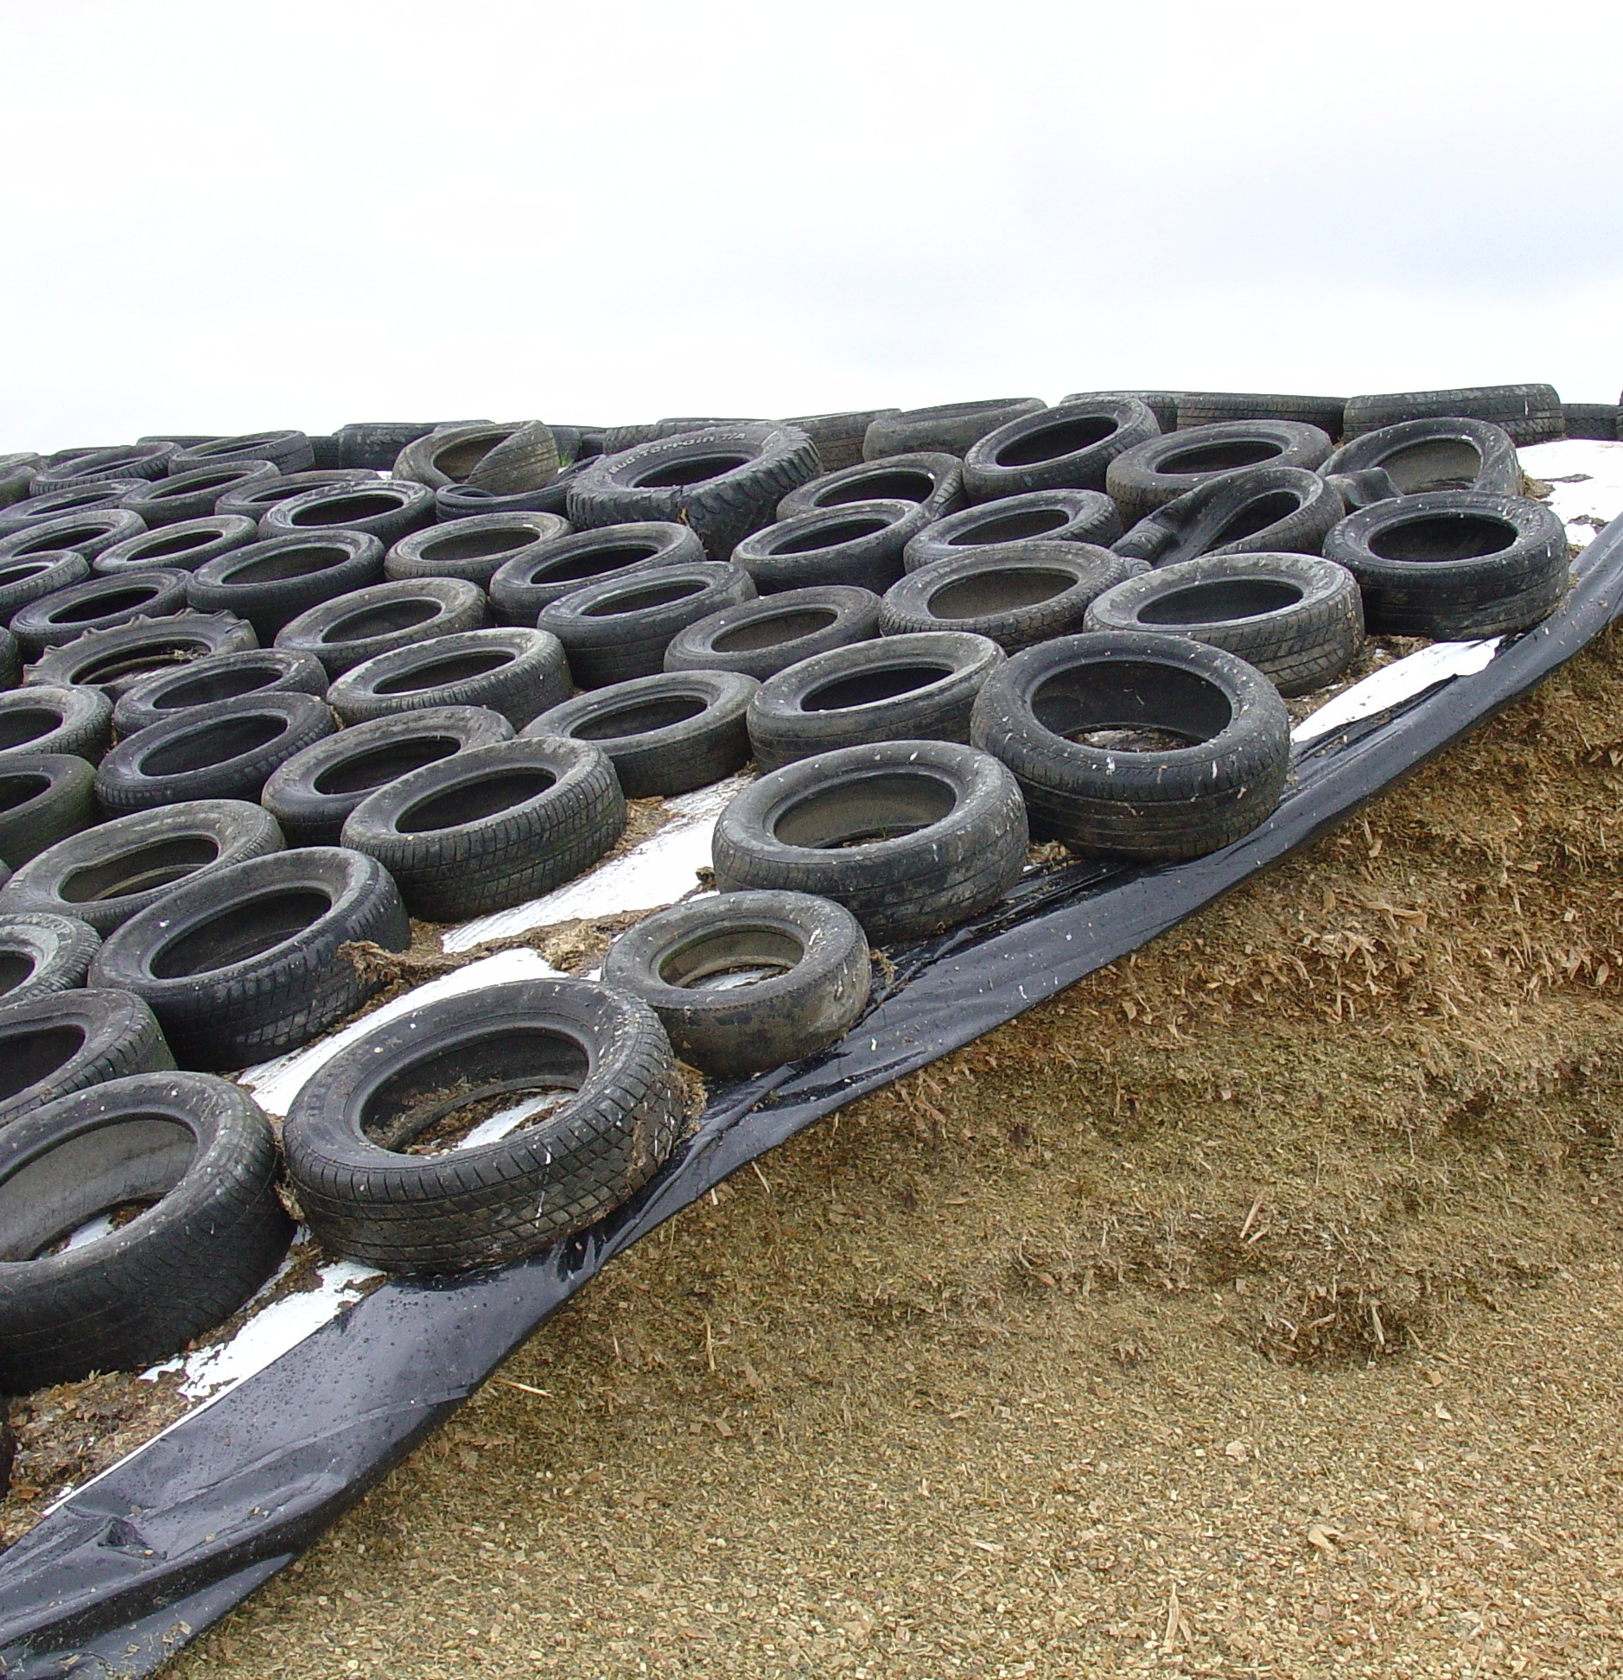
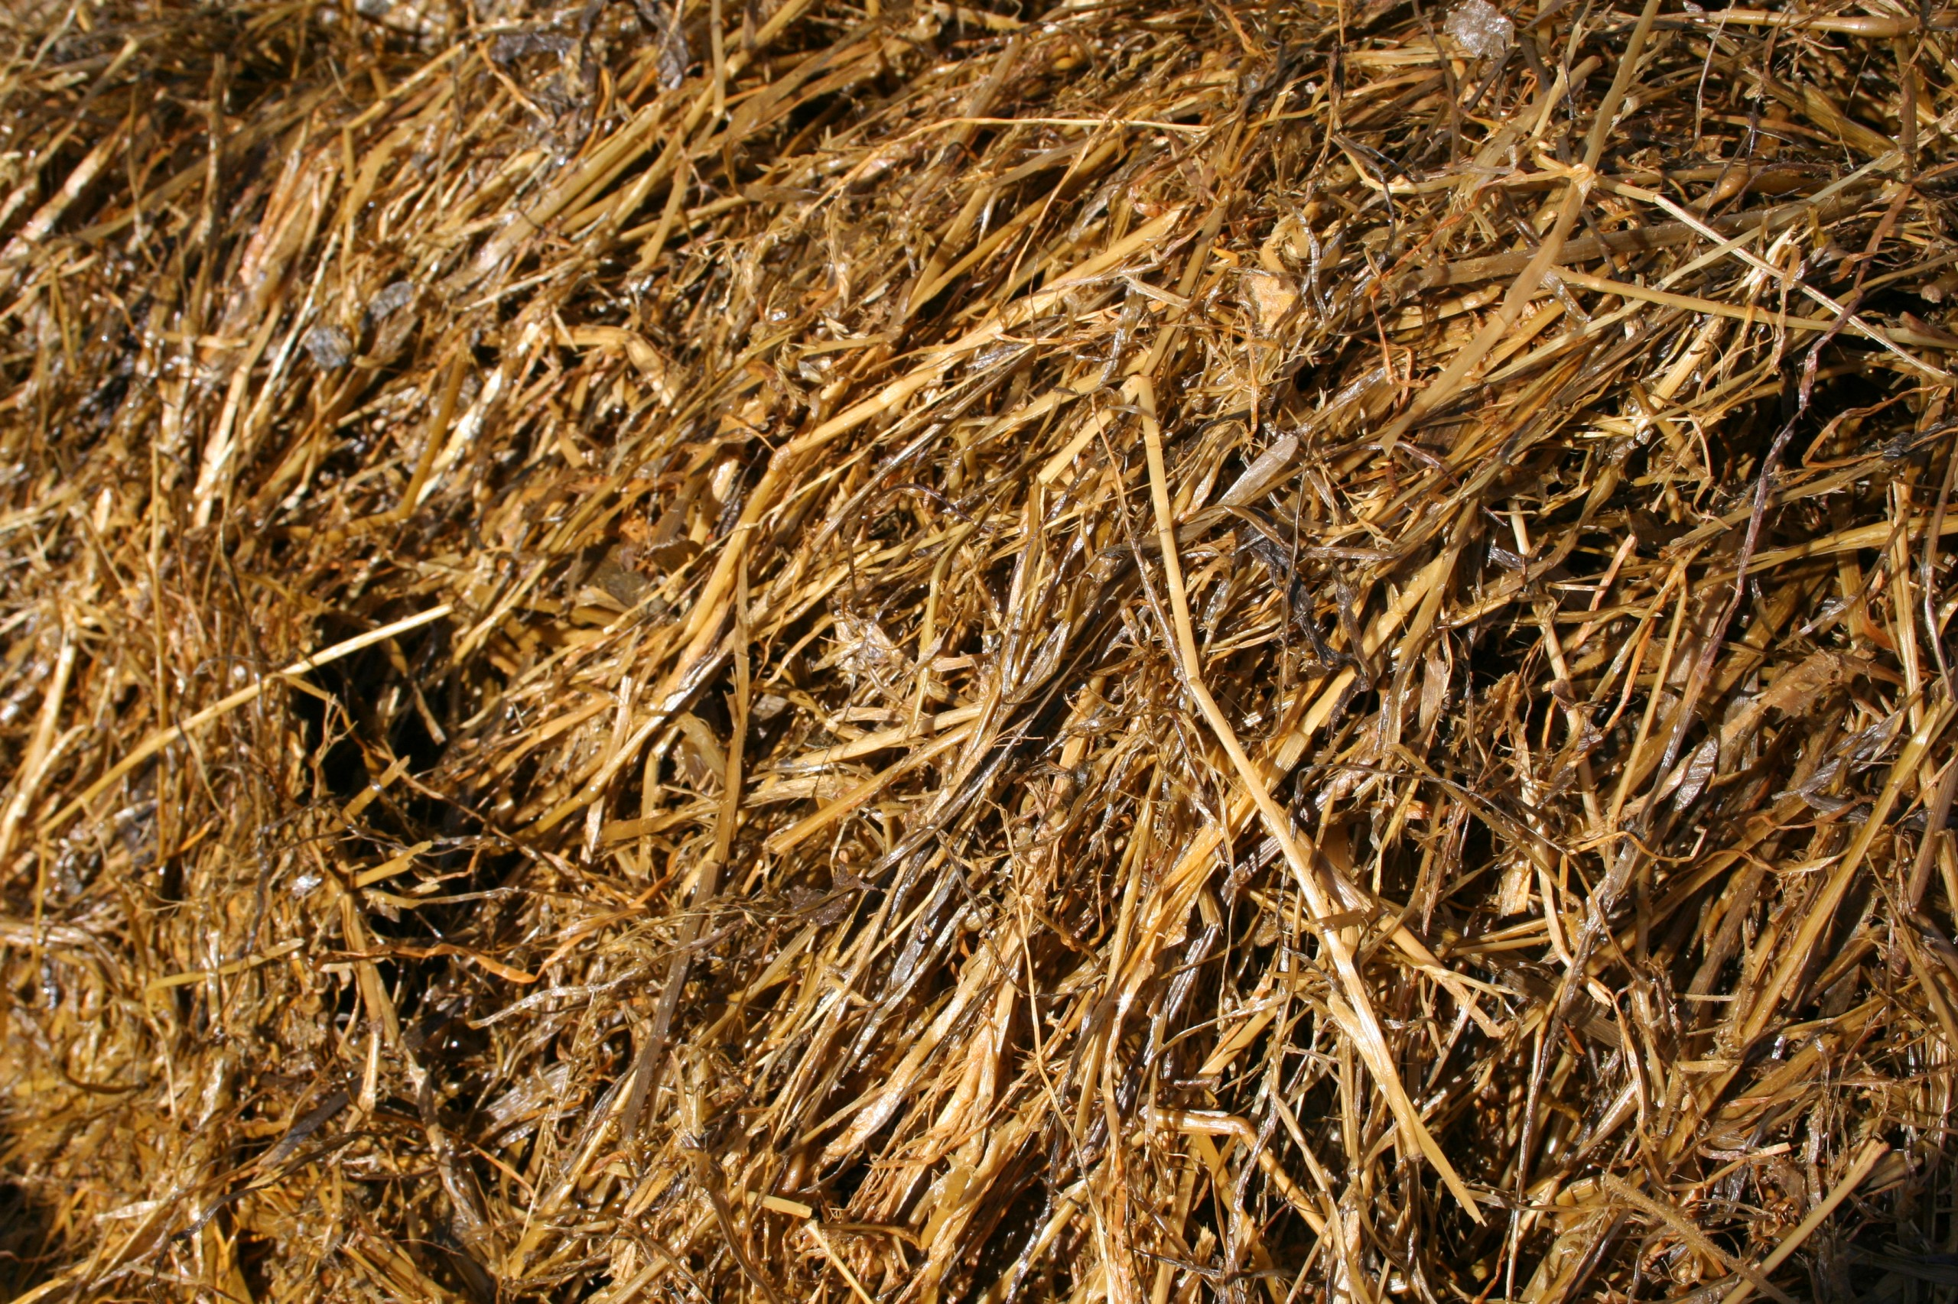
High quality silage
High quality silage has lots of leaf, and very little stem in it with 10-11 MJME.
The more stem in silage, the poorer its quality- 9 MJME.

Slide 13
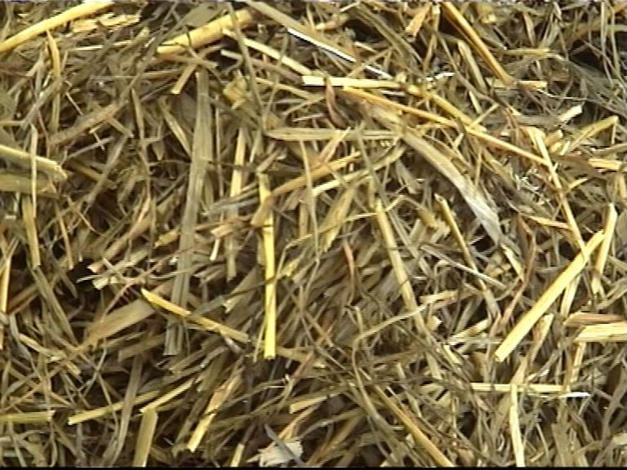
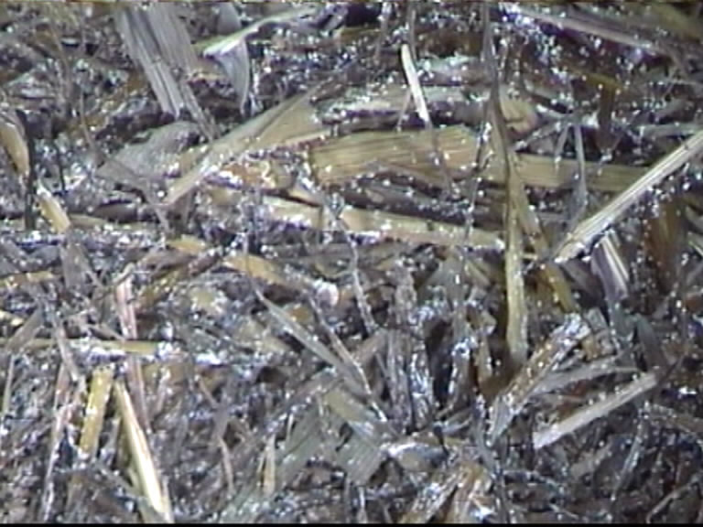
Assessing silage quality
Colour: Well-preserved silages are green, yellow, or pale brown. Dark brown silage is generally poorly preserved.
Smell: Well preserved silage has a sweet, tobacco smell. Foul, rancid smells indicate the presence of butyric acid from poor preservation.
Moulds: Moulds grow where silage has been exposed to air. Some fungi can produce toxins.

Slide 14
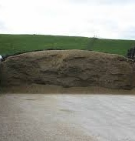
Environmental considerations
Silage stacks should be:-
At least 50 metres from waterways, open drains or dams, and the catchment areas of bores; further away if the land is steep, soils are coarse textured, or ground water may enter sensitive waterways.
Away from gullies or other places where run-off catchment water can flow into the storage area not prone to flooding or that has a high water table away from any subsurface drains.
Silage leachate should never enter waterways as it is highly toxic to aquatic life.
The walls and floor of a silage bunker must be capable of withstanding the hard knocks of tractors and other machinery as well as resisting corrosion from leachate.
The silage bunker floor should be watertight and extend out beyond the bunker walls
Properly covering stacks to keep the oxygen out and prevent rainwater entering is crucial to reduce the volume of leachate.

Slide 15
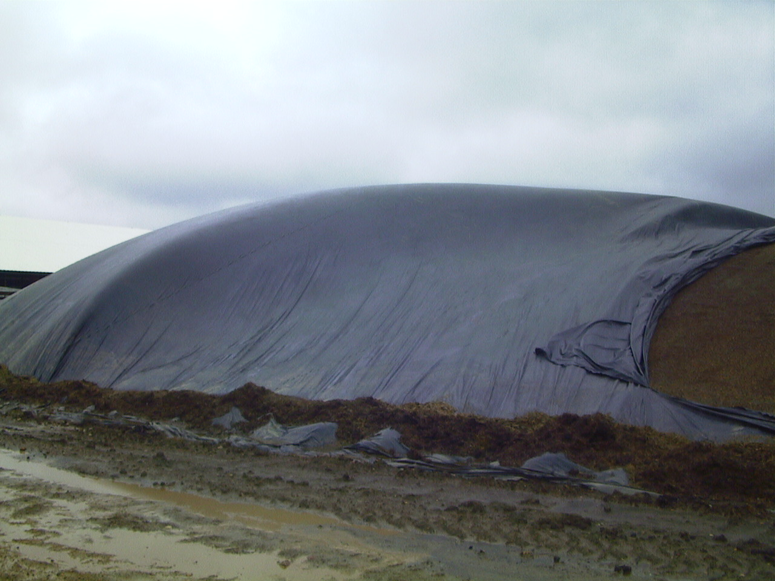
Discussion activity
What’s has gone wrong?
Describe the impact on the quality of the silage.
What should have been done?

