Slide 1


Slide 2
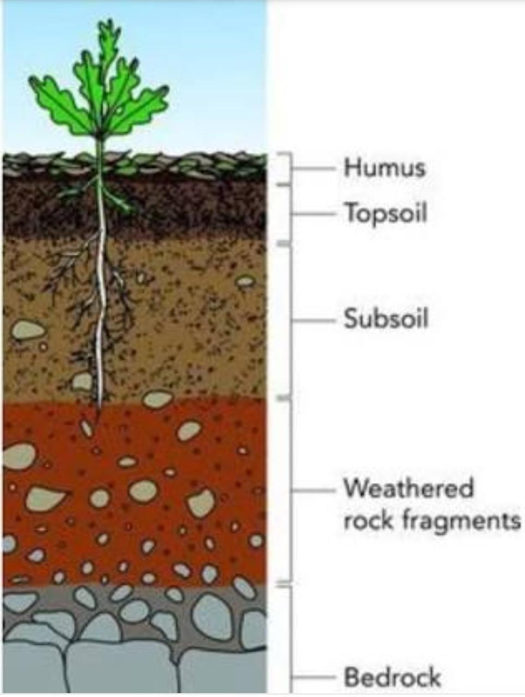
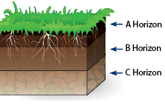
Soil Science

Slide 3
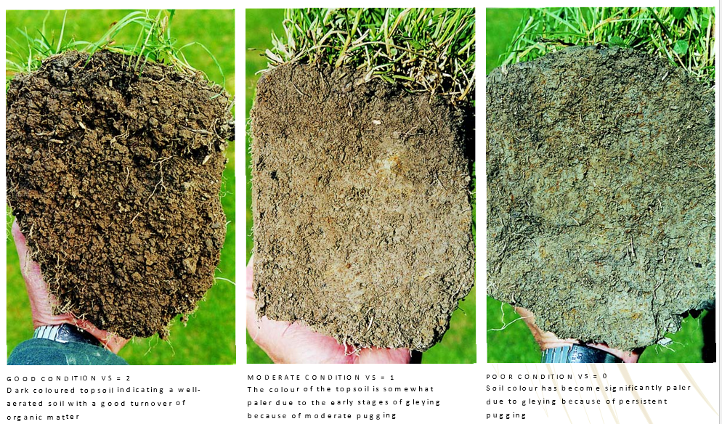
Discussion Activity
What is soil?
Why is soil important?
What would the world look like if there was no soil?
Why do plants need soil?
Are soils all the same?
What makes soils different?
What is a fertile soil?

Slide 4
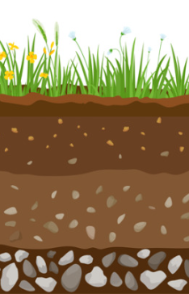
Soil Forming Factors
Plants and Animals
Topography
(slope of the land)
Parent material
(the type of matter the soil is made up from)
Climate
rainfall
temperature
Time

Slide 5
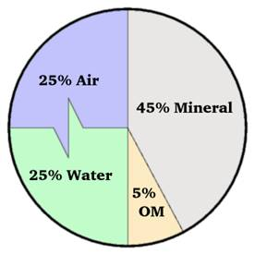
Factors common to all soils
Solids
Liquids
Air
Ideal soil
Inorganic/Mineral matter
Organic matter
Soil water
Oxygen
Carbon dioxide
Methane
Ammonium
Gravel
Sand
Silt
Clay
Plant remains
Animal remains
Dung
Effluent
Soil organisms
Earthworms
Bacteria
Fungi

Slide 6
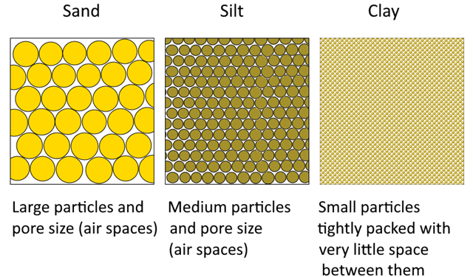
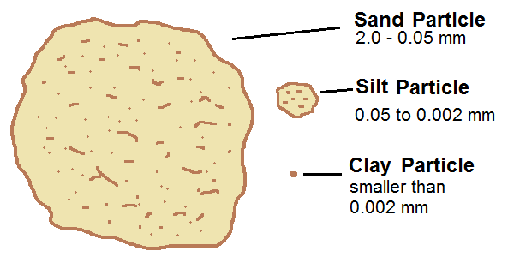
Soil particle sizes
The particles that make up soil are categorized into three groups by size- sand, silt and clay. Sand particles are the largest and clay particles the smallest.
Most soils are a combination of the three.
The relative percentages of sand, silt and clay are what give soil texture

Slide 7
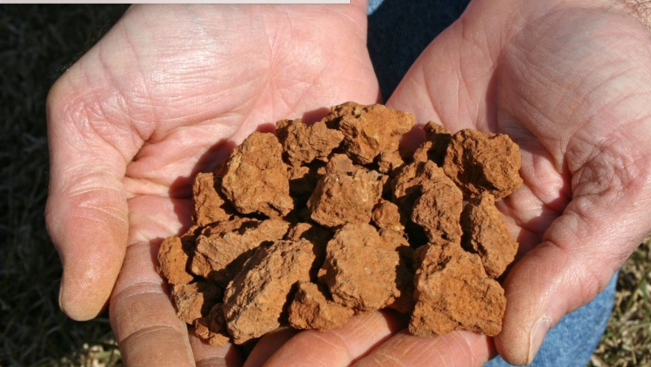
Clay particles
In a clay soil the particles are very small and very close together therefore they have very tiny pore spaces (have a large number of micropores).
DISADVANTAGES | ADVANTAGES
Poor aeration and drainage unless well structured Warms up slowly in spring Difficult to cultivate when too wet or too dry Cracks in dry conditions High water holding capacity | Is rich in plant nutrients High water holding capacity

Slide 8
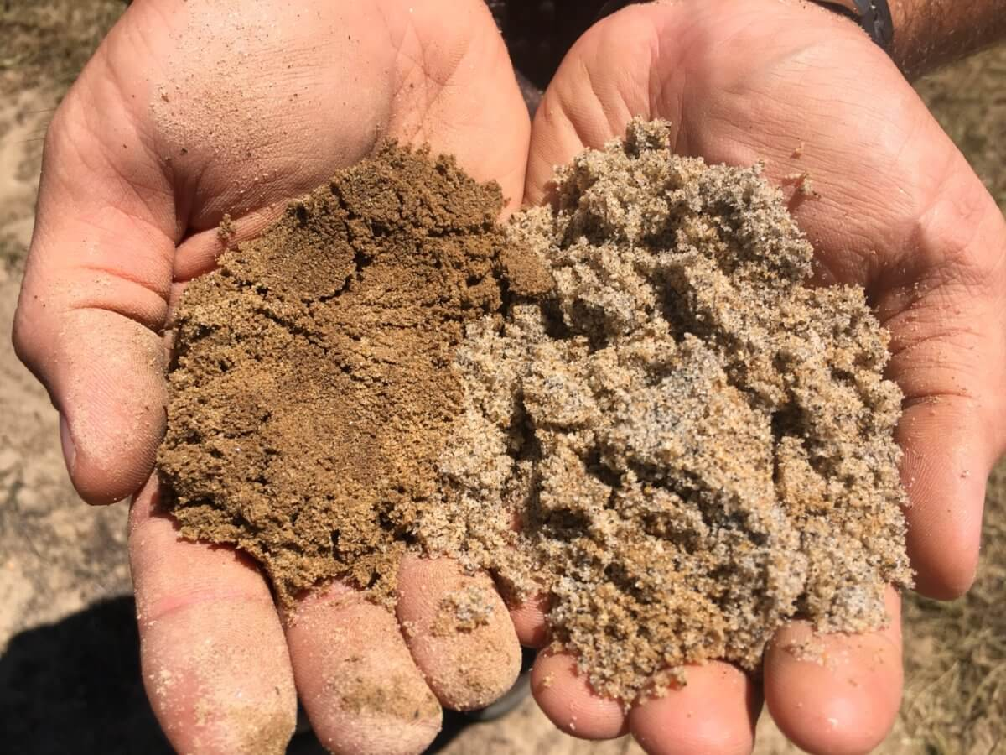
Sand particles
In a sandy soil, the particles are large; therefore, the pore spaces between the particles are large (have a large number of macropores).
DISADVANTAGES | ADVANTAGES
Is structureless Contains few plant nutrients Low water holding capacity Requires irrigation in dry conditions Nutrients are easily leached Organic matter breaks down rapidly | Good aeration Good drainage Warms up quickly in spring Not affected by wetting and drying

Slide 9
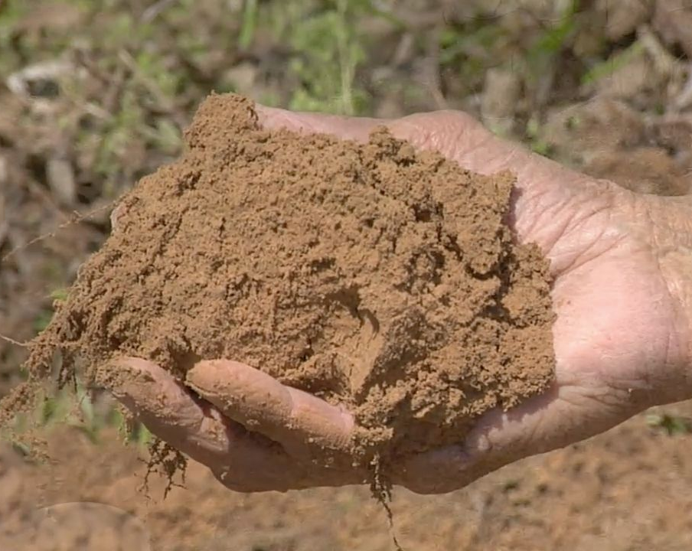
Silt particles
In a silt soil the particles are medium sized, therefore the pore spaces between the particles vary in size from small to medium.
DISADVANTAGES | ADVANTAGES
Has a week structure Contains few plant nutrients Low to moderate water holding capacity Requires irrigation in dry conditions Nutrients are leached under high rainfall conditions Organic matter breaks down gradually | Moderate aeration Moderate drainage Warms up faster than clay in spring but slower than sand

Slide 10
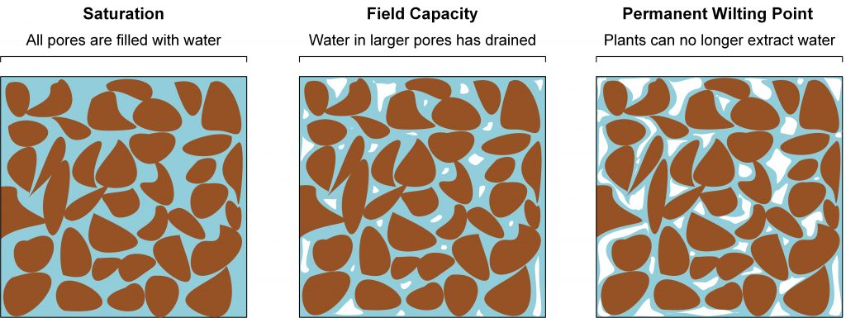
Discussion activity
Why is particle size important in soils.
How does particle size affect how quickly or slowly a soil drains after a period of rain?
Which type of soil would warm up the quickest and why?
What could a producer do to improve drainage in a clay soil?
What could a producer do to increase the amount of water a sandy soil can hold?
Field capacity is the maximum amount of water a soil can hold against gravity
Gravitational water
is found in the macropores
drains out of the soil
not considered to be available to plants.
Hygroscopic water
Is water held tightly by soil particles and is unavailable to plants
Capillary water
is held tightly between the soil particles
some capillary water is available to plants.
Leaching

Slide 11
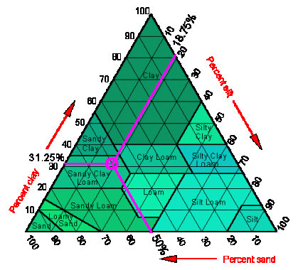
Soil texture
Soil texture refers to the proportion (percentage) of sand, silt and clay in a soil. Sandy soils are made up mostly of sand sized particles. Clay soils are made up of clay sized particles. Silty soils are made up of silt sized particles. A loam is a mixture of sand, silt and clay particles. Particle size is important, it affects how much air and water the soil will hold.
Sedimentation experiment
Texture by feel analysis
Soil texture worksheet

Slide 12
Soil organic matter
Organic matter is a source of food for soil organisms
Improves soil structure
Increase water holding capacity of soil
Effect of organic matter on soil
Soil organic matter is the product of decomposition of plant and animal remains and waste. When fully decomposed it forms very tiny particles called humus. Humus is dark coloured and affects soil colour especially in the topsoil
Humus makes the soil darker- increase soil temperature
Adds nutrients for plant roots to absorb
Increases the soils’ ability to hold onto nutrients reducing loss of nutrients by leaching

Slide 13
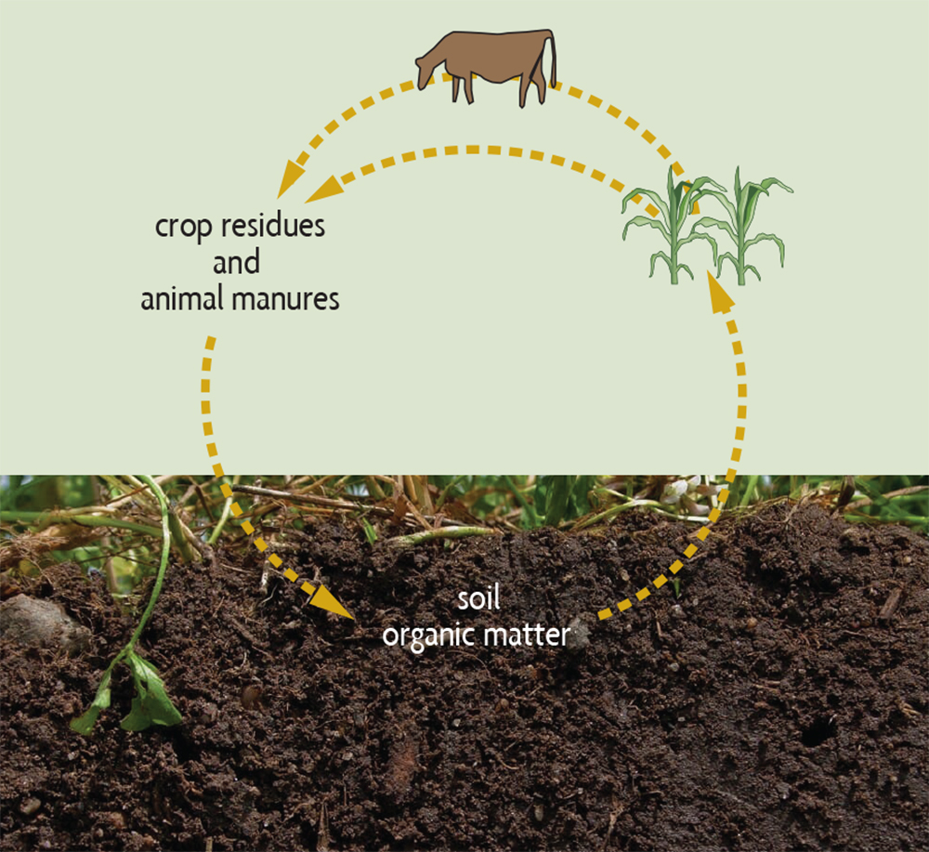
Discussion Activity
What would affect the amount of organic matter in the soil?
How could these producers increase the amount of organic matter in a soil?
  dairy farmer
  arable farmer
  market gardener
How could you increase the amount of organic matter in the school garden plots?

Slide 14
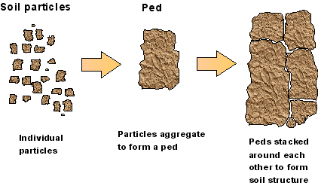
Soil structure
Soil particles are usually joined together into lumps of soil called ‘peds’.
The way particles are grouped (aggregated) together into peds is called Soil Structure
Soil structure can be weak, friable or firm depending on how easily the peds break apart. Friable is the best as the soil is easy to cultivate and for plant roots to grow in. Also, the peds are not so likely to fall apart and then form a surface crust or be eroded away by wind or water.

Slide 15
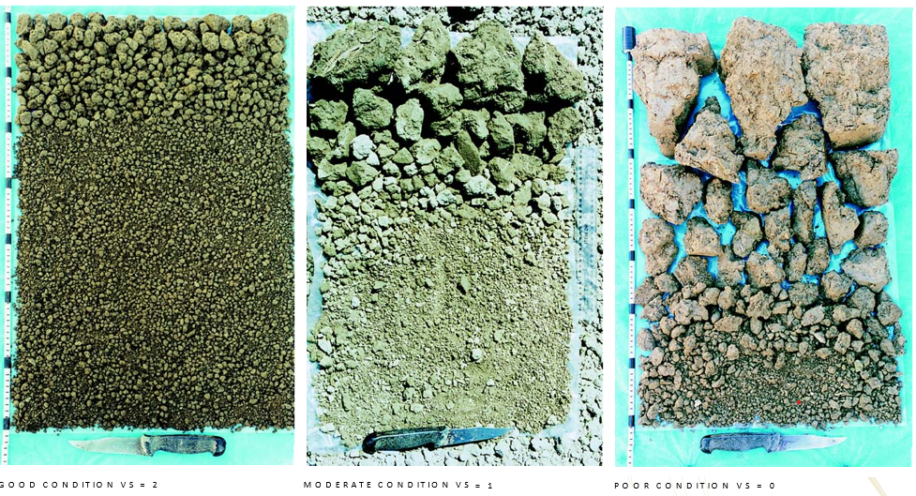
Discussion activity
What are the characteristic of a good soil structure?
Which soil structure is the best. Why?
Soil structure can be destroyed and improved. How?
Why is a good soil structure important for plant growth?

Slide 16
Has a large number of macro pores
Plant roots can move through the soil easily
Requires less cultivation
Characteristics of a good soil structure
Allow rain/water to move through the soil
Less erodible
Good aeration and drainage

Slide 17
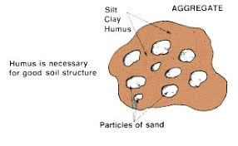
Factors influencing soil structure
Organic matter - (amount of humus in the soil)
Soil texture-(amount of clay in a soil)
Climate
Cultivation
Soil structure can be improved by: | Soil structure can be destroyed by:
Adding organic matter Ploughing in crop stubble Planting a green manure crop Digging in compost Spreading effluent 2. Leaving in pasture or returning to pasture | Over cultivating a soil Cultivating in the wrong conditions, e.g. too wet or too dry Over cropping - decreases OM levels Over stocking on a wet paddock causing pugging Compaction of soil by heavy machinery.

Slide 18
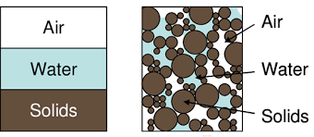
Soil air
Soil air and water share the pore spaces of soils. Therefore texture, structure and the amount of water in a soil affects the amount of air in a soil.

Slide 19
Discussion activity
Why is air in soil important?
What would affect the amount of air in a soil?
How is soil air measured?

Slide 20
Soil air
Plant roots need oxygen to carry out respiration
Soil organisms require oxygen for respiration and to breakdown organic matter
Importance of soil air
The amount of air in a soil depends on the
amount of water in a soil
soil texture
soil structure
Seeds need oxygen to germinate
Nitrogen fixing bacteria require a supply of Nitrogen gas
Oxygen convers toxic compounds into less toxic forms

Slide 21
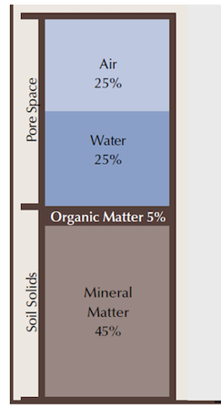
Measuring air in soil
Aim: To find out how much air is in different types of soil.
Method:
Place 50mL of each soil type in a measuring cylinder.
Add 50mL of water
Shake well, but do not let water escape.
Let the mixture settle and read the volume.
Calculate the volume of air in the sample by subtracting the final volume from 100. This will be a percentage.
Record your results in a table
Conclusion:- Explain why different soils have different amounts of air in them.

Slide 22
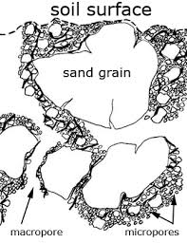
Soil water
Soil water is found in the pore spaces.
The size and number of pores spaces in soils influence water movement and water holding capacity. Fine micro pores hold water, while larger macro pores allow water to drain.
Well structured soils have a network of interconnected macro-pores and micro pores. This allows good water entry and drainage of excessive water while still retaining a good supply of water for plants.

Slide 23
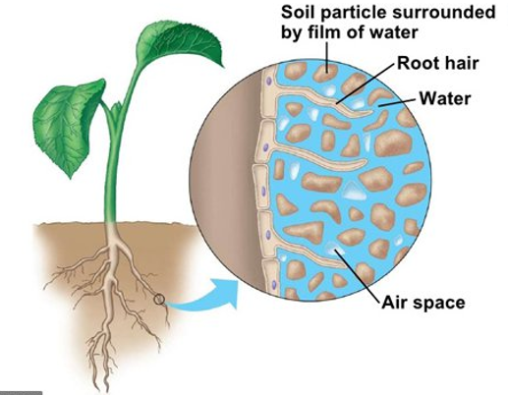
Discussion activity
Why is soil water important?
Can too much water in a soil be harmful?
How can water movement through soil be measured?
How do producers add water and remove water from a soil?
How could these producers improve the water holding capacity in a soil?
  dairy farmer
  arable farmer
  market gardener

Slide 24
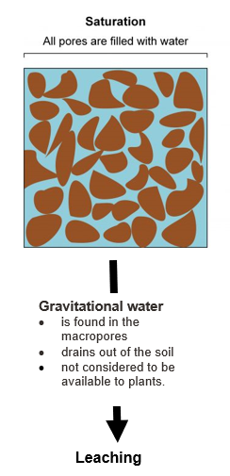
Tips
Supporting the soil structure
Photosynthesis
Soil organisms
Importance of soil water
Dissolving nutrients so they can be absorbed by plant roots
Transpiration
(movement of water through the plants)

Slide 25
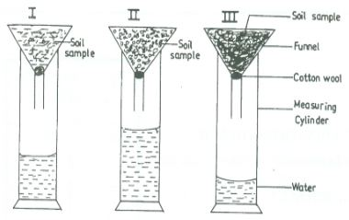
Measuring water movement through different soil types
Aim: To recognise the relationship between pore size and rate of drainage.
Method
Weigh equal amount of each different soil and place in the funnel
Pour 40mL of water slowly into each of the three funnels.
Time how long the water takes to run through from the moment of pouring to the moment the water begins dripping out of the funnel.
Measure the volume of water after 30 mins.
Record results
Conclusion
 | Loam | Silt | Clay loam | Sand
Time taken for first drop to fall
Volume of water after 30 mins

Slide 26
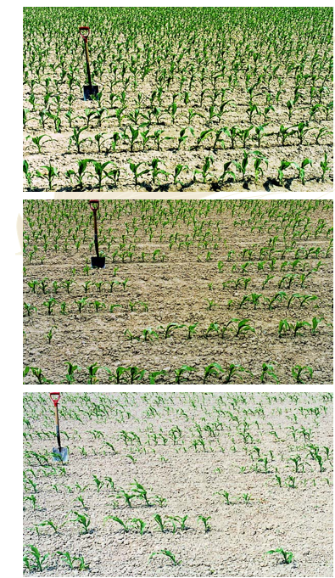
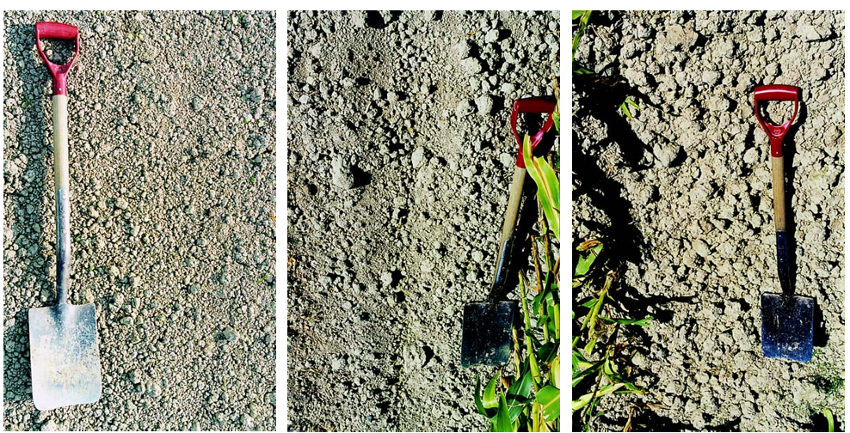
Discussion activity
Which soil is the best for growing crops. Why?
Which soil is the worst for growing crops. Why?

Slide 27
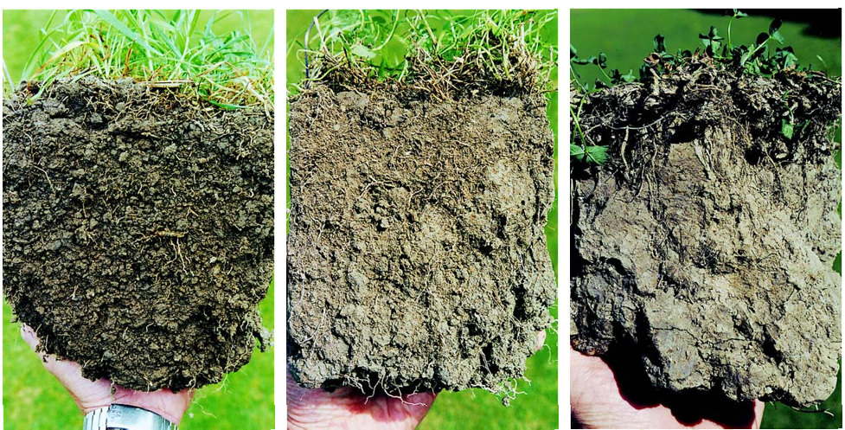
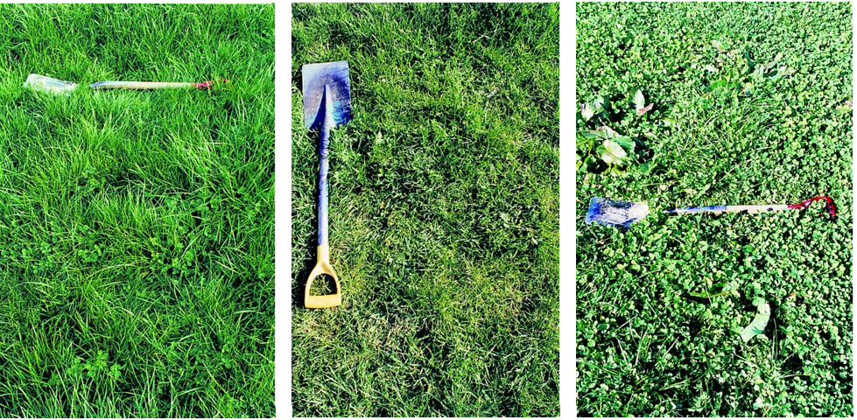
Discussion activity
Describe the difference in soil structure for each soil.
Discuss possible reasons for the difference in soil structure.
Discuss the impact of soil structure on plant growth.

Slide 28
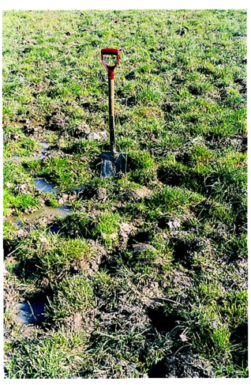
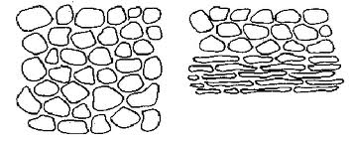
Discussion activity
Describe the impact of pugging on the soil structure.
How can farmers minimize the impact of pugging?
What other management practices could cause soil compaction.

Slide 29
Compaction

Slide 30
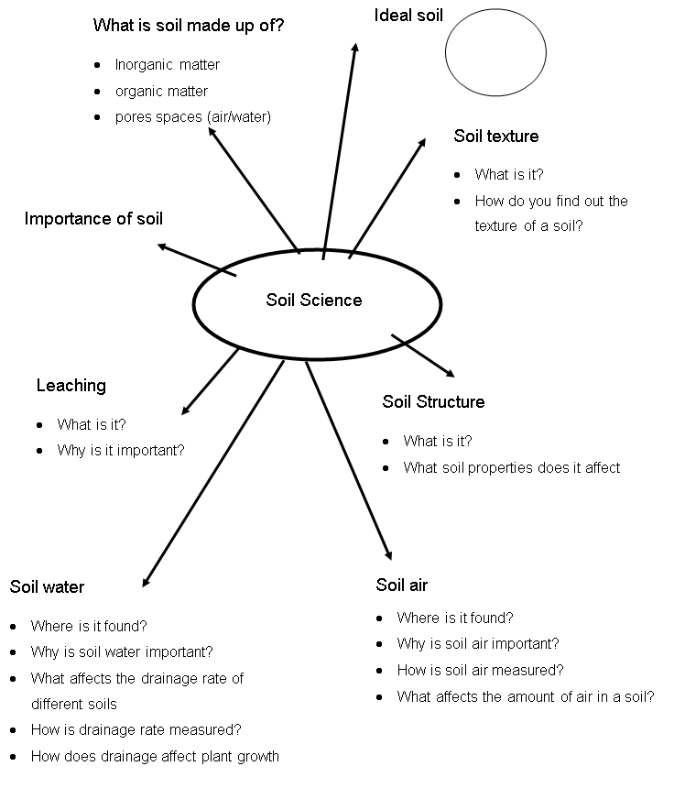
What do you know about soil?
Test yourself

Slide 31
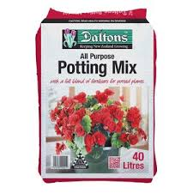
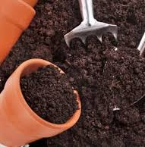
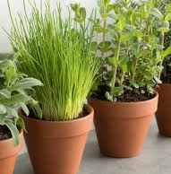
Alternative growing media
Soil isn’t the only growing medium for plants. Many container-grown and indoor crops like tomatoes and capsicums actually grow better in alternative media that offer improved aeration, moisture control, and nutrient delivery compared to regular soil

Slide 32
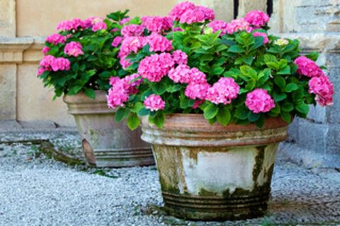
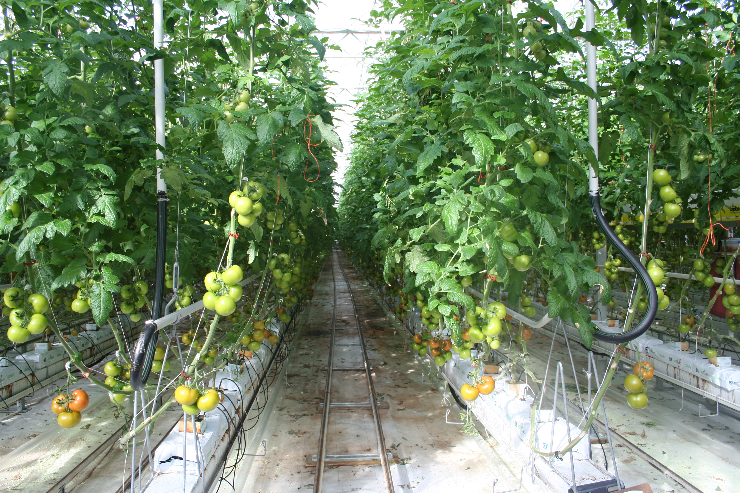
Discussion activity
Why soil is not the best growing media for use in containers and indoor growing systems?
What are the characteristics of an alternative growing media.
Research the ingredients used in alternative growing media and discuss their advantages and disadvantages.

Slide 33
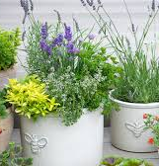
Why soil is unsuitable for indoor and container growing
Soil is a natural medium with variable properties, making it harder to precisely control water, nutrients, and pH in a container system.
In containers soil -
has poor drainage and aeration
is heavy
is inconsistent quality
has a risk of pests and diseases
is difficult to sterilise
can have a nutrient imbalance

Slide 34
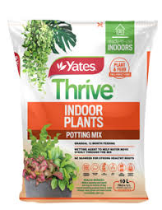
Characteristics of a good artificial growing media
Adequate drainage
Good root anchorage
Holds water
Holds air
Stable
No diseases, pests, weeds
Low fertility unless nutrients added

