Slide 1


Slide 2
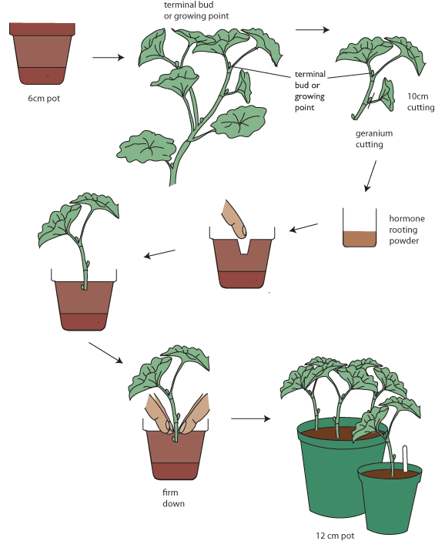
Making Stem Cuttings

Slide 3
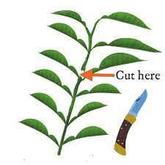

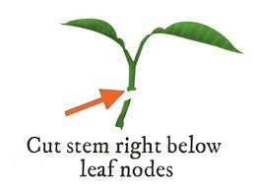
Stem Cuttings
A stem cutting is a piece of stem that is cut off the parent plant and helped to form roots and shoots. There are several types of stem cutting depending on the type of parent material they are taken from. These include,
Softwood or herbaceous cuttings
Tip cuttings
Semi- hardwood cuttings
Deciduous hardwood cutting

Slide 4
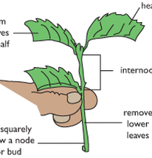
Environmental and biological conditions needed for the successful propagation of plants from cuttings
Always cut beneath the node. This is where there is:
A high concentration of the plant hormone AUXIN
The cambium cells are very active.
Use of Seradix or Clonex - artificial auxin – stimulates root production
Open mix e.g. pumice provides air needed for respiration to make energy needed for root production.
Bottom heat increases root production
Providing water and humidity reduces water loss from leaves, stress and stimulates root production.
Trimming the leaves also reduces water loss.
Enough light for photosynthesis but not too bright a light
Wounding exposing the cambium stimulates root development.

Slide 5
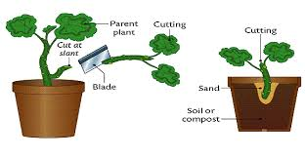
Herbaceous (softwood) Cuttings
This method is used for succulent herbaceous plants e.g Dahlia, Chrysanthemum, Lupin, Geranium, Coleus and Impatiens
The soft stems are cut into pieces 50-100mm long. Each cutting is cut squarely across at the bottom below a node and has its lower leaves removed. If the plant secretes a sticky sap from the cut end it should be left to dry before planting.
Rooting hormones are not normally required but may result in the development of a better root system. The cuttings are planted in containers in the basic growing medium. Bottom heat and high humidity are beneficial, but often not necessary. Many of these cuttings will also form roots if they are placed in water.

Slide 6
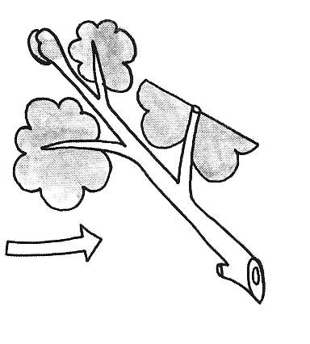
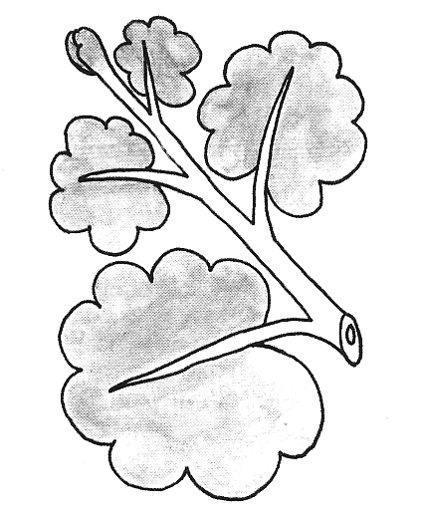
Step to make Softwood (soft tip)stem cutting
This method is used for a wide range of plants e.g Dahlia, Chrysanthemum, and Geranium, .
Soft, immature shoots are cut from the parent plant during spring and summer.
Each cutting is cut squarely across at the bottom below a node; has its lower leaves removed and should be 50-100mm long. Any flowers present should be removed.
The cuttings are dipped in Seradix 1 rooting hormone and are planted in containers in the basic growing medium. Bottom heat and high humidity are beneficial

Slide 7
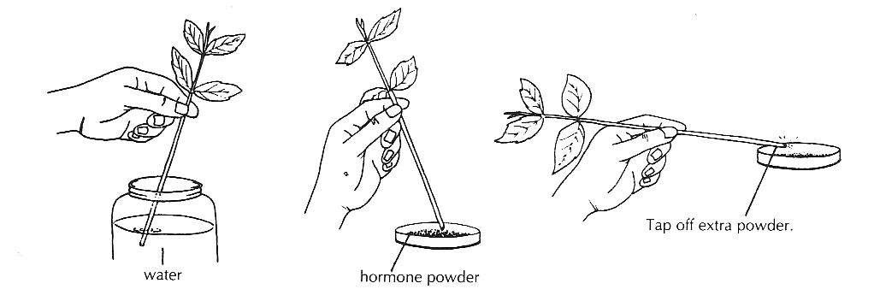
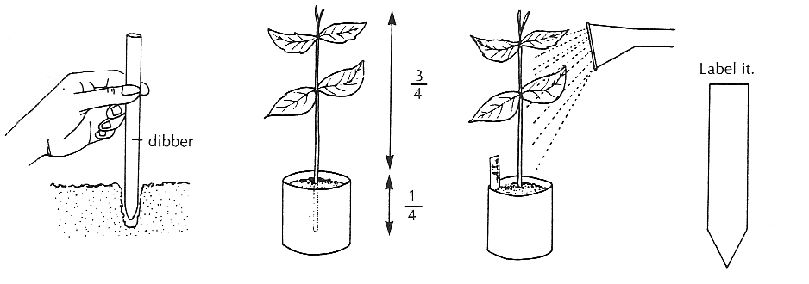
Semi-Hardwood (half ripe) Cuttings
This method is used for a wide range of plants e.g roses, camellia, hebbes.
Side shoots of current year’s growth which is moderately woody, but still growing at the tip are cut from the main stem during summer or autumn.
Each cutting is cut squarely across at the bottom below a node; has its lower leaves removed just above a node. The cuttings should be 80-150mm long. Several cuttings may be made from one stem.
The cuttings are dipped in Seradix 2 rooting hormone and are planted in containers in the basic growing medium. Bottom heat and high humidity are beneficial.

Slide 8
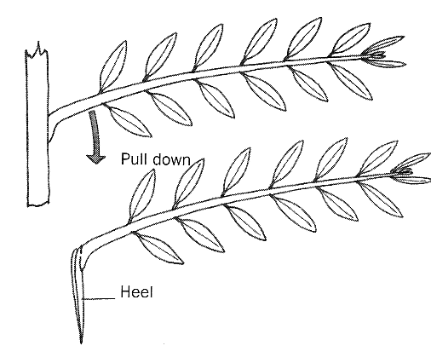
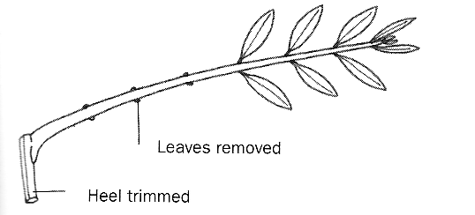
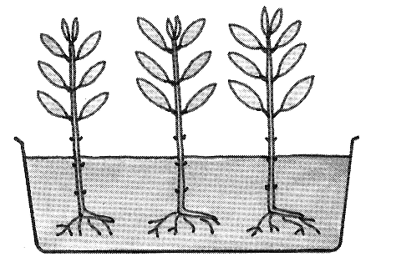
Evergreen Hardwood Cuttings
This method is used for evergreen trees especially conifers, rhododendrons camelias. These cuttings are more difficult to strike than deciduous hardwood cuttings and may take up to a year to form roots.
Small side shoots of fully mature wood are pulled from the main stem of the parent plant during autumn or winter. The cuttings have a heel which is a small part of the main stem, and which should be trimmed back to about half its size.
The lower leaves should be removed so that they don’t touch the growing medium and upper leaves can be trimmed back slightly if they are large.
The cuttings are dipped in Seradix 2 rooting hormone and are planted in containers in the basic growing medium. They require bottom heat and high humidity.

Slide 9
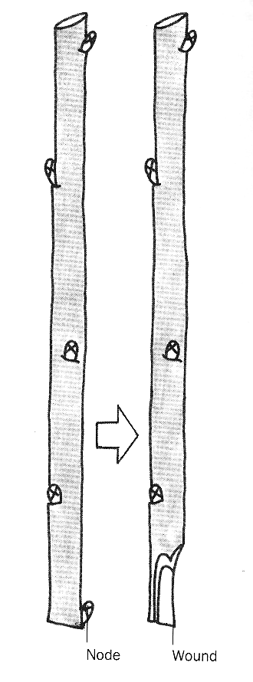
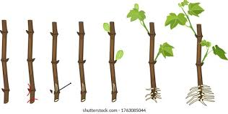
Deciduous Hardwood Cuttings
This method is used for deciduous trees eg poplar, roses, apple, blueberry.
Stems of the current year’s growth which have become hard and woody are cut off using secateurs. This normally takes place in winter when the plant is dormant. The stems are cut into pieces 200-250mm long and should have at least two nodes. Each cutting is cut squarely across at the bottom just below a node and at the top just above a node. The cuttings are wounded to assist root development by removing a slice of bark about 15mm long at their base.
The cuttings are dipped in Seradix 3 rooting hormone and are planted outside in an area with light, friable soil or in a deep box containing the basic growing medium. Each cutting should have nearly half of its length in the medium.
After roots have formed in the spring the cuttings are either potted on or planted out into their final growing position.

Slide 10
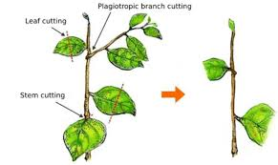
Discussion Activity
Discuss how bottom heat helps cuttings to form roots.
Discuss why a humid environment is required for most cuttings to form roots.
Discuss why each of the following are important for propagating plants by cuttings.
  Equipment used should be clean and sterile.
  Only fresh healthy plant material should be used.
  Cuttings should not be allowed to dry out.

