Slide 1


Slide 2
Plant Reproduction
Sexual and Asexual

Slide 3
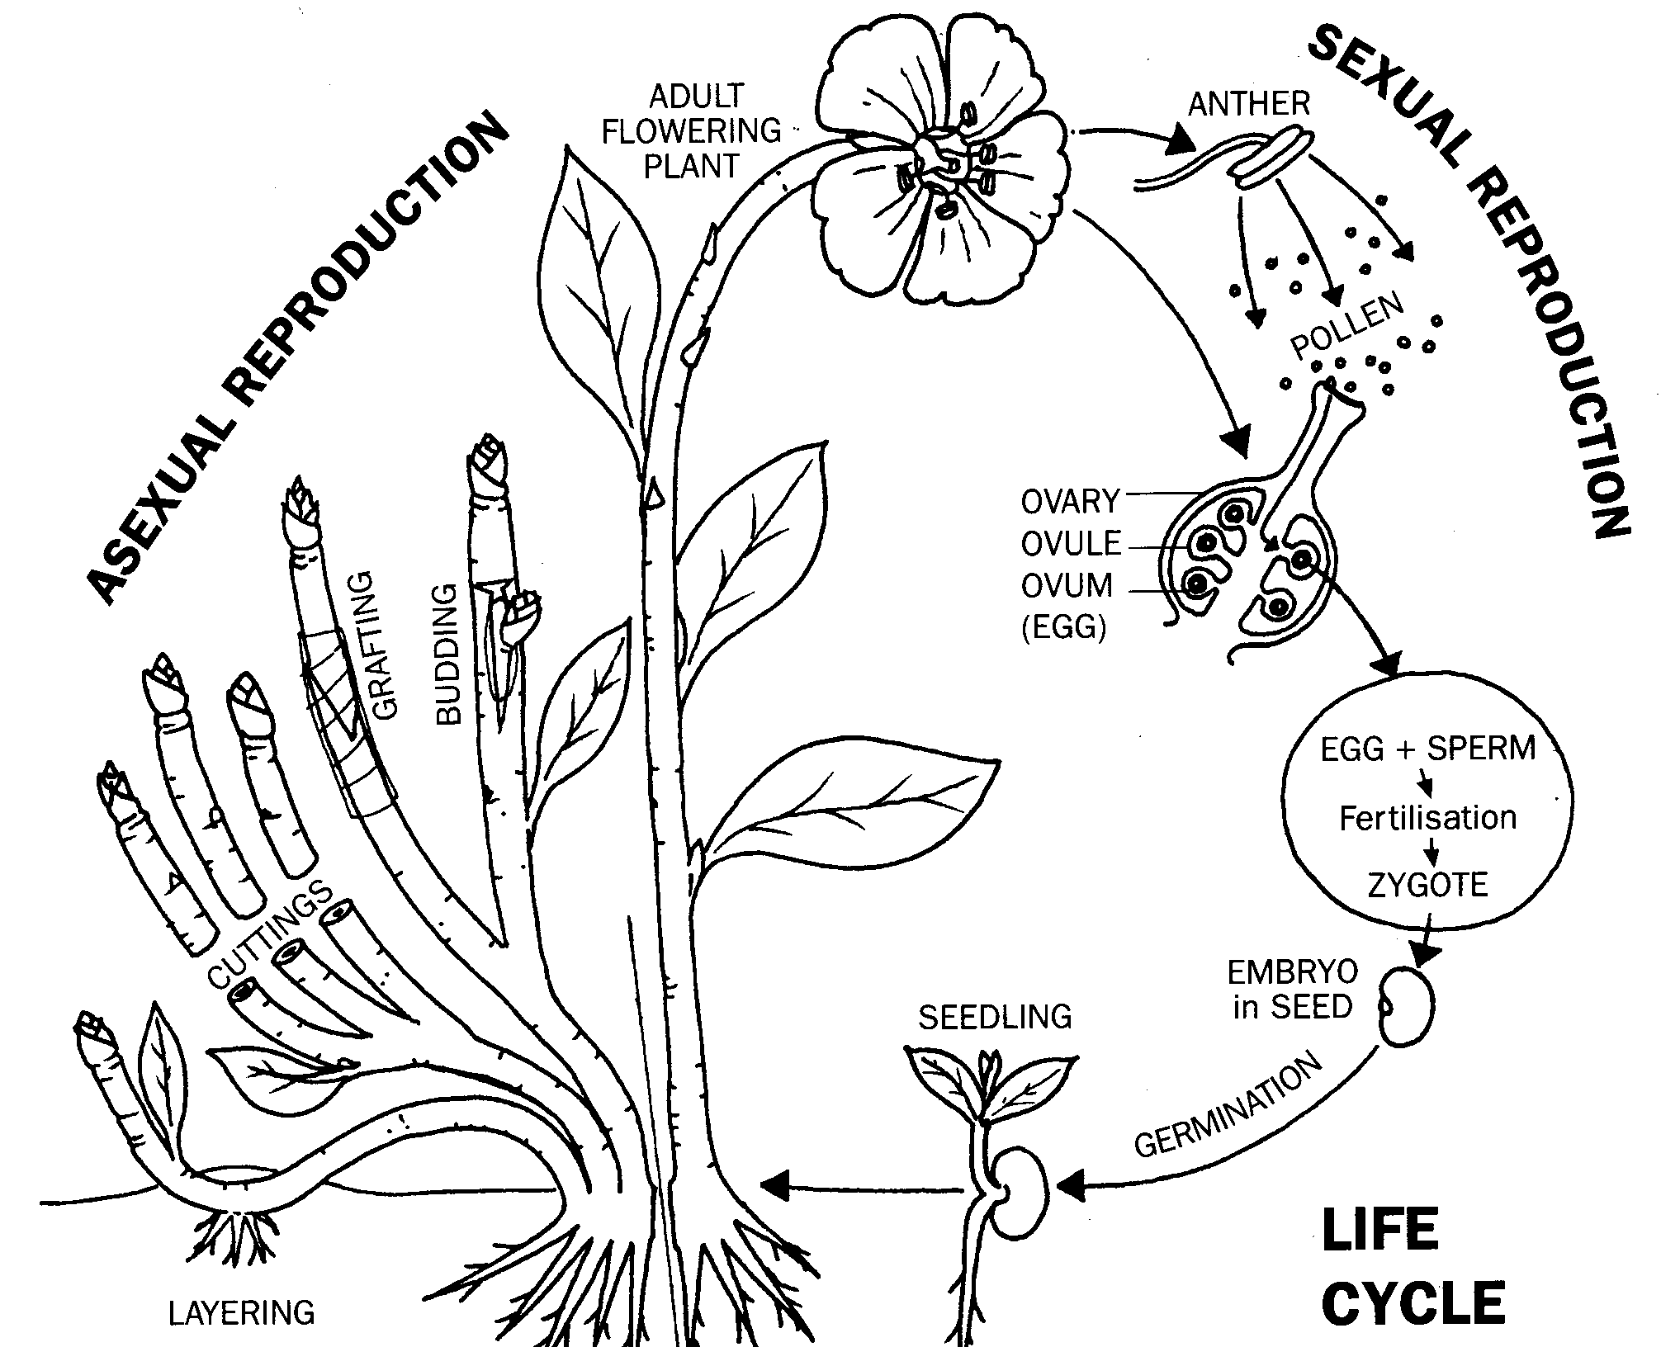
Plant propagation
Plant propagation is producing plants. Plants can be produced from seeds (sexual reproduction) or from parts of the plant such as the leaf and stem (asexual reproduction).

Slide 4
Discussion Activity
PLANT PROPAGATION
Sexual Reproduction
Asexual
Reproduction
What are the differences between sexual and asexual reproduction?
What are the advantages and disadvantages of sexual and asexual reproduction?
Seeds
Natural
Artificial
Bulbs
Corms
Runners
Rhizomes
Tuber
Plantlets
Offsets
Cuttings
Leaf
Stem
Divisions
Layering
Genetic Variation
Identical to Parent Plant

Slide 5
Sexual reproduction
Advantages | Disadvantages
Some plant can only be propagated by seed. | Some plants don’t produce seed.
Variation in offspring allows new varieties to be produced | Variation in offspring makes it difficult to reproduce desired characteristics.
Seeds are easy to transport and store. | Seeds may be difficult to germinate and deteriorate quickly.
Low risk of transferring disease from parent plant to offspring | Offspring may take a long time to reach maturity.
Cheap and convenient method of producing large numbers of offspring.

Slide 6
Asexual reproduction
Advantages | Disadvantages
Offspring are identical to parents. This allows continued propagation of varieties with desirable characteristics. | High risk of transferring diseases from parent plant to offspring.
Offspring may reach maturity more quickly. | A large amount of material which is often perishable is handled during the propagation process
 | Some propagation techniques are complicated; time consuming and not always successful.

Slide 7
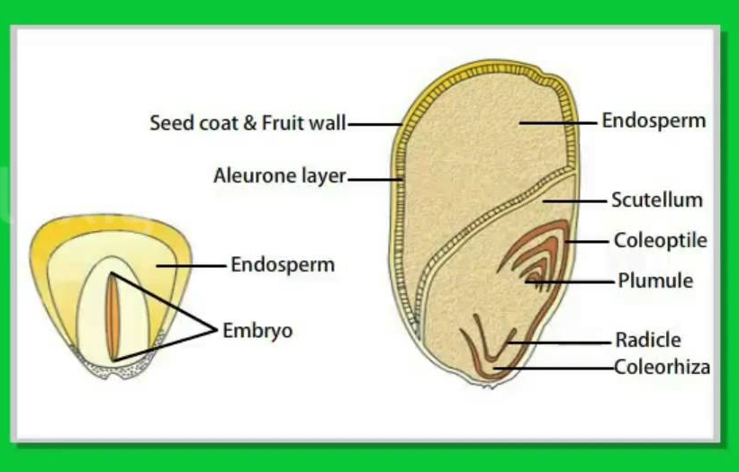
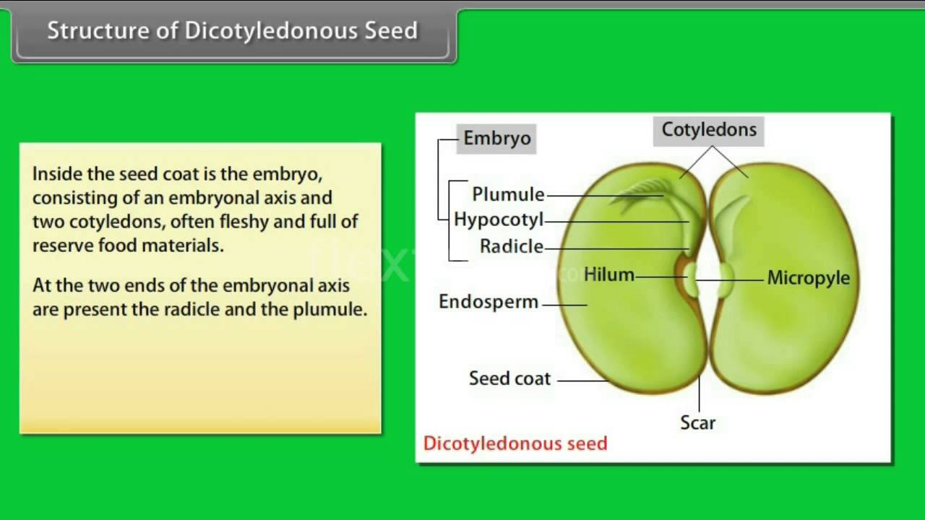
Seeds
The seed, or embryo consists of a radicle from which the root will grow, a plumule from which the shoot grows, and one or two seed leaves called cotyledons. Some seeds have a mass of food deposited around the embryo, called the endosperm. The seed is enclosed by a protective seed coat called the testa.

Slide 8
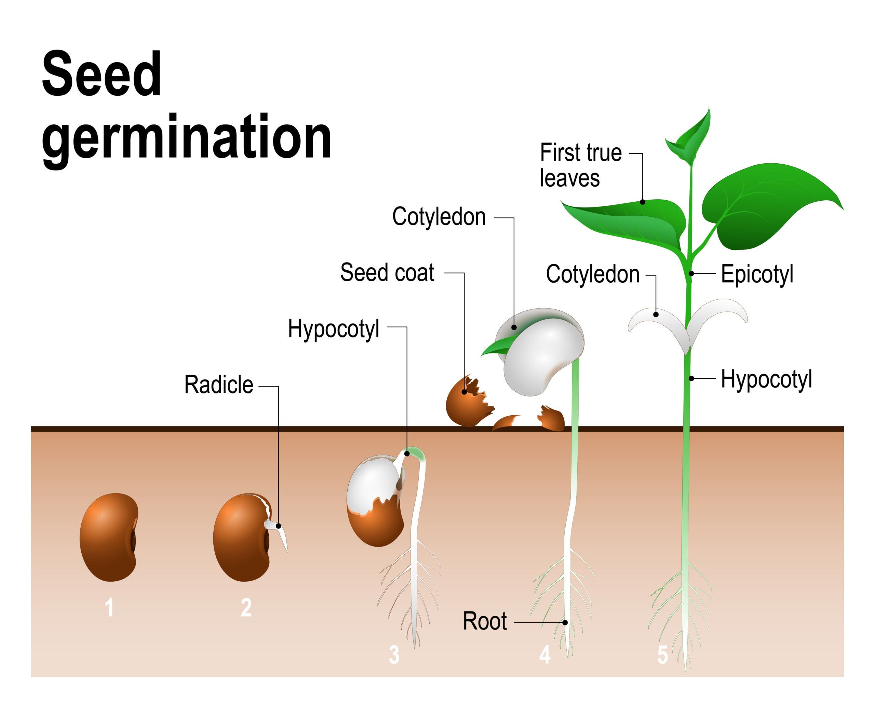
Discussion activity
What is germination?
What do seeds need to germinate?
What is the sequences of events that occur when seeds germinate?
What is the source of energy for germination?

Slide 9
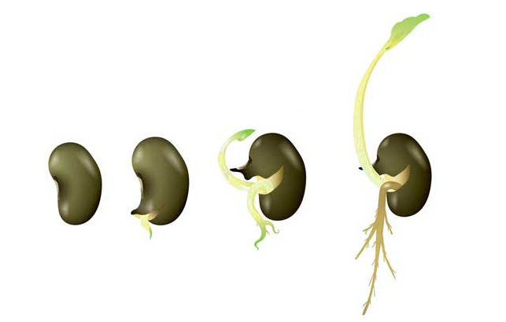
Germination
To germinate, a seed needs an adequate supply of water, oxygen and warm temperatures. The first step in germination is to absorb water. A seed can absorb enough water to increase its volume by 200%. It expands and splits the testa. The water triggers the embryo to release a hormone gibberellin, which activates the enzymes to start digesting the food store and start feeding the embryo.
The first organ to emerge from the seed is the hypocotyls with the attached radicle, which grows downwards toward gravity. By the time, the shoot (plumule) starts to emerge the radicle has grown a set of young roots able to anchor the plant and absorb water and minerals.

Slide 10
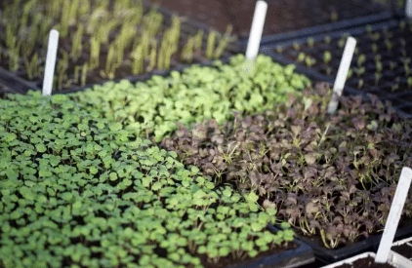
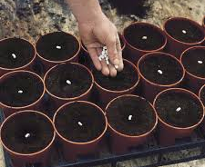
Seed-experiments, activities and how to sow seeds.
PowerPoints
Seeds types and germination
Steps involved in sowing seeds
Seeds - link to junior resource. For information and activities related to seed, either visit
  For HATA members (restricted to members only), https://hata.nz/course/view.php?id=9&notifyeditingon=1
  Agribusiness in Schools website (not restricted) https://www.agribusiness.school.nz/course/view.php?id=20

Slide 11
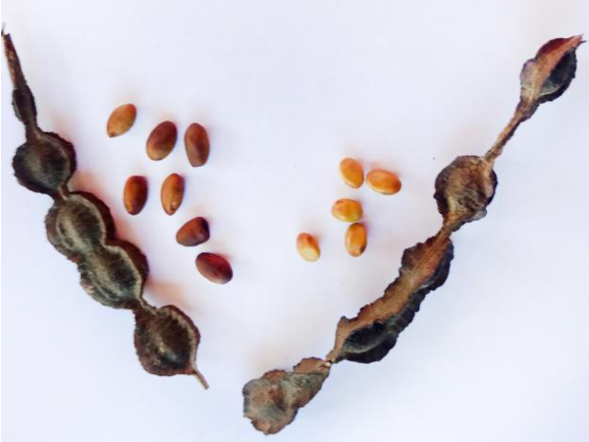
Seed Dormancy
If conditions are not ideal for germination, a seed can remain alive but dormant until it receives the right combination of environmental factors—such as water, oxygen, and warmth.
Breaking Dormancy
If the seed is viable, we can encourage germination by simulating optimal conditions using the following techniques:
Scarification – weakening or breaking the seed coat to allow moisture and gases to enter.
Stratification – exposing seeds to a period of moist cold to mimic natural winter conditions.
Soaking – immersing seeds in water to soften the seed coat and trigger metabolic activity.
Rinsing – regularly washing seeds to remove natural germination inhibitors or reduce mold growth
Investigate-Breaking dormancy in Kōwhai seeds

Slide 12
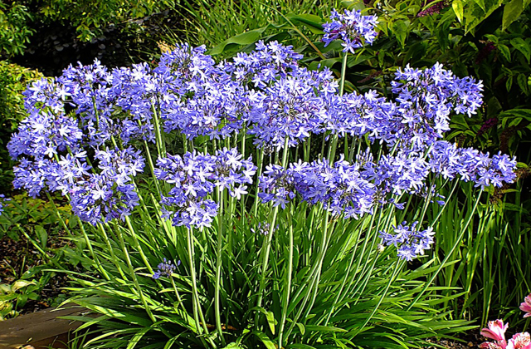
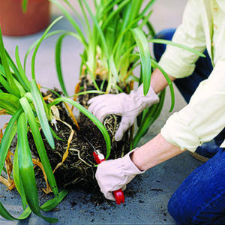
Asexual reproduction
Some plants naturally reproduce asexually through modified stems or roots, which store food and help the plant produce new individuals. This is known as natural asexual reproduction. Additionally, plants can be artificially propagated using various methods such as cuttings, grafting, layering, and division, where parts of a parent plant are used to grow new plants.

Slide 13
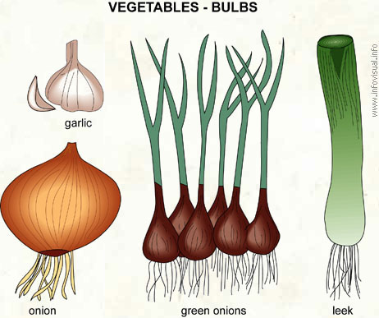
Discussion activity
How do some plants naturally reproduce themselves?
What are the advantages of natural asexual reproduction?
What are the disadvantages of natural asexual reproduction?

Slide 14
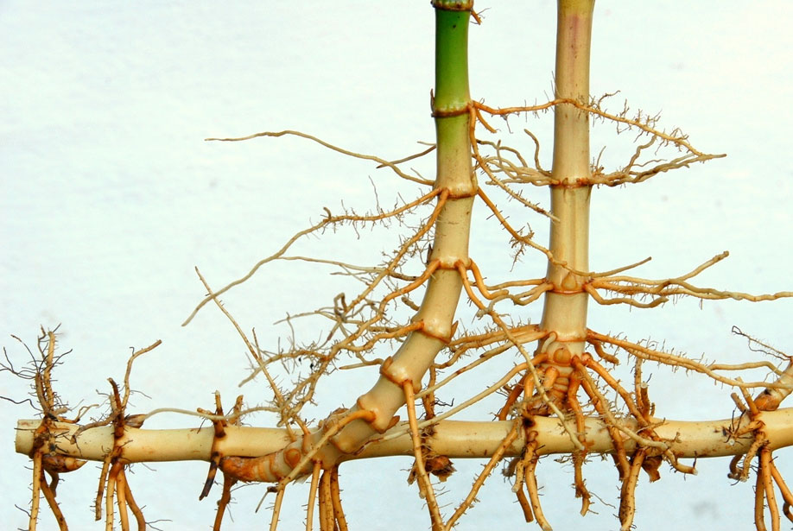
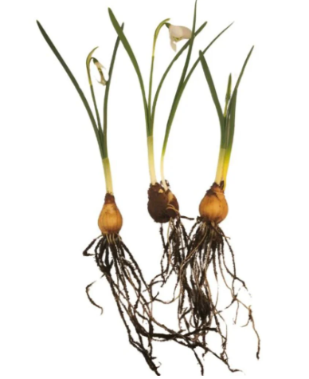
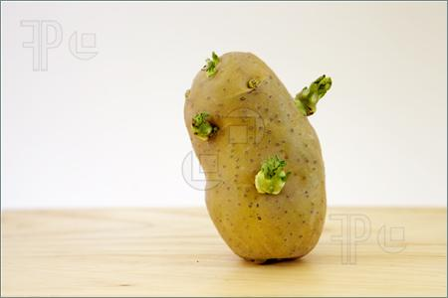
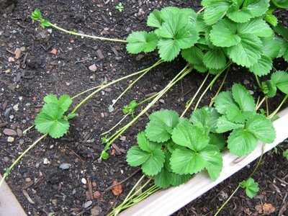
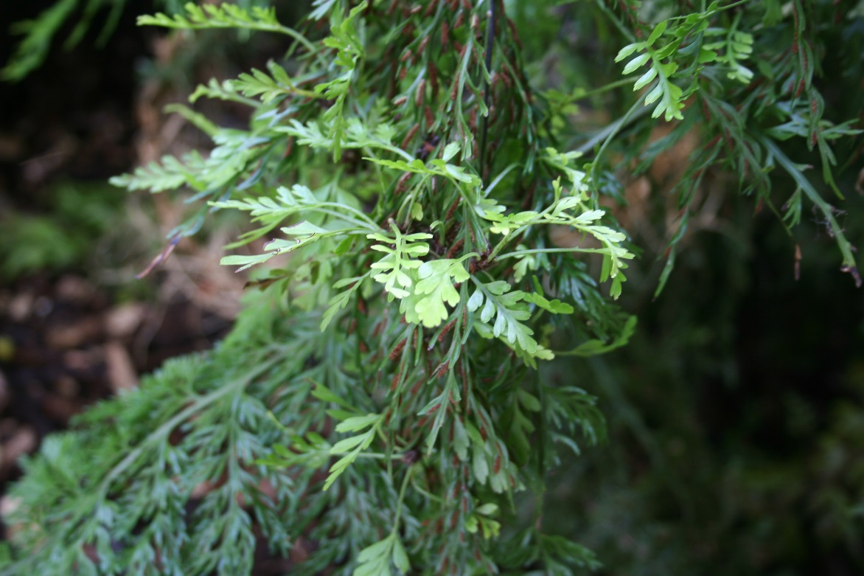
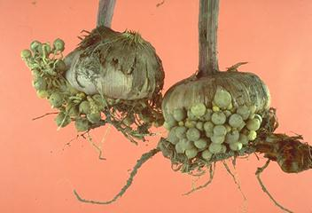
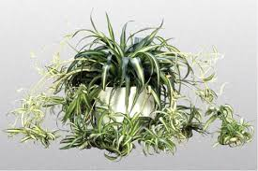
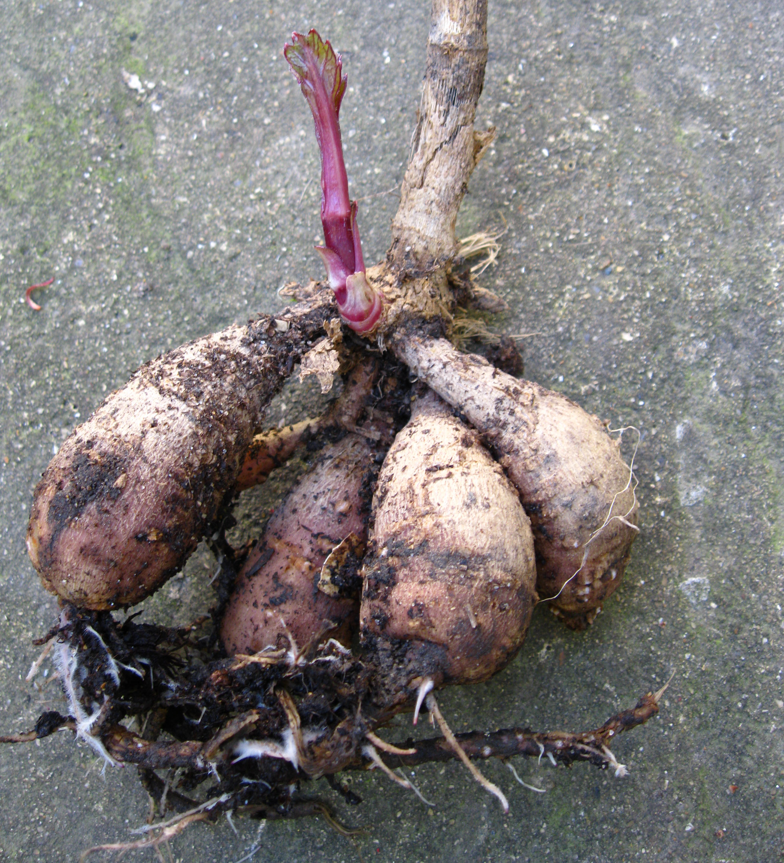
Methods of Natural Asexual Propagation
Stem tuber
Runner
Rhizome
Bulb
Leaflets
Corm
Offset
Roots tuber

Slide 15
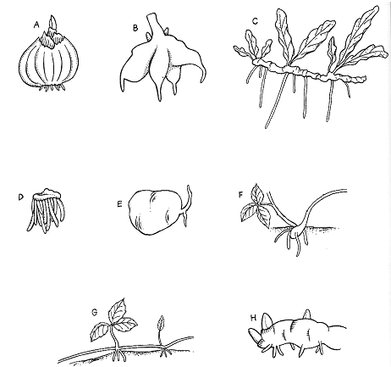
Activity
Drag the names to match the naturally method of asexual reproduction.
Stolon
Rhizome
Root tuber
Stool
Stem tuber
Bulb
Runner
Corm

Slide 16
Answer
Drag the names to match the naturally method of asexual reproduction.
Bulb
Root tuber
Stolon
Corm
Stem tuber
Stool
Runner
Rhizome

Slide 17
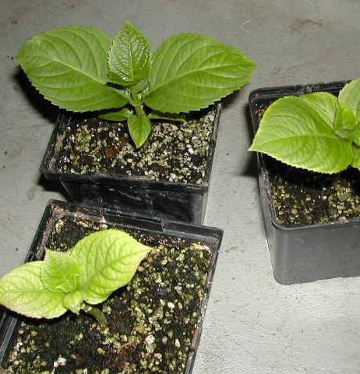
Artificial Methods of Asexual Propagation
Tip (softwood) cuttings of Hydrangeas
There are four main methods of artificial asexual propagation in plants:
Cuttings – Using parts of a plant to grow a new one. This includes:
  Stem cuttings – A piece of the stem is planted to grow roots and form a new plant.
  Leaf cuttings – A leaf or part of a leaf is used to generate a new plant.
  Petiole cuttings – The stalk that connects the leaf to the stem (petiole) is used for propagation.
Division – The plant is separated into two or more parts, each with roots and shoots, which can grow independently.
Grafting – A part of one plant (the scion) is joined to the stem or root system of another plant (the rootstock), and they grow together as one plant.
Layering – A stem is bent down to touch the soil while still attached to the parent plant, and it forms roots before being separated as a new plant.
For information on how to make leaf and stem cutting see power points

Slide 18
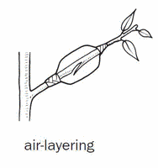
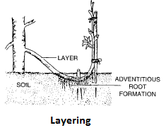

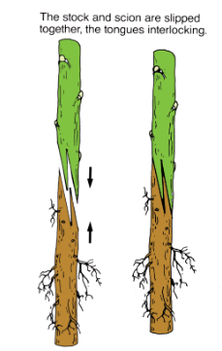
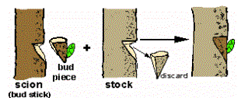
Discussion
Activity
Discuss advantages and disadvantages of these methods of asexual plant propagation.
T Bud
Whip & Tongue
Chip Bud

