Slide 1


Slide 2
Plant Management

Slide 3
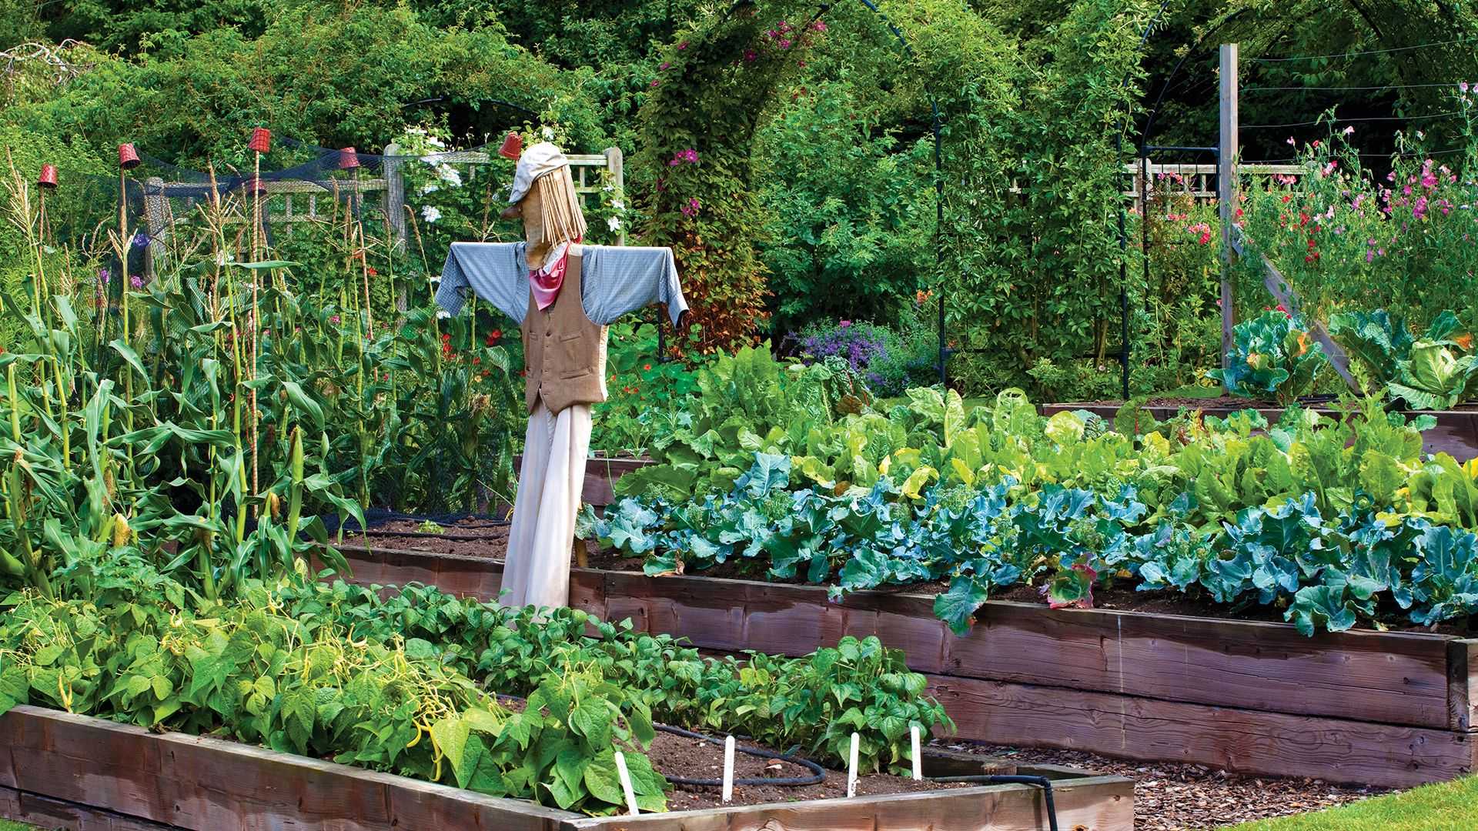
Discussion activity
What are the advantages and disadvantages of growing a vegetable garden?
Make list of factors that would be needed for a vegetable garden to be productive?
Why are these factors important?

Slide 4
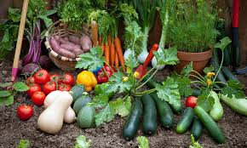
Growing vegetables
Advantages | Disadvantages
Cheaper vegetables Fresh vegetables No chemicals Good exercise/ hobby Can sell of give surplus vegetables away | Time consuming Land availability Initial cost of equipment, seeds fertiliser plants

Slide 5
Discussion activity
Make a list of vegetables.
Group the vegetables under the heading below.
Which vegetables can you grow outdoors in
  Summer
  Winter
  All year round
Vegetable crops
Tuber | Legume | Root | Leaf | Flower | Fruit | Other
Vegetable crops
Summer | Winter | All year

Slide 6
A few suggestions to get you started
Vegetable crops
Tuber | Legume | Root | Leaf | Flower | Fruit | Other
Potatoes Kumara Yams | Peas Beans | Carrots Parsnips Beetroot | Lettuce Cabbage Silverbeet | Cauliflower Broccoli | Tomatoes Pumpkin Courgette | Sweetcorn Asparagus

Slide 7
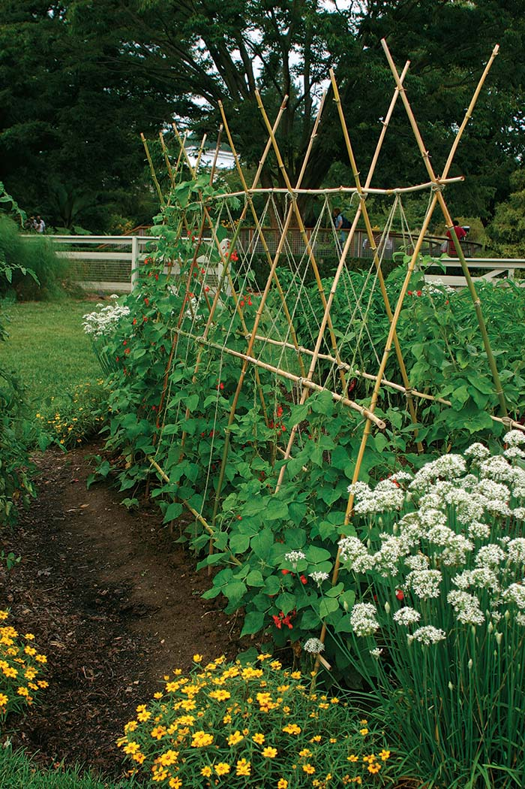
Discussion Activity
Make a list of factors that plants require for growth.
Make a list of factors that harm or slow down plant growth.
Discuss why they harm or slow down plant growth.
Make a list of factors you need to consider when planning a vegetable garden.

Slide 8
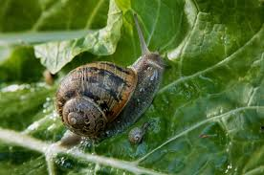
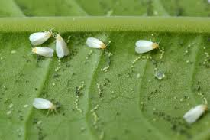
Pests
Damage the leaves, stems and fruit
Cause the spread of diseases
Weeds
Complete for light, water and nutrients
High humidity (above 80%)
Increases the risk of bacterial and fungal diseases
Wind
Damages stems and branches
Increases loss of water from leaves through transpiration
Cools plant down and can slow growth
Reduces the number of bees affecting pollination
Diseases
Damage the leaves, stems and fruit decreasing the value of the product
Factors that harm or slow down plant growth
Low light
low rate of photosynthesis, slow plant growth
cause etiolation of plants
Cold temperature
Slows down the rate of photosynthesis
Frosts damage new growth, flowers and fruit

Slide 9
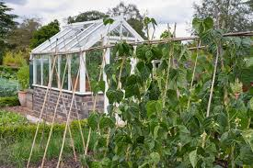
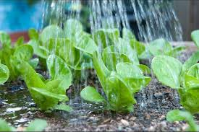
Training and Pruning
Increase the light available for photosynthesis
Light
Photosynthesis
Air
Oxygen- respiration for energy for growth
Carbon dioxide- photosynthesis
Water
Photosynthesis
Transport nutrients
Keep plant cool
Keep plant cells fill for support
Plant requirements for growth
Nutrients
Fertiliser to supply nutrients for plant growth
Temperature
Warm temps increase plant growth
Cold temps slow down plant growth
Humidity (60-80%)
Reduces loss of water through leaves (transpiration)

Slide 10
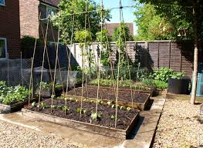
Factors you need to consider when planning a vegetable garden.
How many factors did you get?
Discuss why each factor is important for plant growth.
Successional sowing
Control of pests & diseases
Crop rotation
Fertiliser
Harvesting
Aspect
Planning a vegetable garden
Planting distances
Shading
Drainage
Shelter
Soil
Growing season
Irrigation
Weed control
Staking & Training

Slide 11
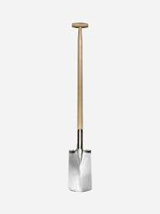
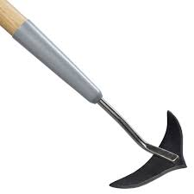
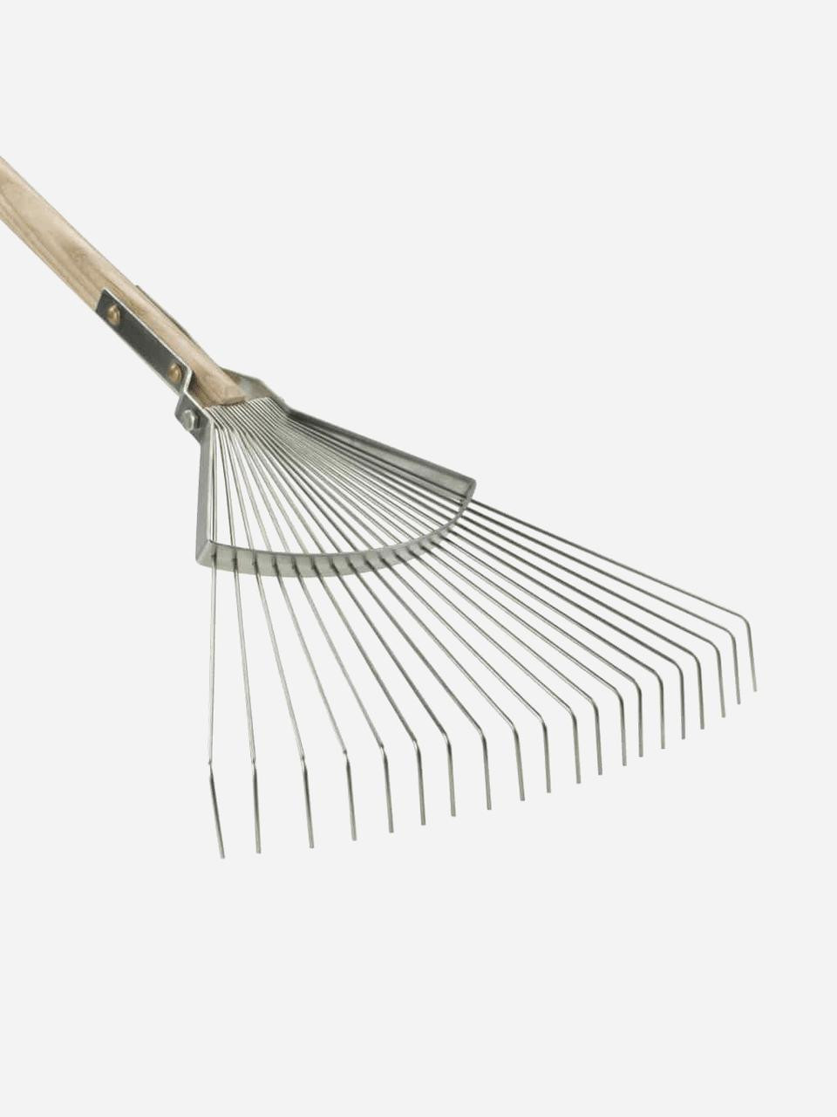
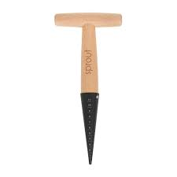
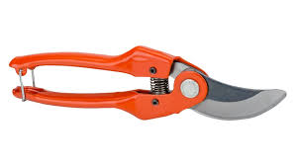
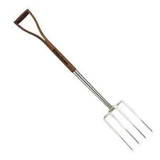
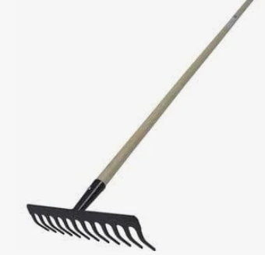
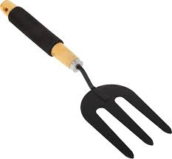
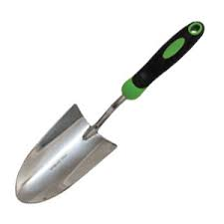
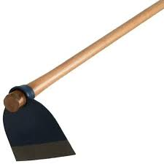
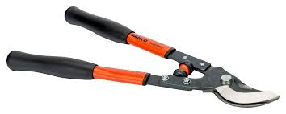
Name these tools
E
D
A
B
C
J
I
H
G
F
K

Slide 12
How many did you get correct?
What is each tool used for?
Push hoe
Spade
Leaf rake
Secateurs
Rake
Bibber
Fork
Hand fork
Trowel
Push hoe
Loppers

Slide 13
Quiz
Which part of a spade makes it easier to push the spade in with your foot?
Which gardening tool has fine strong tines?
How would you use a rake to make a drill for sowing seeds?
Which tool is used to cut through soil just below the surface.
Should you walk backwards or forward when you are using a chop hoe?
When would you use a hand fork?
How should gardening tools be stored?
Which tool would be best to use for these activities
  Breaking large clumps of soil into smaller clumps?
  Making a pile of dead leaves?
  Digging a hole to plant an apple tree?
  Trimming a hedge?
  Pruning a grape vine?

Slide 14
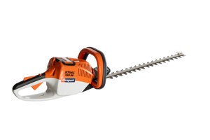
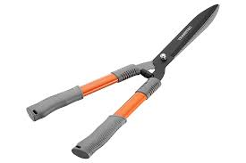
Answers
The tread (the top edge of the blade where you place your foot).
A fork or hand fork or a rake
Turn the rake onto the back edge to draw a straight shallow line in the soil.
A push hoe
Walk backwards, so you don’t step on the area you’ve just hoed.
For loosening soil, or weeding around plants
Clean and dry them before storing. Store them in a dry, sheltered place, ideally hung up or placed securely to avoid rust and accidents.
8
  A garden fork or hoe.
  A leaf rake
  A spade.
  Hedge shears
  Secateurs

Slide 15
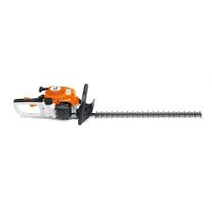
Answers
The tread (the top edge of the blade where you place your foot).
A fork or hand fork or a rake
Turn the rake onto the back edge to draw a straight shallow line in the soil.
A push hoe
Walk backwards, so you don’t step on the area you’ve just hoed.
For loosening soil, or weeding around plants
Clean and dry them before storing. Store them in a dry, sheltered place, ideally hung up or placed securely to avoid rust and accidents.
8
  A garden fork or hoe.
  A leaf rake
  A spade.
  Hedge shears
  Secateurs

Slide 16
Test yourself
Name two
  Root vegetables
  Legume vegetables
  Leaf vegetables
  Tuber vegetables
  Flower vegetables
Which tool would you use to
  level the ground before making a seed drill?
  harvest potatoes?
  prick out seedling?
  prune a tomato plant?
3. Describe two reasons why a crop rotation is important?

Slide 17
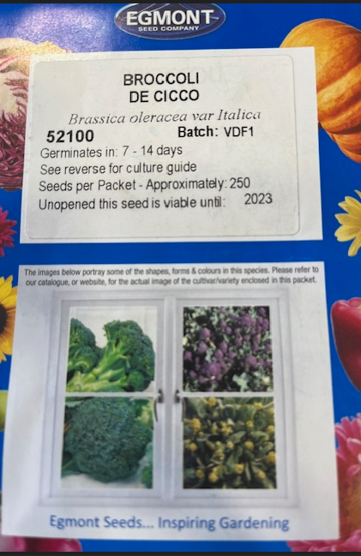
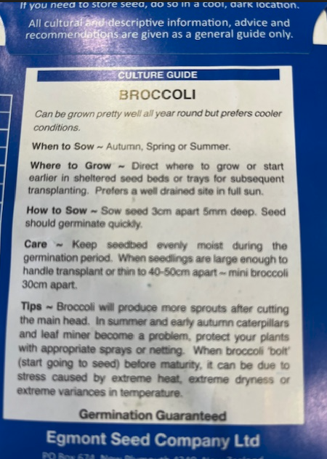
Seed packet
Activity
2027
Use the information on the seed packet and your own knowledge to answer questions.
Before what date should the seeds be sown.
How deep should you sow the seeds?
How far apart should the seedling be planted?
Why are seeds stored in foil?
Activity- Design your own seed packet for seed you have collected

Slide 18
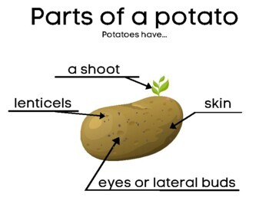
Study a vegetable crop Potatoes
For information and activities on growing potatoes - link to junior resource, either visit
For HATA members (restricted to members only), https://hata.nz/course/view.php?id=9&notifyeditingon=1
Agribusiness in Schools website (not restricted) https://www.agribusiness.school.nz/course/view.php?id=20

