Slide 1


Slide 2



Future Proofing to Ensure Business Viability.

Slide 3
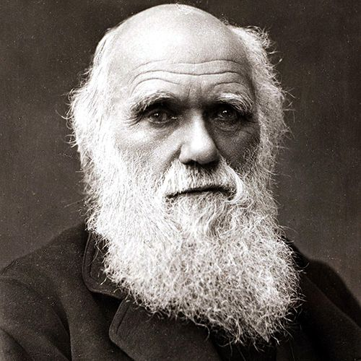
Discuss this statement by Charles Darwin and its relevance to future proofing businesses.
“It is not the strongest that survive, nor the most intelligent, but the ones most responsive to change”.

Slide 4
So what is future proofing?
Future proofing is the understanding of the impacts of outside influences on businesses & their ability to meet present & future needs to ensure business viability for future generations.

Slide 5
So, why is it important?
The business will be progressively impacted by resource scarcity, climate change, supply chain insecurity, stakeholder demands, increased regulations & rising costs for resources, insurance & finance & sustaining by itself is not enough. The business wants to thrive. This drives change.
What are the consequences if we don’t future proof?
  Reputation,
  Profitability,
  Innovation &
  Unviability.

Slide 6
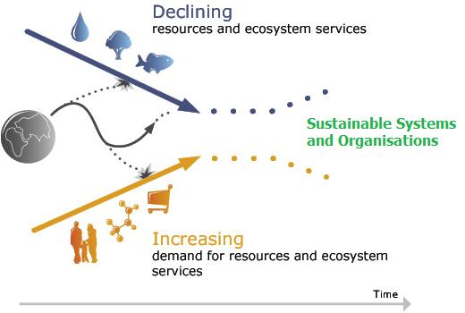
Funnel effect.
Discuss how this Funnel Effect image is relevant to future proofing a business.

Slide 7
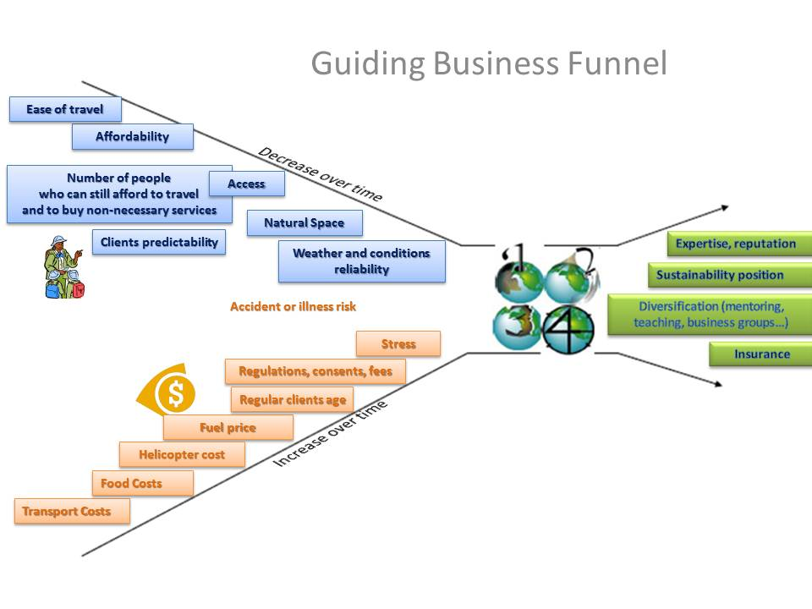

Slide 8
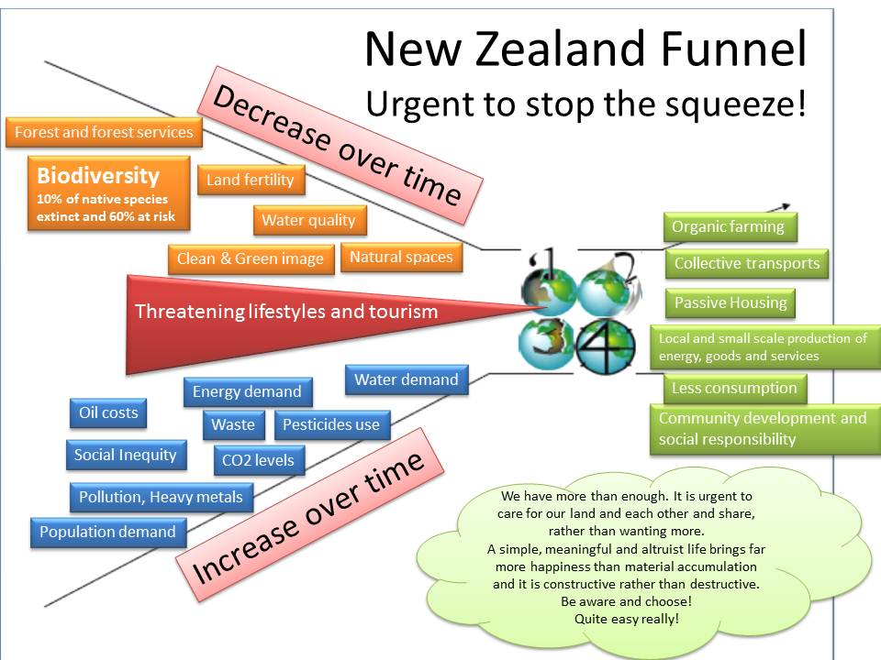

Slide 9
Long term viability
Viability refers to ensuring the continuity of a business to meet current & future needs.
The viability of a business is measured by its long-term survival, & its ability to have sustainable profits over a period of time.
If a business is viable, it is able to survive for many years, because it continues to make a profit year after year. The longer a company can stay profitable, the better it's viability.
A business demonstrates its viability by making a profit every year of its existence.

Slide 10


Environmental influences
Is about maintaining the integrity of life support systems.
It incorporated the important notions of biodiversity and ecosystem services.
Examples include;
  Climate change
  Product contamination e.g. pesticide residue
  Biosecurity
  Biodiversity – loss of
  GAP (Global Agricultural Practices)
  Over-exploitation of natural resources
  Carbon emissions
  Pollution levels

Slide 11


Technological influences
An impact on how a business operates that are related to the equipment used or a product made within the business’s environment.
Due to increased reliance on equipment, technological factors currently exert a considerably more important effect on the success of a business than they did.
Examples include;
  Precision Agriculture.
  Sensors (data).
  More efficient production.
  Robotic technology.
  Drones.
  Technology disruptions.
  Manipulation of information from agri-tech-automation & smart data devices

Slide 12


Social influences
Is about equity within & between generations, & within & between ethnic & social groups.
It is inclusive of people’s mental & physical well-being & the cohesion of their communities based on a fair distribution of natural resources.
Examples include;
  Animal welfare
  Traceability
  Conscientious consumer
  Market requirements
  Negative publicity
  Food safety
  Food losses and waste.

Slide 13


Cultural influences
Is the nourishment & sharing of attitudes & values that represent diverse ways of viewing the world.
Cultural sustainability is inclusive of political sustainability, which is about all citizens having the opportunity to express their views freely & participate in decision making.

Slide 14


Economic influences
Using resources to provide necessary & desirable products & services for the present generation without compromising the ability of future generations to do the same.
Examples include;
  Financial risks.
  Trade agreements.
  Global economic trends.
  Reduced demand.
  Volatility of income.
  Market requirements.

Slide 15


Political influences
Government policy & its administrative practices that can have an effect on businesses or which could have a substantial impact on how their business operated & its bottom line.
Examples include;
  Legislation.
  Regulatory shifts or changes.
  Geopolitical.
  Globalisation of trade.

Slide 16


Ethical influences
Morals or values that are attributed to a system of beliefs, i.e. religious, political or philosophical.
Businesses must apply these beliefs in short or long term decisions.
These concepts inevitably are intertwined & must be applied carefully to maintain an image of professionalism & accountability.
Examples include;
  Bioethics e.g. genetically modified food
  Nuclear free.
  Synthetic food

Slide 17

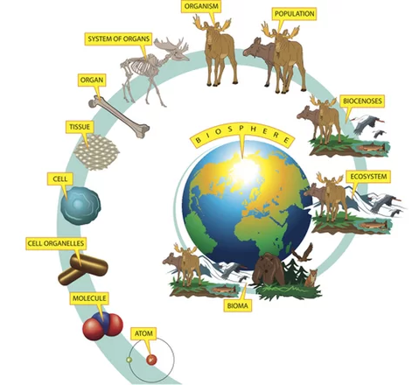
Biological influences
Manipulates or affects the function or behaviour of a living organism. Can be physical, physiological, chemical, neurological, or genetic.
Examples include;
  Product contamination e.g. pesticide residue.
  Genetically modified organisms.
  Natural resistances.
  Probiotics.

Slide 18


Scientific influences
Based on or characterised by the methods & principles of science.
Examples include;
  Biocontrol.
  Biotechnology.

Slide 19


Legal influences
Allowable or enforceable by being in conformity with the law of the land & / or the public policy.
Examples include;
  Cybersecurity.
  Food safety.
  Certification processes.

Slide 20
Influence Examples.
Give New Zealand real life examples for each of the these influences impacting on the viability of a business.
Economic
  TPP, tariffs, dairy global auctions, stockpiling products
Ethical
  Bioethics (horsemeat, genetically modified organisms or not)
Technological
  Drones for mapping and ground analysis
Environmental
  Biosecurity (painted apple moth)
  Carbon footprints re transport exporting
  Climate change i.e. grapes growing in different regions than before
  Pollution example i.e. nitrogen leaching into Lake Taupo.

Slide 21
Influence Example Answers.
Give New Zealand real life examples for each of the these influences impacting on the viability of a business.
Social
  Animal welfare (bobby calves)
  Traceability (cattle drenching and tags)
  Negative publicity (melanin in milk formula - China)
Cultural
  Food usage and preparation (fruit in Japan, Halal meat, roasts in China)
Legal
  Health and safety regulations e.g. hairnets.
Scientific
  Biocontrol e.g. rabbit haemorrhagic disease.
Biological
  Genetically modified organisms / food.
  New species.
  Modification of Methanogens

Slide 22
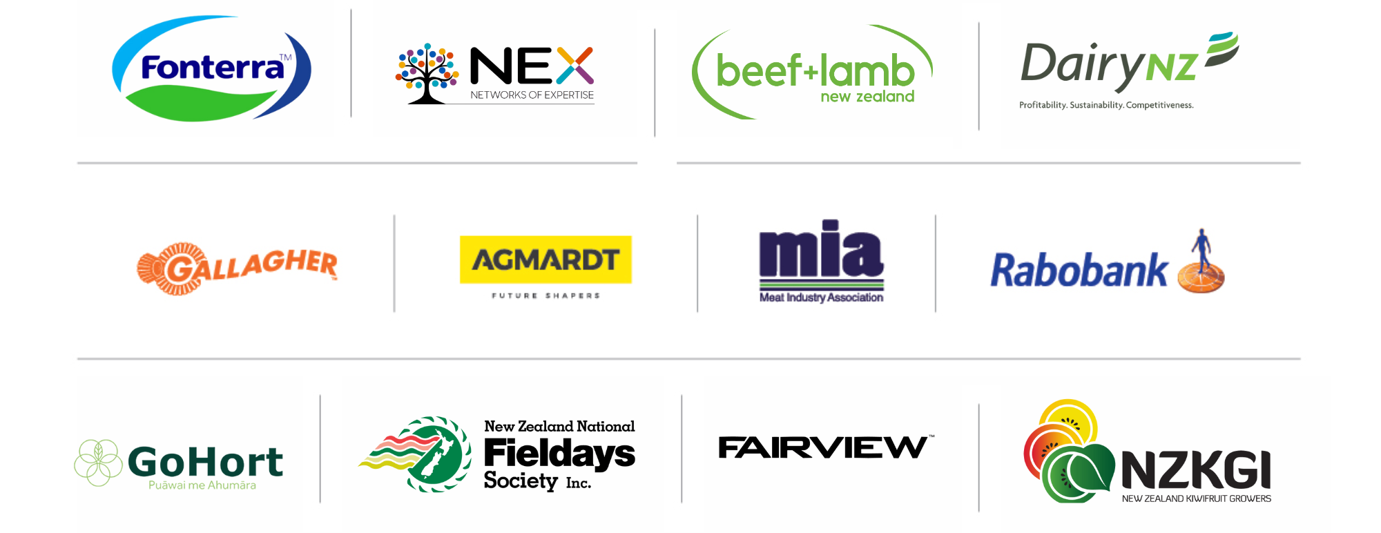
PARTNERS IN THE DELIVERY OF THE NATIONAL AGRIBUSINESS IN SCHOOLS PROGRAMME

