Slide 1


Slide 2

What are future proofing strategies?
Future proofing is the process of anticipating the future and developing strategies to minimise the negative effects while taking advantage of the positive effects of shocks and stresses due to future influences, events or issues

Slide 3
What are future proofing strategies?
Future proofing strategies are courses of action that influence a business and may effect long-term viability. The strategies could be innovative and revolutionary.
Outside influences must be predicted, prevented, limited, minimised, enhanced or corrected to ensure long-term business viability.
Businesses need to show leadership by example and to contribute by making decisions that lead to actions for a viable future.
Identify how these strategies mitigate the high probability and / or high impacts of the influences.
Analyse the strategies to ensure that they met the long-term viability of the business.
Think about the possible outcomes that are likely to occur under each given strategy.
What will the consequences of each outcome be for each strategy?
Recommend strategies that will best meet the future needs of the business to ensure long-term viability.

Slide 4
Example strategies to mitigate future proofing.
General:
Awareness, knowledge and advice. Seek help if required.
Show leadership by example and contribute to collective decisions that lead to actions for a sustainable future.
Stimulate flexibility and adaptability. Adaptability to the environment, uses, occupant needs, and future technologies is critical to the long-term viability of a business.
Consider long-term life-cycle benefits. Embodied energy in existing structures and products should be incorporated in environmental, economic, social, and cultural costs for any business.

Slide 5
Example strategies to mitigate future proofing.
Technological
An impact on how a business operates that are related to the equipment used or a product made within the business’ environment.
Due to increased reliance on equipment, technological factors currently exert a considerably more important effect on the success of a business than they did.
Examples include;
  Direct marketing - using internet to miss out the ‘middleman’.
  Precision Agriculture
  Sensors (data)
  More efficient production.
  Robotic technology
  Drones
  Manipulation of information from agri-tech automation and smart data device.

Slide 6
Sustaining and disruptive technologies
  Sustaining technologies relies on incremental improvement to an already established technology. Large corporations are designed to work with sustaining technologies. They excel at knowing their market, staying close to their customers, and having a mechanism in place to develop existing technology. Conversely, they have trouble capitalising on the potential efficiencies, cost savings or new marketing opportunities created by low margin disruptive technologies.
  A disruptive technology is one that displaces an established technology and shakes up the industry or a ground-breaking product that creates a completely new industry.
  Examples are; PC, Windows operating system, email, cell phones, social media, Uber, Airbnb, the internet.

Slide 7
Example strategies to mitigate future proofing.
Economic.
Being in financial control of your business by using cashflow forecasting.
Fix loan interest rates for a defined period reducing the uncertainty of fluctuations on cash flows.
Diversify into different products or services so the business income is not dependent upon returns from just one source.
Taking out insurance policies e.g. fire, health, damage, public liability, loss of profit, contamination.
Spreading sales if possible throughout the year rather than at peak times.
Hedging or forwarding sales. This involves agreeing on a sale or purchase price at some time before the transaction actually takes place. This technique removes price uncertainty but can also reduce the opportunity to increase returns should prices improve later in the year.
Reduce the likelihood of obsolescence. A product should be able to continue to be used for centuries into the future.

Slide 8
Example strategies to mitigate future proofing.
Environmental
Adopt stability strategies that reduce the effects of the most variable influences that you can control within the business. An example is the installation of an irrigation system on dairy farms to reduce the impact of drought on production
Reduce deterioration of product materials. Future proofed structures and products should not accelerate the deterioration of existing materials.
Extend service life. Help to make the product usable for the long-term.
Fortify against extreme weather and shortages of materials and energy. Prepare structures and products for the impacts of climate change by reducing energy consumption, reducing consumption of materials through durable material selections and be able to be fortified against extreme natural events such as hurricanes and tornadoes.
Increase durability and redundancy. Use durable materials.

Slide 9
Example strategies to mitigate future proofing.
Social
Incorporate local materials, parts and labour. The parts and materials used in future proof structures and products should be available locally and installed by local labour. This means that the materials and manufacturing capabilities will be readily available in the future for efficient repairs.

Slide 10
Resources
A burgeoning apple industry in Canterbury L3
Conscious Valley L3

Slide 11
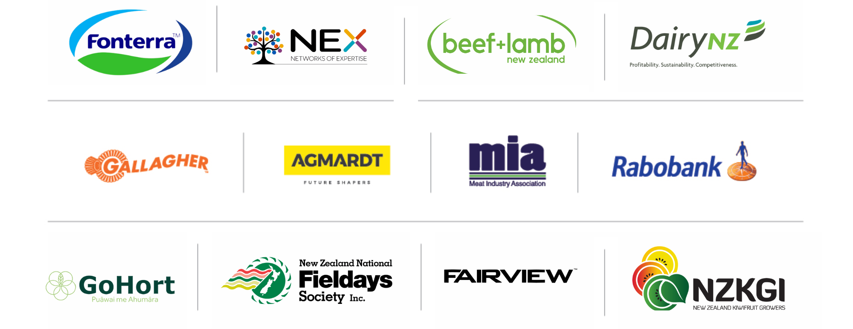
PARTNERS IN THE DELIVERY OF THE NATIONAL AGRIBUSINESS IN SCHOOLS PROGRAMME

