Slide 1

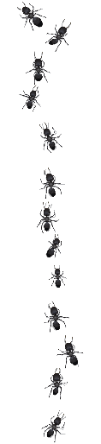

ants & ladders
Finish | 63 | 62 little fire ants hiding in undeclared fruit. $50 fine | 61 | 60 | 59 | 58 | 57
49 | 50 | 51 | 52 | 53 too many little fire ants. You lose your crops | 54 machinery treated with insecticide before shipping | 55 | 56
48 | 47 rubbish moved from yellow crazy ant infested area | 46 | 45 | 44 | 43 | 42 | 41 yellow crazy ants stole your dinner!
33 | 34 | 35 yellow crazy ants invade a nature reserve | 36 | 37 | 38 successful management reduces ant numbers | 39 | 40
32 potted plants moved from little fire ant infested area | 31 | 30 | 29 | 28 biosecurity officer finds & destroys red imported fire ant nest | 27 | 26 | 25
17 | 18 | 19 | 20 | 21 | 22 little fire ant queens hiding in your Macadamia nuts | 23 | 24
16 | 15 movement controls prevent spread of African big-headed ants | 14 | 13 | 12 | 11 | 10 aware community reports little fire ant incursion | 9
Start | 2 | 3 | 4 crops grow well without ants & mealybugs | 5 | 6 vehicles cleaned before boarding ferry | 7 | 8
62 When travelling it is important to declare high risk items. Not declaring biosecurity risk items (such as fresh fruit) can result in a fine in many nations in the Pacific
54 Items of machinery have lots of small spaces that ants can nest in. Machinery should be treated with insecticides, or at least cleaned well before being moved between islands
53 Little fire ants have a nasty sting which makes it difficult to harvest crops. Some people in French Polynesia have even abandoned their land because of little fire ants
47 Ants love nesting in rubbish piles (and piles of decaying coconuts and plants). Moving these items provides a way of ants invading new places
41 In Tokelau yellow crazy ants invaded homes an even tried to take food off people’s plates before they had a chance to eat
35 Wildlife such as lizards, land birds and sea birds and crabs are at great risk from ants. They ants can kill the animals directly or make them leave the area
38 There are ways to reduce numbers of ants so that they don’t have effects on people, agriculture and wildlife
32 A very important ‘pathway’ for little fire ants in Hawaii is potted plants from nurseries. This ants can spread very easily this way. Make sure to get plants from areas not infested with ants
28 Biosecurity officers are the first line of protection against invasive ants. Help them do their job by reporting any ants that you think are a problem
22 Little fire ants are so small that a whole colony can nest in a Macadamia nut. Other ants, such as yellow crazy ants, love nesting in rotting coconuts
15 Movement controls are the first step in preventing invasive ants spreading. It is very important to pay attention to these controls and not move risk items (plants, rubbish, machinery), without first having them approved
10 A little awareness can help stop ant problems. Report any ants that you think are a problem to biosecurity officers
6 Vehicles have lots of small spaces that ants can nest in. They should be checked and cleaned before being moved between islands
4 Ants ‘farm’ plant pests such as mealybugs and scale insects, which can reduce plant growth. Plants grow better without these pests

Slide 2
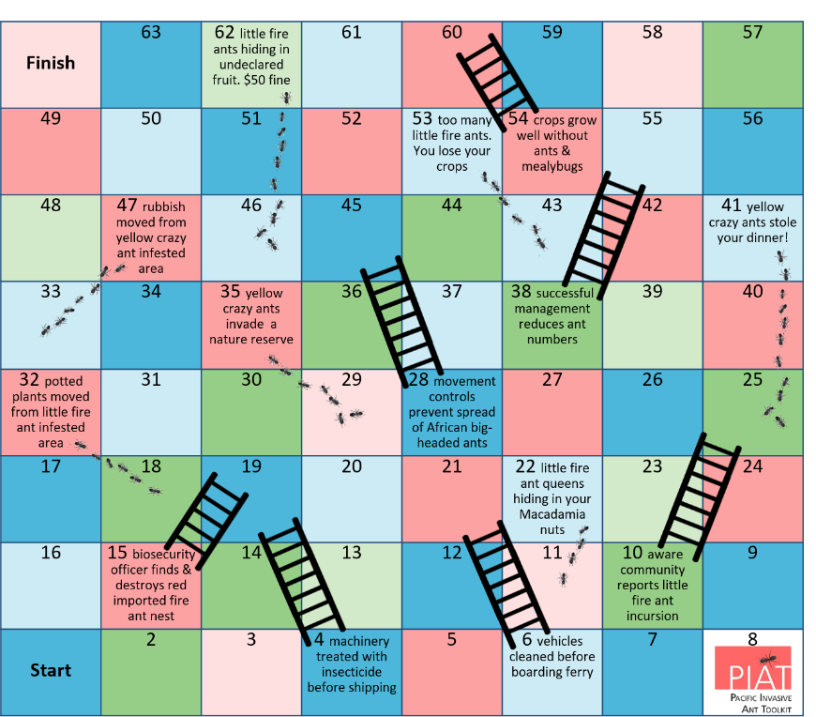
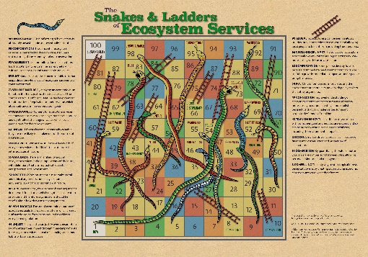
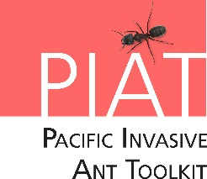
About ants & ladders
ants & ladders is a variation of the snakes and ladders game to help young people understand the consequences of ant invasions and poor biosecurity
Feel free to customise the board to your own language or for a particular ant
Credits
ant & ladders was created by Allan Burne & Monica Gruber of Pacific Biosecurity for the PIAT on behalf on New Zealand Ministry of Foreign Affairs and Trade
ant & ladders was inspired by the Snakes & Ladders of Ecosystem Services © Iain H Woodhouse http://forestplanet.wordpress.com
Trail of ants image © Leo Blanchette / Shutterstock
Ladder image © gst / Shutterstock

