Slide 1


Slide 2
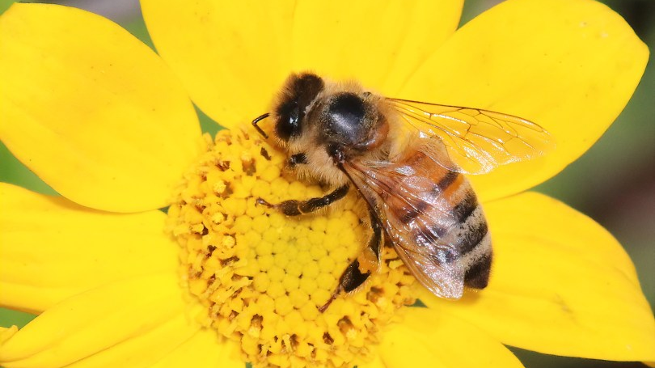
Bee Biosecurity
Resources from
Biosecurity for a better future
New Zealand Bee Biosecurity Visual ID Guide

Slide 3
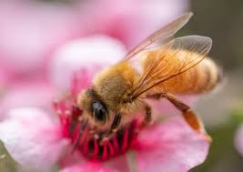
Bee Biosecurity:
Protecting Our Bees
Bee biosecurity means keeping our bees safe from harmful bugs and diseases. Everyone in New Zealand has a part to play in this.
Taking care of bee health is very important for beekeepers. If pests or diseases get into a bee farm, it can cause problems like:
  Fewer healthy bees and less honey
  Higher costs to fix the problems
  Losing important markets where honey is sold
Bees are also super important for other plants and fruit because they help with pollination.
The best way to protect our bees is to spot any problems early and tell the right people right away. This helps stop pests and diseases quickly before they spread.

Slide 4
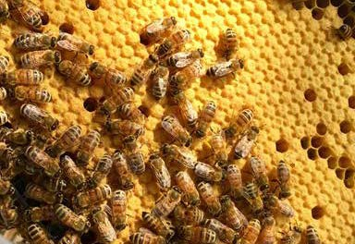
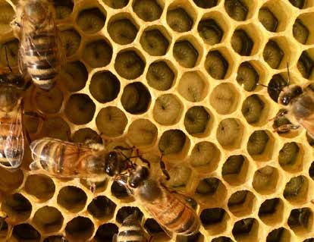
Healthy brood
In NZ
Eggs are uniformly laid at the base, one per cell. Uncapped larvae are pearly white in colour.
Pupating larvae are solid with even, unperforated cappings.

Slide 5
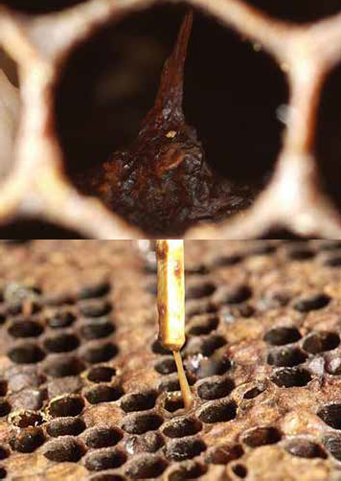
American Foulbrood
Paenibacillus larvae (Sphingobacteriales: Flexibacteraceae)
In NZ
Typical symptoms: spotty brood pattern, dead and discoloured larvae (often yellow) in uncapped cells, sometimes a strong ammonia-like smell, larvae will often rope.

Slide 6
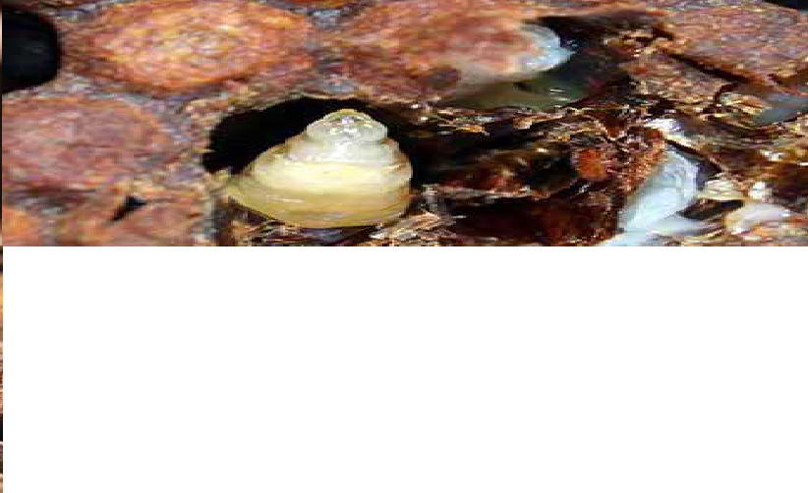
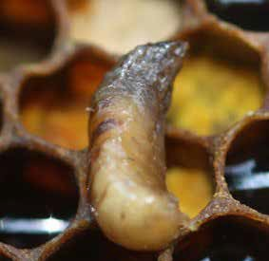
Sacbrood virus
(Picornavirales: Iflaviridae)
In NZ
Typical symptoms: spotty brood pattern, sunken and perforated cappings, dead and discoloured larvae (often brown), banana-shaped larvae die after capping, skin of the dead larva may change to a sac that can be removed.

Slide 7
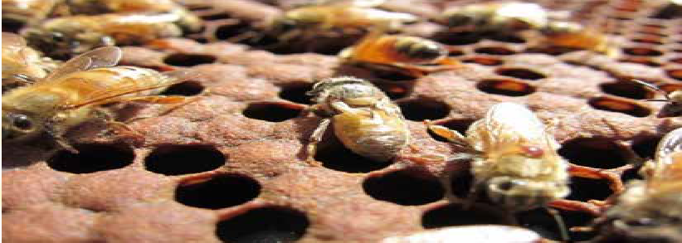
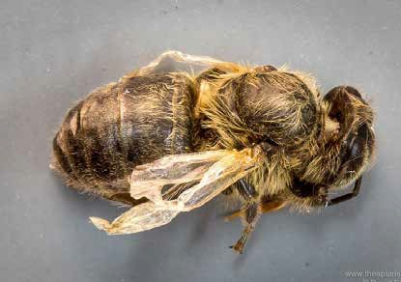
Deformed wing virus
(Picornavirales: Iflaviridae)
In NZ
Typical symptoms: shrivelled or greatly reduced wings, decreased body size and discoloration

Slide 8
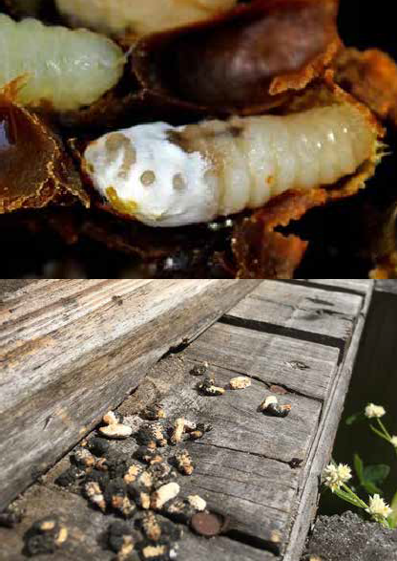
Chalkbrood fungus
Ascosphaera apis (Onygenales: Ascosphaeraceae)
In NZ
Typical symptoms: : hard, shrunken chalk-like mummies in the brood and in and around the entrance to the hive.
Mummies may be white to grey-black in colour.

Slide 9
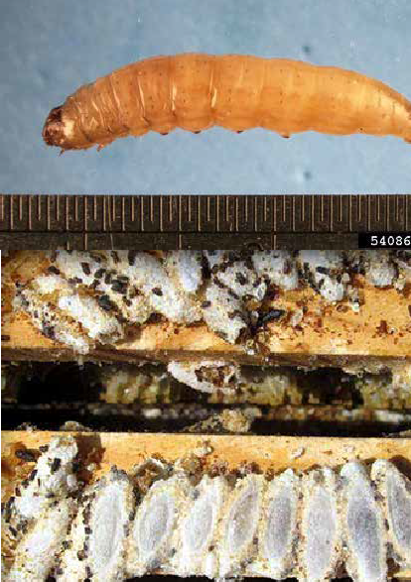
Wax Moth
Achroia grisella and Galleria mellonella (Lepidoptera: Pyralidae)
In NZ
Typical symptoms: Wax moth are small and grey (10-19 mm long). Larvae have dark heads with several body segments. They create white, yellow and/or dark brown cocoons.

Slide 10
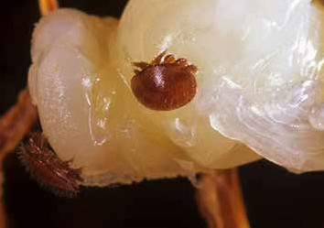
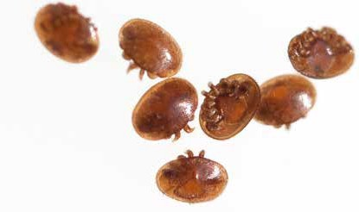
Varroa destructor
(Parasitiformes: Varroidae)
In NZ
Typical symptoms: Varroa mites are oval, flat, red-brown coloured, around1.1 mm long and1.5 mm wide. They can be seen on adult honey bees and in the brood

Slide 11
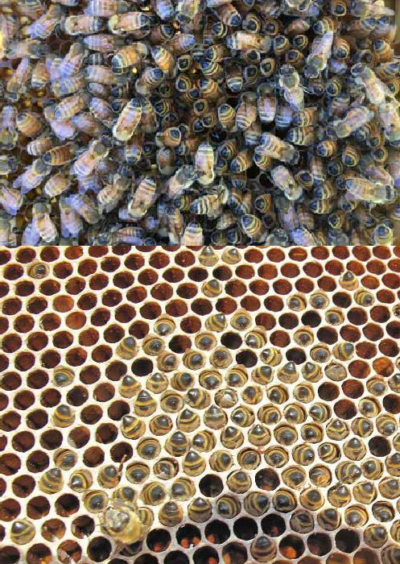
Starvation
In NZ
Typical symptoms: decrease in stored resources, dwindling bee number low productivity, bees clustering with their heads in cells and/or cannibalising larvae.

Slide 12
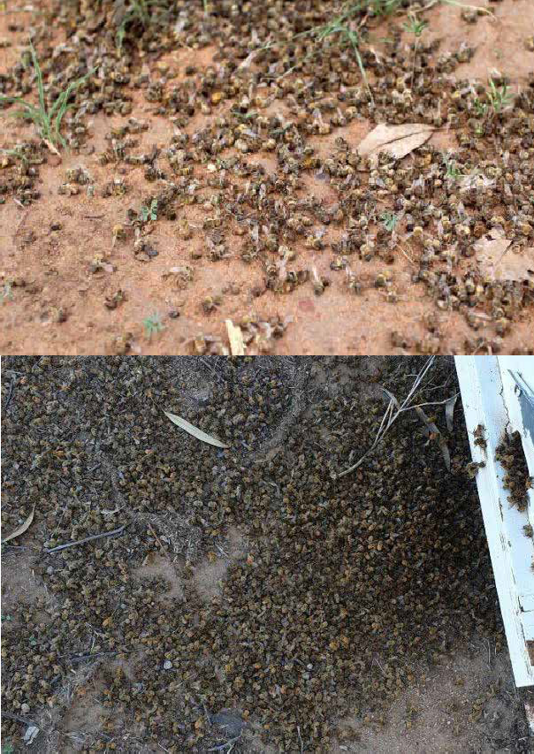
Poisoning
In NZ
Typical symptoms: Excessive number of dead bees, disorientated and/or dwindling forager population

Slide 13
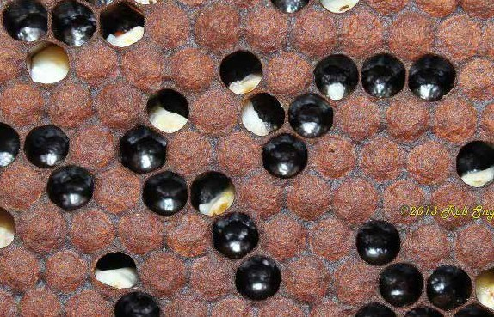
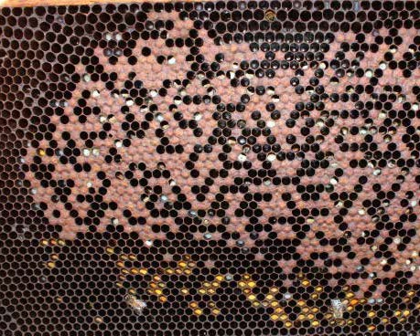
Parasitic Mite Syndrome (PMS)
In NZ
Typical symptoms: spotty brood pattern, lack of adult population, high mite infestation, larvae do not rope, and/or larvae are slumped and possibly discoloured.

Slide 14
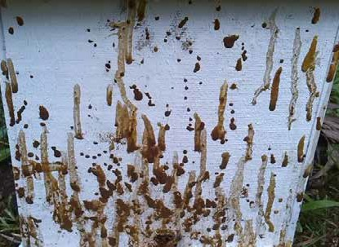
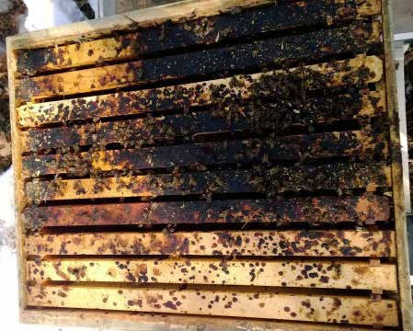
Dysentery
In NZ
Typical symptoms: voided bee faeces on hive ware.

Slide 15
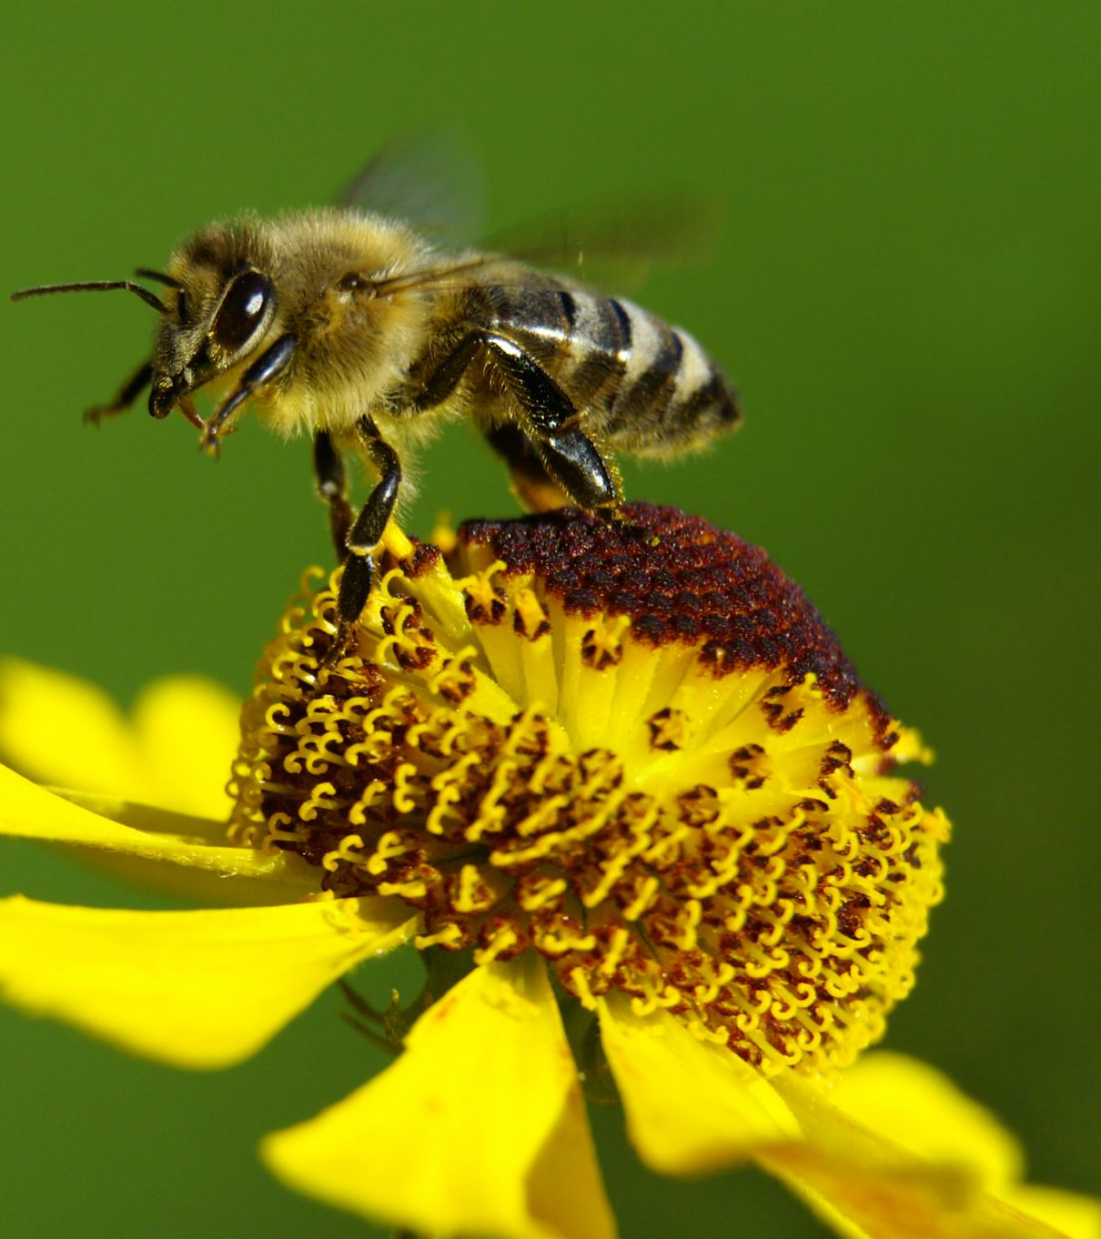
Resources & Activities
American foulbrood (WS)
American Foulbrood- basics & Quiz (WS)
Fighting a little bee mite(WS)
Varroa Mites- the basics & Quiz (WS)
Honeybee Pest and disease Quiz
Research Project: A Threat to New Zealand Honey Bees

Slide 16
Yellow-Legged Hornet
(Vespa velutina)
In NZ but not established
The yellow-legged hornet is large, (2 cm to 3 cm long) with a black head and a yellow face, black thorax, and legs with black femur and tibia and yellow tarsus. Between the first and second abdominal segment is a narrow yellow band, and the fourth abdominal segment is yellow, with the remainder being black or dark brown. The wings are a smoky brown colour and not transparent like other common wasps.

Slide 17
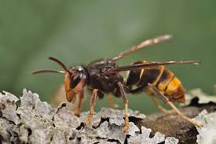
Yellow- Legged Hornet
Activities & Resources
Hornets-Activity-Sheet_schools-Maori-print
Hornets-Activity-Sheet_schools
How-to-build-a-homemade-hornet-trap-factsheet-v3
Look-out-for-hornets-A4-poster
Look-out-for-hornets-factsheet
Yellow-legged hornets (WS)
Watch
Biosecurity lays over 100 yellow-legged hornet traps in Auckland | RNZ
https://www.youtube.com/watch?v=Sjao_9Wiz_M
Yellow-legged hornets are spreading - and there's only a short time to stamp them out | Stuff.co.nz
https://www.youtube.com/watch?v=G5CKCux4R-g
Learn where to look for yellow-legged hornet nests
https://www.youtube.com/watch?v=jmJbV2QOSoU

Slide 18
Yellow legged Hornet Quiz
1. Is the yellow-legged hornet native to New Zealand?
Yes or No
2. About how big is a yellow- legged hornet?
  5–10 mm
  11–16 mm
  2–3 cm
3. Name TWO things the yellow-legged hornet eats.
4. What should you do if you see a hornet nest?
  Touch it carefully
  Throw something at it
  Take a photo and report it
5. Circle TWO places you might see a yellow-legged
hornet:
Houses Gardens Oceans Parks Deserts
6. Why is it important to report sightings of yellow-legged
hornets in New Zealand?

Slide 19
Yellow legged Hornet Quiz Answers
1. No
2. C- 2–3 cm
3. Any two of
  Insects
  Honeybees
  Tree sap
  Fruit
4. Take a photo and report it
5. Correct answers:
  Houses
  Gardens
  Parks
6. To help protect New Zealand’s environment,
stop the hornets from spreading, and protect
honeybees and plants.
Scenario
You are walking home from school and notice a large insect with yellow legs near a tree. High above, there is a large, smooth nest.
Task:
Write 3 things you should do and 2 things you should NOT do in this situation.

Slide 20
The honeybee pest and diseases below are not in
New Zealand
Why do we want to prevent these pest and diseases from arriving in New Zealand?
What can bee keepers do to prevent these pest and diseases from arriving in New Zealand?
What can we do to prevent these pest and diseases from arriving in New Zealand?
The hornet invasion that could cost New Zealand dearly | The Front Page
Watch
https://www.youtube.com/watch?v=25xy4DDQL9M

Slide 21
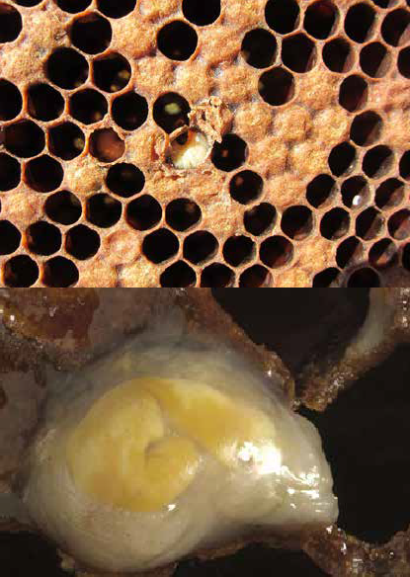
European Foulbrood
Melissococcus plutonius (Lactobacillales: Enterococcaceae)
Not In NZ
Typical symptoms: spotty brood pattern, dead and discoloured larvae (often yellow) in uncapped cells, sometimes a strong ammonia-like smell, larvae will often rope

Slide 22
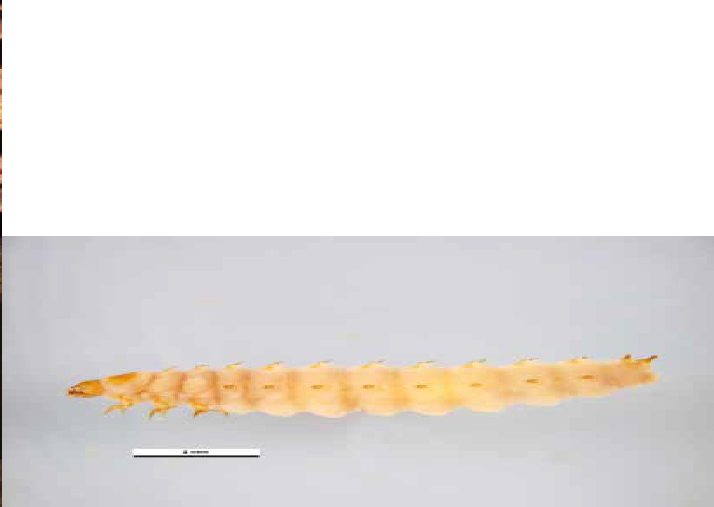
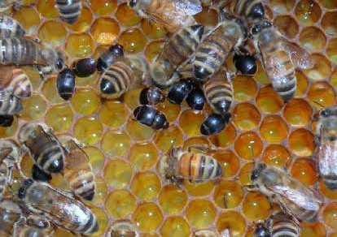
Small hive beetle
Aethina tumida (Coleoptera: Nitidulidae)
Not In NZ
Typical symptoms: Adult beetles are 5–7mm long, brown/black, with club-like antennae. Larvae are 10 mm long, white/tan, three pairs of prolegs, rows of small spikes down back.

Slide 23
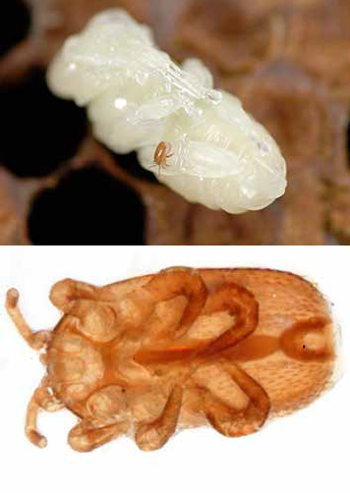
Tropilaelaps mites
Tropilaelaps clareae, T. mercedesae,
T. koenigurum, T. thaii (Acari: Laelapidae)
Not In NZ
Typical symptoms: Tropilaelaps mites are active, red-brown and one third the size of varroa. They can be seen on adult honeybees and in the brood.

Slide 24
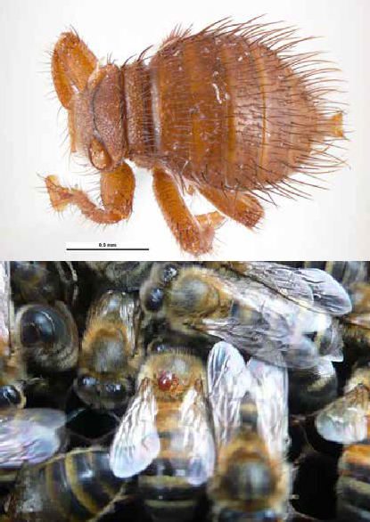
Braula fly
Braula coeca (Diptera: Braulidae)
Not In NZ
Typical symptoms: a small (1.5 mm long) wingless fly, that is red-brown coloured, covered in hairs and has six legs.

Slide 25
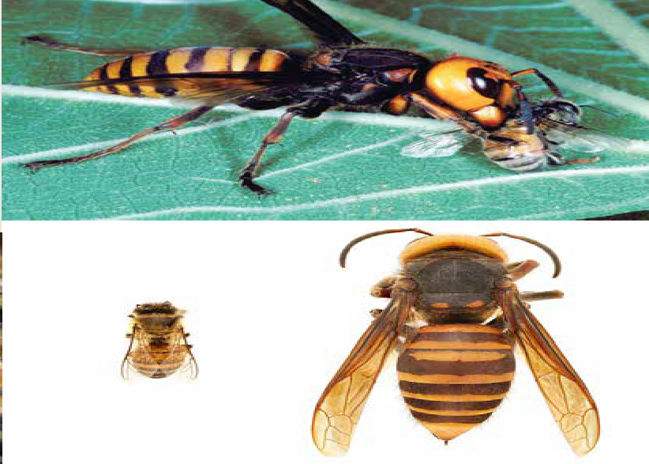
Asian hornets
Vespa sp. (Vespidae: Hymenoptera)
Not In NZ
Typical symptoms: Asian hornets are an invasive predatory pest of bees. There are dozens of known species and subspecies of the Asian hornet.

