Slide 1


Slide 2
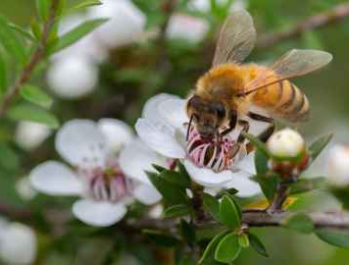
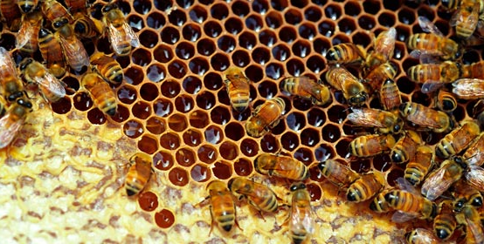
Honeybee
Pest and Diseases
Quiz

Slide 3
Identify the problem affecting honeybees
Using the list of problems affecting honeybees, match each problem to the correct photo.
American Foulbrood
Chalkbrood Fungus
Deformed Wing Virus
Dysentery
Parasitic Mite Syndrome (PMS)
Poisoning
Sacbrood Virus
Starvation
Varroa Mite
Wax Moth

Slide 4
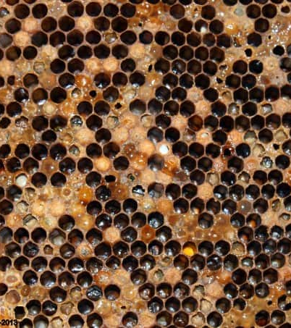
What is the problem?

Slide 5
American Foulbrood
Typical symptoms: spotty brood pattern, dead and discoloured larvae (often yellow) in uncapped cells, sometimes a strong ammonia-like smell, larvae will often rope.

Slide 6
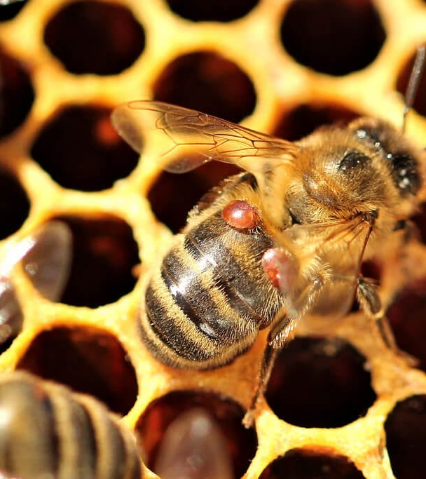
What is the problem?

Slide 7
Varroa Mite
Typical symptoms: Varroa mites are oval, flat, red-brown coloured, around1.1 mm long and1.5 mm wide. They can be seen on adult honey bees and in the brood

Slide 8
What is the problem?

Slide 9
Poisoning
Typical symptoms: Excessive number of dead bees, disorientated and/or dwindling forager population

Slide 10
What is the problem?

Slide 11
Starvation
Typical symptoms: decrease in stored resources, dwindling bee number low productivity, bees clustering with their heads in cells and/or cannibalising larvae.

Slide 12
What is the problem?

Slide 13
Parasitic Mite Syndrome (PMS)
Typical symptoms: spotty brood pattern, lack of adult population, high mite infestation, larvae do not rope, and/or larvae are slumped and possibly discoloured.

Slide 14
What is the problem?

Slide 15
Dysentery
Typical symptoms: voided bee faeces on hive ware.

Slide 16
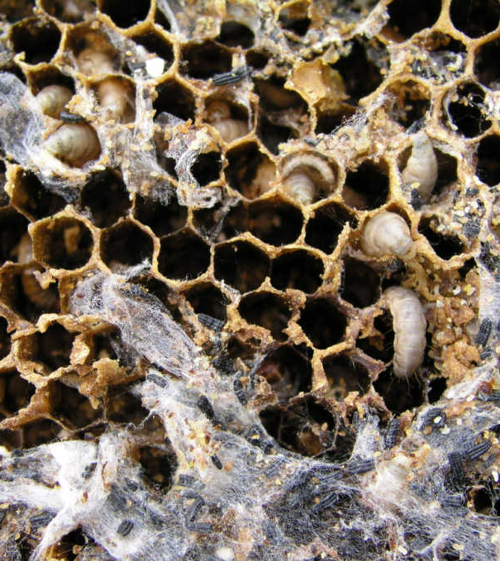
What is the problem?

Slide 17
Wax Moth
Typical symptoms: Wax moth are small and grey (10-19 mm long). Larvae have dark heads with several body segments. They create white, yellow and/or dark brown cocoons.

Slide 18
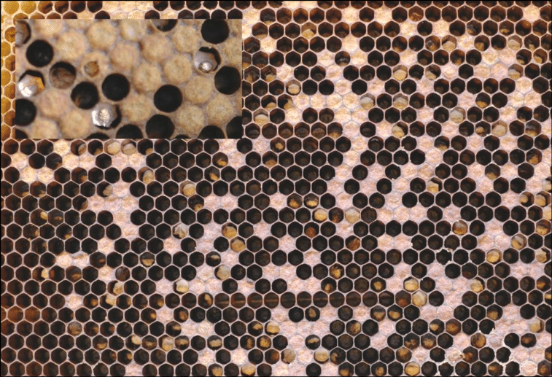
What is the problem?

Slide 19
Chalkbrood Fungus
Typical symptoms: : hard, shrunken chalk-like mummies in the brood and in and around the entrance to the hive.
Mummies may be white to grey-black in colour.

Slide 20
What is the problem?

Slide 21
Deformed Wing Virus
Typical symptoms: shrivelled or greatly reduced wings, decreased body size and discoloration

Slide 22
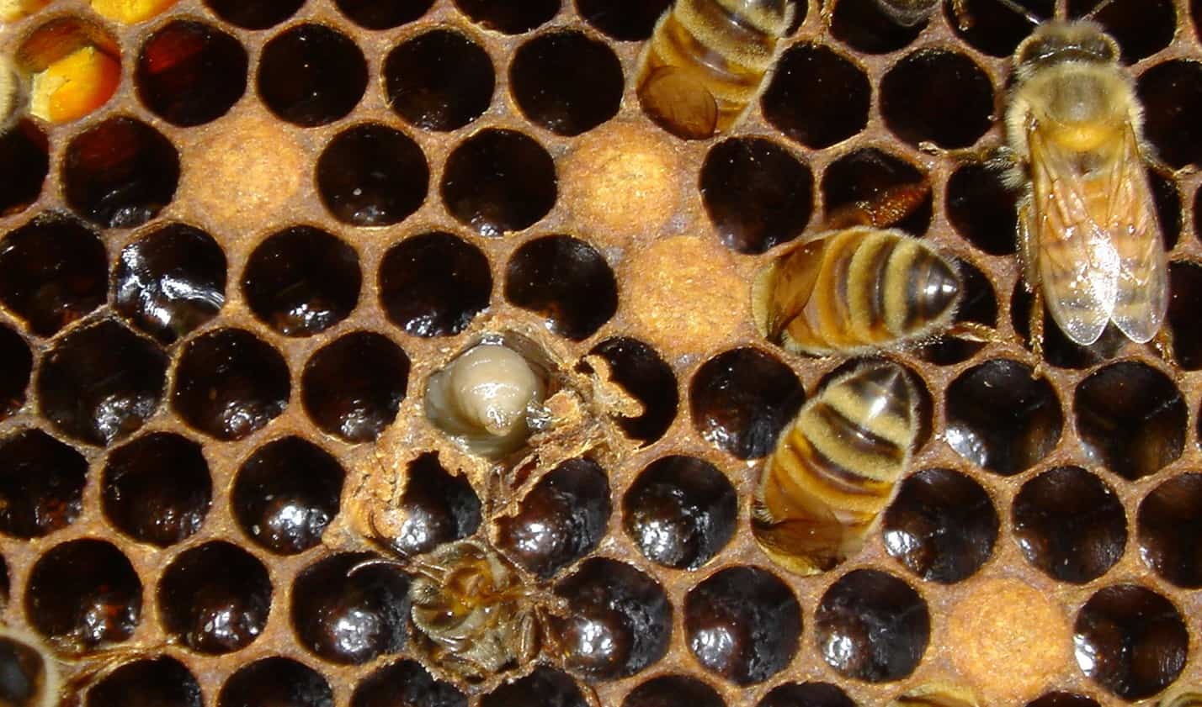
What is the problem?

Slide 23
Sacbrood Virus
Typical symptoms: spotty brood pattern, sunken and perforated cappings, dead and discoloured larvae (often brown), banana-shaped larvae die after capping, skin of the dead larva may change to a sac that can be removed

