Slide 1


Slide 2
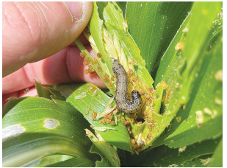
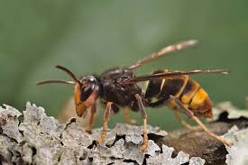
Biosecurity Risk
Current incursions

Slide 3
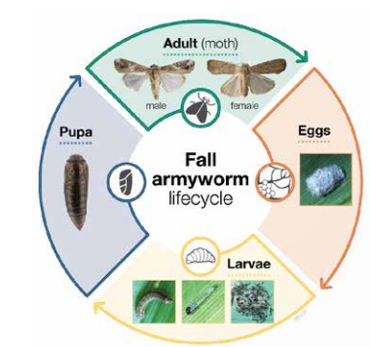
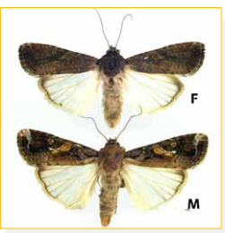
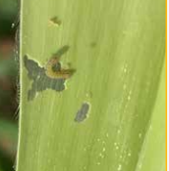
Fall armyworm
Fall armyworm is an invasive insect pest that was first found in New Zealand in February 2022. It is not native to New Zealand and is a threat to our crops, especially maize and sweetcorn.

Slide 4
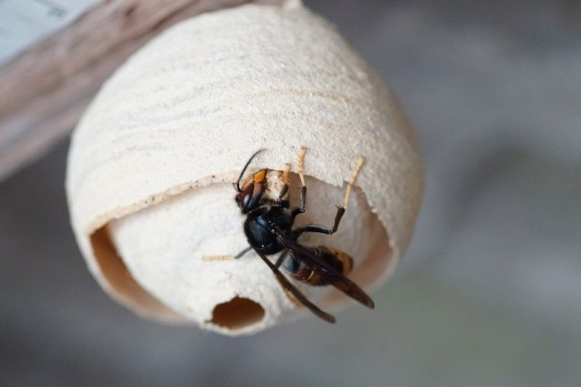
Yellow-legged hornet (Vespa velutina)
Multiple yellow-legged hornets, an invasive hornet species have been detected around Auckland. Biosecurity New Zealand is actively searching for and removing queens, nests, and workers to prevent establishment, because they pose a threat to pollinators (like bees), public safety, and the horticultural sector.

