Slide 1


Slide 2
Horticulture Pest and Diseases
Information sourced from
Outdoor-Crops-Manual-WEB-SP

Slide 3
Some examples of biosecurity incursions
There have been many cases of biosecurity incursions in New Zealand horticulture.
Some incursions have resulted in pest eradication, while others have not been eradicated.
These examples highlight the importance of good biosecurity management and being vigilant on your farm. Practicing good biosecurity management on your farm reduces the risk of pest or disease establishment and potential spread, that could threaten crop and vegetable production in New Zealand.

Slide 4
Impacts of biosecurity incursions on growers
Increased cost of production: control and eradication of pest and diseases once found on a property is a costly exercise.
Significant loss of yield: pest and diseases can stunt crop growth or decimate harvestable crop.
Loss of sell-able crop: a pest or disease outbreak could leave a crop unfit for human consumption.
Loss of access to markets: outbreaks of pest and diseases in New Zealand can limit international market access for not only the crop in question but also for potential host crops.
Loss of right to grow crops: in some cases, pest eradication will be attempted by banning the production of crops in a certain area. See the Pea weevil case study as an example.

Slide 5
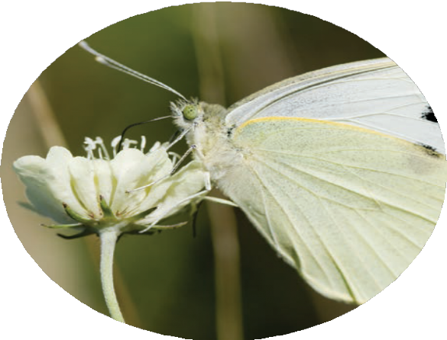
GREAT WHITE BUTTERFLY Pieris brassicae
Not In NZ
The great white butterfly can threaten brassica crops and New Zealand native cress species. The caterpillars are voracious feeders and can quickly reduce plants to a skeleton, significantly reducing crop yields. Stock will also not graze on infested plants

Slide 6
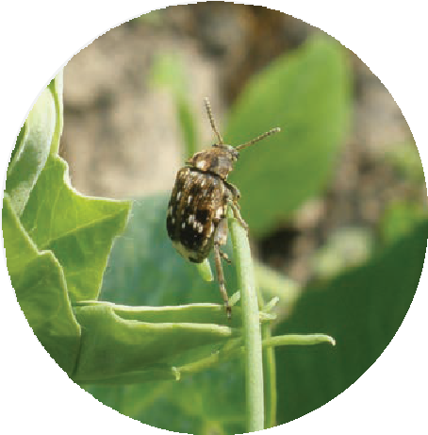
PEA WEEVIL Bruchus pisorum
Not In NZ
Pea weevil is a threat to fresh peas and pea seed. New Zealand’s pea crop is worth $50m domestically, and $73m in exports. With the rise in plant-based food products, the international demand for peas is increasing by 12% annually.
Pea weevil larvae feed on growing peas causing damage which reduces crop yield, seed germination rates, and seed quality. The infested peas become foul and are unfit for human consumption.
Pea Weevils were eradicated in 2020 but remain a significant biosecurity threat.

Slide 7
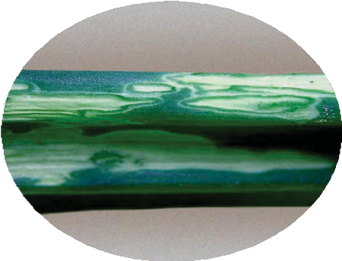
IRIS YELLOW SPOT VIRUS
In NZ
The disease, Iris Yellow Spot Virus, is widespread in New Zealand and so far, has had little economic impact. The important economic hosts of Iris Yellow Spot Virus are onions, garlic, leek, shallots, and chives.

Slide 8
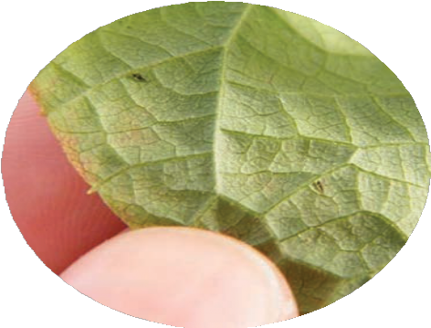


POINSETTIA THRIPS Echinothrips americanus
In NZ but not established
Poinsettia thrips is a pest of greenhouse and ornamental species.
In New Zealand, it is not expected to survive outdoors because the climate is cooler.
Poinsettia thrips is a potential vector for viruses, and can impact on Integrated Pest Management (IPM) programmes.
Poinsettia thrips cause damage to host plants by chewing and feeding on the leaves. They target older leaves and woody stems rather than softer stemmed plants such as vegetables. They also feed on flower parts.

Slide 9
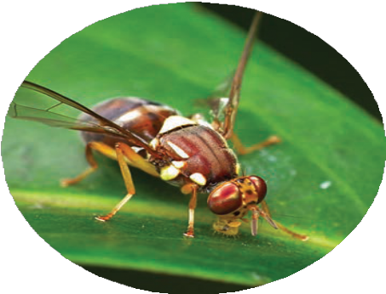
QUEENSLAND FRUIT FLY Bactrocera tryoni
Not In NZ
Major problems would be encountered if fruit flies became established in New Zealand – the loss of market access to important overseas markets could occur.
The Queensland fruit fly is the most damaging horticultural pest in its native Australia, costing hundreds of millions of dollars in damage and control each year. New Zealand needs to stay alert to fruit flies because many vegetable and fruit crops would be susceptible.
The Queensland fruit fly causes damage when the larvae feed on the fruit host and cause it to rot. Adult fruit flies lay their eggs below the skin, which hatch into larvae in 2-3 days. The larvae live for 10-31 days and cause considerable damage during this time.

Slide 10
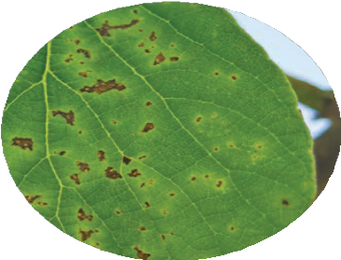
PSA Pseudomonas syringae pv. actinidiae
In NZ
Psa is one of the most serious diseases of kiwifruit. Gold kiwifruit in New Zealand were particularly susceptible with 85% of vines removed and destroyed. Today, the kiwifruit industry has largely recovered by planting Psa-resistant varieties.
Kiwifruit is New Zealand’s largest horticultural export industry with an export value of over $2.3b (Fresh Facts 2019). At the time of the outbreak in 2010, the loss in exports was estimated to cost the industry $930 million.
Psa is a bacteria that causes canker of green and gold kiwifruit, and kiwiberry. It does not directly affect the fruit but affects plant health and its viability. The disease often causes the vines to die. It first appears as brown leaf-spotting and in severe cases cankers develop on the vines which produce an exudate.
Psa is highly infectious and is spread by spores which are easily spread by heavy rain, strong winds, animals, people, and farm equipment. Harsh winters followed by hot summers are ideal conditions for Psa populations to increase.

Slide 11
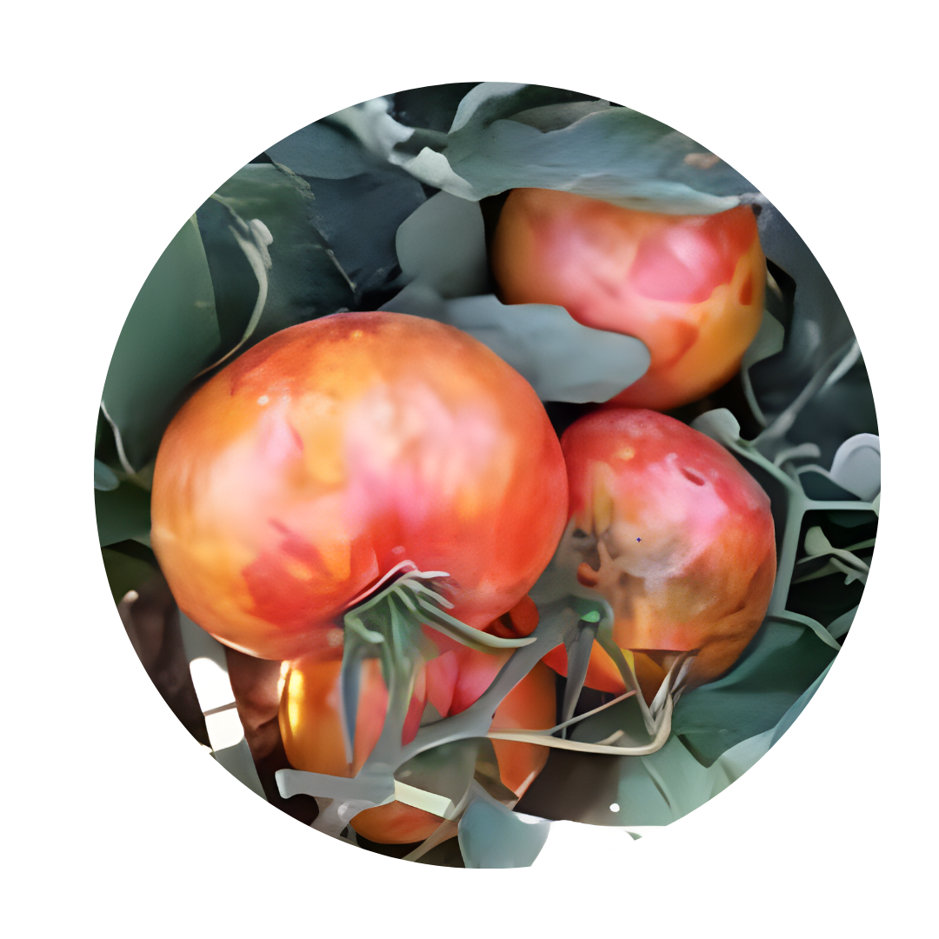
Tomato BROWN RUGOSE FRUIT VIRUS (ToBRFV)
Not In NZ
ToBRFV affects tomatoes, capsicums, and other solanaceous plants. It’s a plant virus of global concern and has prompted import restrictions and monitoring to reduce the risk of incursion into NZ horticulture.
The virus causes symptoms including mosaic and distortion of leaves and brown, wrinkly spots on fruits

Slide 12
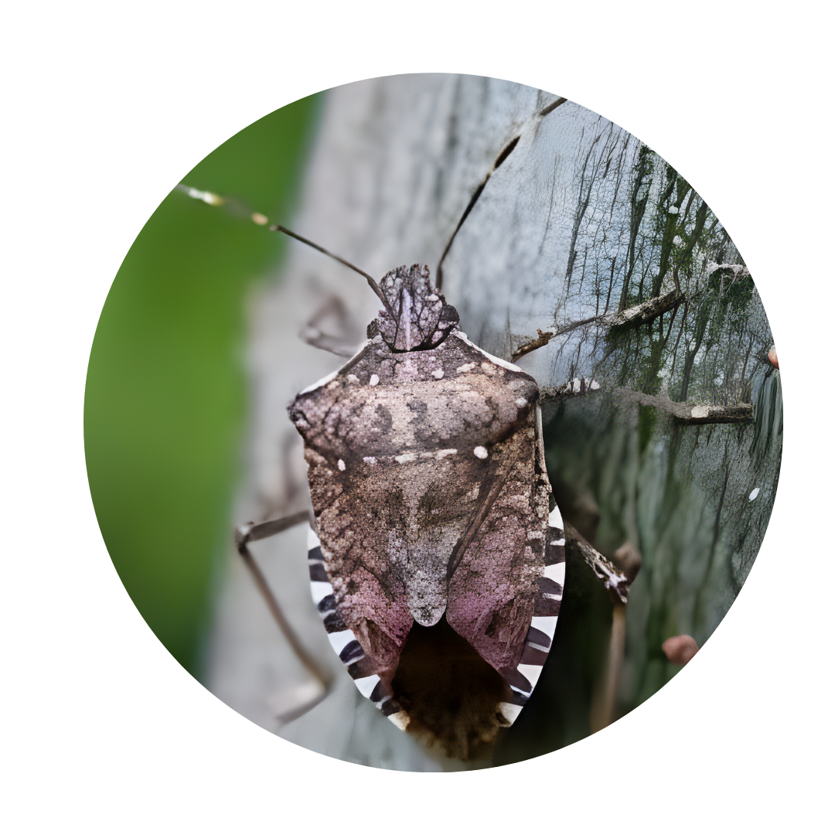
BROWN MARMORATED STINK BUG
Not established
The Brown Marmorated Stink Bug (BMSB) is considered one of New Zealand’s most significant biosecurity threats. While it is not yet established in the country, it is frequently intercepted at the border in luggage, mail, and imported cargo.
It is a serious threat to fruit and vegetable crops.

Slide 13
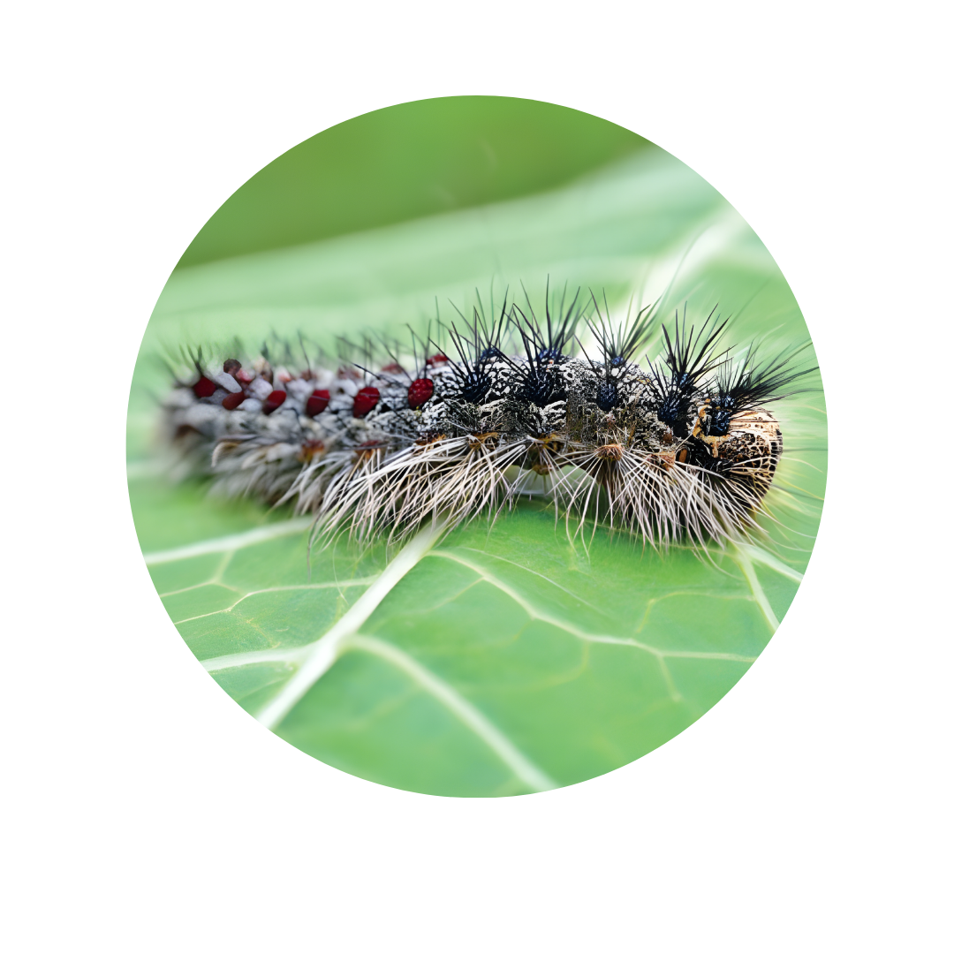
SPONGY MOTH (formerly known as Gypsy moth)
Not In NZ
Spongy moths have an extremely wide host range, being able to complete their lifecycle on over 650 plant species. Spongy For New Zealand, many urban tree species and horticultural crops would be affected, including apples and pears.
Spongy moth lay hundreds of eggs in a single mass. The egg masses then hatch, releasing hundreds of caterpillars. These caterpillars strip the leaves from entire trees, devastating stands of trees including fruit trees

Slide 14
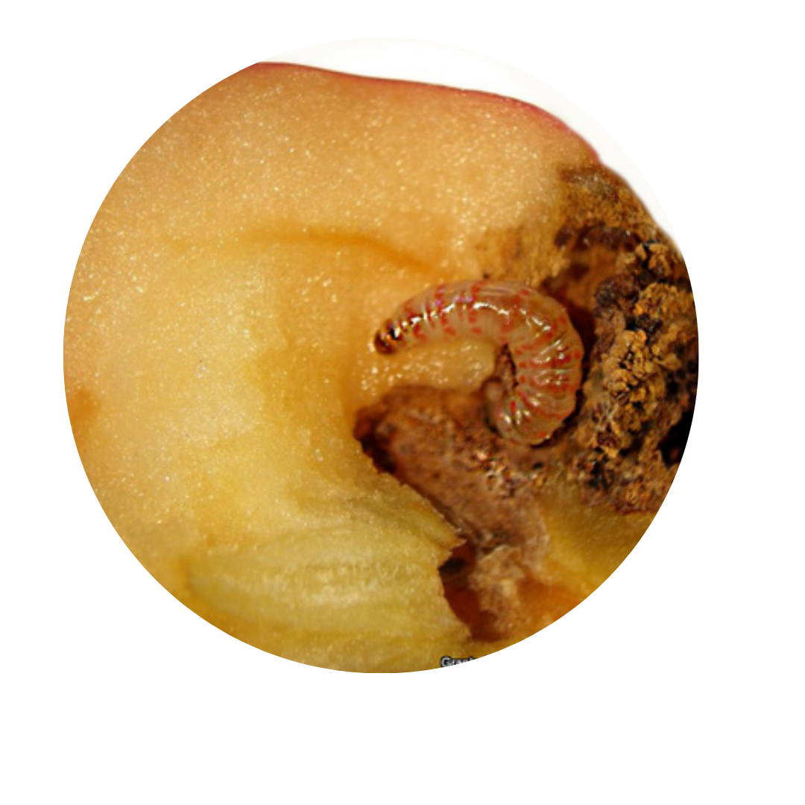
MANCHURIAN FRUIT MOTH
Not In NZ
The Manchurian fruit moth is an insect pest of rosaceous fruits, with apples being its main host. The Manchurian fruit moth is in the same family as codling moth, and it is thought that it would have a similar economic impact. Manchurian fruit moth larvae feed under the skin creating a flat hollow before moving to the core and feeding on seeds.

Slide 15
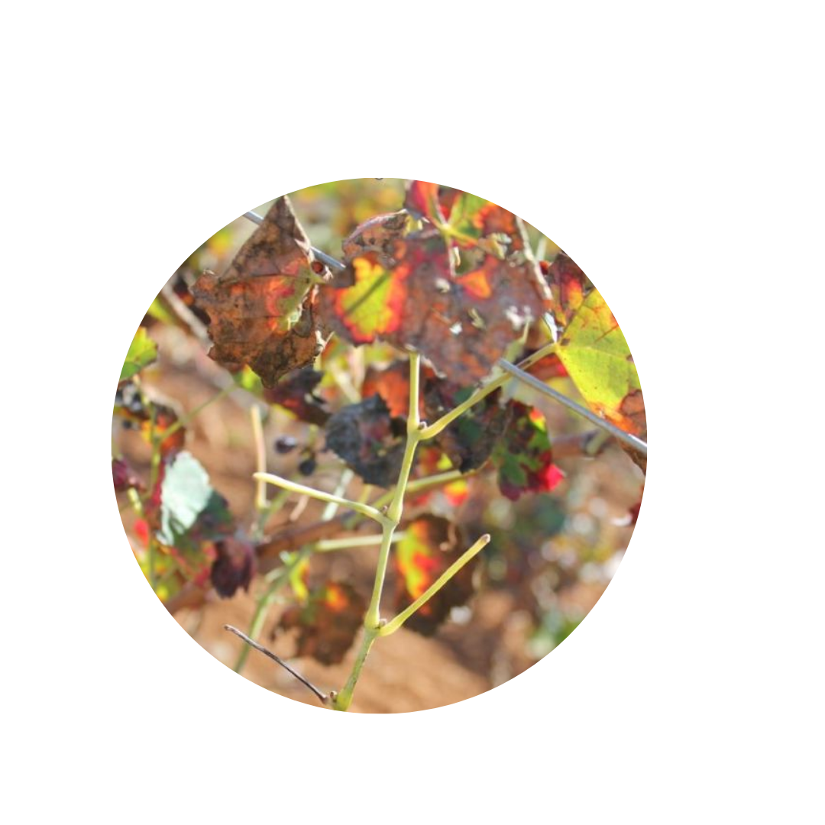
Xylella fastidiosa-Bacterial leaf scorch
Not In NZ
Xylella fastidiosa is an invasive bacterial plant disease that is spreading around the world. It poses a threat to New Zealand’s environment and economy.
It infects more than 600 plant species, including native, horticultural, and ornamental plants. It's important we keep this plant disease out of New Zealand.
Xylella fastidiosa kills plants by blocking their water-carrying vessels, causing a typical leaf scorching symptom. There is no cure for the disease once the plant is infected. Help us to keep it out by being aware of symptoms in your crops and how to identify and report plants with suspected symptoms.

