Slide 1


Slide 2
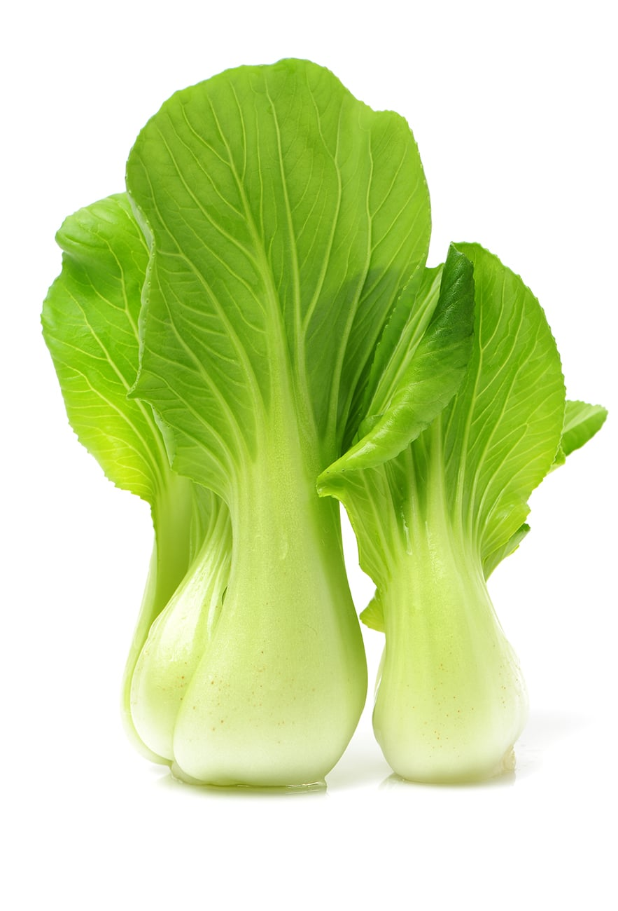
Asian Greens

Slide 3
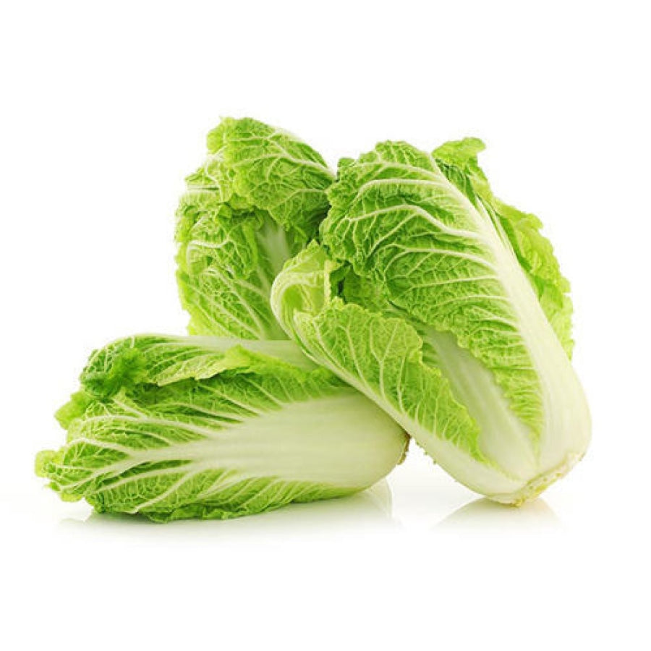
Find out what your students know.
Do you recognise any of these leafy green vegetables?
Where do these vegetables originally come from?
How long have these vegetables been grown in New Zealand?
Where are Asian Greens commercially grown in New Zealand?
Is there a growing demand for Asian green vegetables in New Zealand?
Where would you buy Asian green vegetables?
Who has eaten any of these Asian green vegetables?
Which plant family do these vegetables belong to?
Name other vegetables in this plant family.
Watch Growing Asian greens in NZ https://www.youtube.com/watch?v=T3J1qI0pCLY

Slide 4
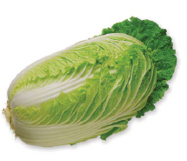
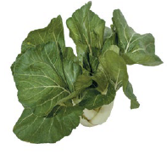
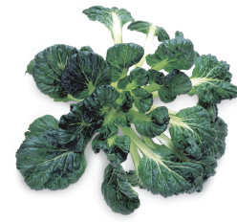
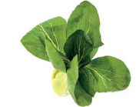
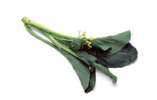
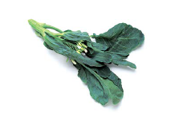
Name these vegetables.
A
B
C
D
E
F

Slide 5
Answers
Chinese cabbage / Wong bok
Bok choy
Chinese flat cabbage
Shanghai bok choy
Choy sum
Gai lan

Slide 6
Bok Choy
(buk choy, pak choi, baak choi)
Is a type of Chinese cabbage and belongs to the Brassica family. It is grown as a leaf vegetable.
Varieties do not form heads and have green leaf blades with lighter bulbous bottoms instead.

Slide 7
Shanghai bok choy
Is a tender, mild, and slightly sweet leafy green with jade-green spoon-shaped stalks.

Slide 8
Chinese / Peking cabbage / Wong Bok ?
Is a large, oval-headed Chinese cabbage. It has crunchy white ribs, pale green leaves.

Slide 9
Flowering Chinese cabbage
(choy sum or choi sum)
Is a leafy vegetable similar to gai lan and can be recognised by distinct yellow flowers. It is an annual and a member of the Brassica family.

Slide 10
Gai lan - Chinese broccoli
(Chinese sprouting broccoli, Chinese kale – gaai laan)
Is a leafy vegetable with thick, flat, glossy blue-green leaves with thick stems, and edible white flowers.

Slide 11
Chinese flat cabbage
Chinese flat cabbage is round, relatively flat like a plate, with a stronger flavour and slightly tougher texture than Chinese white cabbage.

Slide 12
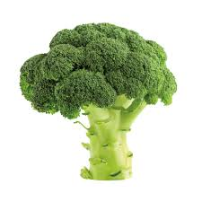

Brassica Crops

Slide 13
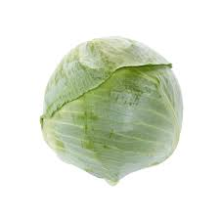
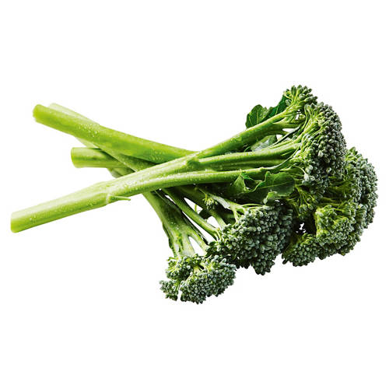
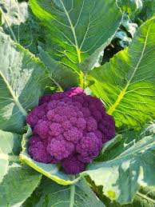
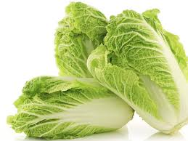
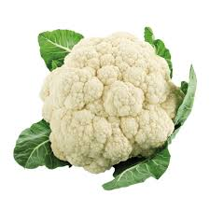
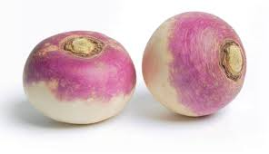
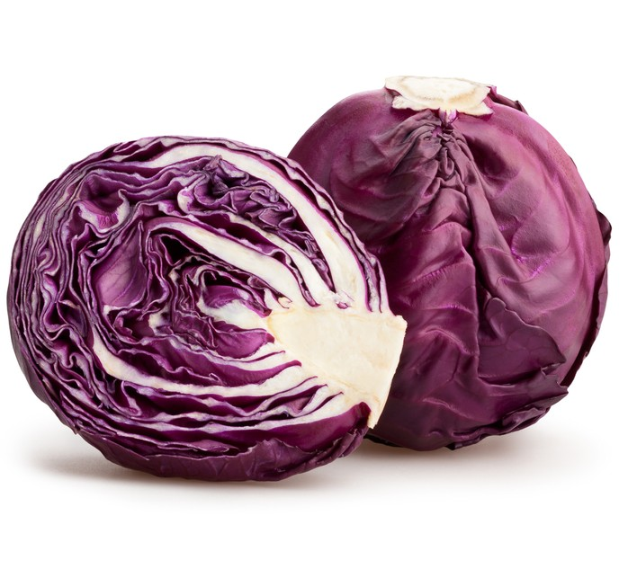
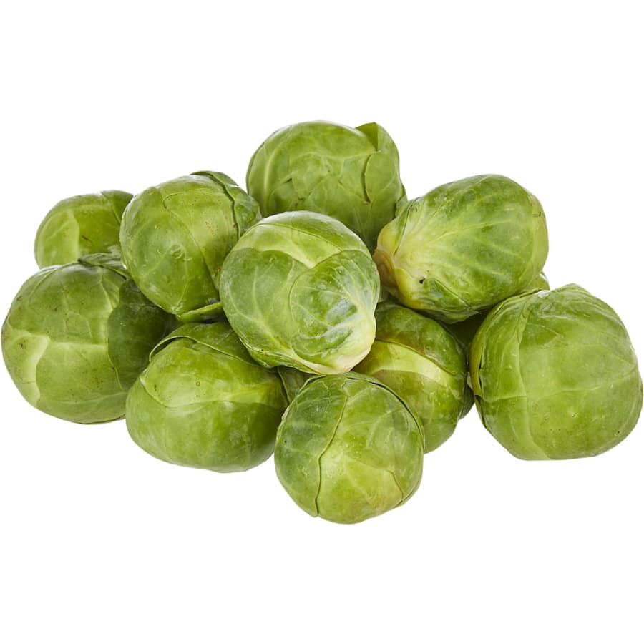
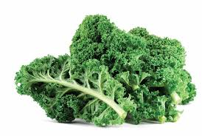
Which of the vegetables belong to the brassica family?

Slide 14
Brassica Vegetables
All of these vegetables belong to the Brassica oleracea family or Brassica rapa.
Now
Group these vegetable under Brassica rapa or Brassica oleracea.

Slide 15
Brassica rapa

Slide 16
Brassica oleracea

Slide 17
References
PPT brassica crops
booklet_asian_vegetables.pdf
FLYER_ASIAN_GREENS.pdf
ASIAN-VEGETABLES-A4.pdf

