Slide 1


Slide 2
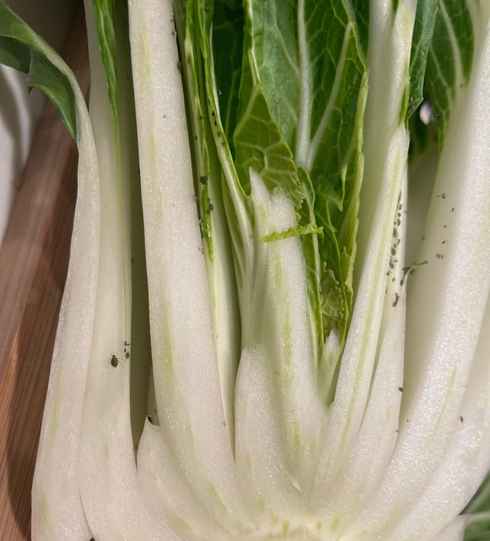
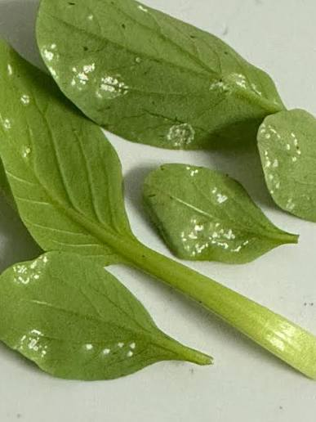
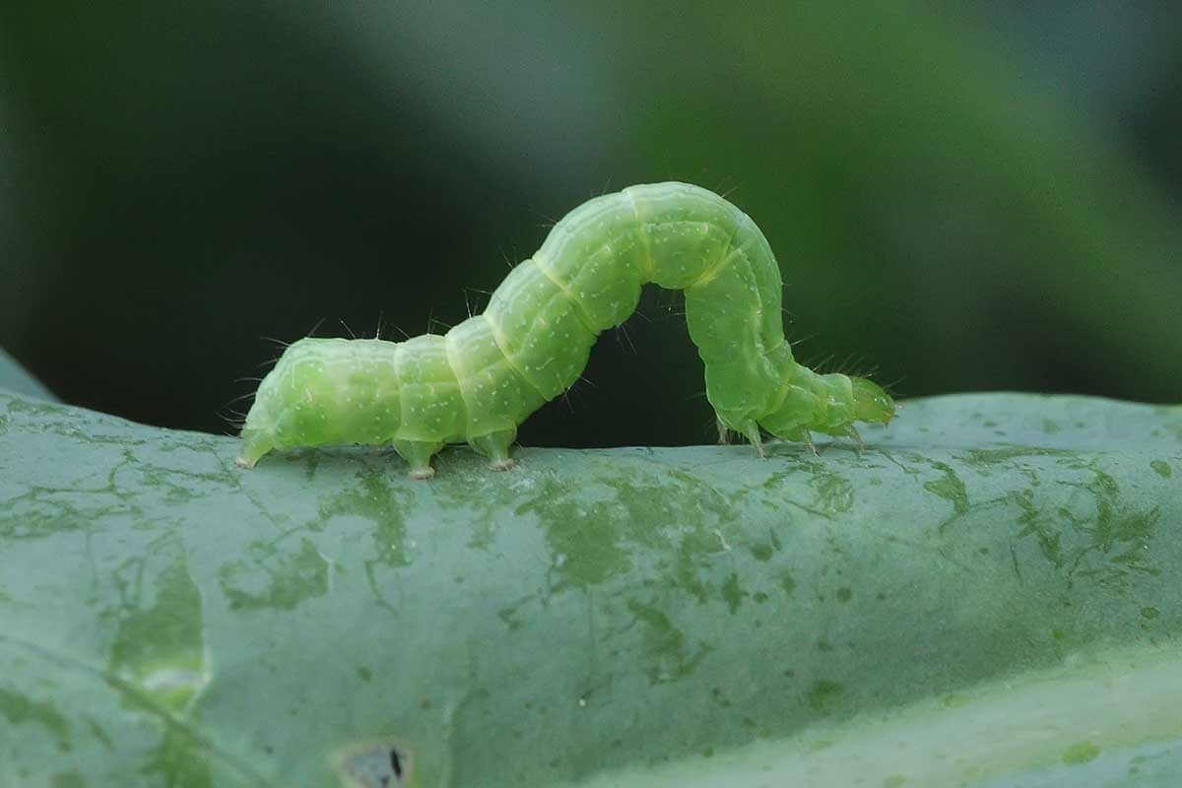
Bok Choy Pests and Diseases

Slide 3
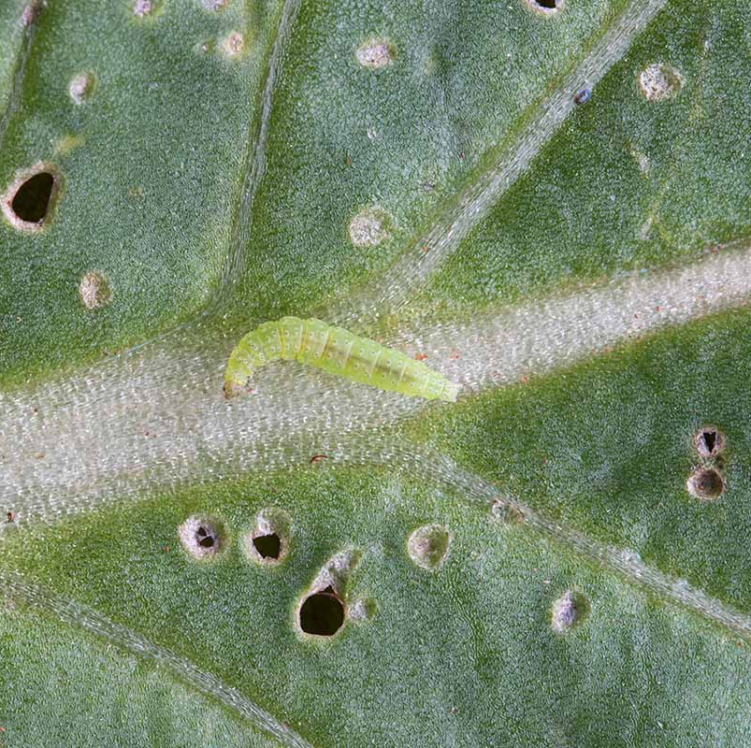
Pests and Diseases in
Bok Choy Crops
Bok choy is relatively resilient crop but as a member of the brassica family, it can be affected by a range of common pests and diseases.
Pests and diseases can:
  Reduce plant growth
  Lower crop quality
  Decrease yields
  Cause financial losses for growers
  Reduce the supply of fresh vegetables

Slide 4
Some Common Bok Choy
Pests
Aphids: suck plant sap and can distort leaves.
Slugs: chew holes in leaves, especially in moist conditions.
Caterpillars: chew holes in leaves and reduce crop quality.
  Looper caterpillars.
  Diamondback moth caterpillars
Leaf miner: Create winding, silvery-white “mines” or tunnels in leaves
Diseases
Damping-off: affects young seedlings and can cause them to collapse.
Downy mildew: causes pale or yellow areas on leaves and may produce fuzzy growth underneath.
White blister: produces white blister-like areas on leaves.
Clubroot: causes swollen, distorted roots and poor plant growth

Slide 5
Management Strategies
Integrated Pest and Disease Management (IPDM)
Maintain soil pH above 6.5 to help reduce the risk of clubroot.
Use well-drained soils to reduce conditions that favour disease.
Use a crop rotation to reduce the build-up of soil-borne pests and diseases.
Use disease-resistant cultivars where available.
Use pelleted and treated seed to support good establishment and help reduce damping-off.
Use appropriate plant spacing to improve air movement through the crop.
Check crops frequently for pests, diseases and plant damage.
Use approved pesticides and fungicides only when needed and according to recommended thresholds.
Rotate modes of action to reduce the risk of pesticide resistance.
Keep accurate records of chemical applications as part of Good Agricultural Practice (GAP).

Slide 6
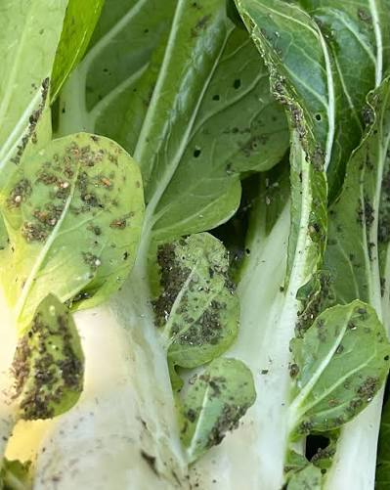
Aphids
(Brevicoryne brassicae)
Small pests about 2 mm long, grey-green in colour with a waxy, dusty appearance
Found in dense colonies common on the undersides of leaves and new plant growth
Suck sap from plant tissues causing leaves to:
  Curl
  Turn yellow
  Become stunted in growth
Reduce overall plant health
Can spread plant viruses

Slide 7
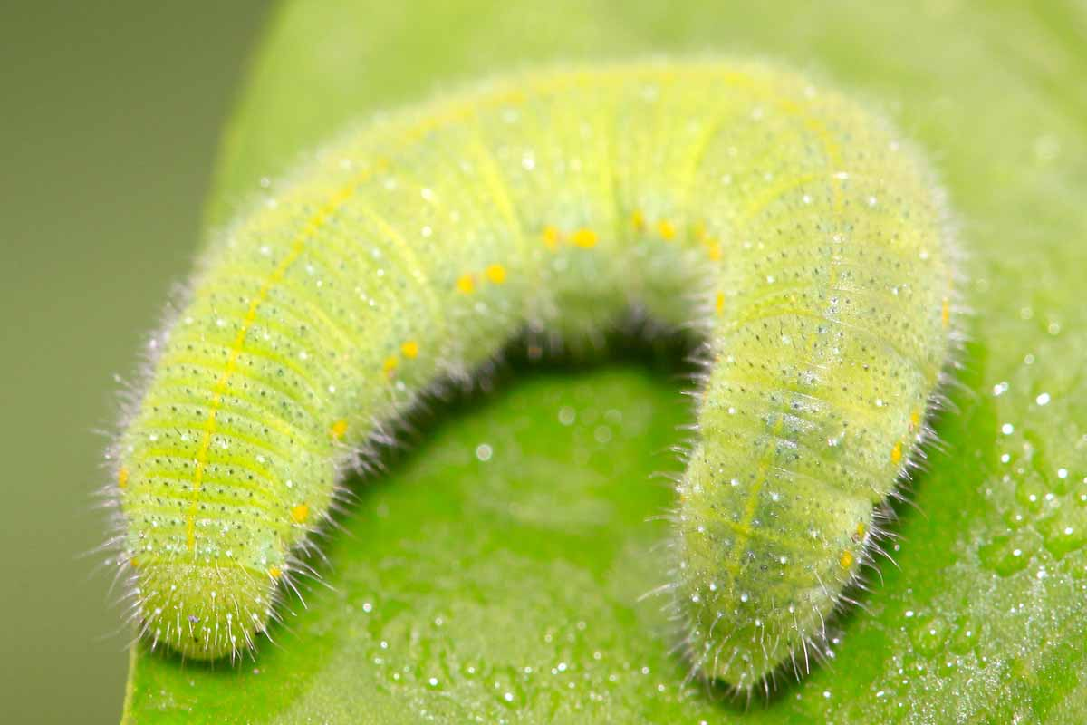
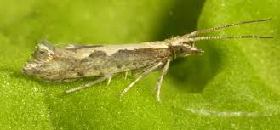
Diamondback moth
(Plutella xylostella)
The Diamondback Moth is a major pest of brassica crops causing severe damage, especially during winter and spring.
Caterpillars
Small green caterpillars (8–12 mm long)
Highly destructive feeders, create small holes in leaves
Adult Moths
Small brown moths with diamond-shaped patterns visible on wings when resting
Damage
Damages leaves and developing heads
Reduces crop quality and plant growth and yield
Management strategies
Regular inspection of brassica crops is essential for detecting early signs of larvae.
Biological controls such as parasitoid wasps, lacewings, hoverflies, and ladybirds are effective for management.
Integrated Pest Management (IPM) combining monitoring, biological control and targeted insecticides

Slide 8
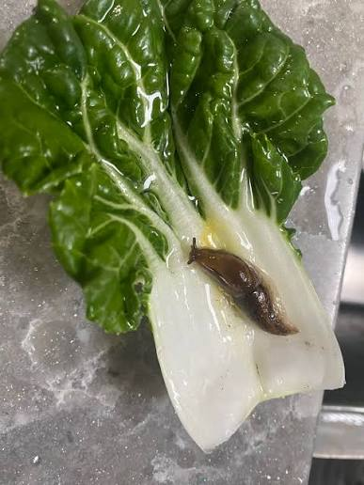
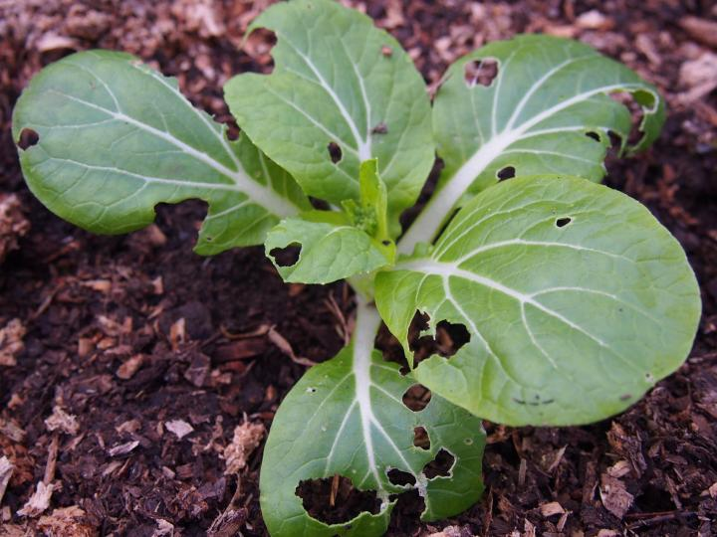
Slugs and snails
Slugs and snails are night time plant eaters that can quickly damage young vegetable crops
They are soft-bodied animals called molluscs.
They have a muscular foot to move and rough mouthparts that scrape plant leaves.
Damage
Eat young lettuce leaves and seedlings.
Leave holes in leaves and can chew through young stems.
Are most active on cool, wet nights and in damp, shady places.
Signs to look for
Silvery slime trails on leaves or soil.
Holes chewed in leaves.
Young seedlings damaged or cut off near the base.

Slide 9
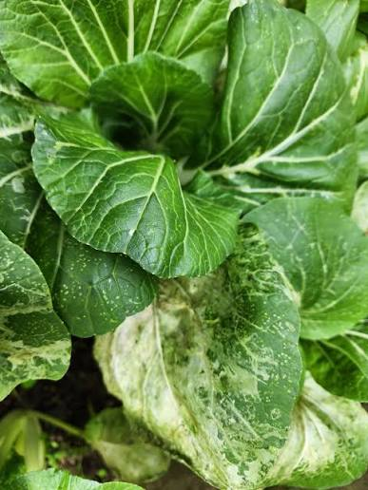
Leaf miners
Leaf miners are small fly-related pests that lay eggs inside plant leaves.
The larvae live and feed within the leaf tissue.
Damage
Create winding, silvery-white “mines” or tunnels in leaves
Damaged areas may turn yellow
Reduce photosynthesis
Impact on Brassica crops
Weakens plants and reduces crop quality and yield
Management strategies
Crop monitoring- use of sticky traps to catch adults
Crop hygiene

Slide 10
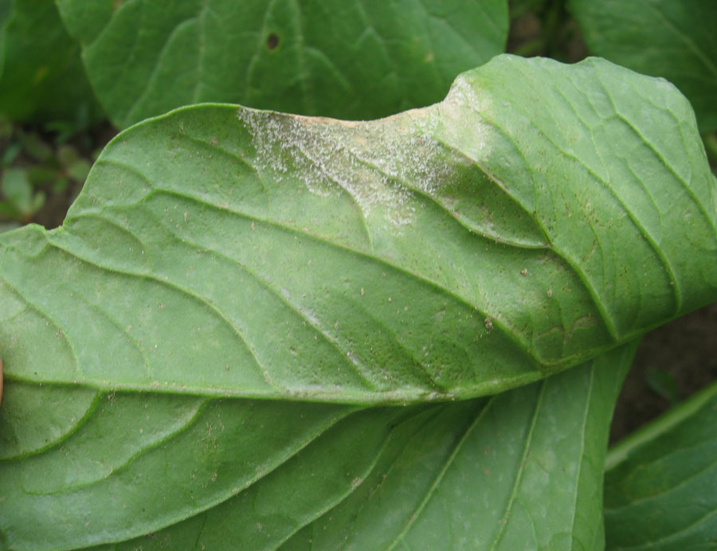
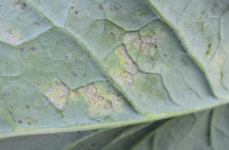
Downy Mildew
Hyaloperonospora brassicae
A common disease of brassica crops
Develops in cool (8–16°C) and wet or humid conditions.
Symptoms
Seedlings
  White, fluffy mould on the underside of leaves.
  Black speckles and puckered leaves which may die and fall off.
Mature plants
  Yellow or grey angular spots on the upper leaf surface.
  Yellowing of older leaves.
Spread
  Spores are spread by wind and water droplets.
  Thrives in high humidity, dew, fog, and rain.
Management strategies
  Space plants to improve air movement and help leaves dry quickly.
  Rotate brassica crops for 2–3 years before planting in the same field
  Apply preventative fungicides when weather conditions favour disease.

Slide 11
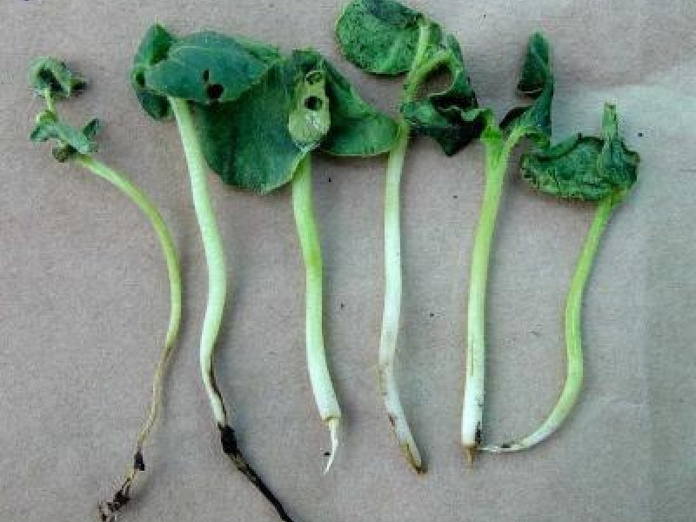
Damping-off
A disease that attacks young
Caused by soil-borne fungi and water moulds.
Once a seedling is infected, it cannot be saved.
Symptoms
Seeds rot before they germinate.
Seedlings collapse at the soil line and fall over.
Conditions that increase risk
Wet or overwatered soil.
Cool, damp weather.
Poorly drained or compacted soil.
Management strategies
Use treated seed.

Slide 12
White blisters
Albugo candida
A disease caused by a fungus-like organism that affects brassica crops such as bok choy.
Favoured by cool, wet and humid conditions.
Symptoms
Raised white or cream-coloured blisters develop, often on the underside of leaves.
Blisters can also occur on stems and leaf stalks.
The blisters may burst and release a powdery mass of white spores.
Pale yellow or purplish patches may appear on the upper surface of the leaf.
Management Strategies
Crop rotation- avoid growing brassicas in the same area year after year.
Plant spacing to allow good air movement through the crop.
Reduce leaf wetness
Use approved fungicides when necessary

Slide 13
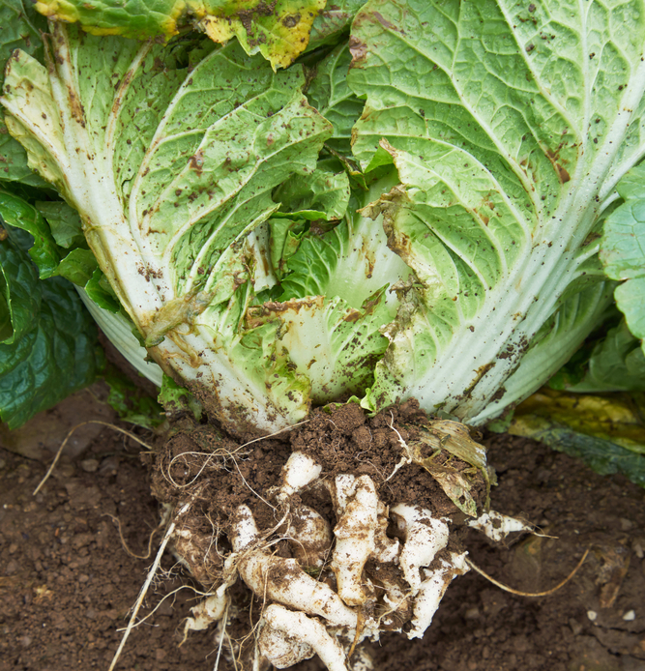
Clubroot
(Plasmodiophora brassicae)
Clubroot is a severe soil-borne pathogen affecting brassicas
It thrives in acidic, wet soils and can persist for up to 10–20 years.
Damage
Stunted plant growth
Wilting plants (especially in warm weather)
Swollen, deformed roots (“club-like” roots)
Poor nutrient and water uptake
Management Strategies
Strict farm hygiene (clean tools and equipment)
Liming soil to increase pH (reduce acidity)
Long crop rotations (avoid brassicas in affected soil for years)
Using clubroot-tolerant varieties where available

Slide 14
References
How to identify and manage common bok choy pests
https://gardenerspath.com/plants/vegetables/control-bok-choy-pests/
How to identify and control bok choy diseases
https://gardenerspath.com/plants/vegetables/bok-choy-disease/

