Slide 1


Slide 2
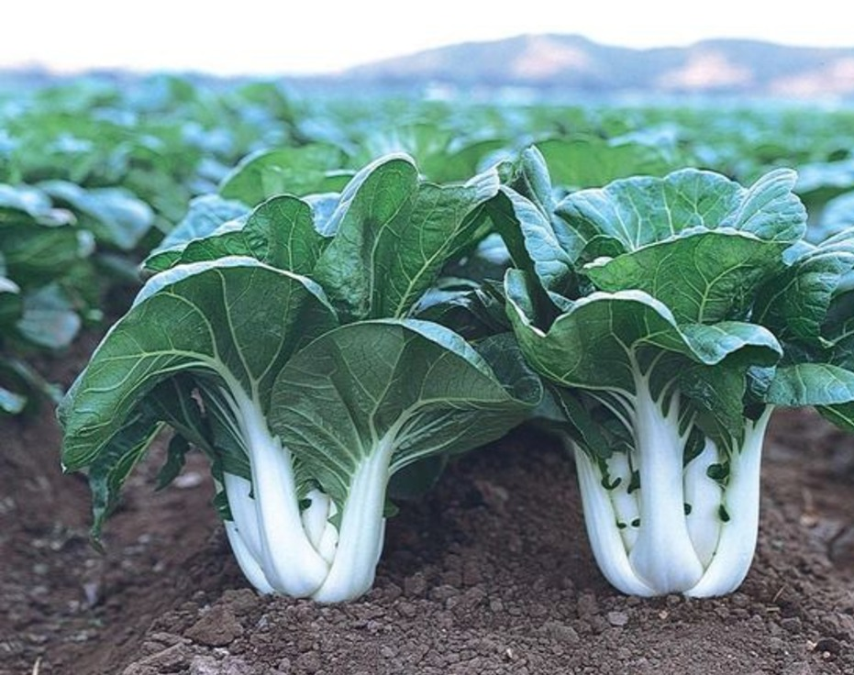
Bok Choy
pak choi /pak choy

Slide 3
Hybrid plants
A hybrid is a plant that is produced by crossing two carefully selected parent plants to combine their best characteristics.
Hybrid bok choy varieties are bred to produce vigorous, uniform plants with rapid growth, improved disease resistance, better tolerance to bolting, and high-quality leaves and stems. However, seeds saved from hybrid bok choy plants will not produce the same characteristics as the parent crop, so commercial growers purchase new hybrid seed each season to ensure consistent quality and performance.

Slide 4
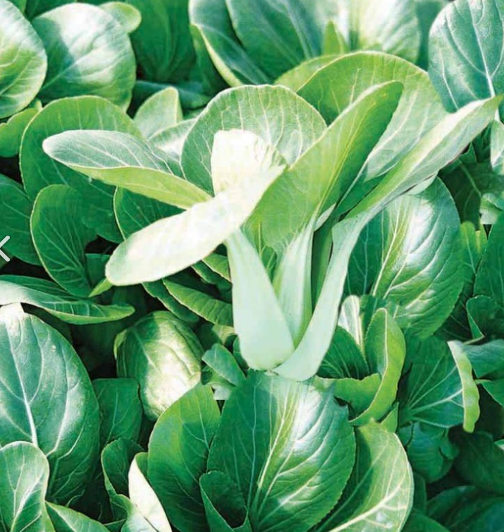
Sumo
Sumo is a hybrid green-stemmed bok choy that is well suited to commercial production throughout New Zealand. It is known for producing high-quality plants and is very slow to bolt, making it reliable across different growing seasons.
Key Features
Hybrid green-stemmed bok choy
Dark green stems (petioles) and leaves
Produces compact, dense heads
Very uniform size, shape, and maturity
Excellent resistance to bolting (flowers late)
Uniform maturity allows harvesting in one pass
Produces high-quality, marketable heads
Suitable for year-round production
Can be grown in both open fields and hydroponic systems

Slide 5
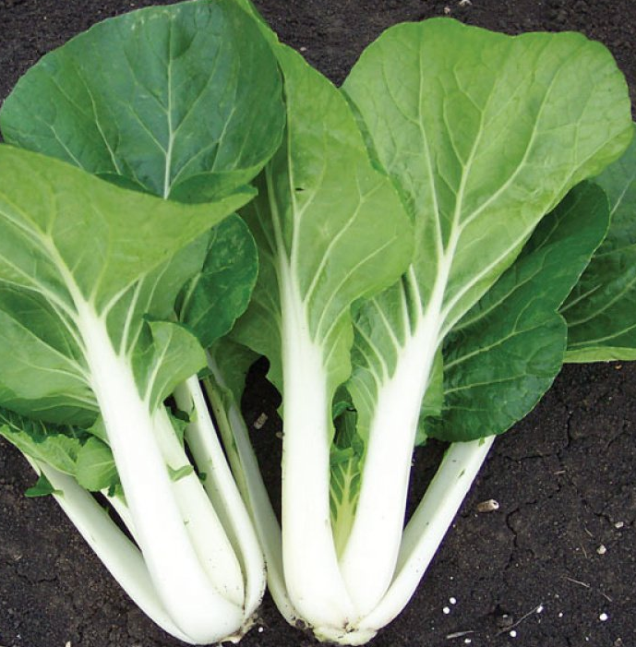
Joi Choi
Joi Choi is a popular hybrid bok choy variety grown by commercial growers. It is also known as pak choi, pak choy, or bok choy.
Key Features
Produces uniform plants with similar size, shape, and maturity
Vigorous growth with large, compact heads
Thick, fleshy white stems
Dark green leaves
Slow to bolt, meaning it is less likely to flower too early
Suitable for year-round production
Can be grown in both open fields and hydroponic systems
Uniform maturity allows growers to harvest the crop in one pass, saving time and labour

Slide 6
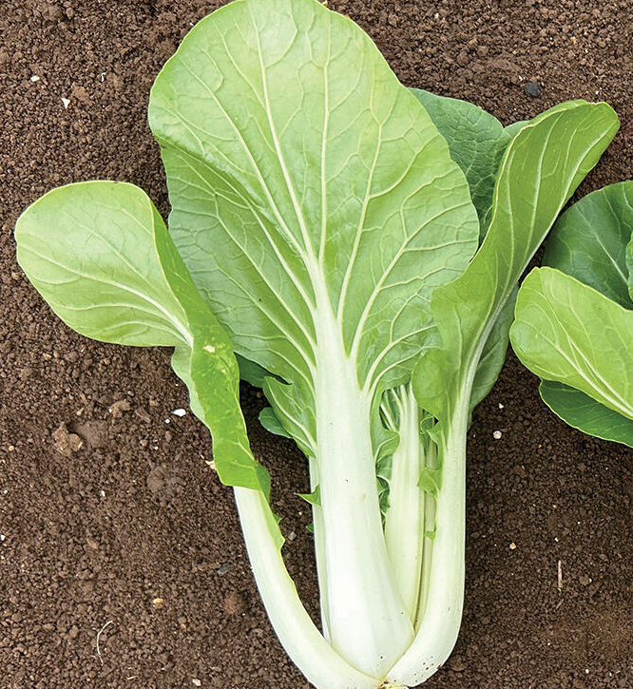
Kaizen
Kaizen is a hybrid white-stemmed bok choy that is an improved version of the popular Joi Choi variety. It has been bred to produce even more consistent plants for commercial growers.
Key Features
Produces very uniform plants with similar size, shape, and maturity
Vigorous growth with a compact plant
Thick, fleshy white stems
Dark green leaves
Slightly smaller than Joi Choi
Semi-upright growth habit
Suitable for year-round production
Can be grown in both open fields and hydroponic systems
Uniform maturity allows harvesting in one pass, saving time and labour
Suitable for both bagged and bunched sales

Slide 7
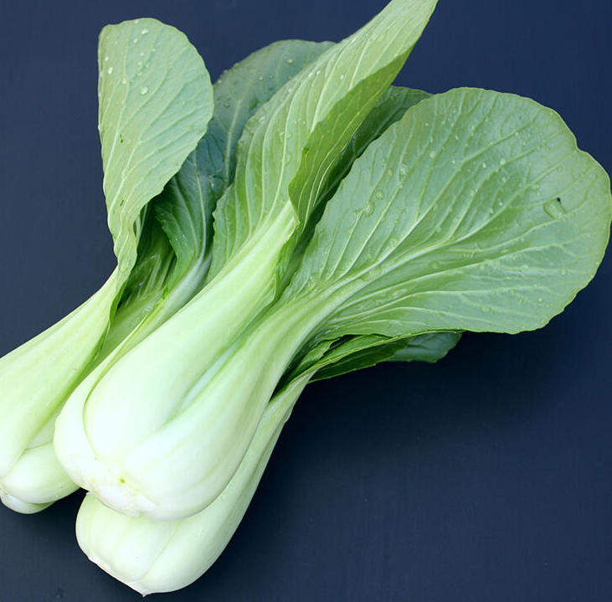
Taido
Taido is a hybrid green-stemmed bok choy that is suitable for commercial production throughout the year. It is especially well suited to winter growing because of its good tolerance to cold conditions.
Key Features
Hybrid green-stemmed bok choy
Dark green leaves
Produces uniform, well-shaped heads
Good cold tolerance, making it ideal for winter production
Suitable for year-round production
Can be grown in both open fields and hydroponic systems

Slide 8
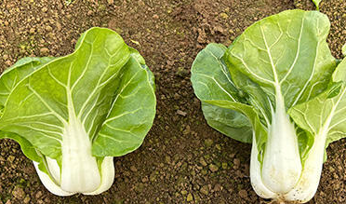
Osaka
Mini Bok Choy Variety
Osaka is a hybrid mini white-stemmed bok choy that is grown commercially throughout the year. It is especially valued for its uniform size and its ability to grow well during cooler, wetter conditions.
Key Features
Hybrid mini white-stemmed bok choy
Mid-dark green leaves
Produces very uniform, compact heads
Suitable for year-round production
Good tolerance to leaf diseases during cold, wet winter conditions
Good resistance to bolting (flowers late)
Matures faster than larger Shanghai-type bok choy
Suitable for both open-field and hydroponic production

Slide 9
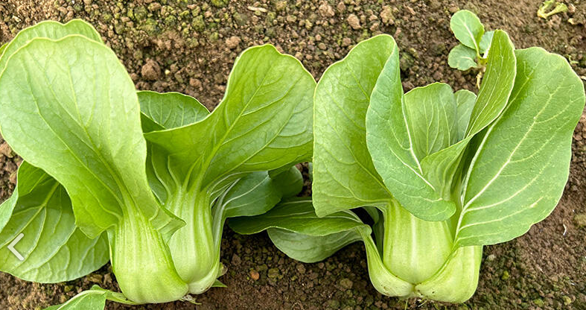
Kyoto
Mini Bok Choy Variety
Kyoto is a hybrid mini green-stemmed bok choy that is suitable for commercial production all year round. It is a fast-growing variety that produces small, uniform plants for the fresh market.
Key Features
Hybrid mini green-stemmed bok choy
Dark green leaves
Produces very uniform, compact heads
Intermediate tolerance to bolting (moderate resistance to flowering too early)
Matures faster than larger Shanghai-type bok choy
Suitable for year-round production
Can be grown in both open-field and hydroponic production systems

Slide 10
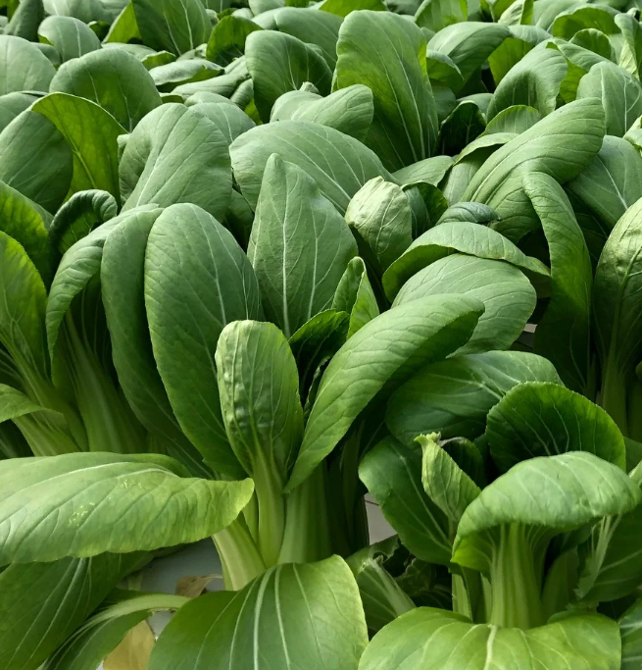
Showman F1
Uniform medium compact green stem pak choi, with elegant shape.
Bright glossy green stem and leaves
Exceptional vigour and uniformity
Fresh market single head or bunching.
Suited to late spring to winter harvest.
High resistance to clubroot
Suits field and hydroponic production systems

Slide 11
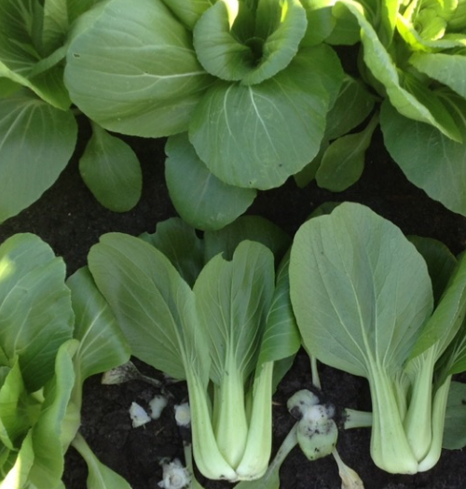
Miyako F1
Green stem pak choi with glossy green leaves
Market leading variety, known for its exceptional versatility
Very slow bolting, suitable for harvest all year round
Intermediate resistance to clubroot

Slide 12
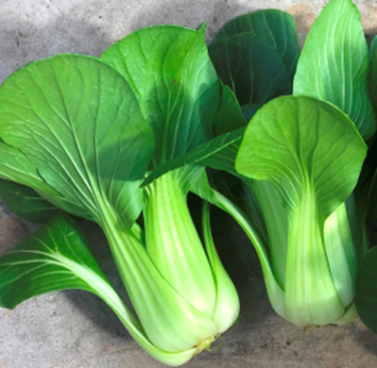
Parade
Excellent dark green colour, similar to market standard Showman
Beautiful hour-glass shape and strong against bolting
Versatile variety with clubroot resistance
Suited to late spring through until mid winter harvest dependent on location
High resistance to PB. "PB resistance" stands for resistance to Plasmodiophora brassicae, the soil-borne pathogen that causes clubroot disease

Slide 13
Test yourself quiz
Write True or False beside each statement.
 | Statement | True or False
1 | Hybrid plants are produced by crossing two carefully selected parent plants.
2 | Commercial growers usually save seed from hybrid bok choy plants to plant the following season.
3 | Some hybrid bok choy varieties are bred to resist bolting.
4 | All hybrid bok choy varieties are exactly the same
5 | Uniform plants allow growers to harvest crops more efficiently.

Slide 14
Test yourself quiz
Answers
 | Statement | True or False
1 | Hybrid plants are produced by crossing two carefully selected parent plants. | True
2 | Commercial growers usually save seed from hybrid bok choy plants to plant the following season. | False
3 | Some hybrid bok choy varieties are bred to resist bolting. | True
4 | All hybrid bok choy varieties are exactly the same | False
5 | Uniform plants allow growers to harvest crops more efficiently. | True

Slide 15
Do
Activity 2: Choosing a hybrid

Slide 16
References
South Pacific Seeds
  https://www.spsnz.com/our-products
Fairbanks Seeds
  https://fairbanks.co.nz/product/miyako-f1/
Lefroy Valley
  https://lefroyvalley.co.nz/products/chinese-greens-pak-choi-showman

