Slide 1


Slide 2
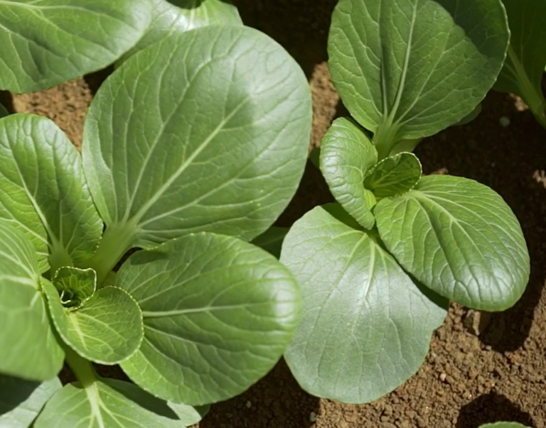
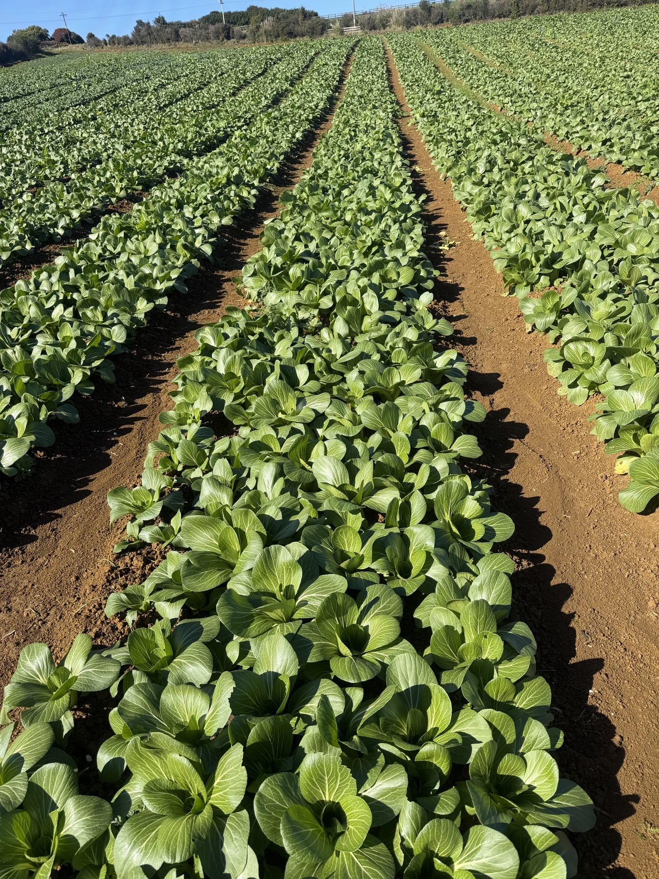
Growing Bok Choy
Watch: Growing Asian greens in NZ https://www.youtube.com/watch?v=T3J1qI0pCLY

Slide 3
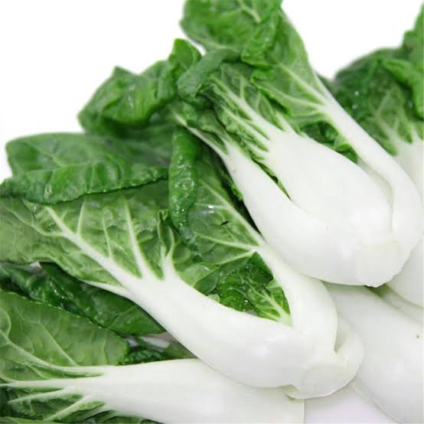
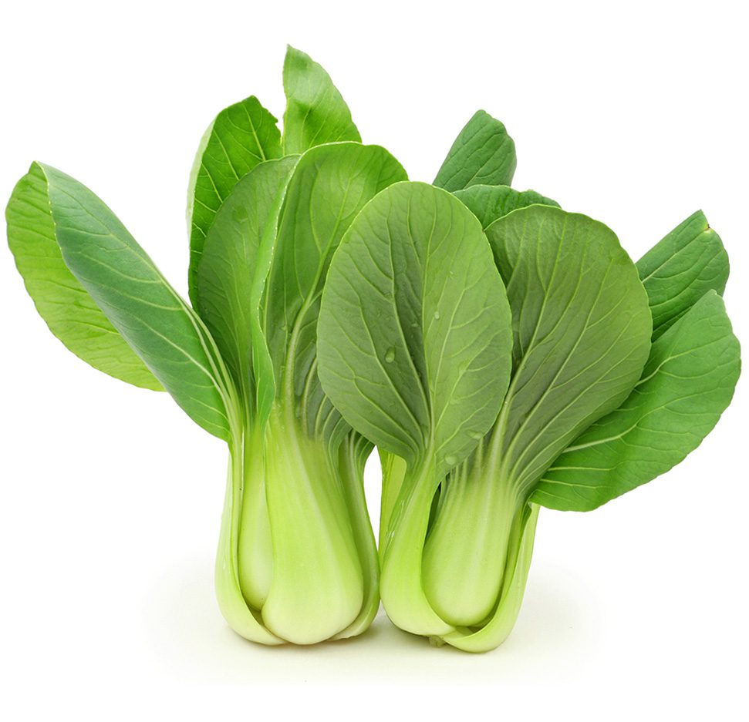
Bok Choy
Bok choy (Brassica rapa subsp. chinensis), also called pak choi, is a fast-growing Asian green in the Brassicaceae (mustard and cabbage) family.
Common commercial types
White-stemmed bok choy – white stalks with dark green leaves.
Shanghai bok choy – smooth green stalks and a slightly sweeter flavour.

Slide 4
Bok choy - Growing Requirements
Best growth occurs in cool to mild conditions: about 15–22°C.
Can be grown outdoors for much of the year in suitable NZ regions.
Prefers fertile, well-drained loam soils.
Ideal soil pH: 6.5–7.0.
Good drainage is important because bok choy has shallow roots and does not tolerate waterlogging.
Needs consistent soil moisture for rapid, healthy growth.
Irrigation is particularly important during warm or dry weather.
Baby bok choy: about 30–40 days.
Larger marketable plants: about 40–60 days under favourable conditions.
Growth is slower in winter, so crops may take longer to reach harvest size.

Slide 5
Bok Choy Crop Calendar of Operations
(Sowing weekly all year, Summer 6-8 weeks to harvest, winter 10-12 week to harvest)
Use integrated pest management practices to control pests and diseases
Pre- emergence herbicide
Cultivar selection
Pelleted Seed
Direct drilled
Crop scouting
Site Selection
Pre- sowing
Sowing
12.5 cm between plants and 14 cm between rows, with 8 rows
Growing
Summer 6-8 weeks to harvest
Winter 10-12 week to harvest
Harvesting
Soil test
irrigation
Hand harvest daily (5 x per week)
Spraying fungicides & insecticides
Cultivation
Seedbed preparation
Add required fertiliser for crop needs
Apply lime

Slide 6
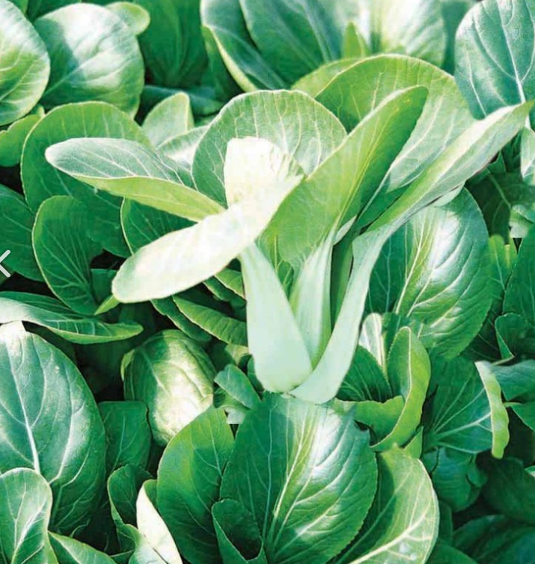
Cultivar Selection
(PPT Bok choy)
Commercial growers choose cultivars based on:
Growing conditions and season
Market demand
Disease resistance
Uniform size, shape and maturity
Resistance to bolting
Example
Sumo is a commercial hybrid cultivar valued for:
Uniform plants and maturity
Good size and shape
Good resistance to bolting
Useful disease resistance
Activity 2: Choosing a hybrid variety

Slide 7
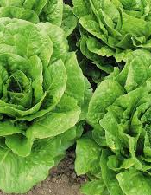
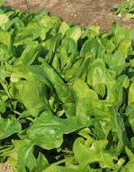
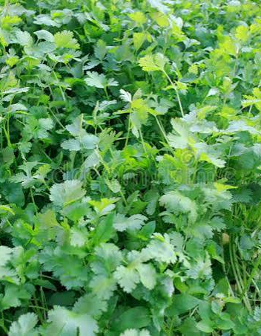
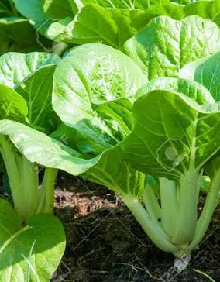
Site selection
Based on
  Crop rotation
  Soil type
Lettuce
Spinach
Coriander
Bok choy

Slide 8
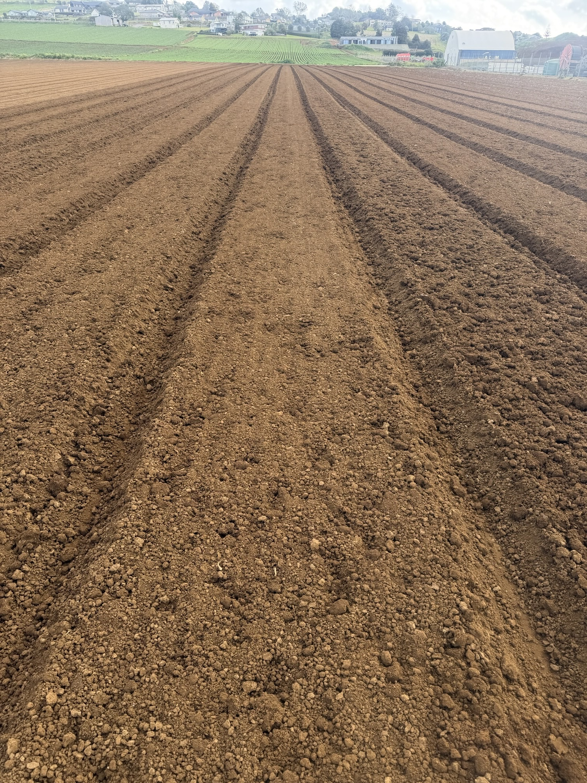
Seedbed preparation
A well-prepared seedbed gives bok choy seeds the best start for even germination and growth.
Typical cultivation process
1. Ripper / Subsoiler
  Deep tines break up compacted soil.
  Improves drainage and aeration.
2. Finer tines
  Break up large soil clods.
  Creates a friable soil structure suitable for sowing seed.
3. Power harrow + bed maker
  Power harrow creates a fine soil tilth.
  Bed maker forms the raised, firm seedbed.
GPS-guided machinery improves accuracy and efficiency as well as minimising soil compaction .

Slide 9
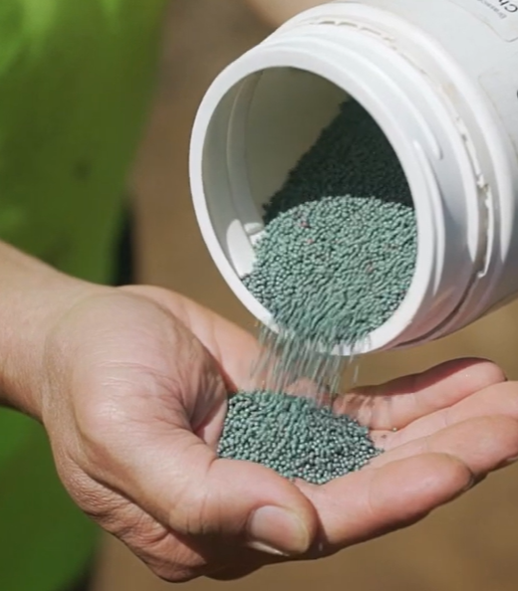
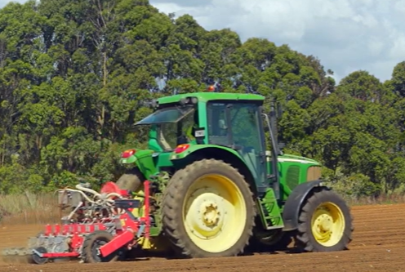
Sowing
Bok choy is commonly sown directly into a prepared seedbed.
Pelleted and treated seed can be sown using a precision seeder.
Precision sowing gives consistent depth and spacing, producing a more uniform crop.
New crops are sown at regular intervals, often weekly.
Provides a continuous supply for the market.
Seeds are generally sown 5–10 mm deep.
Closer spacing produces smaller/baby bok choy.
Wider spacing allows plants to develop larger stems and leaves.
The seedbed is kept evenly moist during germination.
Spacing varies depending on variety sown and equipment.
Example
12.5 cm between plants × 14 cm between rows, with 8 rows per140cm bed.

Slide 10
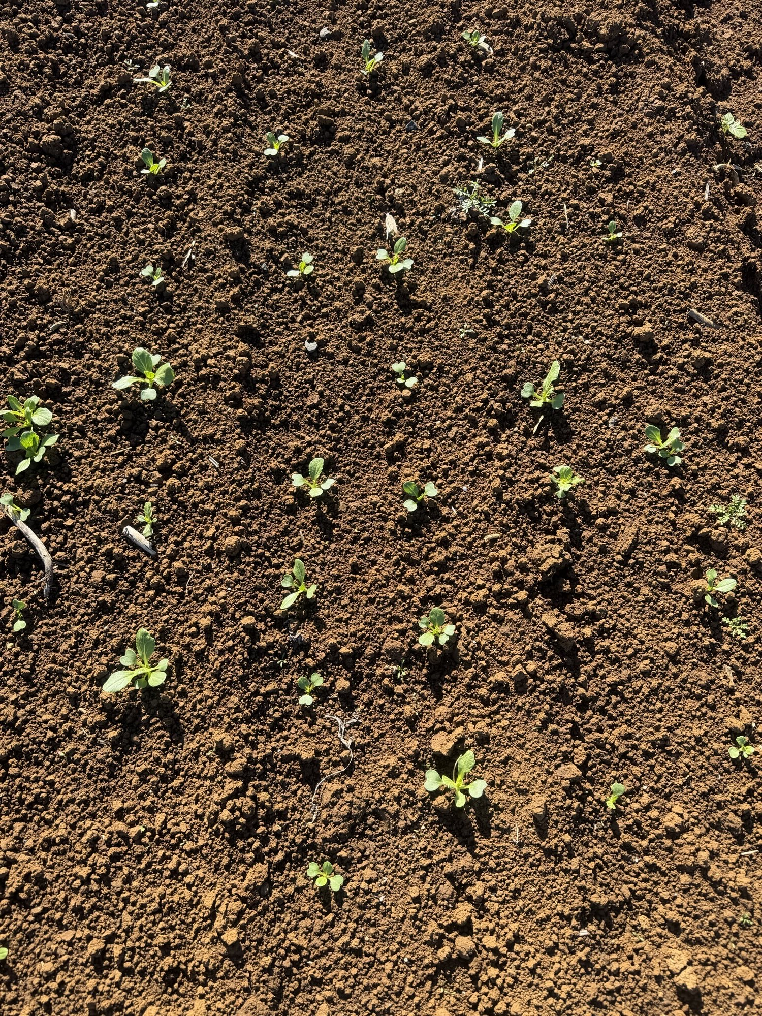
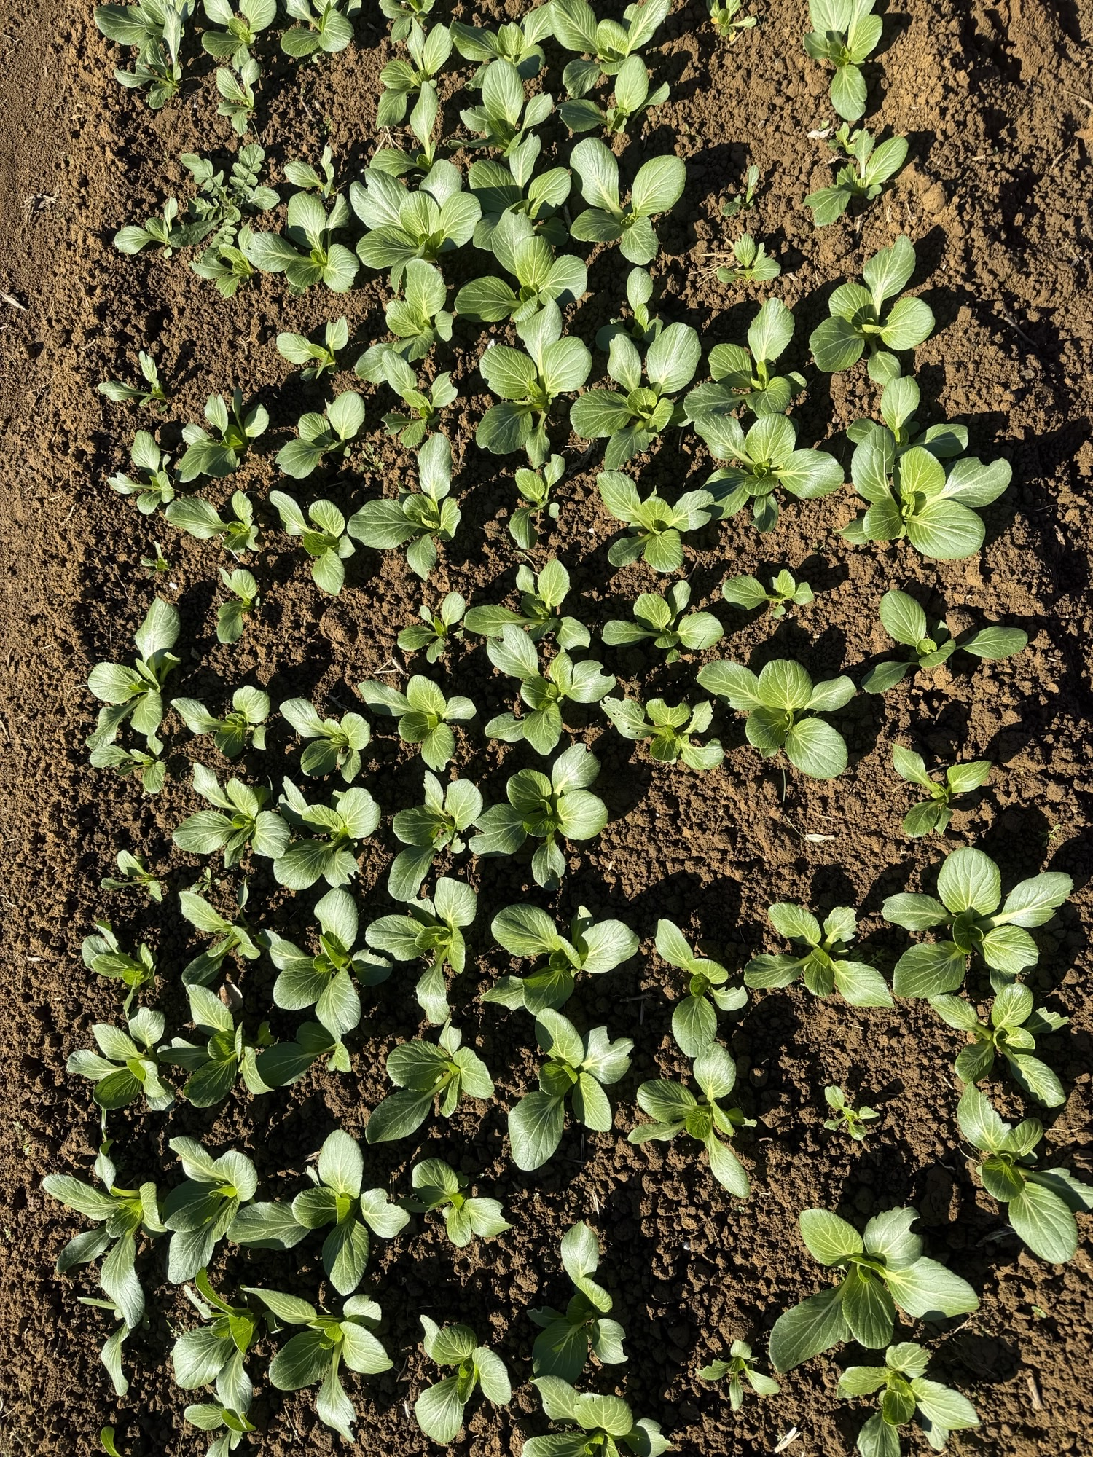
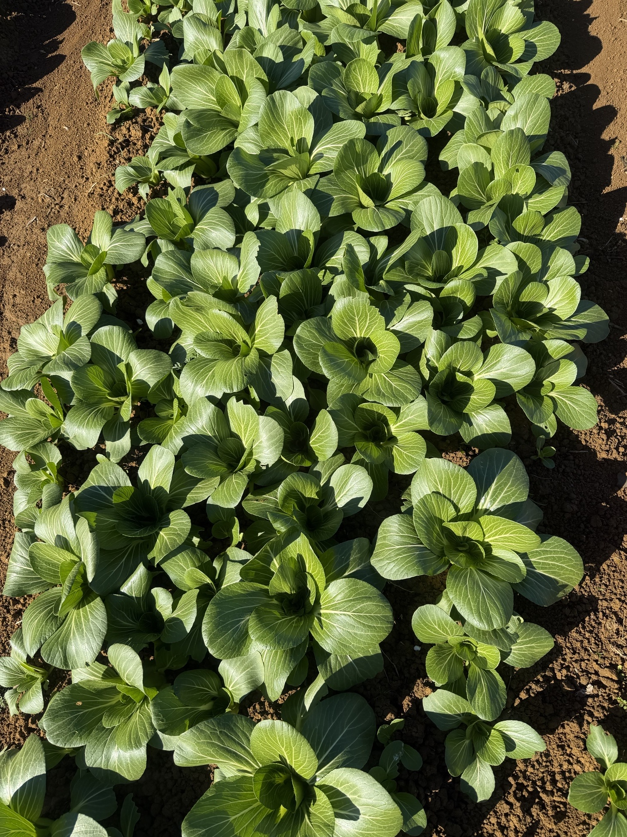
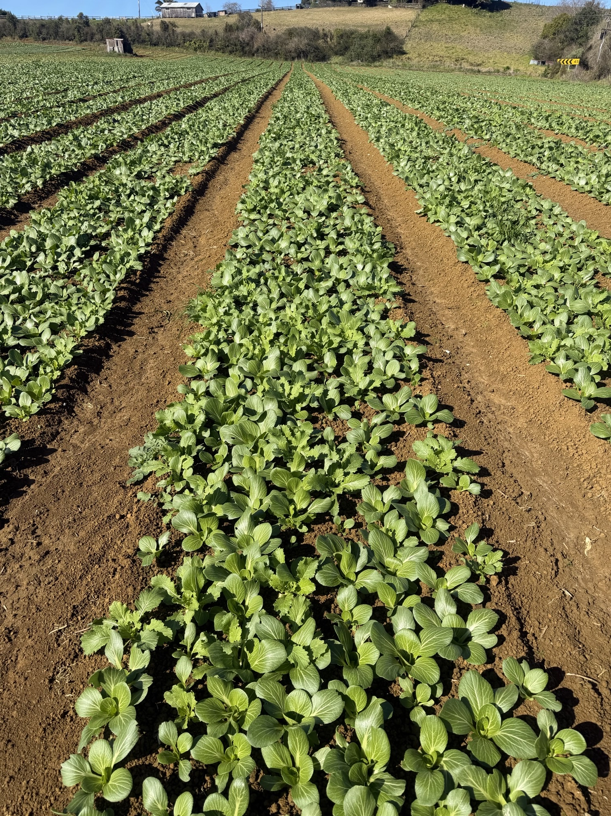
Growth

Slide 11
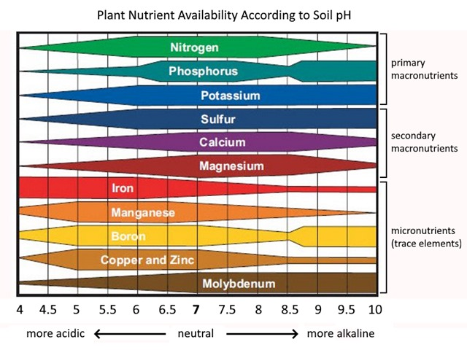
Nutrition management
Growers carry out soil testing to check pH and nutrient levels.
Results help determine the type and amount of fertiliser needed.
A base fertiliser may supply most nutrients during the short growing period.
Key Nutrients
After heavy rainfall: Nitrogen can be lost through leaching. If needed, growers may apply calcium ammonium nitrate (CAN) as a side-dressing.
Note:
  Too much nitrogen can reduce crop quality and shelf life.
  Maintaining soil pH around 6.5–7.5 can help reduce the risk of clubroot, but soil pH also affects the availability of nutrients to the crop.
Do Activity on soil pH
Nutrient | Main role
Nitrogen (N) | Leaf and stem growth
Phosphorus (P) | Root growth and establishment
Potassium (K) | Plant health and stem quality
Calcium & Magnesium | Healthy growth and leaves
Trace elements | Prevent nutrient deficiencies

Slide 12
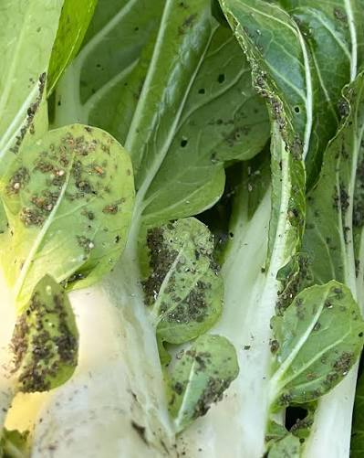
Pest and Diseases
Bok choy is relatively resilient, but pests and diseases can still reduce crop quality and yield.
Growers regularly monitor crops and use a combination of:
Cultural controls
Biological controls
Good crop management
Approved pesticides and fungicides when necessary
Refer PPT Bok choy pest and diseases
Common insect pests | Common diseases
Aphids Slugs Caterpillars, including: Looper caterpillars Diamondback moth | Damping-off Downy mildew Clubroot Alternaria Bacterial leaf spot White blister

Slide 13
Weed management
Weeds compete with bok choy for:
  Water
  Nutrients
  Sunlight
  Growing space
  Weeds can also provide shelter for pests and diseases.
Weed Management Strategies
Good soil preparation
  Prepare a fine, firm seedbed.
  Helps bok choy germinate quickly and establish strongly.
  Healthy seedlings can compete more effectively with weeds.
Pre-emergence herbicides
  May be used to control weeds before crop emerges.

Slide 14
Irrigation
Bok choy is about 95% water, so a consistent water supply is essential for rapid, healthy growth.
Why does it need regular irrigation?
Bok choy has a shallow root system and cannot access water deep in the soil.
It is sensitive to dry conditions.
During hot, dry or windy weather, daily irrigation may be needed.
Benefits of consistent moisture
Promotes rapid growth
Produces crisp, tender leaves and stems
Helps maintain good flavour and quality
Reduces plant stress
Helps reduce bitterness and premature bolting

Slide 15
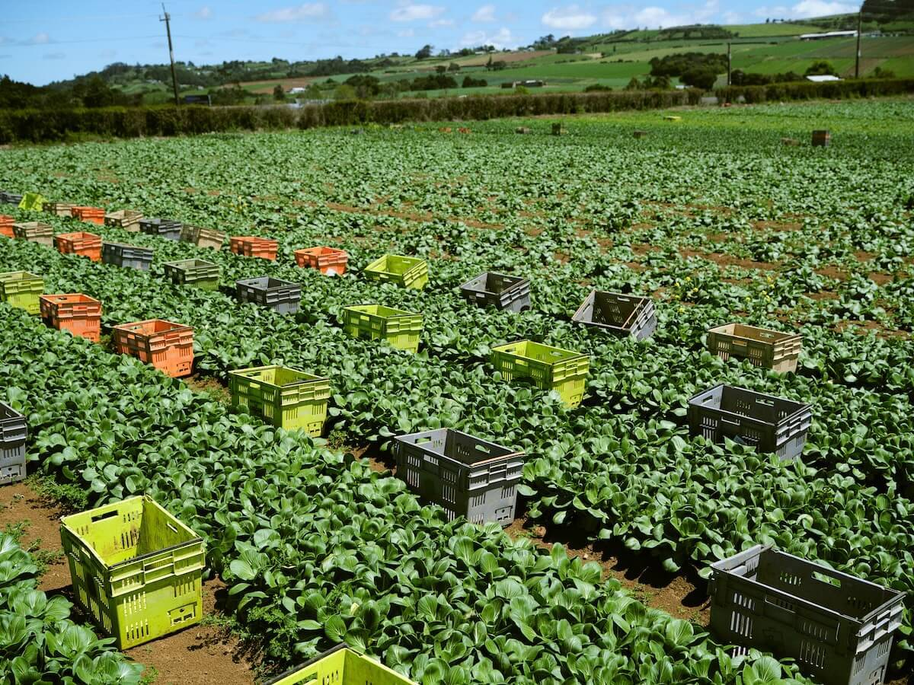
Harvesting
Harvested by hand when plants reach the right size and quality for the target market.
Harvesting is often carried out 5 days a week to maintain freshness and meet market demand.
Growers aim to harvest as close to 100% of marketable plants as possible.
Workers look for:
Dark-green, healthy leaves,
Firm, crisp stems
No significant pest or disease damage
Harvesting
Plants are cut at the base using a sharp knife.
Damaged or discoloured outer leaves may be removed.
After harvesting
Bok choy is carefully placed into clean crates or containers.
Produce is moved quickly to the packhouse for cooling, packing and distribution.

Slide 16
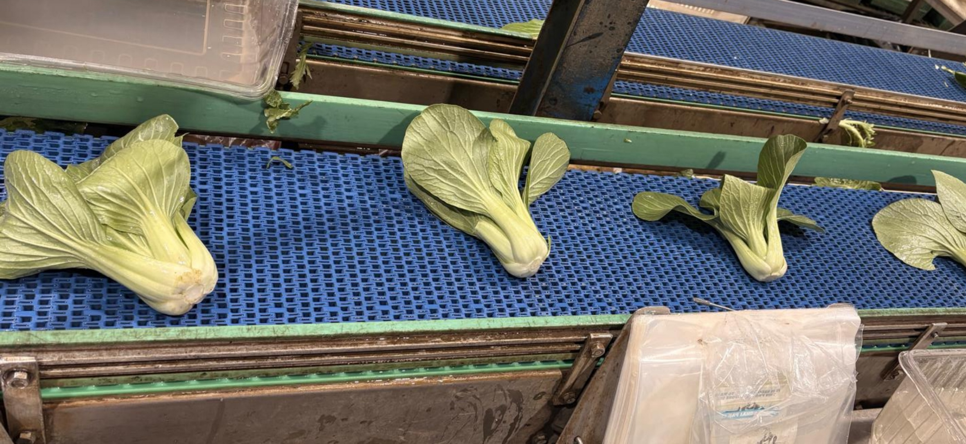
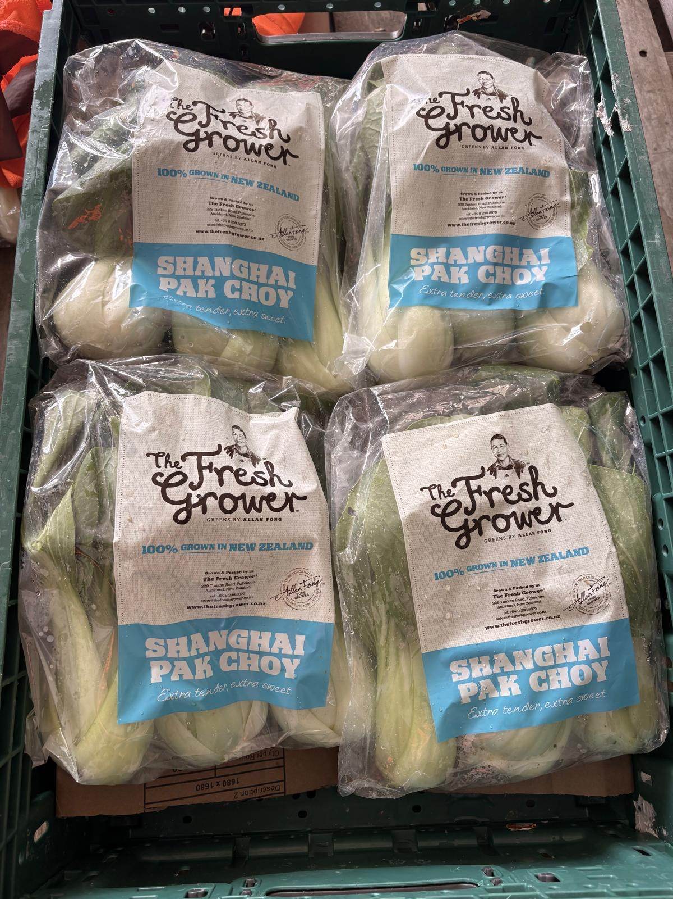
Post-Harvest Handling
Inspect – Remove damaged or poor-quality leaves.
Wash – May be washed to remove soil and contaminants.
Rapid cooling – Cooled to around 3°C to remove field heat.
Grade and pack – Produce is sorted and packed to meet market requirements.
Refrigerated storage and transport – Kept cool until it reaches the customer.
Why rapid cooling is important?
Maintains crispness and freshness
Reduces water loss and wilting
Slows respiration and deterioration
Helps extend shelf life

Slide 17
Do
Bok choy questions (WS)
Activity 5: Careers in growing a crop
Use integrated pest management practices to control pests and diseases
Pre- emergence herbicide
Cultivar selection
Pelleted Seed
Direct drilled
Crop scouting
Site Selection
Pre- sowing
Sowing
12.5 cm between plants and 14 cm between rows, with 8 rows
Growing
Summer 6-8 weeks to harvest
Winter 10-12 week to harvest
Harvesting
Soil test
irrigation
Hand harvest daily (5 x per week)
Spraying fungicides & insecticides
Cultivation
Seedbed preparation
Add required fertiliser for crop needs
Apply lime

Slide 18
Acknowledgements
We gratefully acknowledge The Fresh Grower for sharing their expertise, practical knowledge and guidance on the commercial production of Asian greens, and for providing photographs to support the development of these resources.

