Slide 1


Slide 2
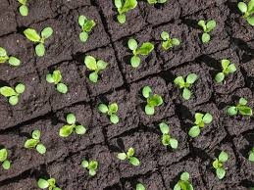
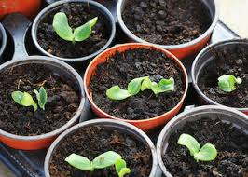
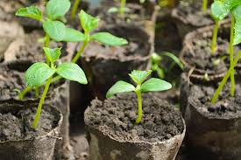
Steps involved in sowing seeds in containers.

Slide 3
Equipment
Seeds
Seed raising mix
Potting mix
Punnets- small seeds
Pots- large seeds
Sieves
Access to water
Float to firm seed mix-(block of wood)
String lines
Rakes

Slide 4
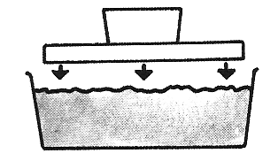
Step 1
Fill the punnet three-quarters full with sterile seed sowing mix. Level and lightly firm down the surface with a float. This makes sure that the seeds will all;
be at the same depth
come up at the same time
grow to about the same size

Slide 5
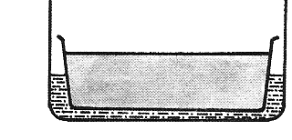
Step 2
Soak the growing medium by standing the filled punnet in a tray of water. The water soaks up through the drainage holes. This ensures the medium is wetted through evenly.

Slide 6
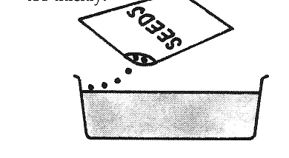
Step 3
Sprinkle seeds evenly over the surface so when they germinate their roots do not tangle and the seedlings do not compete for light and water.

Slide 7
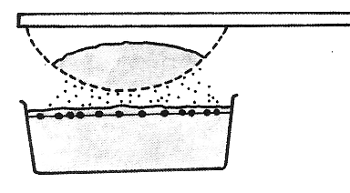
Step 4
Cover the seeds with seed raising mix to a depth of twice their diameter so the seeds will germinate evenly and have enough stored energy for the shoot to reach the surface.

Slide 8
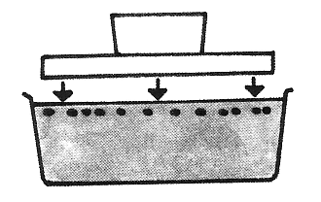
Step 5
Use a float to gently firm the surface to get good contact between the seed and growing media so the seeds get enough water and air to germinate
Place seeds in controlled environment.

Slide 9
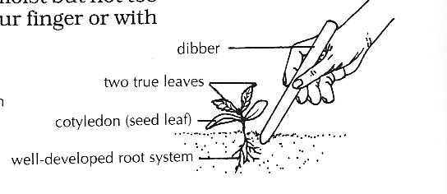
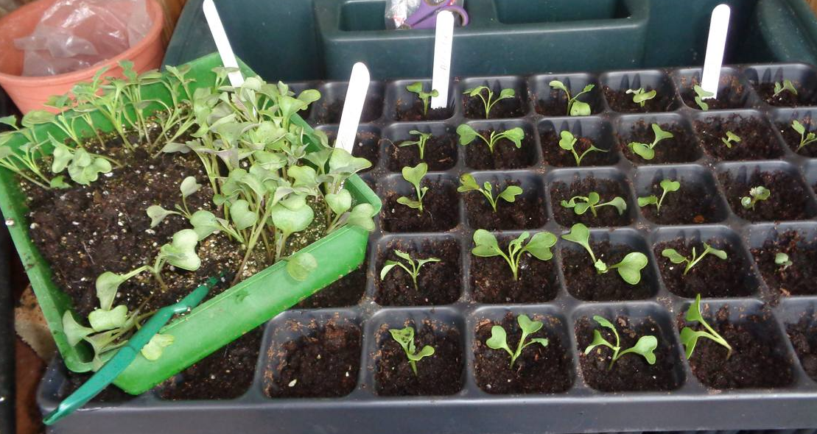
Pricking out seedlings
When seedlings have grown their first true leaves they will need to be pricked out. This is when they are lifted from the punnet, separated and replanted with more growing space between them.
Pricking out is necessary because crowded seedlings compete with each other for light, water, nutrients, air and space to spread roots and leaves.
Pricked out seedlings can be graded for size. All seedlings at the same age and development can be grown together.

Slide 10
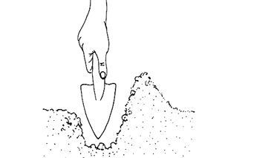
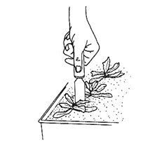
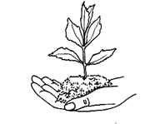
Transplanting Seedlings
Step 1
Water the plants the day before transplanting. This helps them to be full of moisture when you plant them. It also helps to hold the medium around the roots when you take them out of the container.
Step 2
Make the planting hole deep enough to take the roots without bending them. Do this with a trowel
Step 3
Disturb the roots as little as possible. It the roots of several plants have joined in the container cut them with a knife.
Step 4
Lift each plant out with a block of the growing medium around its roots.

Slide 11
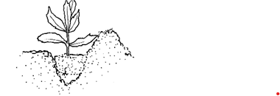
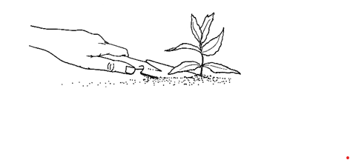
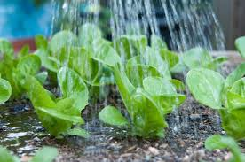
Step 5
Set the plant in the soil slightly lower than it has been, but do not bury the leaves
Step 6
Put moist soil, rather than dry surface soil, into the hole and press the soil firmly around the roots

