Slide 1


Slide 2
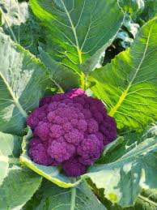
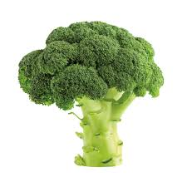
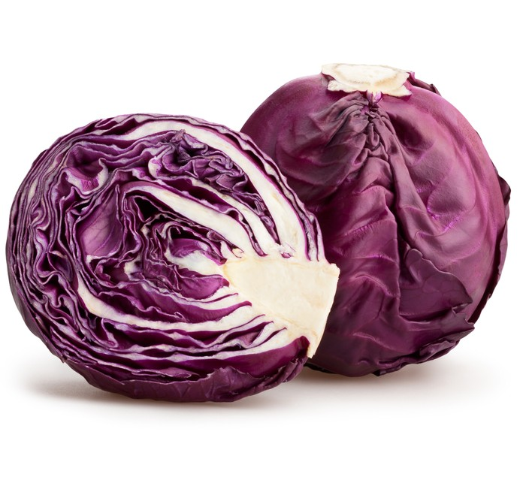
Brassica Crops

Slide 3
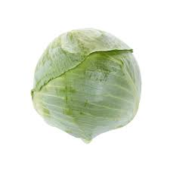
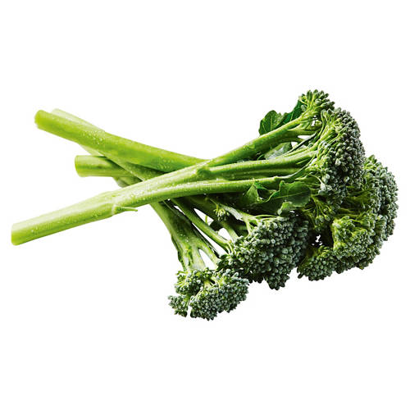
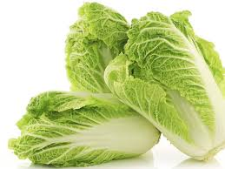
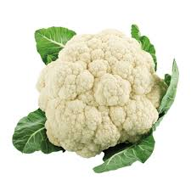
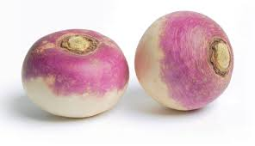
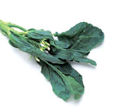
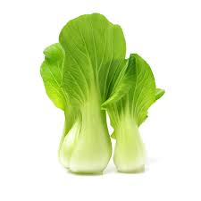
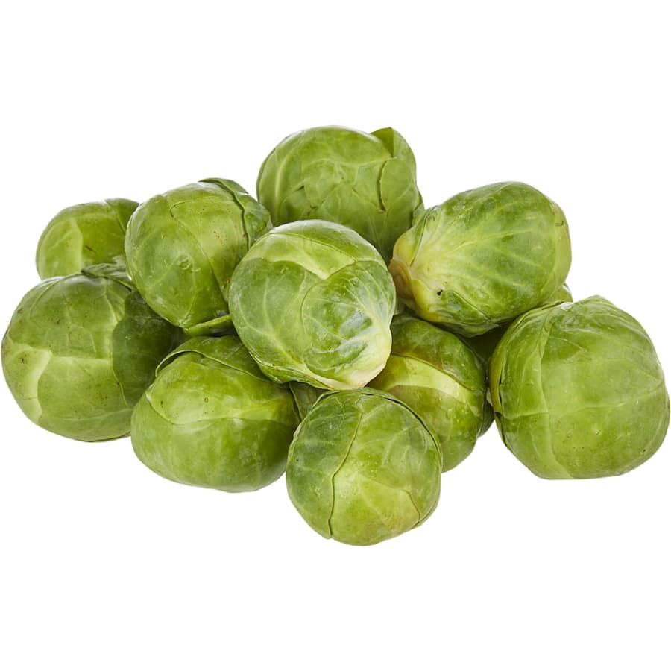
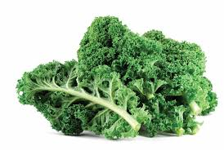
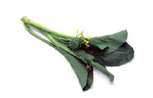
Name these vegetables

Slide 4
Answers
Chinese Cabbage
White Cabbage
Broccolini
Broccoli
Purple cauliflower
Cauliflower
Turnip
Gai lan
Red Cabbage
Bok choy
Brussel sprouts
Kale
Choi sum

Slide 5
Which of the vegetables belong to the brassica family?

Slide 6
Brassica Vegetables
All of these vegetables belong to the Brassica oleracea family or Brassica rapa.
Now
Group these vegetable under Brassica oleracea or Brassica rapa.

Slide 7
Brassica oleracea

Slide 8
Brassica rapa

Slide 9
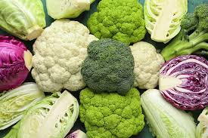
Dichotomous key
From Topic 3: Identification and classification of vegetables
Dichotomous key
A scientific tool used to identify organisms or objects
Works by choosing between two contrasting observable characteristics at each step
Helps narrow down options to correctly classify specimens
Used for identifying
Plants
Animals
Other objects or specimens
Can also identify vegetables based on the plant part we eat
  Roots
  Leaves
  Stems
  Flowers
  Fruits
  Seeds

Slide 10
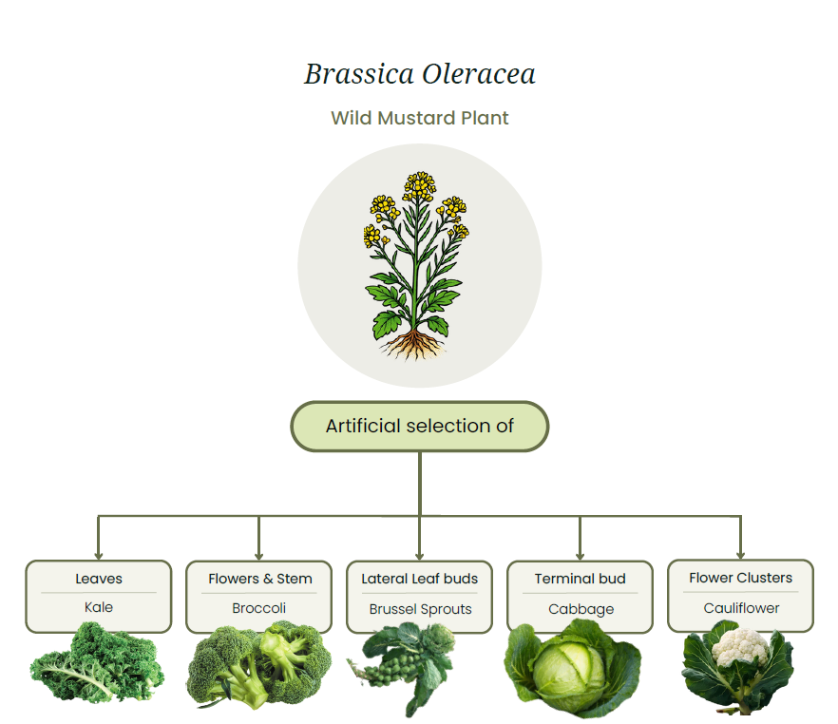
Revision activity
Students create a dichotomous key to identify vegetables in the Brassica oleracea family
  Cabbage
  Broccoli
  Cauliflower
  Kale
  Brussels Sprouts

Slide 11
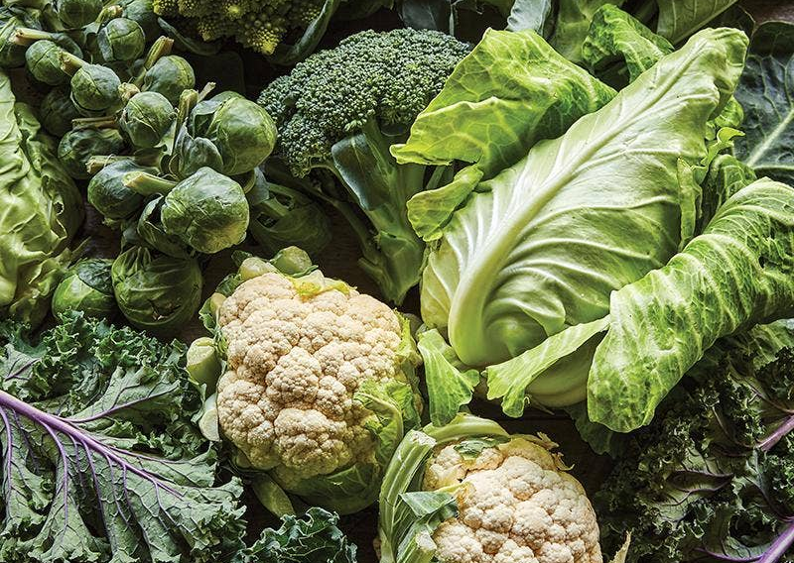
Sample answer
1a. Plant forms a tight round head of leaves → Go to 2
1b. Plant does not form a tight round head of leaves → Go to 3
2a. Large single head made of tightly packed leaves → Cabbage
2b. Small round heads growing along the stem → Brussels sprouts
3a. Plant grown mainly for its flowering head → Go to 4
3b. Plant grown mainly for its leaves → Kale
4a. Flower head is green with small buds → Broccoli
4b. Flower head is white and compact → Cauliflower

