Slide 1


Slide 2
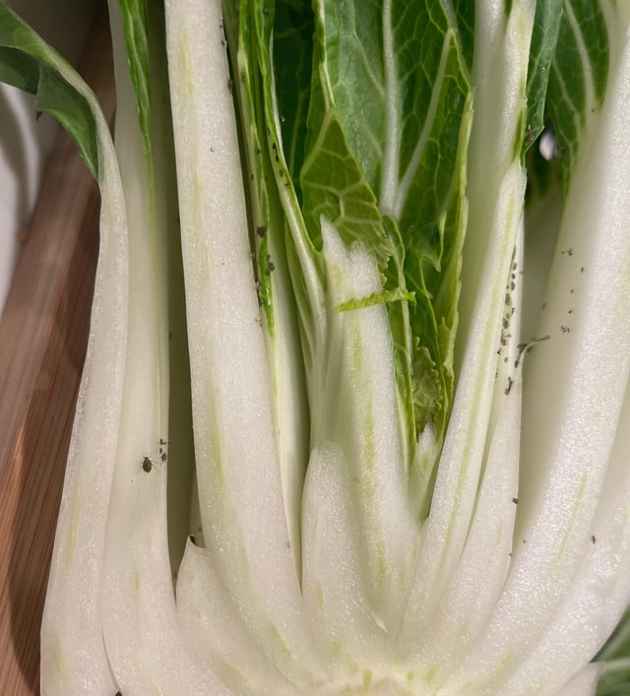
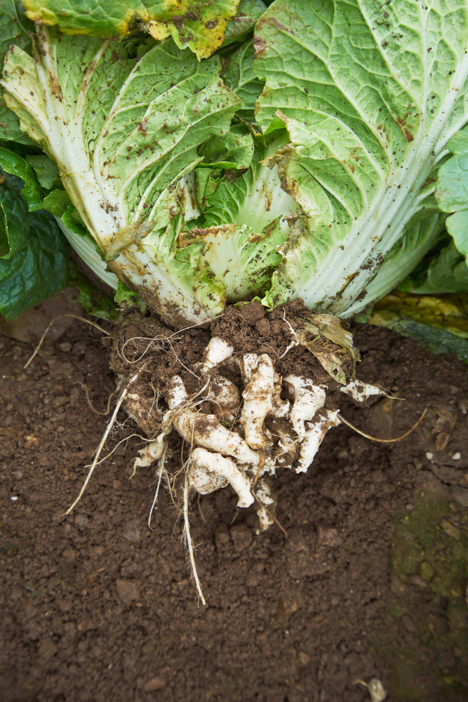
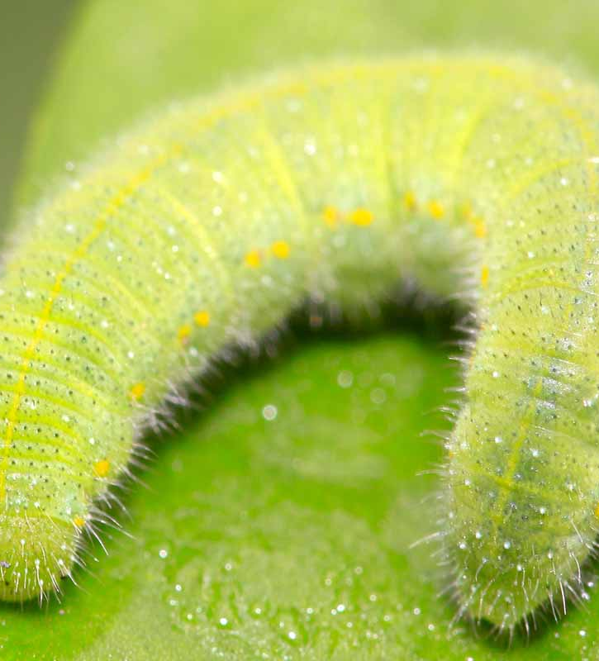
Brassica Pests and Diseases

Slide 3
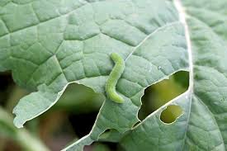
Pests and
Diseases in
Brassica Crops
Pests and diseases can:
  Reduce plant growth
  Lower crop quality
  Decrease yields
  Cause financial losses for growers
  Reduce the supply of fresh vegetables

Slide 4
Some Common Brassica
Pests
White butterfly caterpillars
Diamondback moth caterpillars
Leaf miner
Aphids
Thrips
Rabbits
Pukekos
Diseases
Clubroot
Downy Mildew
Sclerotinia
Black rot
White blister
Brown Heart / Hollow Stem

Slide 5
Integrated
Pest and Disease Management (IPDM)
IPDM is a sustainable way of managing pests and diseases by combining cultural, biological, and chemical controls. The aim is to produce healthy crops while reducing the use of pesticides and protecting the environment.
A sustainable approach that combines different strategies:
  Crop rotation
  Seedling drenching
  Scouting and monitoring pest and diseases Encouraging beneficial insects
  Careful chemical use when needed

Slide 6
Cultural Controls
Rotating crops to reduce soil-borne diseases.
Drenching seedlings
Planting resistant hybrid varieties where available.
Using good irrigation, well-drained soils, and correct plant spacing.
Regularly scouting of crops for early signs of pests or disease.

Slide 7
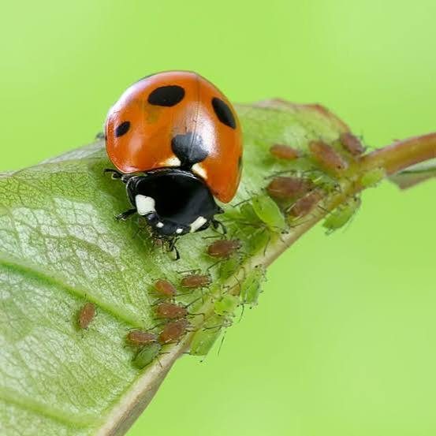
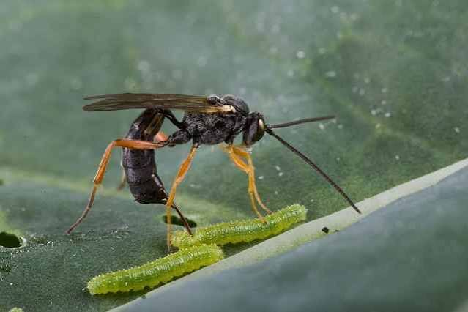
Biological Controls
Beneficial insects help keep pest numbers low.
  Ladybirds eat aphids.
  Parasitic wasps attack caterpillars such as diamondback moth.
Using beneficial insects reduces the need for chemical sprays

Slide 8
Biological Products for
Pest and Disease Management
Growers use biological products as part of an IPDM programme to help prevent and manage pests and diseases and reduce reliance on conventional pesticides. Thes biochemicals target specific pests and disease which helps protect beneficial organisms.
Examples
MycoForce – contains beneficial mycorrhizal fungi that can support root growth and nutrient and water uptake.
Aureo Gold – a BioGro-certified biological product used to help protect plants from some diseases.
Bacillus thuringiensis (Bt) – a naturally occurring bacterium used to control caterpillars and other target insect larvae.
Bacillus subtilis – a beneficial bacterium used in some products to help suppress plant diseases.
Bio-fungicides – products containing beneficial Bacillus species can help prevent or suppress some fungal and bacterial diseases.

Slide 9
Chemical Controls
Seedling drenching
Before transplanting, many growers drench seedlings selecting from a range of biological and chemical products.
Growers only apply insecticides or fungicides when pest or disease levels reach the economic threshold (the point where crop damage costs more than the cost of treatment).
Chemicals are:
Applied only when necessary.
Carefully selected for the target pest or disease.
Rotated between different modes of action to slow pesticide resistance.

Slide 10
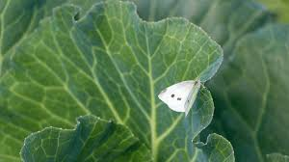
White Butterfly
(Pieris rapae)
The white cabbage butterfly commonly seen in New Zealand is a non-native pest established around 1930.
The butterfly lays eggs on brassica vegetables which hatch into velvety green caterpillars.
Caterpillars:
  Eat holes in leaves
  Skeletonise leaves
  Burrow into the heart of vegetables
Severe infestations can reduce crop quality and yield.
Control measures:
Seedling drenching prior to transplanting into the field.
Growers encourage beneficial insects such as parasitic wasps (Pteromalus puparum) that attack and kill caterpillars, helping reduce pest numbers naturally.
Use of registered and approved insecticides when required.

Slide 11
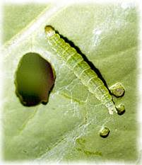
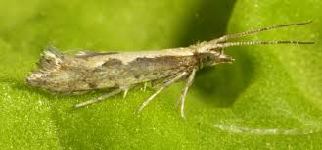
Diamondback moth
(Plutella xylostella)
The Diamondback Moth is a major pest of brassica crops causing severe damage, especially during winter and spring.
Caterpillars
Small green caterpillars (8–12 mm long).
Highly destructive feeders, create small holes in leaves.
Adult Moths
Small brown moths with diamond-shaped patterns visible on wings when resting.
Damage
Damages leaves and developing heads.
Reduces crop quality and plant growth and yield.
Management strategies
Seedling drenching prior to transplanting into the field.
Regular inspection of brassica crops is essential for detecting early signs of larvae.
Biological controls such as parasitoid wasps, lacewings, hoverflies, and ladybirds are effective for management.
IPM combining monitoring, biological control and targeted insecticides.

Slide 12
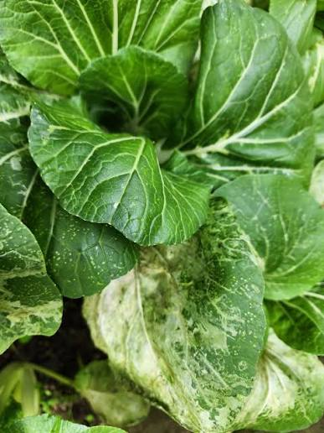
Leaf miners
Leaf miners are small fly-related pests that lay eggs inside plant leaves.
The larvae live and feed within the leaf tissue.
Damage
Create winding, silvery-white “mines” or tunnels in leaves.
Damaged areas may turn yellow.
Reduce photosynthesis.
Impact on Brassica crops
Weakens plants and reduces crop quality and yield.
Management strategies
Crop monitoring- use of sticky traps to catch adults.
Crop hygiene.

Slide 13
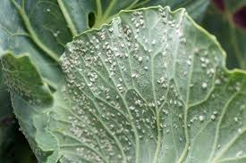
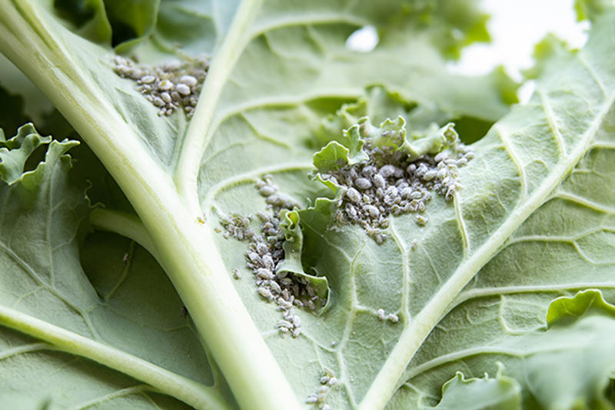
Other brassica pests
White Fly (Aleyrodes proletella)
Small white insects (about 1.5 mm long) found in clusters on the underside of leaves
Suck sap from plant leaves
Produce sticky honeydew
Lead to the growth of black sooty mould on leaves
Impact on Crops
Weakens plant growth
Reduces photosynthesis
Makes leaves dirty and less marketable
Can lower crop quality and yield
Aphids (Brevicoryne brassicae)
Small pests about 2 mm long, grey-green in colour with a waxy, dusty appearance
Found in dense colonies common on the undersides of leaves and new plant growth
Suck sap from plant tissues causing leaves to:
  Curl
  Turn yellow
  Become stunted in growth
Reduce overall plant health
Can spread plant viruses such as Turnip Mosaic Virus

Slide 14
Clubroot
(Plasmodiophora brassicae)
Clubroot is a severe soil-borne pathogen affecting brassicas
It thrives in acidic, wet soils and can persist for up to 10–20 years
Damage
Stunted plant growth
Wilting plants (especially in warm weather)
Swollen, deformed roots (“club-like” roots)
Poor nutrient and water uptake
Management Strategies
Strict farm hygiene (clean tools and equipment)
Liming soil to increase pH 7.0-7.5
Long crop rotations (avoid brassicas in affected soil for years)
Using clubroot-tolerant varieties where available

Slide 15
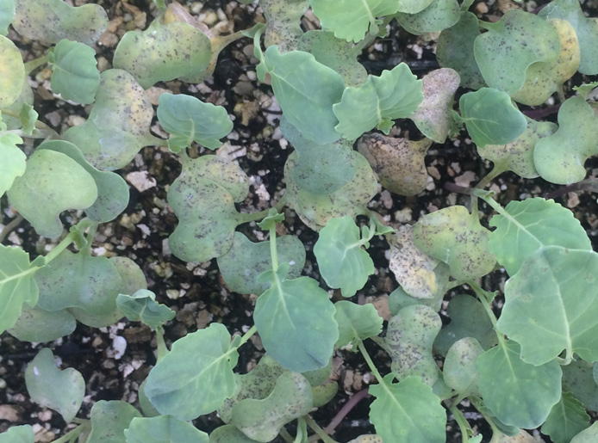
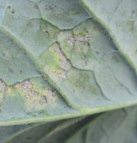
Downy Mildew
Hyaloperonospora brassicae
A common disease of brassica crops such as broccoli, cabbage, cauliflower, kale, and bok choy.
Develops in cool (8–16°C) and wet or humid conditions.
Symptoms
Seedlings
  White, fluffy mould on the underside of leaves.
  Black speckles and puckered leaves which may die and fall off.
Mature plants
  Yellow or grey angular spots on the upper leaf surface.
  Yellowing of older leaves.
Spread
Spores are spread by wind and water droplets.
Thrives in high humidity, dew, fog, and rain.
Can survive in, infected crop debris and weeds.
Management strategies
Space plants to improve air movement and help leaves dry quickly.
Rotate brassica crops for 2–3 years before planting in the same field
Manage timing of irrigation
Apply preventative fungicides when weather conditions favour disease.

Slide 16
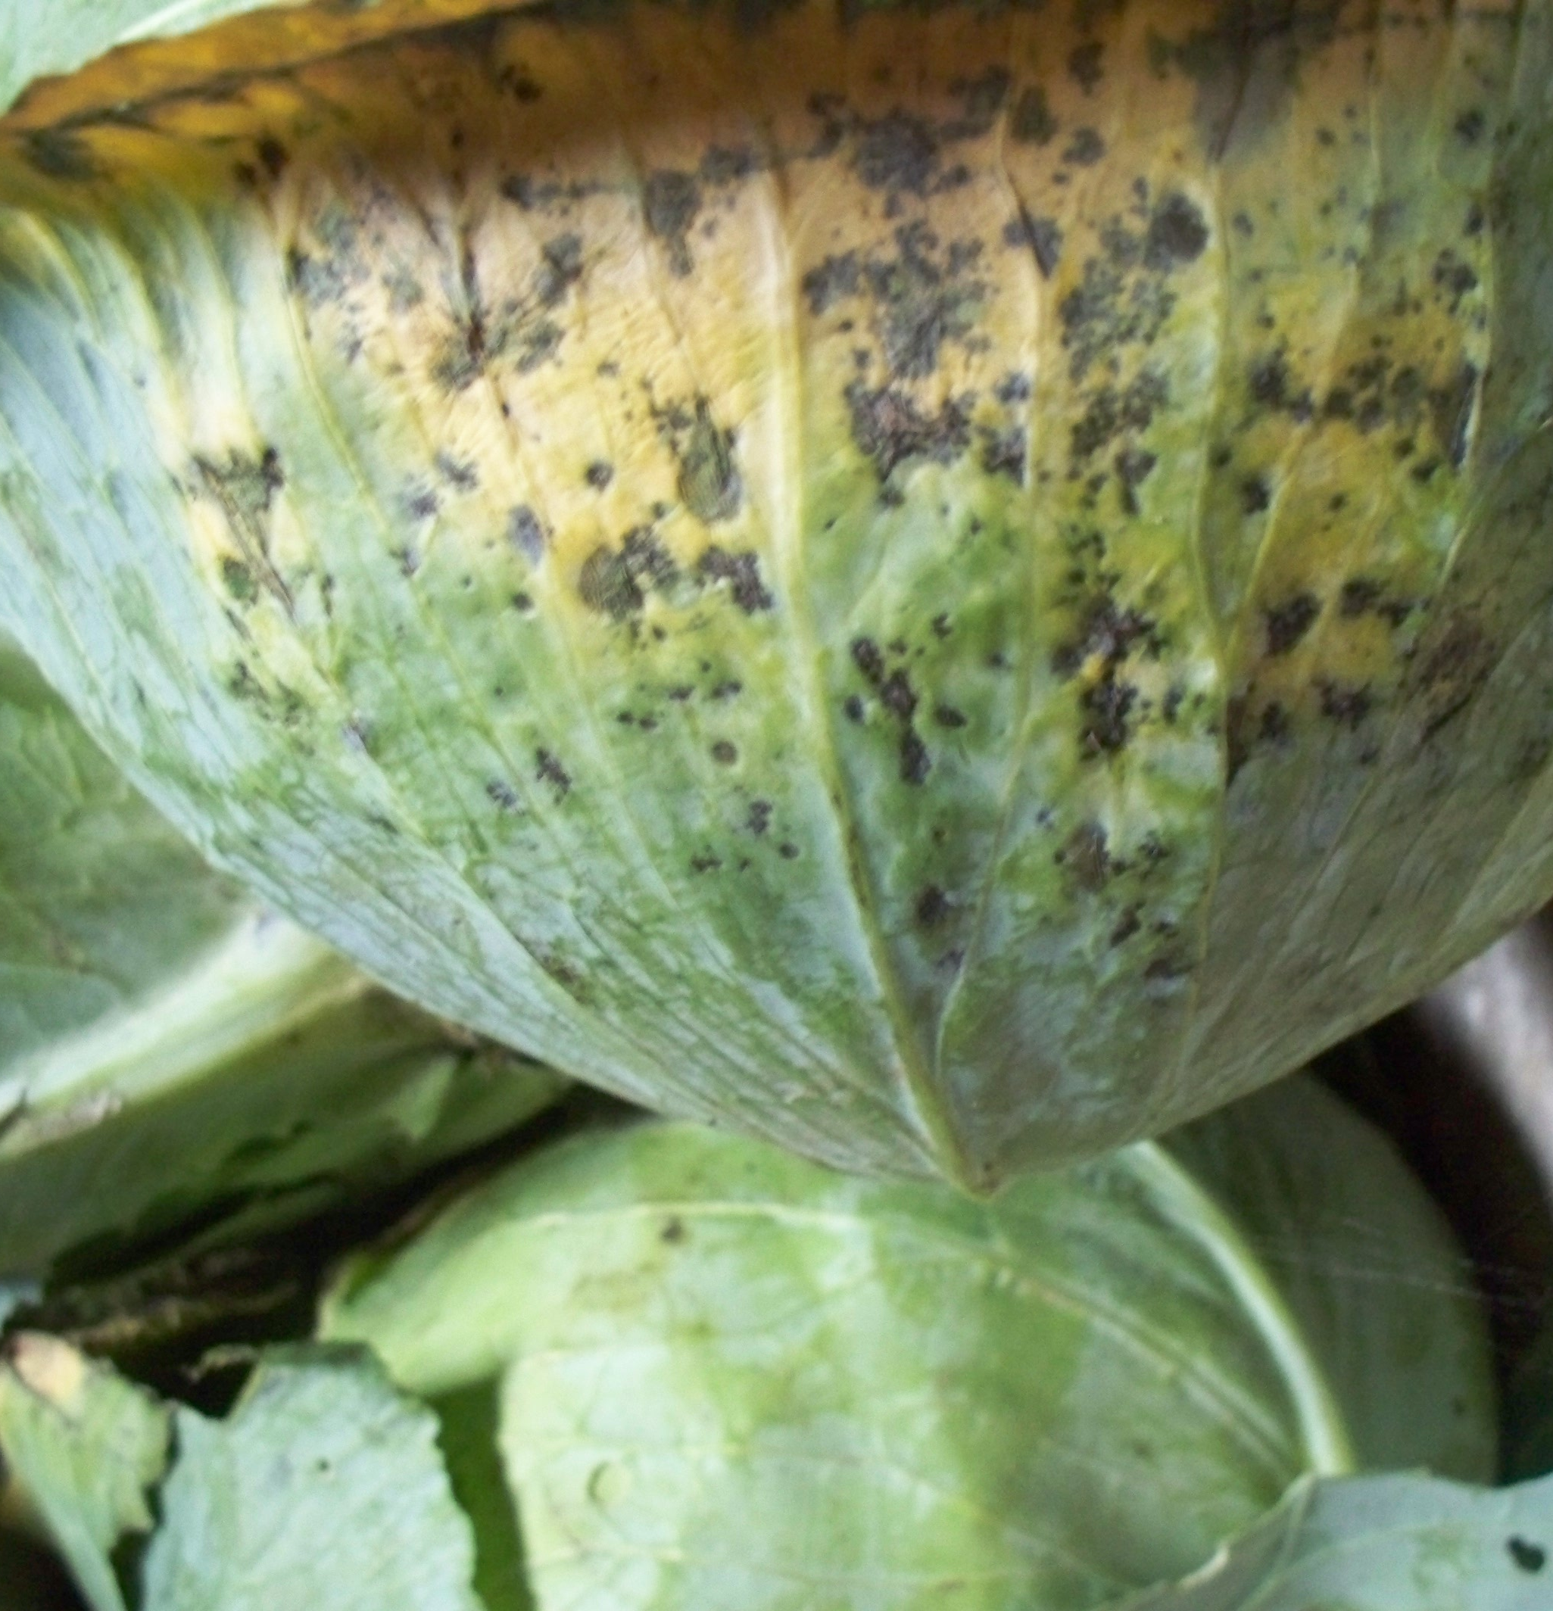
Alternaria leaf spot
Alternaria brassicicola and Alternaria brassicae.
A fungal disease that affects broccoli, cabbage, cauliflower, kale, and other brassicas.
Reduces crop quality and yield.
Symptoms
Black or brown leaf spots with target-like rings.
Yellow halos around leaf spots.
Dark sunken spots on broccoli heads and cauliflower curds.
Older leaves turn yellow, dry up, and fall off.
Spreads
Thrives in warm (15–25°C), wet, and humid conditions.
Spread by infected seed, crop debris, weeds, wind, rain splash, irrigation, and insects.
Management strategies
Plant certified disease-free seed.
Rotate brassica crops for at least 3-4 years.
Remove or bury infected crop residues after harvest.
Apply protective fungicides when disease risk is high.

Slide 17
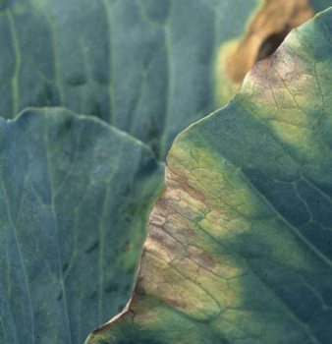
Black Rot
Xanthomonas campestris pv. campestris
A bacterial disease that affects broccoli, cabbage, cauliflower, kale, and other brassicas.
Spreads through infected seed, water splash, and crop debris.
Can greatly reduce crop growth and yield.
Symptoms
V-shaped yellow or brown patches on leaf edges.
Black veins inside infected leaves.
Dark rings or black staining inside stems.
Yellow leaves that drop early, causing plants to become stunted.
Management strategies
Use certified disease-free seed.
Rotate brassica crops for 3–4 years.
Remove and destroy infected crop residues.
Avoid working with wet plants to reduce spread.

Slide 18
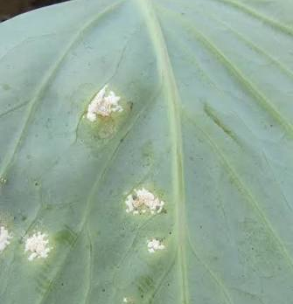
White blisters
Albugo candida
A disease caused by a fungus-like organism that affects brassica crops such as bok choy.
Favoured by cool, wet and humid conditions.
Symptoms
Raised white or cream-coloured blisters develop, often on the underside of leaves.
Blisters can also occur on stems and leaf stalks.
The blisters may burst and release a powdery mass of white spores.
Pale yellow or purplish patches may appear on the upper surface of the leaf.
Management Strategies
Crop rotation - avoid growing brassicas in the same area year after year.
Plant spacing to allow good air movement through the crop.
Reduce leaf wetness.
Use approved fungicides when necessary.

Slide 19
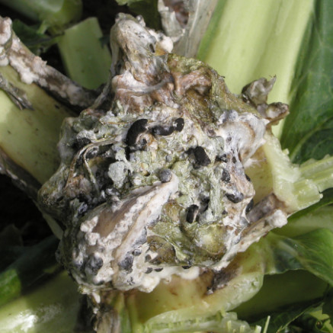
Sclerotinia
Sclerotinia sclerotiorum
A fungal disease that can affect brassica crops such as broccoli, cabbage and cauliflower.
The fungus survives in soil as hard, black structures called sclerotia for several years.
Symptoms
Water-soaked lesions – dark, wet-looking patches develop on stems or leaves.
White mould – fluffy white fungal growth appears in damp conditions.
Black sclerotia – hard, black structures form on or inside infected plant tissue.
Wilting and collapse – infected plants may wilt, yellow and collapse.
Management Strategies
Crop rotation – avoid susceptible crops for 3–4 years where practical; include cereals or grasses.
Manage plant density – avoid overly dense growth to improve air movement and reduce humidity.
Fungicides – used registered and approved chemicals when required.

