Slide 1


Slide 2
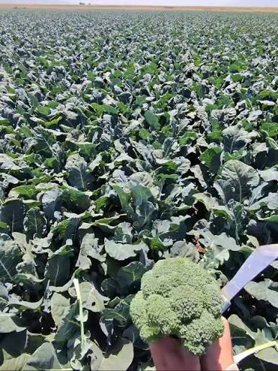
Broccoli cultivars

Slide 3
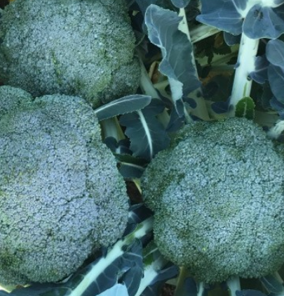
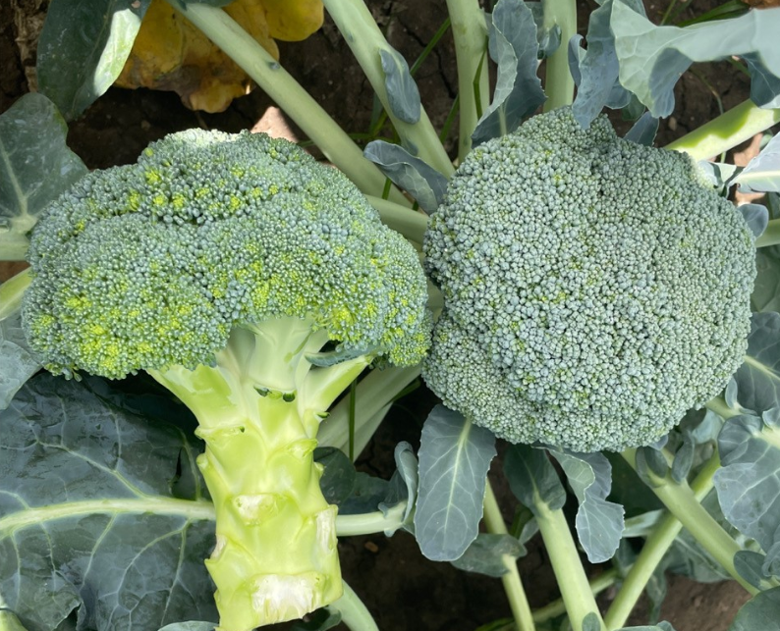
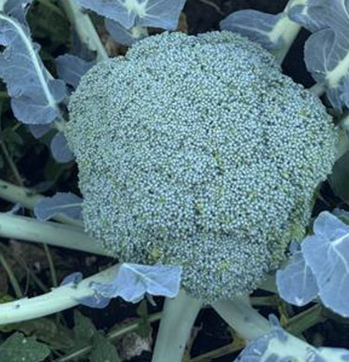
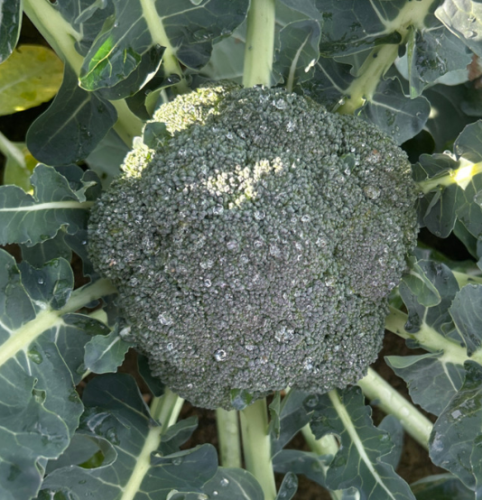
Are these broccoli all the same?

Slide 4
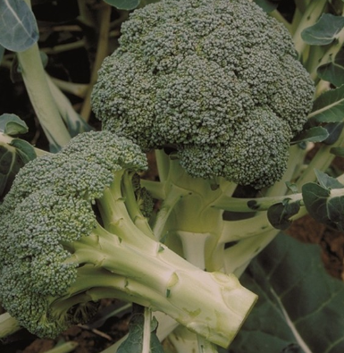
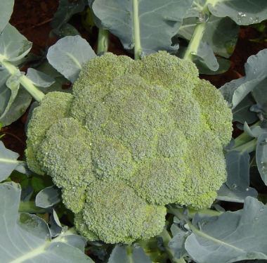
Broccoli cultivars
Similar appearance, but each cultivar hybrid has different characteristics.
Bred for disease resistance and strong crop performance.
Selected for different growing seasons and climates.
Allows staggered planting and harvesting throughout the year.
Ensures a consistent supply of high-quality broccoli to meet market demand year-round.

Slide 5
Hybrid
A hybrid is a plant that is produced by crossing two carefully selected parent plants to combine their best characteristics.
Hybrid broccoli varieties are bred to produce stronger, more uniform plants with higher yields, better disease resistance, and improved quality, but,
seeds saved from hybrid plants will not grow into identical plants.

Slide 6
Mclaren F1
Warm-season broccoli variety.
Features TopRes clubroot resistance.
One of the first commercial clubroot-resistant varieties in Australia and New Zealand.
Tight, firm, dark green heads with good heat tolerance.
Strong, vigorous, upright plants.
Uniform maturity and excellent head quality.
Easy to harvest and well suited to growers, especially where clubroot is a problem.
Watch:
Fairbanks Seeds - McLaren Broccoli, Clubroot resistance variety https://www.youtube.com/watch?v=g-y1xNT4Ukc&t=10s

Slide 7
Beany F1
A cool season broccoli from Syngenta with excellent uniformity to maturity and a wide harvest period.
Beany has a medium sized plant with a stem that is easy to trim at harvest.
Dome shaped, dense, firm heads with good field holding ability.

Slide 8
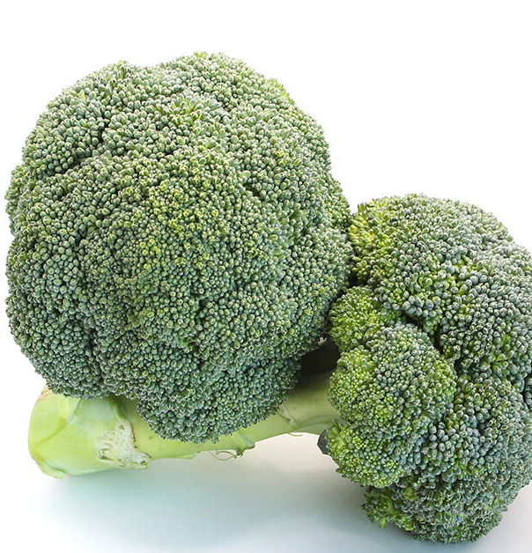
Denali F1
Denali is a broccoli variety that grows well during hot summer weather. It is specially bred to produce high-quality heads even when temperatures are warmer.
Key Features
Excellent heat tolerance.
Best for summer and early autumn growing.
Green-blue, tightly packed, domed heads.
Fine-sized flower buds (beads).
Ready to harvest in 10–14 weeks.
Main harvest season: January to April.
Keeps well after harvest, making it good for transport to markets.

Slide 9
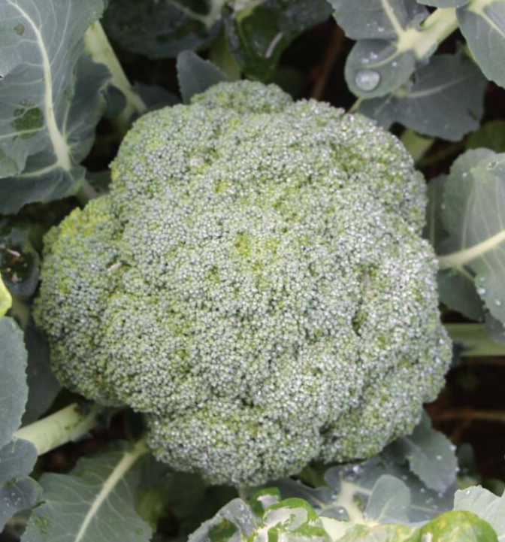
Brumby F1
Brumby is a versatile broccoli cultivar suited to summer and autumn production because of its heat tolerance, strong growth and good head quality.
Key features
Strong plant growth – large, tall plants with good vigour.
Heat tolerant – performs well in summer.
Autumn performance – continues growing in cooler conditions.
Good head quality – fine bead size and green/blue-green colour.
Head protection – tall leaves help protect the broccoli head from strong summer sun.
Good holding ability – heads can remain in good condition before harvest.
Maturity: approximately 9–13 weeks.
Growing considerations
Susceptible to blindness – plants may fail to produce a normal head.
Avoid over-fertilising – Brumby has naturally strong plant vigour and may not need extra nutrients.

Slide 10
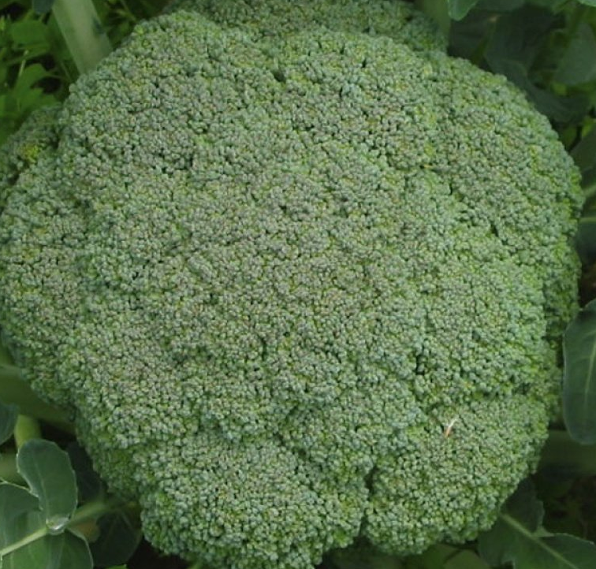
Medley F1
Medley is a versatile broccoli cultivar that performs well across cooler seasons and produces large, high-quality heads with good shelf life.
Key Features
Adaptable – grows well in both warm and cool conditions.
Long harvest window – suited to autumn, winter and spring production.
Excellent head quality – fine bead size and mid-green colour.
Large heads – can grow to a large size without florets becoming loose.
Good shelf life – harvested broccoli stays in good condition.
High marketable yield – produces a high proportion of saleable heads.
Maturity: approximately 15–20 weeks.
7–10 days later to mature than Marathon and Legacy.
Growing considerations
Susceptible to blindness – plants may fail to produce a normal head.
May need extra trimming depending on growing conditions and market requirements.

Slide 11
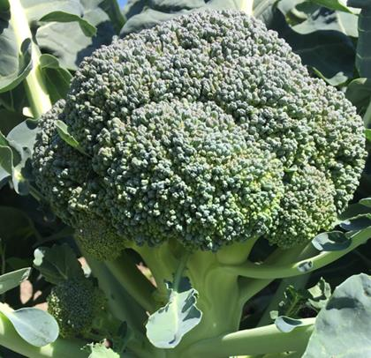
Marques F1
Very adaptable for autumn to spring harvest.
Medium dome with a medium fine bead.
Medium dark green head of good size.
Compact plant with minimal stem trimming required.
Maturity 75-85 days from transplant depending on location.

Slide 12
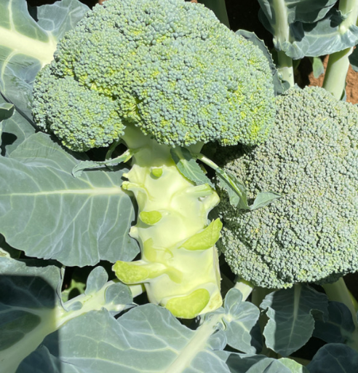
Gongga F1
A warm season broccoli with exceptional uniformity.
Has a tight firm holding heads, with excellent bead uniformity.
Medium green head colour on a sturdy upright plant with good vigour.
Exciting variety with excellent overall head quality.

Slide 13
Monaco F1
New broccoli variety suited to cool-season and spring production.
Medium to large, upright plants for easy harvesting.
High-domed, smooth, dark green heads.
Excellent bead uniformity and firm head quality.
Produces consistent, high-quality heads for the fresh market.

Slide 14
Kingy F1
A year round hybrid broccoli from Syngenta with strong heat tolerance.
Fantastic quality smooth heads, with head weight and size equal to current standards.
Dome shaped heads with great uniformity.
Large plant frame, with a semi-upright habit.

Slide 15
Legacy
Reliable variety for cool-season production.
Strong early vigour, even in cold conditions.
Uniform plant growth and maturity.
Fine-beaded, dome-shaped, dark green heads.
Good stem thickness and excellent overall quality.

Slide 16
Heritage
Excellent holding ability in the field.
Maintains deep green colour when other varieties begin to purple.
Firm, uniform heads with good shelf life.
Well suited to the late-spring transition season.
Produces high-quality heads for the fresh market.

Slide 17
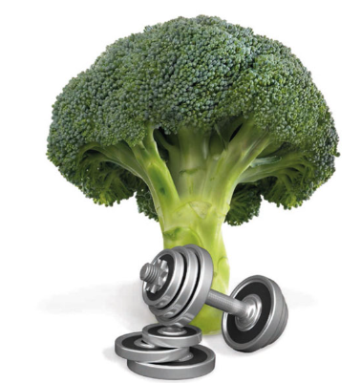
Titanium
Best suited for July to mid-October harvests in Pukekohe.
Firm, fine-beaded heads with reduced water damage and head rot.
Long, clean stems for quick and easy harvesting.
Highly uniform maturity, reducing the number of harvest passes.
Can lower labour costs and improve harvesting efficiency.

Slide 18
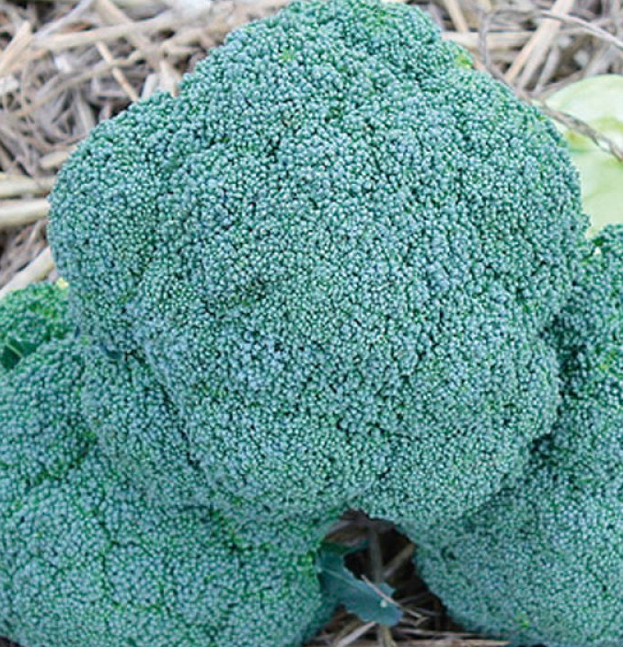
Marathon
Marathon is one of the most popular broccoli varieties grown in New Zealand. It grows well in many parts of the country, especially during the cooler months.
Key Features
Produces uniform, good-quality heads.
Reliable in different weather conditions.
Blue-green head colour.
Medium-sized flower buds (beads).
Best grown for winter and spring harvests.
Ready to harvest in 14–18 weeks.
Main harvest season: July to November.
Performs especially well in the South Island during winter.

Slide 19
Test yourself quiz
Write True or False beside each statement.
 | Statement | True or False
1 | Hybrid plants are produced by crossing two carefully selected parent plants.
2 | Commercial growers usually save seed from hybrid broccoli plants to plant the following season.
3 | Some hybrid broccoli varieties are bred to tolerate warm conditions.
4 | All hybrid broccoli varieties are exactly the same
5 | Uniform plants allow growers to harvest crops more efficiently.

Slide 20
Test yourself quiz
Answers
 | Statement | True or False
1 | Hybrid plants are produced by crossing two carefully selected parent plants. | True
2 | Commercial growers usually save seed from hybrid broccoli plants to plant the following season. | False
3 | Some hybrid broccoli varieties are bred to tolerate warm conditions. | True
4 | All hybrid broccoli varieties are exactly the same | False
5 | Uniform plants allow growers to harvest crops more efficiently. | True

Slide 21
References
Bayer Vegetables New Zealand
https://www.vegetables.bayer.com/nz/en-nz/products/broccoli.html
Fairbanks Seeds
https://fairbanks.co.nz/products/brassica/broccoli/
South Pacific Seeds NZ
https://www.spsnz.com/our-products/broccoli
Lefroy Valley
https://lefroyvalley.co.nz/products/broccoli-marquez

