Slide 1


Slide 2
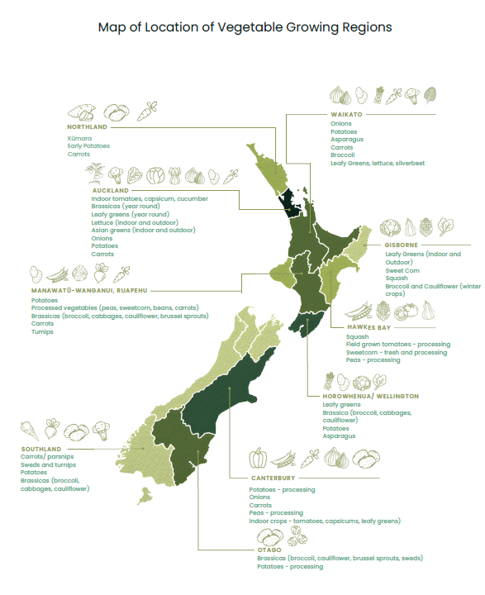
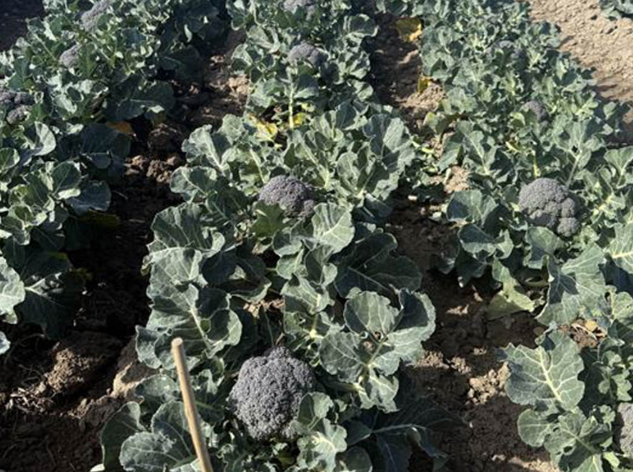
Growing Broccoli

Slide 3
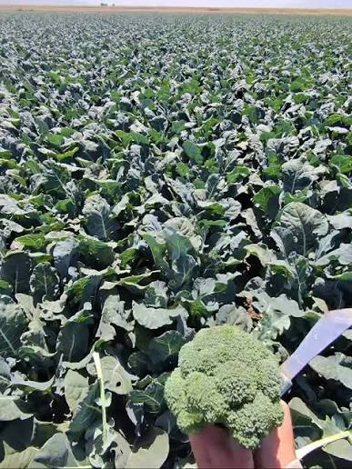
Calendar of operations
Site Selection to Harvest
Covers the main stages of commercial broccoli production, from site selection to harvest.
Based on one crop cycle, which is repeated 2-3 times per week to ensure a continuous year-round supply.
Seedling transplanting:
  Summer: ~5 weeks old (faster growth in warm temperatures)
  Winter: ~10weeks old (slower growth in cooler temperatures)
Watch: Broccoli -Planting to plate https://www.youtube.com/watch?v=lUYdOYKFi1o

Slide 4
Broccoli Crop Calendar of Operations
(Seedlings transplanted 2-3 per week to ensure year-round supply)
Cultivar selection
Use integrated pest management practices to control weeds, pests and diseases
Drench Seedling
Seedlings
(5-10 weeks)
Sowing seed into trays
Monitor crops for pests and diseases
Site Selection
Pre emergence herbicide
Pre- planting
Planting
Growing
70-100 days
Harvesting
Soil test
Cultivation
Seedbed preparation
irrigation
Spraying
Hand harvest
daily
Lime added based on pH
Add required fertiliser for crop needs.
Apply fertilise as side dressing based on herbage tests

Slide 5
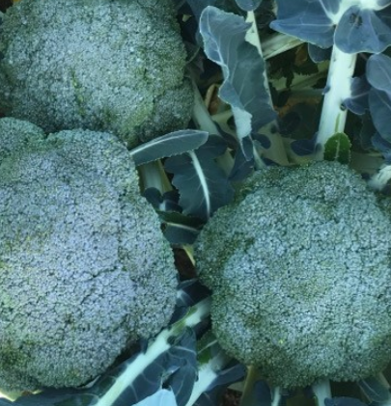
Cultivar Selection for Year-Round Supply
Beany F1
Commercial growers generally use hybrid cultivars because they can provide:
  More uniform plants
  Consistent head size and quality
  High marketable yields
  Improved resistance or tolerance to some diseases and environmental stresses
Using several cultivars helps growers spread production risk and maintain a consistent supply when weather conditions change.
PPT Broccoli cultivars.
Do: Test yourself quiz

Slide 6
Site Selection
Growers carefully select fields as part of a crop rotation programme.
Crop rotation
Avoid growing broccoli and other Brassica crops in the same field too frequently.
A 3–4 year rotation can help reduce the build-up of soil-borne pests and diseases, particularly clubroot.
Rotation also helps maintain soil health and reduce disease problems in other crops.
Before planting
Soil is tested each year, well before planting begins.
Tests measure soil pH and nutrient levels.
A technical adviser uses the soil test results, crop requirements and expected yield to recommend the appropriate fertiliser programme.

Slide 7
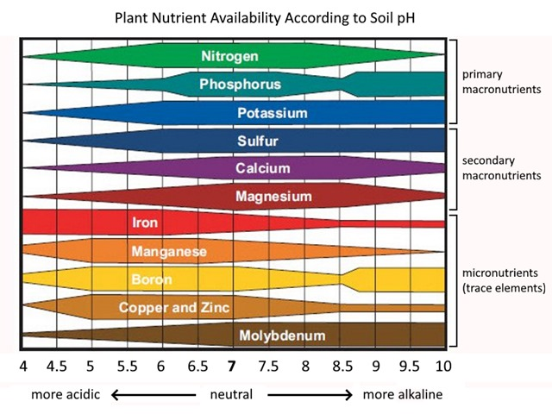
Managing soil pH
Target soil pH: approximately 7.0–7.5.
Maintaining a higher soil pH can also create conditions that are less favourable for clubroot.
If the soil is too acidic, lime may be applied to raise the pH.

Slide 8
Seedbed preparation
Soil is cultivated into fine, firm, raised seedbeds before transplanting.
Bed size and shape depend on the machinery and equipment available.
Well-prepared seedbeds promote:
  Rapid seedling establishment and strong root development.
Base fertiliser
Before planting, growers apply a base fertiliser based on soil test results.
The fertiliser supplies:
  Macronutrients – needed in larger amounts.
  Micronutrients – needed in smaller amounts.

Slide 9
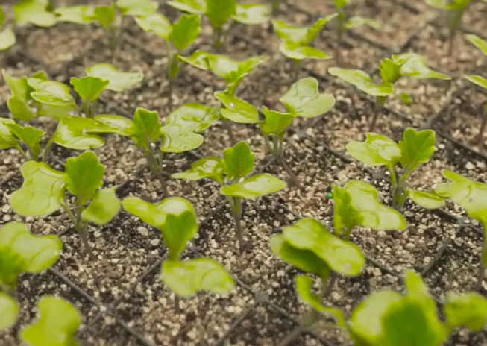
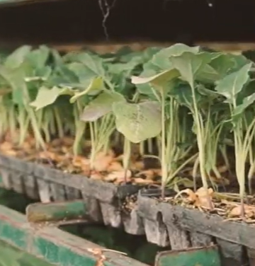
Seedlings
Broccoli is grown from seedlings, not direct seeding.
Seedlings are raised in trays using disease-free seed by commercial nurseries or growers.

Slide 10
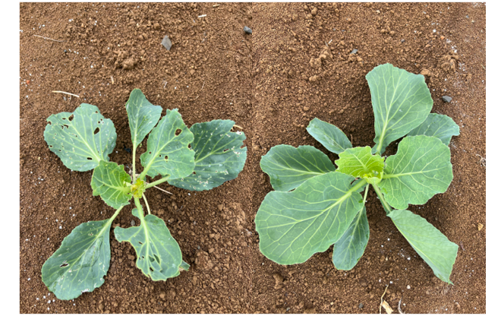
Drenching seedlings
Seedling drenches are one tool growers can use to protect young plants as part of an IPDM programme.
A seedling drench is a liquid treatment applied to the growing medium in a seedling tray before transplanting.
The treatment is absorbed by the roots and can help protect young seedlings from pests and diseases.
Untreated vs DURIVO® treated

Slide 11
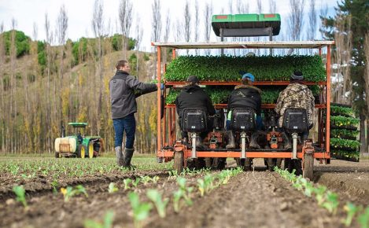
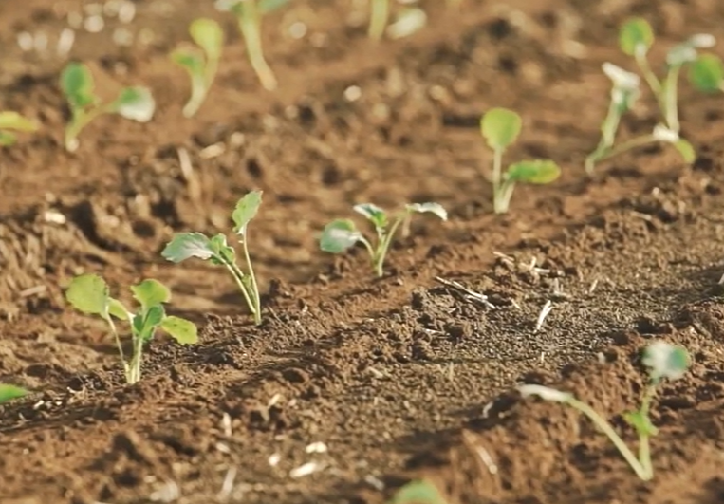
Transplanting seedlings
Seedlings are transplanted:
  At 5–10 weeks old, when they have 4–6 true leaves.
  Using mechanical transplanters to plant quickly and accurately.
  Workers check plants to ensure correct position and spacing.
Plant spacing
  Spacing varies with cultivar, season and desired head size.
    35–45 cm between plants.
    45–50 cm between rows.
At transplanting
  Water and nutrients applied to reduce transplant stress, settle the soil around the roots and support rapid establishment.
  Irrigation helps ensure good root-to-soil contact and provides moisture for early growth.

Slide 12
Nutrient management
Broccoli needs a balanced supply of nutrients for strong growth and high-quality heads.
Fertiliser management
Soil testing identifies nutrient requirements.
Fertiliser is applied at the correct rate based on soil test results and crop needs.
A base dressing is applied before or at planting.
Additional side dressings are applied as the crop grows.
  Summer crops may receive 2 side dressings.
  Winter crops may receive up to 3 side dressings.

Slide 13
Irrigation management
Broccoli has a relatively shallow root system and requires a consistent supply of soil moisture for healthy growth. Water stress can reduce plant growth, head size and yield.
Efficient irrigation helps growers:
provide the crop with enough water for healthy growth.
maintain consistent soil moisture.
reduce water wastage and runoff.
use soil moisture and weather data to make better irrigation decisions.
maintain crop quality and yield.

Slide 14
Pest and disease management
Brassica crops are vulnerable to a range of insect pests, diseases, that can reduce plant growth, lower crop quality, and decrease yields.
See PPT Brassica Pests & Diseases
Some Common Brassica
Pests | Diseases
White butterfly caterpillars Diamondback moth caterpillars Leaf miner Aphids Thrips Rabbits Pukekos | Clubroot Downy Mildew Sclerotinia Black rot White blister Brown Heart / Hollow Stem

Slide 15
Weed management
Weeds compete with broccoli for:
  Water
  Nutrients
  Sunlight
  Growing space
Competition can lead to smaller plants, smaller broccoli heads and lower yields.
Weeds can also provide a place for pests and diseases to survive.
Managing weeds
  Prepare a good seedbed for healthy plant establishment.
  Apply pre-plant herbicides to control weeds before broccoli is transplanted.

Slide 16
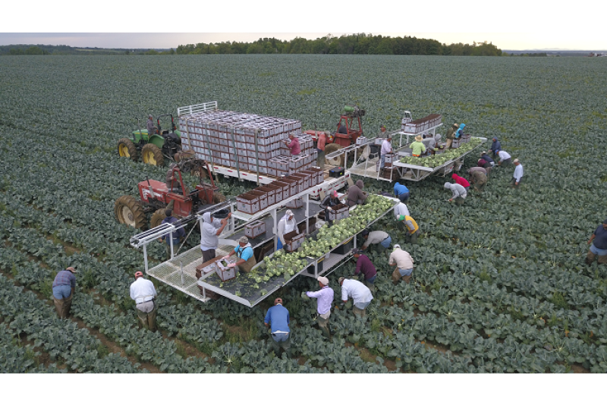
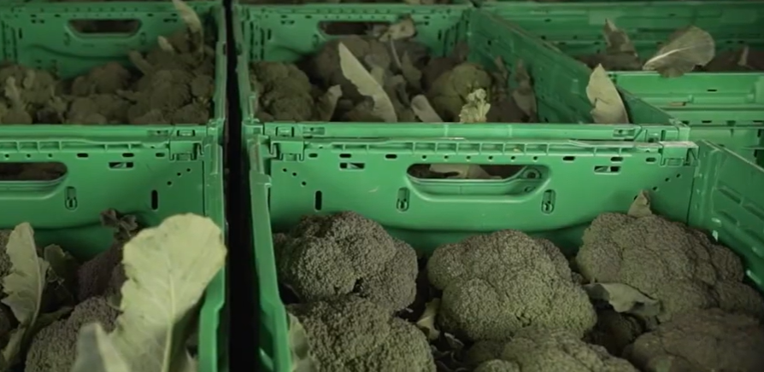
Harvesting
Broccoli is hand-harvested into crates.
Harvesting takes place five days a week to provide a regular supply of fresh produce.
Workers select heads that meet market standards for:
  Size
  Colour
  Shape
  Quality
Marketable Yield
Growers aim to harvest as many marketable heads as possible.
Typically, 80–90% of harvested heads meet the required market standards.

Slide 17
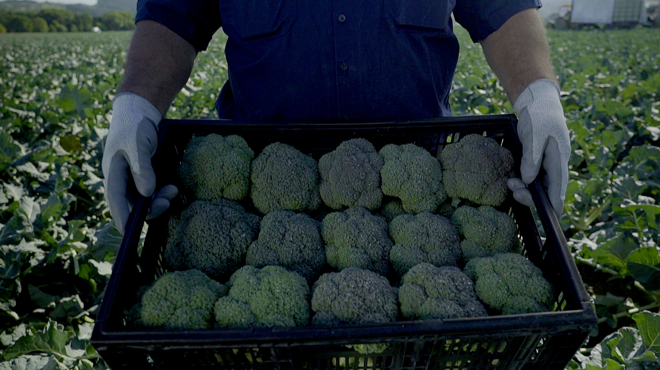
Packhouse and Distribution
After Harvest
Broccoli is transported quickly to the packhouse.
It is rapidly cooled to maintain freshness and quality.
Cooling also helps extend shelf life before the broccoli reaches consumers.

Slide 18
Test yourself quiz
1. Why do growers avoid planting broccoli in the same field every year?
  A) It makes the soil too wet
  B) It leads to the build-up of soil-borne pests and diseases like clubroot
  C) Broccoli plants absorb too much sunlight
  D) It causes the crop to grow too quickly
2. What ideal soil pH range helps broccoli grow best and reduces the risk of clubroot disease?
  A) 4.5 – 5.5
  B) 5.5 – 6.0
  C) 7.0 – 7.5
  D) 8.5 – 9.0
3. What can a grower apply to acidic soil before planting to raise the soil pH?
  A) Sand
  B) Lime
  C) Water
  D) Nitrogen
4. Why are crop drenches applied to seedling trays before transplanting?
  A) To make the plants change colour
  B) To protect young plants from early pests and diseases
  C) To make the plants grow faster
  D) To stop the plants from needing water
5. What is the main benefit of forming raised soil beds before planting?
  A) It keeps the soil completely dry at all times
  B) It improves soil drainage and reduces the risk of waterlogging
  C) It prevents all weeds from growing
  D) It speeds up hand-harvesting
6. What does Integrated Pest and Disease Management (IPDM) combine to protect crops?
  A) Water and fertilizer only
  B) Cultural, biological, and chemical control methods
  C) Irrigation and spraying
  D) Lime, weed sprays and side dressings

Slide 19
Answers
1. Why do growers avoid planting broccoli in the same field every year?
  A) It makes the soil too wet
  B) It leads to the build-up of soil-borne pests and diseases like clubroot
  C) Broccoli plants absorb too much sunlight
  D) It causes the crop to grow too quickly
2. What ideal soil pH range helps broccoli grow best and reduces the risk of clubroot disease?
  A) 4.5 – 5.5
  B) 5.5 – 6.0
  C) 7.0 – 7.5
  D) 8.5 – 9.0
3. What can a grower apply to acidic soil before planting to raise the soil pH?
  A) Sand
  B) Lime
  C) Water
  D) Nitrogen
4. Why are crop drenches applied to seedling trays before transplanting?
  A) To make the plants change colour
  B) To protect young plants from early pests and diseases
  C) To make the plants grow faster
  D) To stop the plants from needing water
5. What is the main benefit of forming raised soil beds before planting?
  A) It keeps the soil completely dry at all times
  B) It improves soil drainage and reduces the risk of waterlogging
  C) It prevents all weeds from growing
  D) It speeds up hand-harvesting
6. What does Integrated Pest and Disease Management (IPDM) combine to protect crops?
  A) Water and fertilizer only
  B) Cultural, biological, and chemical control methods
  C) Irrigation and spraying
  D) Lime, weed sprays and side dressings

Slide 20
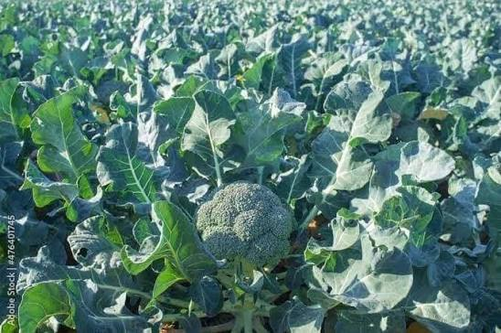
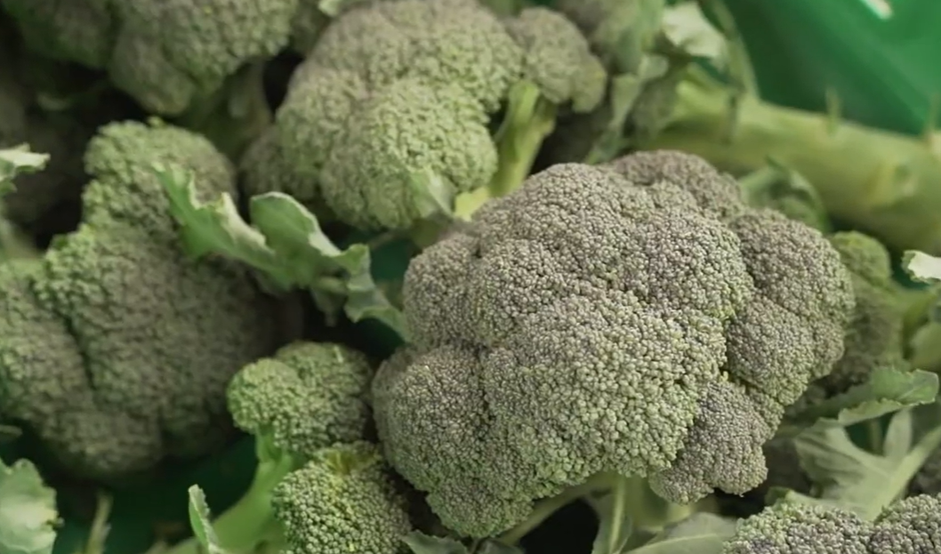
Activity 2: Careers growing broccoli.

Slide 21
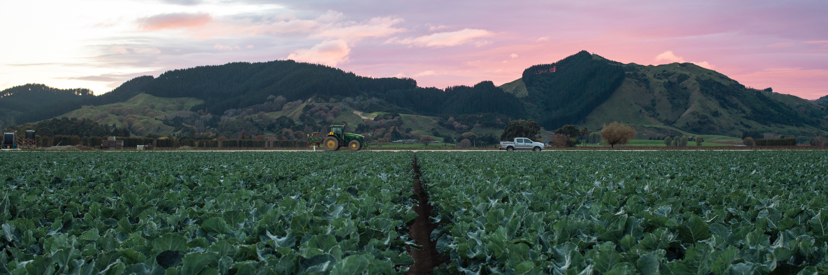
Acknowledgements
We gratefully acknowledge Leaderbrand for sharing their expertise, practical knowledge and guidance on the commercial production of broccoli to support the development of these resources.

