Slide 1


Slide 2
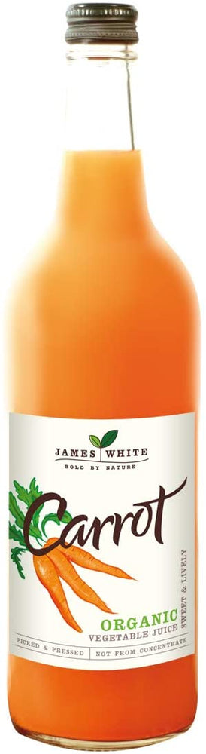
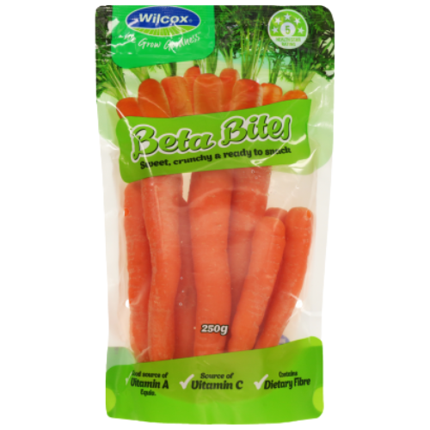

Carrots Markets
Fresh and Processing

Slide 3
Domestic retail market quality requirements
Uniform, long cylindrical shape
Consistent size
Bright orange colour
Smooth, blemish-free skin
Free from defects (cracks, splits, damage)

Slide 4
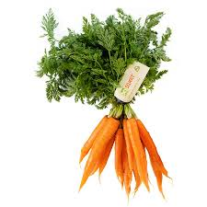
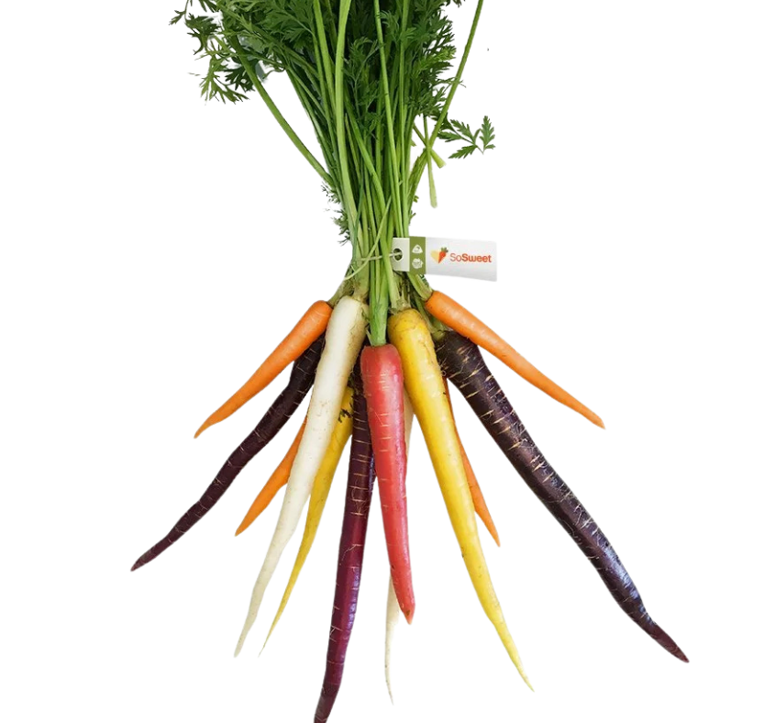
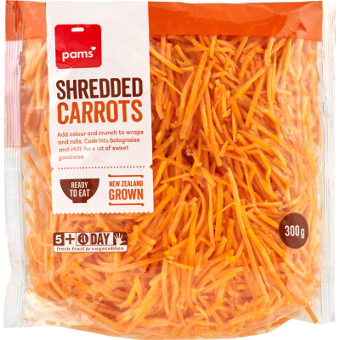
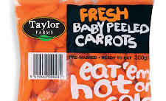
Changing consumer trends
Popular options include peeled, shredded, and baby-cut carrots
  Quick to prepare or ready to eat, suiting busy lifestyles
Carrot bunches (smaller carrots with tops attached) are popular for their fresh appearance
  Can be eaten fresh or cooked whole
Carrots are a common inclusion in vegetable delivery boxes, such as bargain or “wonky” boxes, which promote value and reduce food waste

Slide 5
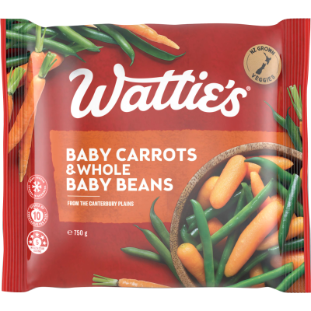
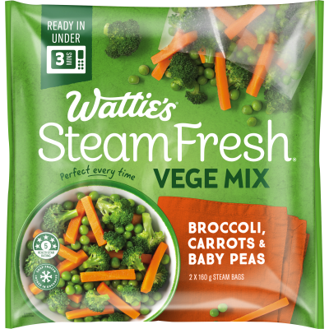
Carrot Process Market
Used in products such as frozen foods, baby food, and concentrated juice
Grown under contract with processors like Wattie’s and Juice Products New Zealand
Contracts are signed before planting, giving growers certainty
Contract details usually include:
Variety of carrot to be planted
Required harvest time
Price paid per tonne
Quality and supply conditions:
Must meet quality standards (e.g. free from major defects and diseases)
Sugar content (Brix level) requirements
Agreed quantity the processor will purchase

Slide 6

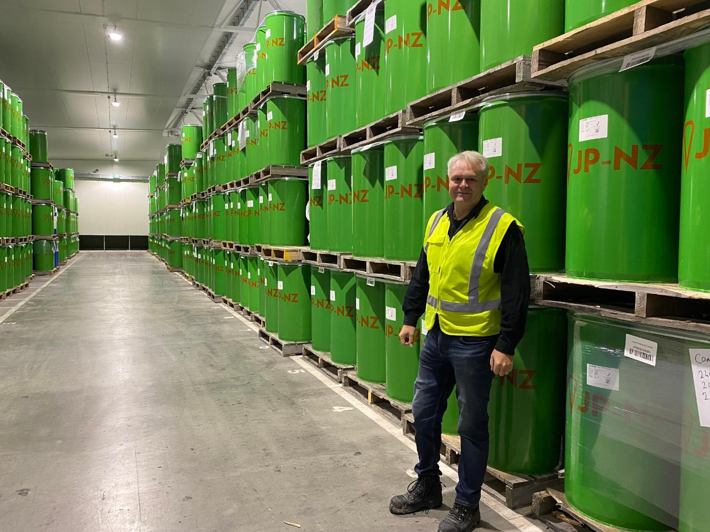
Juice Concentrates
Juice Products New Zealand (JP-NZ) in Timaru produces large quantities of carrot juice concentrates, including yellow and orange varieties. These are used for vegetable juices, smoothies, soups, baby food, and dairy products.
Watch Processing carrots south canterbury
One billion kg of carrots have disappeared in the Juice Products Washdyke factory and come out the other end as various products
Activity 6: Research
Timaru carrot juice gone global (WS)
Research the products and the company mission of Juice Products New Zealand (JP-NZ)

Slide 7
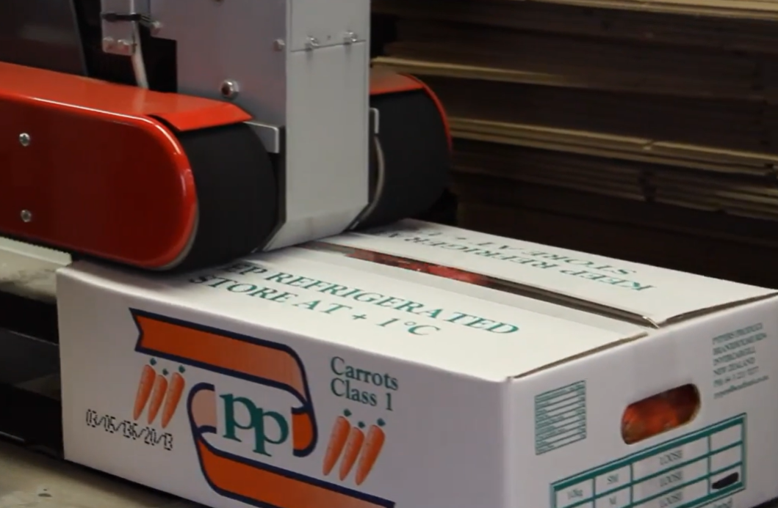
Export
Focus
Premium, high-quality fresh carrots
Processed products (e.g., concentrated carrot juice)
Key export destinations
Fiji
United Arab Emirates
Saudi Arabia
Japan
Other Asian markets
Challenges
Limited market access
Competition from domestic supply in importing countries
Strategy
Time exports to match periods of low local supply in target markets

