Slide 1


Slide 2
Some Common Carrot
Pests, Diseases and Disorders
Pests | Diseases | Disorders
Aphids Carrot Rust Fly Root-Knot Nematodes Slugs and snails Wireworms | Alternaria leaf blight Bacterial Soft Rot Black Rot Crown rot Sclerotium rot | Cracking Bolting

Slide 3
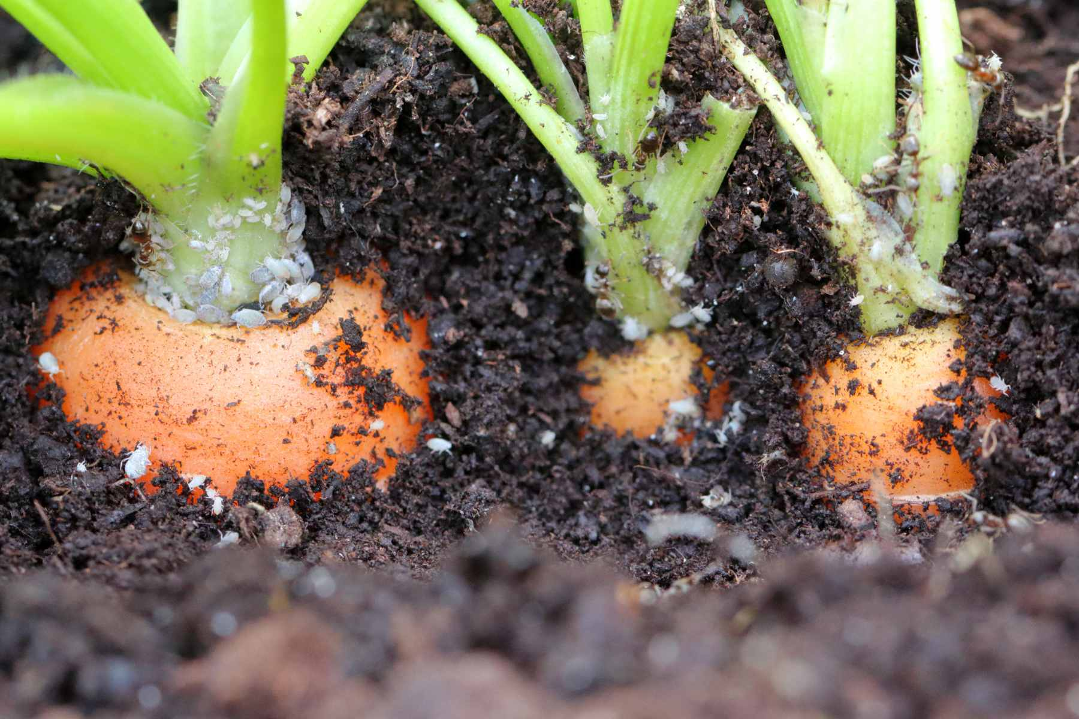
Aphids
Aphids are small, sap-sucking insects that can transmit plant viruses.
Damage
Heavy infestations can cause yellowing, curling, and distortion of leaves.
Feeding can stunt plant growth and reduce crop vigour.
The greatest potential damage is the transmission of plant viruses, such as Carrot virus Y, which can significantly reduce crop yield and quality.

Slide 4
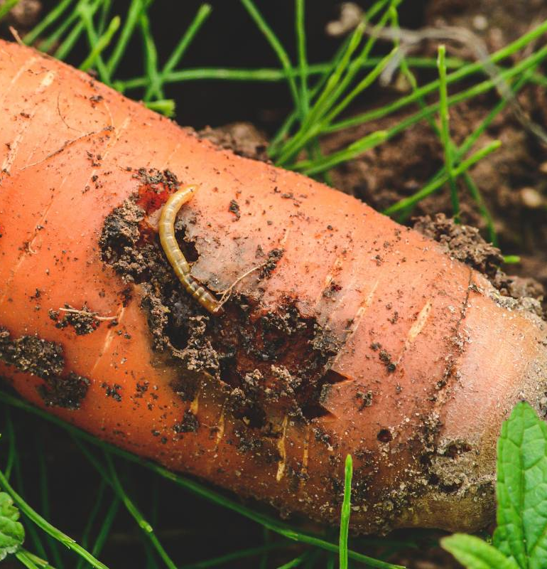
Carrot Rust Fly
(Psila rosae)
Female carrot flies lay eggs in the soil around host plants, especially carrots.
The first eggs hatch in spring.
Larvae are slender, smooth, creamy-white maggots up to 9 mm long.
Young larvae feed on fine hairy roots first.
Older larvae tunnel into larger tap roots.
Feeding causes rusty-brown tunnels inside carrots.
Damaged roots often rot and become unusable.
Impact
Reduced crop quality.
Root decay and rot.
Severe damage to harvestable carrots.

Slide 5
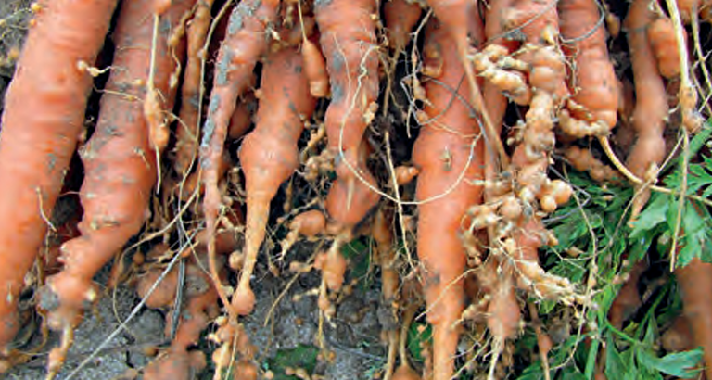
Root-Knot Nematodes
Tiny soil-dwelling worms (<1 mm) that attack carrot roots.
Cause swollen galls (root knots) on roots.
Damage
Carrots become short, forked, and misshapen.
Plants show yellow leaves, stunted growth, and wilting.
Impact
Lower yields.
Poor-quality carrots that may not be suitable for sale.
Spread
Irrigation water.
Contaminated soil on machinery or seedlings.
Management
Practice good farm hygiene.
Rotate with non-host crops.

Slide 6
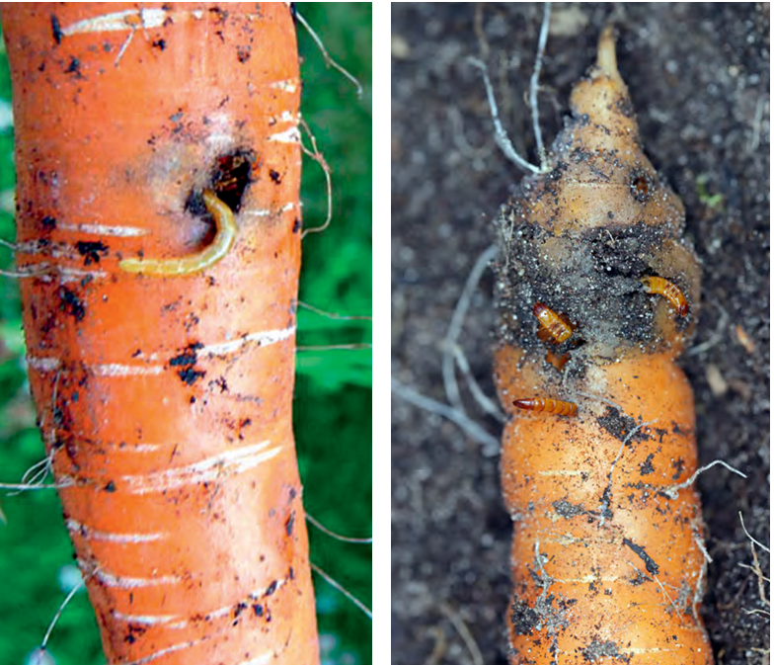
Wireworms
Tan to orange, hard-bodied larvae with a cylindrical shape
Usually 1–2 cm long
Live in damp, grassy soils
Damage
Bore tunnels into carrots and other taproots
Create holes that allow fungi and bacteria to enter
Damage is similar to carrot rust fly larvae
Impact
Carrots become soft and rotten
Reduced crop quality and market value
Lower overall yield

Slide 7
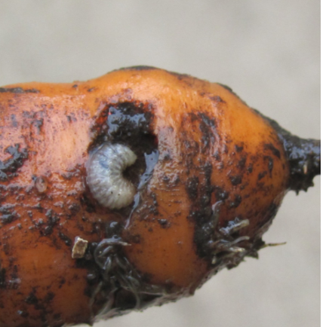
Slugs and Snails
Thrive in cool, damp conditions.
Feed on young seedlings and developing carrot roots.
Damage
Can destroy young carrot seedlings overnight.
Chew holes into mature carrot roots.
Damaged carrots are more likely to rot and cannot be sold.
Impact
Reduced plant numbers and lower yields.
Poor-quality carrots with reduced market value.
Management
Remove weeds and crop debris to reduce hiding places.
Monitor crops regularly, especially in wet weather.

Slide 8
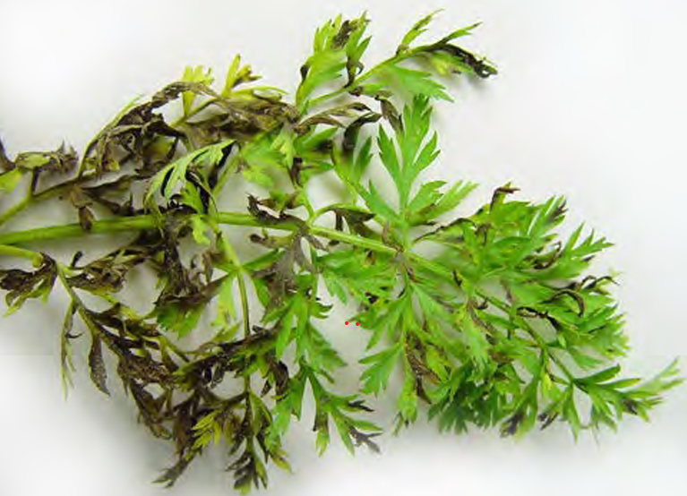
Alternaria Leaf Blight
(Alternaria spp.)
A fungal disease that causes:
Small dark brown or black spots appear on older leaves.
Leaves turn yellow, die, and collapse.
Leaf stalks weaken and may break during harvest.
Favourable conditions
Warm, wet weather.
Rain or overhead irrigation increases spread.
Impact
Reduces healthy leaf growth.
Makes harvesting more difficult.
Can lower carrot yield and quality.
Management
Use disease-free seed.
Avoid overhead watering where possible.
Remove infected crop debris and rotate crops.

Slide 9
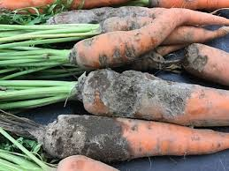
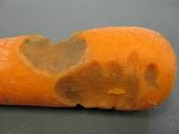
Bacterial Soft Rot
(Erwinia spp.)
Symptoms
Water-soaked spots appear on leaves, stems, or roots.
Plant tissue becomes soft, slimy, and may smell bad.
Plants can collapse as roots and crowns rot.
Favourable Conditions
Warm, wet weather.
Damaged plants are more easily infected.
Wet storage conditions increase the risk after harvest.
Impact
Crops rot before or after harvest.
Carrots become unsellable due to soft, rotten tissue.
Management
Avoid damaging plants during harvest.
Keep crops and harvested carrots as dry as possible.
Store carrots in cool, well-ventilated conditions.

Slide 10
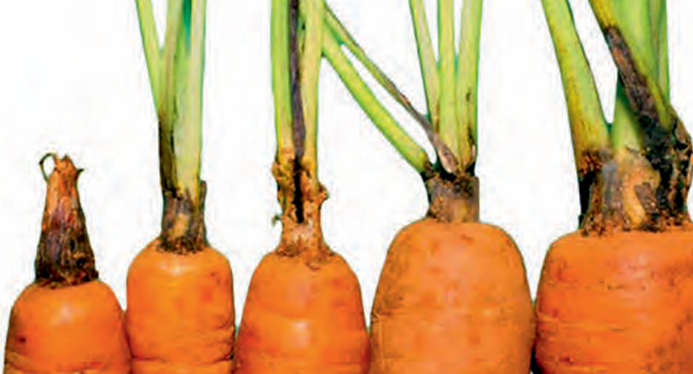
Black Rot
(Alternaria radicina)
Symptoms
Small yellow spots appear on older leaves.
Spots turn dark brown or black and spread.
Black rot develops where the leaves join the root (crown).
Dark, sunken black patches form on the carrot root, especially during storage.
Favourable Conditions
Warm, humid weather.
The disease can spread from infected seed and crop residues.
Symptoms may continue to develop after harvest during storage.
Impact
Carrots rot and lose quality making then difficult to sell.
Severe infections can cause major crop losses.
Management
Use disease-free seed.
Remove infected crop residues.
Rotate crops and store carrots in cool, dry conditions.

Slide 11
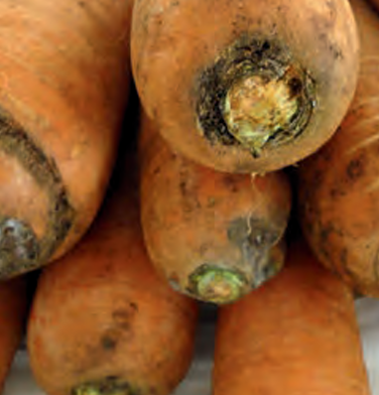
Crown rot
Symptoms
Leaves turn yellow, plants become stunted and wilt.
Black rot develops where the leaves join the carrot root (crown).
Leaves may break off during harvest.
Roots can become brown, soft, and rot.
Favourable Conditions
Mild temperatures (18–25°C) and wet soils.
More common in soils with poor drainage or nutrient imbalances.
Impact
Lower yields and poor-quality carrots.
Makes harvesting more difficult.
Rot reduces the market value of the crop.
Management
Improve soil drainage.
Maintain balanced soil nutrition and pH.
Rotate crops and remove infected plant material.

Slide 12
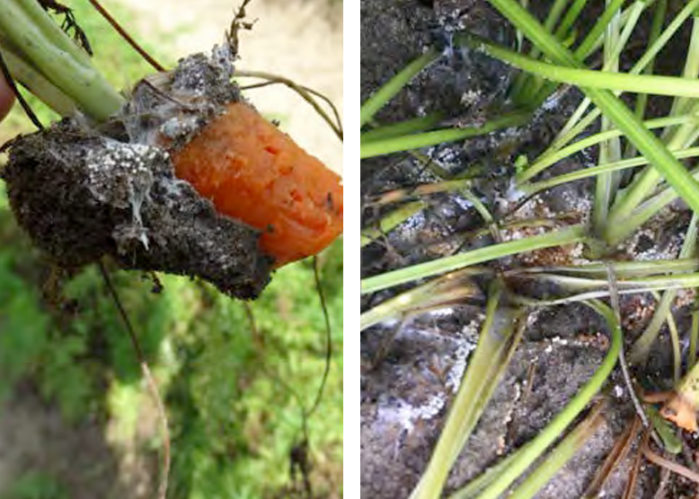
Sclerotium rot
(Sclerpotinia rolfsli)
Symptoms
Leaves turn yellow and begin to wilt.
White, thread-like fungal growth appears around the base of the plant.
Small, round brown fungal bodies (sclerotia) develop near the crown.
Plants are easy to pull from the soil as the crown and root rot.
Favourable Conditions
Warm, wet weather.
The fungus can survive in the soil for many years.
Impact
Causes root rot and plant death.
Reduces crop yield and carrot quality.
Management
Rotate with non-host crops.
Remove infected plants and crop debris.
Improve soil drainage and avoid over irrigating.

Slide 13
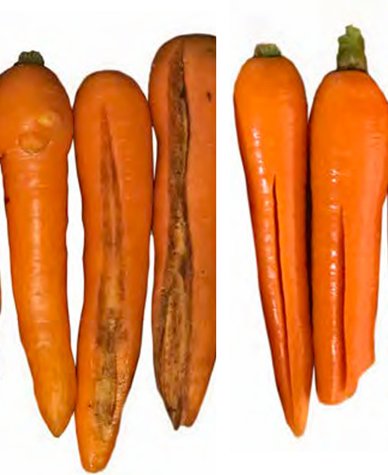
Cracking
A physical disorder where carrot roots split or crack.
Cracks can run along the length of the carrot.
Causes
Sudden changes in soil moisture.
Dry conditions followed by heavy rain or overwatering.
Higher risk when soil is cold and wet at harvest.
Impact
Cracked carrots are lower quality.
Fresh cracks may allow rots and diseases to enter.
Reduces market value.
Management
Maintain even soil moisture throughout growth.
Avoid overwatering after dry periods.
Harvest when soil conditions are suitable.

Slide 14
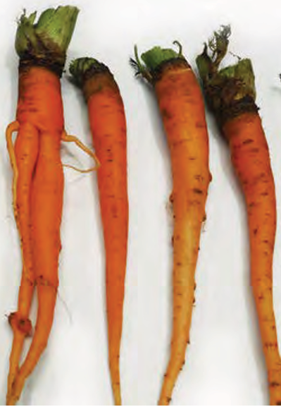
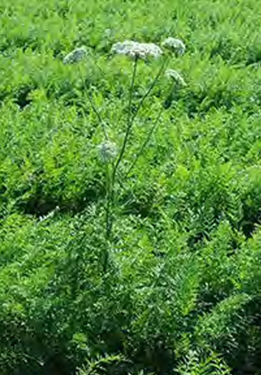
Bolting
A disorder where carrots produce a flowering stem too early.
The plant uses stored energy to make flowers instead of growing the root.
Symptoms
Carrots become:
  Small and shrunken
  Tough and stringy
  Poor in flavour
Leaf base becomes thicker.
Causes
Cold temperatures (4–10°C) for more than 10 days.
Cold periods followed by warmer weather can trigger early flowering.
Impact
Poor root quality, reducing yield and market value.
Management
Choose carrot varieties suited to the climate.
Avoid planting too early in cold conditions.
Harvest before bolting affects quality.

Slide 15
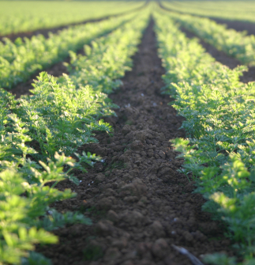
Strategies to minimise pest and disease risks
Preventative Practices
Use high-quality, disease-free seed.
Maintain good soil drainage to reduce disease risk.
Practise 3–5 year crop rotation to break pest and disease cycles.
Crop Monitoring
Regularly inspect crops for early signs of:
  Pests
  Diseases
  Plant stress
Cultural Control
Remove infected plant material and crop debris.
Maintain good field hygiene.
Avoid spreading diseases through machinery and irrigation.
Chemical Control
Apply registered pesticides or fungicides when pest/disease levels are high.
Use chemicals as part of an Integrated Pest Management (IPM) programme.

