Slide 1


Slide 2
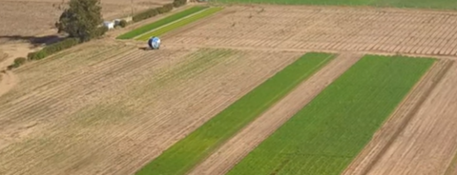
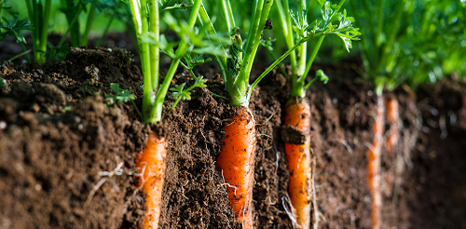
Growing Carrots
Watch Video:
Wilcox Growing carrots in NZ-
Country Calendar - Growing organic carrots - Feb 26

Slide 3
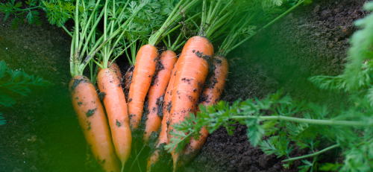

The perfect carrot
Long cylinder shaped
really smooth skin
Bright orange colour

Slide 4
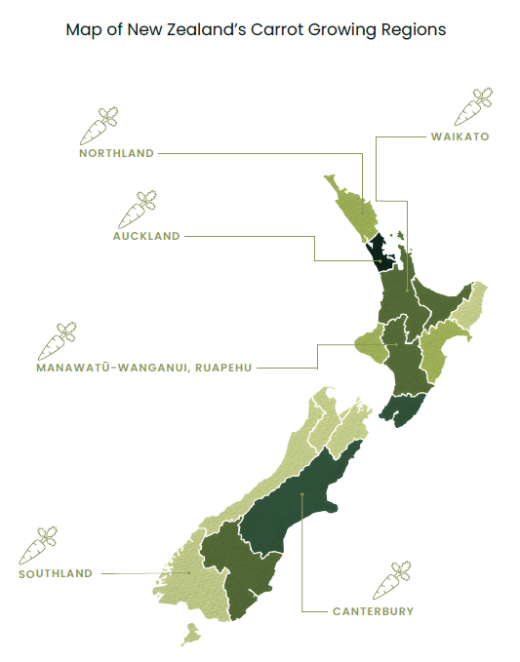
Growing conditions
Growing a high-yielding carrot crop requires:
Full sun
Deep, loose, well-drained soil with a pH of 6.0–6.8
A fine, firm seedbed cultivated to a depth of 30–40 cm to promote straight root growth
Ideal temperatures of 15–20°C
Consistent soil moisture while avoiding waterlogging

Slide 5
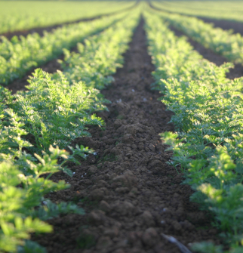
Calendar of operations
The New Zealand carrot industry operates year-round using staggered sowing and harvesting to supply fresh, processing, and export markets.
Carrots typically take 12–20 weeks (3–5 months) to reach maturity.
Growers aim to produce long, smooth, bright orange carrots with high yields and quality.
Key Management Practices
Careful site selection and crop rotation
Fine, even seedbed preparation
Precision sowing for uniform root size
Regular pest and disease monitoring (IPM)
Effective irrigation and nutrient management
Early weed control
Mechanical harvesting to maintain quality

Slide 6
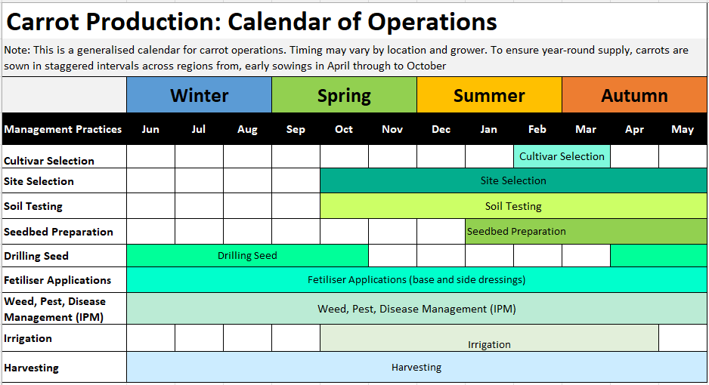

Slide 7
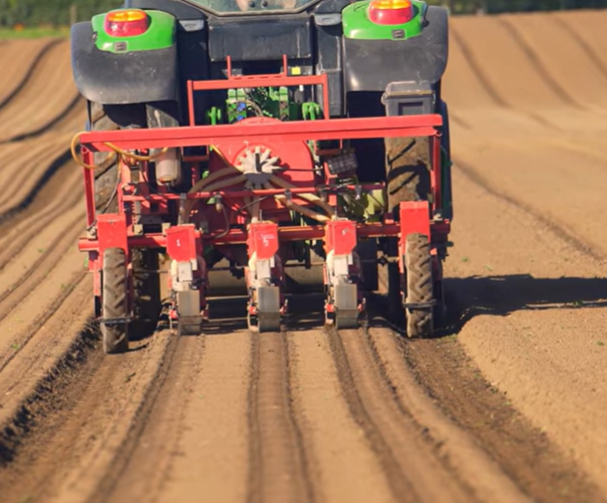
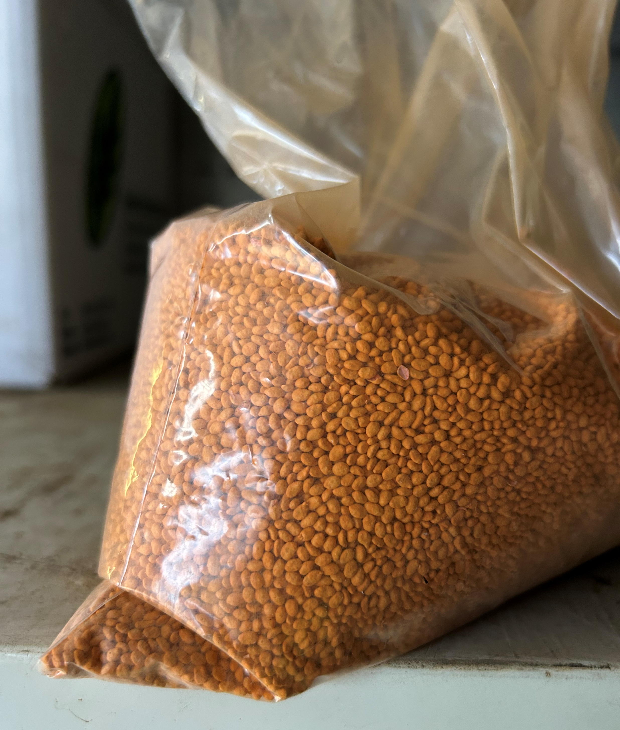
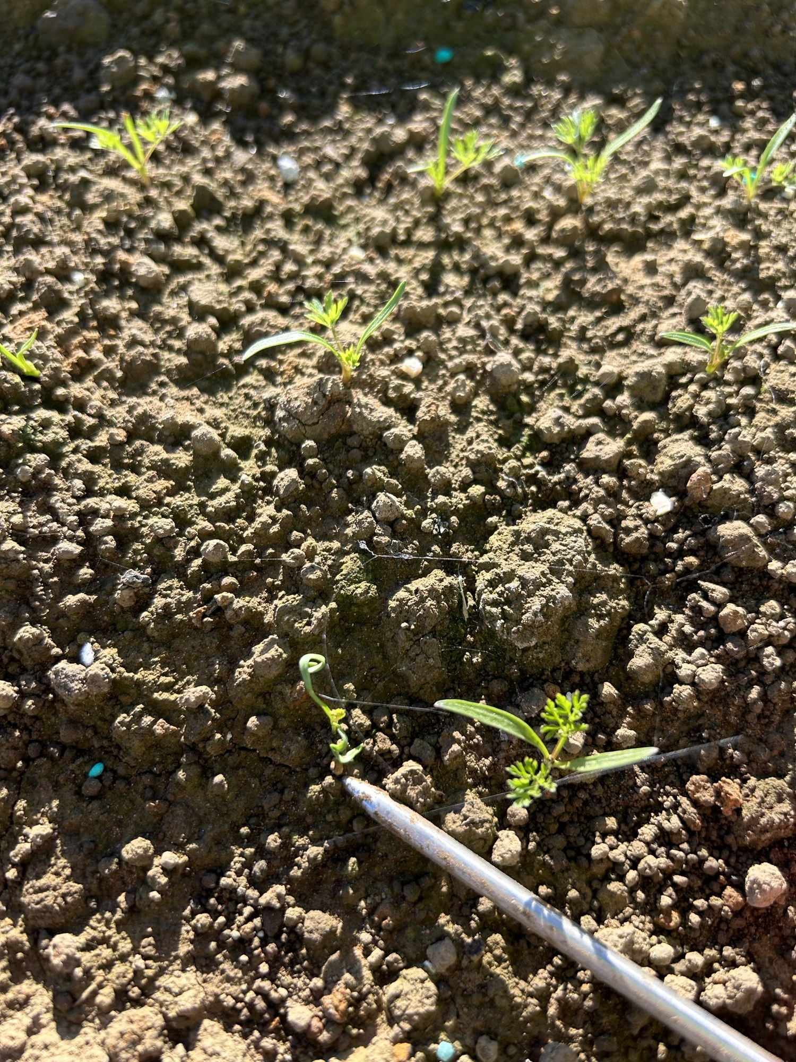
Seedbed preparation and sowing
Seedbed preparation
Deep, fine, firm seedbed for good root development
Raised beds often used to improve drainage
Fertiliser applied based on soil test results
Sowing
Pelleted seed sown just below the soil surface
Seeds spaced 42–45 mm apart
Rows spaced 30–50 cm apart
Target plant population: 50–80 plants/m²
Correct spacing improves root size, harvest efficiency, and reduces disease risk
Year-Round Production
Sowing and harvesting times vary between regions
Staggered planting schedules allow fresh carrots to be supplied throughout the year

Slide 8
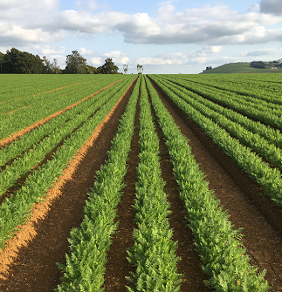
Nutrient management
Carrots require low to moderate nitrogen (N) and high phosphorus (P) and potassium (K) for healthy root growth.
Fertiliser is applied before sowing based on soil test results and may be side-dressed during growth if required.
Key Nutrients Macronutrients
Nitrogen (N): Promotes leaf growth, but too much can cause split roots and excessive foliage.
Phosphorus (P): Essential for root development.
Potassium (K): Improves plant strength, yield, and storage life.
Micronutrients: These nutrients help maintain carrot quality, health, and productivity.
Boron (B)
Magnesium (Mg)
Manganese (Mn)

Slide 9
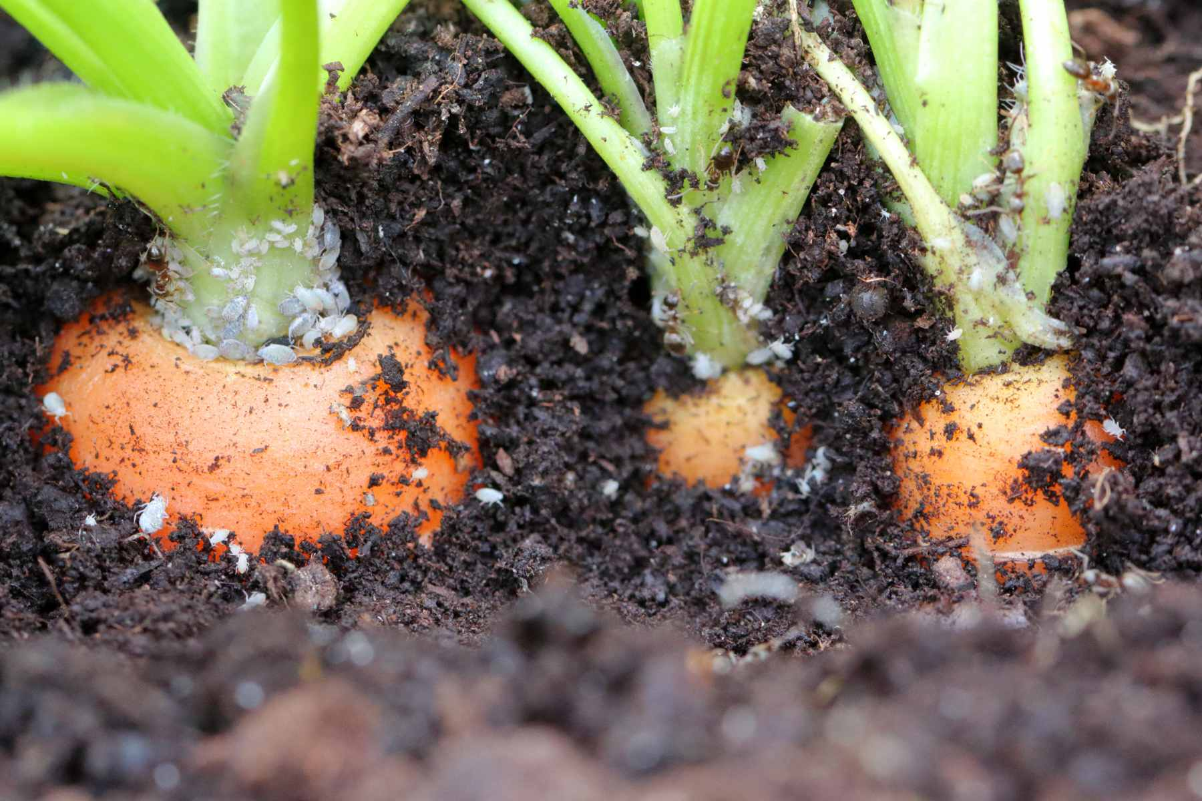

Some Common Carrot Pests, Diseases and Disorders
Pests | Diseases | Disorders
Aphids Carrot Rust Fly Root-Knot Nematodes Slugs and snails Wireworms | Alternaria leaf blight Bacterial Soft Rot Black Rot Crown rot Sclerotium rot | Cracking Bolting

Slide 10
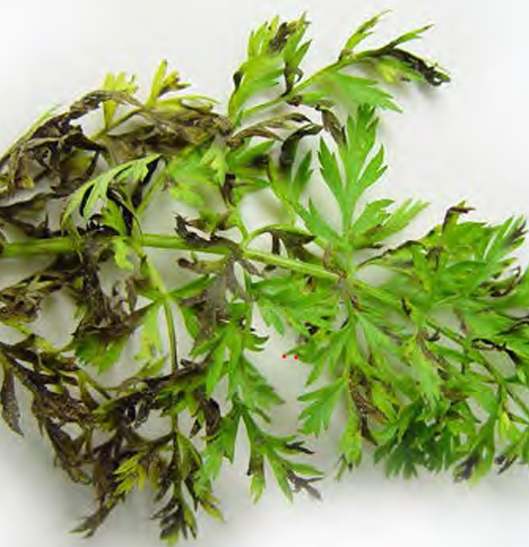
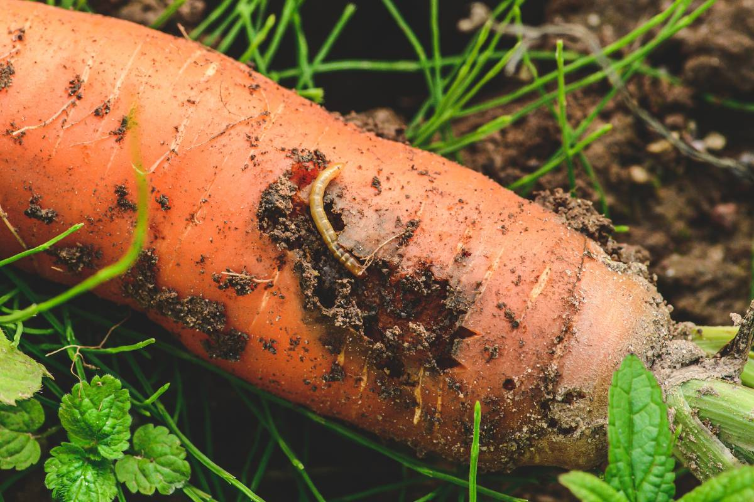
Pest and disease management
Carrot pest and disease control uses an integrated approach (IPM) combining cultural, preventative, and chemical methods.
Key prevention practices
3–5 year crop rotation
Use disease-free seed
Ensure good soil drainage
Maintain good crop hygiene (remove residues, weeds, volunteer plants)
Soil pests (e.g. nematodes):
Nematicides may be applied before sowing
Seed is usually sown within 24–48 hours for best protection
Monitoring and control
Regular crop inspections to detect pests and diseases early
Fungicides used when disease risk is high
Helps protect yield, quality, and marketable production
Refer to PPT Carrot pest and diseases

Slide 11
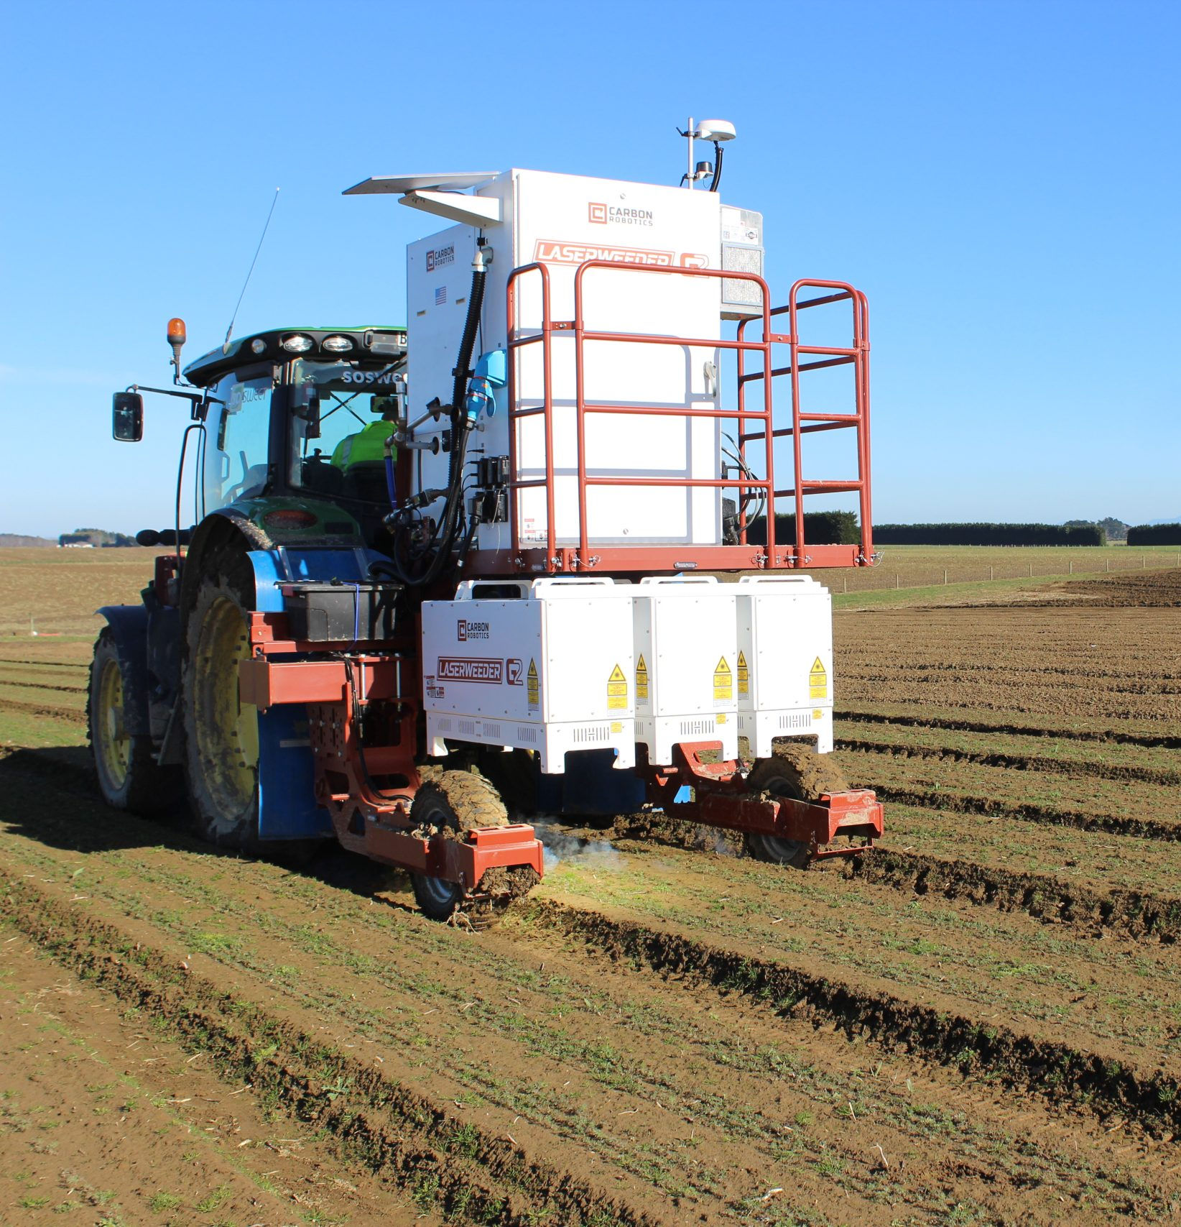
Weed management
Carrots are slow-growing and compete poorly with weeds, so effective weed control is essential for high yields.
Integrated weed control
Careful seedbed preparation
Stale seedbed technique (weeds germinated then removed using a herbicide
Pre-emergence and post-emergence herbicides
AI Laser Technology (e.g. LaserWeeder)
Reduces reliance on herbicides
Lowers labour costs and manual weeding
Removes weeds quickly and accurately, improving crop growth
Does not disturb soil structure or increase erosion
Highly precise and can operate for long periods
Overall benefits are- more sustainable, efficient, and higher-quality carrot production
Activity 8: LaserWeeding
Watch Country Calendar - Growing organic carrots - Feb 26
Do LaserWeeding Carrots in Southland (WS)

Slide 12
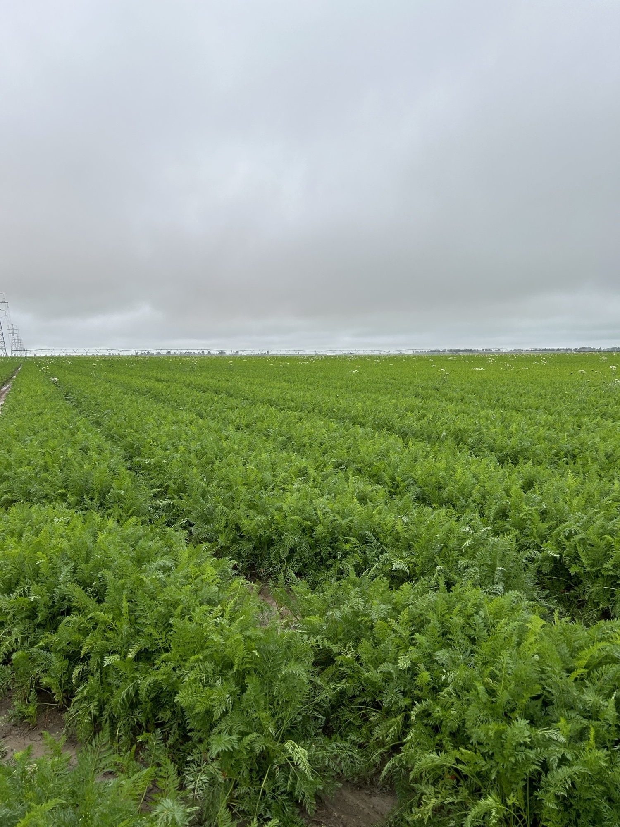
Irrigation management
Carrots need careful water management throughout all growth stages.
Key Requirements
Adequate moisture is critical during germination
Avoid heavy irrigation that can displace seed or cause soil crusting
Maintain consistent moisture for root development and high yields
Prevent stress to avoid defects like splitting, cracking, or misshapen roots
Avoid overwatering, which increases disease risk
Irrigation Scheduling
Based on soil moisture monitoring (sensors or field checks)
Adjust irrigation during hot, dry periods (higher evapotranspiration)
Maintain steady moisture near harvest to protect root quality

Slide 13
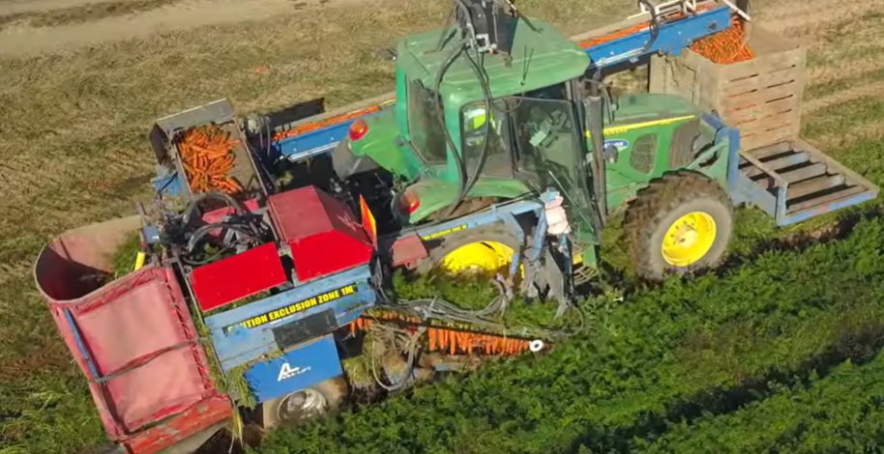
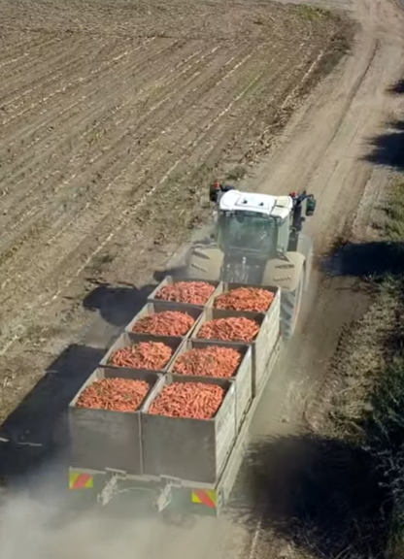
Harvesting
Fresh-market carrots are harvested:
October–January in warmer regions
Late January–October in cooler main crop regions (carrots can be stored longer in-ground due to cooler temperatures)
Mechanical harvesting process
Harvester undercuts and lifts carrots using their leaves
Carrots travel along belts where tops are cut off
Roots are collected into storage containers for transport
Activity 8: Harvesting
Watch: Harvest Fresh Carrot Production https://www.youtube.com/watch?v=wTBthCAB5C0&t=1s
Do Carrot harvesting on a giant scale (WS)

Slide 14
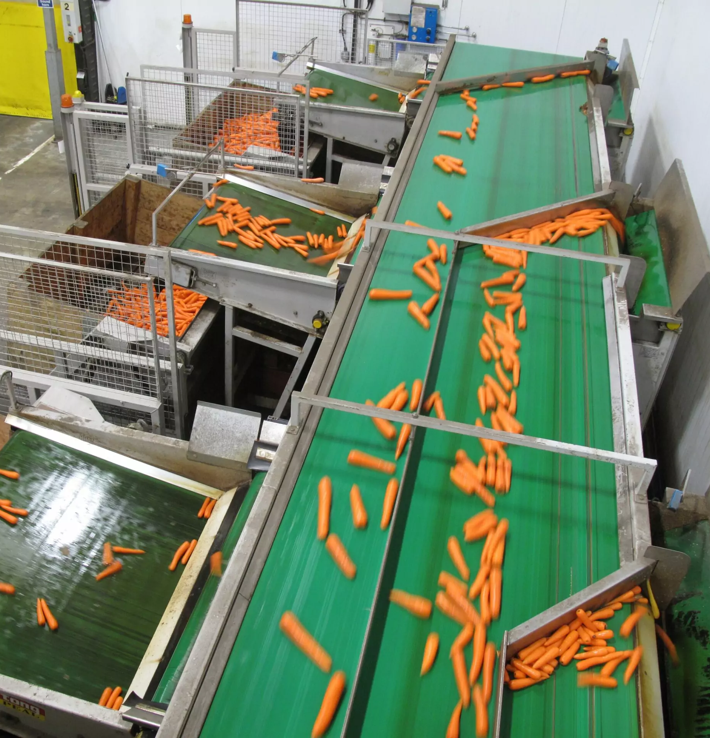
Packhouse and Storage
Packhouse
Carrots are washed, cleaned, graded, and packed for supermarkets
Careful handling is essential to prevent damage during processing
Storage
In-ground storage allows carrots to remain in the soil after maturity
Helps spread harvest and maintain year-round supply
Risk: wet weather can cause rot, splitting, or disease
Post-harvest storage uses cool, high-humidity environments to maintain freshness
Combined storage methods help maintain quality and reduce waste year-round

Slide 15
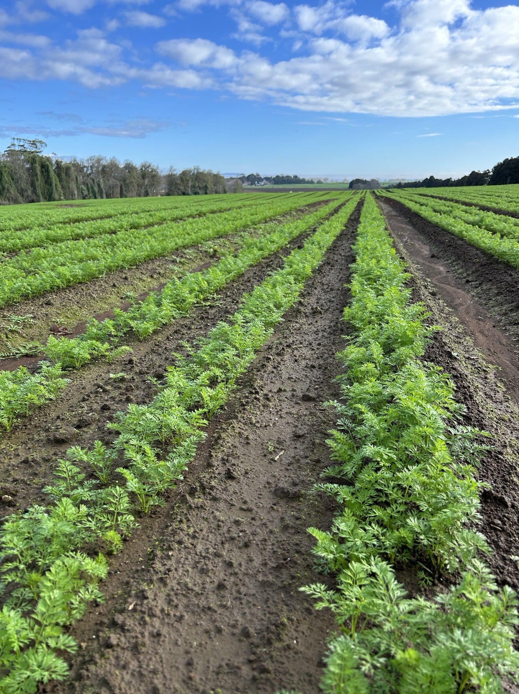
Test yourself quiz

Slide 16
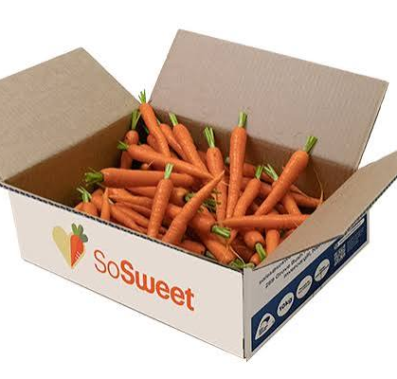
Questions
Why are carrots grown in a crop rotation system?
What type of soil is preferred for growing good-quality carrots?
Why are carrot seeds pelleted before sowing?
Name two nutrients that carrots need for healthy root growth.
What is one way growers prevent pests and diseases in carrot crops?
Why is regular crop monitoring important?
Why do carrots need good weed management?
Give one benefit of AI laser weeding technology.
Why is irrigation important during carrot germination?
What can happen if carrots experience dry conditions followed by lots of water?
Name one pest that affects carrots.
What happens during bolting in carrots?
How are carrots harvested?
Why are carrots stored in cool, humid conditions after harvest?
What is the goal of integrated pest and disease management?

Slide 17
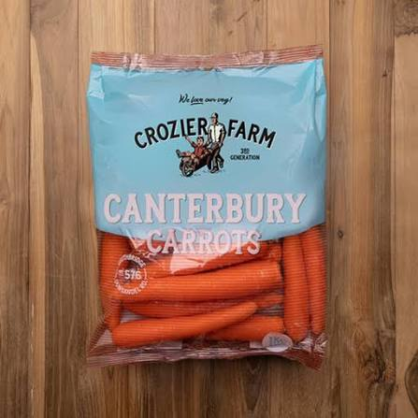
Answers
Reduce pests and diseases
Sandy loam soil
Improve accurate planting/precision sowing
Phosphorus and potassium (also nitrogen, boron, magnesium, manganese)
Crop rotation, clean seed, hygiene, drainage, pesticides when needed
To detect problems early
Weeds compete for water, nutrients, and sunlight
Reduces herbicide use / saves labour / targets weeds accurately
Seeds are small and can dry out quickly
Root cracking
Aphids, nematodes, slugs/snails, carrot rust fly, wireworms
Produces a flower stem too early, reducing root quality
Mechanical harvesters
Maintain freshness and reduce spoilage
Reduce crop losses and maintain quality yields

