Slide 1


Slide 2
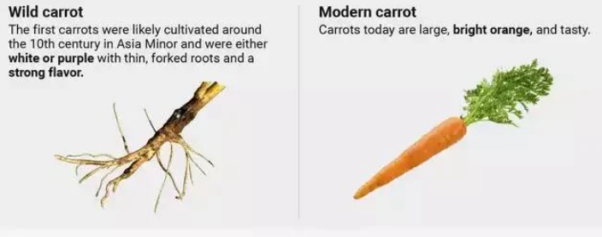
History of carrots
From wild plant to everyday vegetable

Slide 3
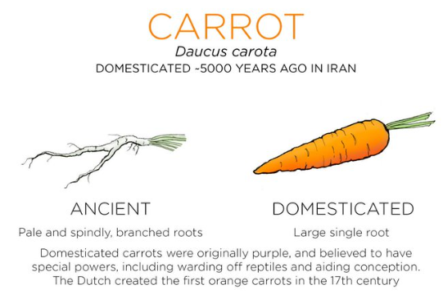
Wild carrots (Long ago)
Grew in Europe, North Africa, and Western Asia
Small, thin, white roots
Tough, forked, and bitter
Often confused with parsnips

Slide 4
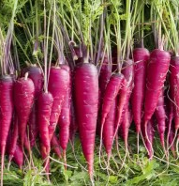
First Domesticated Carrots
(9th–10th Century)
Grown in Central Asia (Afghanistan & Iran)
Not orange! Usually purple or yellow
Purple carrots: strong flavour, stained pots
Yellow carrots: contained carotene
Farmers began selecting better plants
Carrots Spread Around the World
Seeds travelled through trade and migration
Spread to Europe, North Africa, and other parts of Asia
Farmers kept improving them

Slide 5
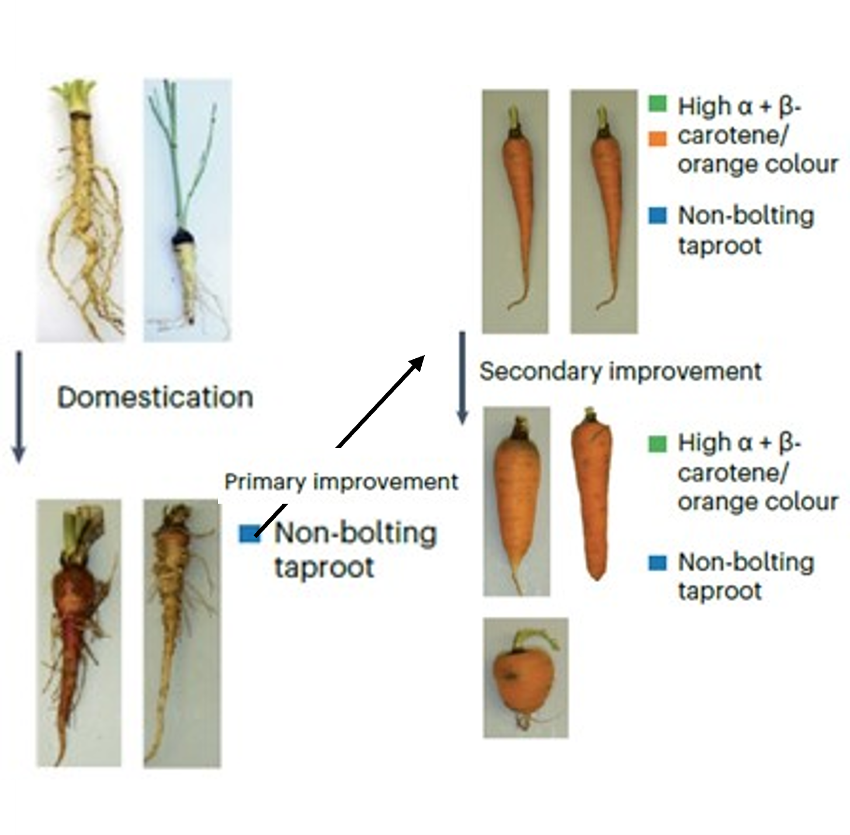
Orange carrots appear (15th–16th Century)
Developed in Europe (Spain and Germany)
Bred from yellow carrots
Sweeter, smoother, less bitter

Slide 6
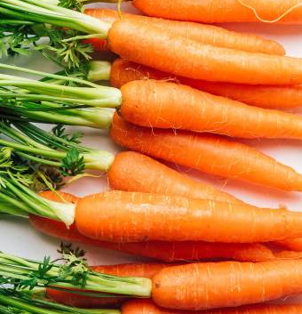
Dutch improvements (1600s)
Dutch farmers improved orange carrots
Larger, straighter, more reliable
Became the basis of modern carrots
Myth vs Reality
Story: created to honour Dutch royalty
Reality: improved for better taste and quality

Slide 7
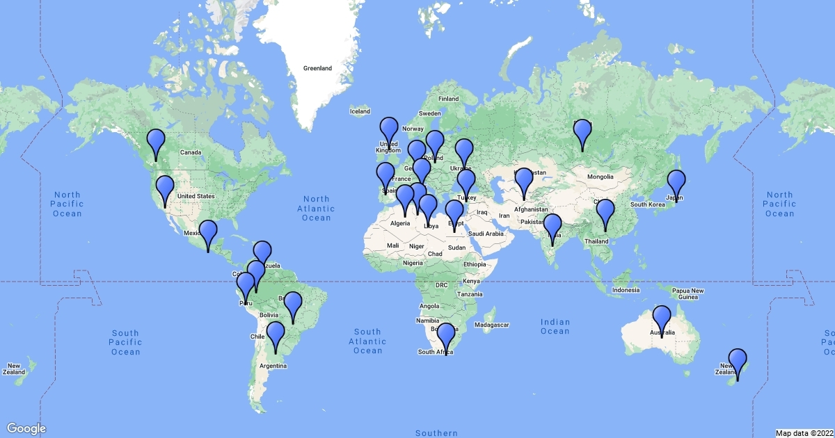
From animal feed to human food
Early carrots often fed to animals
Improved taste made them popular for people
Became common in diets
Modern carrots today
Grown worldwide
Breeding focuses on:
  Sweetness
  Bright colour
  Pest resistance

Slide 8
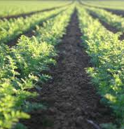
Carrots in New Zealand
(1800s–today)
Brought by European settlers (early 1800s)
Grew well in local conditions
Important crop today
Yields:
  ~70 tonnes/hectare (fresh)
  ~96 tonnes/hectare (processing)
  Can exceed 100 tonnes/hectare

Slide 9
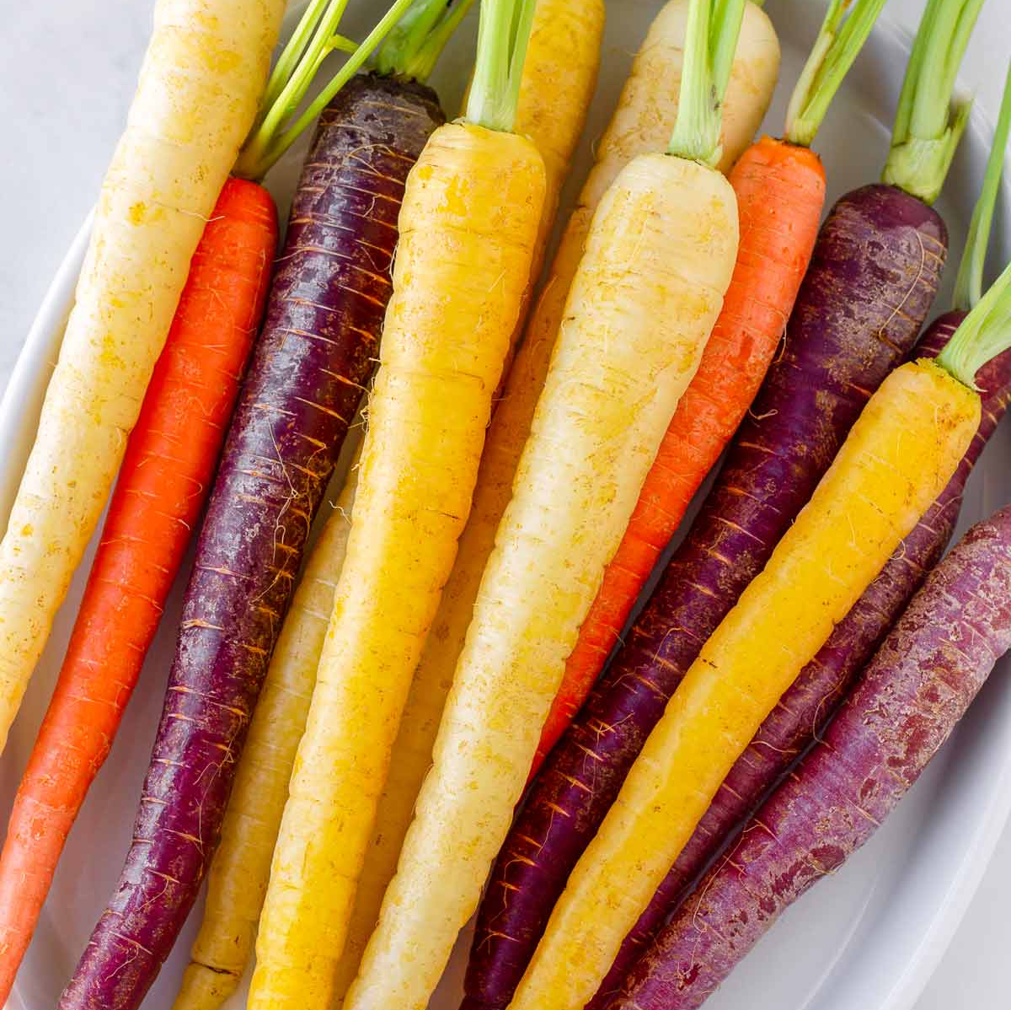
Summary
Carrots changed a lot over time
From small, bitter white roots
To sweet, colourful vegetables
A great example of how humans shape plants

Slide 10

Activity 3:
Read the article on the history of carrots, then complete the tasks below.
1. Timeline challenge
Put these events in the correct order (1–5)
  Orange carrots are developed in Europe
  Wild carrots grow in Europe, Asia, and North Africa
  First purple and yellow carrots are farmed in Central Asia
  Carrots spread through trade to Europe and other regions
  Carrots are improved in the Netherlands

Slide 11
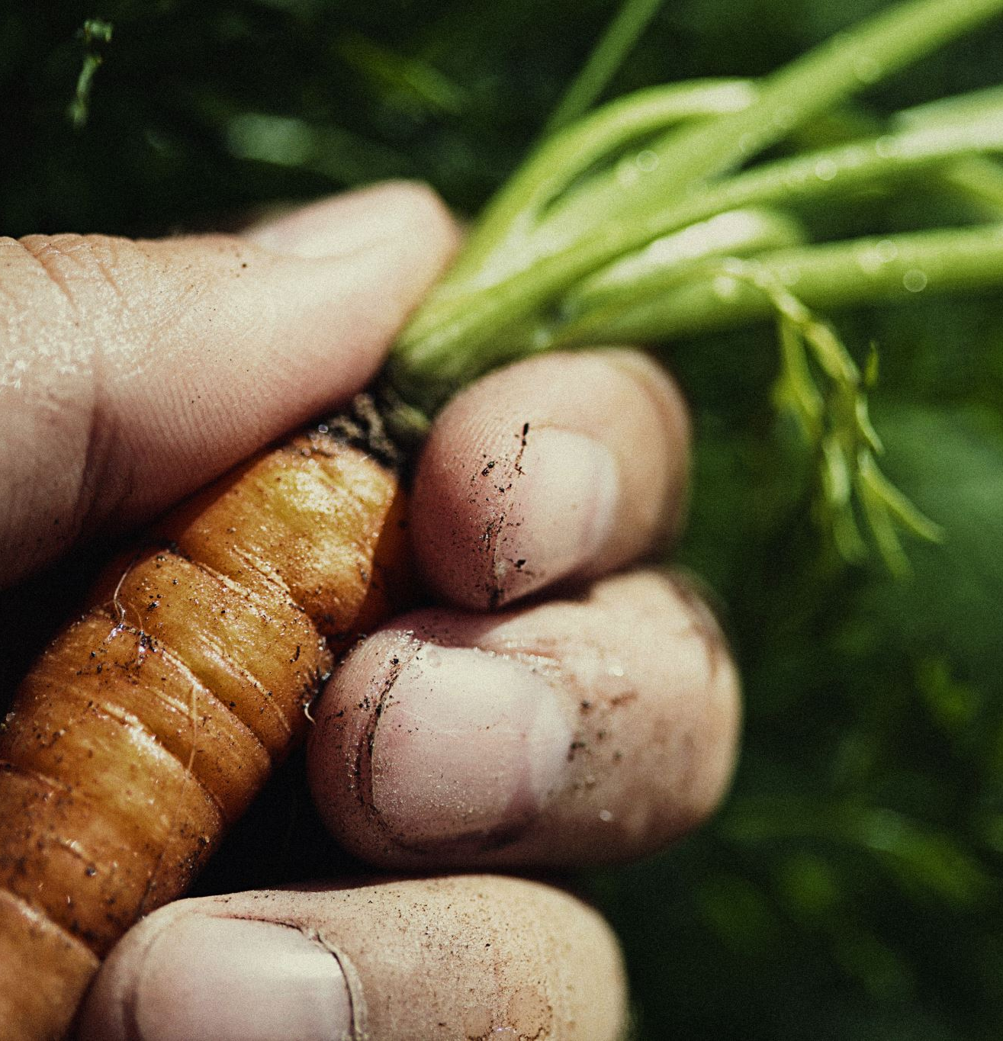
2. Comprehension
What did wild carrots originally look like, and how did they taste?
Why were carrots and parsnips often confused in the past?
Where and when were the first domesticated carrots grown?
What colours were the earliest cultivated carrots, and what gave them these colours?
Why did orange carrots become more popular than purple and yellow varieties?
How have scientist and growers improved carrots today?

Slide 12
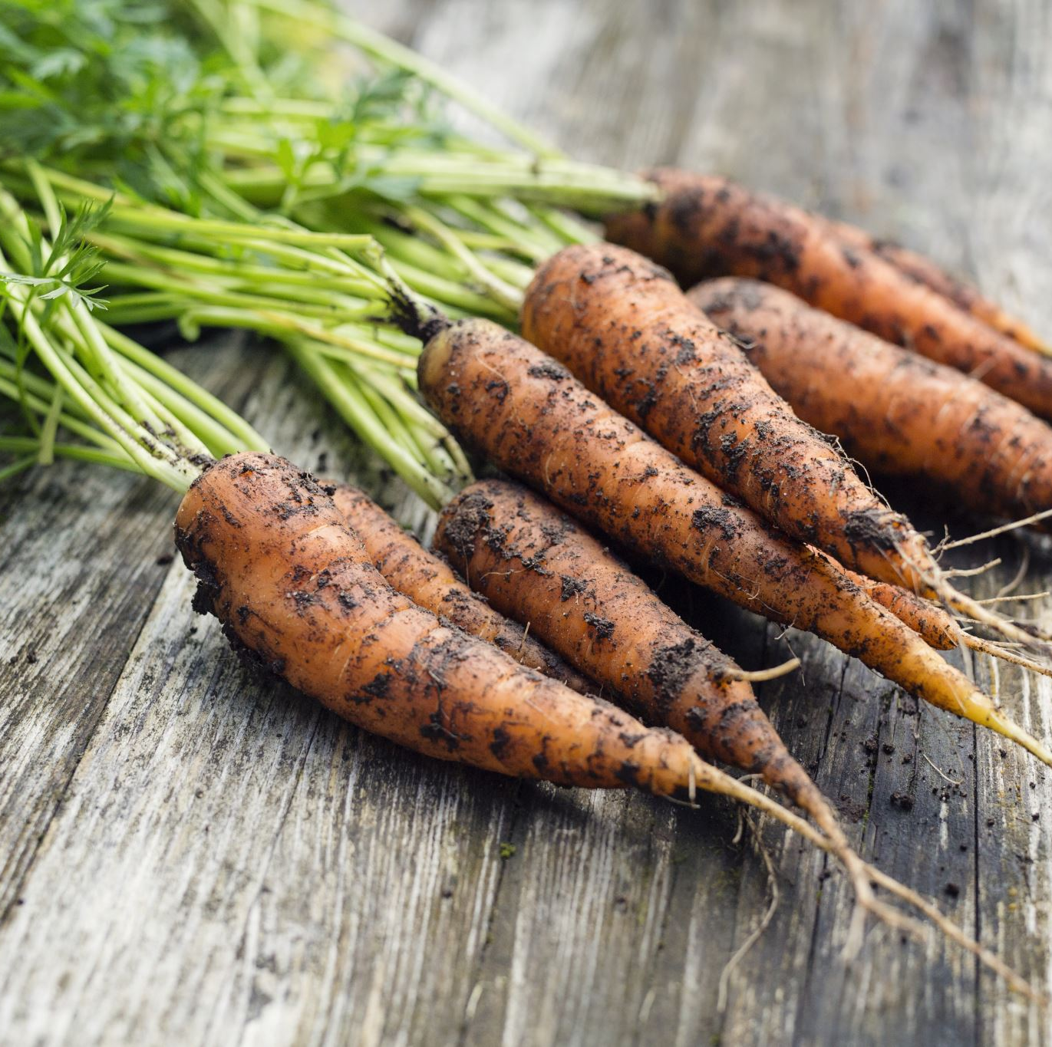
3. Creative task
Design your own “future carrot”!
Draw what you think carrots might look like in 100 years. Label at least two features for example:
  Colour
  Taste
  Size
  Resistance to pests

Slide 13
Answers
Timeline challenge
Wild carrots grow in Europe, Asia, and North Africa
First purple and yellow carrots are farmed in Central Asia
Carrots spread through trade to Europe and other regions
Orange carrots are developed in Europe
Carrots are improved in the Netherlands

Slide 14

Comprehension
a. What did wild carrots originally look like, and how did they taste?
Wild carrots originally had small, thin, white roots. They were tough, forked, and often tasted bitter.
b. Why were carrots and parsnips often confused in the past?
Carrots and parsnips were often confused because they looked very similar and were both root vegetables with pale, similar-shaped roots.
c. Where and when were the first domesticated carrots grown?
The first domesticated carrots were grown around the 9th and 10th centuries in Central Asia, in areas that are now Afghanistan and Iran.
d. What colours were the earliest cultivated carrots, and what gave them these colours?
The earliest cultivated carrots were purple and yellow. Purple carrots got their colour from anthocyanins, and yellow carrots contained carotene.
e. Why did orange carrots become more popular than purple and yellow varieties?
Orange carrots became more popular because they were sweeter, less bitter, had smoother roots, and were more pleasant to cook with since they didn’t stain pots or water.
f. How have scientist and growers improved carrots today?
Scientists and growers have improved carrots through selective breeding. This means they choose the best plants to grow the next generation. Over time, this has produced carrots that are sweeter and less bitter, with better colour, stronger resistance to pests and diseases, and much higher crop yields.

