Slide 1


Slide 2
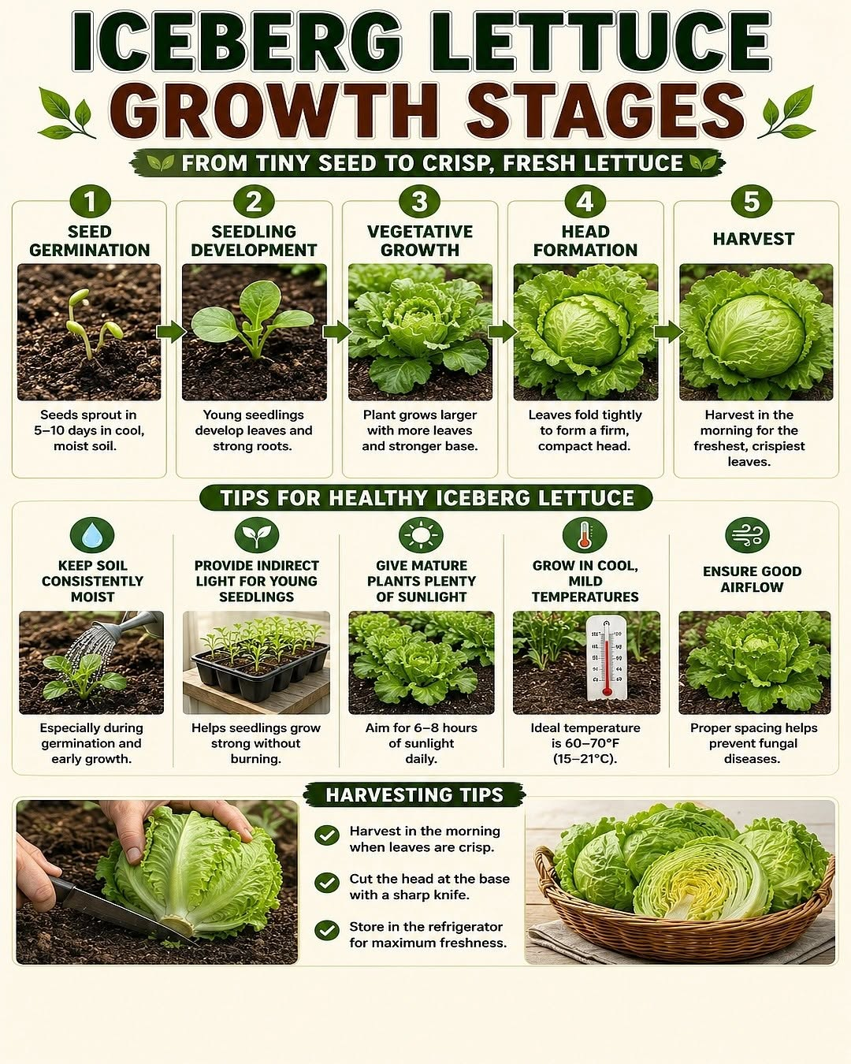
Growing lettuce
Watch: Growing leafy greens in NZ
https://www.youtube.com/watch?v=Om6QyUwXcXs&t=11s

Slide 3
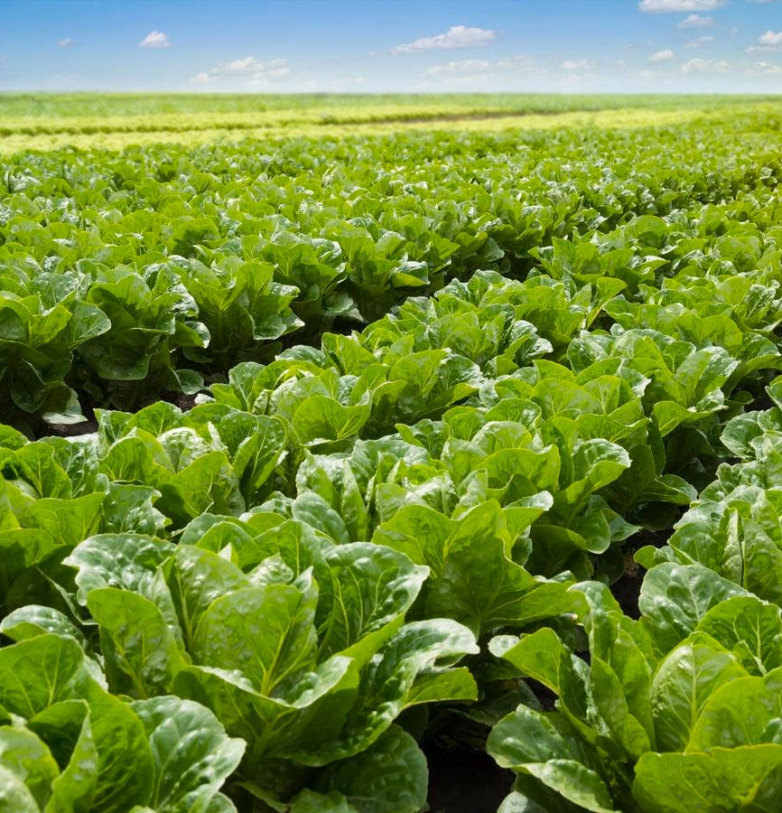
Growing Lettuce
Lettuce is grown with different vegetable crops each season to maintain soil structure and reduce pests and diseases.
Grow best in cool, moist, sunny conditions and can be grown almost all year with the right varieties.
Needs fertile, well-drained soil with a pH of 6.2–7.0.
Requires regular watering, especially during hot weather.
Prefers full sunlight
Growing through the seasons
Spring and Autumn: Best growing seasons with cool, mild temperatures.
Summer: Extra watering and shade are needed to protect the crop from heat.
Winter: Hardier lettuce varieties are grown in sheltered areas to reduce frost damage.

Slide 4
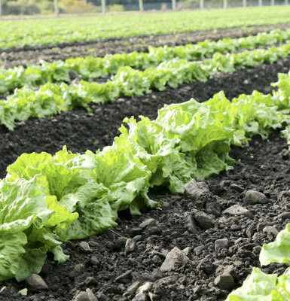
Calendar of Operations:
Site Selection to Harvest
Covers the main stages of commercial field-grown iceberg lettuce production, from site selection to harvest.
Based on one crop cycle, which is repeated weekly to ensure a continuous year-round supply.
Seedling transplanting:
  Summer: ~5 weeks old (faster growth in warm temperatures)
  Winter: ~8 weeks old (slower growth in cooler temperatures)

Slide 5
Growing Iceberg Lettuce Outdoors
Crop Calendar of Operations (Repeated weekly)
Cultivar selection
Use integrated pest management practices to control pests and diseases
Seeds sown into trays
Seedlings drenched against pests
Site Selection
Pre- planting
Transplanting
seedlings
Growing
Harvesting
Foliage spraying
Hand harvest
Soil test
Base dressing
irrigation
Cultivation
Seedbed preparation
Blast chilling
Side dressing based on herbage tests
Distribution to markets

Slide 6
Cultivar Selection for Year-Round Supply
Growers choose suitable cultivars for local microclimates and harvest periods.
Key selection factors:
  Maturity time
  Tolerance to temperature extremes
  Resistance to disorders (e.g., tipburn and bolting)
Activity 3: Choosing the right iceberg lettuce cultivar.
Season | Iceberg Cultivars | Average time to maturity
Spring | Archer | 6- 8 weeks
Summer | Greenmoon | 5 weeks
Autumn | Archer | 6-8 weeks
Winter | Winguard | 10-12 weeks

Slide 7
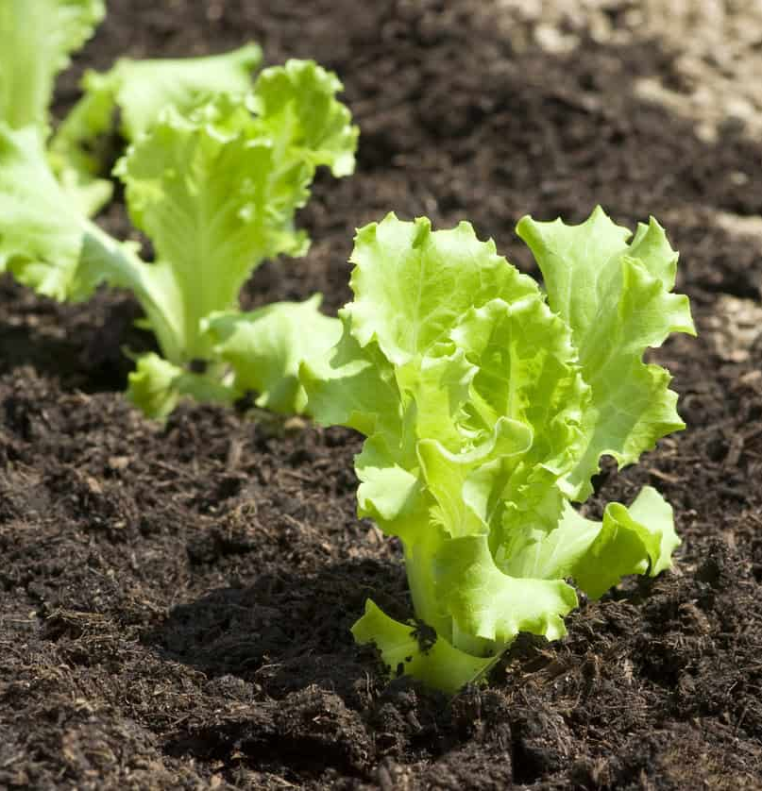
Seedbed preparation
Soil is prepared into fine, firm, raised seedbeds before transplanting.
Well-prepared seedbeds promote:
Rapid seedling establishment and strong root development
Benefits of raised beds:
Improve drainage and prevent waterlogging
Increase soil aeration
Encourage healthy root growth
Enhance water and nutrient uptake
Raised beds are typically 90–120 cm wide, depending on machinery and production systems.

Slide 8
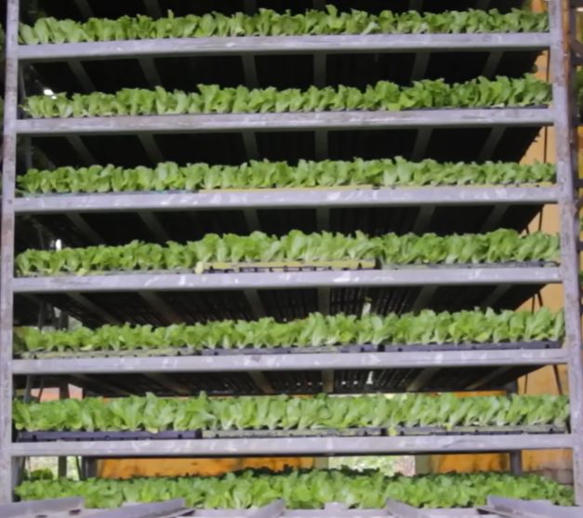
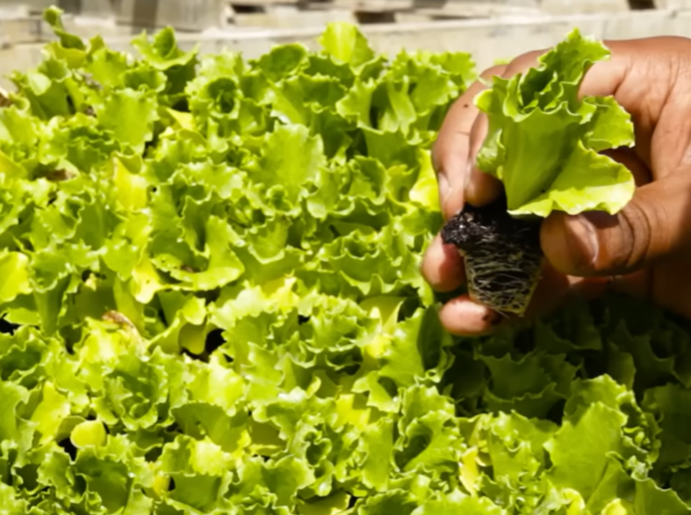
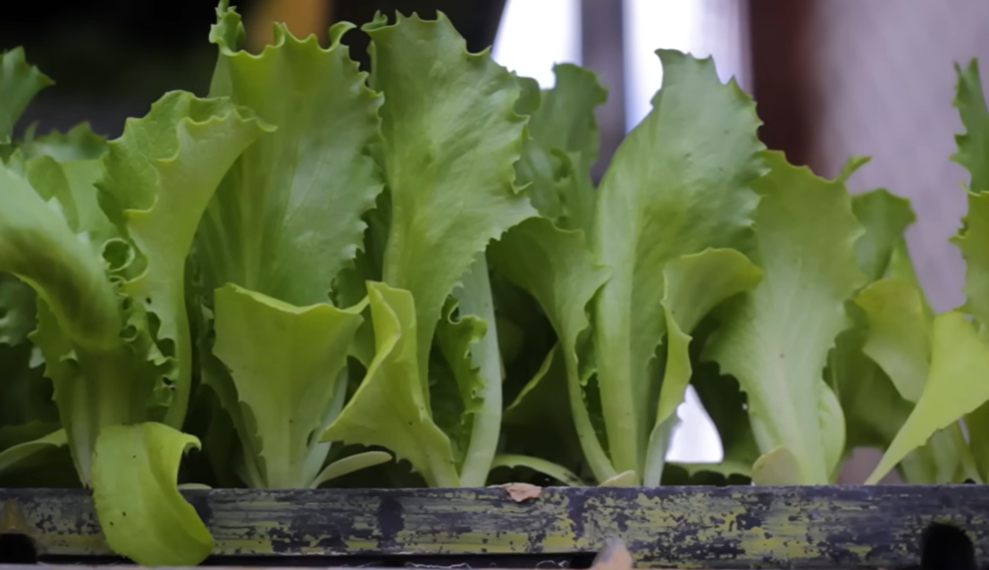
Seedlings
Lettuce is grown from seedlings, not direct seeding.
Seedlings are raised in trays using disease-free seed by commercial nurseries or growers.

Slide 9
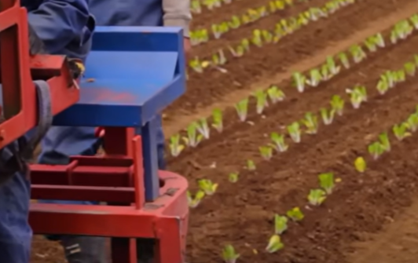
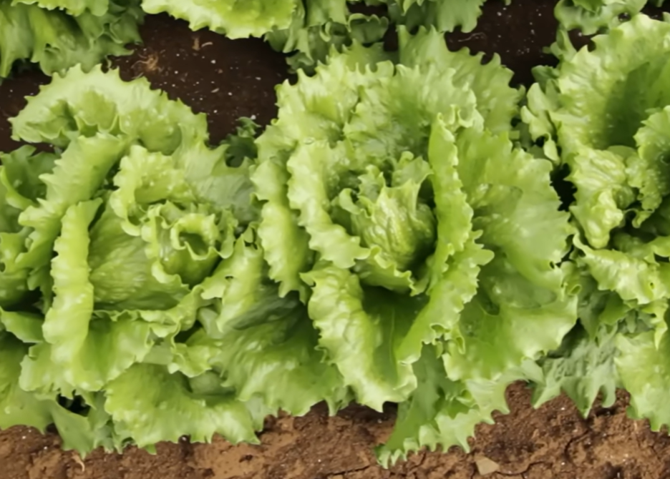
Transplanting seedlings
Transplanted into the field using a mechanical transplanter.
Transplanting age:
Summer: ~5 weeks old
Winter: ~8 weeks old (slower growth in cooler conditions)
Plant spacing:
Three rows per raised bed
40 cm between plants
Proper spacing:
Allows development of large, healthy heads
Improves airflow
Reduces humidity and disease risk

Slide 10
Activity 4: Grow Lettuce
PPT: Steps involved in sowing seeds
For more information about seeds and how they grow, see Junior Unit of Work - Unit 3 Seeds

Slide 11
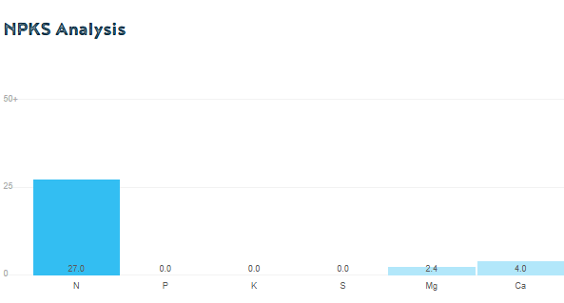
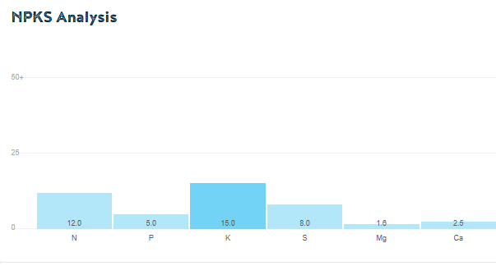
Fertiliser and Crop Nutrition
Complex
Base dressing at transplanting:
  Apply a balanced NPKS fertiliser with trace elements (e.g., Complex).
  Application rates are based on soil test results.
Side dressing during growth:
  Apply Calcium Ammonium Nitrate (CAN).
  Supplies nitrogen for leaf growth and calcium for strong plant development.
Foliar sprays (every 10–14 days):
  Approved fungicides
  Insecticides (when required)
  Trace elements
  Protect crops from pests and diseases while providing rapidly absorbed nutrients.
Complex
CAN
CAN

Slide 12
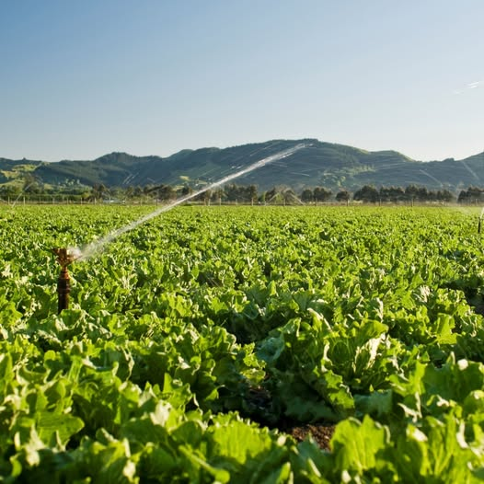
Irrigation
Lettuce is 95% water and have shallow roots, requiring consistently moist soil.
Daily irrigation may be needed during hot, sunny weather.
Consistent watering promotes:
  Fast growth
  Crisp, high-quality heads
Avoid overwatering to reduce the risk of pests and diseases.
Irrigate in the morning or early afternoon so plants dry quickly, helping to minimise disease.

Slide 13
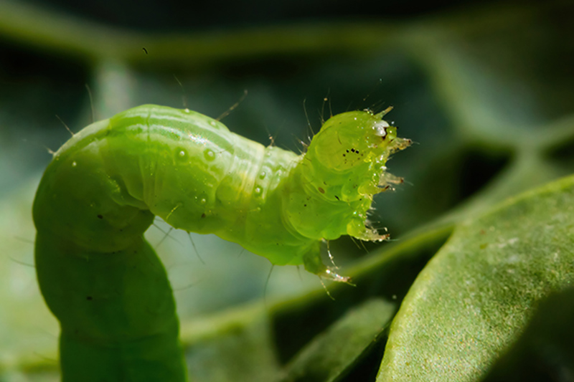
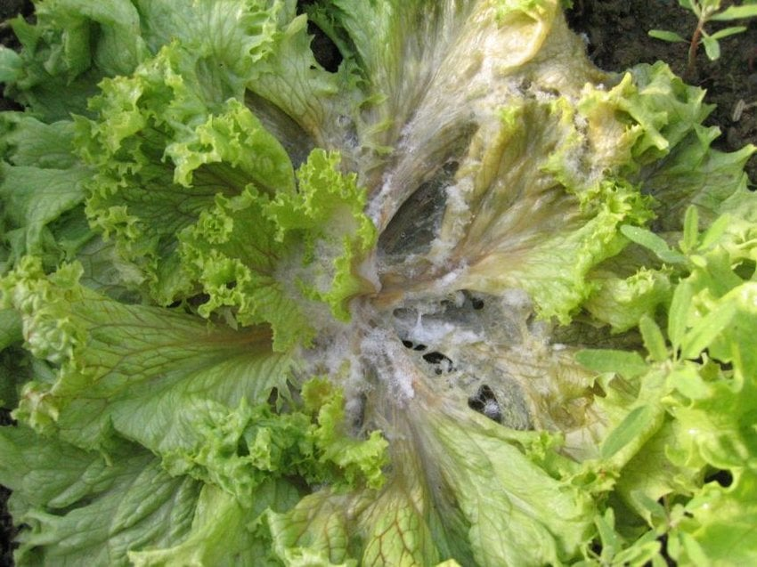
Pest, disease and disorders
Lettuces can be affected by a range of pests, diseases, and growing disorders that can reduce plant growth, damage leaves, and lower crop quality.
Refer PPT Lettuce pest and disease
Some Common Lettuce
Pest | Diseases | Disorders
Aphids Slugs Thrips Caterpillars Rabbits Pūkeko Possums | Downy mildew Sclerotinia (white mould) Bacterial leaf spot | Tip burn Bolting

Slide 14
Integrated Pest and Disease Management (IPM/IDM)
Ladybird
Protects lettuce by combining preventive, biological, cultural, and chemical control methods.
Aims to reduce pests and diseases while minimising chemical use.
Key Management Strategies
Grow resistant varieties and use disease-free seed and seedlings.
Use transplant drenching to control insect pests (especially in spring, summer, and autumn).
Encourage beneficial insects (e.g., ladybirds, lacewings, parasitoid wasps) by increasing biodiversity with flowering plants.
Monitor crops regularly for pests, diseases, and beneficial insects.
Manage irrigation to avoid prolonged leaf wetness.
Improve airflow between plants and rotate crops to reduce disease build-up.
Apply targeted pesticides or fungicides only when necessary.
Parasitoid wasp

Slide 15
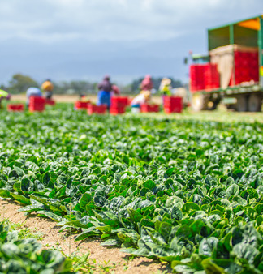
Harvesting
Lettuce is harvested by hand daily at the correct stage of maturity.
Harvest workers select only heads that meet market standards for:
  Size
  Shape
  Firmness
Lettuces are trimmed and packed into crates in the field.
Careful handling prevents bruising and damage.
Commercial growers aim to harvest over 90% of the crop, with only low-quality heads left behind.

Slide 16
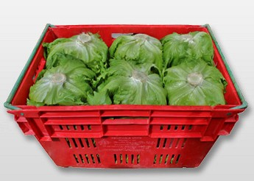
Post-Harvest Handling
Lettuce is transported to the packhouse within 1 hour of harvest to maintain freshness.
At the packhouse, heads are blast cooled to about 2°C to remove field heat quickly.
Rapid cooling:
  Maintains crispness and freshness
  Improves food safety
  Extends shelf life
Cooled lettuce is distributed to supermarkets and other markets, usually within 24 hours of harvest.

Slide 17
Do:
Growing lettuce questions (WS)

Slide 18
Activity 7:
Investigating lettuce prices
Month | Lettuce prices/1kg
Feb 2025 | 4.53
Mar 2025 | 4.48
Apr 2025 | 4.38
May 2025 | 5.4
Jun 2025 | 6.36
Jul 2025 | 6.71
Aug 2025 | 7.79
Sep2025 | 6.75
Oct 2025 | 4.6
Nov 2025 | 3.64
Dec 2025 | 3.07
Jan 2026 | 4.15

Slide 19
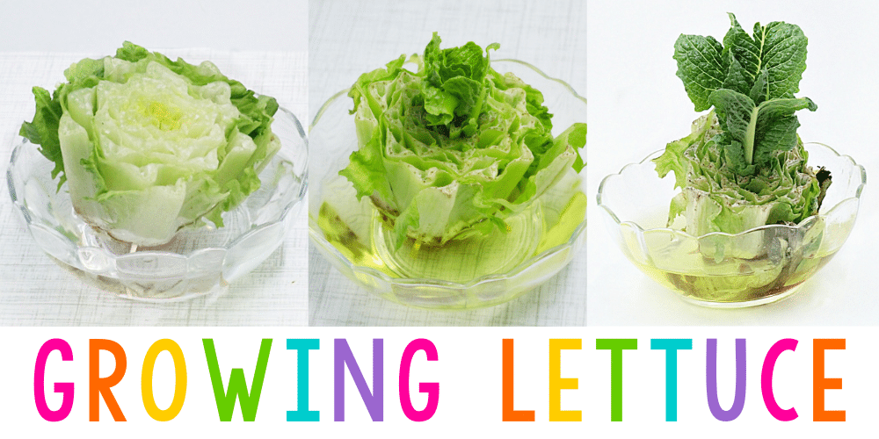
Science for Kids
Growing Lettuce Indoors
https://www.pre-kpages.com/science-for-kids-growing-lettuce/

