Slide 1


Slide 2
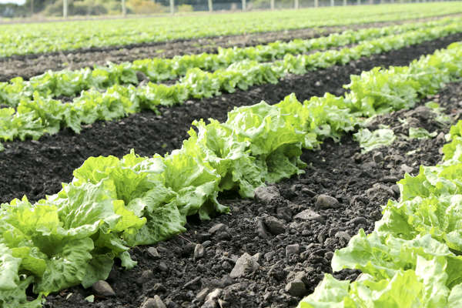
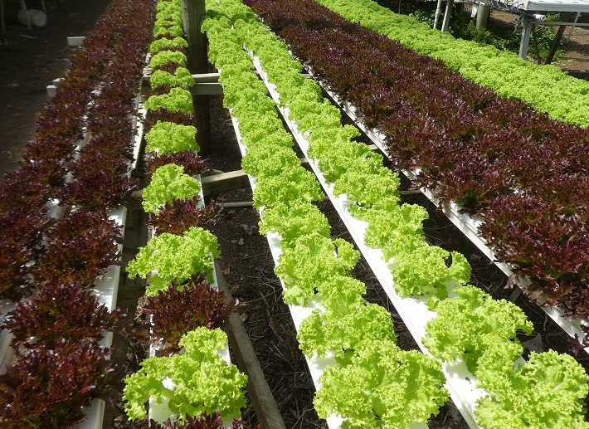
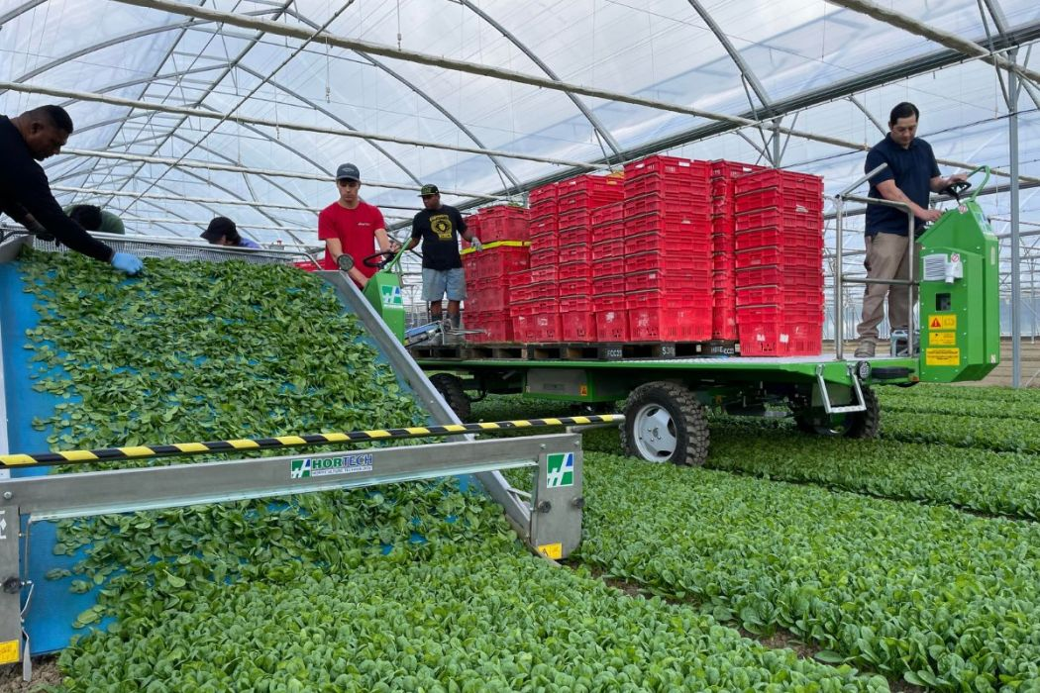

Lettuce Growing Systems
Field, Hydroponic, Inground Covered

Slide 3
Growing Systems for Lettuce
Lettuce in New Zealand is grown using a range of systems to ensure a consistent, high-quality year-round supply
Growers choose methods based on climate, location, and market demand
Main systems: field production, hydroponics, and protected in ground cropping
Each system has different advantages in efficiency, cost, and environmental control

Slide 4
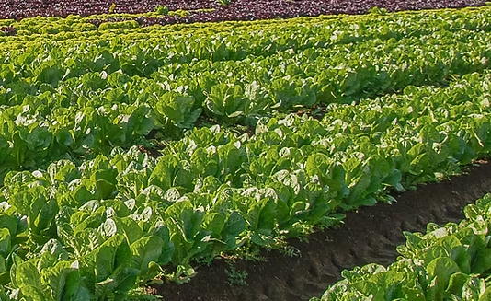
Field Production
Watch: Growing leafy greens in NZ https://www.youtube.com/watch?v=Om6QyUwXcXs&t=11s
Traditional method used for large-scale commercial lettuce growing
Uses raised beds to improve soil drainage and growing conditions
Row spacing is adjusted depending on lettuce variety
Cost-effective and widely used across New Zealand
Limitations:
More exposed to weather changes and seasonal variation
Higher risk of pests and diseases compared to controlled systems

Slide 5
Hydroponic system
Lettuce grown without soil using nutrient-rich water solutions
Common in regions near major cities
A 1hectare system can produce the same yield as 40 hectares of field cropping ~70,000 lettuce plants (varies by system and variety)
Advantages:
Clean consistent product (quality, size, and yield)
Year-round production
Efficient use of water and nutrients
Lower pest and disease risk

Slide 6
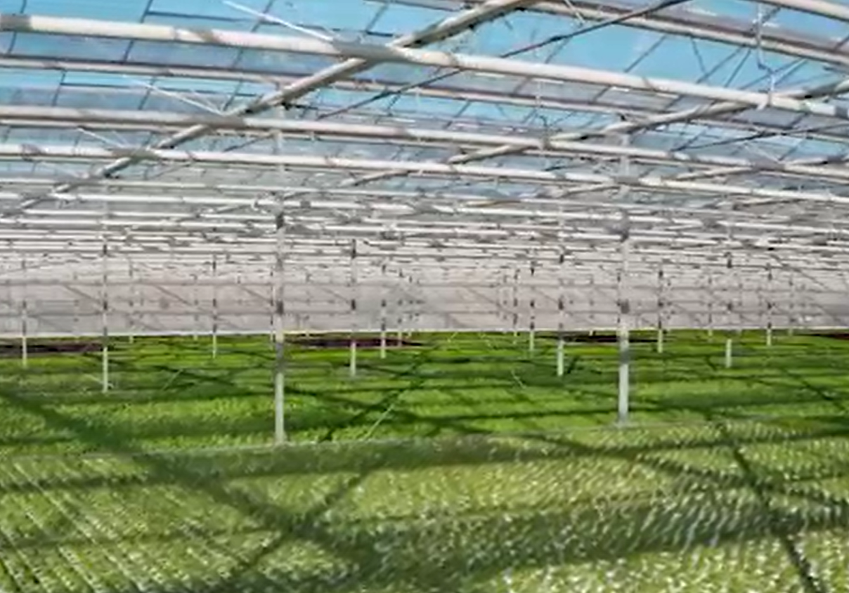
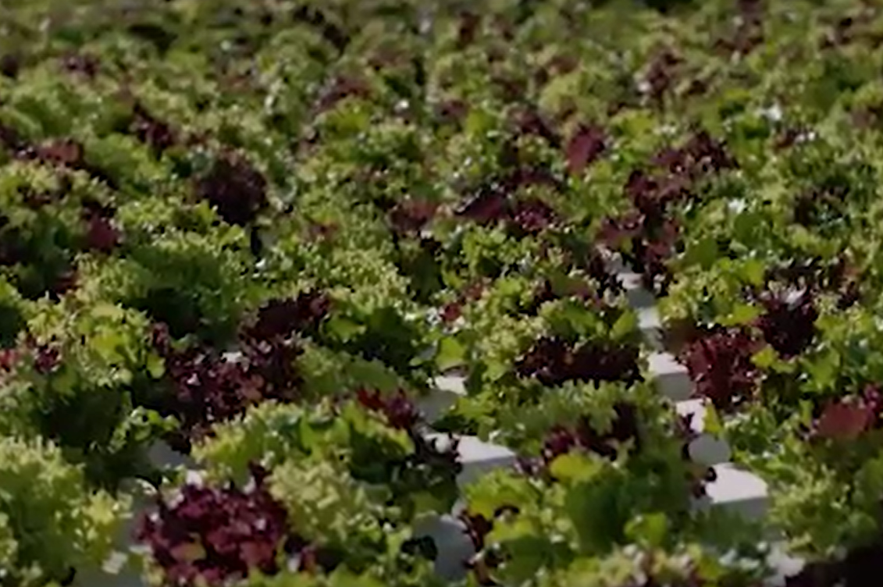
Indoor hydroponics lettuce production

Slide 7
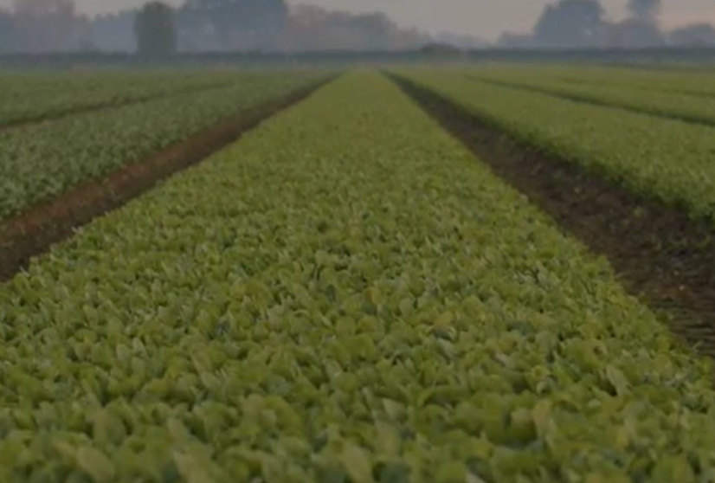
Outdoor and Hydroponic Lettuce and Leafy Crop Production
Watch video: Southern Fresh - leafy green growing and processing https://southernfresh.co.nz/

Slide 8
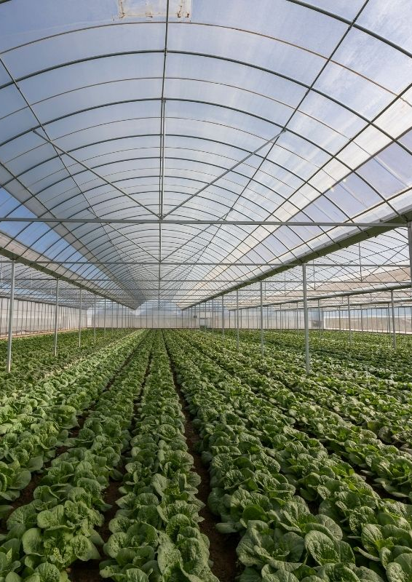
Protected in ground cropping
Uses polytunnels with soil-based growing systems
Protects crops from extreme weather conditions
Creates a more stable and controlled growing environment
Benefits:
Year-round production
Better control of temperature, humidity, and pests
Improved consistency, quality, and supply reliability
More consistent crop supply, helping ensure a steady supply of fresh, healthy vegetables at stable prices in New Zealand
Reduces the impact of weather variability and supply disruptions
Supports more sustainable farming and the adoption of advanced growing technologies

Slide 9
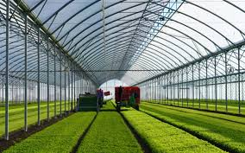
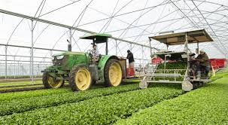
In ground covered salad production watch video https://www.youtube.com/watch?v=IXHHeqlH0C4&t=91s

