Slide 1


Slide 2
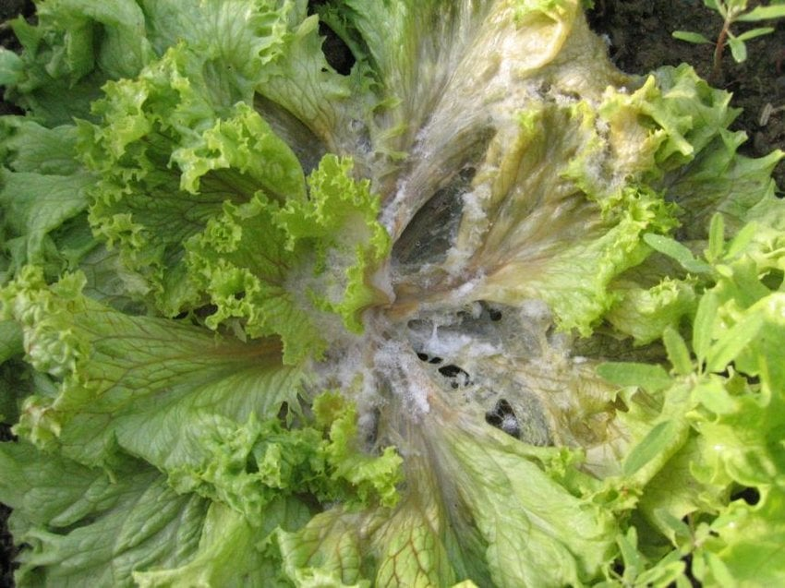
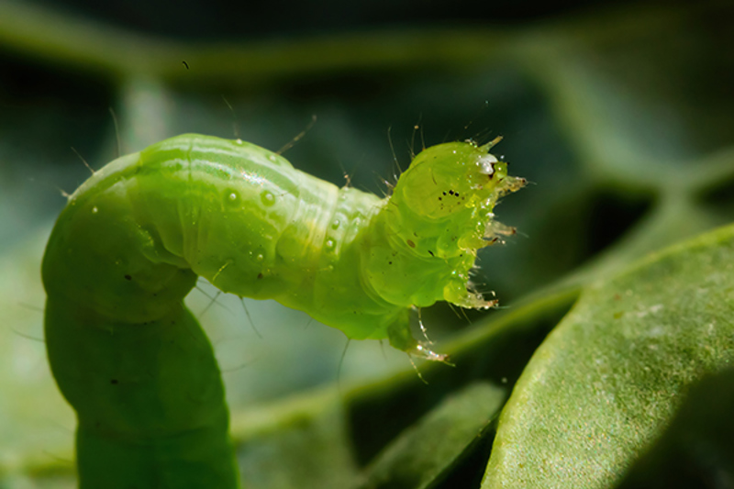
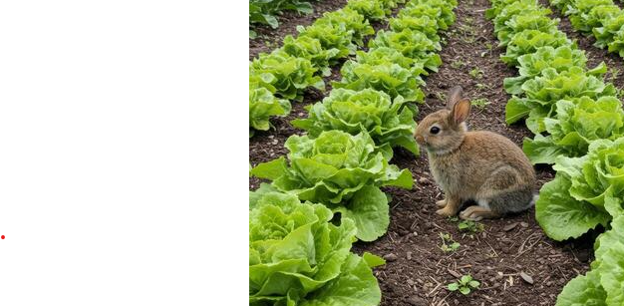
Lettuce
Pest & Disease Management

Slide 3
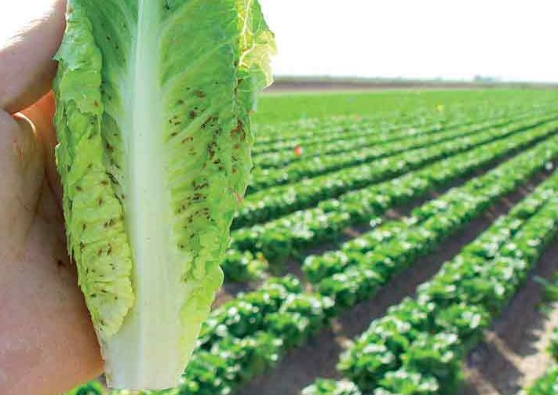
Aphids
Aphids are:
Tiny insects that suck sap from plants.
They use needle-like mouthparts to feed on plant juices.
Damage
Cause leaves to curl and plants to grow poorly.
Leave behind a sticky liquid called honeydew.
Some aphids can spread plant diseases (viruses).
Even a few aphids on lettuce or other leafy vegetables can make the crop difficult or impossible to sell.
Growers monitor aphids carefully because they can reduce crop quality, lower profits, and increase the need for pest management.

Slide 4
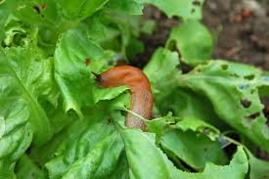
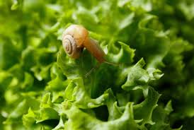
Slugs and snails
Slugs and snails are night time plant eaters that can quickly damage young vegetable crops, so growers monitor them and manage them before they become a serious problem.
They are soft-bodied animals called molluscs.
They have a muscular foot to move and rough mouthparts that scrape plant leaves.
Snails have a shell, while slugs do not.
Damage
Eat young lettuce leaves and seedlings.
Leave holes in leaves and can chew through young stems.
Are most active on cool, wet nights and in damp, shady places.
Signs to look for
Silvery slime trails on leaves or soil.
Holes chewed in leaves.
Young seedlings damaged or cut off near the base.

Slide 5
Lopper caterpillars
Looper caterpillars are:
A common pest of lettuce and other vegetable crops.
They are named for their looping or inchworm-like movement as they crawl.
Damage
Chew large, ragged holes in lettuce leaves.
Can quickly damage crops if their numbers become too high.
Leave behind small, dark droppings (frass) on the leaves.
Growers regularly monitor for looper caterpillars because early detection helps prevent serious crop damage and reduces the need for insecticide sprays.

Slide 6
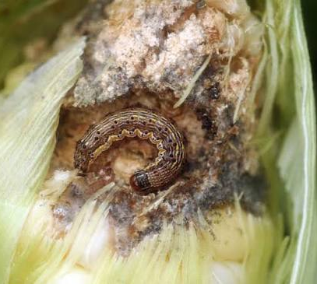
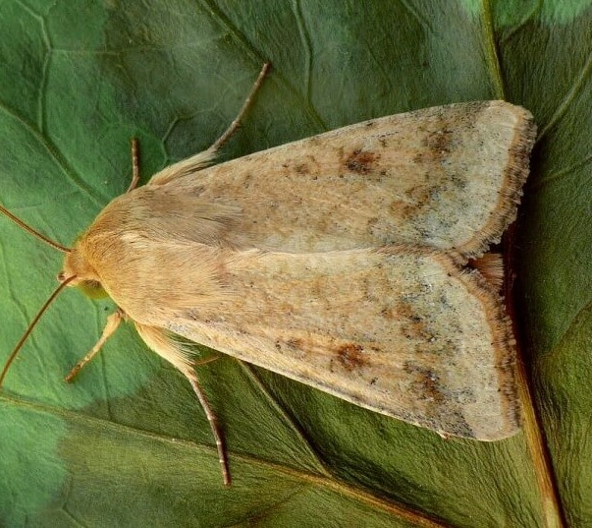
Tomato fruitworm
Heliothis
The tomato fruitworm is the caterpillar (larval stage) of a moth.
It feeds on many crops, including lettuce, tomatoes, corn, and beans.
The caterpillars are usually green, brown, or pink and can grow up to 4 cm long.
Damage
Chews ragged holes in lettuce leaves.
Tunnels deep into the centre of developing lettuce heads.
Leaves behind wet, damaged areas filled with caterpillar droppings.
This makes the lettuce poor quality and difficult to sell.
Growers use Integrated Pest Management (IPM), which combines different methods to reduce pests while protecting the environment.
Parasitoid wasps are one of the best natural controls. These tiny wasps lay their eggs on or inside the tomato fruitworm larvae.
The developing wasp larvae kill the fruitworm before it can damage the inner leaves of the lettuce.

Slide 7
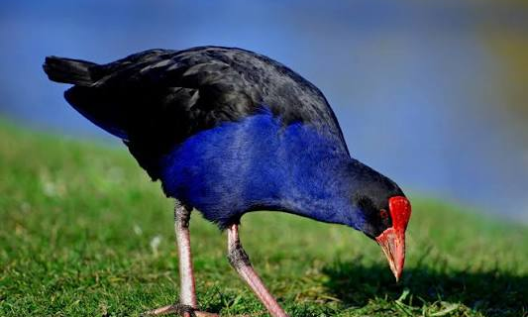
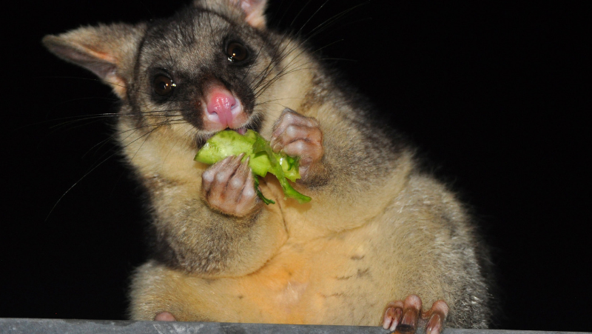
Other pests

Slide 8
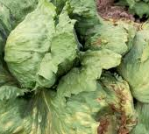
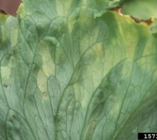
Downy Mildew
Downy Mildew is;
A fungus-like disease that grows in cool, damp conditions.
Looks like white or grey fluffy patches on the underside of leaves.
Damage
Affects all types of lettuce at any growth stage.
Young seedlings can die from severe infections.
Older leaves develop yellow or light green spots that later turn brown and die.
Growers use Integrated Disease Management (IDM) practices to reduce the risk of this disease:
  Plant lettuce where there is good airflow and drainage.
  Leave enough space between plants.
  Plan timing of irrigation to allow leaves dry which helps prevent downy mildew from spreading.

Slide 9
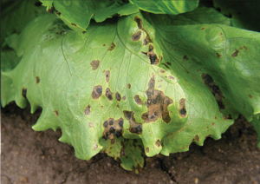
Bacterial leaf spot
Xanthomonas campestris pv. Vitians
Bacterial leaf spot is;
A bacterial disease that affects lettuce leaves.
It spreads easily in wet weather and through rain or overhead watering.
Damage
Starts as small, water-soaked spots on older leaves.
Spots turn dark brown or black and join together.
Leaves can wilt, dry out, and die, reducing the quality of the lettuce.
Growers
Use clean, disease-free seeds.
Space plants to improve airflow so leaves dry quickly.
Rotate crops each season.
Carefully manage irrigation to keep leaves dry and help stop bacterial leaf spot from spreading.

Slide 10
Sclerotinia (White Mould)
Sclerotinia sclerotiorum and Sclerotinia minor
Sclerotinia (White Mould) is;
A soil-borne fungal disease which thrives in cool, wet, and humid conditions.
Symptoms
Soft, watery rot on stems and lower leaves.
White, fluffy fungal growth on infected plants.
Produces hard, black survival structures called sclerotia.
Sclerotia can survive in soil for 5–7 years.
Growers
Space plants to improve airflow so leaves dry quickly.
Rotate crops each season.
Carefully manage irrigation to keep leaves dry and help stop bacterial leaf spot from spreading.
Use approved fungicides only when required.

Slide 11
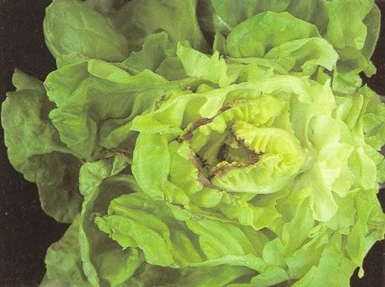
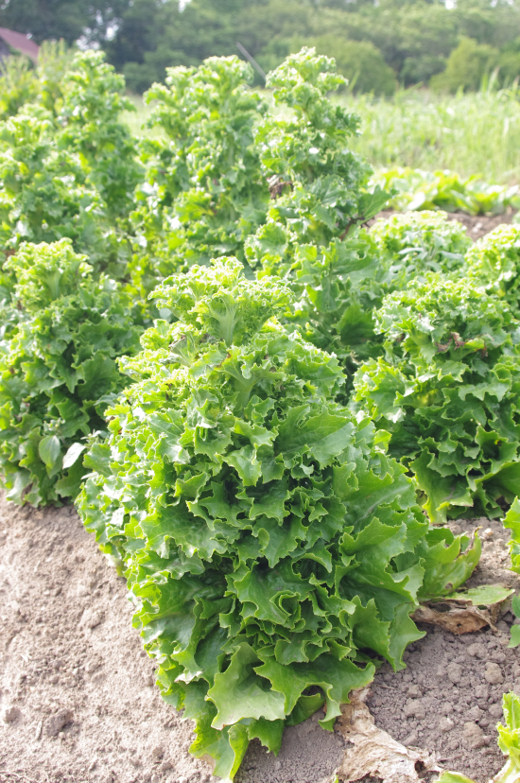
Physiological Disorders
Tipburn and Bolting
Tip burn is a physiological disorder) that affects young, inner lettuce leaves.
It appears as brown, dry, dead areas along the leaf edges.
Cause
Caused by a calcium deficiency in rapidly growing leaves.
Calcium does not move quickly enough to the new leaf tissue when plants are growing fast.
Often occurs during hot weather, rapid growth, or periods of water stress.
Management Strategies
Good cultivar selection, balanced nutrition, and consistent water supply help reduce tip burn and produce high-quality iceberg lettuce.
Bolting occurs when lettuce prematurely produces a tall flower stalk instead of forming a quality head.
Causes
Rapid changes in temperature and long daylight hours
Stress caused by unsuitable growing conditions
Signs
Lettuce head starts stretching upwards as a flower stalk develops.
Leaves become tougher and develop a bitter taste due to increased plant sap production.
Management Strategies
Selecting the right cultivar for the season helps prevent bolting

Slide 12
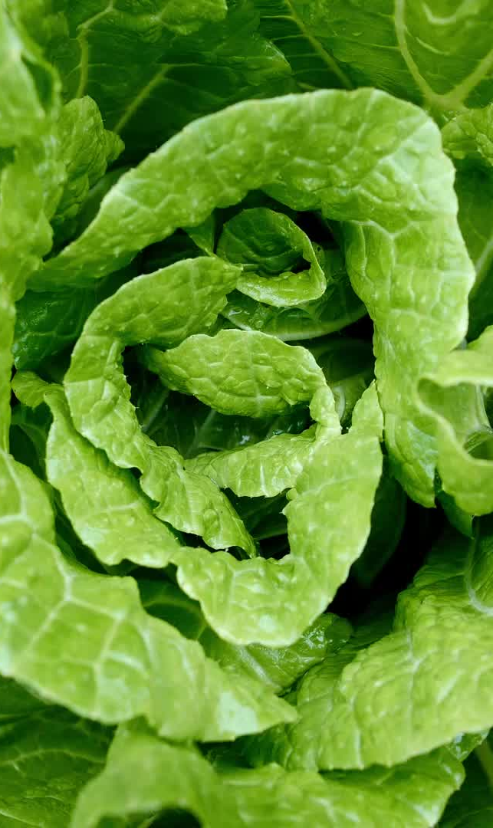
Managing Lettuce Diseases
Integrated Disease Management (IDM)
The best way to protect lettuce is to prevent diseases before they spread. Farmers use Integrated Disease Management (IDM), which combines several methods instead of relying on just one.
Key strategies include:
Choose resistant varieties – Some lettuce varieties are naturally resistant to certain diseases.
Use healthy seeds – Plant disease-free seeds to stop diseases before they start.
Keep fields clean – Remove weeds, old plants, and crop debris that can spread disease.
Manage water carefully – Use drip irrigation instead of overhead sprinklers to keep leaves dry.
Improve airflow – Leave enough space between plants so leaves dry quickly after rain or watering.
Rotate crops – Grow different crops each season to reduce disease build-up in the soil.
Use pesticides only when needed – Fungicides and other products are used carefully as part of the overall management plan.

Slide 13
Beneficial Insects
Healthy populations of beneficial insects help keep pest numbers low, reduce the need for insecticides, and make vegetable crops more resilient.
Beneficial insects help growers by:
Pollinating flowers.
Breaking down dead plant material.
Controlling crop pests as part of Integrated Pest Management (IPM).
Beneficial insects
Many beneficial insects live in New Zealand vegetable crops, including lettuce.
They include predators (which eat pests) and parasitoids (which lay eggs in or on pests, eventually killing them).
Growers can protect them by?
Learning to identify and monitor beneficial insects in crops.
Using selective insecticides that are less harmful to beneficial insects.
Planting biodiverse habitats that provide (SNAP):
  Shelter
  Nectar
  Alternative food
  Pollen

Slide 14
Biodiversity and
Pest Management
Biodiversity means having a variety of plants, insects, and other living things on a market gardens, farms and orchards. Biodiversity works best as part of Integrated Pest Management (IPM), helping growers, grow high quality crops while reducing the need for pesticides
Growers use Integrated Pest Management (IPM) to:
Grow pest-resistant lettuce and other plant varieties.
Encourage beneficial insects such as ladybirds, lacewings, and parasitoid wasps that eat or attack pests.
Use targeted pesticides only when needed, instead of spraying all the time.
Regularly monitor crops for both pests and helpful insects.
Why is biodiversity important?
Beneficial insects naturally reduce pest numbers.
Fewer pesticide sprays help protect pollinators and other useful insects.
Using several methods together creates a healthier, more sustainable growing system.
Healthy biodiversity makes crops more resilient to future pest outbreaks.
Do: Biodiversity (WS)

Slide 15
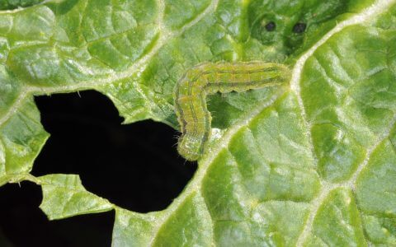
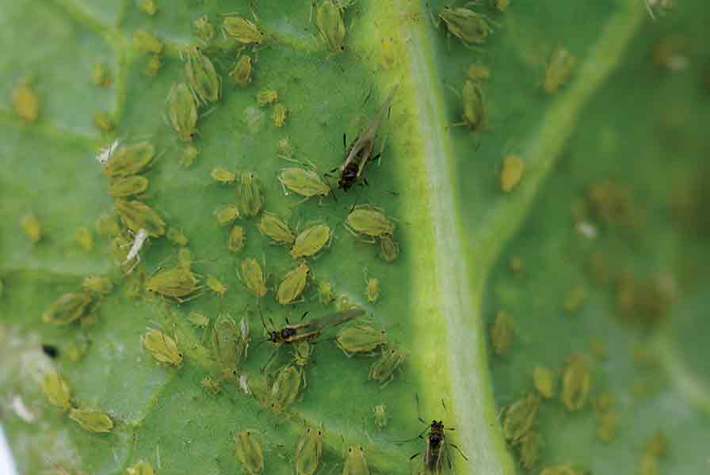
Activity 5: Am I a friend or foe?

Slide 16
Answers: Am I a friend or foe?
Foe
Foe
Friend
Foe
Foe
Foe
Friend
Friend
Friend
Friend
Friend

Slide 17
I am a foe
Slug
Tomato fruitworm
Snail
Looper caterpillar
Aphids

Slide 18
I am a friend
Hover fly larvae
Parasitoid wasp
Damsel bug
Harvestman spiders
Eleven-spotted ladybird
Tasmanian brown lacewing

Slide 19
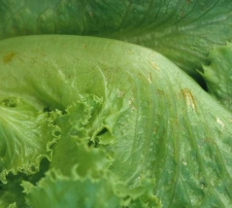
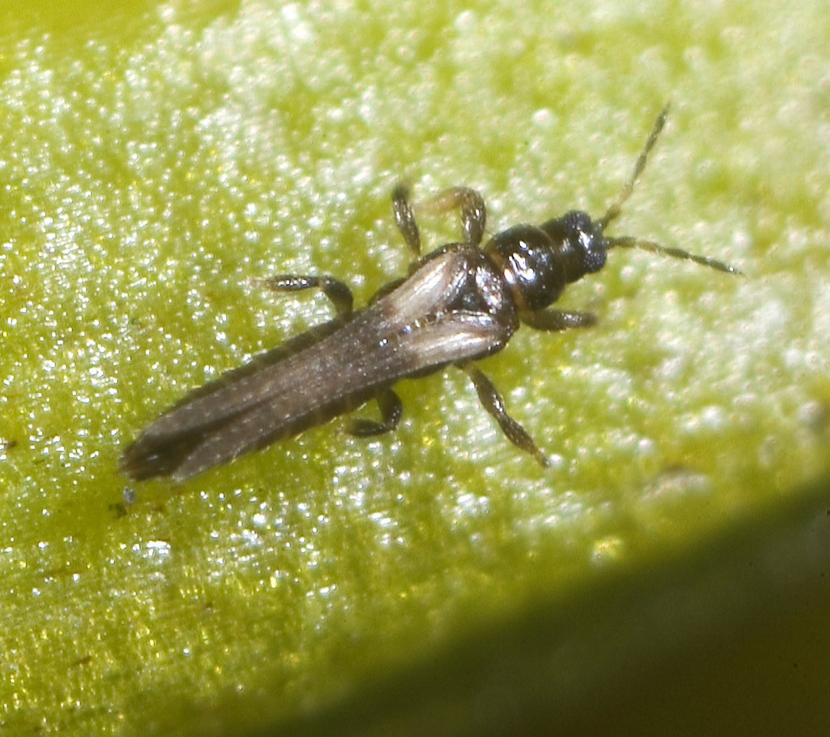
Activity 6:
Research thrips in lettuce

Slide 20
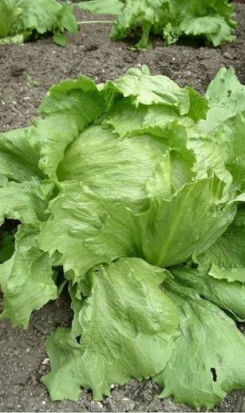
References
2024-07-18-Bacterial-Diseases-of-Lettuce-Factsheet.pdf
Managing-Lettuce-Diseases-Seminis
2024-07-18-Beneficial-insects-in-NZ-Lettuce-Crops.pdf
Spring-lettuce-fact-sheet-v1-revised

