Slide 1


Slide 2
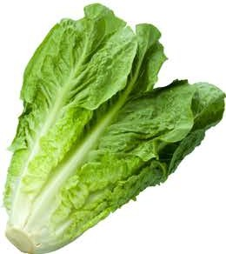
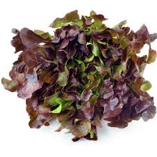
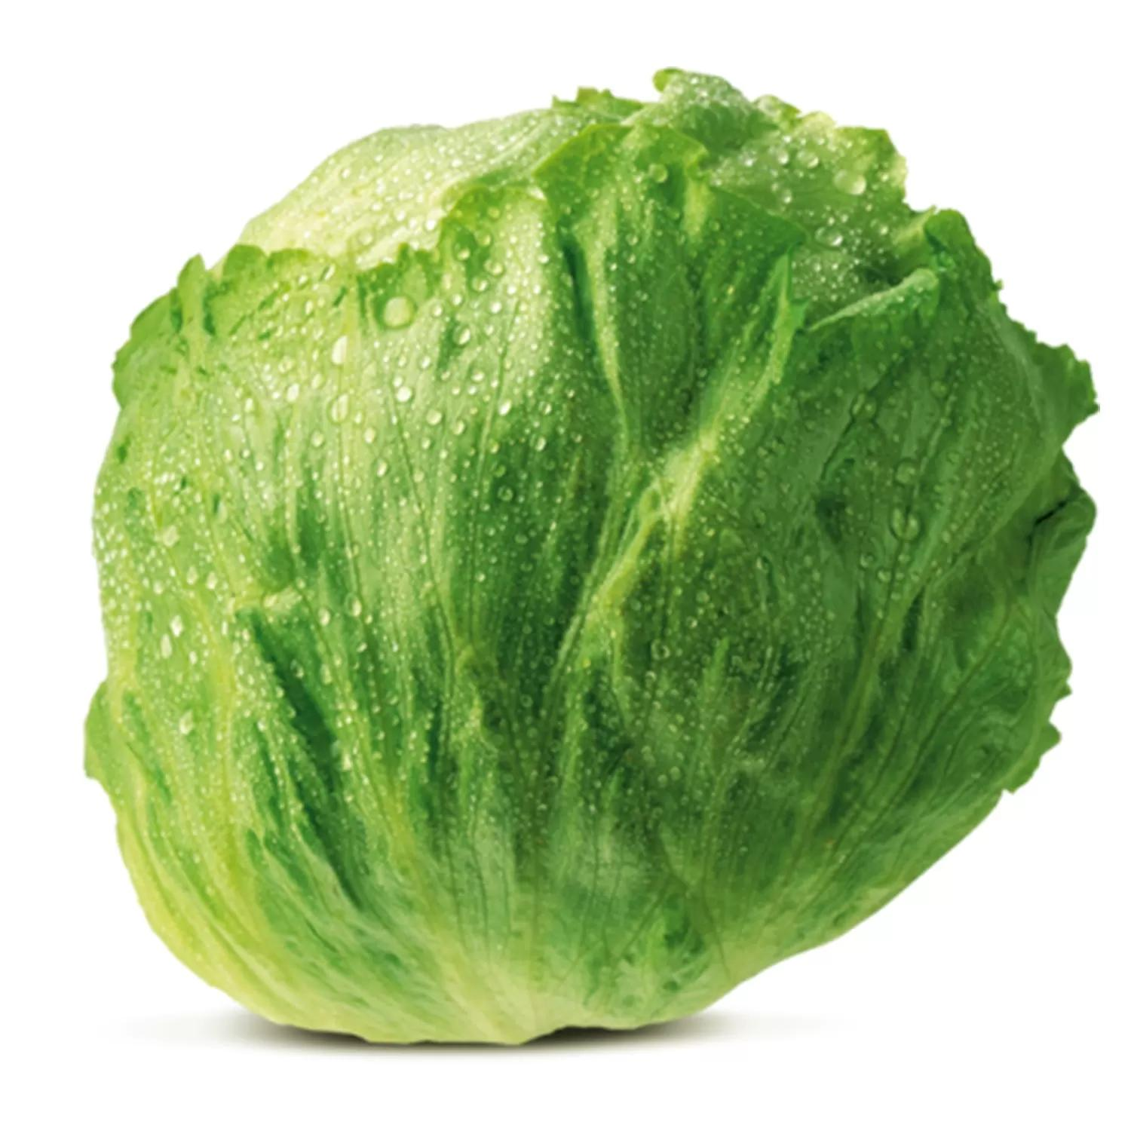
Lettuce Varieties

Slide 3
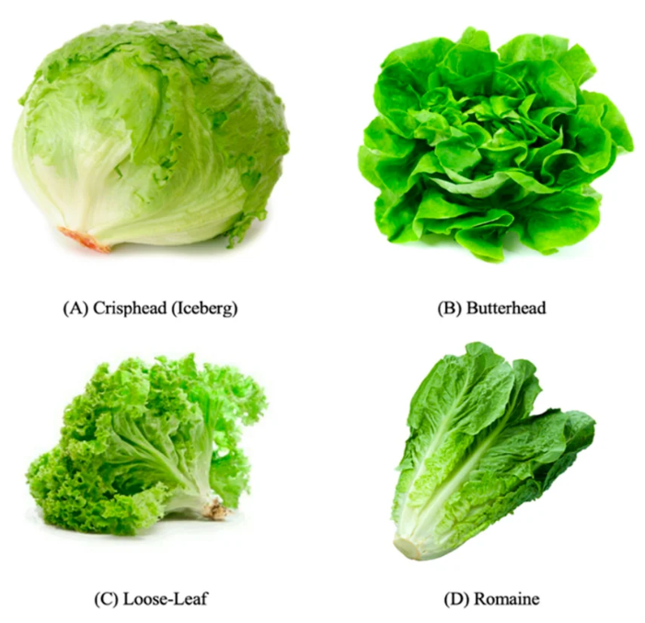
Lettuce Varieties Grown in New Zealand
Commercial growers supply fresh, high-quality lettuce to domestic and export markets year-round.
Production systems are designed to ensure consistent supply, freshness, and quality.
Wide range of varieties grown to meet consumer demand for convenience and diversity.
Key Varieties
Traditional: iceberg, cos (romaine), butterhead
Leafy types: oakleaf, coral
Premium & value-added: baby cos, little gem, Salanova
Specialty greens: rocket (arugula) for salad mixes

Slide 4
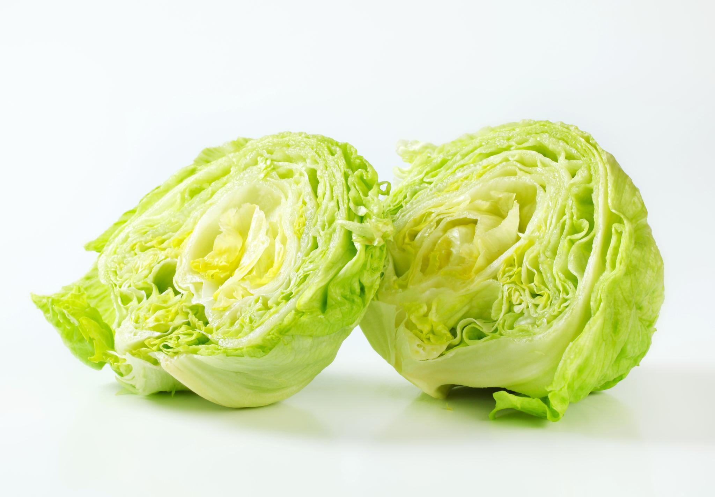
Iceberg Lettuce
Pale green, tightly packed leafy vegetable
Known for its crisp texture and mild flavour
Commonly used in salads, sandwiches, and wraps
Key Characteristics
Texture: Very crunchy and juicy
Flavour: Mild and slightly sweet
Appearance: Round head with tightly layered leaves
Colour: Light green, almost white at the core

Slide 5
Cos (Romaine) Lettuce
Originated from the Mediterranean island of Cos
Features an upright, elongated shape with crisp, sturdy leaves
Has a strong, refreshing flavour and crunchy texture
More nutrient-dense than many other lettuce varieties, providing higher levels of vitamins and minerals
Best known as the key ingredient in classic Caesar salads

Slide 6
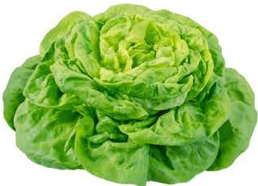
Butterhead (Buttercrunch) Lettuce
Also known as Buttercrunch lettuce
Valued for its soft texture and smooth, succulent leaves
Has a delicate buttery flavour and tender mouthfeel
Forms loose heads with soft green outer leaves surrounding a pale, blanched interior
More heat-tolerant than many other lettuce varieties, making it suitable for diverse growing conditions

Slide 7
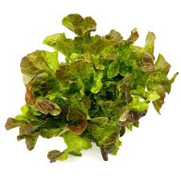
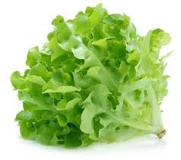
Oakleaf Lettuce
Recognized by its deeply lobed leaves that resemble oak tree leaves
Available in green, red, or mixed-colour varieties
Features a tender texture with a mild, slightly nutty flavour
Forms loose heads with soft, frilly leaves
Best harvested young, as mature leaves can develop a slightly bitter taste when exposed to prolonged sunlight

Slide 8
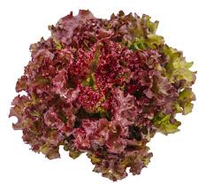
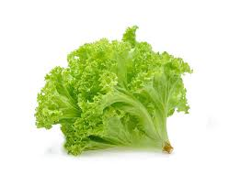
Coral Lettuce
A tender loose-leaf lettuce known for its highly ruffled, curly edges that resemble coral
Commonly available in bright green or deep red-purple varieties, including Lollo Rossa
Often sold with intact roots to help maintain freshness and extend shelf life
Has a mild flavour with a slightly bitter taste and crisp texture
Popular in salads and garnishes for its decorative appearance and vibrant color

Slide 9
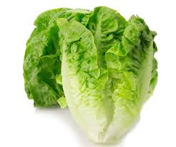
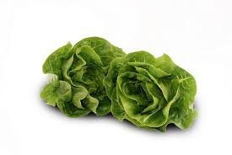
Baby Cos
A smaller, compact version of traditional Cos (Romaine) lettuce
Features elongated heads with crisp, narrow, light green leaves
Has a sweet, crunchy flavour with a slightly sharp taste
Highly versatile and ideal for Caesar salads, sandwiches, wraps, and fresh garnishes
Popular for its convenient size, easy storage, and long shelf life
Perfect for individual servings and modern salad presentations

Slide 10
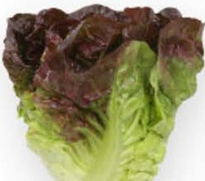
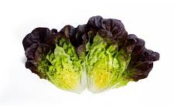
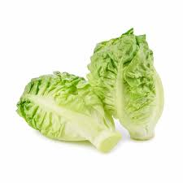
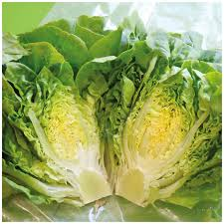
Gems (Mini Cos)
A compact and highly popular mini-cos (romaine) lettuce variety
Known for its exceptionally sweet, crisp, and juicy leaves
Features a dense, crunchy heart with a tender texture
Available in both green and red varieties for colourful salads and garnishes
Convenient miniature size makes it ideal for individual servings and modern dishes
Increasingly popular due to its versatility, fresh flavour, and attractive appearance

Slide 11
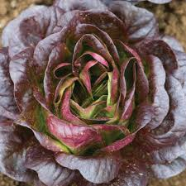
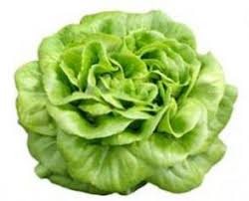
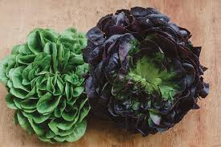
Salanova Lettuce
An innovative lettuce variety developed through advanced breeding techniques
Especially known for the popular Salanova Butter type
Produces hundreds of small, tender leaves from a single head
Can deliver up to 40% higher yields compared to traditional lettuce varieties
Designed to create uniform, bite-sized leaves for easy preparation and serving
Ideal for convenient, ready-to-eat salad mixes and modern food service applications

Slide 12
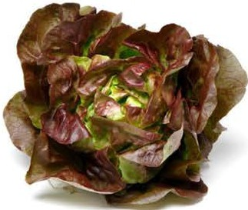
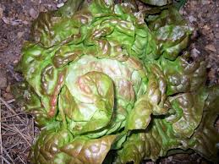
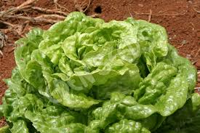
Mignonette Lettuce
A popular French heritage butterhead lettuce variety
Known for its small, compact heads measuring about 20–25 cm across
Features soft, tender leaves with an intense, rich flavour
Available in green, bronze, or red-tinged leaf varieties
Often called “Little Cutie” due to its compact size and attractive appearance
Highly valued for being hardy, easy to grow, slow to bolt, and heat-tolerant

Slide 13
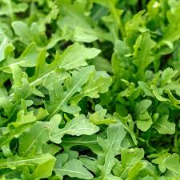
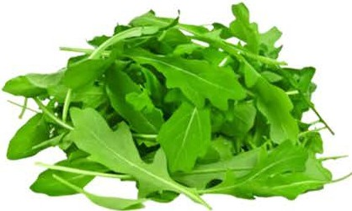
Rocket (Arugula)
A fast-growing leafy green commonly included in salad mixes (though not a true lettuce)
Also known as arugula or rucola
Recognized for its distinctive peppery, spicy flavour
Often used fresh in salads, sandwiches, and as a garnish
Rapid-growing crop with a maturity of approximately 35–50 days
Adds bold flavour and freshness to a wide range of dishes

Slide 14
Quiz:
Match the name to the correct lettuce
Iceberg
Butterhead
Oakleaf
Cos

Slide 15
Quiz:
Answers
Oakleaf
Cos
Butterhead
Iceberg

