Slide 1


Slide 2
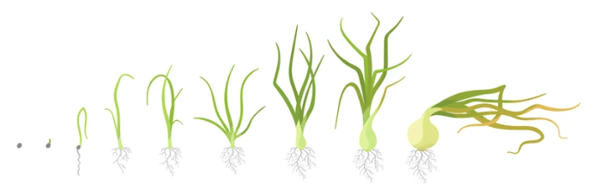
Growing Onions
Videos
Growing onions in NZ- Pukekohe https://www.youtube.com/watch?v=M1c3MhQ4Gqs
Family Farm Onions- Ashburton https://www.youtube.com/watch?v=qtT65N4g_Kc&t=46s

Slide 3
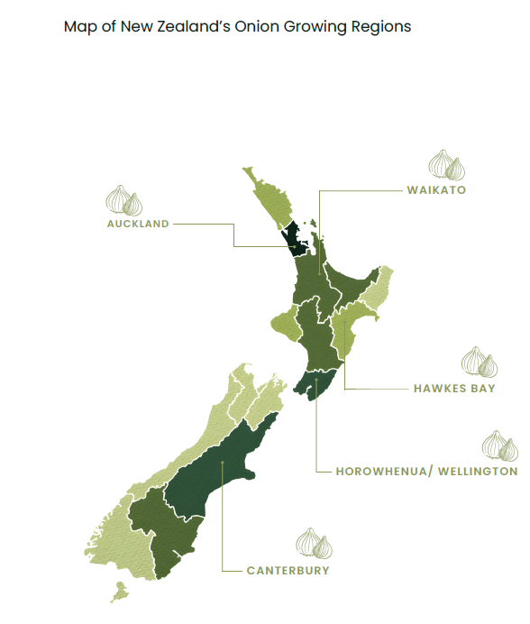
Onion Growing
Requirements
Onions grow best in a temperate climate with plenty of sunlight and consistent moisture.
Ideal temperature range is 13°C–27°C, with bulb formation requiring temperatures above 15.5°C and optimal growth between 21°C–27°C.
Require well-drained, loose loam soils with a pH of 6.0–7.0 for good nutrient uptake and healthy bulb development.
Need regular rainfall or irrigation, but soils must not become waterlogged.
Weed control is important, as onions are poor competitors for nutrients, water, and light.
A dry period during harvest is essential for field curing (typically January in the North Island and February in the South Island)

Slide 4
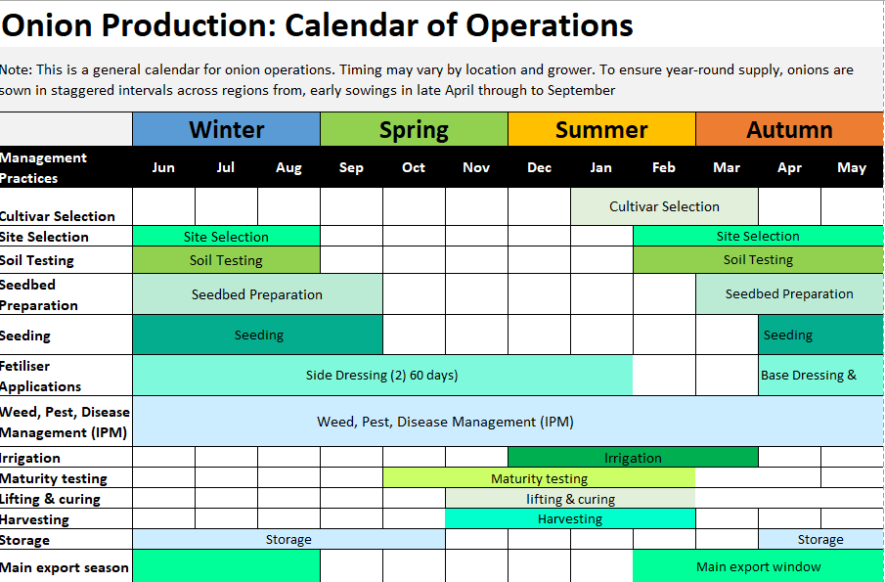

Slide 5
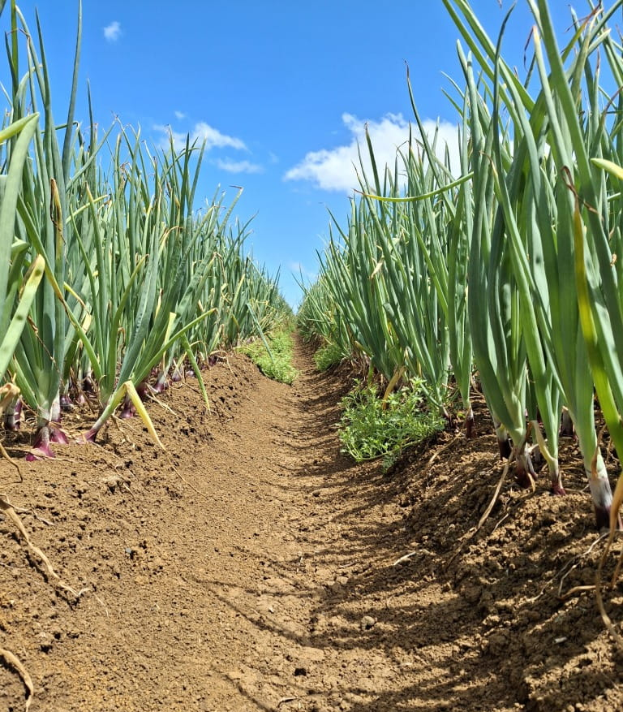
Site selection
Choose well-drained, fertile soils with a pH of 6.0–7.0.
Onions require a long, warm growing season and dry conditions at harvest.
Follow a 4–6 year crop rotation to reduce disease and pest build-up.
Suitable preceding crops include pasture, cereals, and selected brassicas.
Avoid compacted or poorly drained soils, which can reduce yield and increase disease risk.

Slide 6
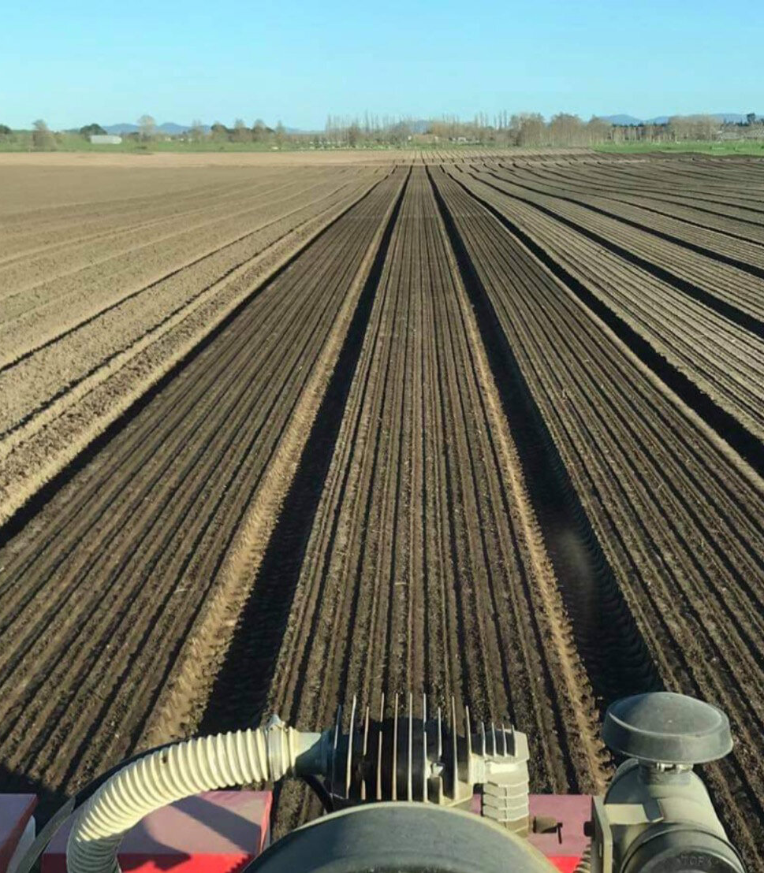
Seedbed preparation
Onions require a fine, firm, and well-prepared seedbed for:
Uniform germination
Strong root establishment
Consistent bulb development
Good seed-to-soil contact, promoting even emergence and crop growth
Cultivation Practices
Cultivation methods are tailored to the soil type and previous crop
GPS-guided cultivation reduces the number of field passes, minimising soil compaction and protecting soil structure
Well-prepared seedbeds improve:
  Moisture retention
  Drainage
  Crop uniformity
Timing
Seedbeds are typically prepared at the end of summer
Soils are then left to rest before planting the next crop.

Slide 7
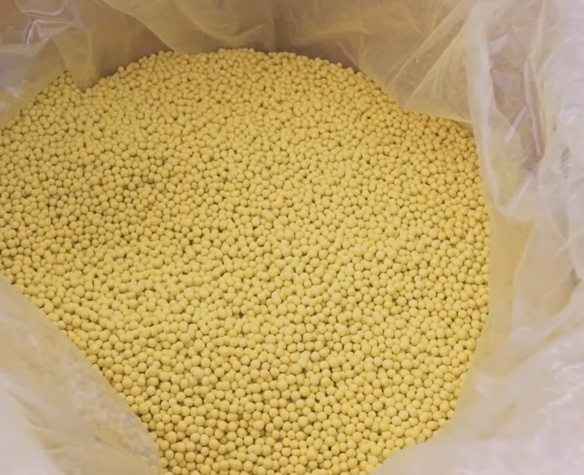
Pelleted onion seed
Onion seed is very small, so it is often coated with a clay-based layer to form pelleted seed and treated with a fungicide.
The coating makes seeds:
  Easier to handle
  More uniform in size
  Suitable for precision planting
Planting benefits
  Allows precision seeders to space seeds accurately
  Helps achieve even germination and uniform crop growth
  Reduces overcrowding and improves bulb quality
Pelleted seed is an important tool for producing consistent, high-quality crops.

Slide 8
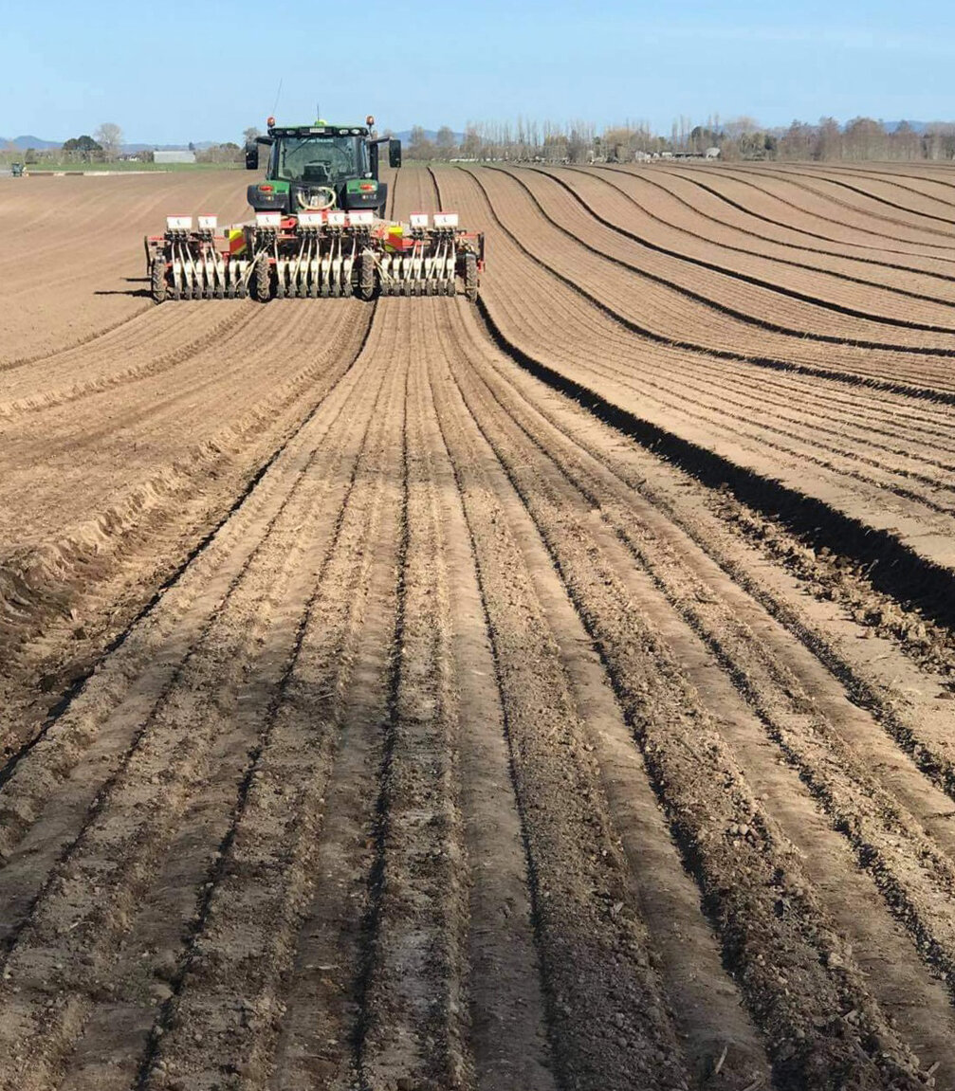
Seeding
Onion seeding in New Zealand can begin as early as late April in the North Island
By September, all onion seed is typically sown nationwide
Seeds are planted using a precision seeder, which ensures accurate spacing and even crop establishment
This helps promote uniform germination and consistent bulb development
Onions being sown into a fine firm seedbed

Slide 9
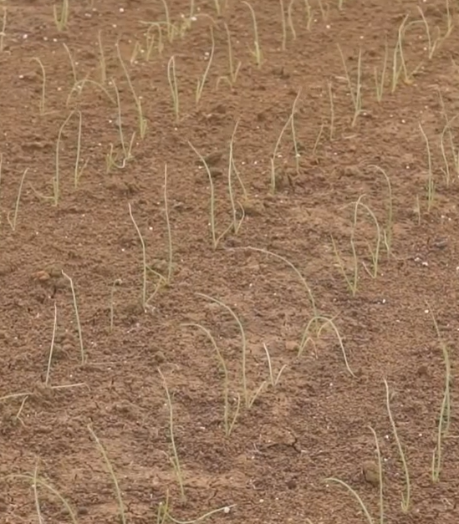
Plant spacing
Planting density is a very important management factor in determining bulb size in onion crops.
  Seed is sown at a depth of 1–2 cm
  Within-row spacing: 2–5 cm between seeds
  Between row spacing
This spacing ensures each plant has enough:
  Light
  Water
  Nutrients
Supports healthy, well-sized bulb development

Slide 10
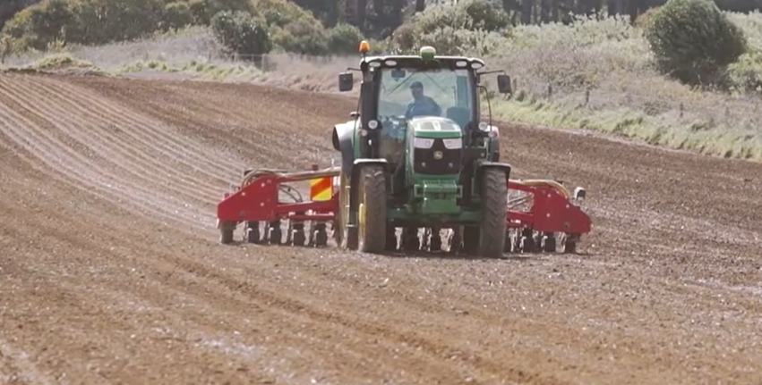
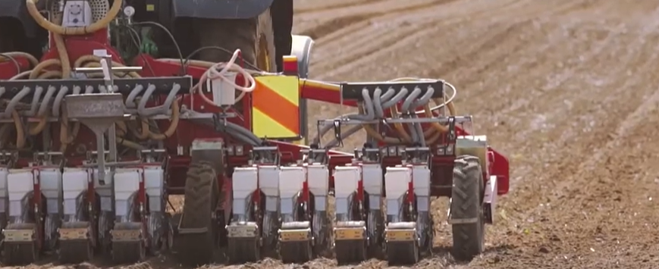
Drilling seed using a precision seeder
Watch : Planting Onions- Precision seeder https://www.youtube.com/watch?v=WNh7C533mhI

Slide 11
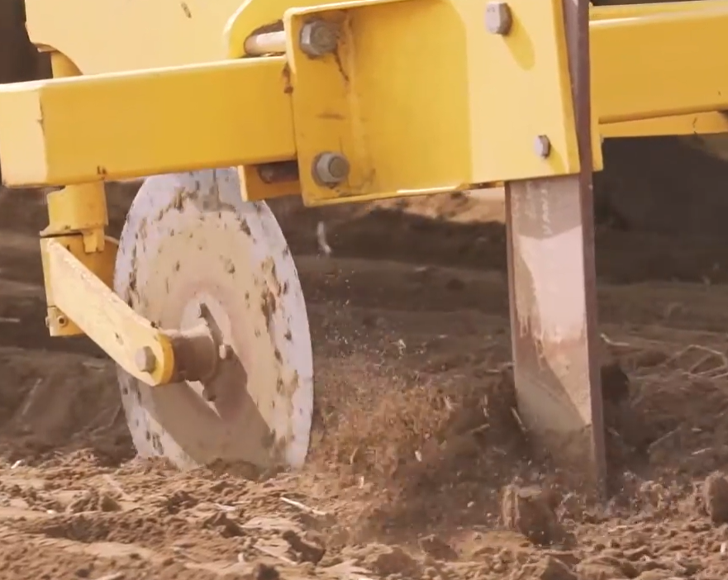
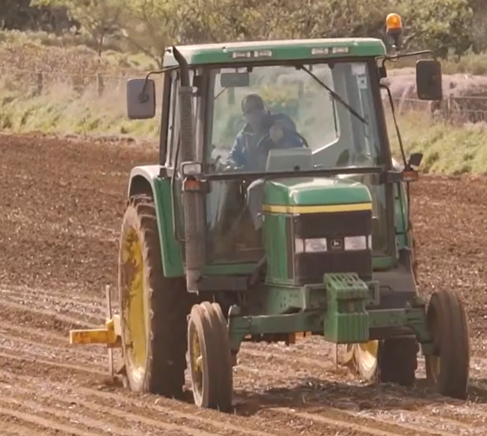
Tramlines ripped to prevent soil erosion

Slide 12
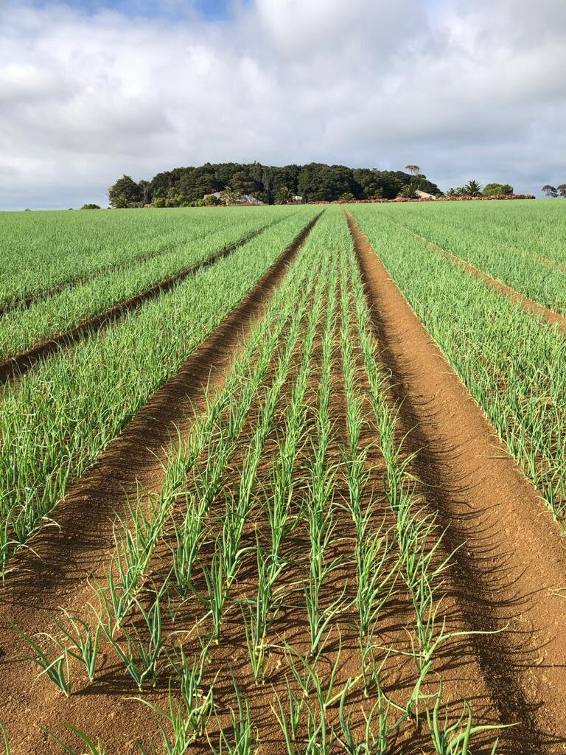
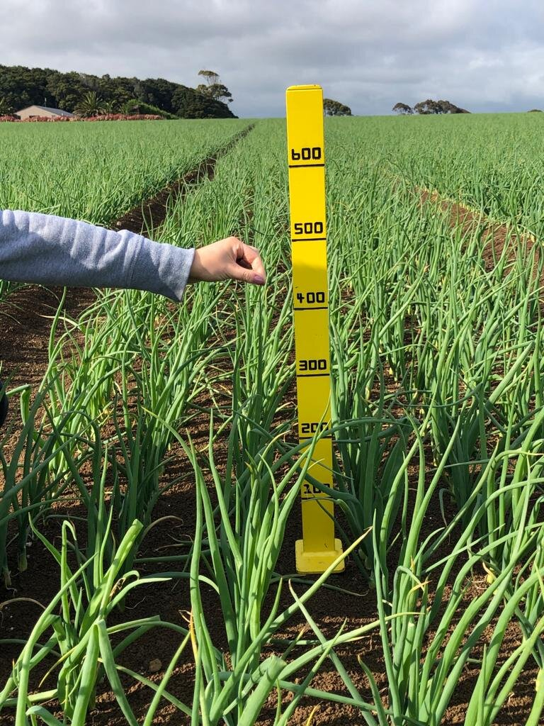
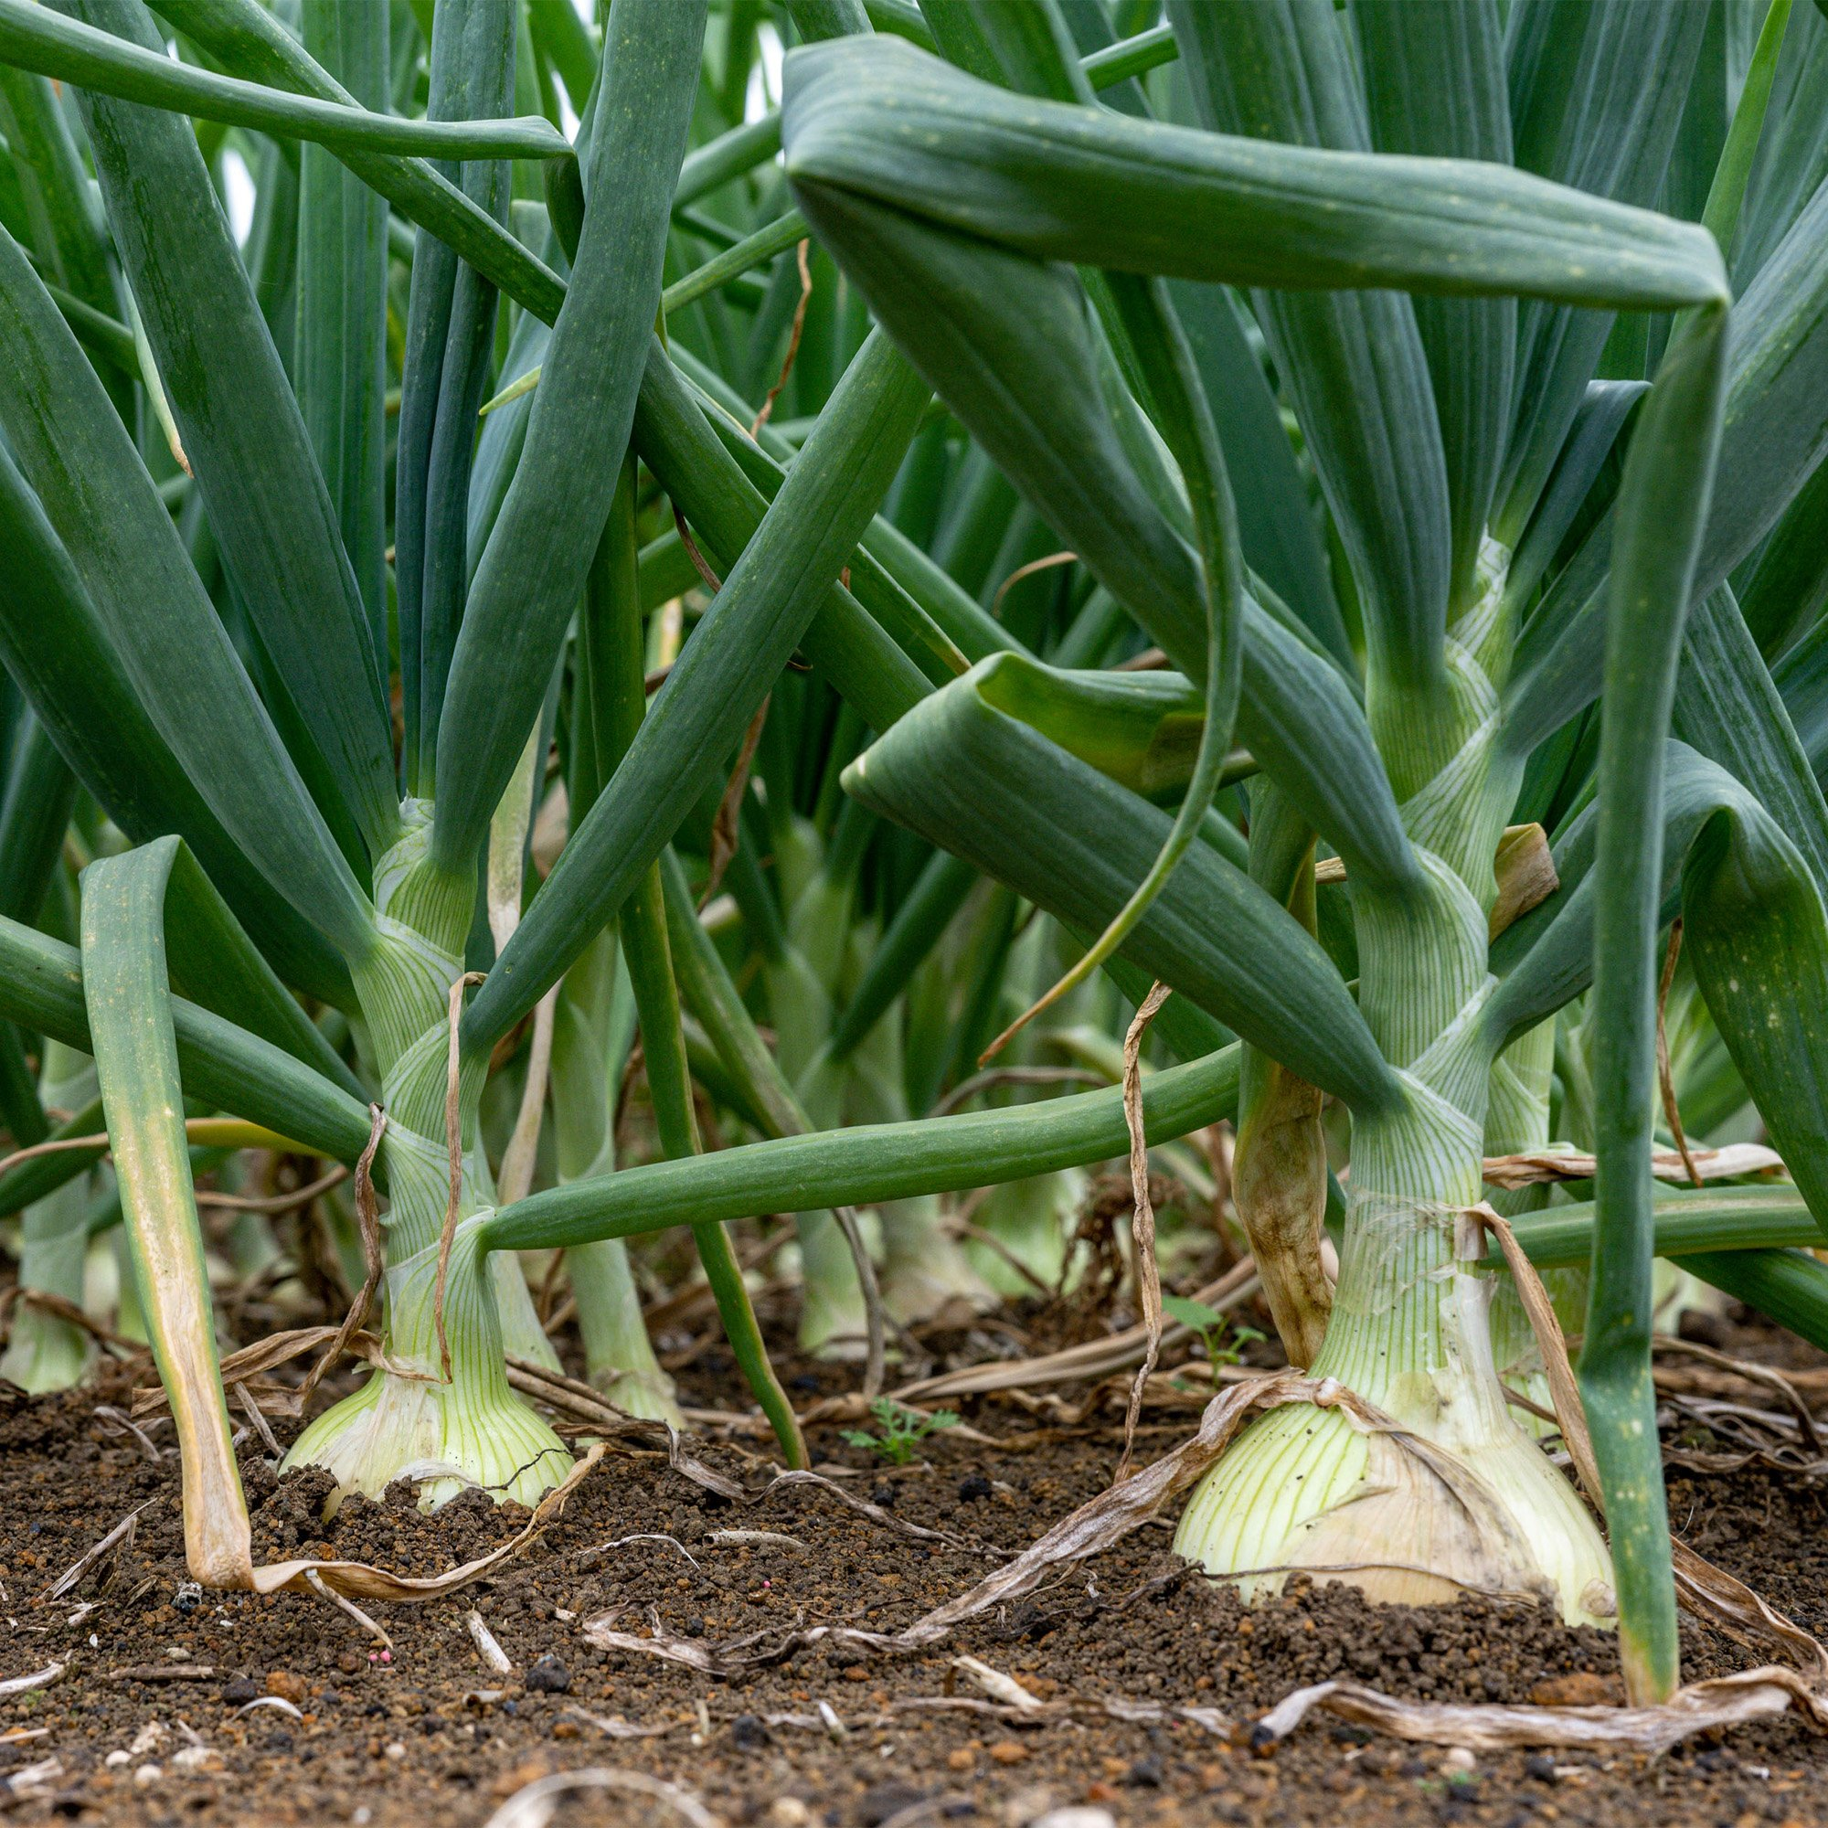
Stages of growth
4 leaf stage
Mid growth
Near maturity

Slide 13
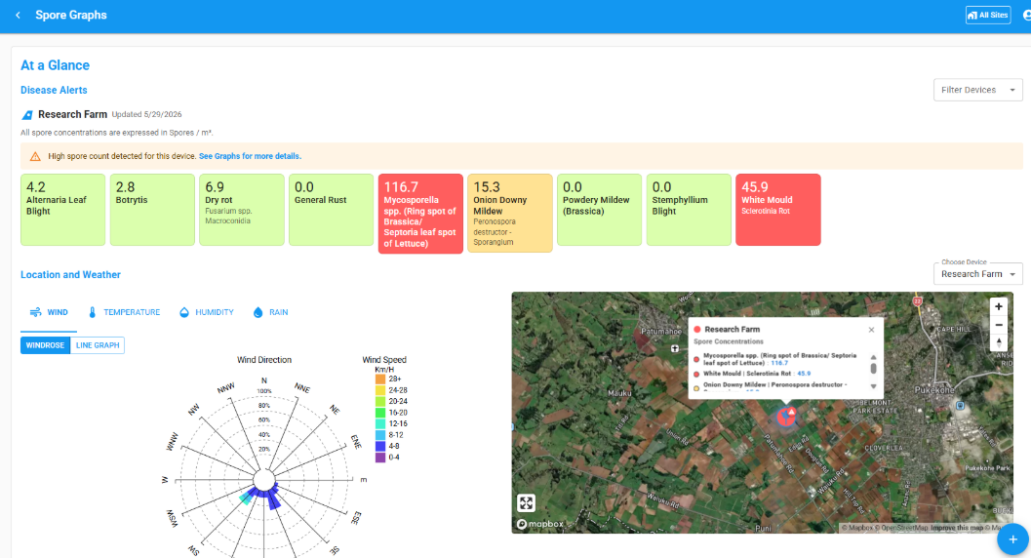
Crop monitoring
Onion crops are regularly monitored throughout the growing season
Ensures plants receive the right balance of water and nutrients
Growers monitor
Plant growth and development
Soil moisture levels
Nutrient status
Pest and disease presence
Crop monitoring
Allows early detection of problems
Enables quick management decisions
Prevents yield and quality loss

Slide 14
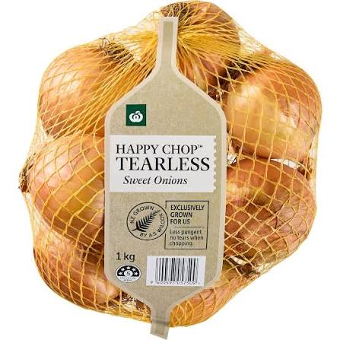
Nutrient management
Essential for high yields and good bulb quality
Requires a balanced supply of macro nutrients
Key Nutrients
Nitrogen (N):
  Supports early leaf and root growth
  Too much later can delay bulb formation and reduce storage quality
Phosphorus (P):
  Promotes strong root development
Potassium (K):
  Important for bulb size, firmness, and overall quality
Sulphur
  Sulphur is an essential component of proteins therefore bulb size and yield

Slide 15
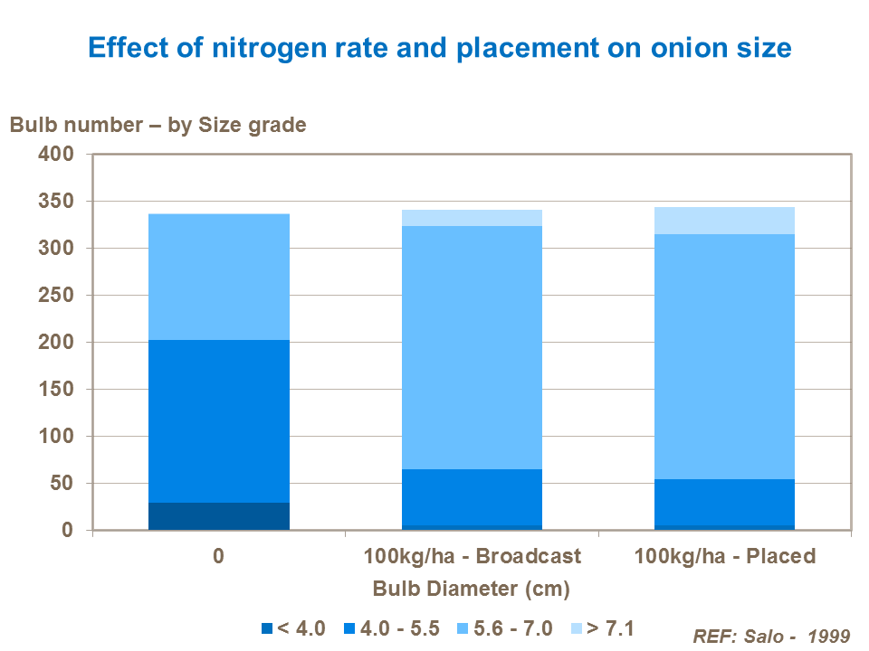
Fertiliser management
Nutrients applied is based on soil testing
Nutrients applied close to the root zone at the right rate and time
Split nitrogen applications improve efficiency and reduce leaching

Slide 16
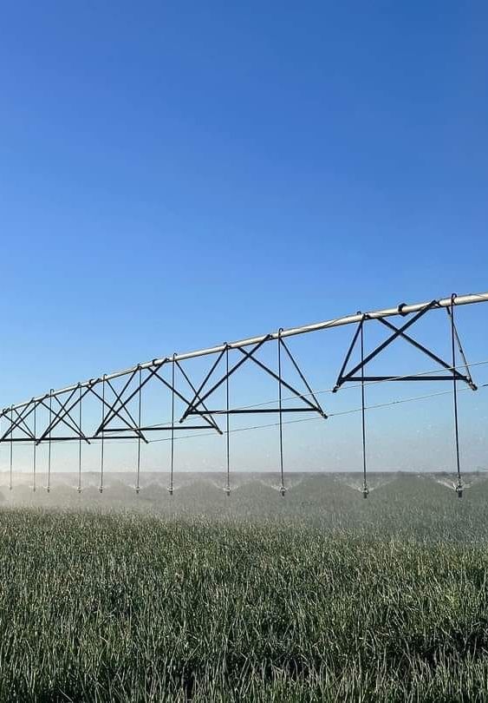
Irrigation management
Onions require a consistent and reliable water supply throughout the growing season.
Water is especially critical during bulb formation, which directly influences bulb size and yield.
Due to their shallow root system, onions are highly sensitive to both water stress and overwatering.
Effects of Poor Water Management
Too little water:
  Smaller bulbs
  Reduced yields
Too much water:
  Increased risk of root diseases
  Bulb rot
  Waterlogged and poorly structured soils

Slide 17
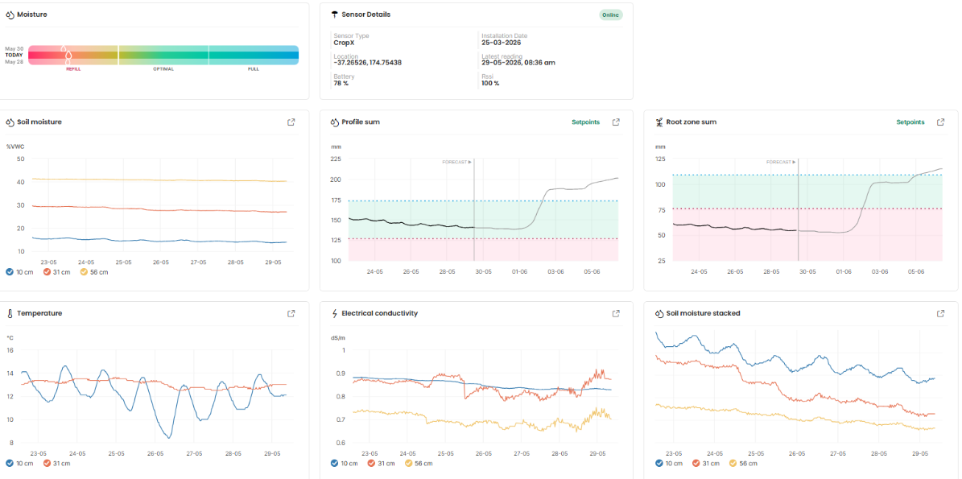
Irrigation practices
Irrigation is used to maintain even soil moisture, particularly during dry periods.
Essential in regions with low or unreliable rainfall.
Careful scheduling helps avoid overwatering and waterlogging.
Harvest Considerations
Irrigation is reduced or stopped before harvest.
This allows bulbs to dry and cure properly.
Proper curing improves storage life, bulb quality, and marketability.

Slide 18
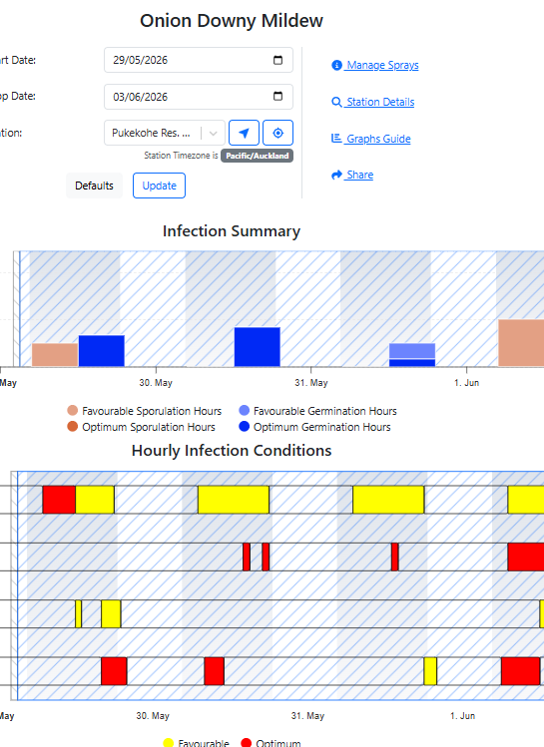
Pest and disease management
Onions are vulnerable to pests and diseases, especially in humid or wet conditions
Essential to protect yield and bulb quality
Integrated Pest Management (IPM)
  Regular crop monitoring
  Use of disease monitoring tool e.g. Met Watch
  Crop rotation
  Use of resistant varieties
  Careful use of pesticides when needed
  Maintain field hygiene
  Remove crop residues
  Control weeds

Slide 19
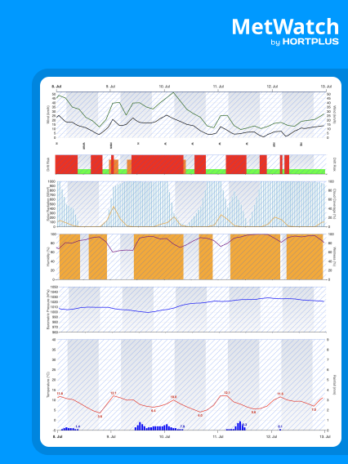
MetWatch
Provides pest, disease and weather insights to help you grow smarter https://www.hortplus.com/metwatch
MetWatch is a powerful digital weather platform for horticulture that brings together weather data, pest and disease models, and crop insights into one reliable system. It helps growers, agronomists, and researchers turn raw data into practical, easy-to-use insights for smarter decision-making. By transforming weather-related risks into clear, actionable information, MetWatch supports better pest and disease management, saving time and money while helping New Zealand growers improve productivity and outcomes.
Do: Smart tech reduces fungicide use (WS)

Slide 20
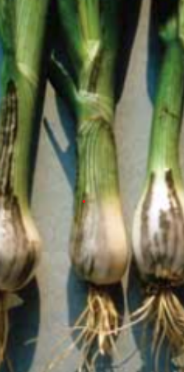
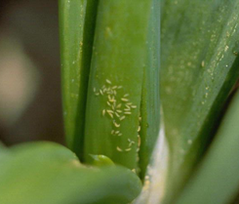
Common onion pests and diseases
Pests
Onion thrips
Allium aphids
Diseases
Downy mildew
White rot
Stemphylium leaf blight
Onion Smut
Allium rust
See PPT Onion pest and diseases

Slide 21
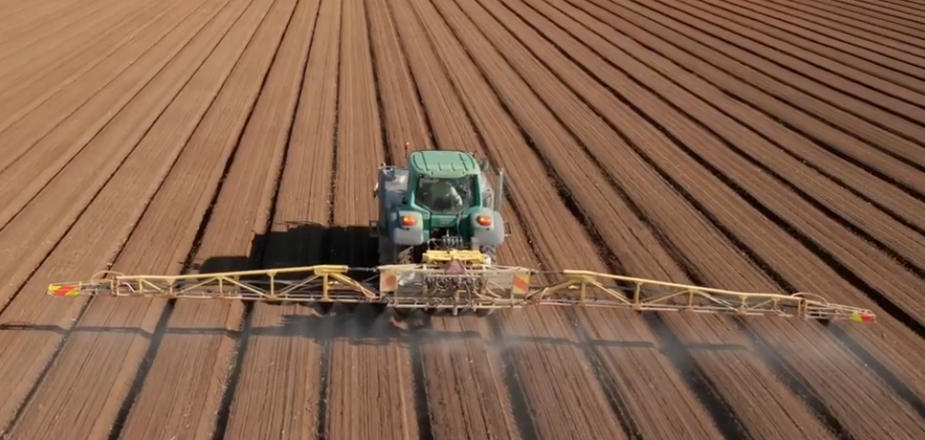
Weed management
Onions are poor competitors, especially during early growth stages
Weeds compete for:
  Light
  Nutrients
  Water
  Can reduce bulb size, yield, and crop quality
Control Methods
Crop rotation and site selection to reduce weed pressure
Establish a clean, weed-free seedbed before planting
Use of:
  Pre-emergence herbicides (before weeds grow)
  Post-emergence herbicides (during crop growth)
Pre emergence herbicide

Slide 22
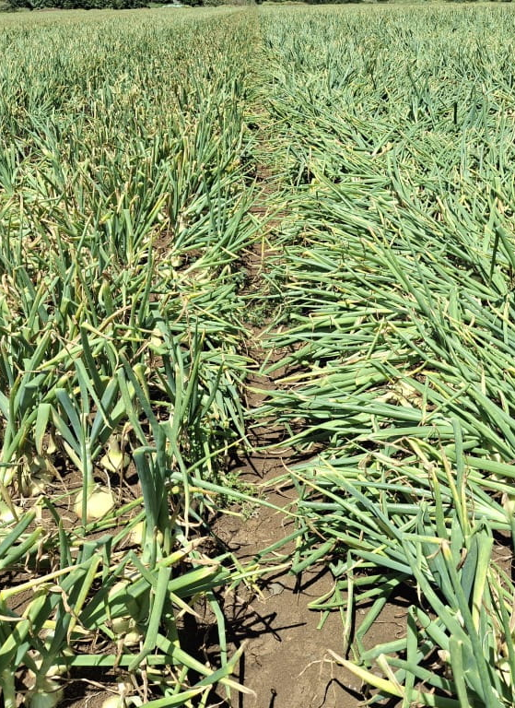
Onions ready to harvest
When
  Tops fall over and begin to dry
  Bulbs are firm to the touch
Timing
  North Island: December-February
  South Island: February
  Timing depends on planting date and local conditions

Slide 23
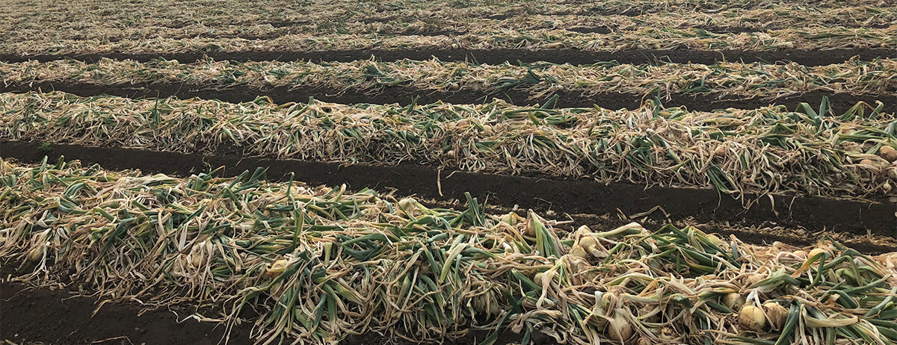
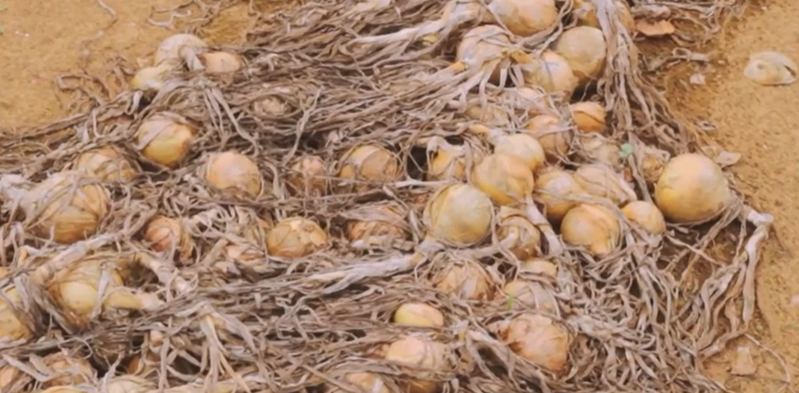
Harvest
Steps
Tops and roots are cut back
Bulbs are carefully lifted from the soil
Onions are handled with care to avoid bruising or damage
Process
After lifting, onions are laid in rows on the soil surface to dry in the sun
This process is called field curing and usually lasts at least 24 hours, but may continue for several weeks depending on weather and variety
Field curing helps form a dry outer skin, which protects the onion and improves storage life

Slide 24
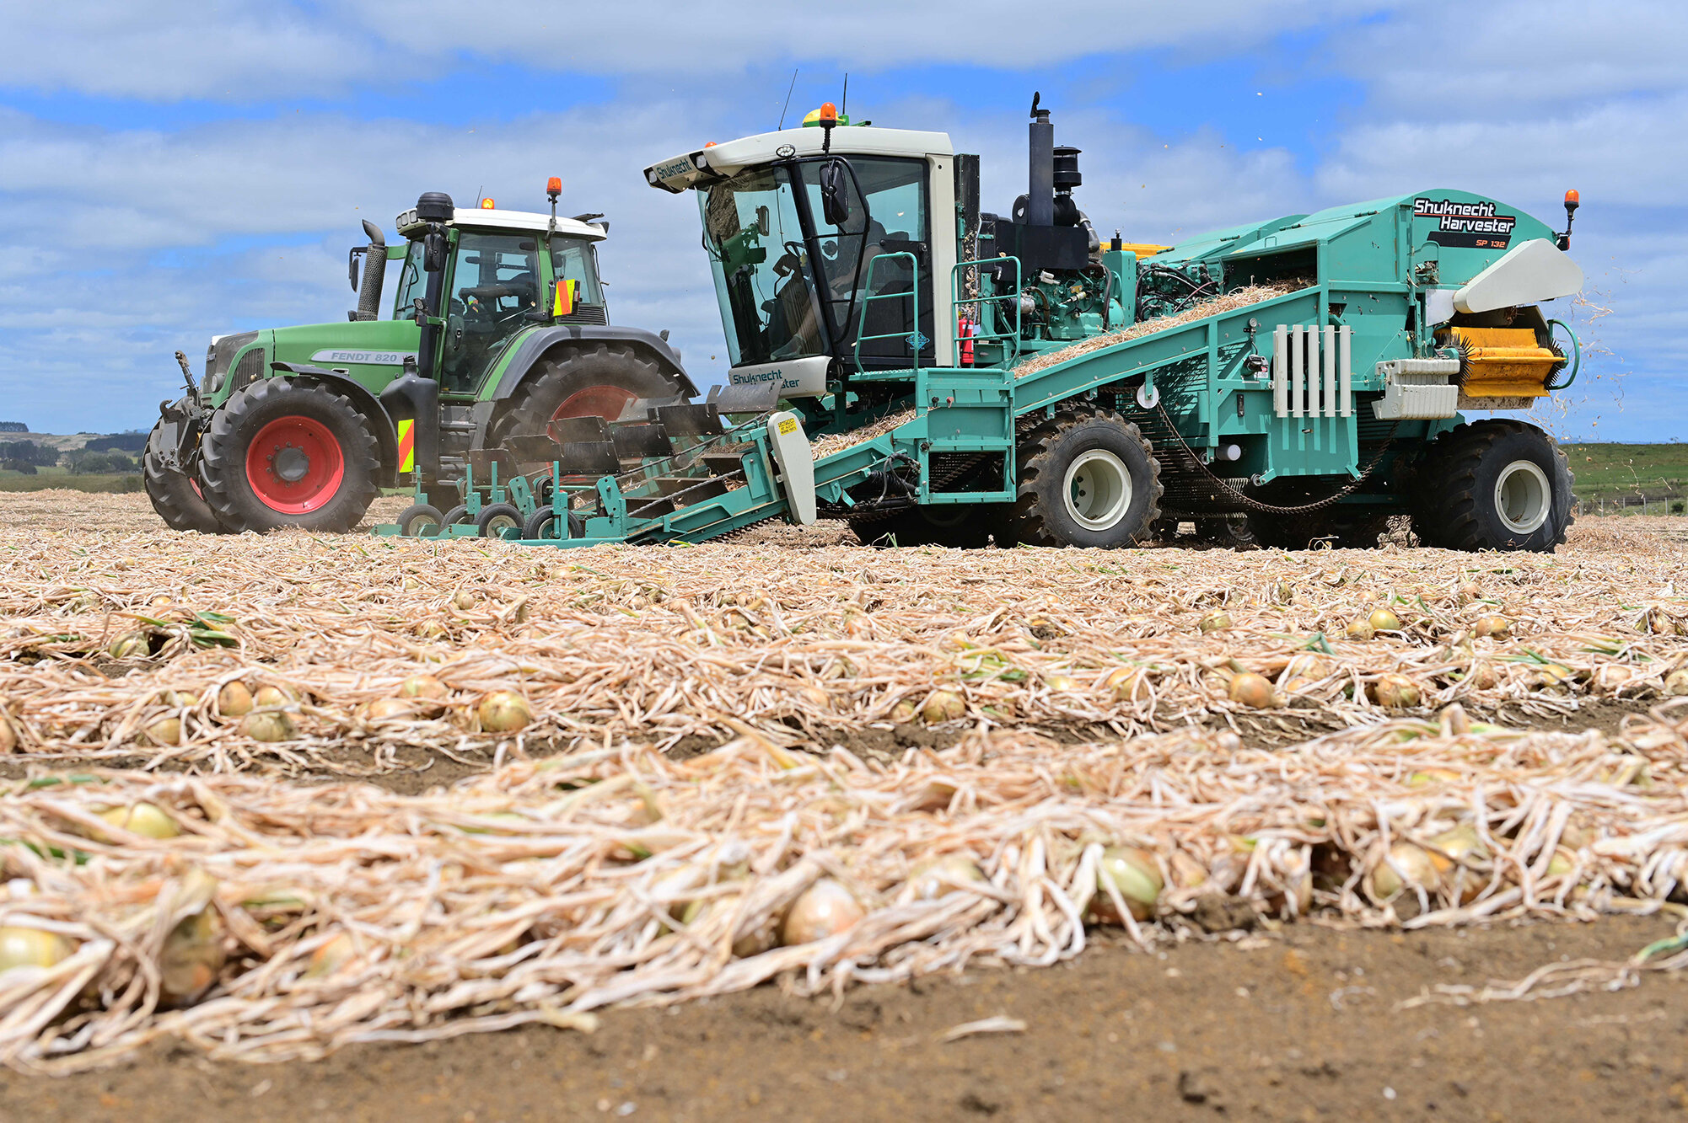
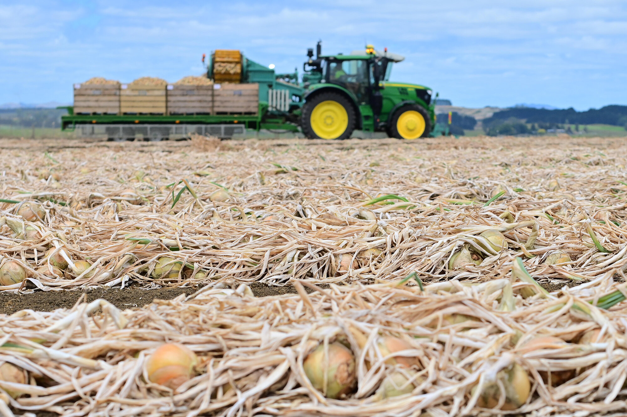
Harvesting
Onion bulbs are lifted from the soil and laid in rows on beds
Sun drying forms protective outer skins
Minimising field curing time is important to avoid weather damage
Onions are harvested and placed into bins
Onions are transported to the packhouse in wooden bins or bulk trailers
Careful handling reduces damage and maintains quality
Watch a short section ST Growers onion harvest 2018
https://www.youtube.com/watch?v=ja7QItli9ts&t=5s

Slide 25
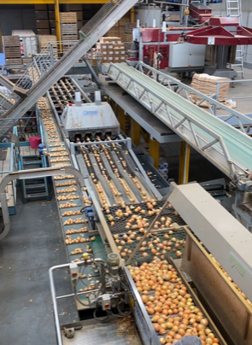
Packhouse
Onions stored in field bins for at least 10 days allowing natural curing to continue
Essential for extending storage life and improving skin quality
Onions graded by size and quality to meet different market requirements
Removes damaged onions and excess skins
Stored in ventilated sheds using ambient air to maintain quality
Cool storage sometimes used for long-term domestic supply

Slide 26
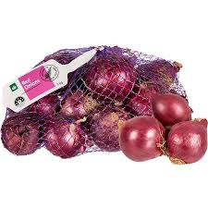
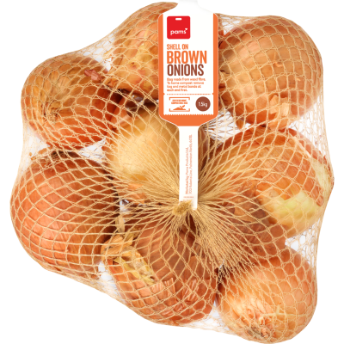
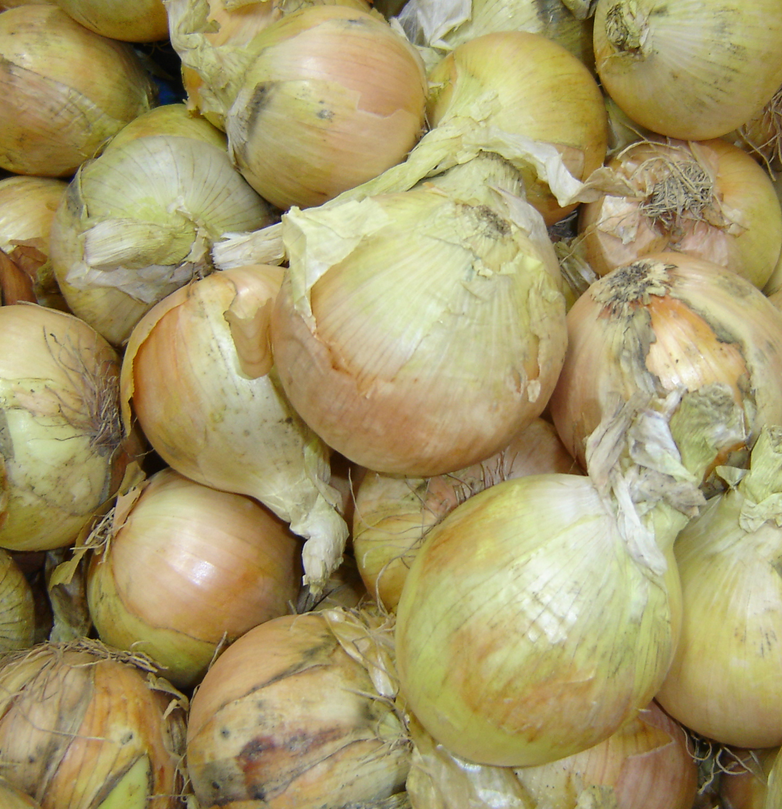
Domestic market
Bulk bin loose onions and a variety of packaging in supermarkets

Slide 27
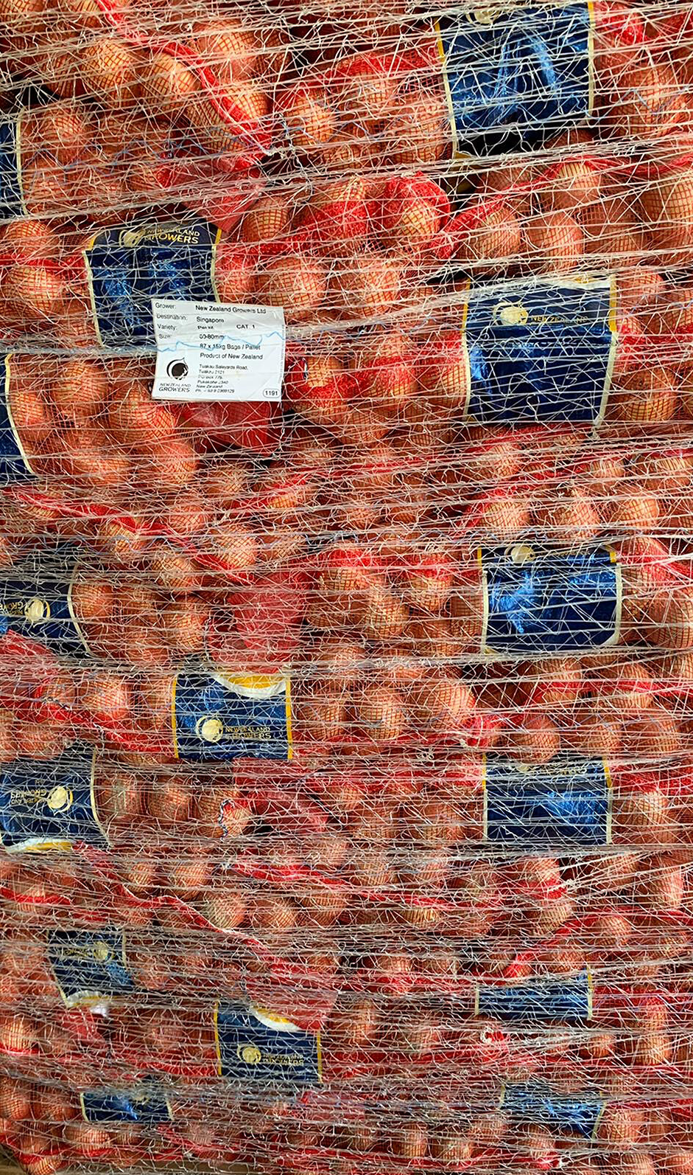
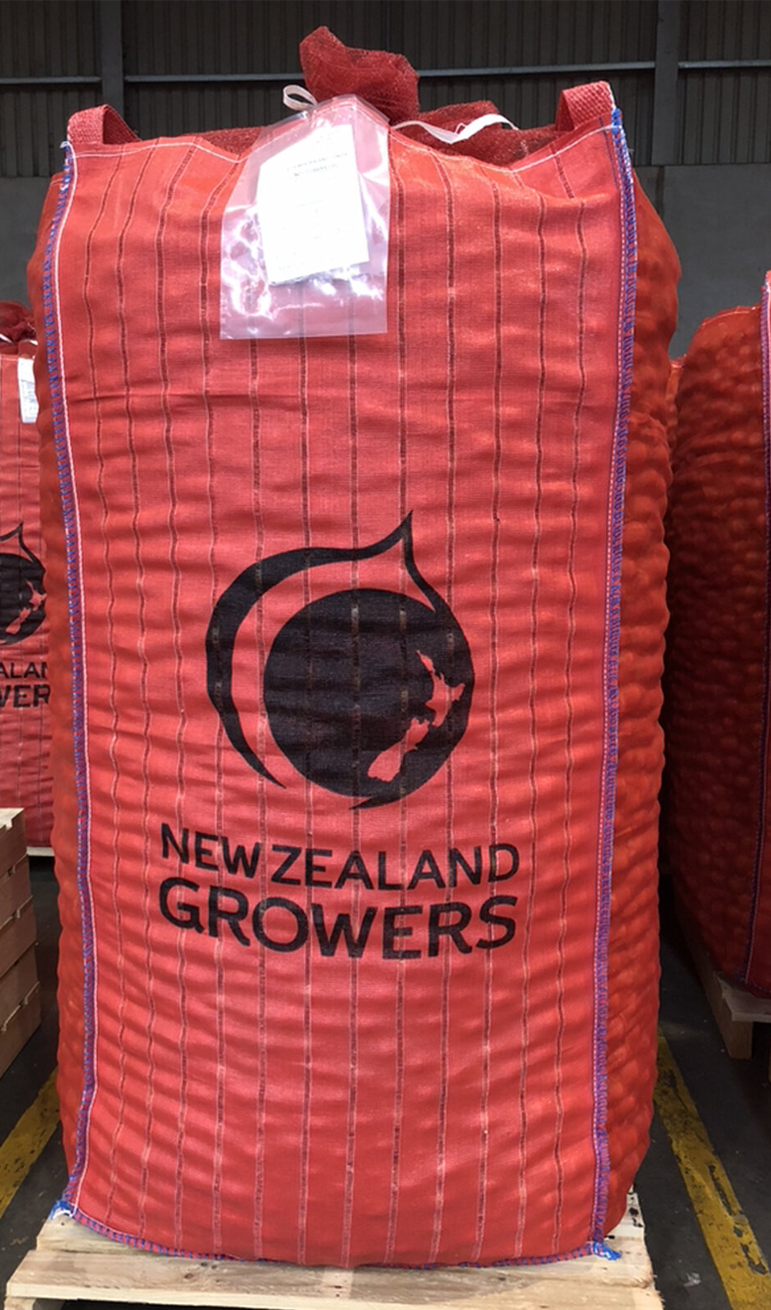
Shipping to Export Markets
Mostly shipped in ambient air containers
Some red and brown onions use refrigerated containers
Transit time: a few days up to 6 weeks
Europe shipments take around 6 weeks
Advanced airflow systems in containers ensure onions arrive in export markets in excellent condition

Slide 28
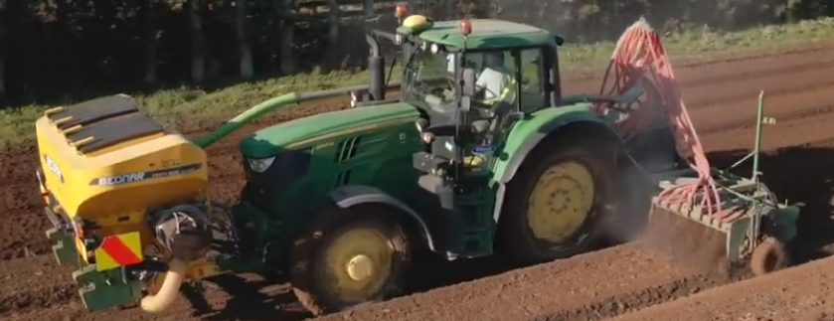
Technology
Auto steer GPS
Cultivation and seedbed formation
  Increase productivity
  Reduces damage
Spraying
Turns spray on and off as enter and exit crop area- reduces chemical use
Pest and disease monitoring tool
  e.g. Met Watch

Slide 29
Test yourself quiz
How long does it usually take onions to reach maturity?
Why do growers use a 4–6 year crop rotation before planting onions again?
What type of soil is best for growing onions?
What is the ideal soil pH range for onion production?
Why are onion seeds coated to make pelleted seed?
How deep are pelleted onion seeds usually planted?
Name two important nutrients onions need for good growth.
Why is careful irrigation important for onion crops?
Name one pest and one disease that can affect onions.
Why is weed control especially important in young onion crops?
What signs show that onions are ready to harvest?
What happens to onions after harvest before they are packed and sold?
Why do growers stop or reduce irrigation before harvest?
How long can exported onions take to reach overseas markets?

Slide 30
Answers
About 6–9 months.
To reduce the build-up of soil diseases and pests and maintain soil health.
Friable, fertile, well-drained soil that allows bulbs to grow easily.
pH 6.0–7.0.
To make seeds easier to handle, improve precision planting, and give more even crop establishment.
1–2 cm deep.
Nitrogen, phosphorus, and potassium (any two).
Onions need consistent moisture, but too little water reduces bulb size and too much water can cause diseases and rot.
Pest: onion thrips or aphids
Disease: downy mildew or bulb rot
Onions are poor competitors, so weeds steal light, water, and nutrients, reducing yield.
The tops fall over and dry, and the bulbs are firm and fully formed.
They are cured, dried, graded, sorted, stored, and packaged.
To help onions dry and cure, improving storage quality.
From a few days up to six weeks.

Slide 31
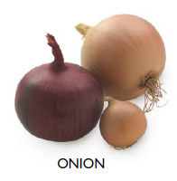
Do Activity 7: Growing Onion Questions (WS)

Slide 32
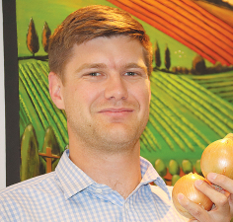
Do Activity 8: Onion industry challenges
In groups, brainstorm and create a list of challenges that onion growers have faced in the past and continue to face today.
Give one or two of the worksheets listed below to each group to read and discuss.
After reading the worksheets, add any new challenges to your list. Then brainstorm and record possible strategies that growers could use to reduce or manage these challenges.
Share your group's ideas and findings with the class.
  NZ Onion Industry Challenges (WS)
  Strong onion crop in Hawkes Bay (WS)
  Auckland floods (WS)
  Strong Quality and Reliable Exports Drive NZ Onion Season (WS)
Onions NZ chief executive James Kuperus

