Slide 1


Slide 2
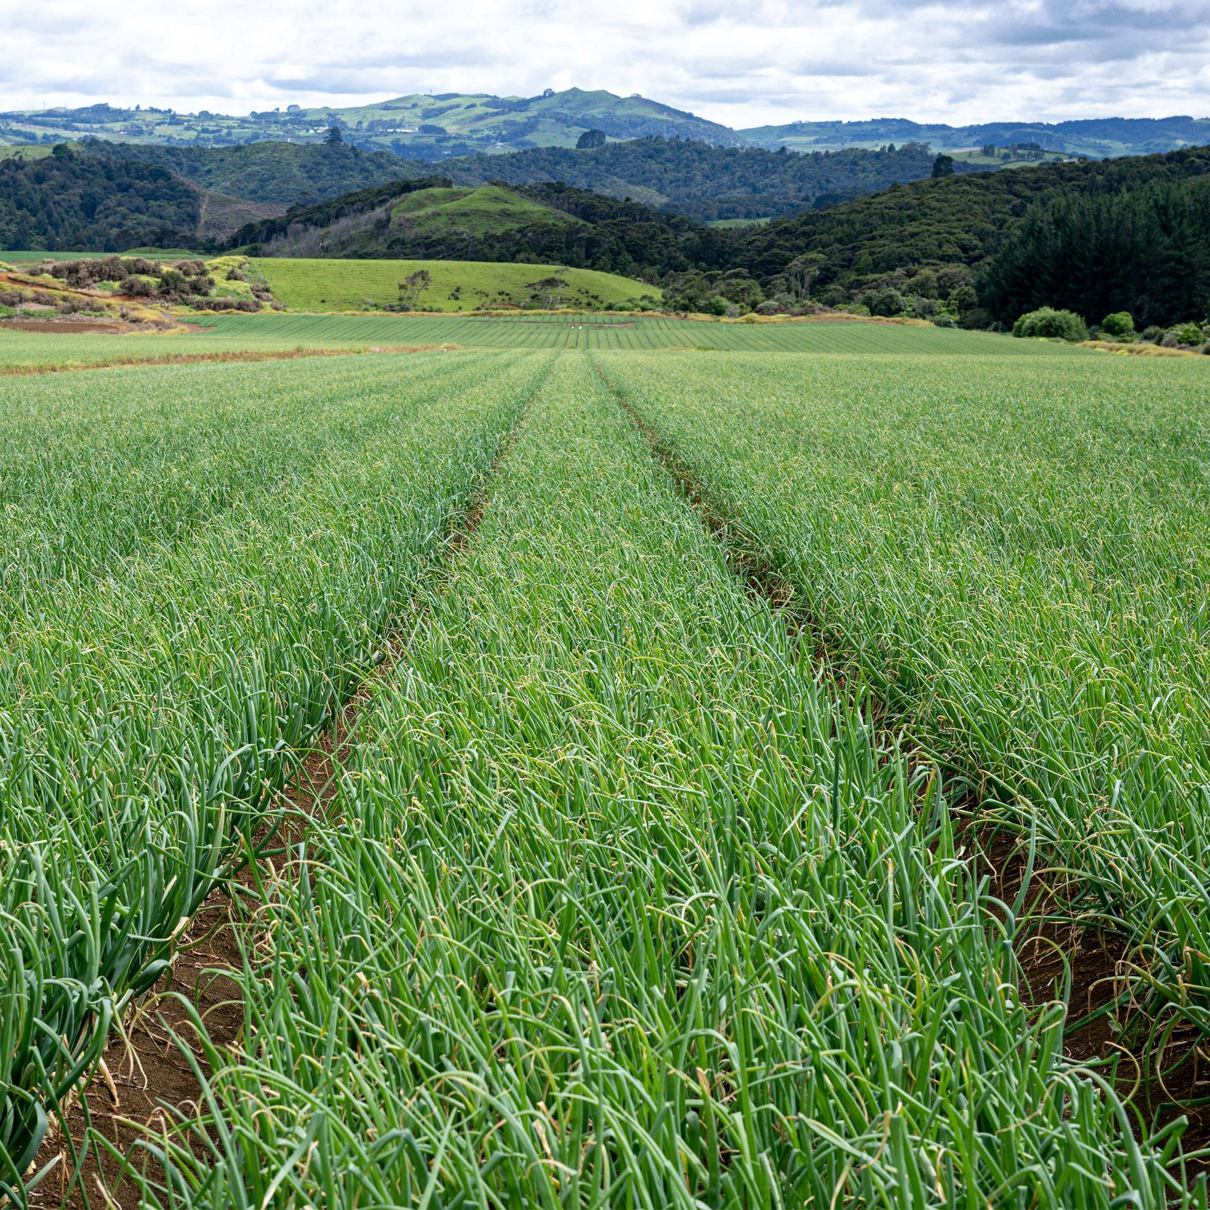
Onion Activities
1-4

Slide 3
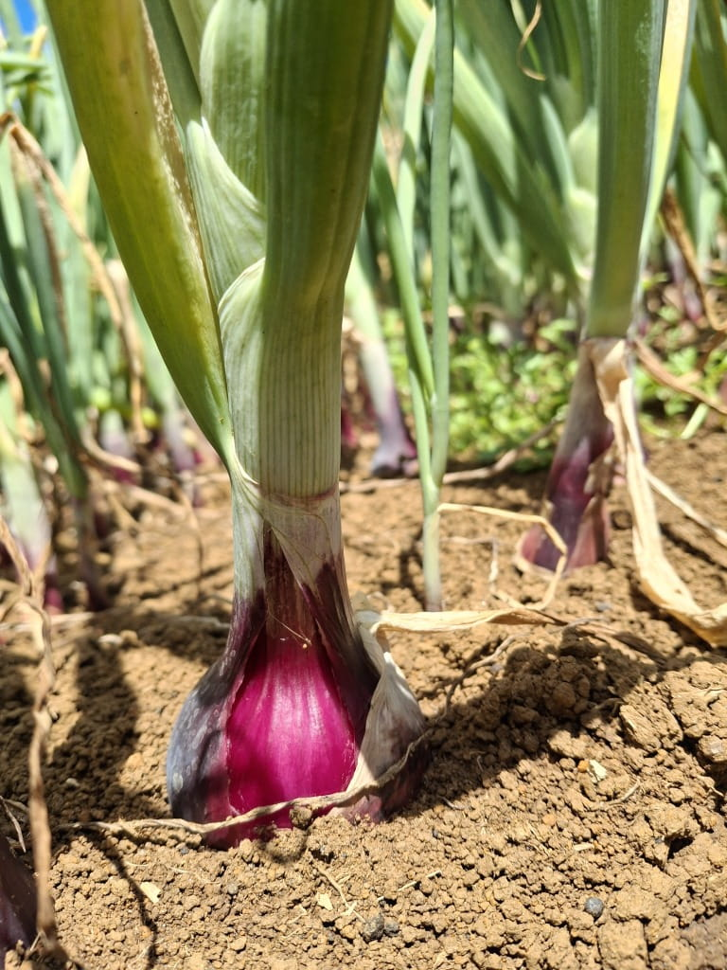
Activity 1: Brainstorm
Work in groups to discuss, share and write down your ideas
What other questions do you have about growing onions?
Make a list of things you are curious to learn more about growing onions?

Slide 4
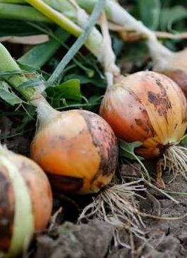
Activity 2:
History of growing onions in New Zealand - Comprehension exercise
When did onion growing begin in New Zealand?
Why is New Zealand well suited to growing onions?
Who developed the Pukekohe Long Keeper (PLK) onion?
What made the Pukekohe Long Keeper (PLK) onion special?
Why was the PLK onion important for New Zealand’s export industry?
Name two regions in New Zealand where onions are grown today.
Why is New Zealand able to supply onions to overseas markets for a long period each year?
What are two reasons why New Zealand onions are popular in international markets?
In the 2024/25 season, how many onions growers were there, and how many hectares of onions were sown.

Slide 5
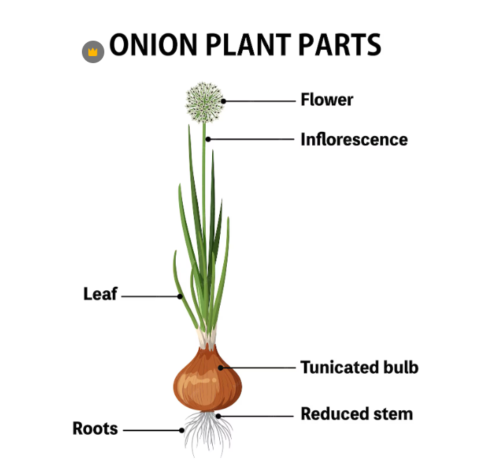
Activity 3:
Investigating Onion Anatomy
Learning outcomes
By the end of this activity, students will be able to:
Identify the main parts of an onion bulb.
Explain the function of each part.
Recognise that onions are modified leaves rather than roots.
Identify different types of onions and members of the Allium family.
Materials
Whole onion (one per group)
Cutting board
Knife
https://www.magnific.com/premium-vector/diagram-showing-parts-onion_39731723.htm#from_element=cross_selling__vector

Slide 6
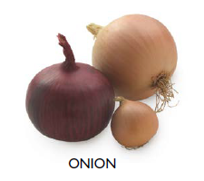
1. Observing an Onion
Carefully examine a whole onion and answer the following questions.
What colour is the outer skin of your onion?
Is the onion firm or soft?
Can you see any roots? If yes, where are they located?
What do you think the purpose of the papery outer skin is?

Slide 7
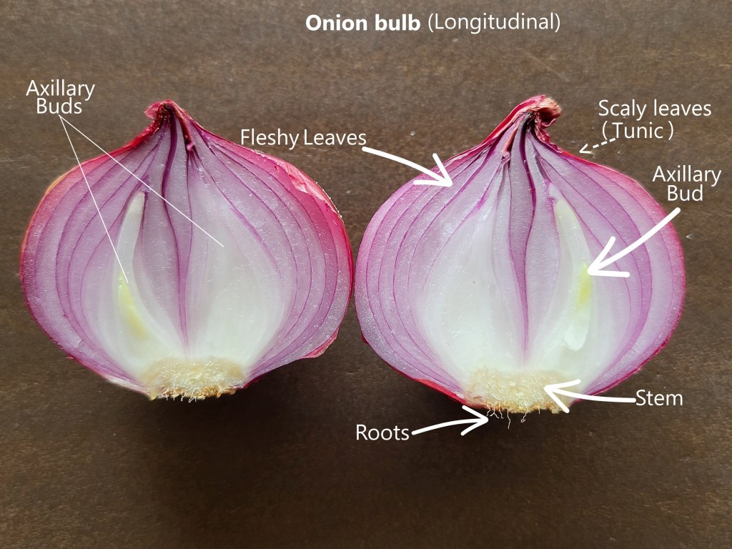
2. Onion dissection
Cut the onion in half from top to bottom.
Observe
  Scale leaves (fleshy layers)
  Dry outer leaves (skin)
  Stem base
  Lateral buds
  Roots

Slide 8
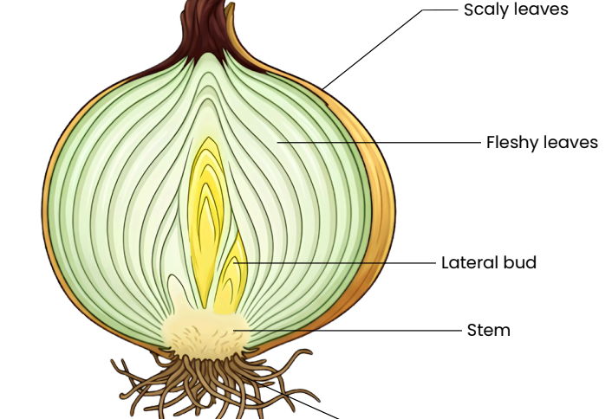
3. Function of parts of onion
Scaly Leaves (Tunic): The dry, papery skin that protects the onion from drying out and from pests and diseases.
Fleshy Leaves: The edible part of the onion. These leaves store nutrients produced by the leaves, protect the central buds, and release chemicals that irritate eyes.
Lateral Buds: These buds have the potential to grow into new onion plants.
Stem: A short stem from which leaves and buds grow.
Roots: Absorb minerals and water for the plant.

Slide 9
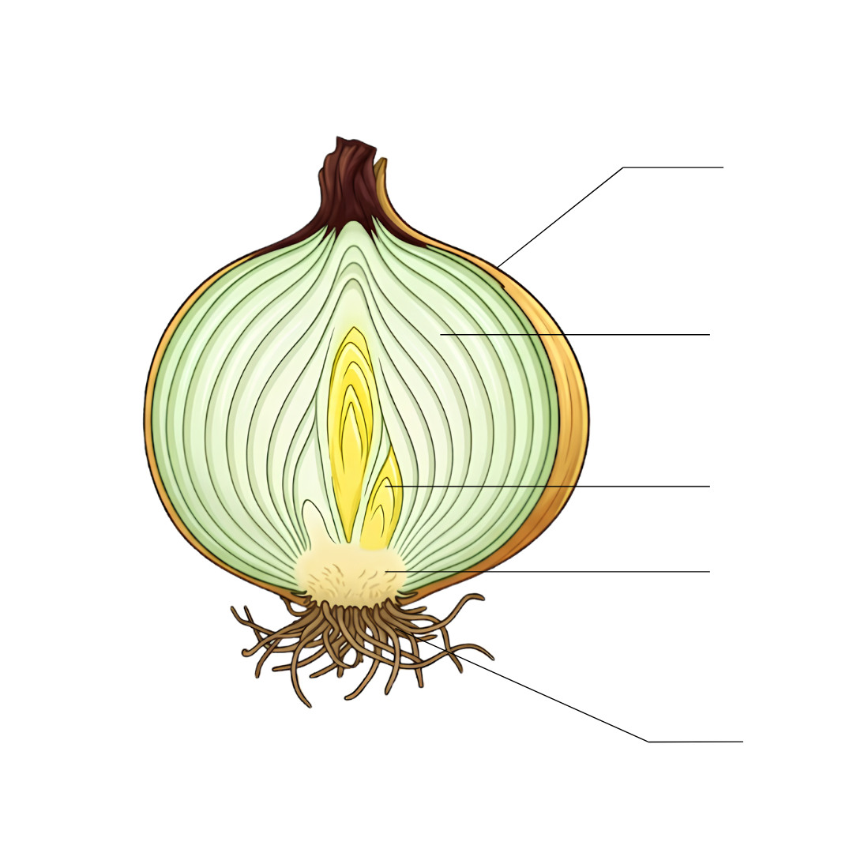
Test yourself:
Drag and drop to label the parts of the onion
Fleshy Leaves
Roots
Lateral Buds
Scaly Leaves
Stem

Slide 10
Test yourself: Functions of Onion Parts
Match the function with the plant part
Onion Part
Scaly leaves
Fleshy leaves
Lateral buds
Stem
Roots
Store food and water for the plant
Protect the onion from water loss, disease, and physical damage.
Supports the bulb and is the point where roots grow downward and leaves grow upward
Absorb water and nutrients from the soil and anchor the plant in the ground.
Can grow into new onion plants

Slide 11
Functions of Onion Parts
Answers
Onion Part
Scaly leaves
Fleshy leaves
Lateral buds
Stem
Roots
Protect the onion from water loss, disease, and physical damage.
Store food and water for the plant
Can grow into new onion plants
Supports the bulb and is the point where roots grow downward and leaves grow upward
Absorb water and nutrients from the soil and anchor the plant in the ground.

Slide 12
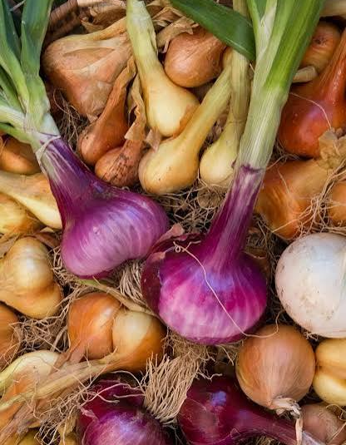
Test yourself: Questions
What is the scientific name of the common onion?
What type of underground storage organ is an onion?
Why is an onion not considered a root vegetable?
What do the fleshy layers store for the plant?
How do the dry outer leaves help protect the onion?

Slide 13
Answers
a. What is the scientific name of the common onion?
  Allium cepa
b. What type of underground storage organ is an onion?
  An onion is a bulb, which is an underground storage organ made up of modified leaves.
c. Why is an onion not considered a root vegetable?
  An onion is not a root vegetable because most of the bulb is made of modified leaves that store food and water, rather than roots.
d. What do the fleshy layers store for the plant?
  The fleshy layers (scale leaves) store food (nutrients) and water for the plant.
e. How do the dry outer leaves help protect the onion?
  The dry outer leaves form a papery skin that protects the onion from:
  Water loss
  Pest and diseases
  Physical damage during growth, harvest, and storage.

