Slide 1


Slide 2
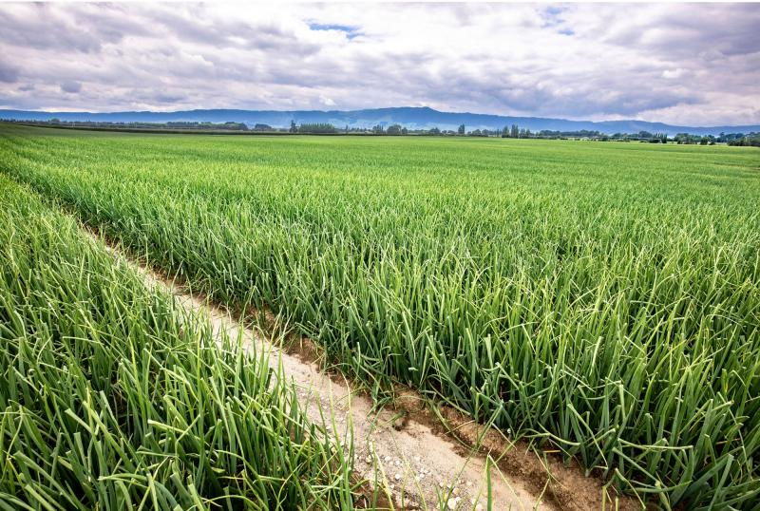
Onion
Pest and Diseases
Management and Control

Slide 3
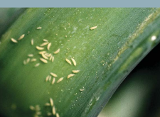
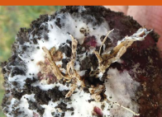
Onion
Pest and disease management
Onions are highly vulnerable to pests and diseases, especially under humid and wet conditions.
Effective management involving monitoring, and targeted control measures is essential to protect crop yield, bulb quality, and storage life.
Integrated Pest Management (IPM) Approach
Conduct regular crop scouting and monitoring to detect problems early.
Use disease forecasting tools to guide timely management decisions.
Practice crop rotation to reduce pest and disease buildup.
Plant treated seed and use disease-resistant varieties where available.
Field Management Practices
Maintain good field hygiene by removing infected crop residues.
Control weeds that can host pests and diseases.
Apply pesticides or fungicides carefully and only when needed, following recommended guidelines.

Slide 4
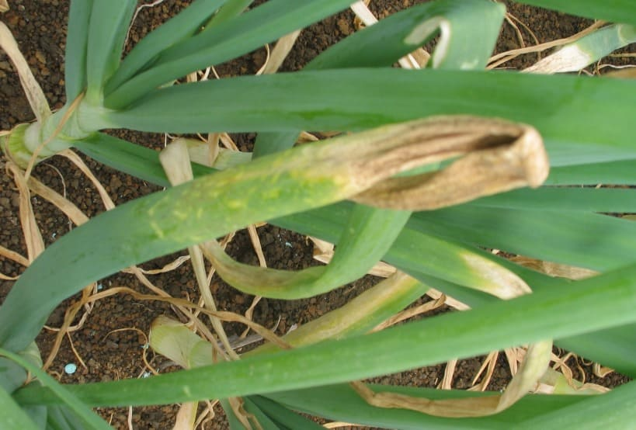
Some common onion pests and diseases
Pests
Onion thrips
Allium aphids
Diseases
Downy mildew
White rot
Stemphylium leaf blight
Onion Smut

Slide 5
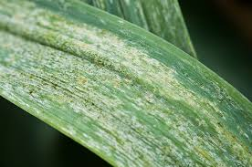
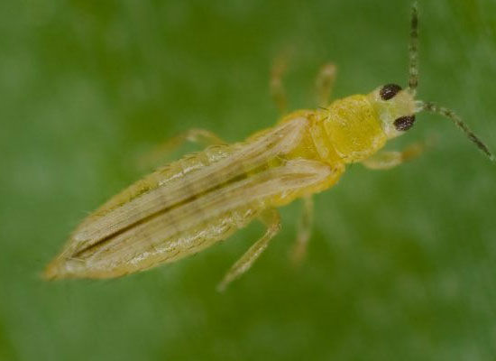
Onion Thrips
(Thrips tabaci)
Very small pale yellow to light brown insects (up to 2 mm) with long, thin bodies
Damage
Pierce the leaf surface and suck out plant sap
Feeding kills leaf cells, causing:
  Silvery or yellow-white speckles on leaves
  Early ripening of bulbs
  Smaller harvests and lower yields
Can also infest stored onion bulbs
Onion thrips can carry harmful plant viruses, including:
  Tomato Spotted Wilt Virus (TSWV)
  Iris Yellow Spot Virus (IYSV)

Slide 6
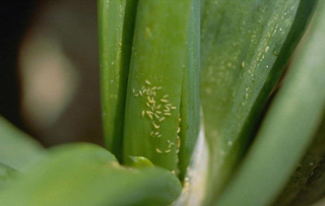
Onion Thrip
Management and Control
Crop Hygiene
Remove weeds and other plants that can shelter thrips.
Monitor crops regularly
Check onion plants often for signs of thrips.
Control them before their numbers become too high.
Use insecticides carefully
Only spray when thrip numbers reach damaging levels.
Insecticides work best against young thrips (larvae) and adults that are feeding.
Prevent insecticide resistance
Do not rely on the same insecticide every time.
Rotate different control methods to slow the development of resistance.

Slide 7
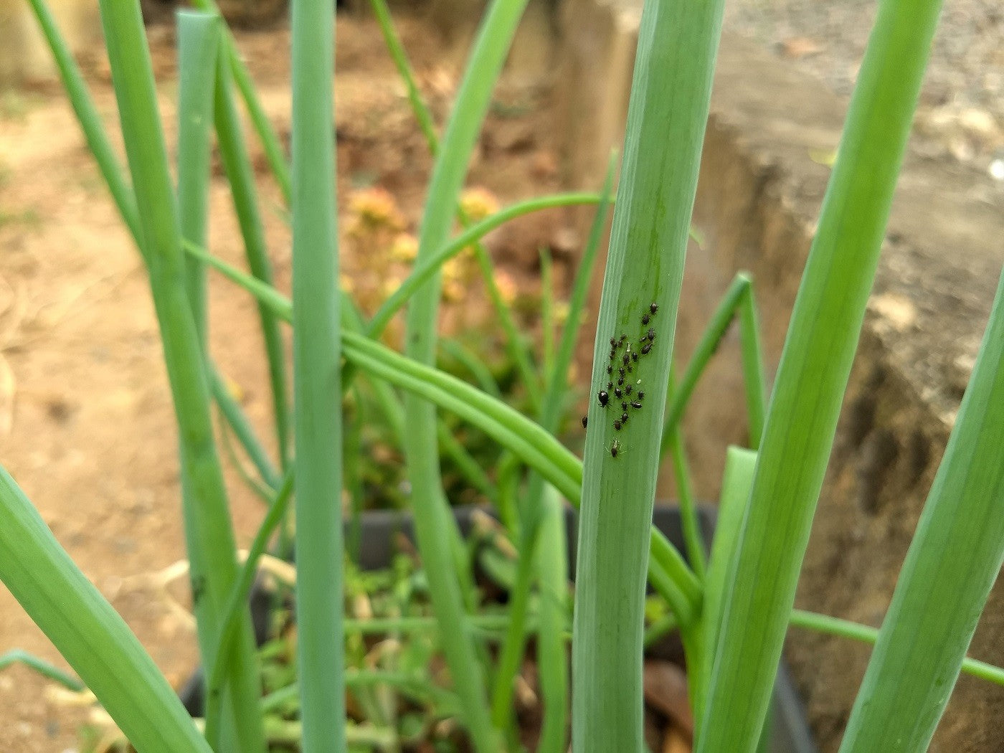
Allium Aphid
(Neotoxoptera formosana)
(Onion / Black Aphids)
Small dark insects that attack onion-family plants
Found on leaves, often in clusters
Affect onions, garlic, leeks, chives, and shallots
Damage:
Leaves turn yellow, curl, and wilt
Plants grow poorly or may die
Can spread plant viruses

Slide 8
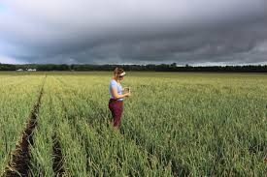
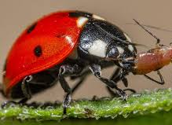
Allium Aphid
Management and Control
Natural predators
Encourage beneficial insects such as ladybird beetles, and lacewings, which feed on aphids.
Maintain good crop hygiene
Remove weeds that can act as alternative hosts.
Destroy or remove leftover onion bulbs after harvest to reduce overwintering aphids.
Rotate crops
Avoid planting onions or other allium crops in the same field every year to reduce pest build-up.
Monitor crops regularly
Inspect plants frequently for aphid colonies so action can be taken early.
Use insecticides only when needed
Apply insecticides only if aphid numbers exceed the economic threshold to reduce unnecessary spraying and help protect beneficial insects.

Slide 9
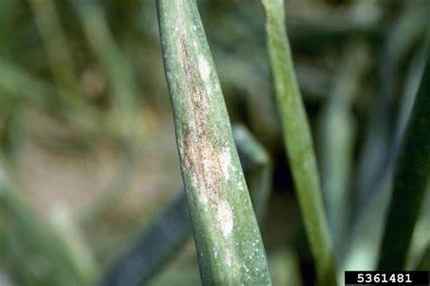
Downy mildew
(Peronospora destructor)
A fungal disease common in New Zealand
Spreads quickly in wet weather with cool nights and warm days
Symptoms:
Small pale spots on leaves
Spots turn yellow, then white
Leaves dry out and look burnt
Effects:
Affects bulb growth and quality causing major crop losses

Slide 10
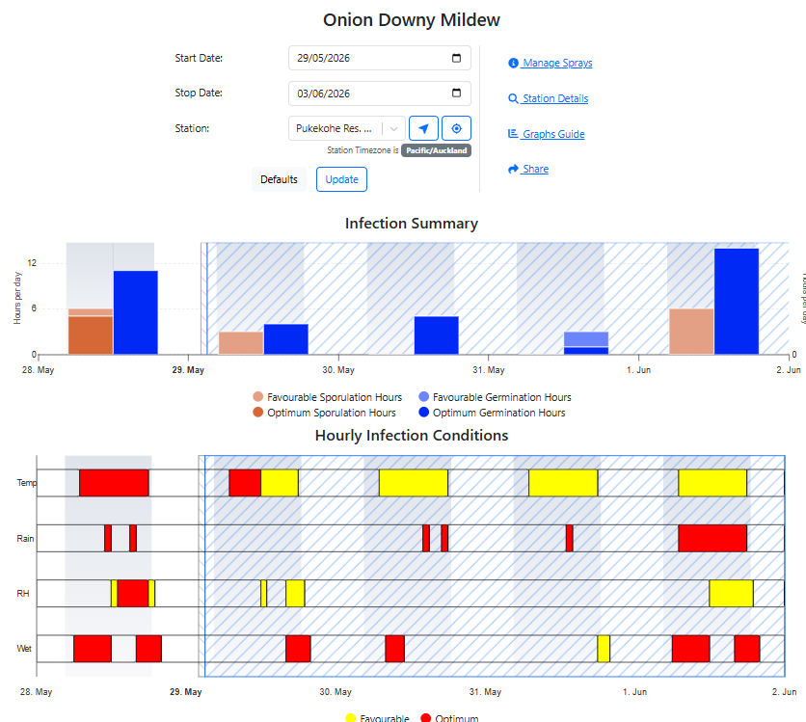
Downy mildew management and control
Crop hygiene
Remove and destroy leftover onion bulbs and crop debris after harvest to reduce sources of infection.
Rotate crops
Avoid growing onions or other allium crops in the same field every year to prevent disease build-up in the soil.
Monitor crops regularly
Inspect plants frequently for fungal and other diseases so action can be taken early
Use disease forecasting models
Use weather and disease forecasting models to predict when conditions favour White Rot and plan control measures.
Manage water carefully
Avoid waterlogged or damp conditions by maintaining good soil drainage.
Irrigate in the late afternoon (or when recommended for your region) so plants are not kept wet for long periods.
Use fungicides when needed
Apply fungicides as part of a preventive spray programme to protect healthy plants before disease becomes severe.
Follow label instructions and rotate fungicides to reduce the risk of resistance.

Slide 11
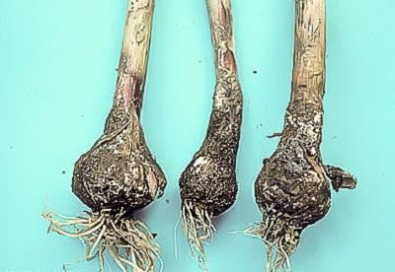
White Rot
(Sclerotium cepivorum)
A serious fungal disease that attacks onions and other allium crops.
It is soil-borne, meaning the fungus lives in the soil.
The fungus can survive in soil for more than 30 years, making it very difficult to eliminate.
The disease often appears in patches across a field.
Symptoms
Young seedlings die soon after emerging.
Older plants become stunted, with yellowing, wilting, and dying leaves.
Bulbs and roots are covered with white, fluffy fungal growth.
Tiny black resting bodies (sclerotia) form on infected bulbs.
Roots rot, and bulbs turn soft and black.
Effects on the Crop
Can kill entire onion plants.
Infected bulbs rot in the field and may continue to rot during storage.
Severe outbreaks can cause major crop losses.
Do White Rot Control in Onions (WS)

Slide 12
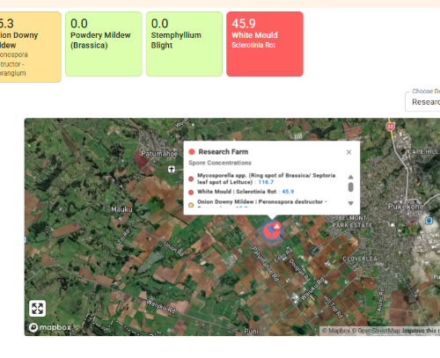
White Rot Management and Control
Rotate crops
Avoid growing onions or other allium crops in the same field for at least 8 years to reduce the build-up of the fungus.
Maintain strict farm hygiene
Clean tractors, tools, boots, and machinery after working in infected fields.
Good hygiene is the best way to prevent White Rot from spreading to new areas.
Monitor crops regularly
Inspect fields often and remove infected plants as soon as they are found.
Use disease forecasting
Use weather and disease forecasting models to predict when conditions favour White Rot and plan control measures.
Apply fungicides when needed
Use fungicides as part of a preventive disease management programme.
Fungicides help reduce disease but cannot eliminate the fungus from the soil.

Slide 13
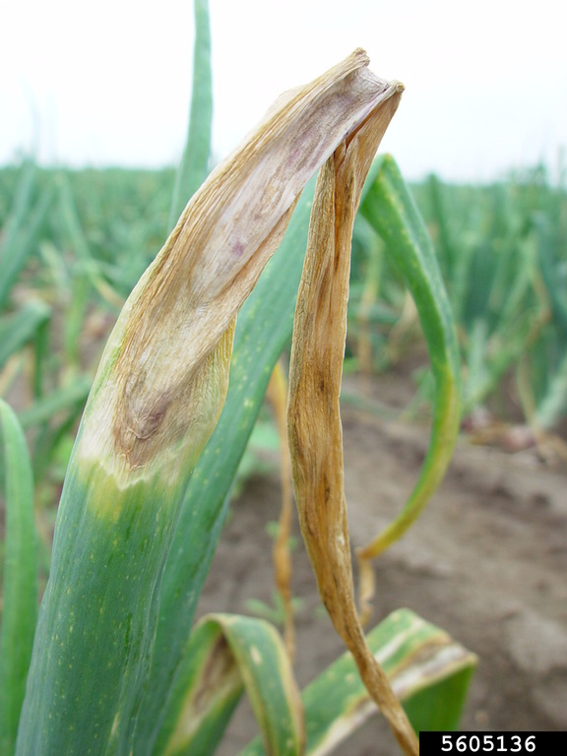
Stemphylium leaf blight
(Stemphylium vesicarium)
Stemphylium leaf blight is a fungal disease that affects onion plants, causing severe damage to the leaves and reducing crop yield.
Symptoms:
Small yellow, water-soaked spots appear on the leaves.
The spots enlarge over time, developing into long, elongated lesions that range from light brown to dark brown or black.
Under severe infection, leaves die rapidly from the tip downward, becoming dry and desiccated.
Effects:
Reduces the plant's ability to photosynthesize due to premature leaf death.
Decreases bulb size, weight, and overall quality.
Severe infections can lead to significant yield losses and poor storage life of harvested bulbs.

Slide 14
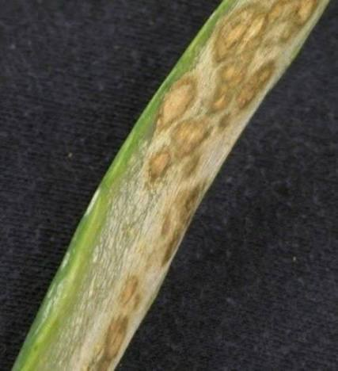
Stemphylium leaf blight management and control
An integrated approach combining regular scouting, good cultural practices, hygiene, and timely fungicide applications provides the most effective control of Stemphylium leaf blight.
Scout fields regularly to detect disease early and limit spread.
Rotate with non-host crops for 3–4 years.
Maintain balanced crop nutrition; avoid excessive nitrogen.
Ensure proper irrigation and avoid prolonged leaf wetness.
Maintain adequate plant spacing for good air circulation.
Provide good soil drainage.
Use certified, fungicide-treated seed.
Use weather and disease forecasting models
Crop hygiene
Remove and destroy infected plant debris, cull onions, and volunteer plants.
Avoid herbicide injury that can increase disease susceptibility.
Manage onion downy mildew to reduce secondary infections.
Apply fungicides when needed
Apply recommended fungicides when conditions favour disease development, rotating fungicide groups to prevent resistance.

Slide 15
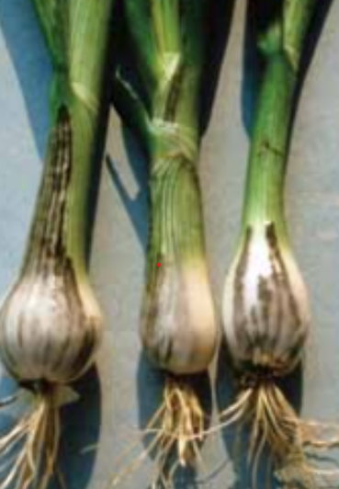
Onion Smut
(Urocystis cepulae)
A fungal disease that affects young onion plants
Lives in the soil for up to 15–20 years
Spreads in cool, wet conditions (10–25°C)
Symptoms:
Black streaks or blisters on leaves and bulbs
Dark, powdery spores inside the streaks
Leaves may bend or curl downward
Plants become stunted
Effects:
Many seedlings die within a few weeks
Surviving plants are weak and small

Slide 16
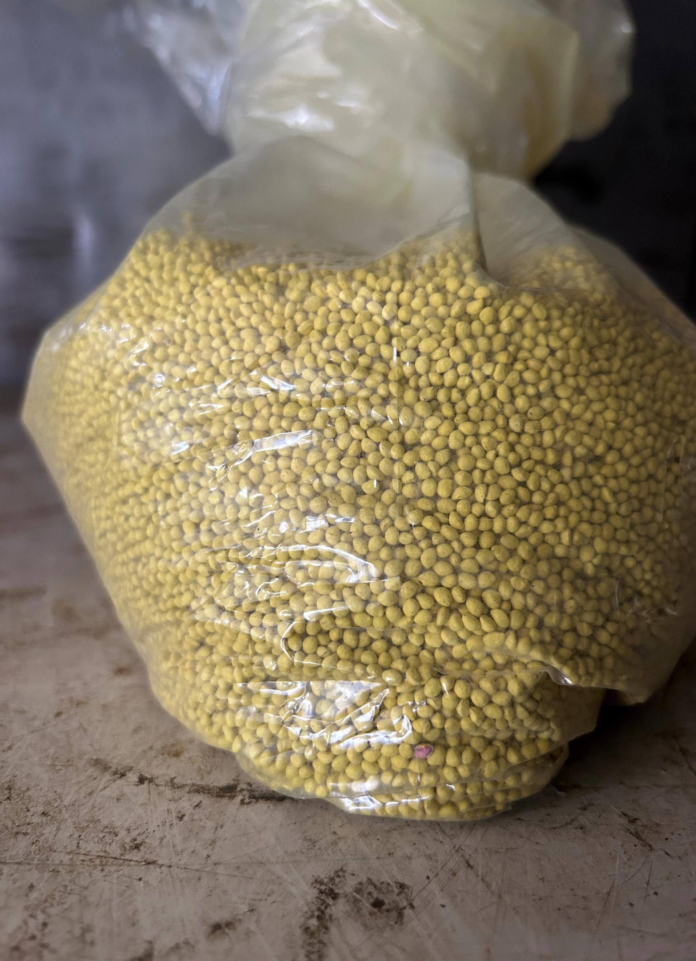
Onion Smut Management and Control
Seed treatment: Coat seeds with recommended fungicides to protect seedlings during early growth stages.
Crop rotation: Use long rotations (3+ years) with non-Allium crops to reduce pathogen survival in soil.
Field hygiene: Clean and disinfect equipment after working in infested fields to prevent disease spread.
Regular scouting: Monitor crops frequently to identify symptoms early and take action before the disease spreads.

Slide 17

Do Worksheets
White Rot Control in Onions (WS)
Smart tech reduces fungicide use (WS)

