Slide 1


Slide 2
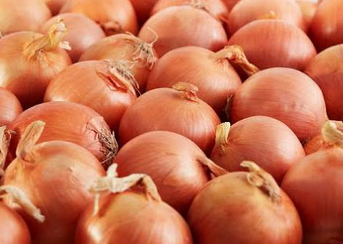
Onion Varieties
Information on a few onion varieties and cultivars grown in New Zealand
Websites
Seminis: https://www.vegetables.bayer.com/nz/en-nz/products/onion.html
Hazera: https://za.hazera.com/crops/rhinestone/
Terranova Seeds: https://terranovaseeds.co.nz/upcp_product/kiwi-gold/
Premier Seeds Direct: https://premierseedsdirect.com/?_gl=1%2Akttyrk%2A_up%2AMQ..%2A_ga%2AMTcwMzY3OTk1

Slide 3
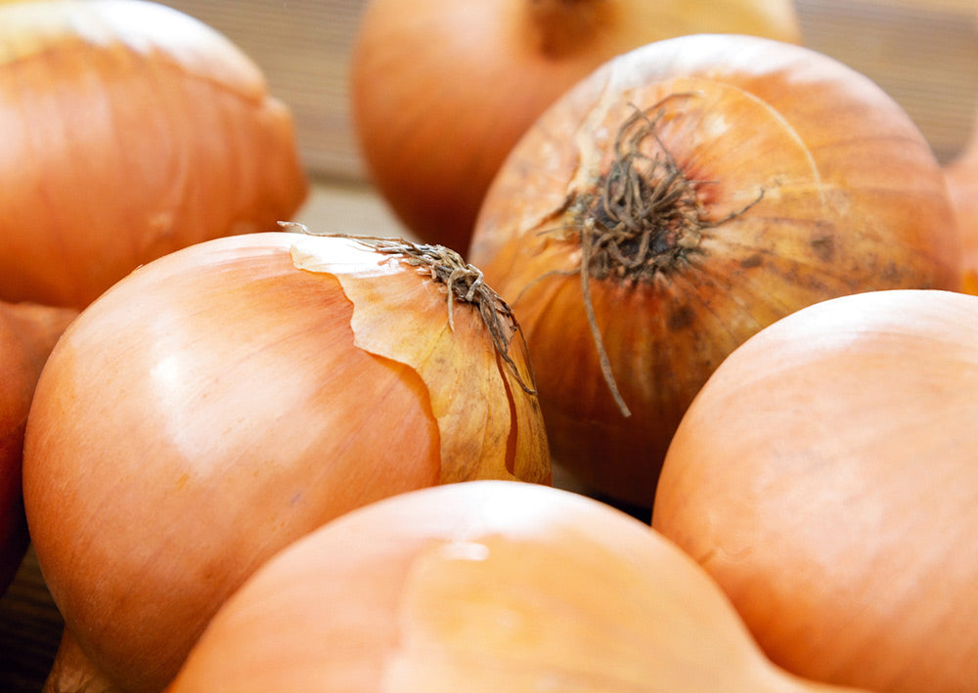
Pukekohe Long Keeper
Pukekohe Long Keeper is a medium-sized onion with golden-brown globe-shaped bulbs and crisp, pungent white to cream flesh. It is one of the best storage onion varieties, capable of lasting up to 10 months under optimal conditions. It takes approximately 180 days from sowing to harvest and has strong resistance to bolting (premature flowering).

Slide 4
WAIKATO
Waikato is a mid-late season hybrid. It has excellent storage with a shorter growing time frame is well-suited for export.
Has intermediate disease resistance.

Slide 5
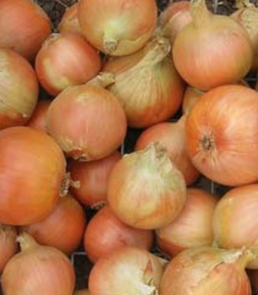
Kiwi Gold
Kiwi Gold is an early long-keeper onion variety with strong vigour, high yield potential, and firm globe shaped bulbs. It has excellent skin quality and good size uniformity, making it suitable for export markets. This variety stores well and is particularly well suited to the European market.

Slide 6
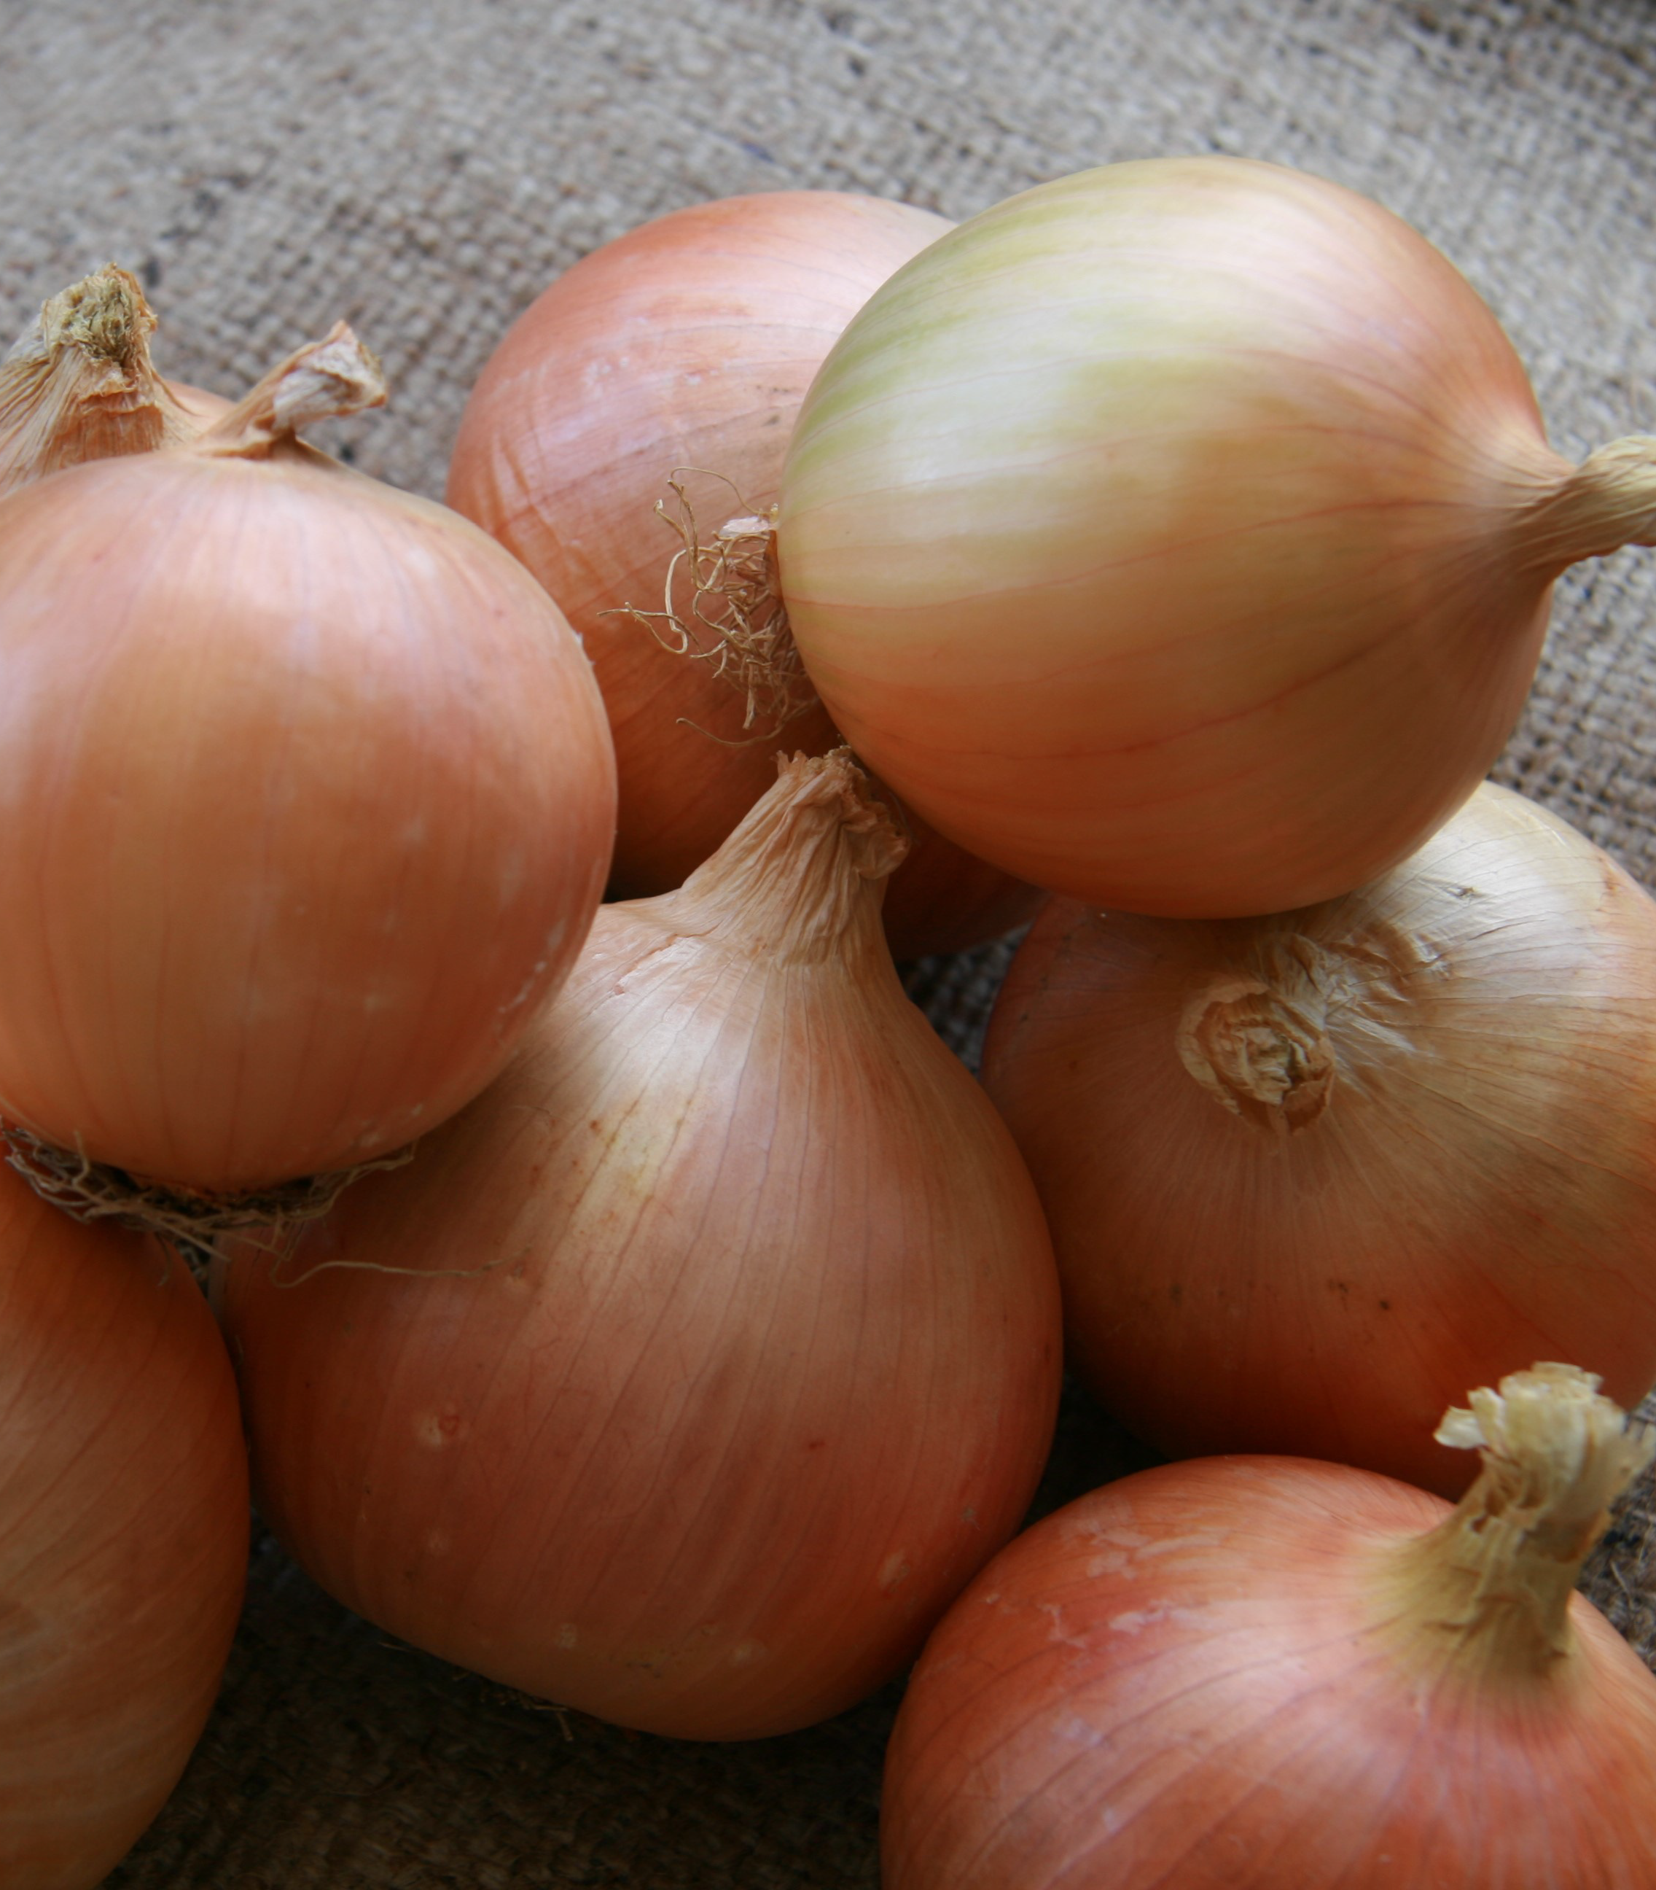
AYOBA
Ayoba is a hybrid onion with globe shaped bulbs and cream-gold skin. It is suitable for mechanical harvest
Has high resistance to Basal rot
Good bolting resistance

Slide 7
CASSOWARIE
Cassowarie is a high-yielding onion variety with a consistent globe shape and attractive golden-brown skin. It is a versatile variety with a wide planting window, excellent storage life, and strong suitability for both domestic and export markets.
Has intermediate disease resistance.

Slide 8
DEVONPORT
Devonport is an early season ELK type onion, which is well suited to the Canterbury region. Devonport produces uniform bulbs with excellent storage.

Slide 9
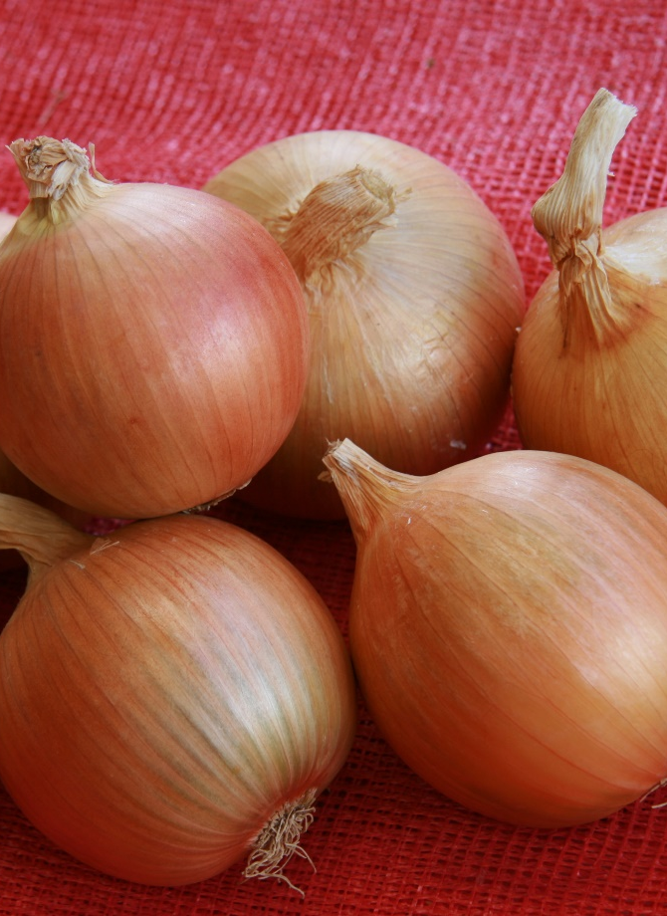
Perez
Perez is an early season, golden brown, vigorous export onion. It has large round bulbs with excellent uniformity and storage potential.

Slide 10
SV6326NN
SV6326NN is an early-maturing sweet onion with a distinctive Granex shape, developed for the New Zealand domestic market. It produces large, attractive bulbs (80–100 mm) and reaches maturity in time for the Christmas market. The variety has vigorous growth and performs well in cooler growing conditions, making it a reliable option for early production.

Slide 11
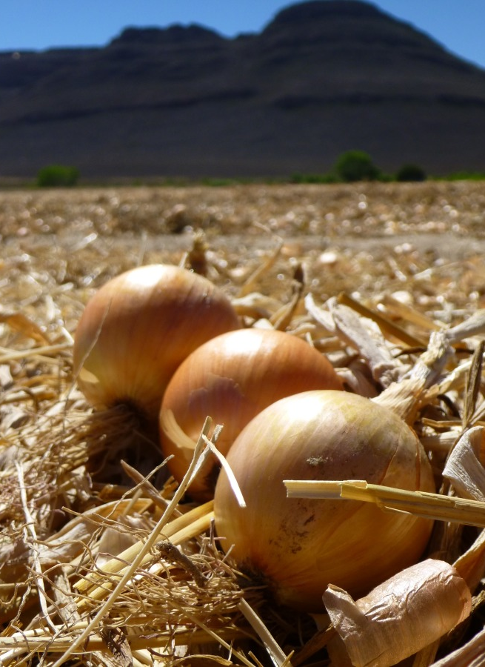
Rhinestone
Rhinestone is a mid–intermediate day onion variety suitable for both direct sowing and transplanting. It produces high yields of uniform, medium-sized bulbs with exceptional bulb quality. The variety has excellent skin retention, making it well suited to mechanical harvesting, and offers outstanding storage life of 5–6 months.

Slide 12
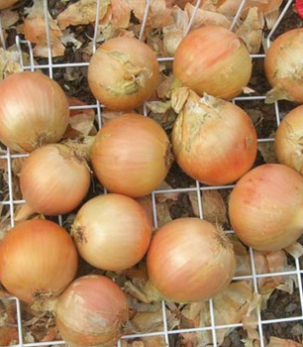
Applause
Applause is a vigorous early long-keeper (ELK) variety with strong plant growth and good resistance to foliar diseases. It produces very uniform, well-shaped bulbs, with most falling in the medium size grade (70–90 mm). The bulbs are firm with excellent skin retention, strong storage potential, and good resistance to bolting.

Slide 13
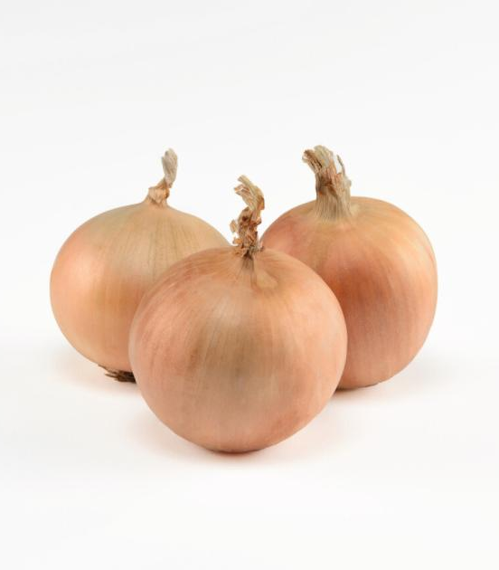
Milano
Milano is a vigorous, high-yielding PLK-type onion. It has strong leaf wax and produces multiple protective skins. Bulbs are high-globe in shape, very firm, and offer excellent long-term storage. It matures in approximately 180 days from sowing, with an ideal planting window from early August through mid-September.

Slide 14
SV7030NS
SV7030NS is a high-yielding red onion variety with an attractive, shiny red skin and a uniform globe shape. This hybrid produces consistent, high-quality bulbs with strong market appeal. It also has excellent pack-out performance and a high percentage of single-centre bulbs, making it well suited to commercial production.
Has some disease resistance attributes.

Slide 15
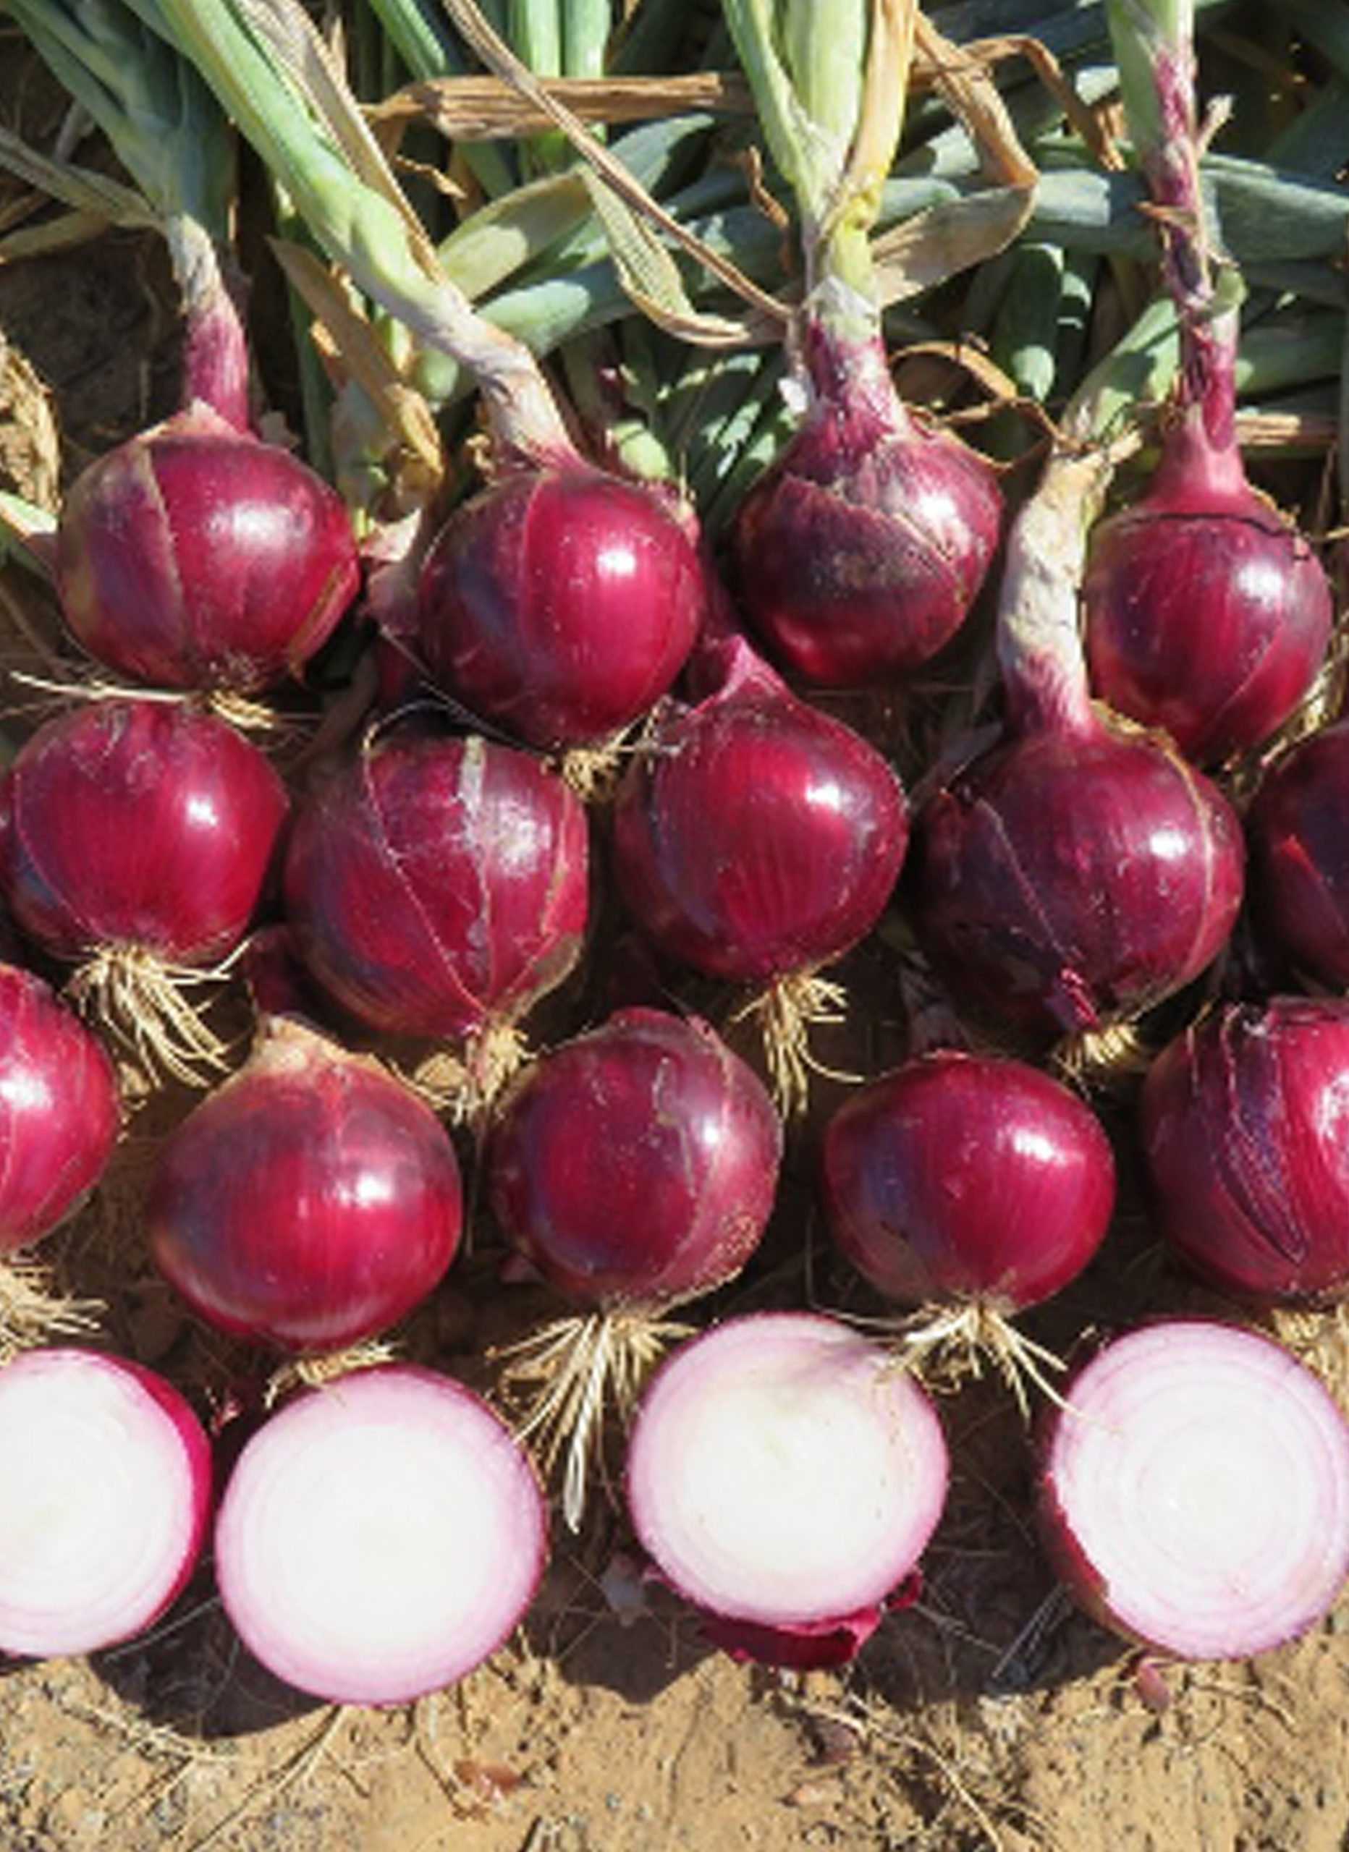
Rubillion
Rubillion is an early long-day onion variety with a uniform globe shape and dark red skin. It develops strong internal red ring colour during storage. The bulbs are firm, have excellent skin retention, and offer strong long-term storage potential.

Slide 16
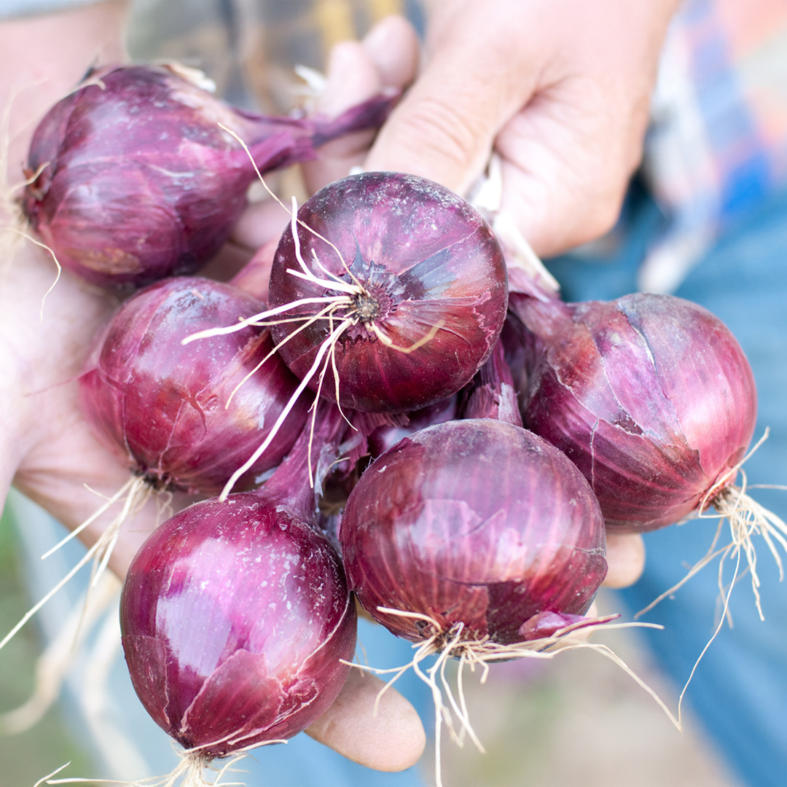
Red Baron
Red Baron is a popular red onion variety that is reliable and mid- to late-maturing. It produces medium-sized, deep red bulbs with excellent flavour. This variety has a moderate storage life and is well suited to fresh market use.

