Slide 1


Slide 2
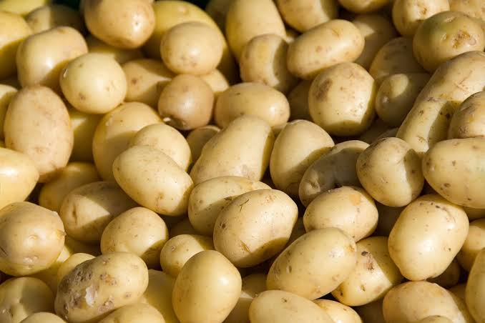
Potato Specific Gravity and Testing Activities

Slide 3
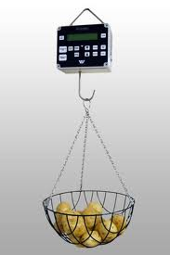
Activity 2:
Calculating the Specific Gravity
Specific Gravity = Weight in air/ weight in air-weight in water

Slide 4
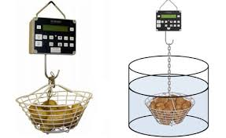
Dry matter content of potatoes
Specific gravity of potatoes is measured to estimate their dry matter content, particularly starch levels. For processing purposes, a specific gravity greater than 1.06 is typically required, as higher starch content improves texture, yield, and overall processing quality.

Slide 5
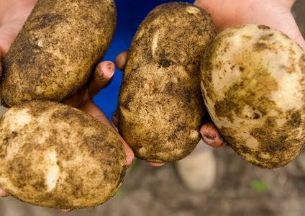
Method
Using an electronic balance weigh the each of the five largest potatoes from each row in air.
Record the result.
Then weigh each of the potatoes in water.
Calculate the specific gravity of each potato using the formula
Specific Gravity = Weight in air/ weight in air-weight in water

Slide 6
Raw Result Table
Row Number ________
Tuber Number | Weight in Air | Weight in water | Specific Gravity
1
2
3
4
5

Slide 7
Processed Result Table
Row Number 1
Tuber No | Specific Gravity | Dry Matter
1
2
3
4
5

Slide 8
Table to calculate dry matter from specific gravity

Slide 9
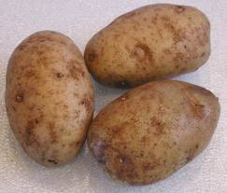
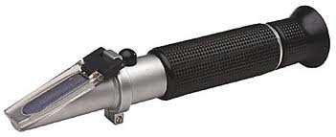
Activity 3:
Testing Potato Varieties for Suitability for Processing

Slide 10
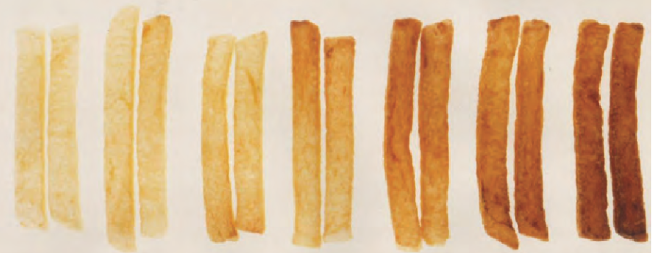
Sugar content
Processing potatoes should have low sugar levels, typically with a Brix value of less than 5, to reduce the risk of excessive browning in the final product.

Slide 11
Investigation: Testing Potato Varieties for Suitability for Processing
Aim:
To compare different potato varieties and determine which are most suitable for processing based on their sugar content (Brix level)
Method:
Calibrate the refractometer using distilled water (should read 0 °Brix).
Choose one potato variety and wash, peel, and grate it.
Place the grated potato into cheesecloth and squeeze to collect the juice.
Put a few drops of juice onto the refractometer prism.
Record the Brix value.
Clean the prism with distilled water and dry it.
Repeat the test two more times for the same variety and calculate the average Brix value.
Repeat steps 2–7 for each potato variety.
Results:
Record your results in a table, including each potato variety and its average Brix value.

Slide 12
Result table
 | Brix level Reading
Potato Variety | 1 | 2 | 3 | Average

Slide 13
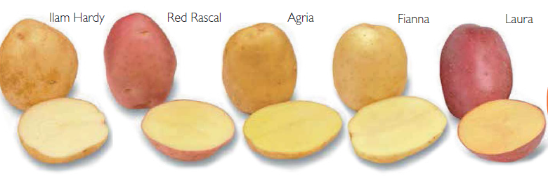
Conclusion
Compare the results and identify which potato varieties are suitable for processing.

Slide 14
Activity 4
Testing the impact of Storage Conditions on Sugar Content

Slide 15
Investigating the Impact of Storage Conditions on Potato Sugar Content
Method:
Divide the potatoes into 4 groups (5 potatoes in each group).
Place each group in a different storage condition:
  The fridge
  In an incubator at 26°C
  At room temperature in the lab (cool area- hot area- direct sun)
Leave the potatoes in these conditions for a set period of time (e.g. 1–2 weeks).
After the storage period, test the sugar content of each potato using the above method,
Repeat for all potatoes and calculate the average Brix value for each storage condition.
Record results for each potato in a table showing each storage condition and the average Brix value.

Slide 16
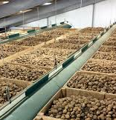
Prediction
Which storage condition do you think would be best for keeping potatoes sugar -Bix sugar levels below 5 during storage for processing?

Slide 17
Results:
Storage method | Brix level Reading for each potato
Potato | 1 | 2 | 3 | 4 | 5 | Average
Fridge
Incubator (26°C)
Room temperature in a cool dark area
Room temperature in a direct sun

Slide 18
Conclusion
Compare the results and identify which storage conditions are best for storing potatoes for processing.

Slide 19
Activity 5: Discussion questions
Why do processing companies care more about inside quality than outside appearance?
Why must growers minimise damage during harvesting, transport, or handling?
How does water content affect profit?
What might happen if potatoes are stored too cold?
Why is consistency important in fast food products?
Why is the shape of potatoes important when processing them into French fries and crisps?
What problems can high sugar levels cause during frying?
Why do processing companies reject potatoes with soil and stones?

Slide 20
Sample answers
Why do processing companies care more about inside quality than outside appearance?
  Processing companies peel and cut potatoes, so the outside skin is removed. What matters most is the inside quality (starch, sugar, and defects), as this affects how the fries cook, their colour, texture, and overall quality.
Why must growers minimise damage during harvesting, transport, or handling?
  Damage such as bruising causes internal dark spots and reduces quality. These defects can lead to potatoes being rejected or trimmed, which reduces yield and profit.
How does water content affect profit?
  Potatoes with high water content lose more weight during frying, producing fewer fries. This results in lower yield and less profit, while high dry matter potatoes produce more usable product.
What might happen if potatoes are stored too cold?
  Cold storage can cause sugars to increase (cold-induced sweetening). This leads to dark, burnt-looking fries when cooked, making them unsuitable for processing.

Slide 21
Why is consistency important in fast food products?
Customers expect fries to look and taste the same every time. Consistency ensures uniform colour, texture, and size, which is important for customer satisfaction and brand reputation.
Why is the shape of potatoes important when processing them into French fries and crisps?
Shape is important because it affects how efficiently potatoes can be cut, how much usable product is produced, and how consistent the final product looks and cooks.
  For French fries, long, oval or “brick-shaped” potatoes are preferred because they:
    Produce longer fries
    Reduce waste by allowing more of the potato to be used
    Improve yield, since fewer small or unusable pieces are cut away
    Create a more consistent product that meets consumer expectations
  For crisps (chips), round to oval potatoes are preferred because they:
    Produce uniform circular slices
    Ensure even cooking, since all slices are similar in size and thickness
    Improve packaging quality and appearance
    Reduce breakage and uneven pieces during processing
What problems can high sugar levels cause during frying?
  High sugar levels cause fries to brown too quickly, resulting in a dark or burnt appearance and an undesirable taste.
Why do processing companies reject potatoes with soil and stones?
  Soil and stones can damage machinery, increase cleaning time, and cause defects like bruising. This increases costs and reduces efficiency.

