Slide 1


Slide 2
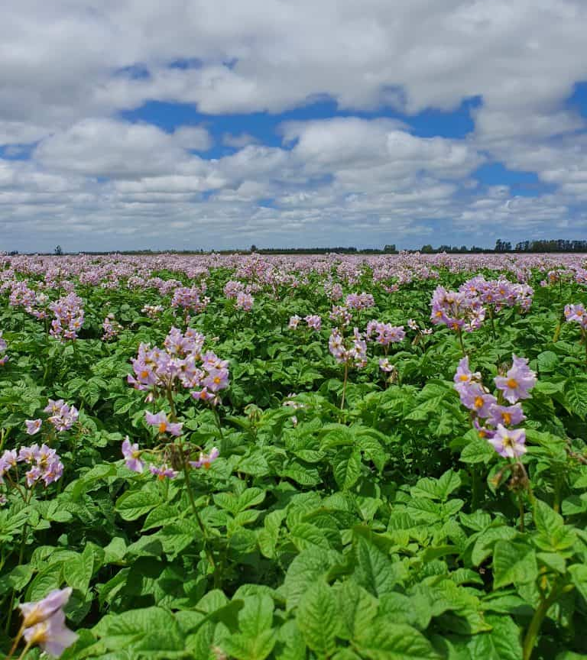
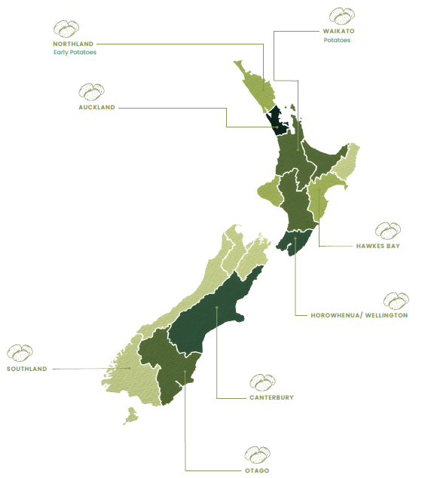
Growing
Potatoes

Slide 3
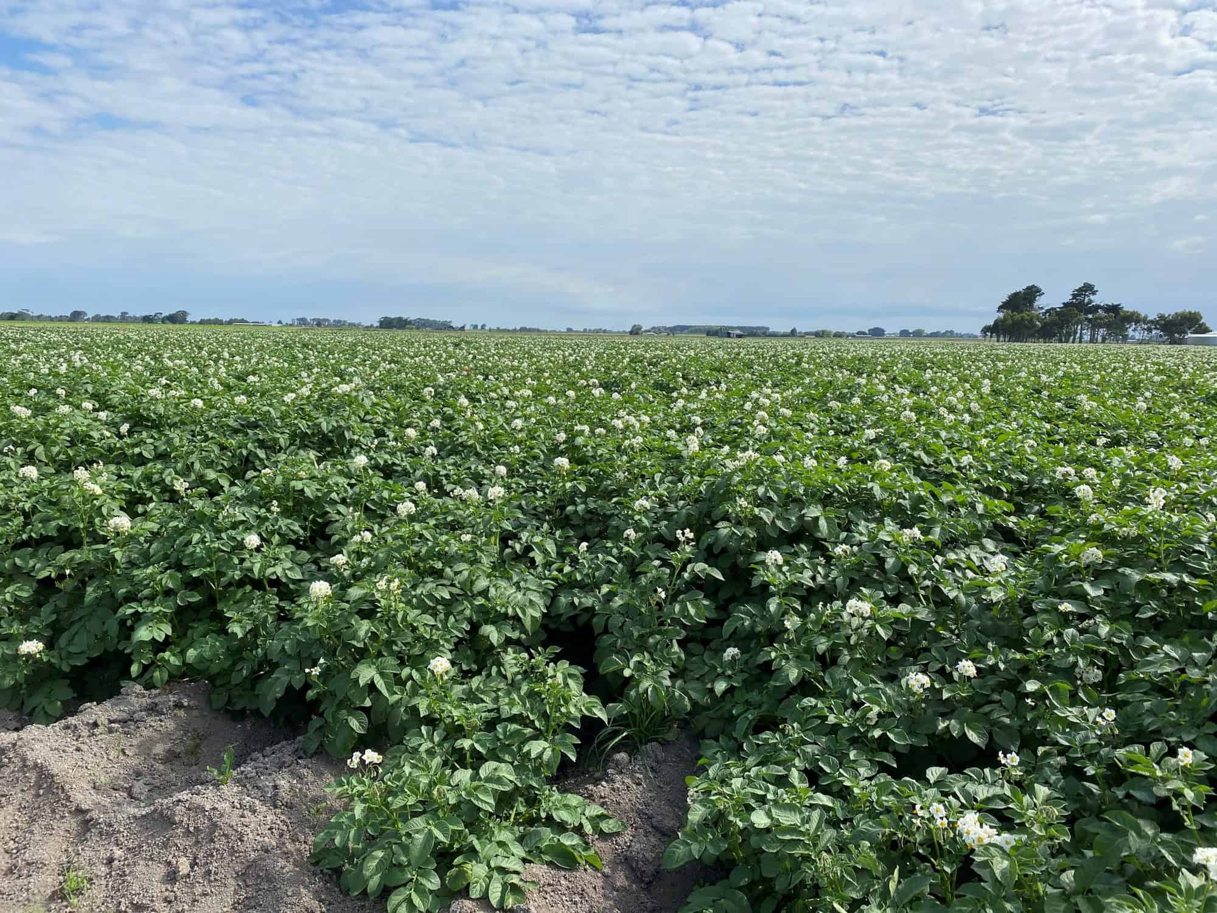
Growing potatoes commercially
Videos
Growing Potatoes in NZ
Perlas New Season Potatoes: How we grow, harvest and pack them
Wilcox and Sons on the importance of information - technology
Ohakune Potato Harvesting- https://www.youtube.com/watch?v=awNcWK4eo3g&t=52s
Agria in full flower – Mike Moleta’s farm, Opiki, January 2021

Slide 4
Growing Potatoes
Flow Diagram of Calendar of Operations
Cultivar selection
Use integrated pest management practices to control weeds, pests and diseases
Certified seed potatoes
Seeds planted in furrows 15 cm deep, 20-40 cm apart in 65 cm rows
Monitor crops for pests and diseases
Site Selection
Defoliation
Pre- planting
Planting
Emergence 21 Days
Growing
100- 120 days
Harvesting
Soil test
Cultivation
Seedbed preparation
Hill potatoes when 12-20cm in height
irrigation
Test for maturity
size and skin condition
Add required fertiliser for crop needs. Base dressing
Apply fertilise as side dressing based on herbage tests

Slide 5
Potato Production: Calendar of Operations
Note: This is a general calendar for potato operations. Timing may vary by location and grower. To ensure year-round supply, seed potatoes are sown in staggered intervals across regions from, early plantings in frost-free Northland in mid-winter to later crops further south as frost risk declines.
 | Winter |  |  | Spring |  |  | Summer |  |  | Autumn
Management Practices | Jun | Jul | Aug | Sep | Oct | Nov | Dec | Jan | Feb | Mar | Apr | May
Cultivar Selection | Cultivar Selection
Site Selection | Site Selection |  |  |  |  |  |  |  | Site Selection
Soil Testing | Soil Testing |  |  |  |  |  |  |  |  |  | Soil Testing
Seedbed Preparation |  |  | Seedbed Preparation |  |  |  |  |  |  | Seedbed Preparation
Sowing Certified Seed | Sowing Certified Seed
Mounding | Mounding
Fetiliser Applications | Fetiliser Applications
Weed, Pest, Disease Management (IPM) | Weed, Pest, Disease Management (IPM)
Irrigation |  |  |  |  |  |  | Irrigation
Maturity Testing |  |  |  | Maturity Testing
Harvest |  |  |  |  | Harvest

Slide 6
Potato Production: Calendar of Operations
Note: This is a generalisel calendar for growing main crop Agria potatoes in the Waikato.
 | Winter |  |  | Spring |  |  | Summer |  |  | Autumn
Management Practices | Jun | Jul | Aug | Sep | Oct | Nov | Dec | Jan | Feb | Mar | Apr | May
Cultivar Selection |  |  |  |  |  |  | Cultivar selection
Site Selection |  |  |  |  |  |  |  |  | Site Selection
Soil Testing |  |  |  |  |  |  |  |  |  |  | Soil Testing
Seedbed Preparation |  |  | Seedbed Preparation
Sowing Certified Seed |  |  |  | Sowing
Hilling |  |  | Hilling
Fetiliser Applications |  |  |  | Fetiliser applications base dressing and two side dressing 35-50 days apart
Weed, Pest, Disease Management (IPM) |  |  |  | Weed, Pest, Disease Management (IPM)
Irrigation |  |  |  |  |  |  | Irrigation
Maturity Testing |  |  |  |  |  |  | Maturity Testing
Harvest |  |  |  |  |  |  |  | Harvest
In ground storage |  |  |  |  |  |  |  |  |  |  | Storage

Slide 7
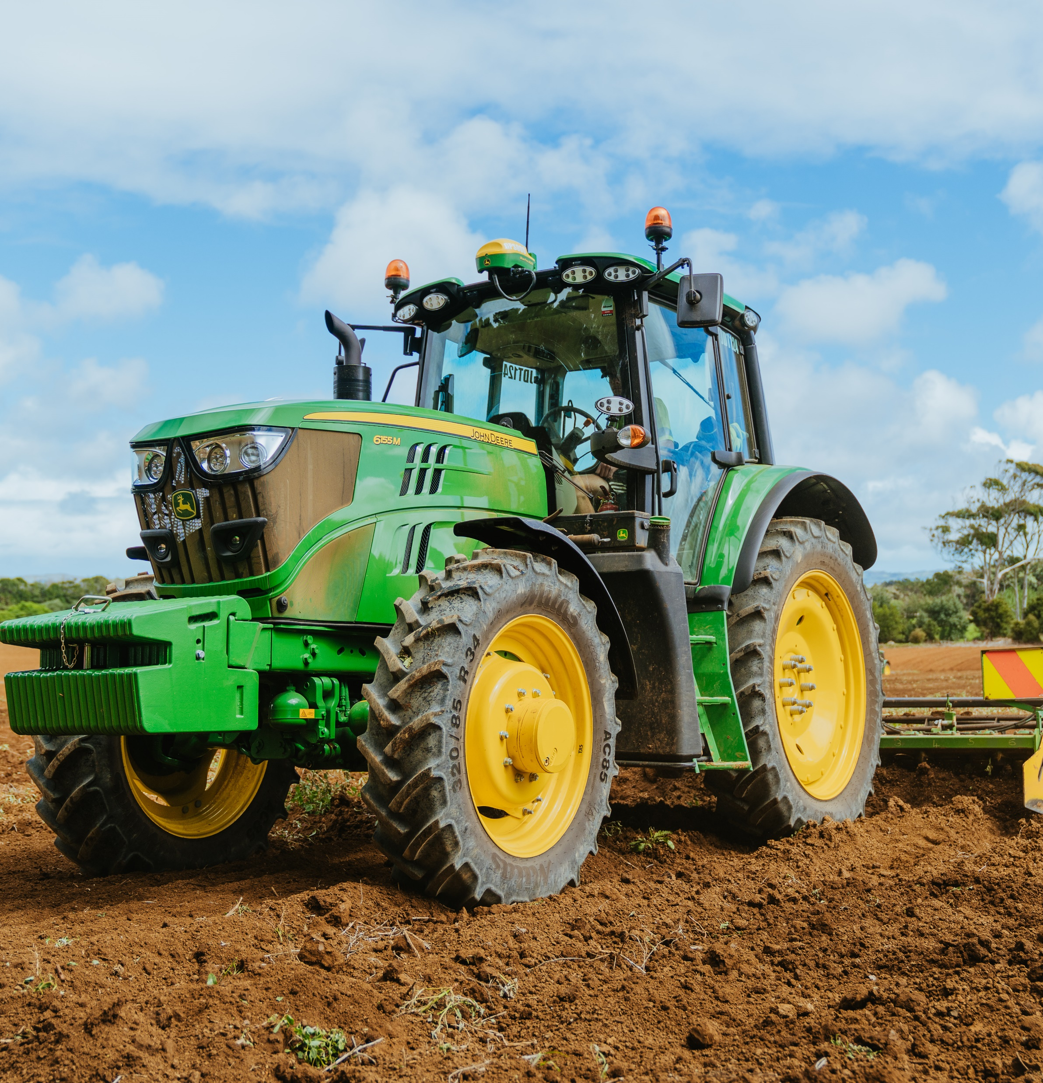
Site selection
What makes a good site for growing potatoes?
Selecting the right site is critical for successful commercial potato production. Key factors growers consider to ensure high yields, good quality tubers, and long-term soil health.
Field history and crop rotation
Climatic factors
Soil type and conditions

Slide 8
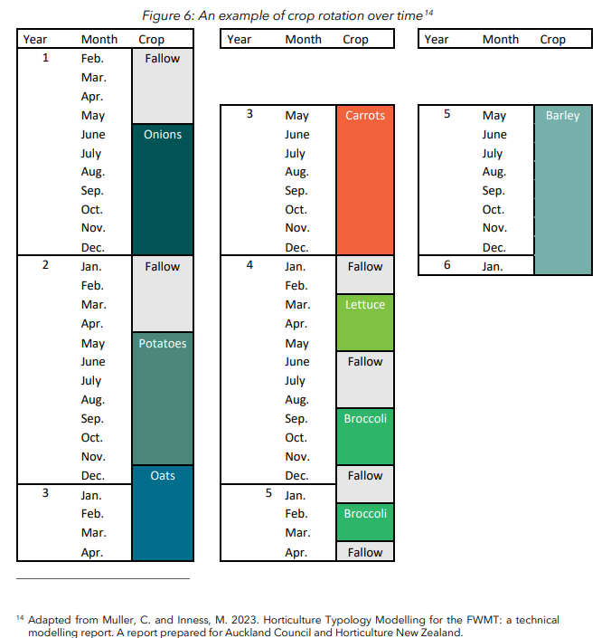
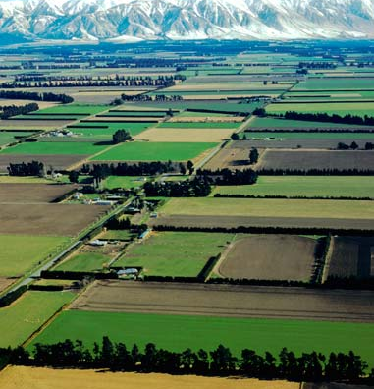
Field history and crop rotation
Previous land use is important
Pasture fields are often preferred due to better soil structure and fertility as well as reduced risk of soil borne diseases
Potatoes are typically grown in the same field only once every 5 years to reduce pests and diseases
Soil fertility must be assessed to ensure it supports healthy crop growth
Existing weeds, pests, and diseases should be identified and managed before planting
Well-planned crop rotation improves soil health, productivity, and long-term sustainability

Slide 9
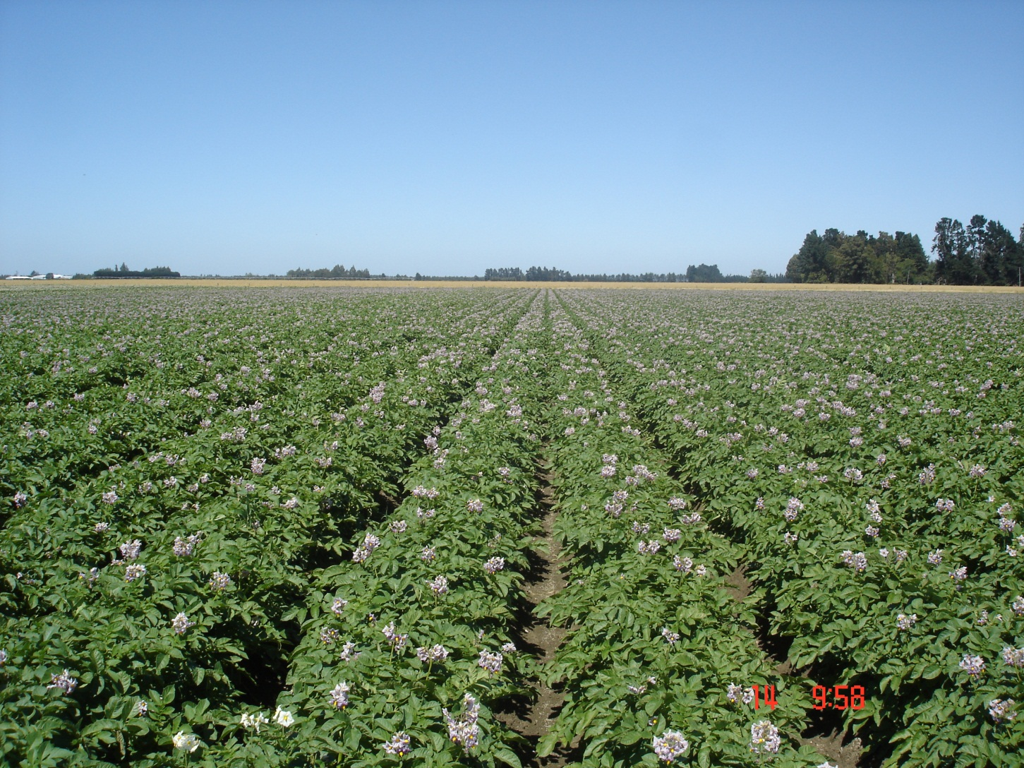
Climatic factors
Temperature: Optimal growth occurs between 10–25°C
Frost: Light frost may be tolerated early, but frost during flowering or near harvest can significantly reduce yields
Water: Consistent moisture is essential; requires adequate rainfall or reliable irrigation
Drainage: Waterlogged soils must be avoided to prevent disease and poor tuber development
Wind: Strong winds can damage plants, increase disease risk, and speed up soil moisture loss

Slide 10
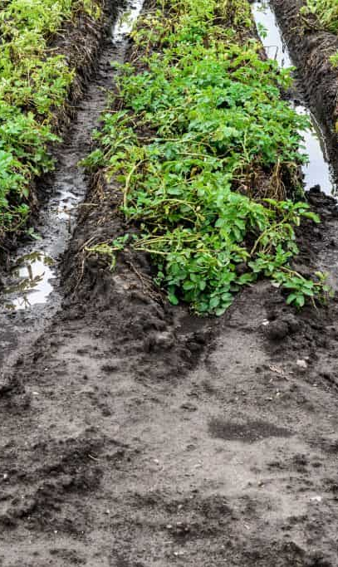
Impact of Wet Weather
Higher disease pressure (fungal and bacterial diseases)
Poor root and tuber growth
Delayed crop development and harvest
Reduced machinery access, especially on clay soils
Increased harvest losses and soil compaction

Slide 11
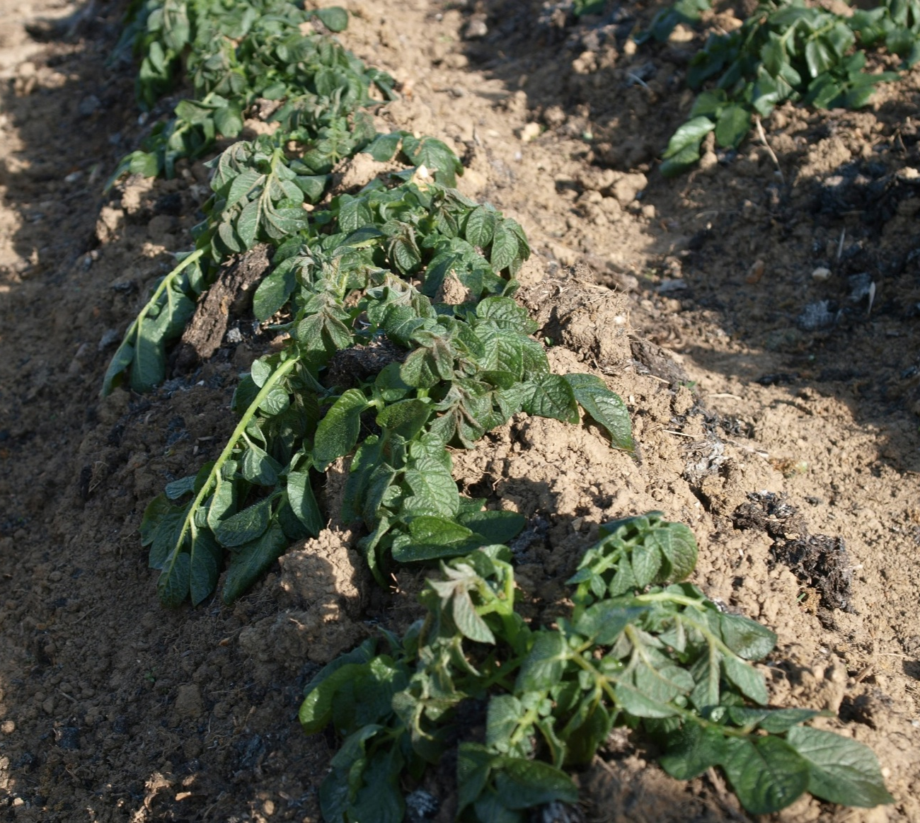
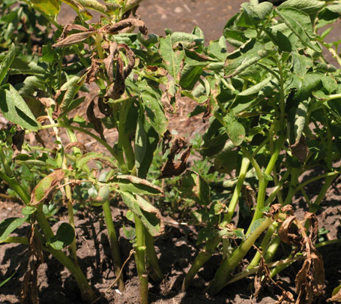
Damage
Too Hot
= heat stress
Too Cold
= frost

Slide 12
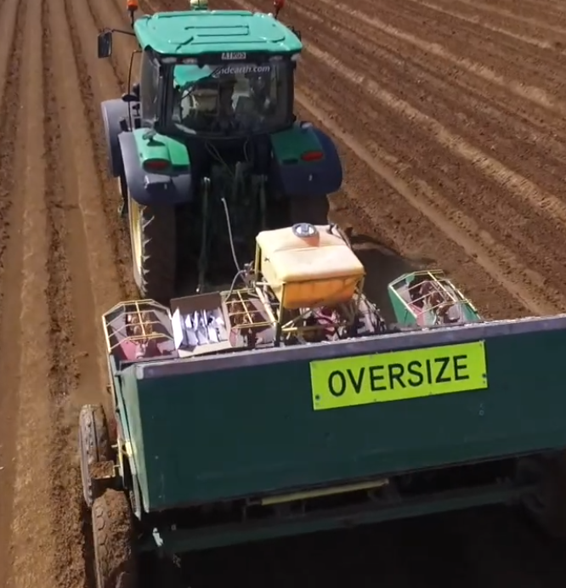
Soil
Potatoes can grow in a range of soils, including clay loam, silt loam, sandy loam, peat, and alluvial soils
Ideal soil is a light to medium loam that is deep, friable, and well-drained, with good water-holding capacity
Optimal soil pH is 5.5–6.5 to support nutrient availability and reduce disease risk (e.g. common scab)
Good soil structure is essential for healthy root growth and tuber development
Soil water-holding capacity influences variety selection and harvest timing

Slide 13
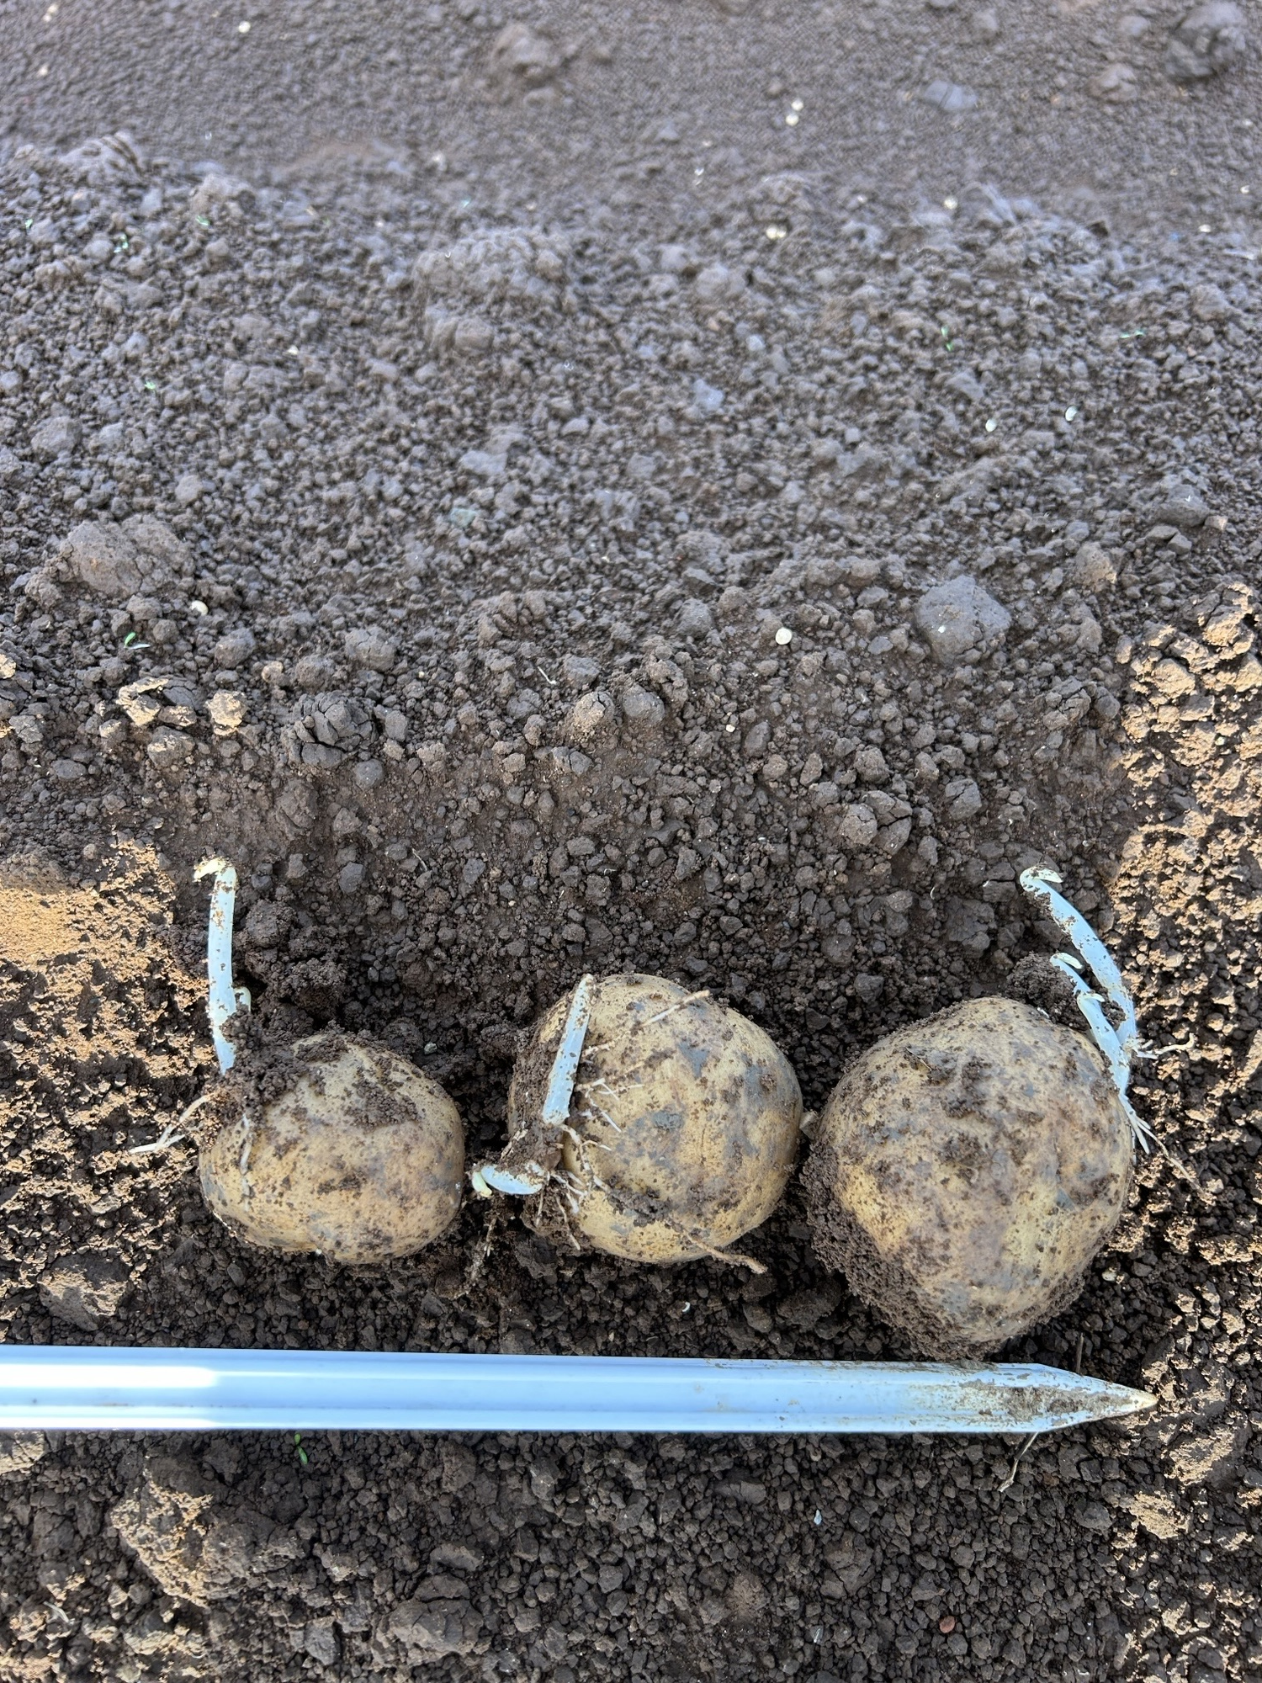
Seed potatoes
Use certified seed potatoes that are free from disease
Select high-quality seed tubers for strong, healthy growth
Match the variety to site conditions such as soil type, climate, and irrigation availability

Slide 14
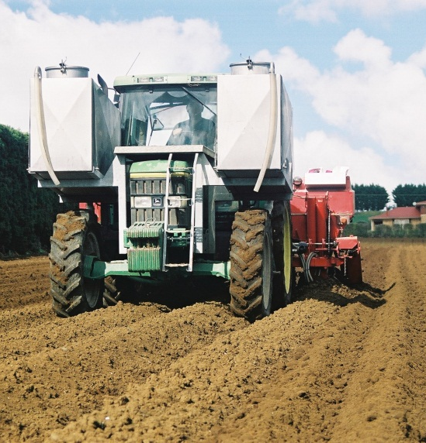
Seedbed
An ideal seedbed for commercial potato production is deep, well-drained, and friable, allowing unrestricted tuber development.
Soil should be finely cultivated but not compacted, with a stable structure that supports aeration, root growth, and uniform emergence.
Furrows should be well-formed, consistent, and of adequate depth to ensure proper soil coverage of seed tubers and developing potatoes. They should also support efficient drainage and irrigation and allow for effective hilling to protect tubers from light exposure and reduce pest and disease risk.
The seedbed should be free of large clods, stones, and crop residues, with adequate moisture to support planting and early growth without becoming waterlogged.
In-furrow application of insecticides and fungicides may be used to reduce early pest and disease pressure.

Slide 15
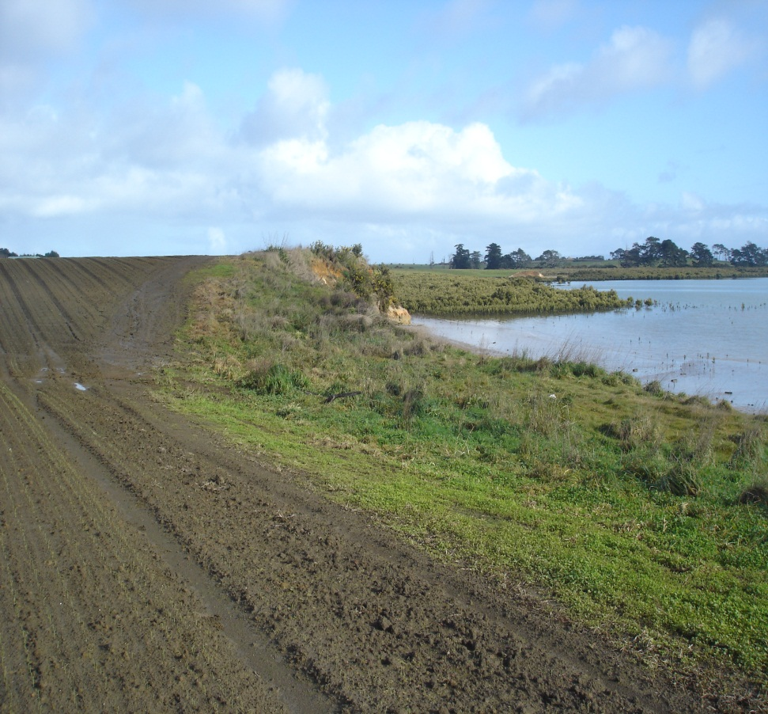
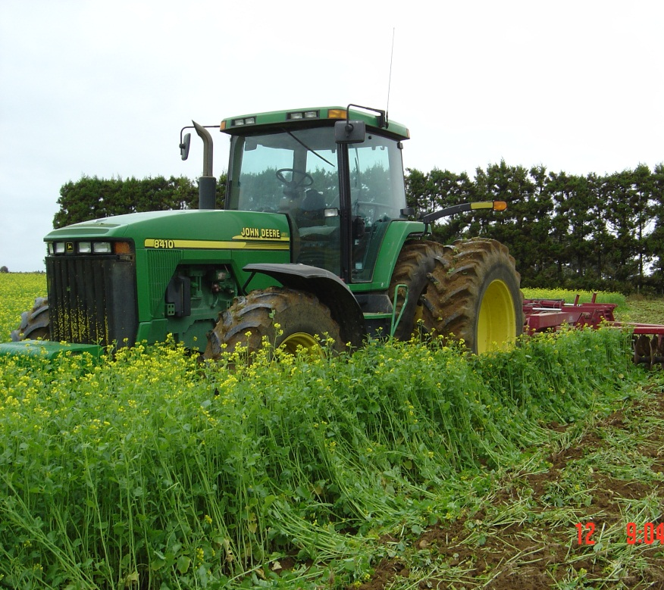
Cultivation:
Impacts and Soil Management
Cultivation can negatively affect the environment through soil compaction, reduced soil stability, and increased erosion risk, but it remains essential for successful crop production.
Cover crops help maintain soil health by increasing organic matter, improving soil structure, fertility, and water retention, supporting nutrient uptake, and reducing leaching losses. They also reduce wind and water erosion by maintaining ground cover.
Silt control measures reduce off-site impacts:
  Riparian buffer strips create protective barriers between farmland and waterways.
  Silt traps capture sediment, allowing cleaner water to be discharged into streams and rivers.

Slide 16
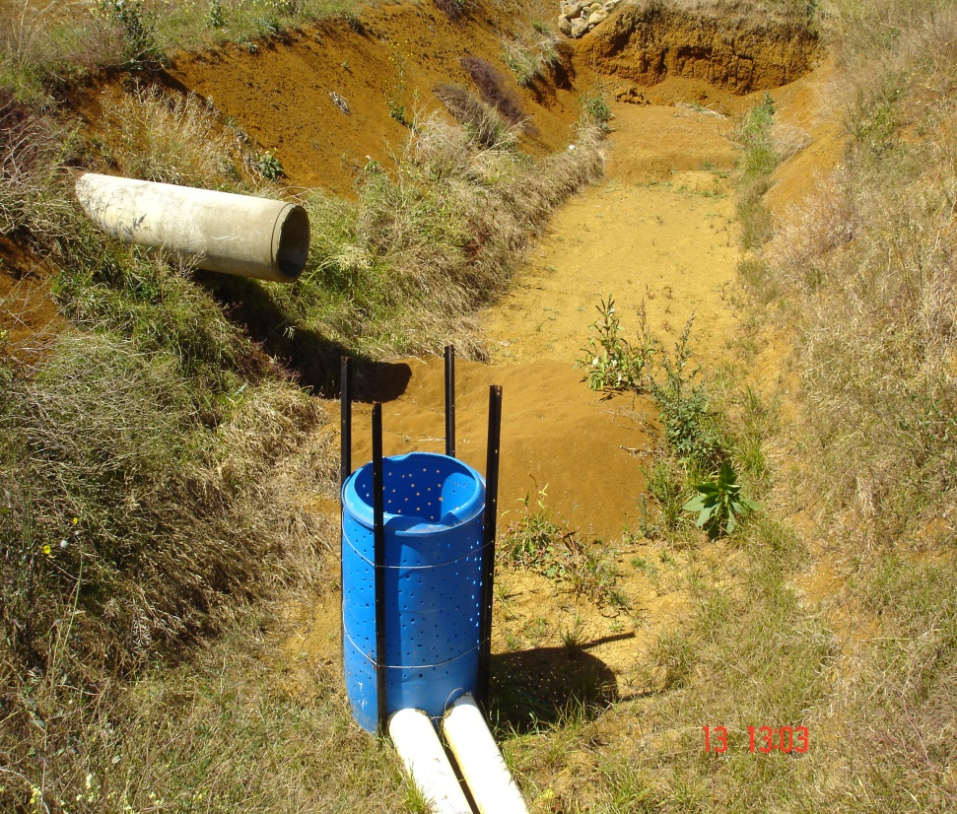
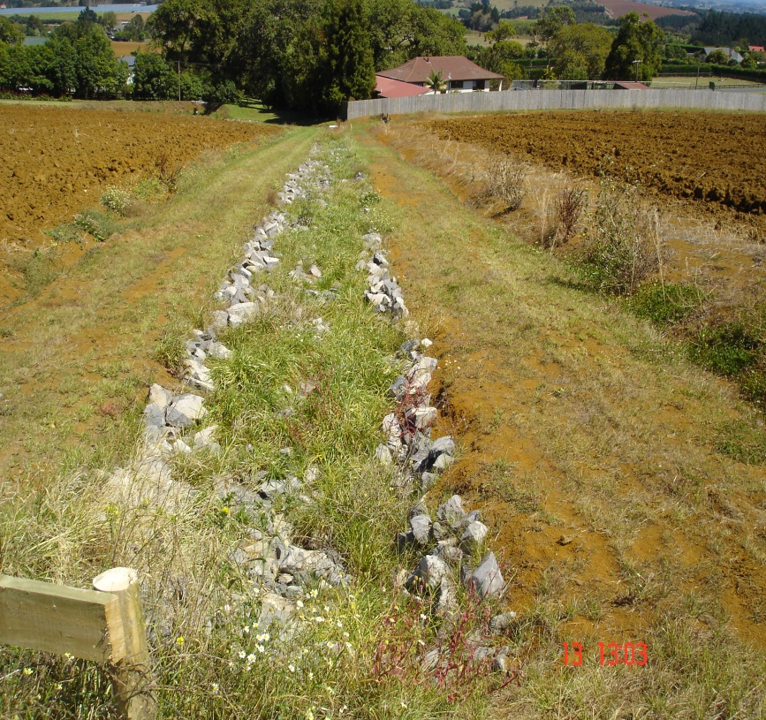
Silt traps

Slide 17
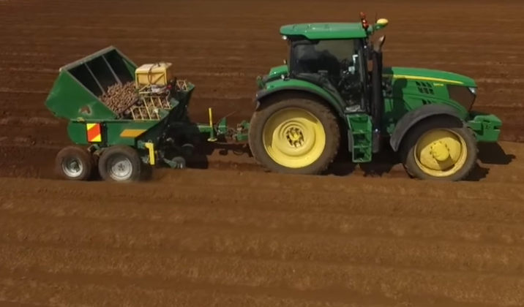
Planting seed potatoes
Whole seed potatoes, typically 40–55 mm in diameter, are planted into furrows using a precision planter and then covered with soil.
Planting time varies by region, starting earlier in warmer areas such as Northland and Auckland, compared with cooler regions like Waikato, Ohakune, and Canterbury
Planting occurs when soil temperatures are rising and frost risk is low, with emergence typically occurring around 21 days after planting.
Spacing & Planting Guidelines
Proper spacing ensures good air circulation, sunlight exposure, and uniform tuber development.
  In-row spacing: 25–35 cm between tubers
  Row spacing: 70–90 cm between rows
  Planting depth: 10–15 cm

Slide 18
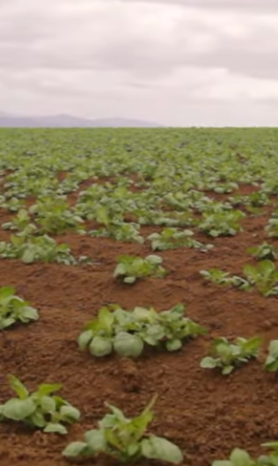
Growth stage
Potato crops take approximately 110–130 days to reach maturity
Leaf emergence occurs around 21 days after planting seed potatoes
Effective crop management is essential to achieve high yields and quality
Key management practices include:
Hilling to support tuber development and protect from sunlight
Fertiliser application to support healthy growth
Irrigation to maintain consistent soil moisture
Pest and disease monitoring to protect crop health
Weed management to reduce competition for nutrients and water
Crop 40 day old

Slide 19
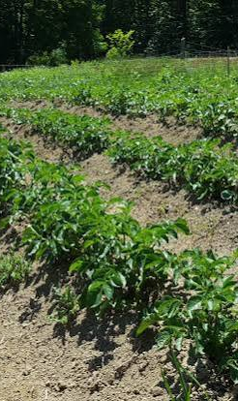
Hilling
Hilling is where soil is pulled up and piled around the base of the growing potato plant.
The first hilling is carried out when plants reach 12–20 cm in height
A second hilling is completed 2–3 weeks later
Hilling
Protects developing tubers from sunlight, preventing greening
Encourages secondary tuber formation, increasing yield
Improves plant stability and supports healthier growth
Improves drainage around the plant and reduces exposure of tubers to pests and disease

Slide 20
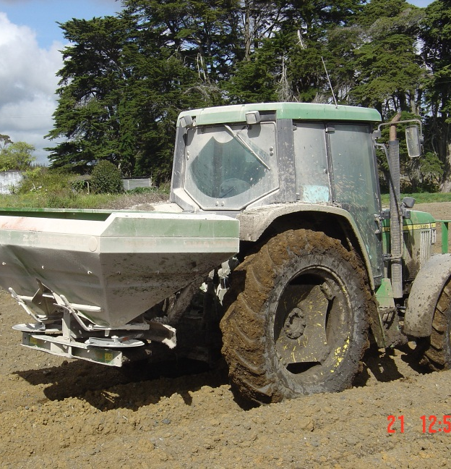
Nutrient management
Potatoes need a balanced supply of nutrients for healthy growth and high yields
Fertiliser use should be based on soil testing to avoid deficiencies or excess nutrients
A two-phase fertiliser programme is commonly used
Phase 1: Early Growth (Foliage Development)
Nitrogen (N): 150–200 kg/ha (supports leaf and stem growth)
Phosphorus (P): 40–60 kg/ha (supports root development and early growth)
Nitrogen is usually applied in split doses to reduce loss
Phase 2: Tuber Bulking (4–10 weeks after emergence)
Potassium (K): 150–250 kg/ha (important for tuber size, quality, and storage life)
Magnesium (Mg) and Boron (B) may be added if soil tests show deficiencies
Key Nutrients
N: Early plant growth (too much reduces tuber yield)
P: Root growth and tuber initiation
K: Yield, quality, and disease resistance
Ca & Mg: Improve plant health and tuber quality\

Slide 21
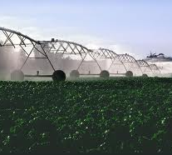
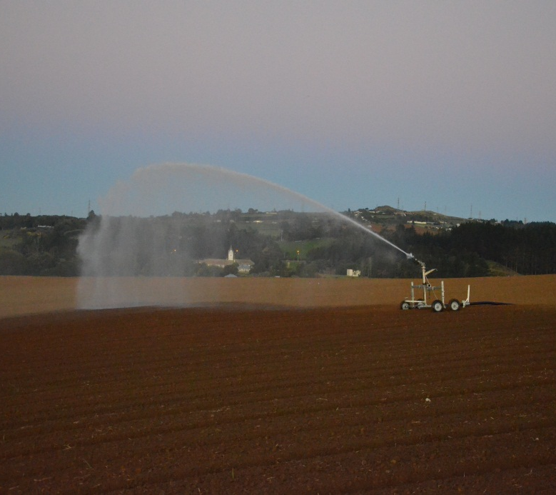
Irrigation
High rainfall areas: irrigation is less important
Low rainfall areas: irrigation is essential for steady growth
An even water supply is needed for high-quality yields
Water management is essential during the tuber bulking stage
Consistent irrigation supports uniform tuber development and good skin set
Avoid overwatering near harvest, as it can cause tuber cracking and increase disease risk
Effects of water availability:
Too little water → defects such as hollow heart
Uneven watering → knobbly or cracked tubers
Too much water → tuber rot in the soil

Slide 22
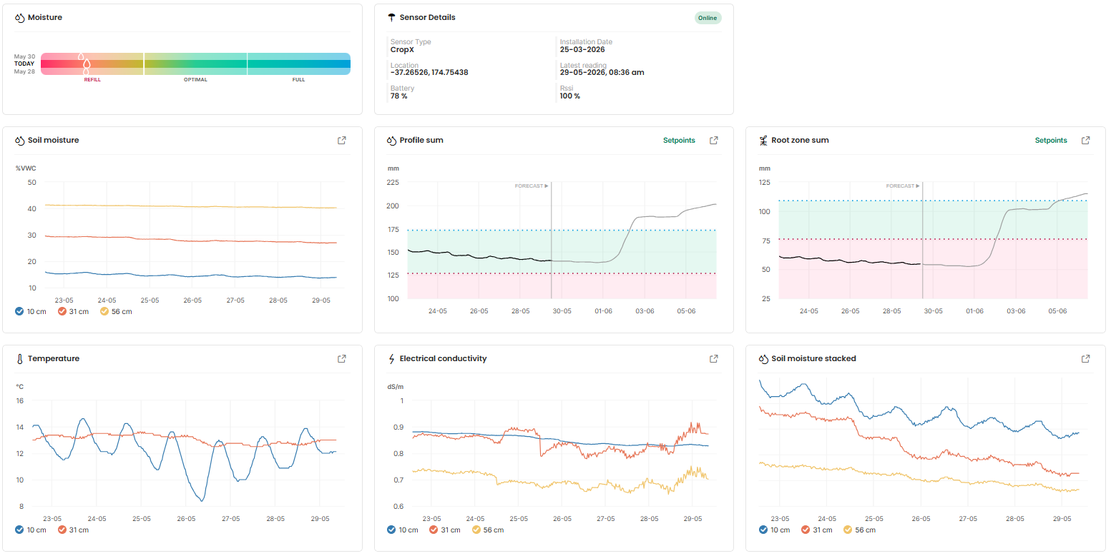
Irrigation scheduling
Irrigation scheduling- based on moisture monitoring.
Irrigation start when soil water falls to 65% of field capacity and it stops once the soil water level reaches 90% of field capacity.
  Determines when a crop is actually ‘dry’.
  Ability to calculate what the plant/soil is able handle.
  Ensures there is no runoff / wasted water or excessive soil erosion caused.

Slide 23
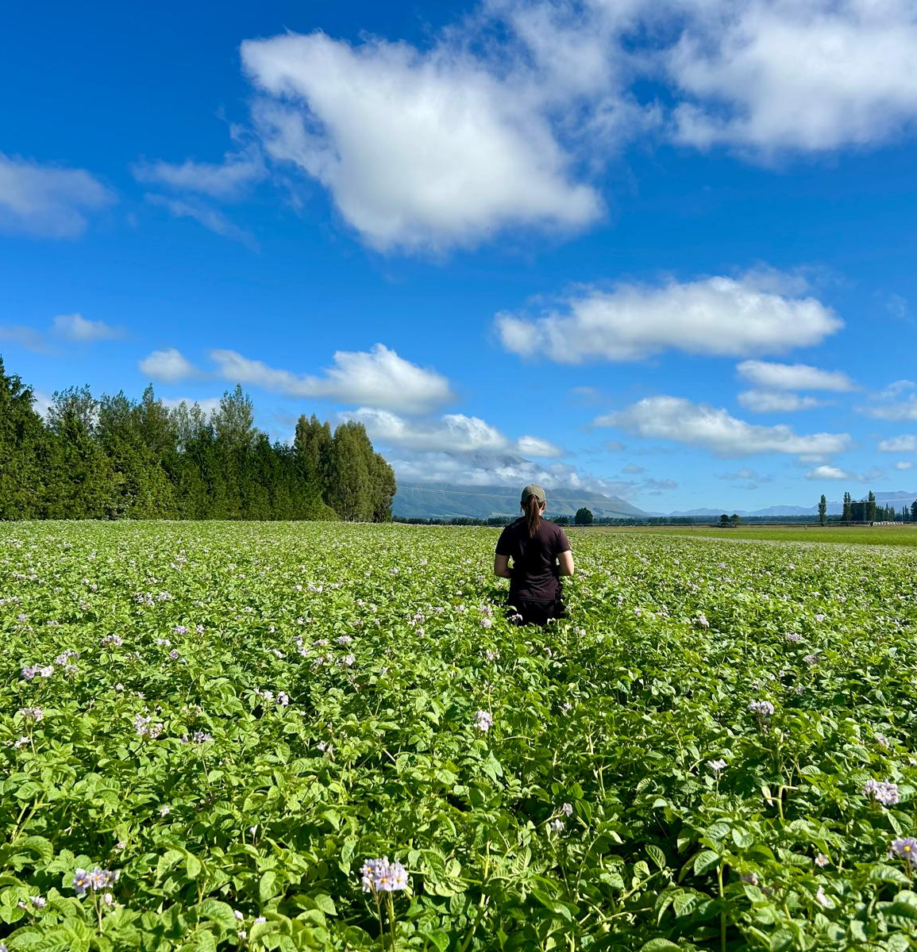
Pest and disease management
Potato production is exposed to multiple pest and disease risks that can reduce yield, tuber quality, and marketability
Regular monitoring and early scouting are essential for effective pest control and early intervention
Integrated management combining monitoring, hygiene, and prevention is essential for protecting crop health and productivity
Biosecurity and hygiene practices are critical
  Clean machinery and equipment between paddocks
  Avoid moving soil and plant material between sites
  Use certified disease-free seed material
See PPT Some common potato pest and disease risks in potato production

Slide 24
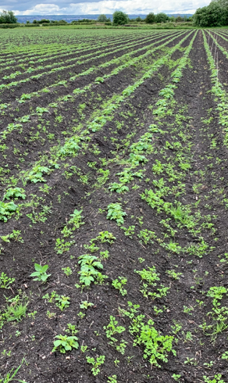
Weed management
Weeds compete with potato crops for nutrients, moisture, and light
They can also harbour pests and diseases, reducing tuber quality and yield
Maintaining weed-free rows early in the season is critical for strong crop establishment
Early control helps potatoes develop a competitive canopy against weeds
Weed control methods include:
  Mechanical cultivation
  Pre-emergence herbicides
Care must be taken to avoid:
  Damage to developing tubers
  Root disturbance
  Soil compaction
An integrated weed management approach helps protect yield and crop quality

Slide 25
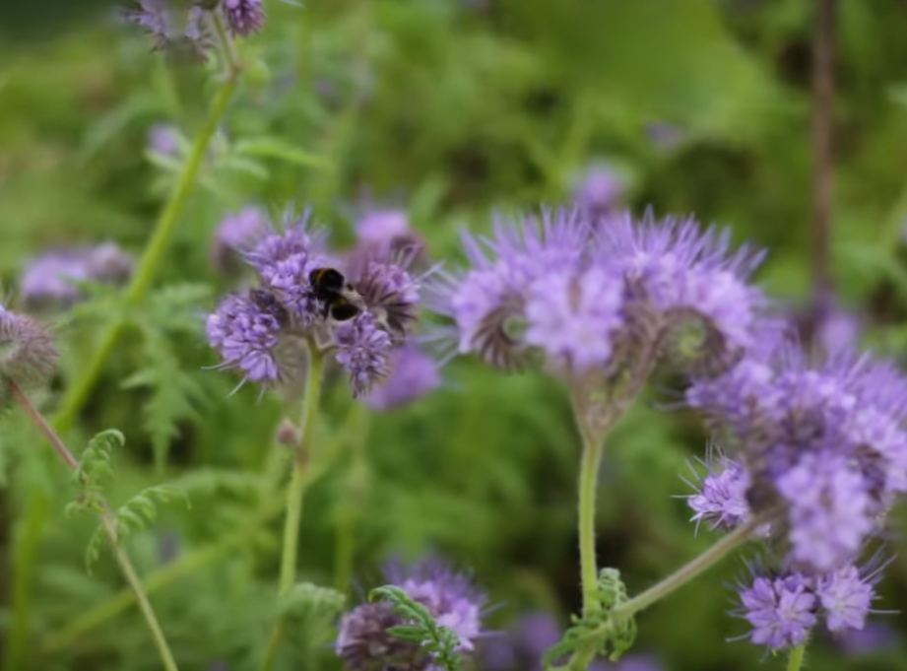
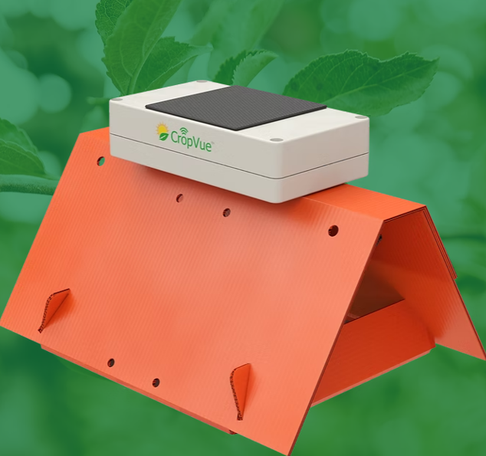
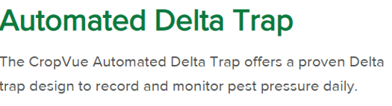
Practices used to minimise the use of agrichemicals
Use of certified, disease-free seed potatoes
Disease forecasting models to guide timely interventions
Regular crop monitoring to detect pests and diseases early
Integrated Pest Management (IPM)combining monitoring, hygiene, and prevention is essential for protecting crop health and productivity
Agrichemical spray programmes based on monitoring results, including the presence of pests, diseases, and beneficial insects

Slide 26
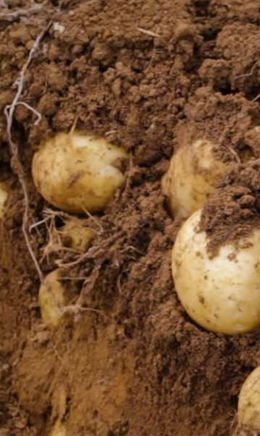
Maturity
Maturity is influenced by several factors, including:
  Location
  Seasonal conditions
  Weather patterns
At Maturity
Tubers should have firm, fully developed skins
Immature skins are more susceptible to damage during handling and curing
Poor skin maturity reduces shelf life and overall marketability

Slide 27
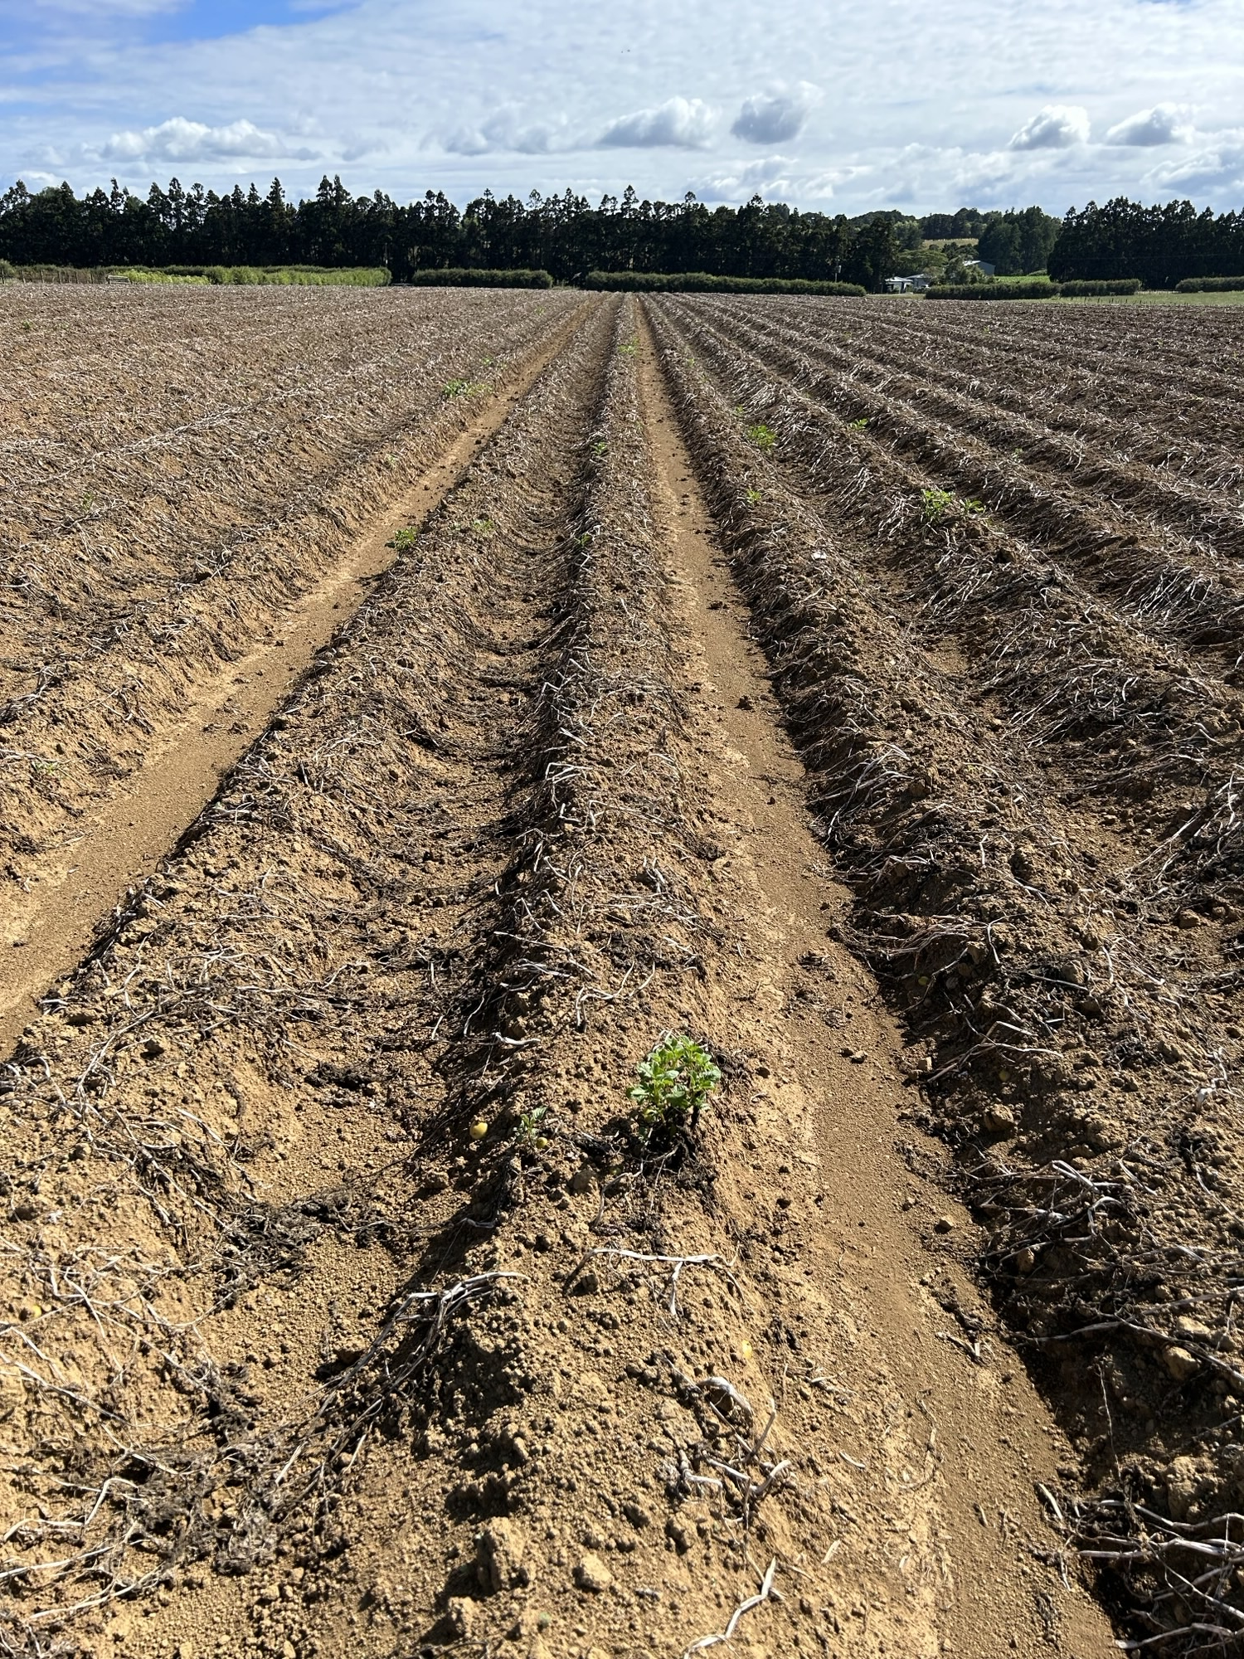
Defoliation
Spraying mature plants to kill off leaves
Encourages conversion of sugars into starch, improving storage life
Makes harvesting easier by removing excess foliage
Irrigation is stopped about a week prior
Excess water during slowed growth can reduce tuber specific gravity

Slide 28
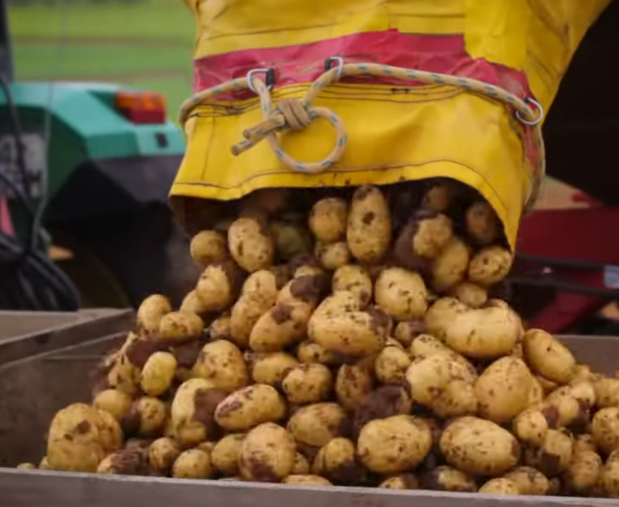
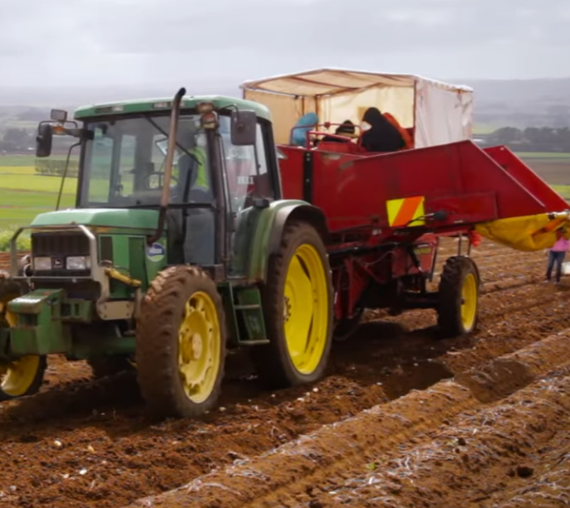
Harvesting
Potatoes are lifted row by row using a harvester
Tubers are handled carefully to minimise bruising and damage
Initial grading removes soil, foreign material, and damaged potatoes
Tubers are placed into bins and transported to the packhouse
Harvest Timing
Late crops should be harvested before the first heavy frost
Frost converts starch in tubers into sugars
High sugar levels cause excessive browning or burning in chips and crisps
This reduces processing quality and market value

Slide 29
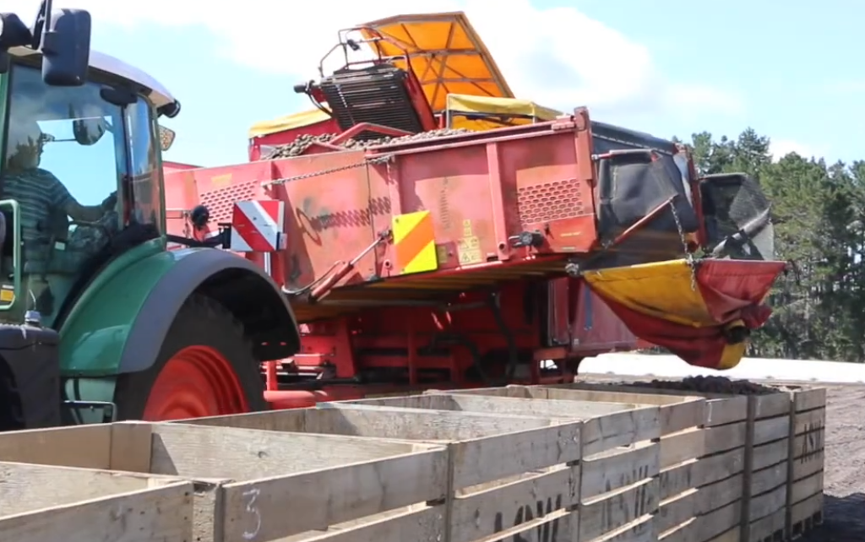
Post-Harvest Handling
Fresh market potatoes are washed and graded through several stages
Ensures quality, consistency, and removal of defects
Packed into bags, boxes, or bulk bins
Prepared according to retailer/supermarket requirements for distribution
Processing Potatoes
Cured for 10–14 days after harvest
Stored in a warm, humid environment
Allows minor skin damage to heal
Reduces moisture loss and disease risk
Prepares tubers for transport or storage

Slide 30
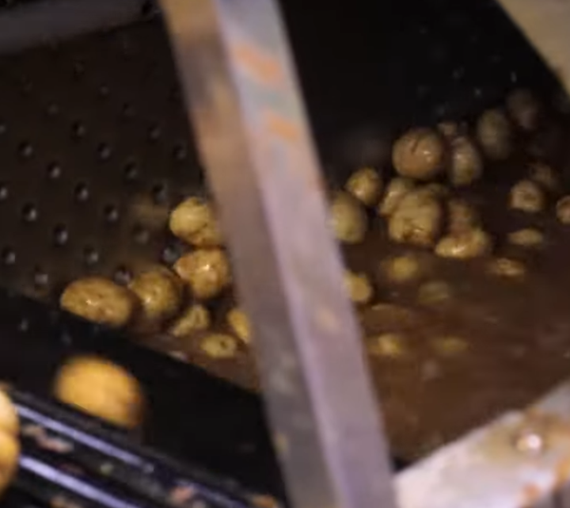
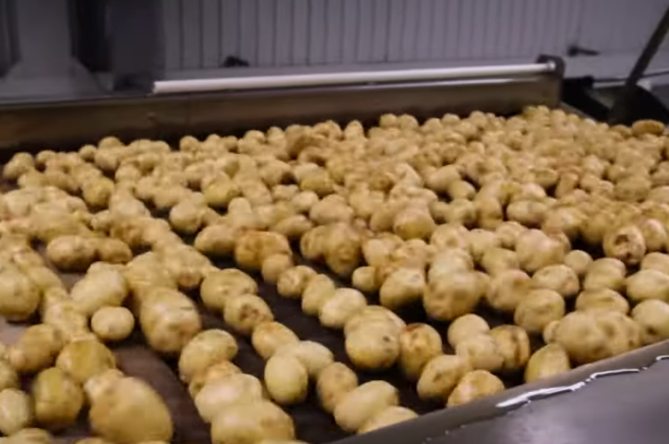
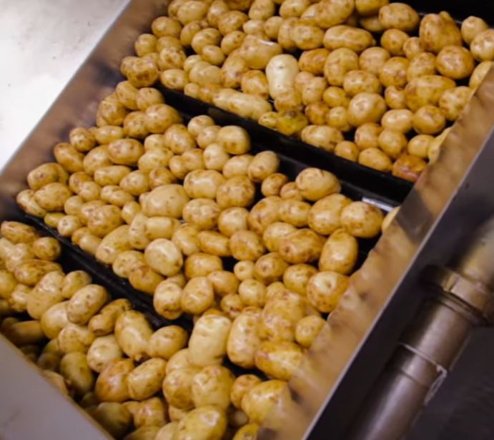
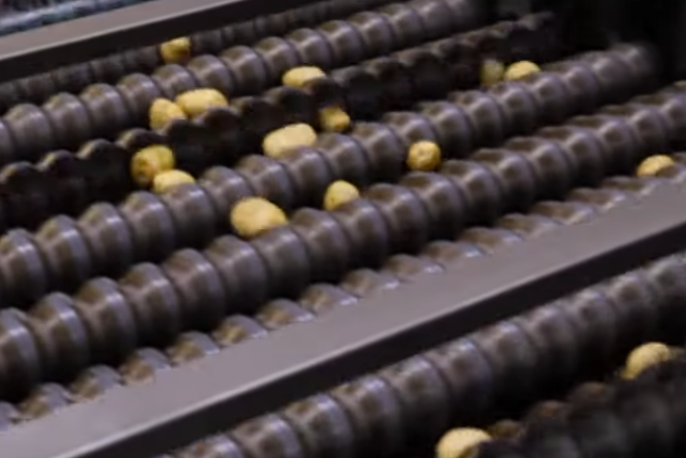
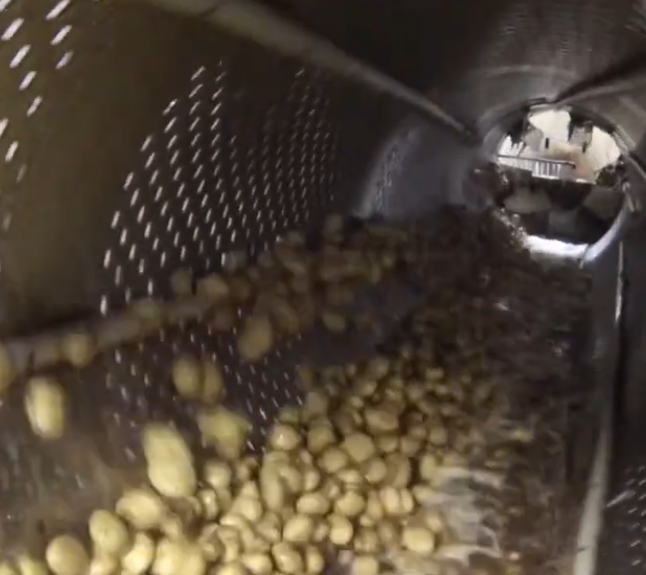
Washing and grading
Soak tank – washing
Primary inspection – remove any rubbish
Tumble washer
Polisher
Final inspection
Sizer

Slide 31
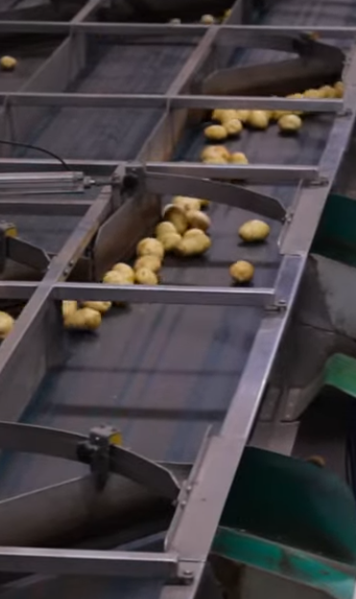
Packing
Packing line
Final inspection
Packed into
  Bags
  Boxes
  crates

Slide 32
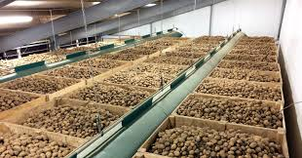
Storage
Proper storage is essential to maintain quality and prevent spoilage
Stored under controlled atmospheric conditions
Ideal Conditions
Temperature: 4–8°C
Dark environment to prevent greening
Well-ventilated storage area
High humidity to reduce shrinkage
Helps prevent sprouting and maintain texture and quality over time

Slide 33
Test yourself Quiz
What type of climate do potatoes grow best in?
a) Tropical
b) Temperate
c) Desert
d) Polar
What happens if soil becomes waterlogged?
a) Plants grow faster
b) Tubers grow bigger
c) Disease and poor growth can occur
d) Nothing changes
What is the ideal soil pH for potatoes?
a) 3.0–4.0
b) 5.5–6.5
c) 7.5–8.5
d) 9.0–10.0
What is “hilling”?
a) Harvesting potatoes
b) Adding fertiliser
c) Piling soil around the plant
d) Watering crops
True or False
Potatoes need a lot of water but should not sit in waterlogged soil.
Frost is only harmful at the early growth stage.
Crop rotation helps reduce pests and diseases.
All potatoes are used for making chips.
Larger potatoes are better for making fries

Slide 34
Answers
What type of climate do potatoes grow best in?
a) Tropical
b) Temperate
c) Desert
d) Polar
What happens if soil becomes waterlogged?
a) Plants grow faster
b) Tubers grow bigger
c) Disease and poor growth can occur
d) Nothing changes
What is the ideal soil pH for potatoes?
a) 3.0–4.0
b) 5.5–6.5
c) 7.5–8.5
d) 9.0–10.0
What is “hilling”?
a) Harvesting potatoes
b) Adding fertiliser
c) Piling soil around the plant
d) Watering crops
True or False
Potatoes need a lot of water but should not sit in waterlogged soil. T
Frost is only harmful at the early growth stage. F
Crop rotation helps reduce pests and diseases. T
All potatoes are used for making chips. F
Larger potatoes are better for making fries T

Slide 35
Activity 8:
Do Potato Production Questions (WS)

