Slide 1


Slide 2
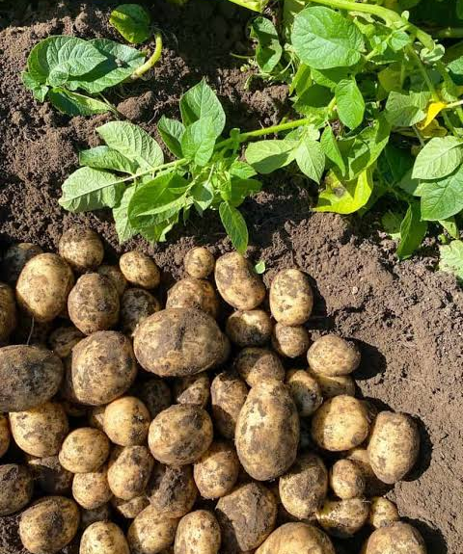
Potato Varieties
Fresh and Process Markets

Slide 3
Potato Varieties and Market Requirements
Potato varieties are selected and grown based on their physical characteristics, cooking qualities, and intended end use.
In the potato industry, varieties are grouped according to market requirements: fresh/table market, dual-purpose, and processing potatoes. Each group has specific quality traits that influence how potatoes are grown, harvested, stored, and used.
Understanding these requirements is important because different end uses demand different qualities. Fresh market potatoes are valued for appearance and cooking quality, while processing potatoes are selected for traits such as dry matter content, sugar levels, and frying performance.
Matching the right variety to the right market ensures high-quality products, reduces waste, and improves efficiency across the supply chain.
Note:
This presentation covers only a selection of common potato varieties used in different markets. Many additional varieties exist for specific growing conditions, markets, and processing requirements.

Slide 4
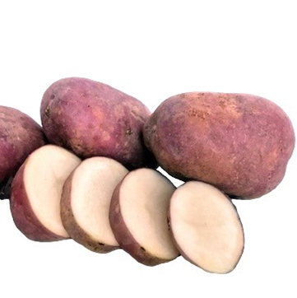
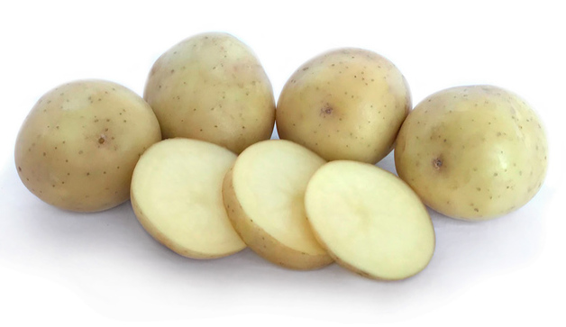
Red Rascal
Nadine
Nadine is a popular fresh-market potato with smooth white skin and creamy yellow flesh. Its mild flavour and waxy texture help it retain its shape during cooking, making it ideal for boiling, steaming, and salads.
Red Rascal is a versatile, floury potato with striking crimson-red skin and bright white flesh. Known for its full flavour and fluffy texture, it is ideal for baking, roasting, wedges, and mashing, making it a popular all-purpose variety.

Slide 5
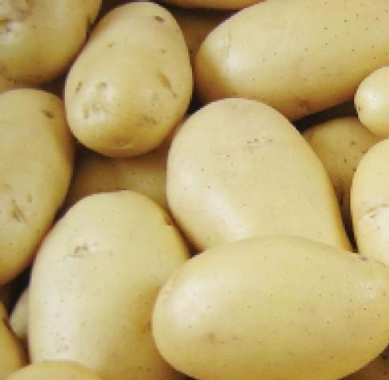
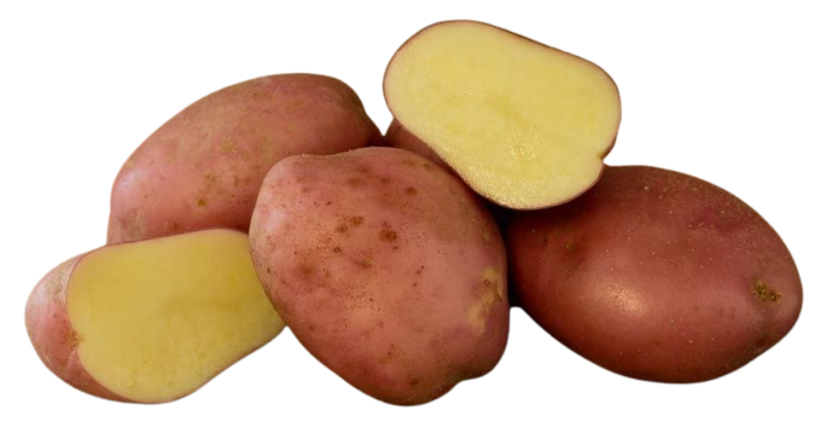
Desiree
Highlander
Desiree is a versatile, all-purpose potato with distinctive pinkish-red skin and creamy yellow flesh. Its firm texture and excellent cooking quality make it ideal for boiling, mashing, roasting, and chips, while retaining its shape well during cooking.
Highlander is a popular, high-yielding potato variety with smooth white skin, white flesh, and an oval shape. Its waxy texture and excellent cooking quality allow it to retain its shape well, making it an ideal choice for boiling and salads.

Slide 6
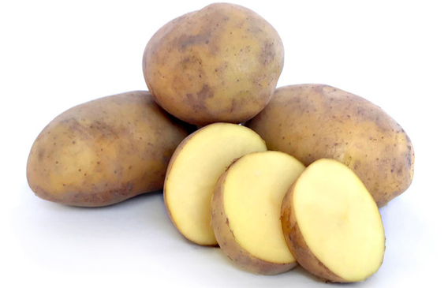
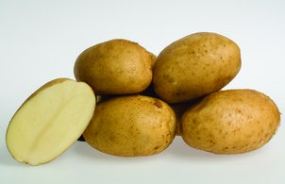
Moonlight
Agria
Agria is popular, high-yielding potato with yellow-brown skin, yellow flesh, and large oval tubers. Its high dry matter content and excellent flavour make it a premium dual-purpose variety, ideal for both the fresh market and processing into chips.
Moonlight is a versatile all-purpose potato with smooth cream-coloured skin and white flesh. Its full flavour, balanced texture, and high dry matter content make it ideal for boiling, mashing, roasting, and chips, while being especially valued for producing high-quality French fries. It also has excellent storability and high yields.

Slide 7
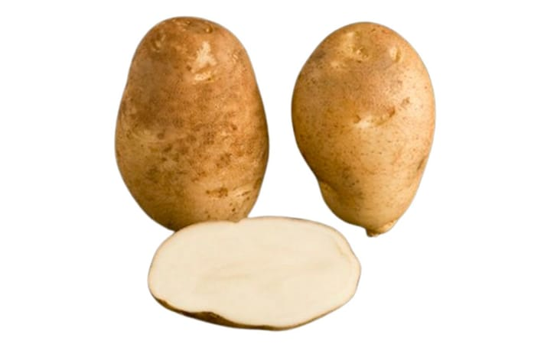
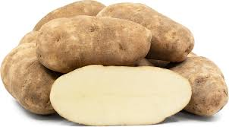
Russet Burbank and Ranger Russet
These processing varieties are grown primarily for French fry production. Their high starch content, low moisture levels, and ideal blocky tuber shape make them the preferred choice for frozen fries. They are widely contracted by major processors such as McCain Foods and Mr Chips due to their consistent quality and excellent processing performance

Slide 8
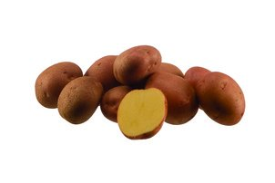
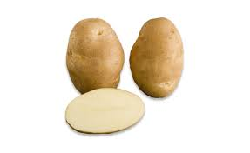
Mustang
Innovator
Innovator is a premium, high-yielding potato with high dry matter content and a consistent tuber shape. Widely used for French fries and crisps, it delivers excellent frying quality, making it a preferred choice for processors and a benchmark variety for premium fry production.
Mustang is a fast-growing, medium-yielding potato with reliable dry matter content, making it ideal for crisping and processing. It produces uniform, round-oval tubers with red skin and light yellow flesh and performs well both fresh and after long-term storage.

Slide 9
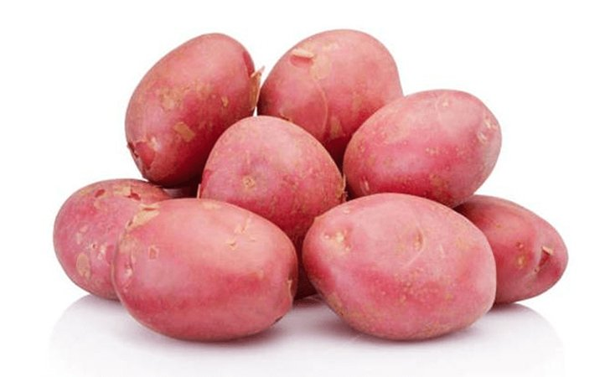
Lady Rosetta
Lady Rosetta is an early-maturing crisping potato widely used in New Zealand’s snack food industry. With bright red skin, pale yellow flesh, high dry matter, and low reducing sugars, it delivers excellent frying quality, making it ideal for consistent, high-quality crisp production.

Slide 10
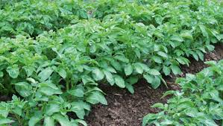
References
Masters -https://www.mastersproduce.co.nz/our-produce
https://www.eurogrow.co.nz/varieties/mustang

