Slide 1


Slide 2
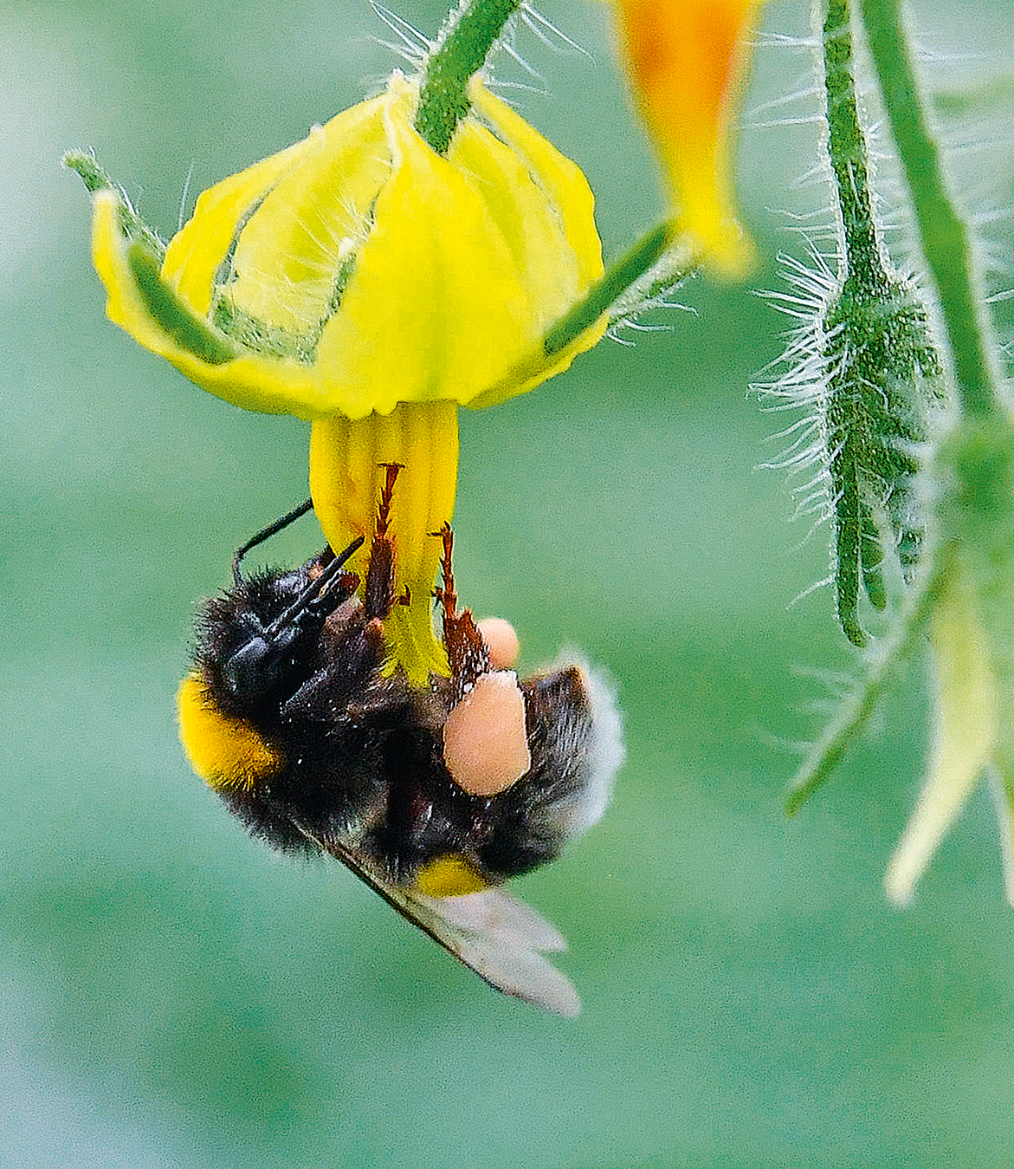
Bumblebees

Slide 3
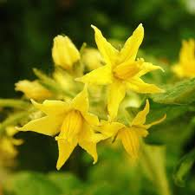
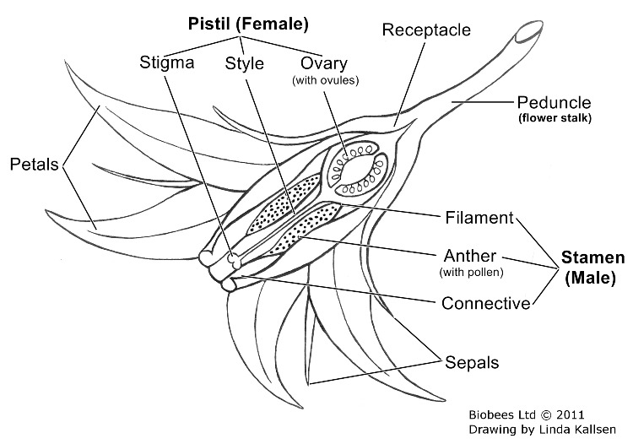
Tomato Pollination
Tomato flowers are self-fertile because they contain both male and female parts.
Most tomato varieties self-pollinate.
Cross-pollination can still occur between plants.
Bumblebee pollinators
Main species used: Bombus terrestris
Also called the buff-tailed bumblebee.
Used year-round in commercial glasshouse tomato production.
Help improve tomato yield and fruit quality.

Slide 4
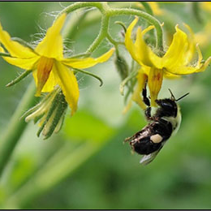
Tomatoes need bumblebees
Tomato flowers do not produce nectar.
Pollen is trapped inside tube-shaped anthers.
Pollen must be shaken loose by vibration.
Bumblebees use “buzz pollination” (sonication) to release pollen.
Buzz Pollination
Bumblebees grip the flower with their jaws.
They vibrate their flight muscles rapidly.
Vibrations shake pollen out of the anthers.
This increases fertilisation and fruit production.
Watch
Bumble Bee Benefits to Greenhouse Tomatoes

Slide 5
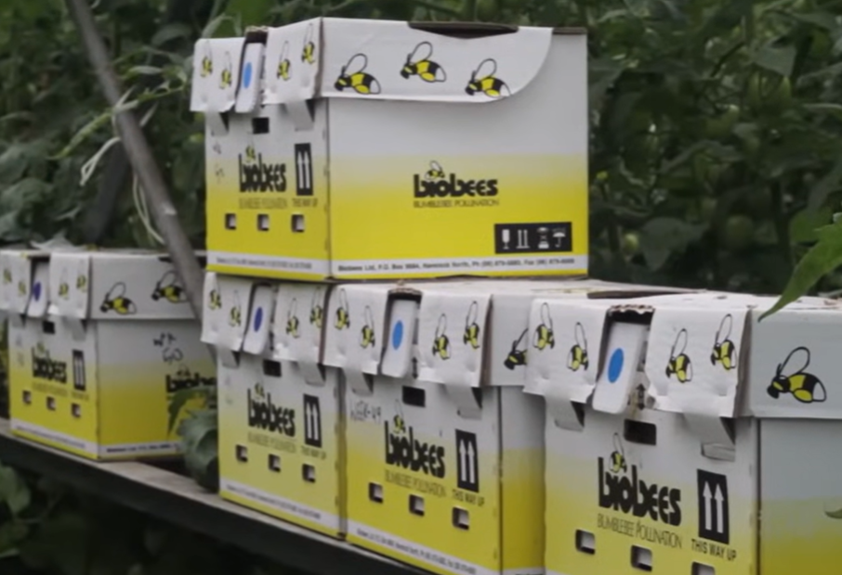
Bumblebees in Glasshouses
Bumblebees are used for reliable pollination.
Honeybees are less effective because they cannot buzz pollinate.
Bumblebee activity decreases above 28–30°C.
Hive Numbers depend on:
  Greenhouse size
  Tomato variety
    Cherry and cocktail tomatoes produce more flowers.
    These varieties may need 2–3 times more hives than larger tomato varieties

Slide 6
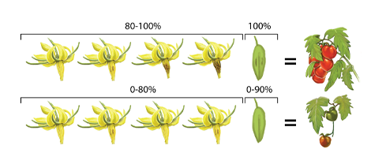
Benefits of bumblebee pollination
Higher fruit set
More seeds
Larger and heavier tomatoes
Better fruit shape and quality
Improved crop yields

Slide 7
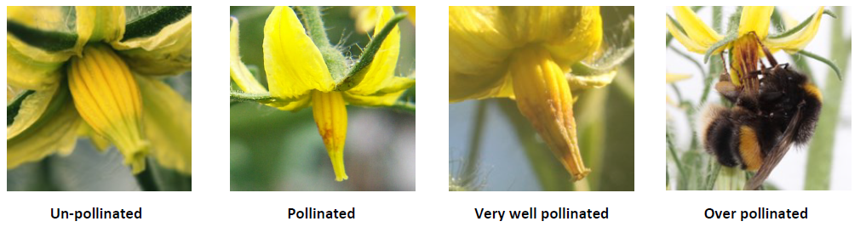
How Growers Check Pollination
Bumblebees leave bite marks or brown bruises on flowers.
Bruises show that pollination has occurred.
Flowers are graded to check pollination success.

Slide 8
Pollination Problems
Too few bees → poor pollination and fewer fruits
Too many bee visits → flower damage
Grade 5 flowers may develop damaged pistils and poor fruit
Best temperature for pollen growth: 21°C
Pollination becomes poor:
  Below 10°C and above 38°C
  High temperatures above 30°C can:
    Dry out the stigma
    Reduce pollen growth
    Cause flowers to drop

Slide 9
Activity 3:
How growers check if tomato flowers have been pollinated by bumble bees.
Read and discuss the information on Tomato Pollination Grading. “biobees bumblebee pollination Checking Pollination in Tomato” then complete the below tasks.
Read the descriptions below and decide which pollination grade each flower belongs to.
Flower Description | Grade (1–5) | What does it mean?
No bite marks on the flower cone
A few flowers have small bite marks
All flowers have clear bite marks
All flowers have many bite marks
Flower cone is dark brown or black and damaged

Slide 10
Questions
Why are bumble bees important for tomato pollination?
Why do growers check closed flowers in summer?
What should growers do if pollination is below Grade 3?
What problems can happen if flowers are over-pollinated?

Slide 11
Draw and label:
an un-pollinated tomato flower
a well-pollinated tomato flower
an over-pollinated tomato flower
Include the bite marks made by bumble bees.

Slide 12
Answers
Flower Description | Grade (1–5) | What does it mean?
No bite marks on the flower cone | Grade 1 | Very poor pollination
A few flowers have small bite marks | Grade 2 | Poor Pollination
All flowers have clear bite marks | Grade 3 | Good pollination
All flowers have many bite marks | Grade 4 | Very good pollination
Flower cone is dark brown or black and damaged | Grade 5 | Excessive pollination

Slide 13
Question answers
Why are bumble bees important for tomato pollination?
Bumble bees use buzz pollination to shake pollen out of tomato flowers, helping more flowers become fertilised and produce larger fruits.
Why do growers check closed flowers in summer?
Flowers close quickly in hot weather, so closed flowers give a better idea of whether bees have visited them.
What should growers do if pollination is below Grade 3?
Growers should add more bumble bee hives to improve pollination.
What problems can happen if flowers are over-pollinated?
Too many bee visits can damage the flower and pistil, which may cause problems with fruit development.

Slide 14
References
Biobees https://www.biobees.co.nz/pages/tomato
Bumble Bee Benefits to Greenhouse Tomatoes
Biobees bumblebee pollination
Biobees user guides

