Slide 1


Slide 2
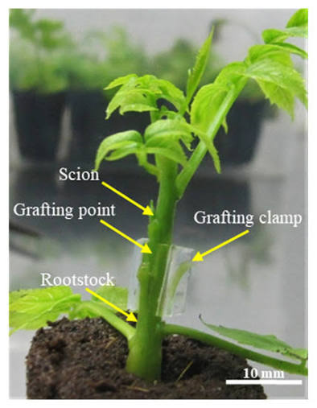
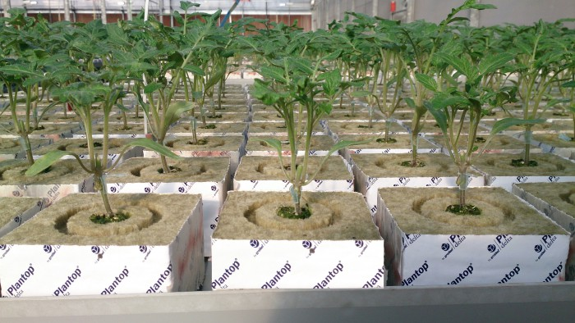
Grafted Tomatoes

Slide 3
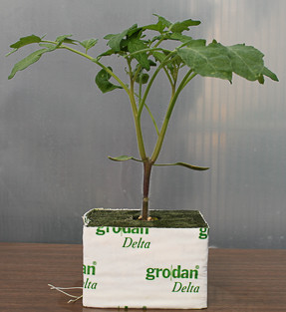
Grafted tomato seedlings
Modern greenhouses grow hybrid Dutch tomato varieties chosen for different markets.
Young plants are grafted onto strong, disease-resistant rootstocks.
The rootstock provides strong roots and helps protect the plant from diseases.
The scion (top part of the plant) produces the tomatoes with the desired size, flavour, and quality.
Each rootstock supports two scions, increasing the number of fruit produced.

Slide 4
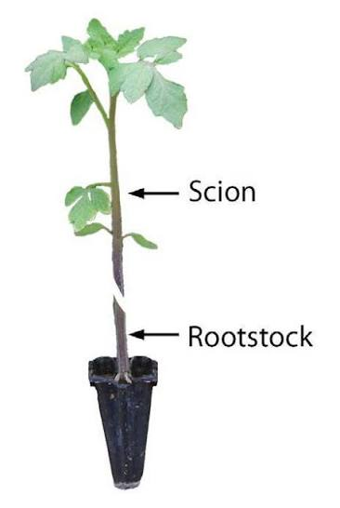
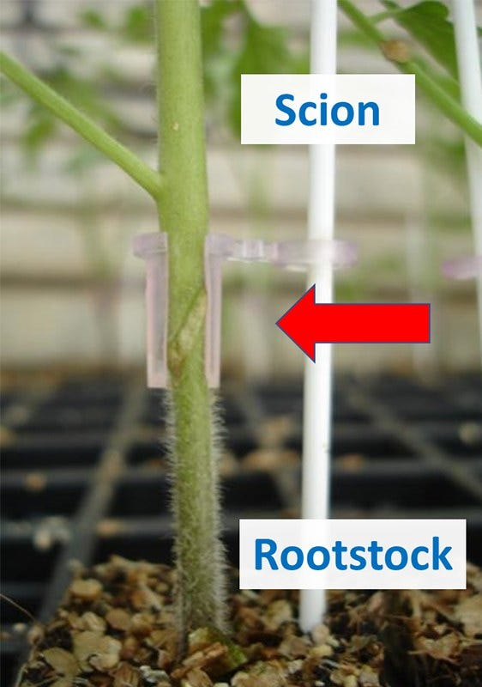
Grafting
What is grafting?
Grafting combines the best parts of two different plants into one stronger plant.
The scion is the top part of the plant that produces the tomatoes.
The rootstock is the bottom part that provides the roots.
Remember:
Rootstock = strong roots that resist diseases and absorb water and nutrients.
Scion = the top of the plant that produces the fruit

Slide 5
Why are tomato plants grafted?
Benefits of Grafting
Produces high-quality tomatoes with good flavour, size, and yield.
Gives the plant a strong, healthy root system.
Protects against many soil-borne diseases, viruses and pests.
Improves water and nutrient uptake.
Helps plants cope with environmental stresses.
Produces vigorous plants that grow faster and produce more fruit.

Slide 6
Why don't breeders just grow one perfect plant?
Developing a new tomato variety with both excellent fruit quality and strong disease resistance can take many years.
Grafting is a faster way to combine these desirable traits into a single plant.

Slide 7
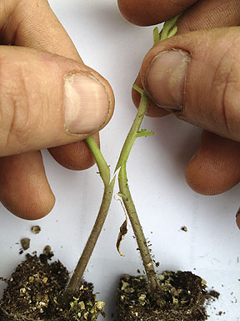
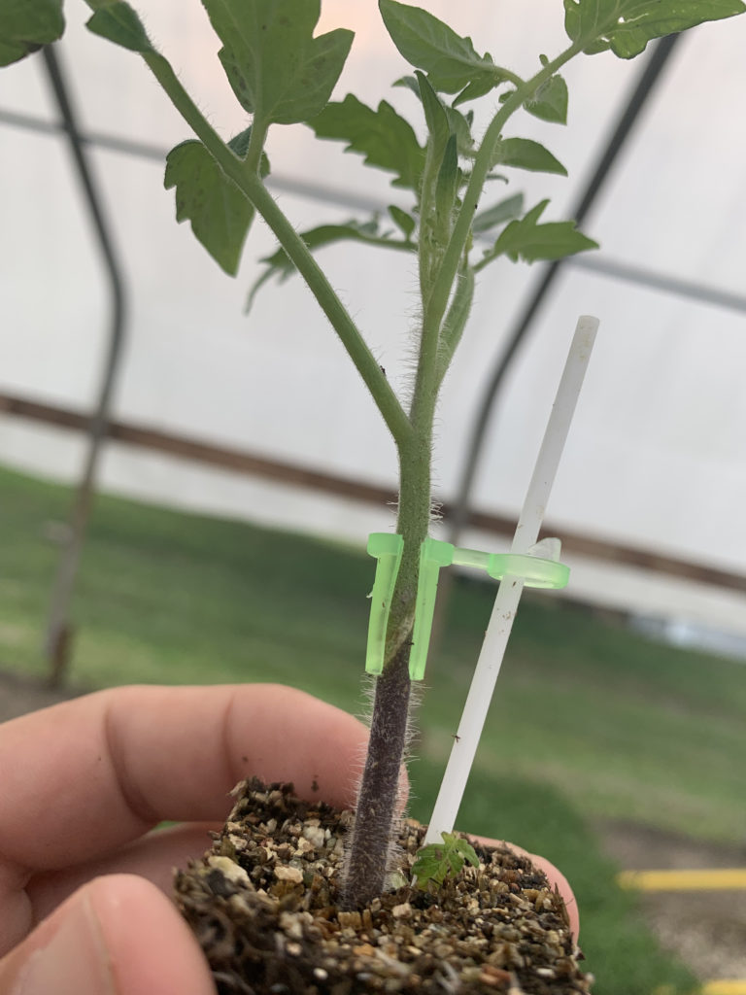
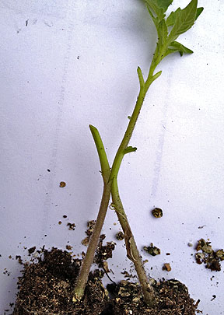
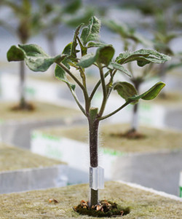
Watch: Tomato Grafting: The Process https://www.youtube.com/watch?v=zhgsPkeZEbk
This segment shows how to attach the scion to the rootstock and gives tips on producing a healthy graft

Slide 8
Fun Fact
Many commercial greenhouse tomato plants are grafted because they:
live longer,
produce more tomatoes,
stay healthier,
and need fewer chemical treatments.

