Slide 1


Slide 2
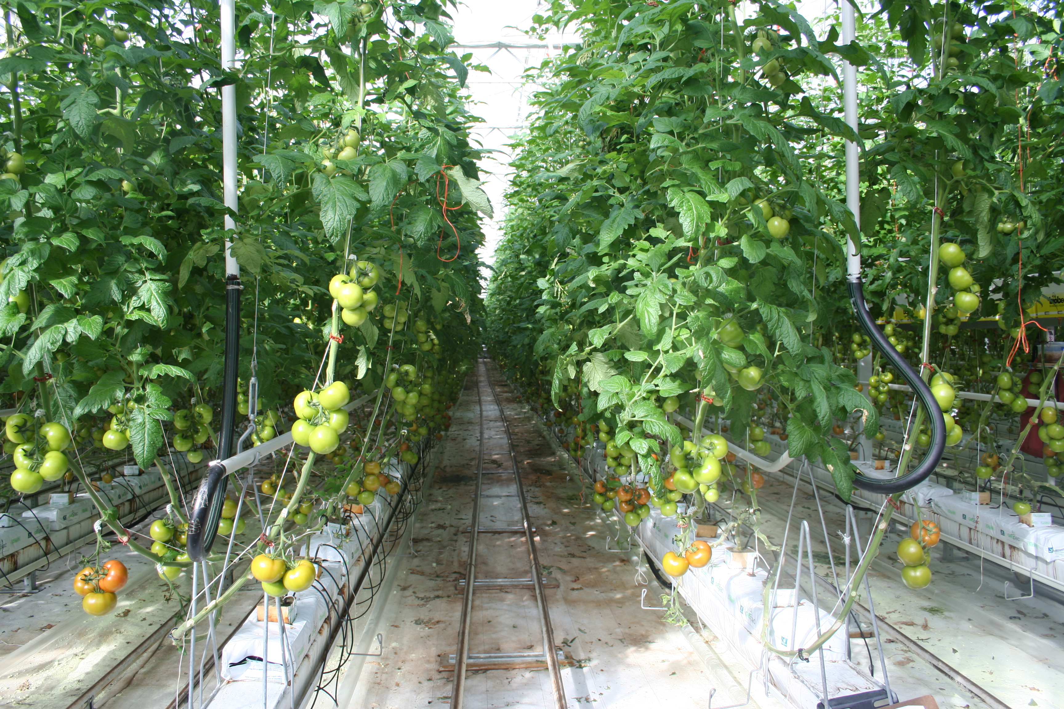
Indoor Tomato Production
Watch:
Just the Job - Hothouse Vegetable Production Careers
Growing tomatoes in NZ

Slide 3
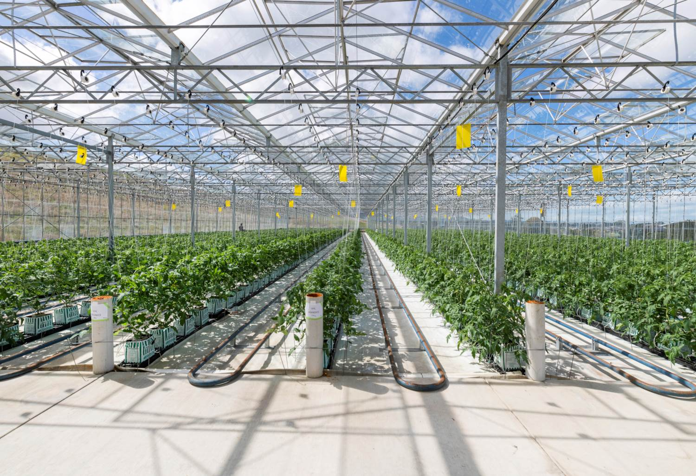
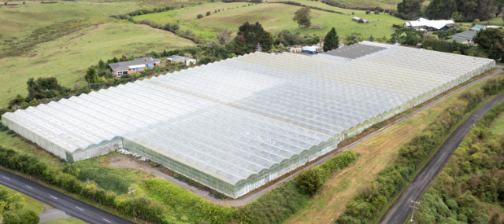
High Tech Greenhouses
Allows tomatoes to be grown year-round
Protects plants from harsh weather, pests, and diseases
Creates ideal conditions for growth and fruit production
Uses computer technology to monitor and control the environment
Carefully controlled greenhouse conditions help produce:
Faster plant growth
Healthy flowers and fruit set
High-quality tomatoes
Increased yields for the domestic market

Slide 4
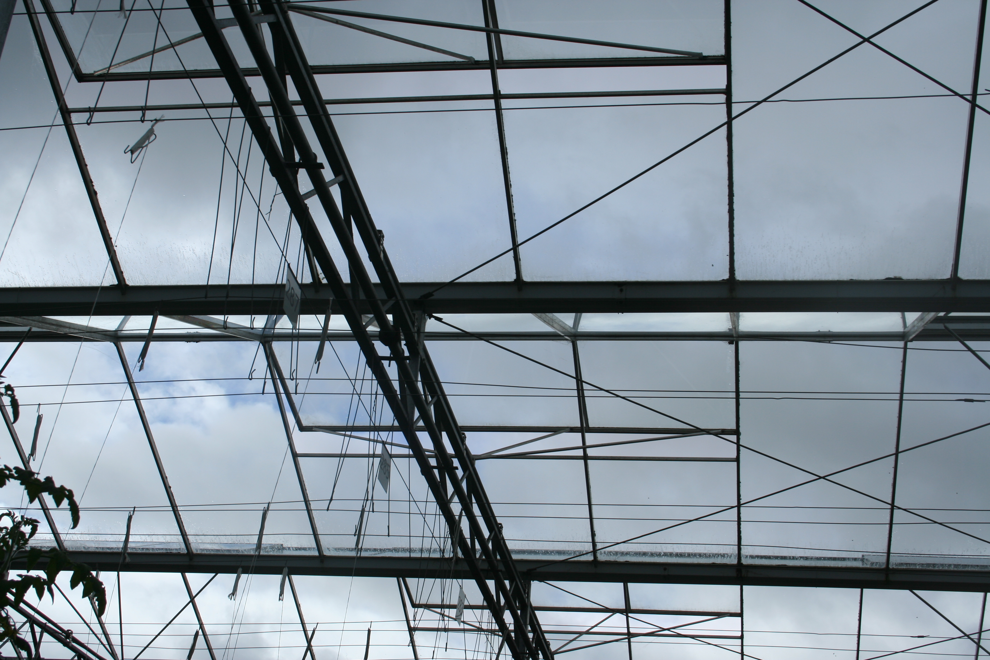
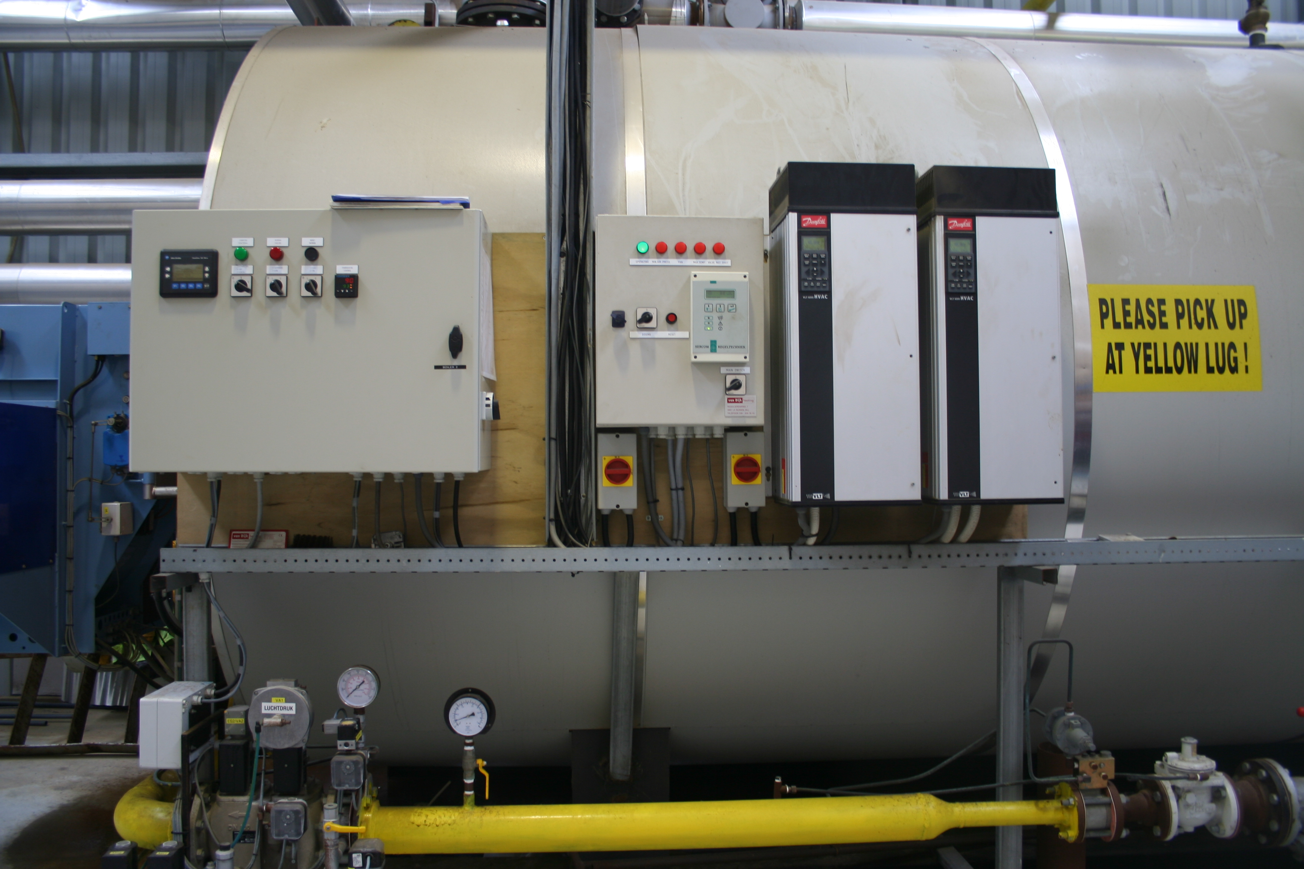
Key conditions controlled in a greenhouse
Temperature
Day: 21–29°C
Night: 15–21°C
Controlled using heating, cooling, and ventilation systems
Helps flowering, pollination, and fruit development
Humidity and Ventilation
Ventilation systems open and close automatically
Maintains air movement and reduces plant stress
Prevents excess humidity that can encourage disease

Slide 5
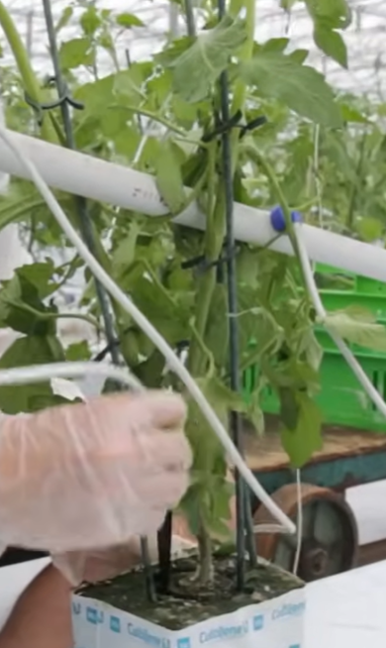
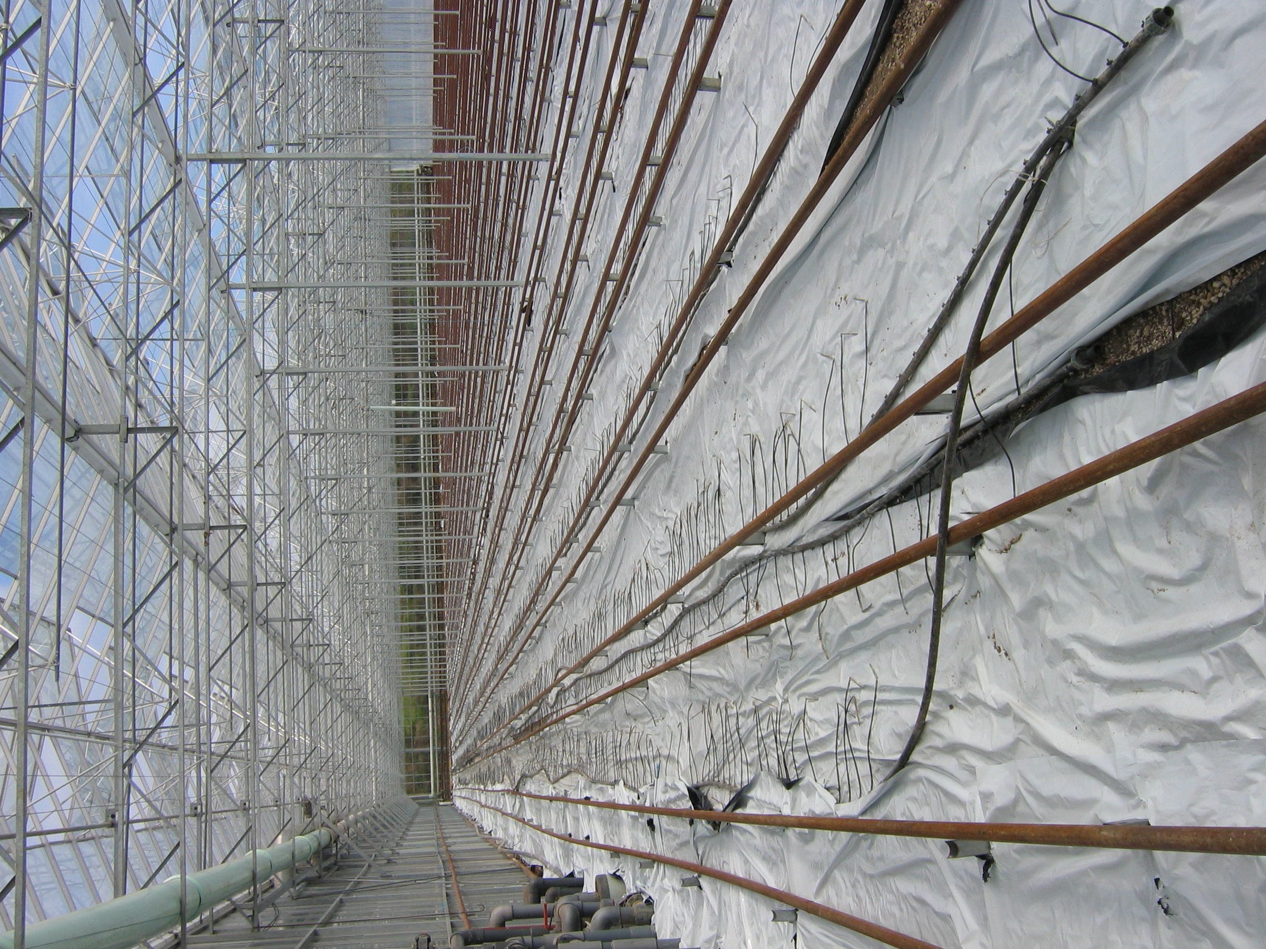
Light, Water and Nutrients
Light
Light is needed for photosynthesis and sugar production
White reflective mulch helps spread light through the crop canopy
Improves photosynthesis and even plant growth
Water and Nutrients
Delivered through fertigation systems
Provides precise amounts of water and dissolved nutrients directly to roots
Reduces waste and improves nutrient uptake

Slide 6
Indoor Grown Tomato Crop Calendar of Operations
(1 calendar year from planting to replanting)
Cultivar selection
Grafted seedlings
delivered between 55-60 days
Use integrated pest management practices to control and manage pests
CO₂ Enrichment
Seedlings grown & grafted in rockwool
Introduce beneficial insects
Soft sprays applied
7-i0 days
Pre- planting
Transplanting seedling
onto rockwool slabs
Growing & harvesting
First harvest 47-60 days after transplanting into greenhouse
Greenhouse cleaned and sterilised
Drippers placed into propagation block
Introduce Bumble bees
2/ha added weekly
Fertigation
Sticky traps installed
Training
removal of laterals, leaf pruning, truss clips
Hand harvest
Seedlings clipped to string training system

Slide 7
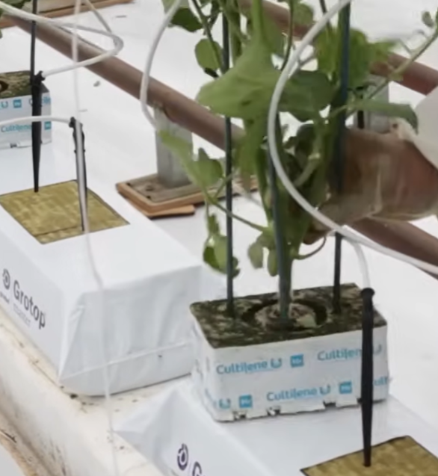
Establishing a Greenhouse Tomato Crop
Preparing the Greenhouse
Greenhouses are thoroughly cleaned and sterilised before planting
Reduces the risk of disease outbreaks in the new crop
Raising tomato seedlings
Seedlings are produced by commercial propagators
Grown in soilless media such as:
  coco coir
  perlite
  rockwool
These media provide:
  good drainage
  aeration
  root support
  reduced soil-borne disease risk

Slide 8
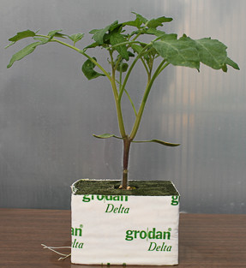
Grafted tomato seedlings
Modern greenhouses grow hybrid Dutch tomato varieties chosen for different markets.
Young plants are grafted onto strong, disease-resistant rootstocks.
The rootstock provides strong roots and helps protect the plant from diseases.
The scion (top part of the plant) produces the tomatoes with the desired size, flavour, and quality.
Each rootstock supports two scions, increasing the number of fruit produced.
PPT Grafted Tomatoes.

Slide 9
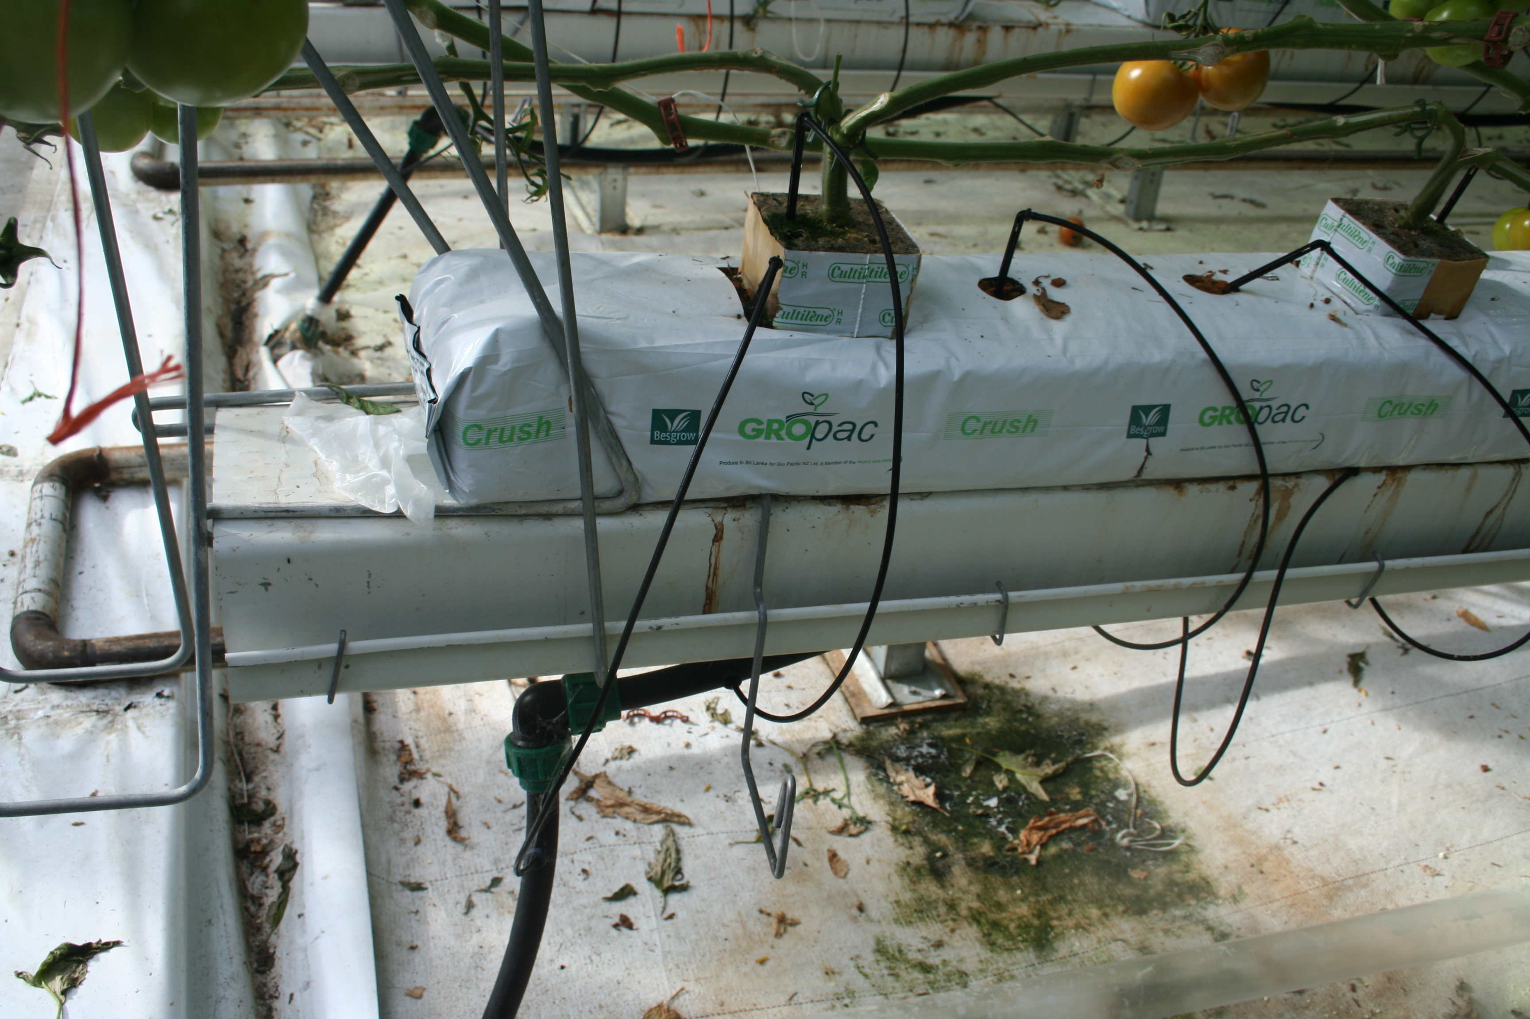
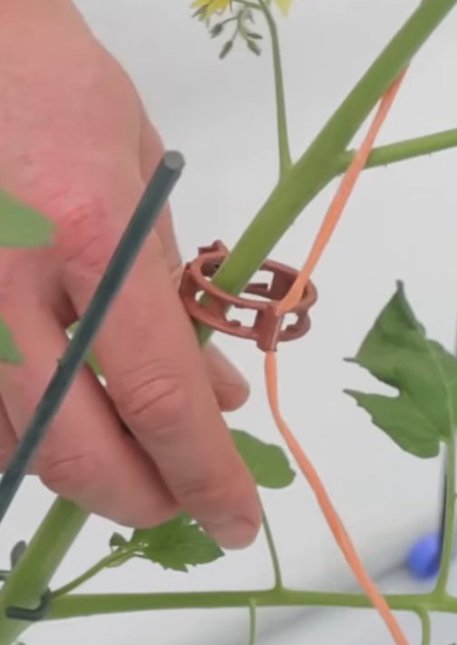
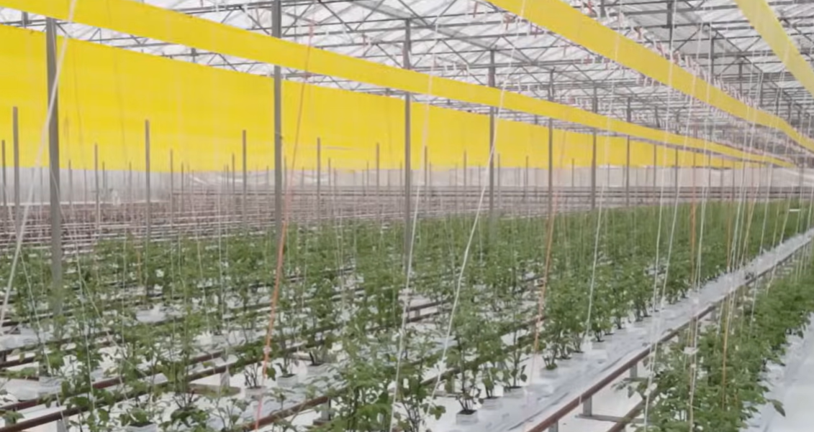
Planting the crop
Drippers provide water and nutrients
Inert growing media
Seedlings are planted into slabs of sterile growing media
Plants are spaced carefully to maximise growth and airflow
Water and nutrients are supplied through a hydroponic nutrient solution
Seedlings are usually about 55 days old when delivered
Many plants are already flowering this allows earlier fruit production and harvests
Training the Plants
Plants are clipped onto support strings hanging from overhead wires

Slide 10
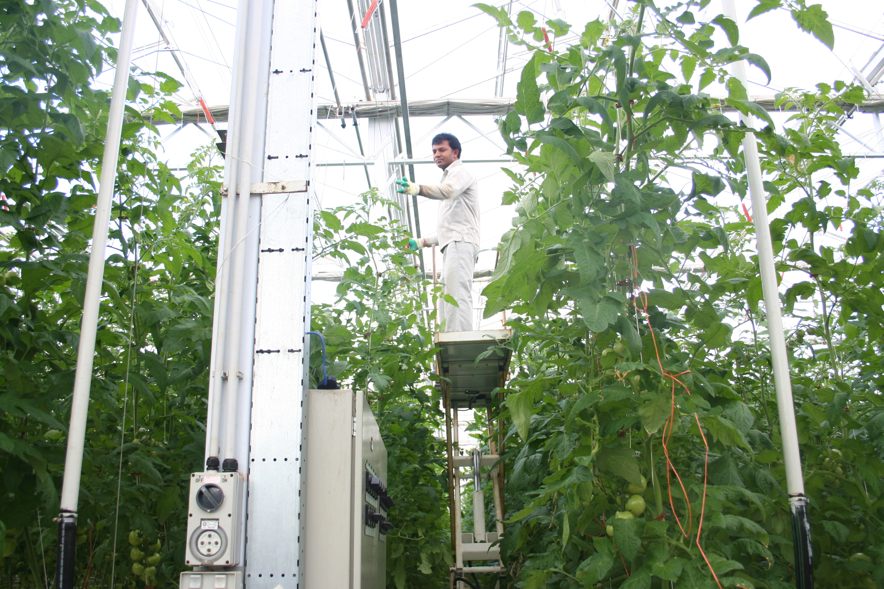
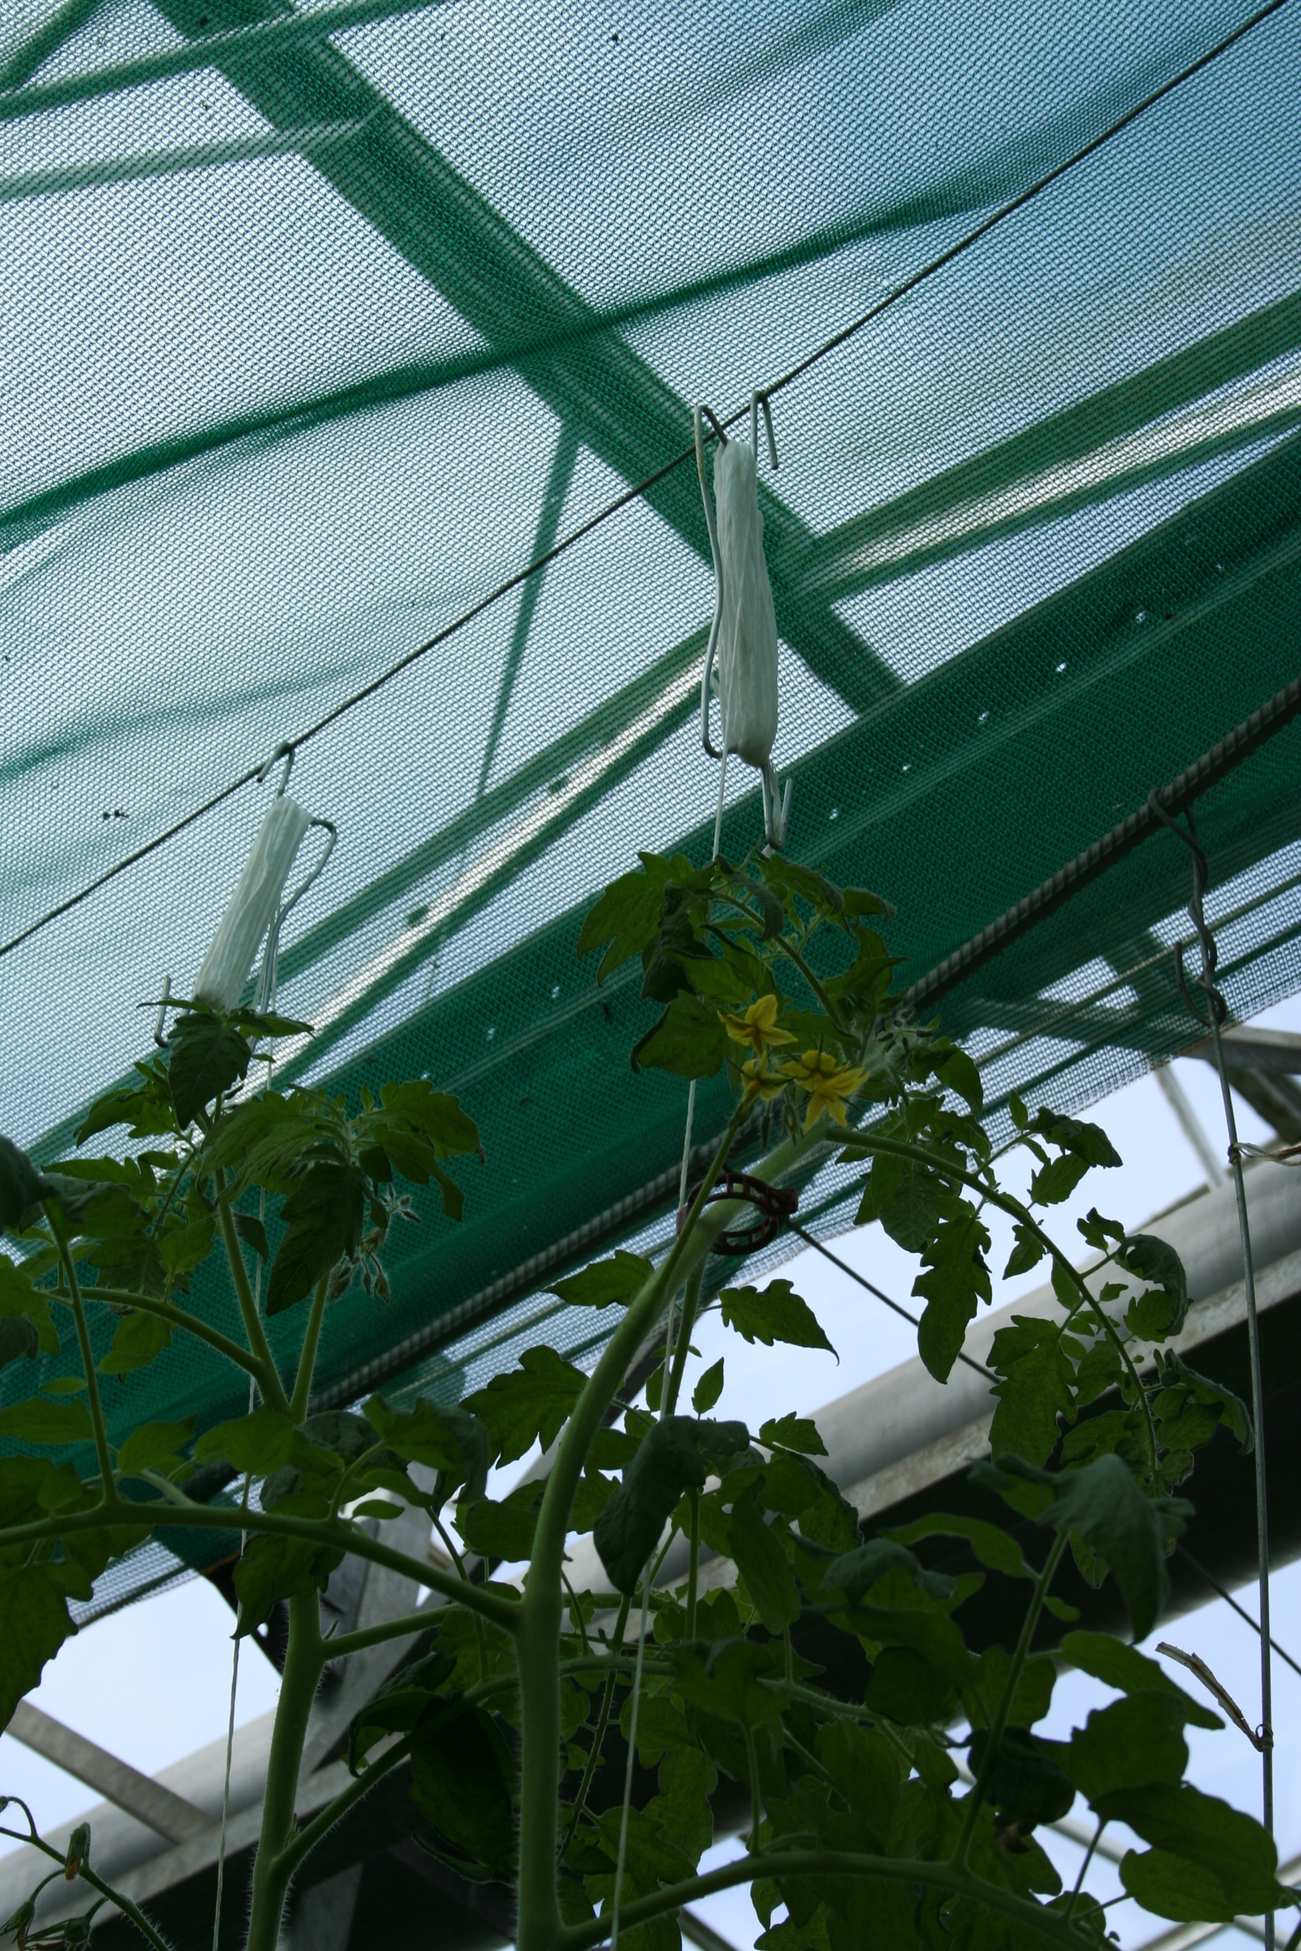
Vertical training
Tomato plants are trained vertically using support strings.
A string attached to a bobbin is twisted around the stem and gradually lowered as the plant grows, allowing the stem to be repositioned.
By the end of the growing season, a single plant stem can reach up to 18 metres in length.
Benefits of Vertical Training
Keeps plants upright and well supported.
Maximises light interception for improved photosynthesis.
Increases airflow through the crop canopy.
Reduces humidity, lowering the risk of disease.
Improves access for pollination, crop maintenance, and harvesting.
Bobbin

Slide 11
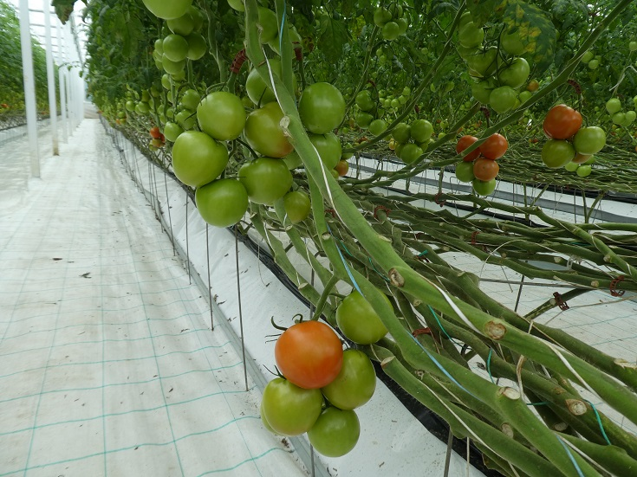
Removal of laterals and de-leafing
Side shoots (laterals) are removed to control plant growth.
De-leafing helps prevent overcrowding in the canopy and improves airflow and pollination
Even plant spacing allows more sunlight to reach the leaves.
Improved light interception increases photosynthesis increasing yield and better-quality tomatoes.

Slide 12
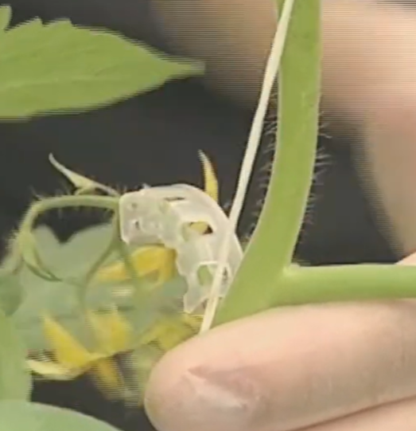
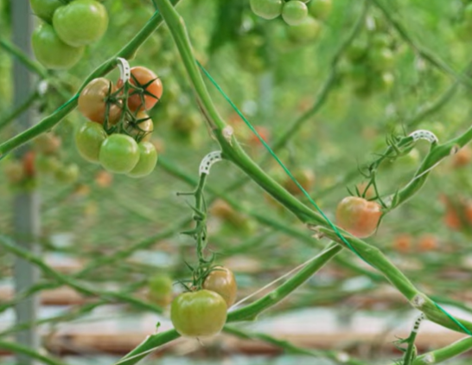
Truss clips
Truss clips are used to support developing tomato trusses (fruit clusters).
They hold each truss in a stable position as it grows.
Benefits of Truss Clips
Prevent trusses from bending or kinking.
Maintain an uninterrupted flow of water and nutrients to the developing fruit.
Promote even fruit growth and consistent fruit quality.
Reduce the risk of damaged, misshapen, or poorly developed fruit.

Slide 13
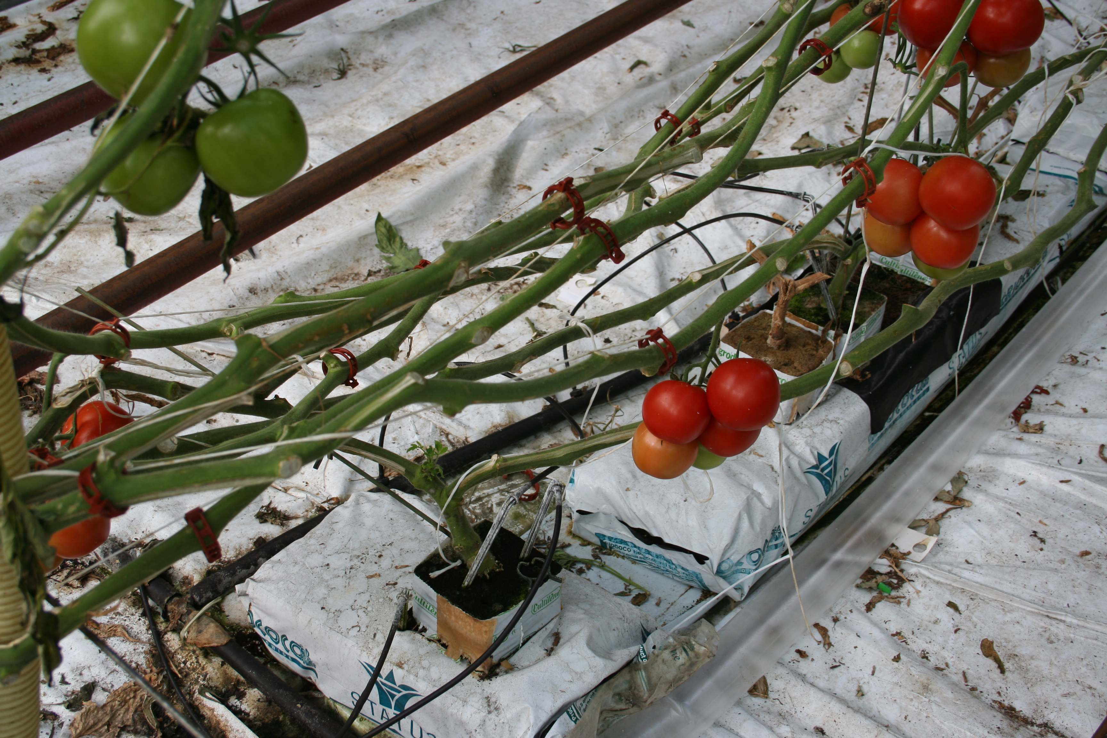
Nutrient management
Tomato plants receive water and nutrients through a fertigation system
Nutrients are dissolved in water and delivered directly to the roots through drippers.
The main nutrients tomatoes need are:
  Nitrogen (N) – leaf and stem growth
  Phosphorus (P) – root growth and flowering
  Potassium (K) – fruit growth and quality
  Calcium (Ca) and Magnesium (Mg) – healthy plant growth
The nutrient solution is kept at a pH of 5.5–6.0 so plants can absorb nutrients easily.
Extra nutrient solution is collected, cleaned, and reused, saving water, fertiliser, and reducing pollution.

Slide 14
Water requirements
Mature plants use:
  1.5–2.5 L per day on average
  3.0–4.0 L per day during hot summer conditions
Computer - Controlled Irrigation
Sensors monitor:
  temperature
  humidity
  light intensity
  solar radiation
Computer systems automatically adjust:
  irrigation frequency
  nutrient delivery

Slide 15
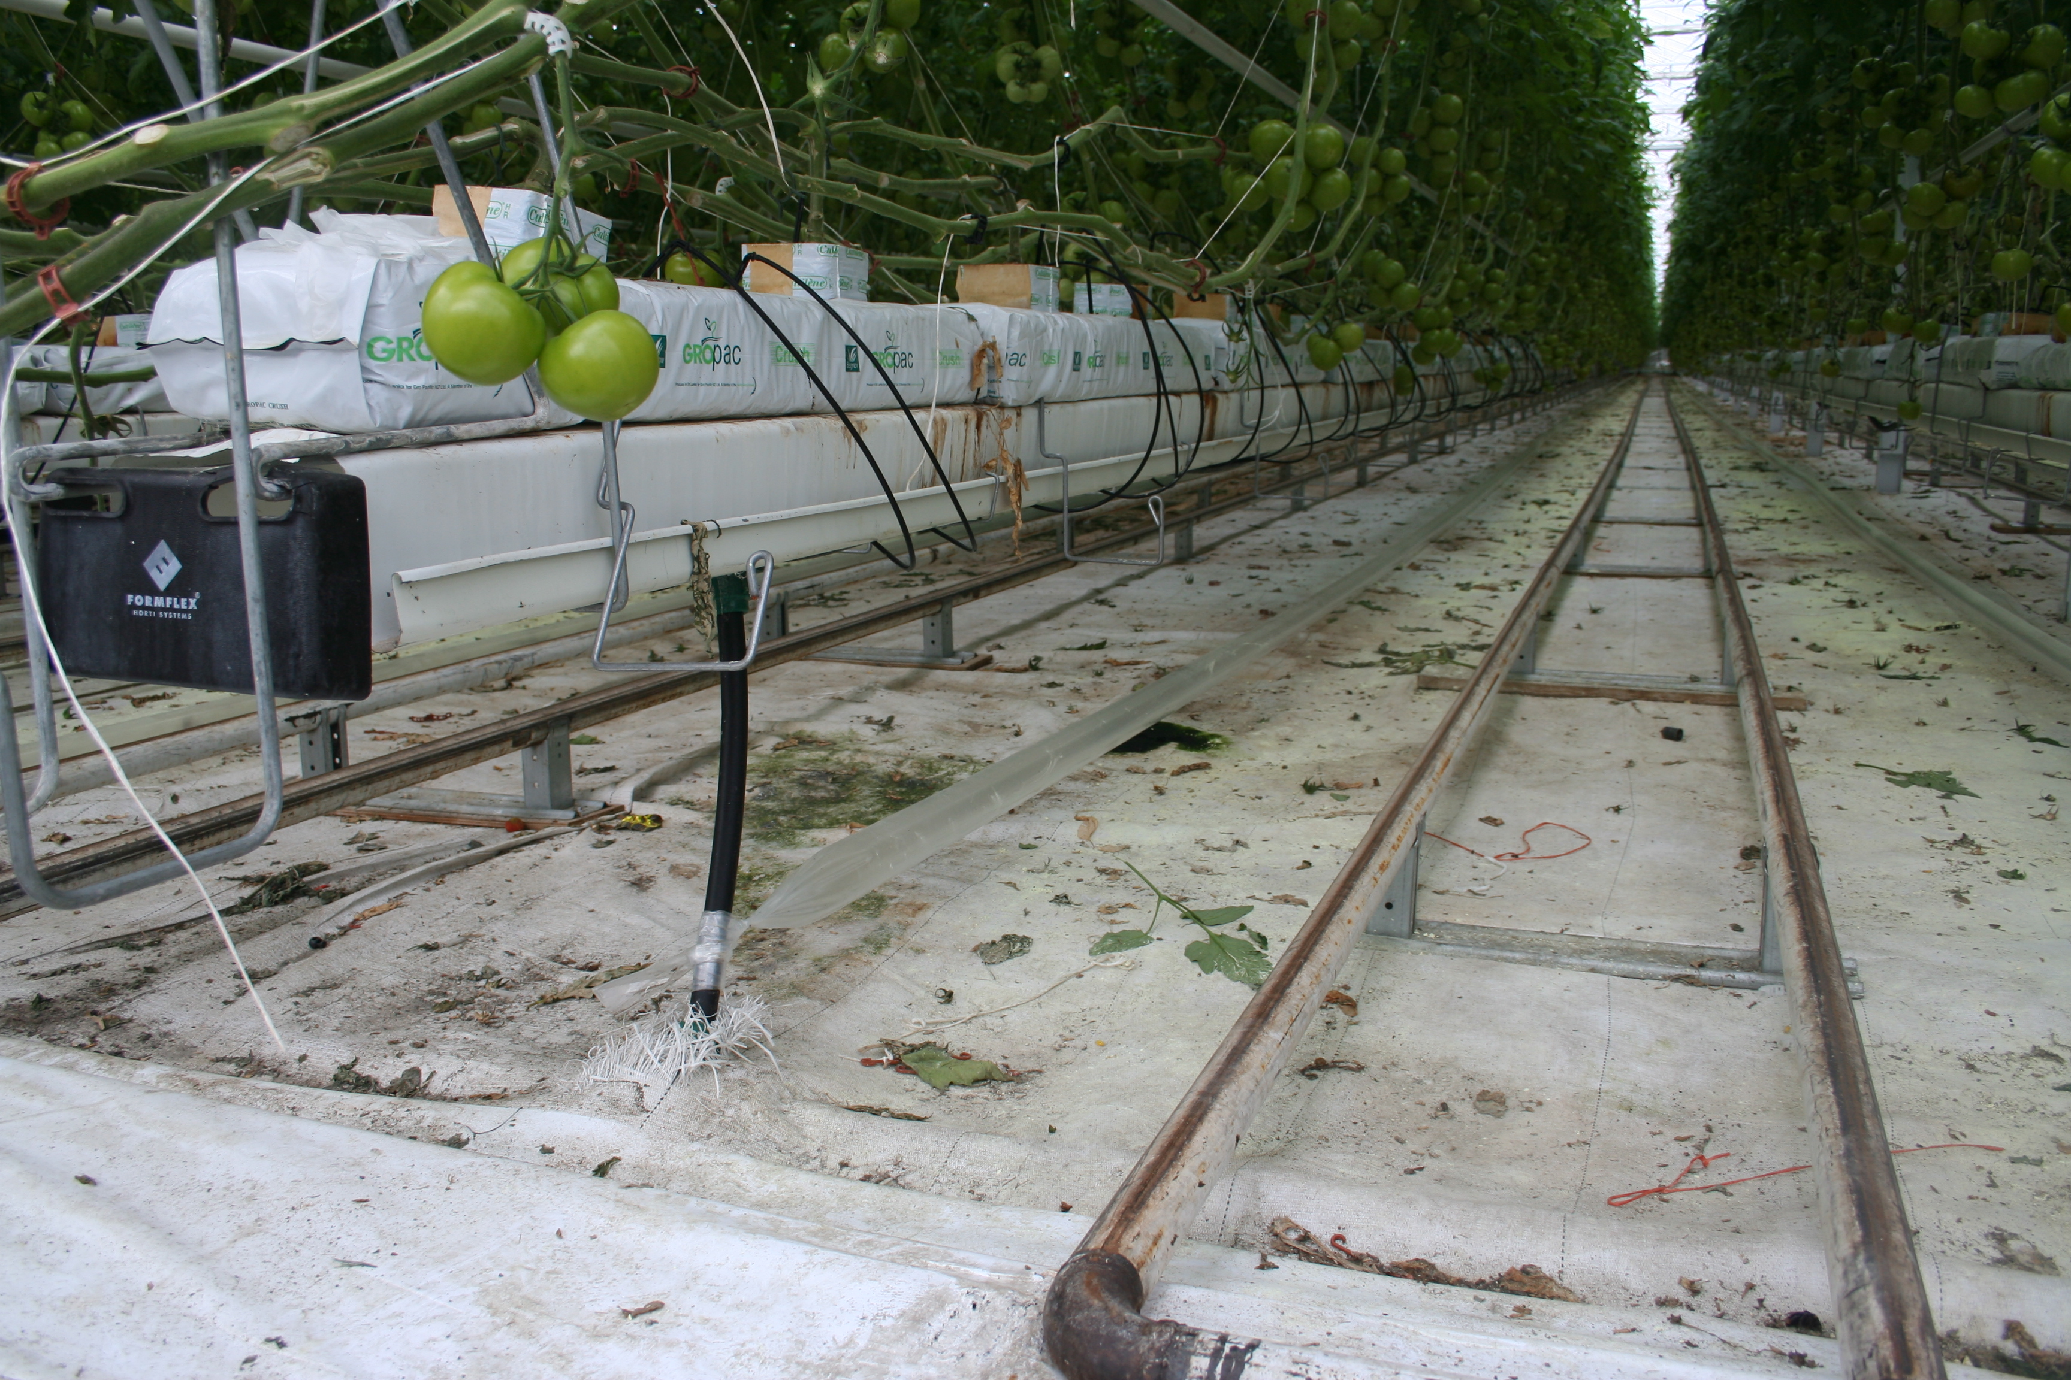
Heating and CO₂
CO₂ Enrichment
Temperature
Day: 21–29°C
Night: 15–21°C
Controlled using heating, cooling, and ventilation systems
Helps flowering, pollination, and fruit development
Carbon Dioxide (CO₂)
CO₂ is essential for photosynthesis
Greenhouses may use CO₂ enrichment systems
Higher CO₂ levels can increase growth and yields

Slide 16
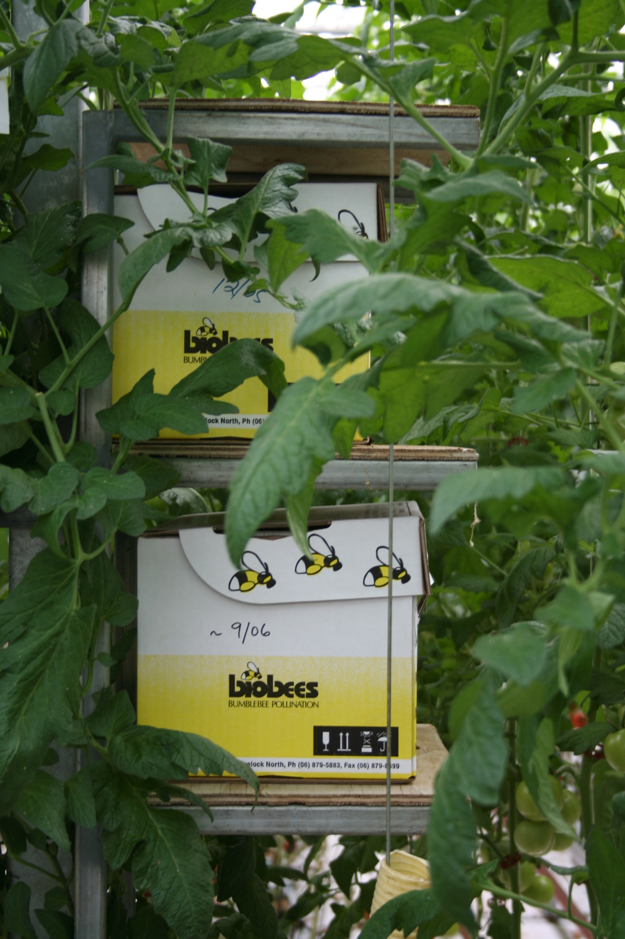
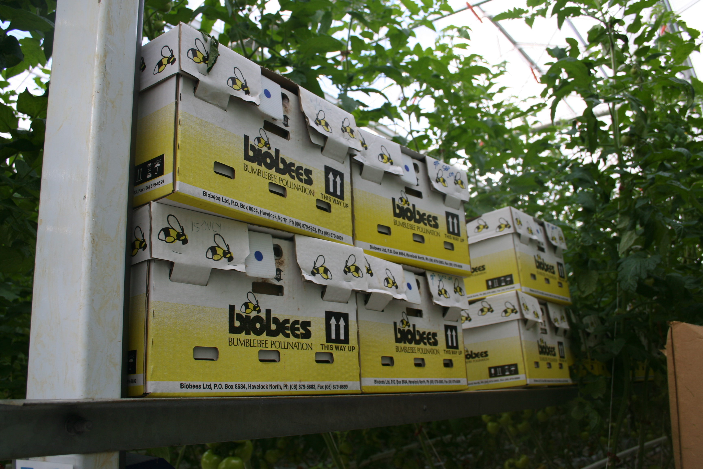
Bubblebees
PPT Bumblebees
Watch: A bumblebee buzz-pollinates a tomato flower
Improve fertilisation and fruit set
Increase fruit size, weight, and quality
Help produce more seeds per fruit
Leave visible signs such as brown marks on flowers
Hive numbers depend on greenhouse size and tomato type
  Cherry and cocktail tomatoes need more bees (more flowers per area)
  Hives are supplied year-round for reliable pollination and high yields

Slide 17
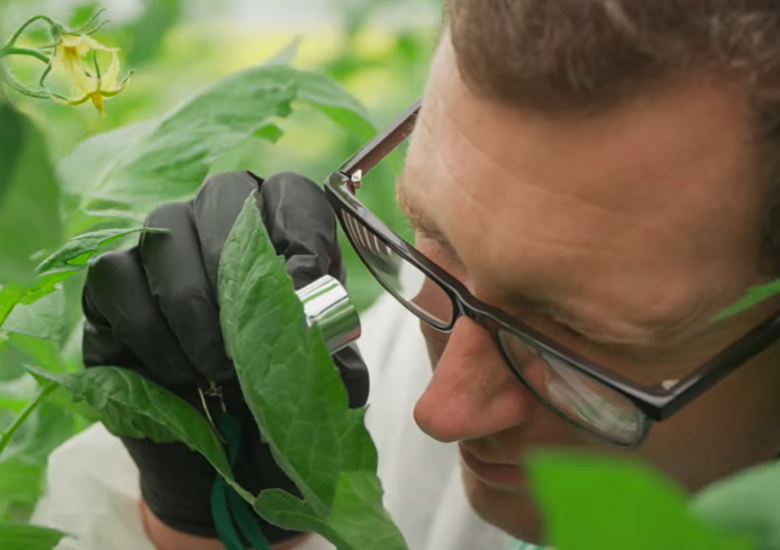
Pest and Disease Management
Greenhouses provide ideal conditions for tomato growth and high yields.
Warm temperatures and high humidity can also encourage pests and diseases.
Dense plant canopies and continuous cropping allow problems to spread quickly.
Poor pest and disease control can reduce fruit quality, plant growth, and yield.
See PPT Tomato P & D management for information on pests and diseases

Slide 18
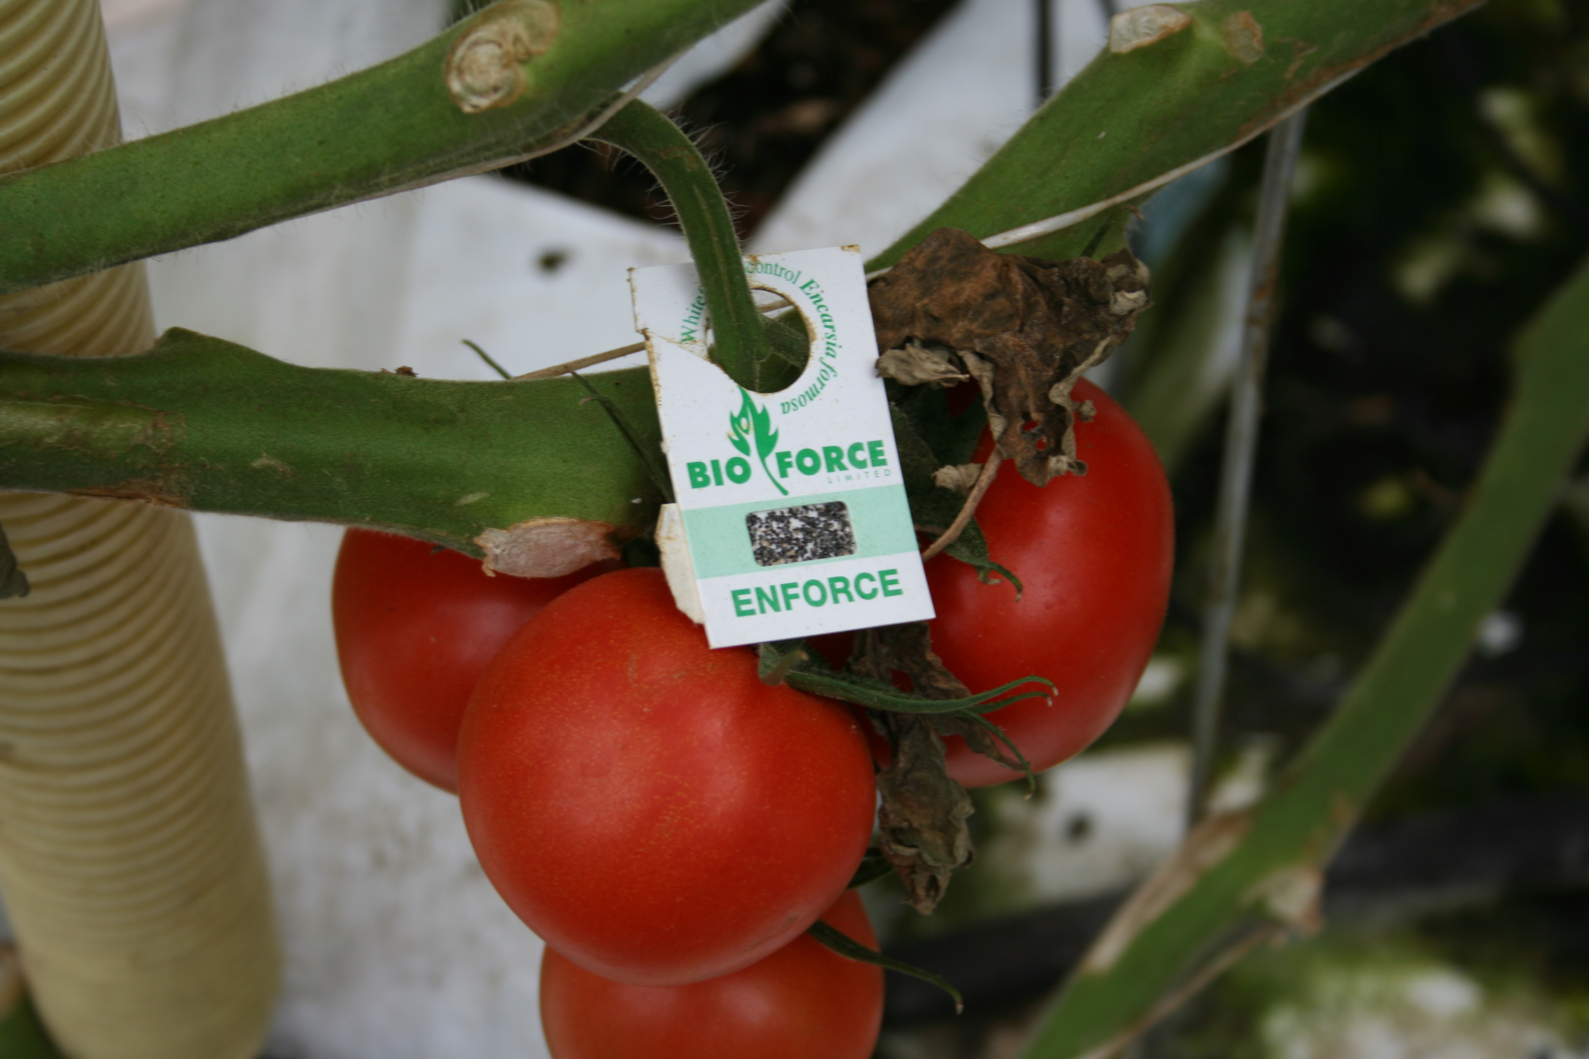
Integrated pest management (IPM)
The goal of IPM is to maintain healthy crops while reducing pesticide use
IPM Strategies
Environmental management
Biological control
Crop monitoring - Scouting
Hygiene and sanitation
Resistant varieties
Targeted chemical use

Slide 19
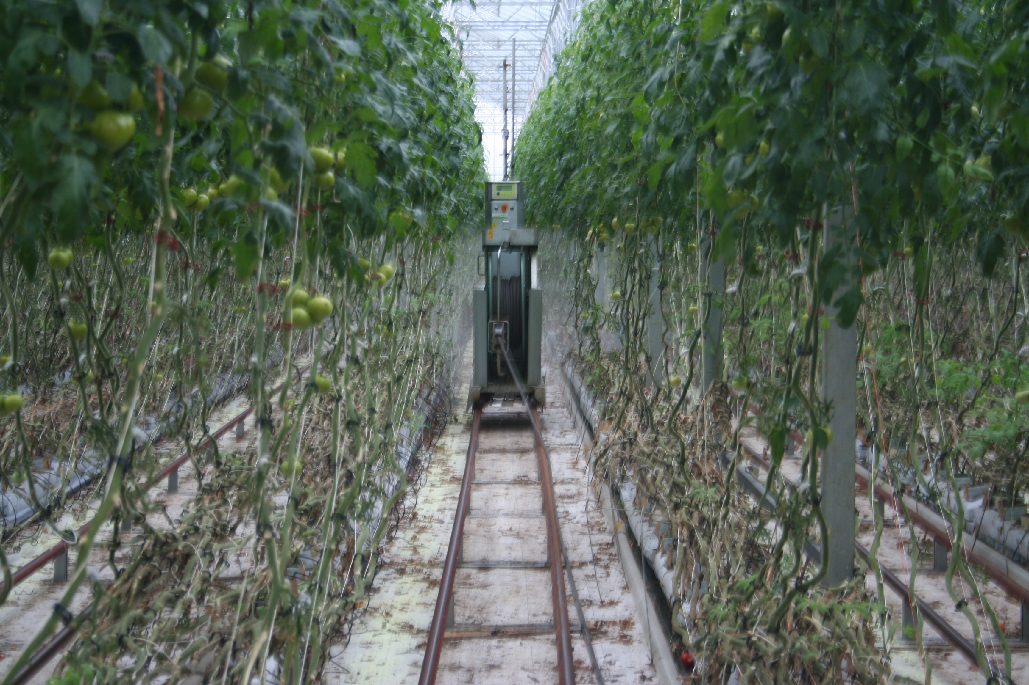
Targeted chemical control of pests and diseases

Slide 20
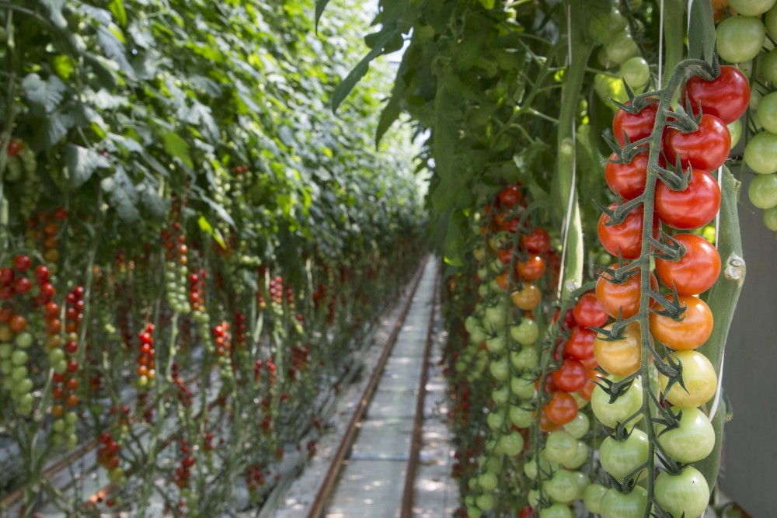
Harvest
Tomatoes are hand-harvested daily at the correct stage of ripeness.
Depending on the variety, tomatoes are picked individually or as whole trusses.
After harvesting, tomatoes are:
Sorted for quality
Graded by size and appearance
Packaged for transport and sale
Careful harvesting and handling help ensure consumers receive fresh, high-quality tomatoes.

Slide 21
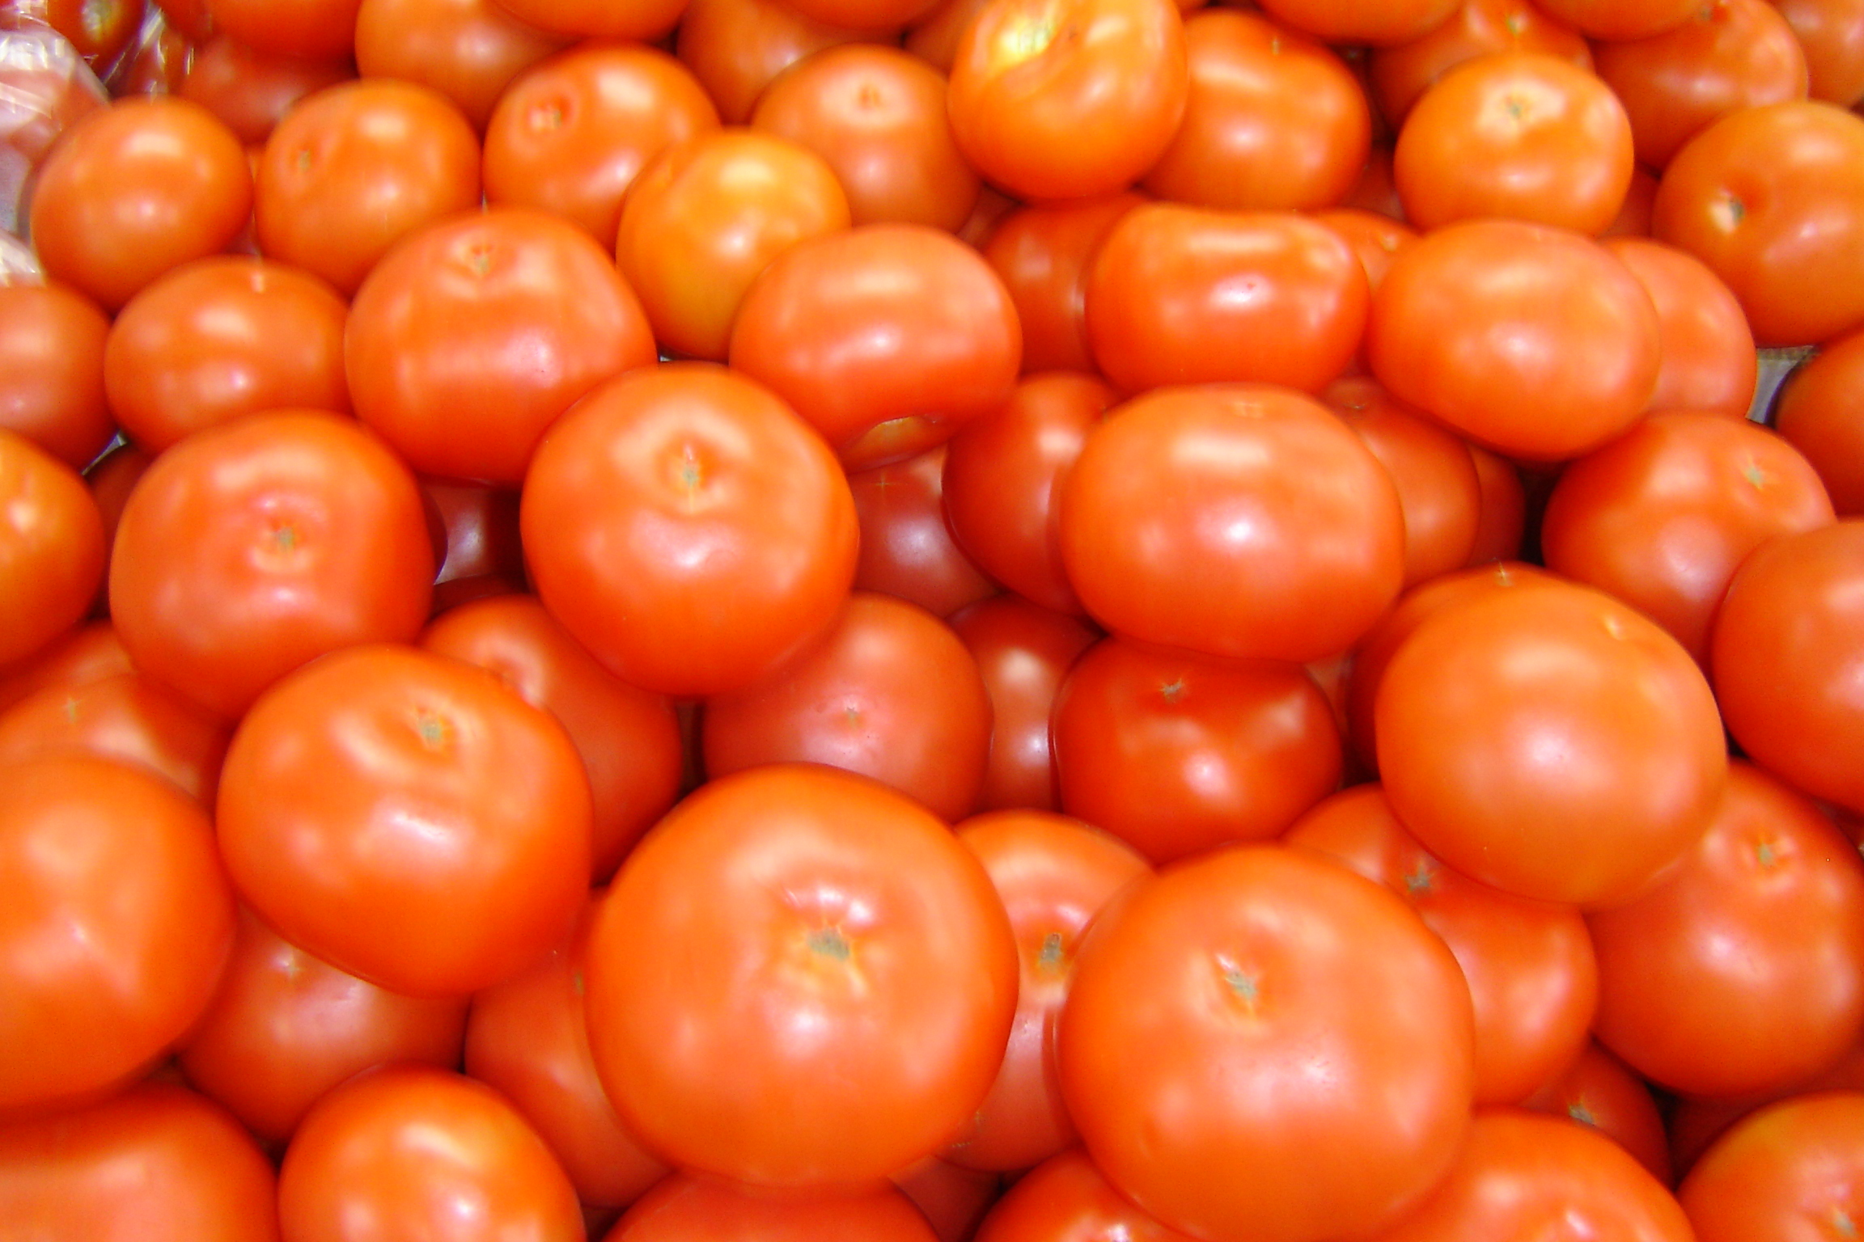
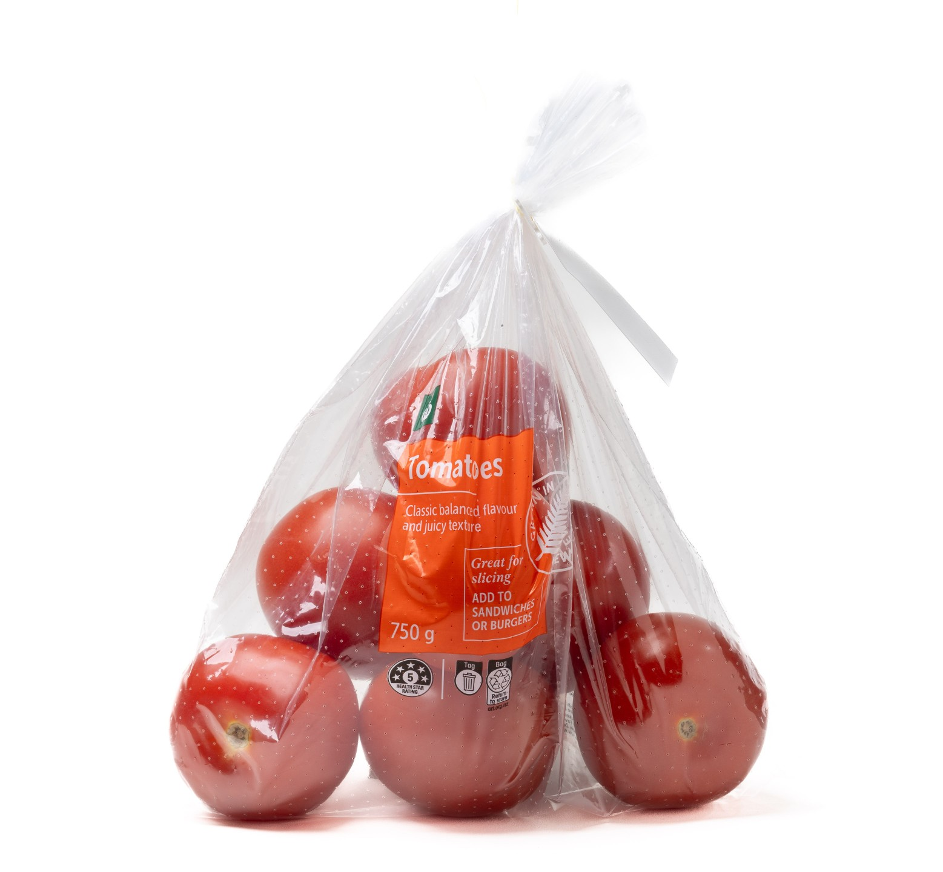
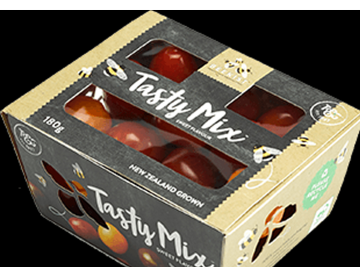
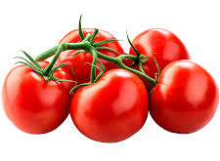
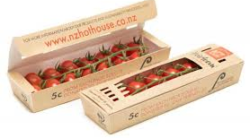
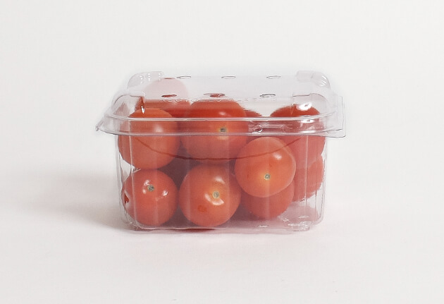
Packing
Activity 4: Investigating different types of tomatoes sold in supermarkets and how packaging helps protect, market, and sell fresh tomatoes.

Slide 22
Activity 4: Create a flowchart
Create a flowchart showing the journey of a tomato from seed to supermarket. Use the following to help you.
Sowing tomato seeds
Tomato seedlings
Grafting seedlings
Planting grafted seedlings
Training tomato plants
Pollination
Harvesting
Grading
Packaging
Transport
Supermarket

Slide 23
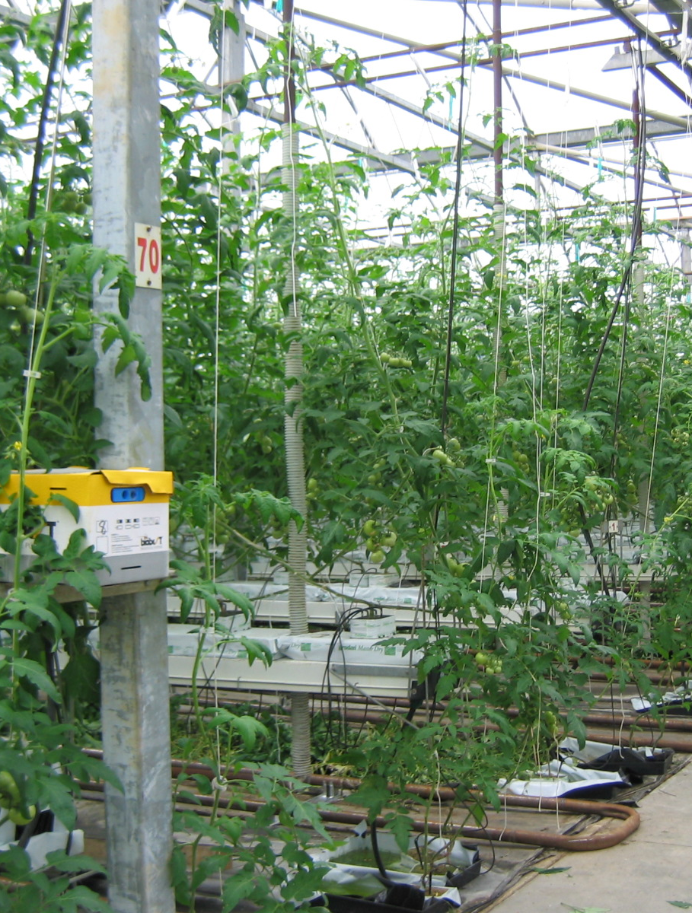
Activity 5: Identify and label
Bobbin
Heating pipes
CO₂ Enrichment
Sticky trap
Reflective Mulch
Truss
Rockwool slab
Ventilation
Support string
Bumblebees
Fertigation drippers

Slide 24
Do:
Growing indoor tomatoes (WS)

