Slide 1


Slide 2
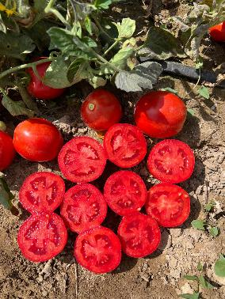
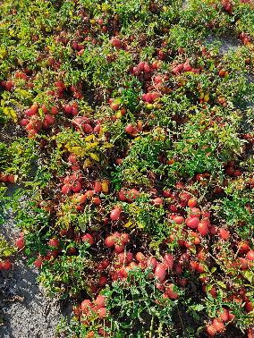
Field Grown Processing Tomatoes
Hawkes Bay

Slide 3
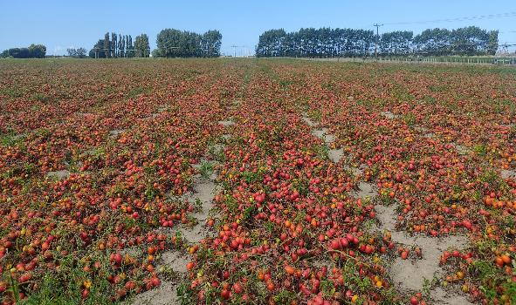
Processing tomatoes
Processing tomatoes are grown to make tomato paste, peeled tomatoes, diced tomatoes, sauces, soups, and other tomato products.
They are specially bred for high yields, uniform ripening, and mechanical harvesting.
Aseptic tomato paste is made by sterilising the tomato paste and packaging separately, allowing it to be stored for 18–24 months without refrigeration.
Heinz Wattie's in Hastings is New Zealand's only processor of field-grown tomatoes.
About 35,000 tonnes of tomatoes are processed each year, supporting local farmers, jobs, and the Hawke's Bay economy.
New Zealand growers compete with lower-cost imported tomato products, so efficient production and processing are essential.

Slide 4
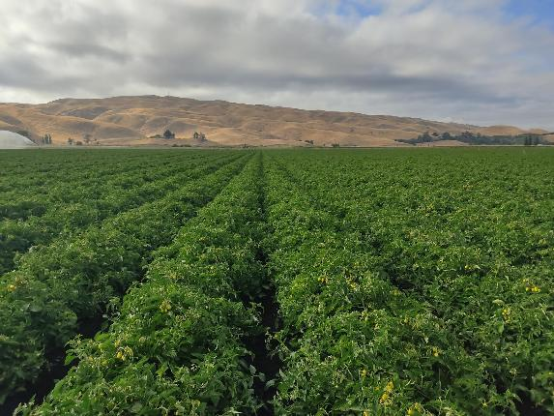
Growing processing tomatoes in Hawke's Bay
Processing tomatoes are grown outdoors from October to April.
Hawke's Bay has a warm, dry climate and fertile soils, making it ideal for tomato production.
The crop is grown to supply Heinz Wattie's in Hastings.
Determinate (bush) varieties are used because they:
  Grow to a fixed size.
  Ripen at the same time.
  Are suitable for mechanical harvesting.
Most processing tomatoes are Roma (plum-type) because they have:
  Firm flesh.
  High soluble solids (°Brix).
  Less water, making them ideal for tomato paste and canned products.

Slide 5
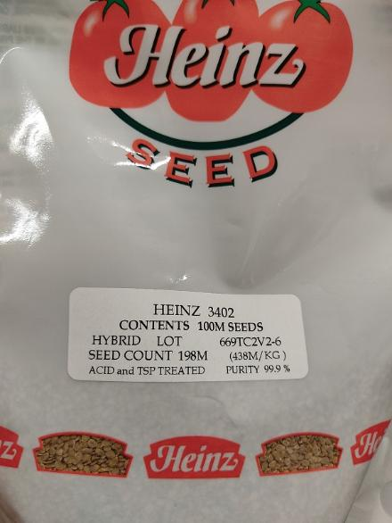
Tomato varieties and production
Growers use hybrid seed from HeinzSeed and HM Clause.
Varieties are selected for:
  High yield.
  Disease resistance.
  Good colour and flavour.
  High °Brix (natural sugars).
  Suitability for paste, peeled, and diced tomatoes.
Average yield is 105 tonnes per hectare, with crops ranging from 80–130 t/ha depending on the season.
Good nutrient, pest and disease management, irrigation, and harvesting are all important for producing high-quality tomatoes for Heinz Wattie's.

Slide 6
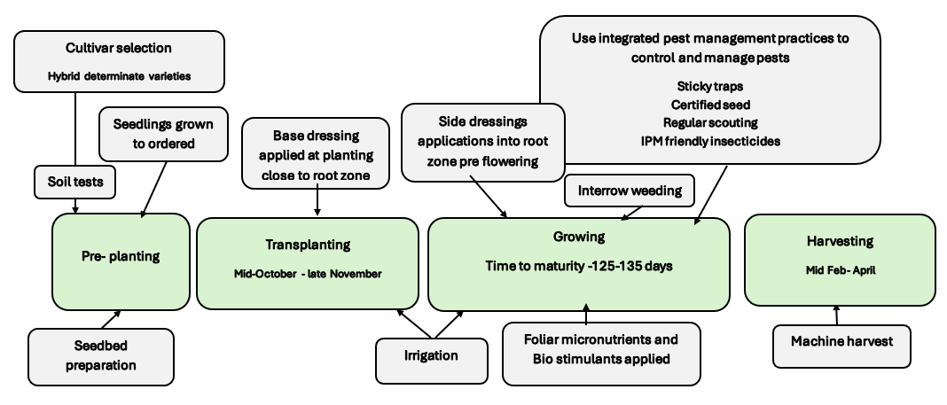
Field Grown Process Tomato Crop Calendar of Operations
Seasonal Crop October to April

Slide 7
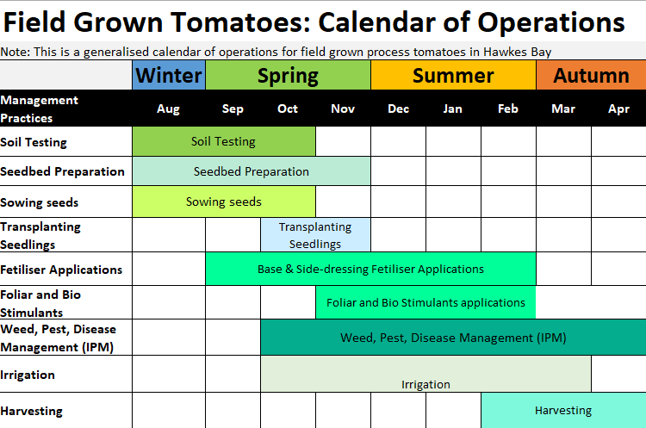

Slide 8
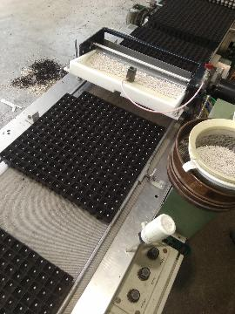
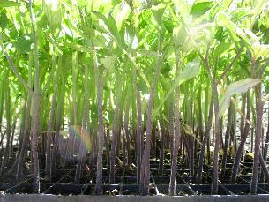
Seedling production
Processing tomatoes are grown from seedlings, not direct-seeded into the field.
Seeds are sown into cell trays at commercial nurseries during August to October.
Seedlings are grown in greenhouses under controlled conditions.
Early seedlings take about 65 days to grow because of cool temperatures and low light.
By mid-October, warmer weather reduces growing time to about 30 days.

Slide 9
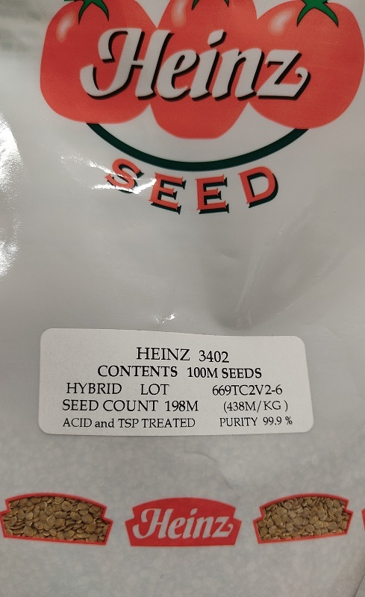
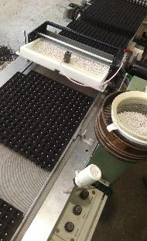
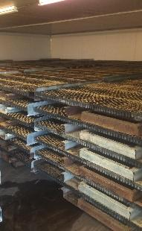
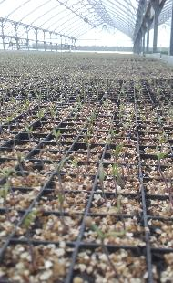
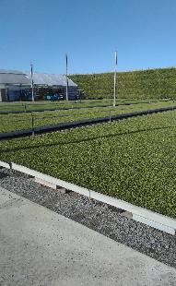
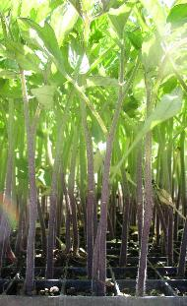
Seeds to seedlings ready to transplant

Slide 10
Seedbed
A well-prepared seedbed helps tomatoes grow strong and produce high yields.
Tomatoes need deep, loose, well-drained soil so roots can grow easily and access water and nutrients.
In Hawke's Bay, free-draining silt loam and alluvial soils are ideal for growing processing tomatoes.
Fields are cultivated to create a fine, level seedbed for quick transplant establishment and even crop growth.
Tomatoes are usually grown on fresh ground using a 3-year crop rotation to reduce pests and diseases and keep the soil healthy.
Soil tests are carried out before planting to check nutrient levels and soil pH (best pH: 6.0–6.8).
Fertilisers are added based on the soil test results.
Raised beds improve drainage, warm the soil faster, and make irrigation and machine harvesting easier.

Slide 11
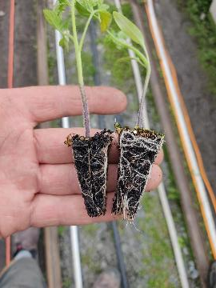
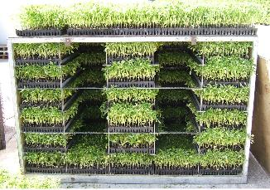
Transplanting
Seedlings are transplanted into the field from October to late November after the risk of frost has passed.
Tomatoes are frost-sensitive, so early crops are planted in low-frost-risk paddocks.
The crop takes about 125–135 days from transplanting to harvest.
Early-, mid-, and late-season varieties are planted to spread the harvest.

Slide 12
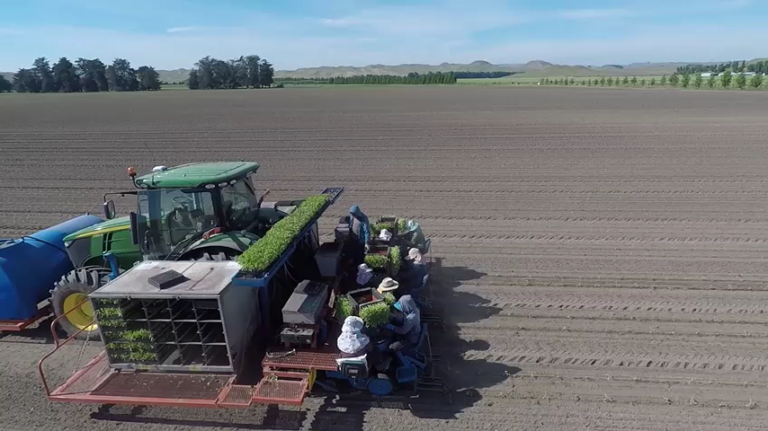
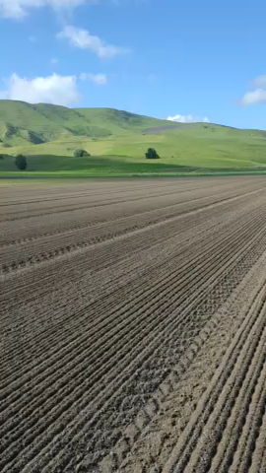
Watch: Transplanting

Slide 13
Nutrient management
Before planting
Soil is tested for nutrient levels and pH (ideal pH 5.5–6.5).
Fertiliser is chosen to match the needs of each paddock.
GPS-guided equipment places NPK fertiliser close to the roots before transplanting.
Key nutrients
Nitrogen (N): Helps leaves and stems grow. Too much delays fruit ripening.
Potassium (K): The most important nutrient for fruit size, colour, firmness, and tomato paste quality.
Phosphorus (P): Encourages strong root growth.
Calcium (Ca): Helps prevent blossom-end rot.
Magnesium (Mg) and Sulphur (S): Support healthy plant growth.
During the growing season
Extra fertiliser is applied before flowering in the root zone.
Growers may spray micronutrients onto the leaves if needed.
Good irrigation helps plants absorb nutrients.

Slide 14
Irrigation
Processing tomatoes in Hawke’s Bay require careful irrigation because summer rainfall is not enough to meet crop water needs.
Tomatoes need approximately 400 mm of water during the growing season, but average spring and summer rainfall provides only about 275 mm.
Growers use scheduled irrigation to supply extra water and maintain healthy plant growth and high yields.
Crop Management Practices
Tomatoes are transplanted into fields instead of direct-sown:
  Helps plants establish faster
  Allows the crop canopy to close quickly
  Improves water use and reduces weed competition
Irrigation is usually stopped about three weeks before harvest:
  Concentrates sugars in the fruit
  Improves fruit firmness
  Helps meet processing quality standards

Slide 15
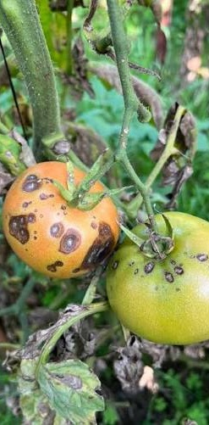
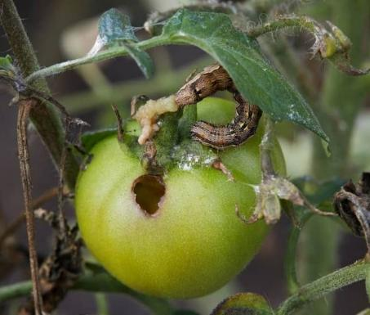
Pest and disease management
New Zealand's cool, wet climate can increase the risk of pests and diseases in field-grown tomatoes.
Common diseases include:
  Bacterial speck
  Early blight (Alternaria)
  Late blight (occasional outbreaks)
Common insect pests include:
  Tomato potato psyllid (TPP)
  Tomato fruitworm
Growers use Integrated Pest Management (IPM) to protect crops by:
  Choosing disease-resistant varieties
  Rotating crops
  Monitoring fields regularly
  Maintaining good crop hygiene
  Using biological controls
  Applying approved crop protection products when needed
Ref- PPT Tomato P & D management- Slides 29-35

Slide 16
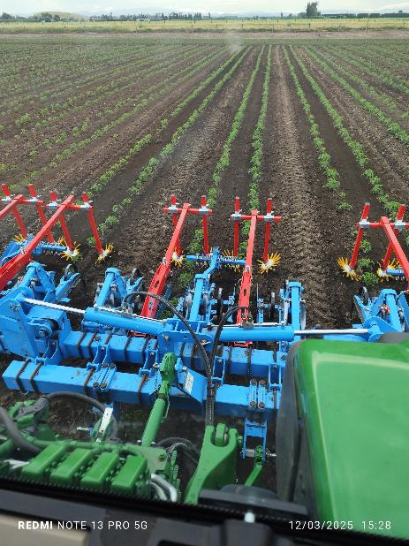
Weed management
Weeds compete with tomato plants for sunlight, water, nutrients, and space.
Too many weeds can reduce plant growth and lower tomato yields.
Weeds can also provide shelter for insect pests and plant diseases.
Growers use integrated weed management, including:
  Crop rotation
  Cultivation before planting
  Herbicides when needed
  Regular field monitoring
GPS-guided cultivators allow growers to remove weeds very close to tomato plants without damaging the crop.
Keeping fields weed-free helps plants grow better, makes harvesting easier, and improves the quality of tomatoes for processing.

Slide 17
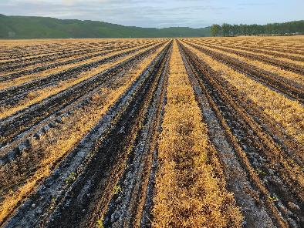

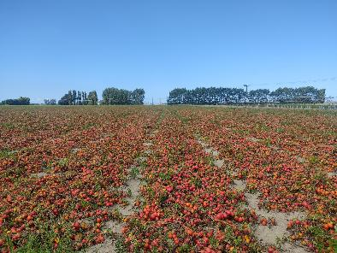
Transplanting to Harvest

Slide 18

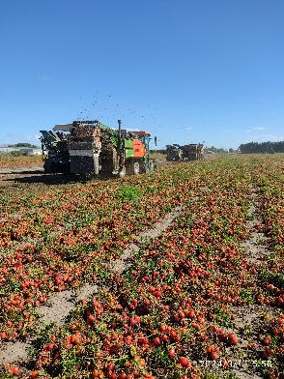
Harvesting
Processing tomatoes are mechanically harvested when the fruit is fully ripe.
Determinate varieties ripen most of their fruit at the same time, making machine harvesting fast and efficient.
Tomatoes are transplanted from October to late November and are usually ready to harvest 125–135 days later.
The harvest season in Hawke's Bay runs from mid-February to April.
Growers plant early-, mid-, and late-season varieties to ensure a continuous supply of tomatoes to Heinz Wattie's throughout the harvest season.

Slide 19
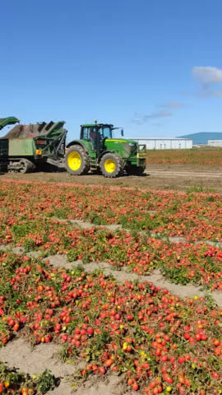
Harvest facts
Average yield: 105 tonnes per hectare (typically 80–130 t/ha, depending on seasonal conditions).
Processing tomato varieties are selected for:
  High yields
  Even fruit ripening
  Strong, compact plants
  Good field holding (ripe tomatoes remain in good condition on the plant until harvest)
After harvesting, tomatoes are transported directly to the processing factory, where they are made into:
  Tomato paste
  Peeled tomatoes
  Diced tomatoes

Slide 20
Quiz
Decide if the statements are True or False, then write correct statements for the false ones
Statement | True/False
Processing tomatoes are indeterminate plants
Harvest usually occurs from February to April
Potassium is the most important nutrient for fruit quality.
Tomatoes are direct seeded into Hawke's Bay paddocks
H3402 is a hybrid processing cultivar
Irrigation usually stops before harvest
Tomatoes tolerate frost well
Processing tomatoes are harvested by machine.

Slide 21
Answers
Statement | True/False
Processing tomatoes are indeterminate plants | False
Harvest usually occurs from February to April | True
Potassium is the most important nutrient for fruit quality. | True
Tomatoes are direct seeded into Hawke's Bay paddocks | False
H3402 is a hybrid processing cultivar | True
Irrigation usually stops before harvest | True
Tomatoes tolerate frost well | False
Processing tomatoes are harvested by machine. | True
Processing tomatoes are determinate plants
Tomatoes seedlings are transplanted into Hawke's Bay paddocks.
Tomatoes are frost sensitive.

Slide 22
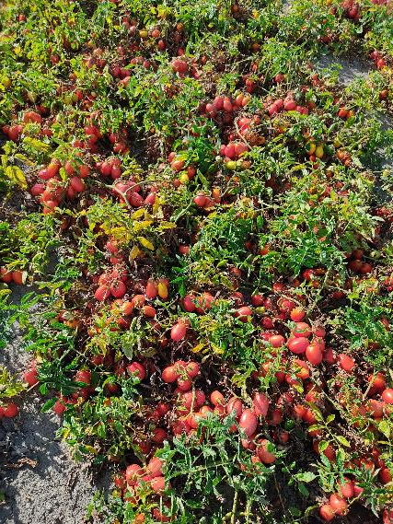
Do
Wattie's whopper tomato harvest (WS)
Activity: You are the crop agronomist

Slide 23
Acknowledgment
Thank you to Heinz Wattie's for providing the information, photos, and videos showcasing how field-grown tomatoes are grown for processing.

