Slide 1


Slide 2
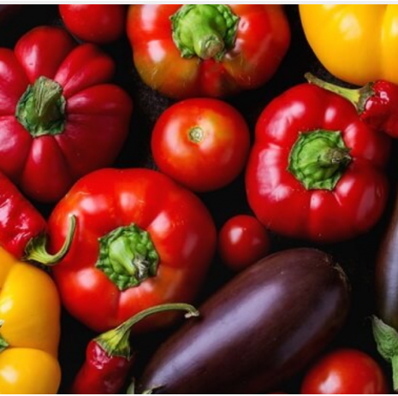
Activity 2: Solanaceae
(Nightshade family)
1. Make a list of vegetables in the solanaceae family.

Slide 3
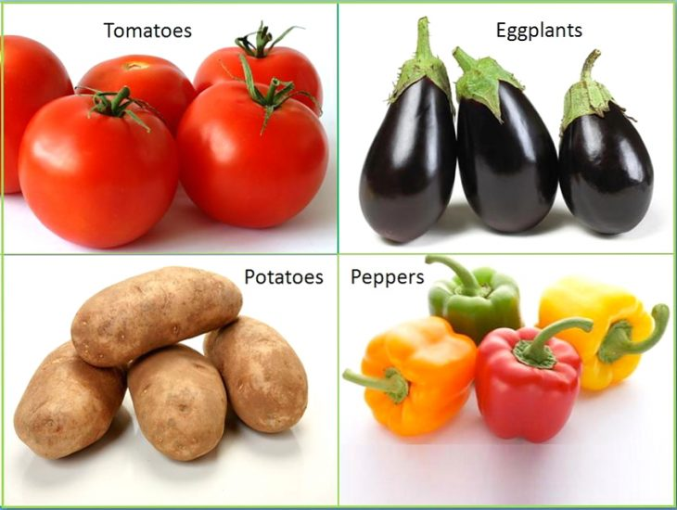
Discussion questions
What do these vegetables have in common?
What other plants belong to the solanaceae family?

Slide 4
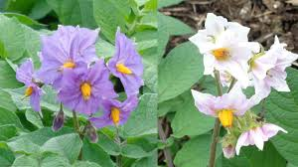
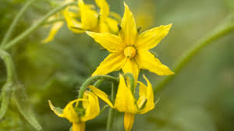
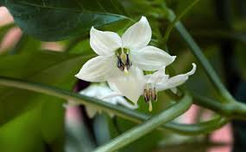
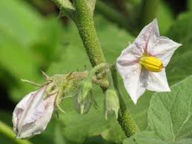
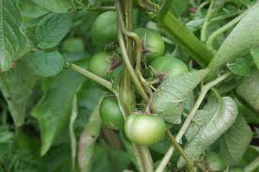
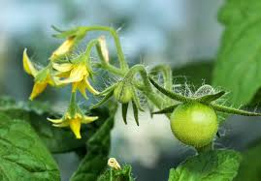
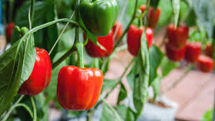
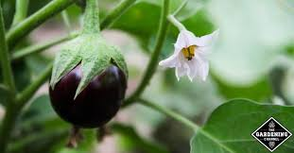
Solanaceae family
All plants in the Solanaceae family have alternate leaves and colorless sap. They have perfect (bisexual) flowers, typically with five fused petals
Potatoes
Tomatoes
Capsicum
Aubergine

Slide 5
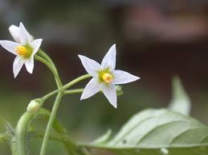
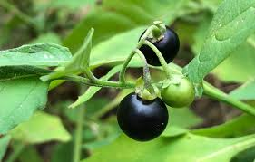
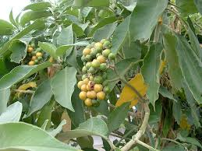
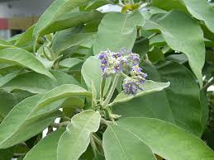
Other members - nightshades
Black Nightshade
Tomatoes belong to the nightshade plant family.
Some nightshade plants contain poisonous alkaloids, especially in their leaves, flowers, and berries.
The tomato fruit is safe to eat.
When tomatoes were first introduced to Europe, many people believed they were poisonous because they were related to plants such as deadly nightshade.
Over time, people discovered that ripe tomatoes were safe, and today they are one of the world's most popular vegetables (botanically, they are actually a fruit!).
Why do you think people thought tomatoes were poisonous?
Woolly Nightshade

Slide 6
Dichotomous key
2. Discuss what a dichotomous key is?
Note: A dichotomous key is a scientific tool used to identify organisms or objects by choosing between two contrasting, observable characteristics at each step. It acts as a guide, narrowing down options to help classify specimens such as plants or animals.
See Topic 3 - Identification and Classification of vegetables for more information and examples.

Slide 7
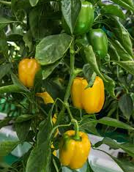
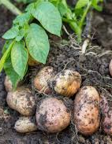
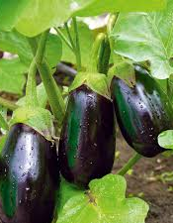
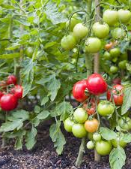
Solanaceae vegetables
3. Create a dichotomous key to identify vegetables in the Solanaceae family.

Slide 8
Dichotomous key for vegetables in the Solanaceae Family
Sample answer
1a. Plant produces underground tubers → Potato
1b. Plant produces above-ground fruit → Go to 2
2a. Fruit is long or bell-shaped with hollow inside → Capsicum
2b. Fruit is round or oval and not hollow → Go to 3
3a. Fruit usually purple and glossy with thick flesh → Eggplant
3b. Fruit usually red, soft, and juicy → Tomato

