Slide 1


Slide 2
Tomato
Pest and Diseases in Commercial
Indoor and Field Grown Crops
Pests and diseases can reduce plant health, yield, and fruit quality.
Field-grown tomatoes are affected by weather conditions, insects, and soil-borne diseases.
Indoor crops face risks from insect pests, fungal diseases, and crop hygiene issues.
Growers use Integrated Pest Management (IPM) to protect crops.
Control methods include:
  Regular crop monitoring
  Disease-resistant varieties
  Crop rotation
  Biological controls
  Approved chemical treatments

Slide 3
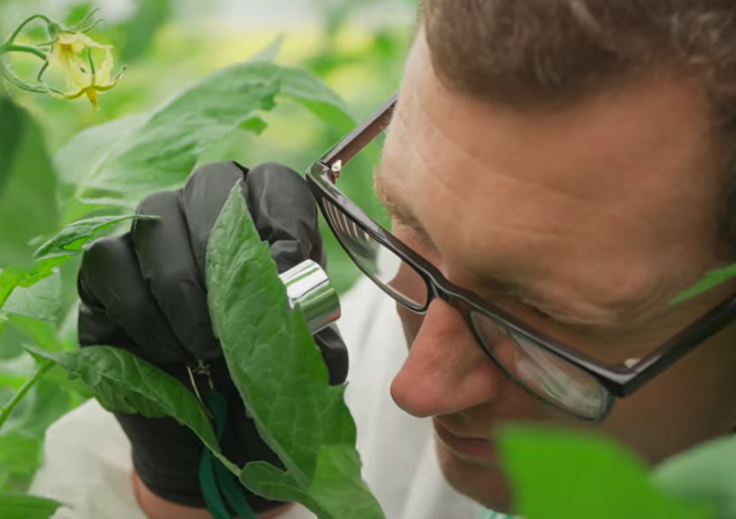
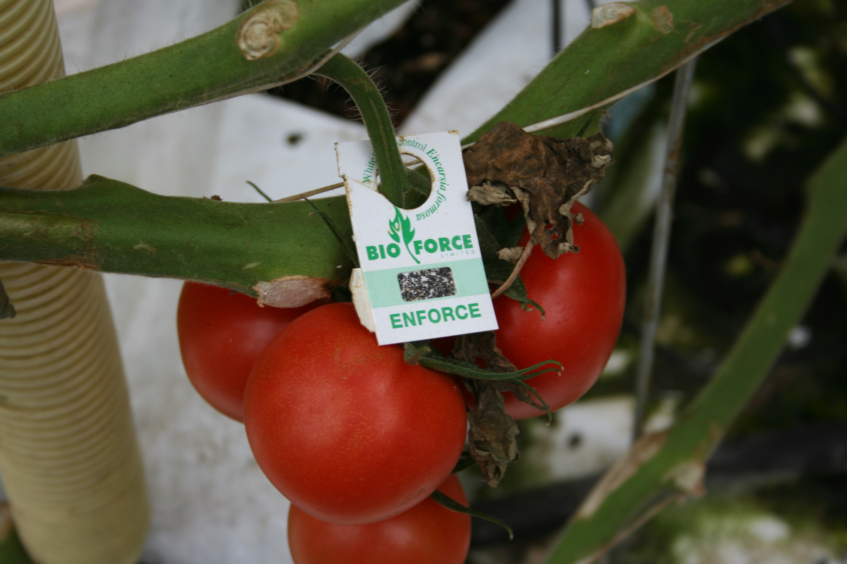
Pest and Disease Management and Control
Greenhouse Tomatoes

Slide 4
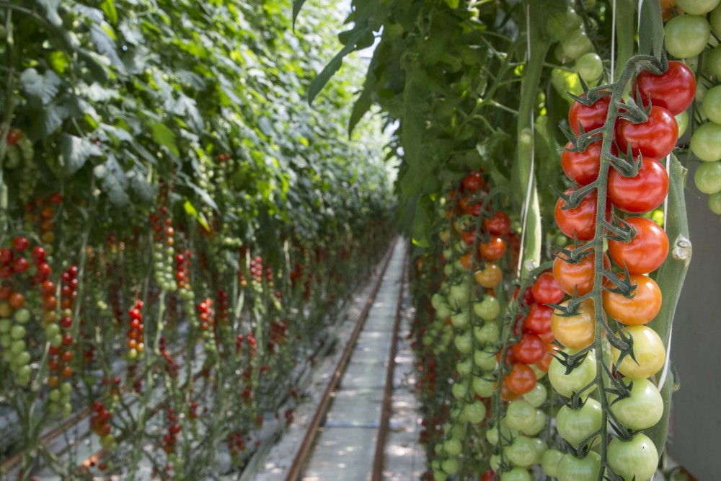
Successful greenhouse tomato production depends on:
Good environmental control
Strong hygiene practices
Early pest and disease detection
Biological control systems
Integrated Pest Management (IPM)
Good management improves:
Crop health
Fruit quality
Yield
Sustainability

Slide 5
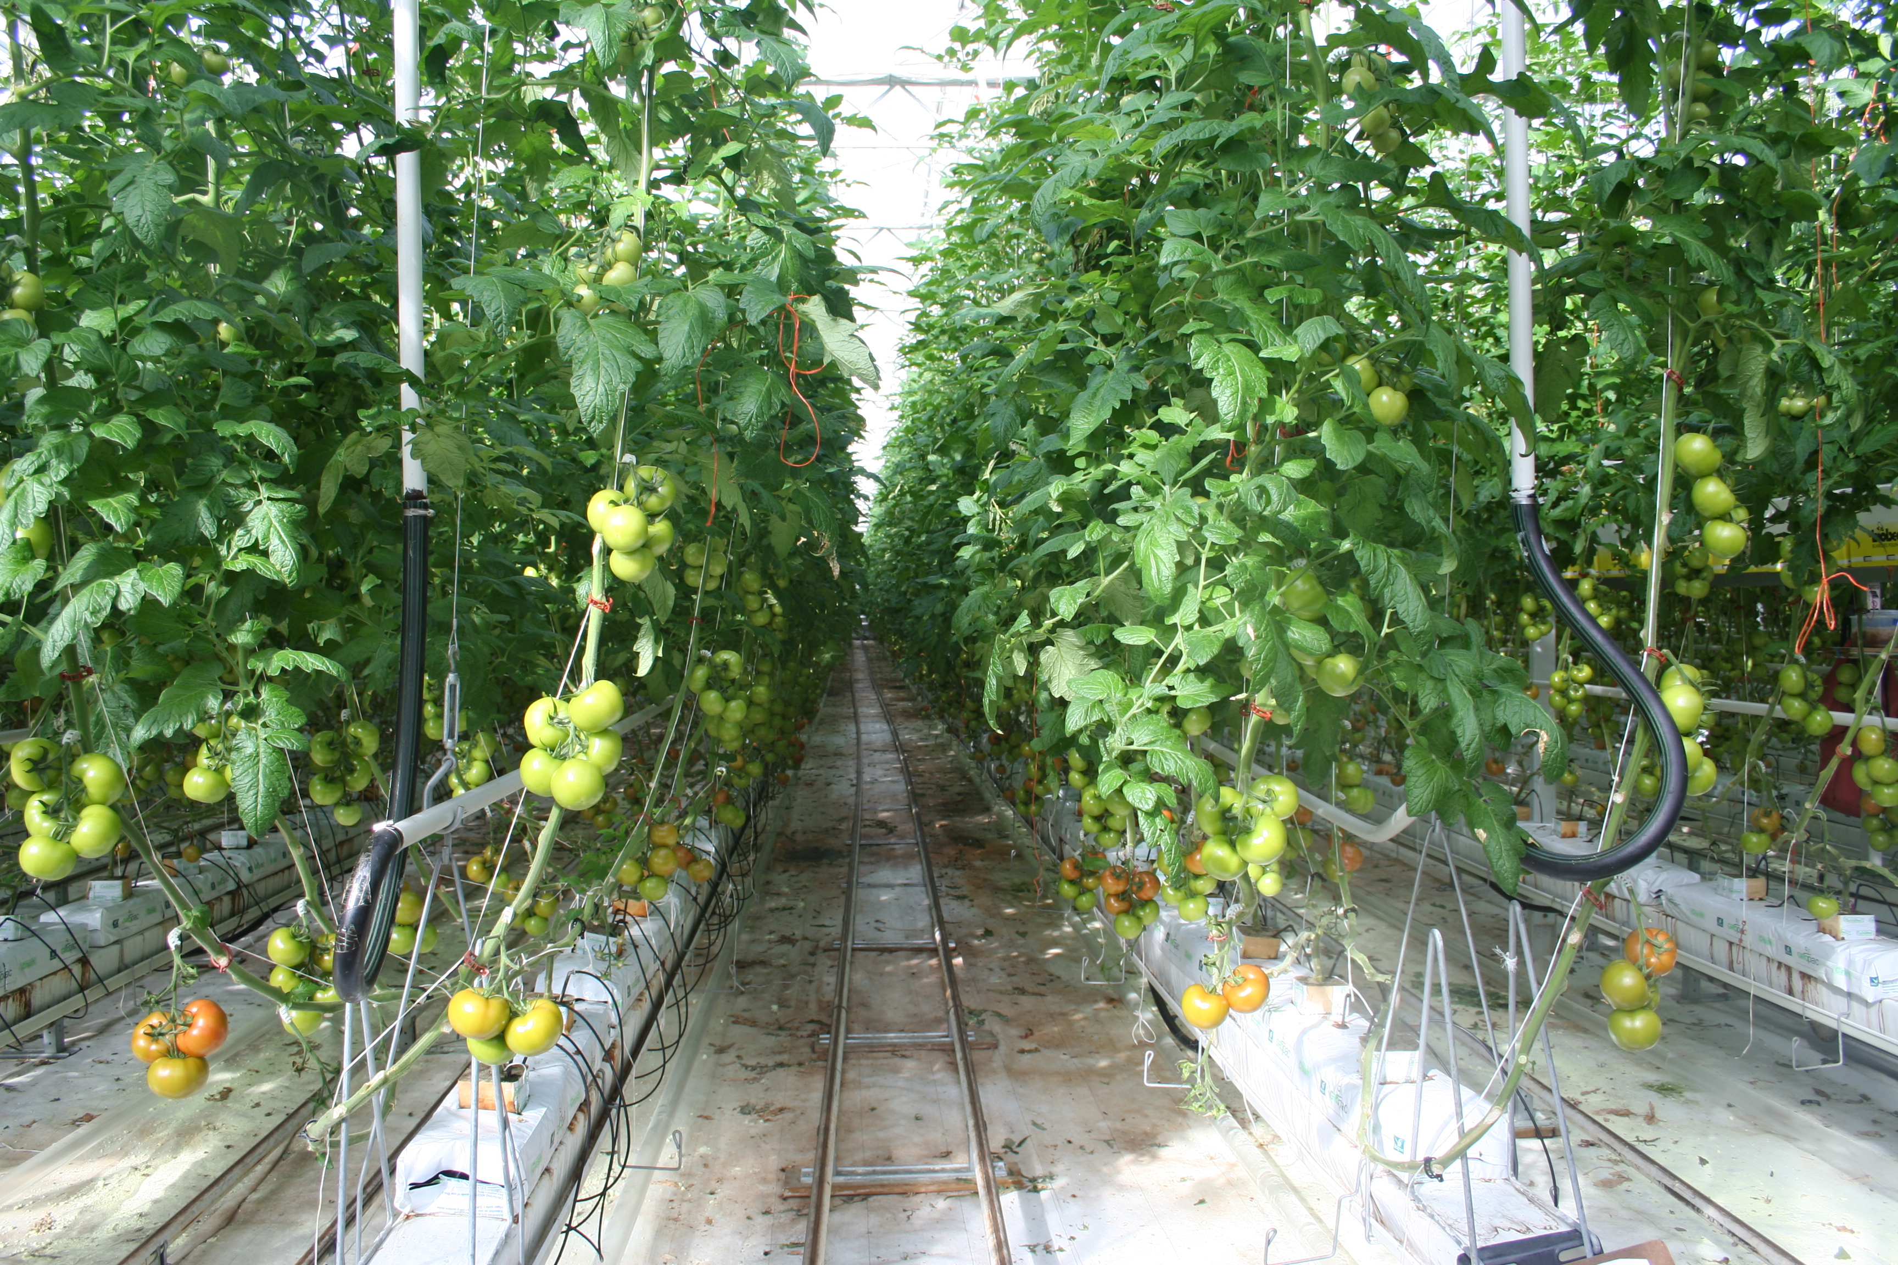
Greenhouse conditions
Humidity
Warm temperatures
Dense plant canopies
Continuous crop production
Limited airflow
These conditions help plants grow quickly but also allow pests and pathogens to survive year-round.
Poor pest and disease control can reduce yield and fruit quality.

Slide 6
Integrated Pest Management (IPM)?
The gaol of IPM is to
Reduce pest and disease outbreaks
Lower chemical use
No impact on bumble bees
Protect crop yield and quality
IPM combines:
Environmental control
Biological control
Crop monitoring - Scouting
Hygiene and sanitation
Careful pesticide use
Watch: How to scout This video explains what good scouting in a greenhouse looks like and why it’s important to do regular scouting as part of your IPM.

Slide 7
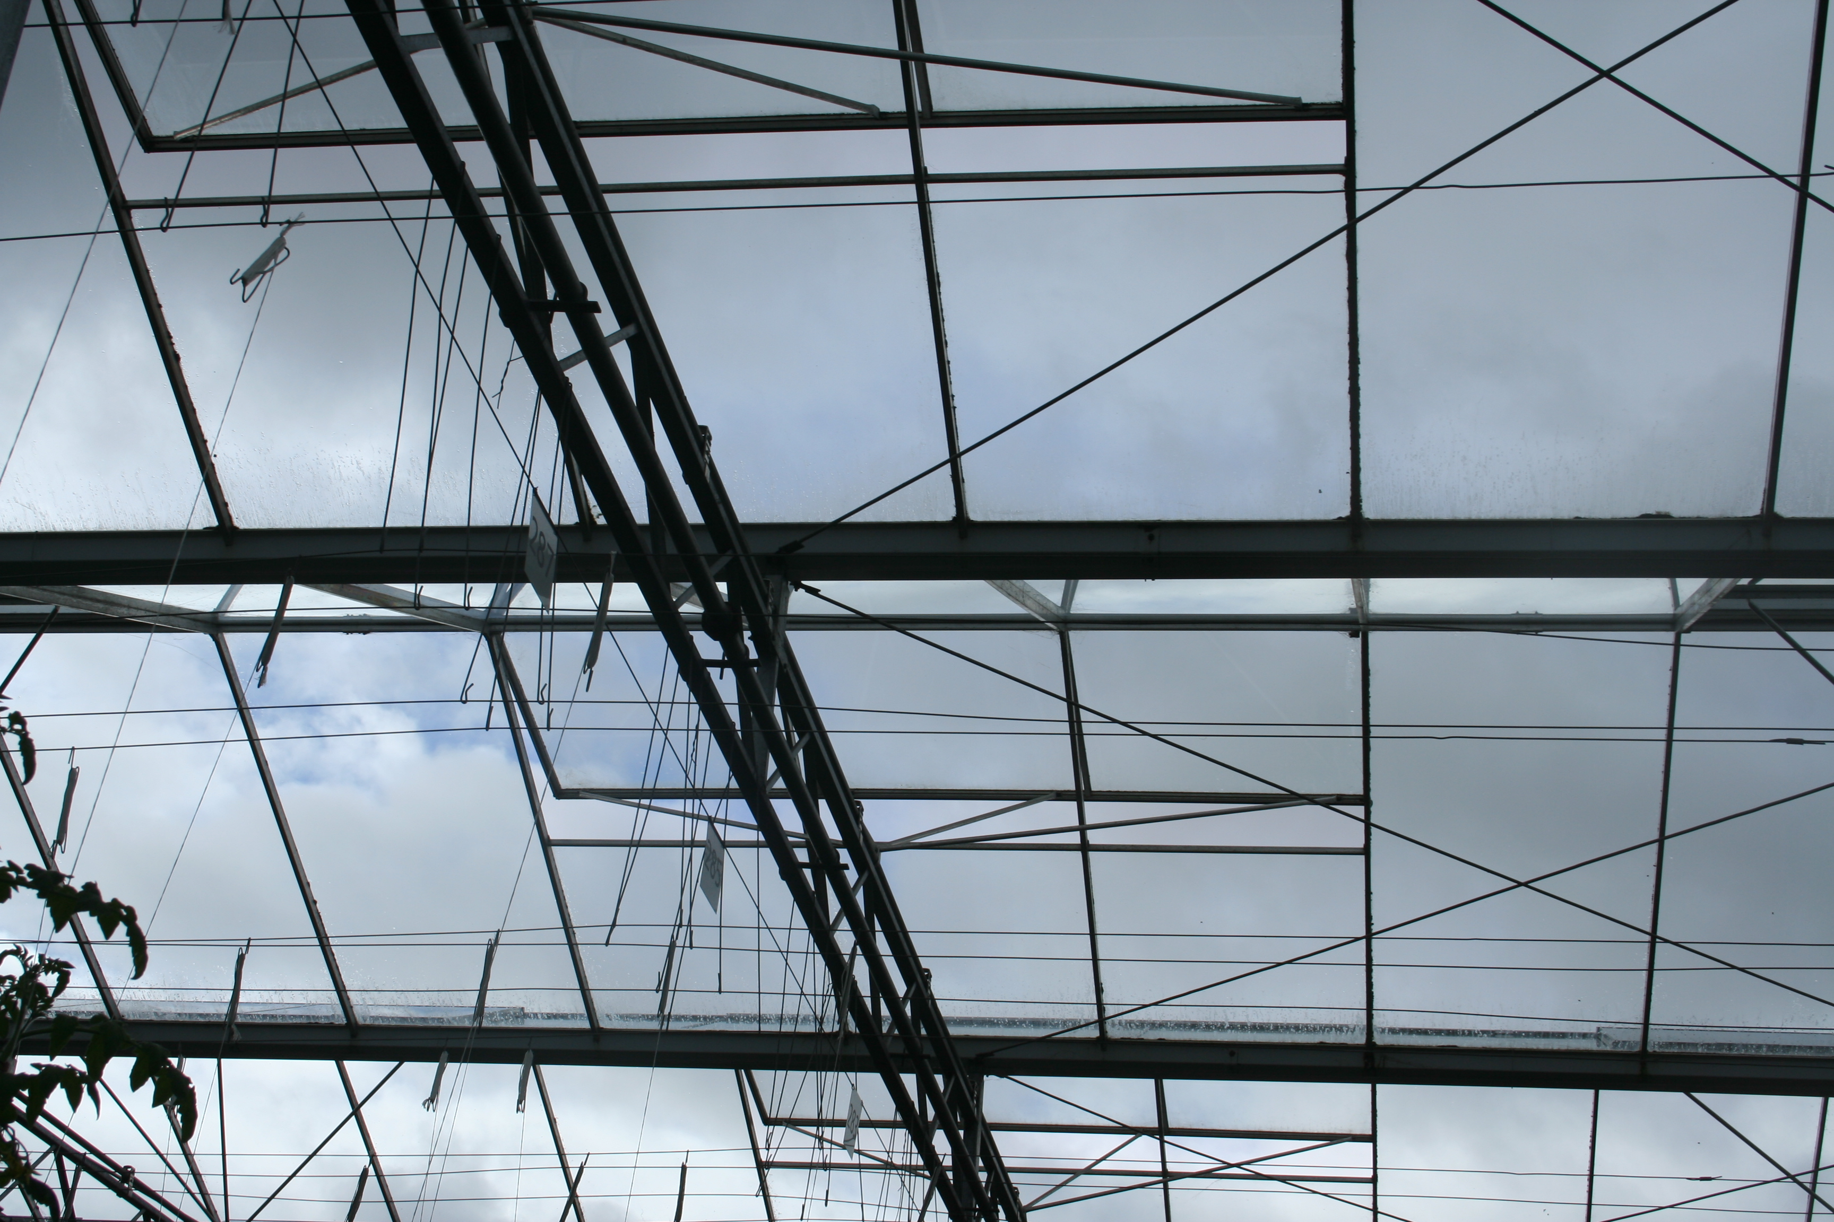
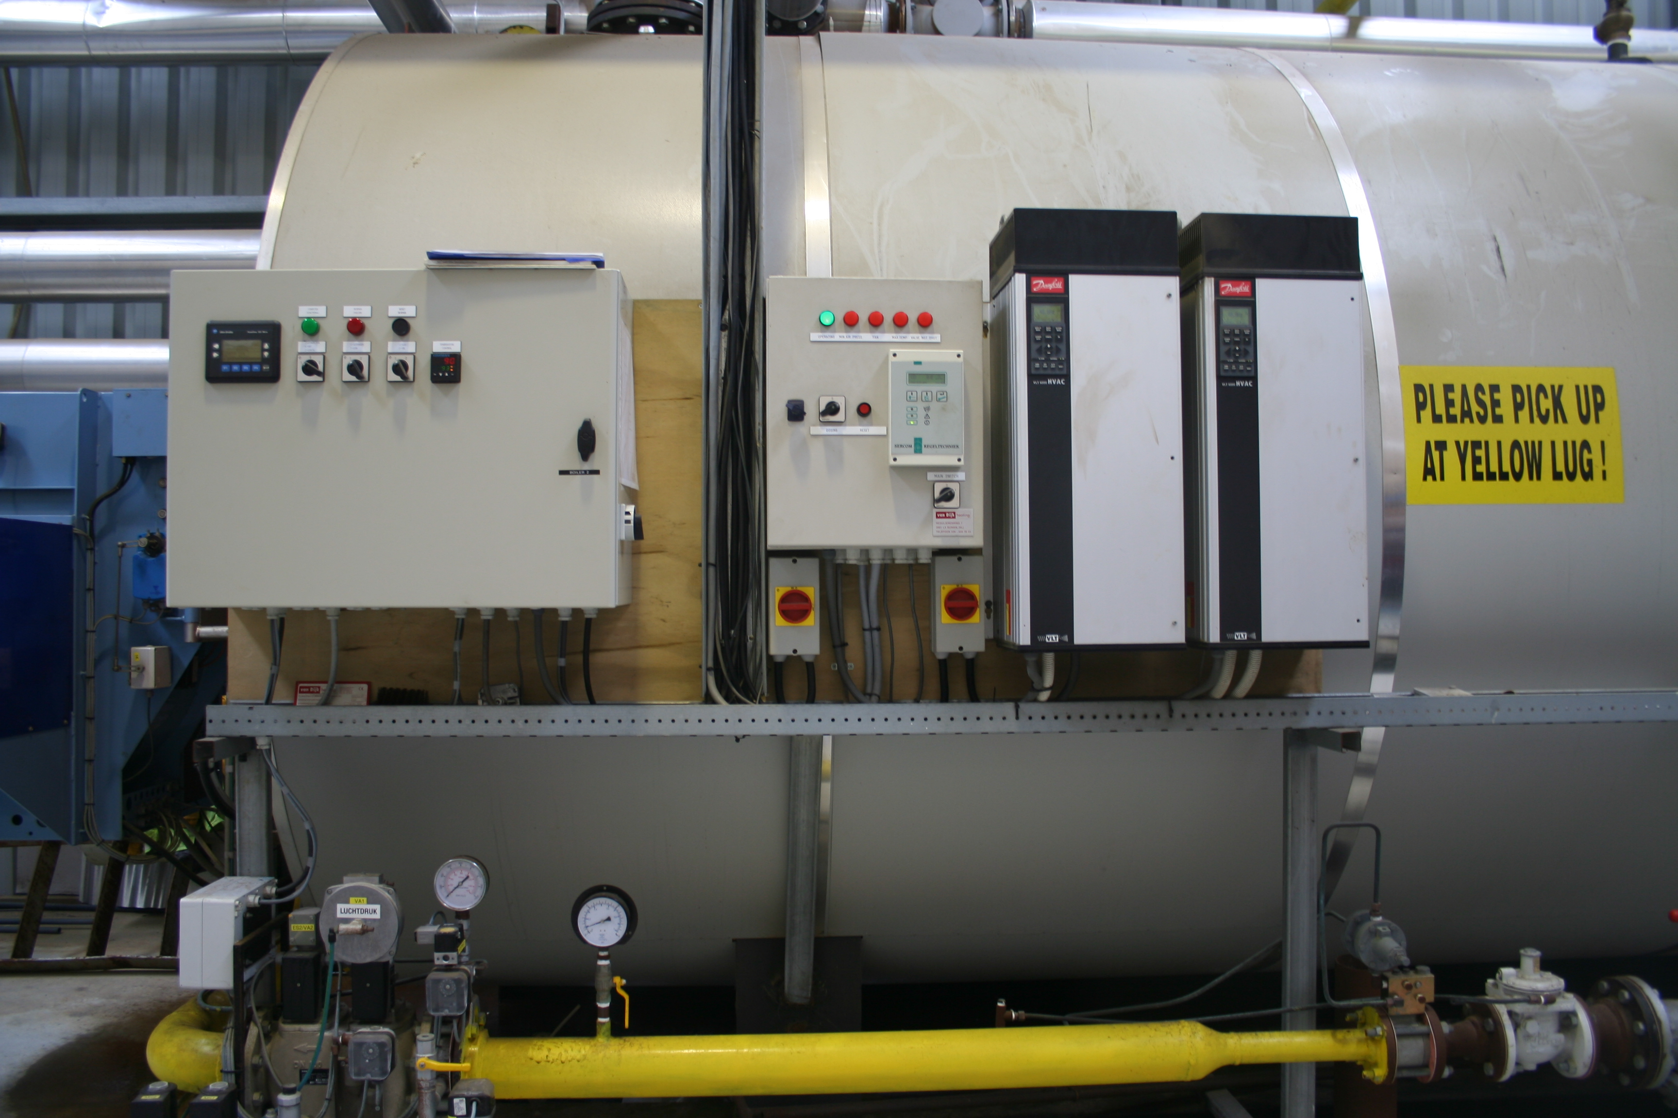
Environmental Control
Maintain relative humidity below 85%
Improve airflow using fans and proper plant spacing
Prevent condensation and prolonged leaf wetness
Manage temperatures carefully to reduce plant stress
Ventilate regularly to remove excess moisture
Benefits
Reduces pest and disease (bacterial and fungal) development and spread
Improves plant health and crop quality
Creates a more stable growing environment

Slide 8
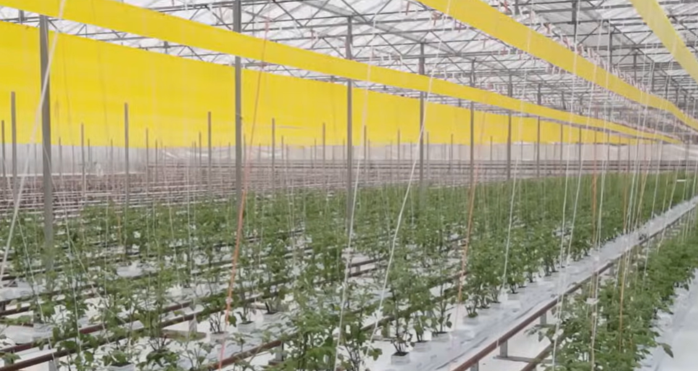
Biological Controls
Beneficial insects provide effective, natural control of key greenhouse pests
Encarsia formosa - controls whiteflies
Phytoseiulus persimilis - controls spider mites
Engytatus – helps control Tomato Potato Psyllid (TTP) and whiteflies
Benefits:
Reduces reliance on chemical pesticides
Supports sustainable and environmentally responsible production
Used by 99% of New Zealand tomato growers
Compatible with bumble bee pollination — no negative impact on pollinators
Early introduction of BCAs improves protection against pest outbreaks
Acts as an “insurance policy” for crop protection and crop resilience
Watch: Revitalising IPM in greenhouse tomatoes: This video explains what a biological control is, how they control pests and found in nature

Slide 9
Hygiene and monitoring
Important hygiene practices:
  Sterilise tools between rows
  Remove infected plant material
  Use foot baths at entrances
  Wash hands regularly
  Monitor crops with sticky traps
  Regular scouting- early detection helps prevent outbreaks.

Slide 10
Tomato pest and diseases
Note:
Only a selection of the major tomato pests and diseases, along with their management and control strategies, has been covered in this presentation.
For further information on these and other tomato pests and diseases, please refer to the resources provided in the Resource Folder or on Tomatoes NZ

Slide 11
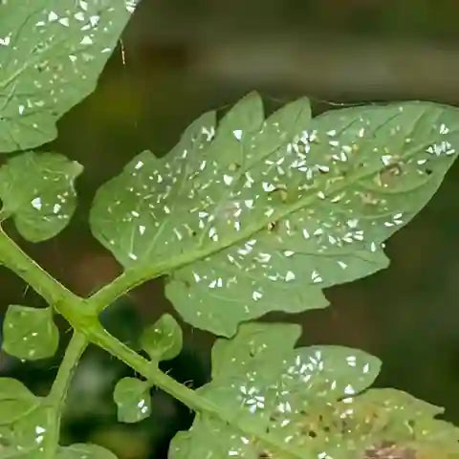
Insect Pests
In Greenhouse production systems
Major pests
Whiteflies
Russet mite
Caterpillars
Minor pests
Thrips
Aphids
Tomato-Potato Psyllid (TPP)
Effects on crop
Feed on plant sap
Reduce plant growth and vigour
Spread viruses and diseases
Damage leaves and fruit

Slide 12
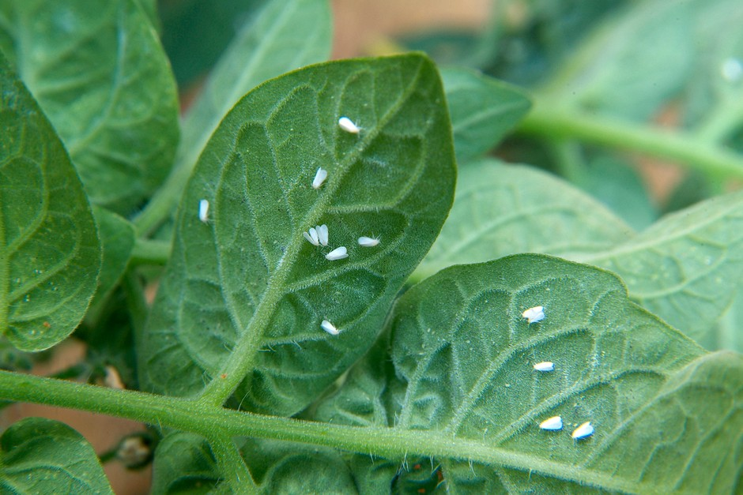
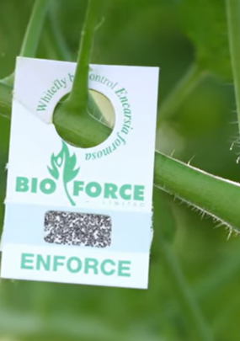
Whitefly
Adults are tiny white winged insects 1.5 mm long
Eggs are pale yellow, turning black before hatching
Found mainly on the underside of young leaves
Signs and symptoms
Whiteflies and nymphs under leaves
Leaf wilting, yellowing, and distortion
Sticky honeydew and black sooty mould
Reduced plant growth and yield
Management and control
Use yellow sticky traps near plant tops
Install insect-proof mesh on vents and doors
Use biological controls such as Encarsia formosa
Use soft chemicals if populations are high

Slide 13
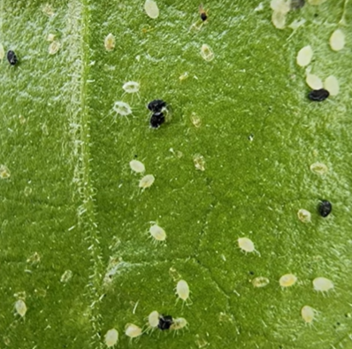
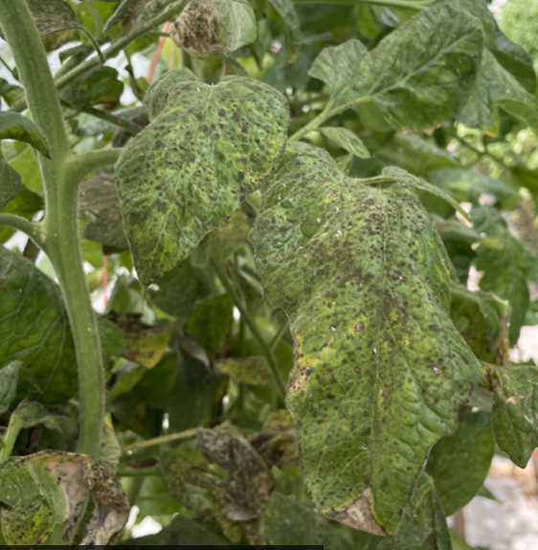
Whiteﬂy Control
Watch: A Masterclass in Whiteﬂy Control
This video gives advice for controlling whiteﬂy as part of an IPM for greenhouse tomatoes. You can use the whiteﬂy decision tree in conjunction with this video.

Slide 14
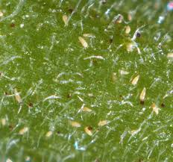
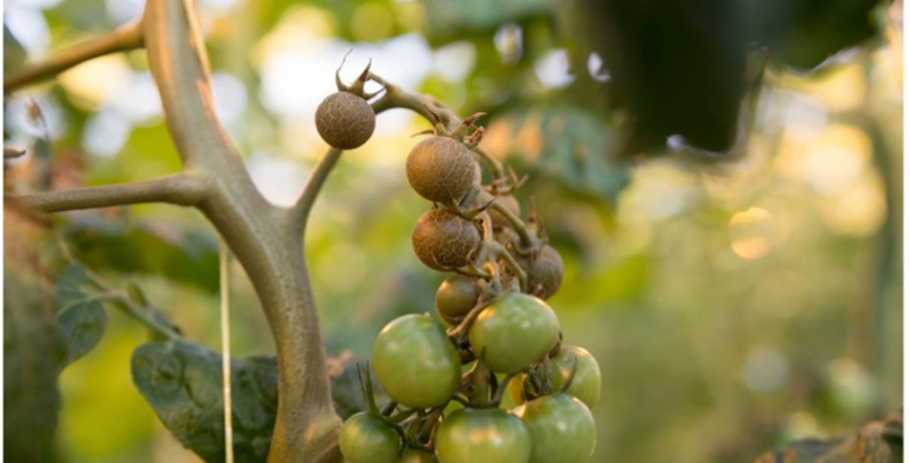
Russet mite:
(Aculops lycopersici)
The tomato russet mite is a microscopic pest that damages tomato plants by sucking cell contents. Because the mites are extremely small, damage symptoms are usually seen before the pest itself.
Symptoms
Greasy bronze or rusty-brown discoloration on stems and lower leaves
Leaves curl, dry out, and become brittle
Fruit may develop russeting and cracking
Damage spreads upward rapidly in hot, dry conditions
Management
Early detection is critical
Spread occurs through wind, tools, and clothing
Maintain good crop hygiene and monitor regularly

Slide 15
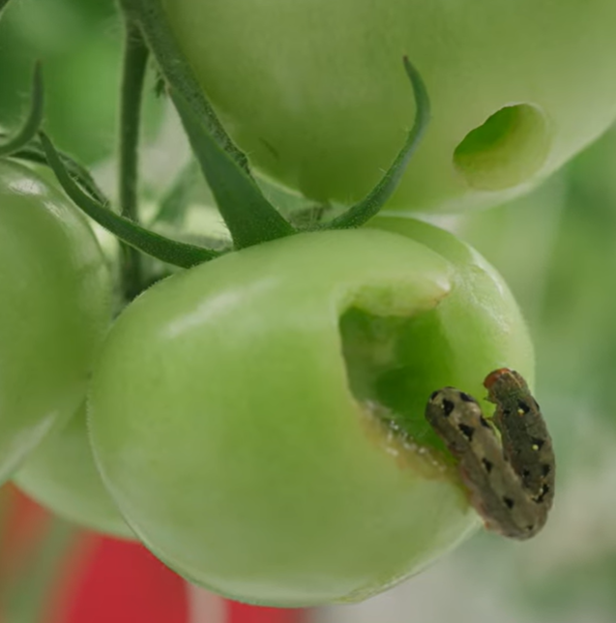
Caterpillars
Green looper, Tropical armyworm, fall armyworm
Tropical armyworm larvae are usually green to brown with distinctive stripes along their bodies and can grow up to 4 cm long.
Damage
Bore into ripening tomatoes, making the fruit unmarketable.
Leave behind frass (caterpillar droppings), which increases the risk of fungal and bacterial infections.
Heavy infestations reduce plant vigour, fruit quality, and overall yield.
Management Integrated Pest Management (IPM)
Regular crop monitoring for early detection.
Release of parasitoid wasps, which lay eggs in or on larvae; developing wasps kill the caterpillars.
Application of Bacillus thuringiensis (Bt), a biological insecticide that specifically controls caterpillars while minimising impacts on beneficial insects.

Slide 16
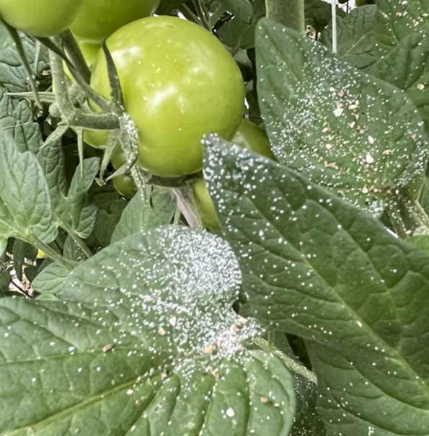
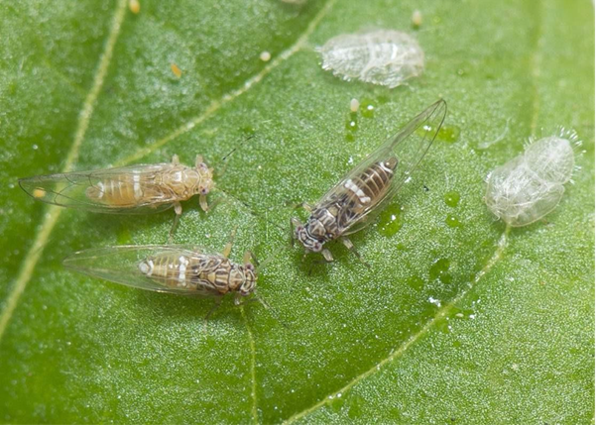
Tomato-Potato Psyllid (TPP) Bactericera cockerelli
Sap-sucking insect pest that can spread plant disease
Signs and symptoms
Nymphs produce white “psyllid sugars” that coat leaves and stems, creating a sticky, dirty appearance
Leaf yellowing and curling
Plant stunting, reduced vigour and poor fruit development
Management and control
Use yellow sticky traps to monitor adult populations
Inspect crops regularly, especially leaf undersides
Encourage or release biological control agents such as Engytatus nicotianae
Apply softer chemical options only when populations exceed thresholds
Maintain good crop hygiene and airflow

Slide 17
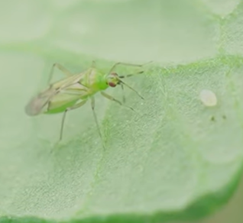
Biological control agent
Engytatus
Watch: How to use Engytatus with banker plants
This video gives tips for using Engytatus, a native predator insect that can be used as a biological control for some pests common in greenhouse tomato plants.

Slide 18
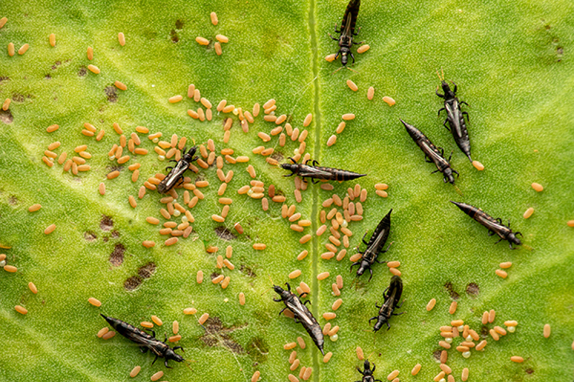
Thrips
(Tetranychusevansi)
Thrive in warm greenhouse conditions
Feed by piercing plant cells and sucking sap
Cause silvering, mottled leaves, distorted fruit, and flower damage
Can spread Tomato Spotted Wilt Virus (TSWV)
Management and control
Use sticky traps to monitor adults
Install fine insect mesh over vents and doors
Release beneficial predators
Maintain greenhouse humidity around 60–70%
Apply soft chemicals, or targeted sprays if populations increase

Slide 19
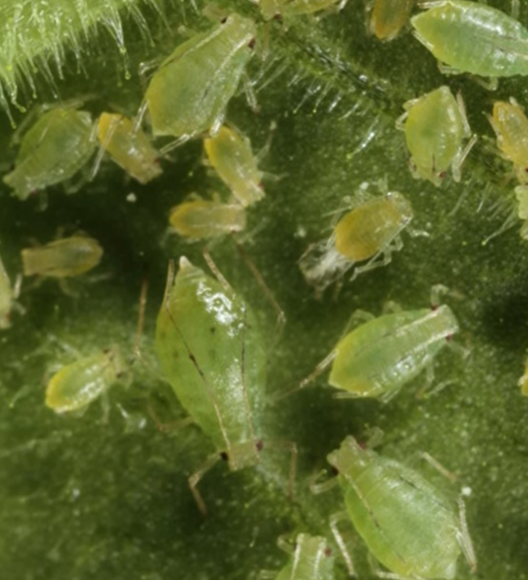
Aphids
Tiny sap-sucking insects that feed on tomato plants using needle-like mouthparts.
They reproduce quickly, especially in warm, protected indoor environments.
Damage
Remove plant sap, weakening the plant and reducing growth.
Cause leaves to curl, yellow, or become distorted.
Produce a sticky substance called honeydew, which encourages the growth of sooty mould and reduces photosynthesis.
Can transmit plant viruses, increasing the risk of disease spread.
Heavy infestations reduce plant health, fruit quality, and tomato yield.
Control measures
Regular scouting
Biological controls such as ladybirds, lacewing and parasatoids.
Spots sprays
Pesticides as a last resort.

Slide 20
Dealing with Spot Pests
Watch: Dealing with spot pests
This video gives lots of tips for how to manage spot pests that might appear in the greenhouse from time to time. It looks at what might typically appear and the treatments you might want to consider. You can use this video in conjunction with the action cards for individual pests.

Slide 21
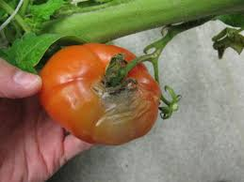
Major Greenhouse Diseases
Some common diseases include:
Powdery mildew
Botrytis (grey mould)
Root diseases such as Pythium and Fusarium
Bacterial canker
These diseases spread rapidly in humid conditions.

Slide 22
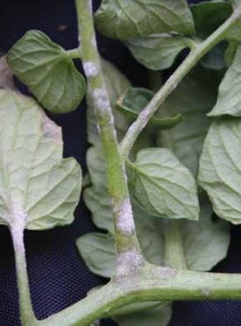
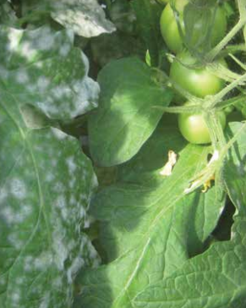
Powdery Mildew
Symptoms
White, powdery fungal growth on leaves and young shoots.
Leaves turn yellow, curl, dry out, and may drop prematurely.
Most common in greenhouse tomatoes.
Management
Grow resistant cultivars.
Maintain good greenhouse climate and avoid prolonged leaf wetness.
Avoid excessive nitrogen fertiliser.
Remove infected leaves and crop debris promptly.

Slide 23
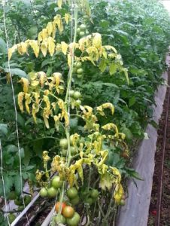
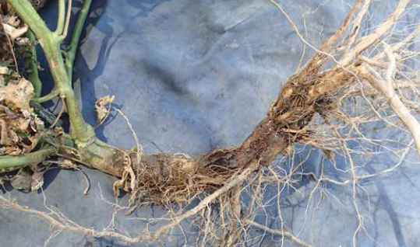
Root diseases in indoor grown tomatoes
Fusarium
Causes and symptoms
Soil-borne pathogens: Pythium, Phytophthora, Fusarium, and Rhizoctonia.
Favoured by excess moisture, poor drainage, and high humidity.
Symptoms include wilting, brown/mushy roots, yellowing leaves, stunted growth, and stem lesions.
Integrated control strategies
Optimise temperature, humidity, irrigation, fertigation, and root-zone aeration to reduce disease risk.
Prevent waterlogging and maintain effective drainage.
Apply beneficial microorganisms through fertigation to suppress pathogens and improve root health, including Trichoderma, Bacillus, and Pseudomonas spp.
Select tomato varieties with genetic resistance or tolerance to reduce disease severity and improve crop performance.

Slide 24
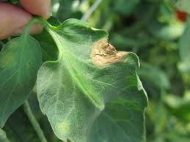
Botrytis (Grey Mould):
(Botrytis cinerea)
Grey mould is a serious fungal disease of tomatoes that thrives in cool, humid conditions and spreads through airborne spores and infected plant material. Prevention through environmental management is essential.
Symptoms
Faint pale “ghost spots” or halos on fruit
Small dark necrotic flecks may appear in the centre
Grey, fuzzy mould on stems, leaves, flowers, or fruit under favourable conditions
Stem rot and leaf death in severe infections
Fruit becomes unmarketable
Method of spread
Spread by wind-borne spores and infected debris
Favoured by high humidity and wet plant surfaces
Infection often enters through wounds or dying tissue
Management and control
Maintain dry conditions and good ventilation
Reduce plant density and manage fruit load
Improve airflow through pruning and spacing
Apply preventative biological or chemical fungicides when required
Maintain strict crop hygiene and remove plant debris

Slide 25
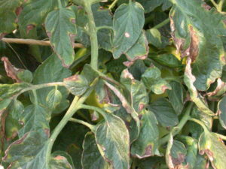
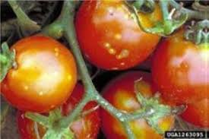
Bacterial Canker:
(Clavibacter michiganensis)
Bacterial canker is a highly contagious tomato disease and a major issue for New Zealand growers. Once infected, there is no cure, making prevention and hygiene essential.
Symptoms
Leaves: Wilting, yellowing, browning, and scorched leaf margins
Stems: Dark streaks, cracks, or cankers that may ooze sap
Fruit: Small white or yellow “bird’s eye” spots with dark centres
Spread
Sap-to-sap contact between plants
Contaminated tools, hands, clothing, and equipment
Splashing water and infected plant debris
Management and prevention
Maintain strict crop and tool hygiene
Control humidity and avoid plant stress
Remove and destroy infected plants and debris

Slide 26
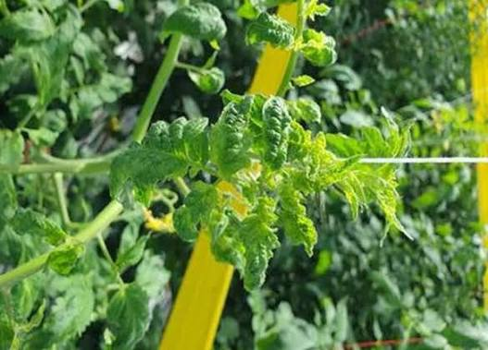
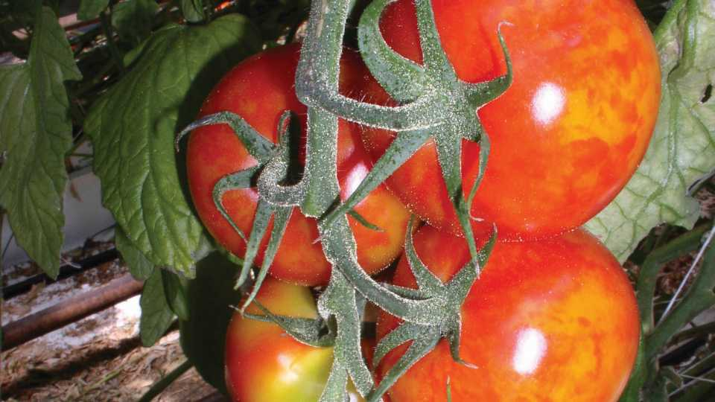
Pepino Mosaic Virus (PepMV )
Cause
Spread mainly through contact with infected plants, tools, hands, and plant waste
Can also spread through bumblebees and contaminated water
Symptoms:
Curled and distorted leaves
Yellow spots and mottled foliage
Weak plant growth
Uneven fruit colouring and ripening
Control strategies
Keep good hygiene: clean tools, equipment, hands, and remove infected plants
Use clean seeds and healthy plants
Maintain good growing conditions
Use tolerant varieties

Slide 27
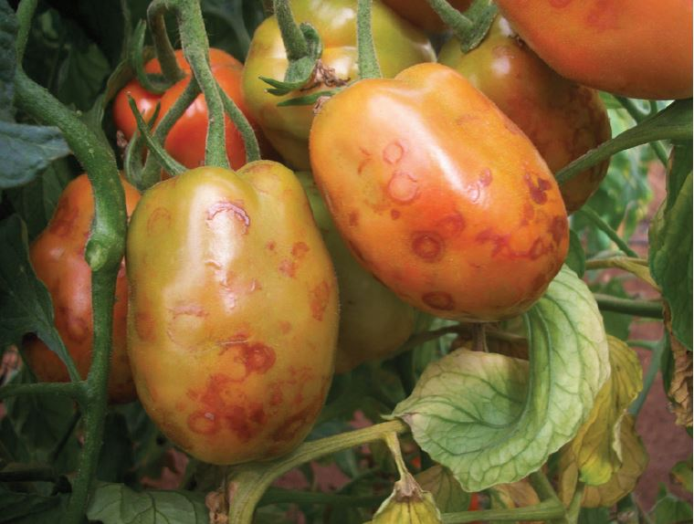
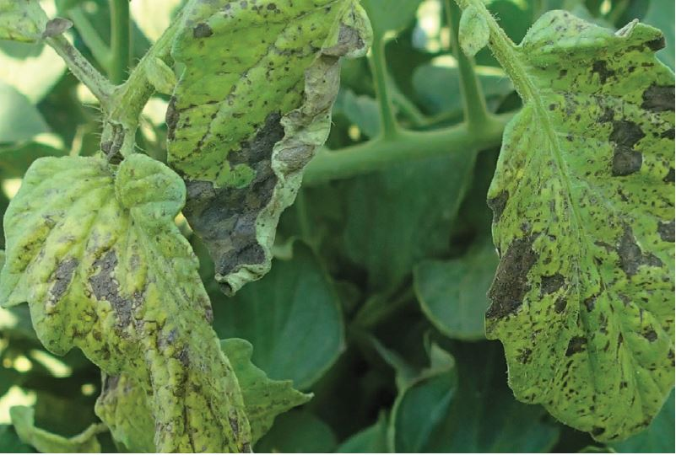
Tomato Spotted Wilt Virus (TSWV)
Tomato Spotted Wilt Virus is a serious viral disease of tomatoes spread by thrips. Early detection and thrips control are essential to reduce the spread and impact of TSWV. Infected plants cannot be cured and must be removed.
Symptoms
Leaves: Bronzing, curling, necrotic spots and streaks
Stems: Dark streaks, lesions, and possible wilting
Fruit: Pale red or yellow patches, ringspots, and deformities
Plant Growth: Stunting and reduced fruit quality/yield
Management and Prevention
Monitor thrips using yellow sticky traps
Install fine-mesh netting in glasshouses
Remove infected plants immediately
Maintain weed-free growing areas and surrounding borders
Regularly inspect crops after planting
Use resistant tomato varieties where available

Slide 28
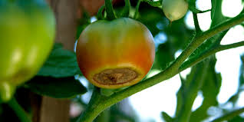
Physiological Disorders
Blossom end rot is a physiological disorder caused by calcium deficiency in developing fruit, usually linked to inconsistent watering or plant stress. It is not an infectious disease.
Symptoms
Sunken black or brown patch on the blossom end of fruit
Affected area becomes leathery and dry
Common during rapid fruit growth
Causes
Poor calcium movement within the plant
Uneven watering or fluctuating soil moisture
Temperature and plant stress
Excess nitrogen fertiliser
Management and Prevention
Maintain consistent soil moisture
Use balanced nutrient management with calcium sources
Remove affected fruit to encourage healthy new growth

Slide 29
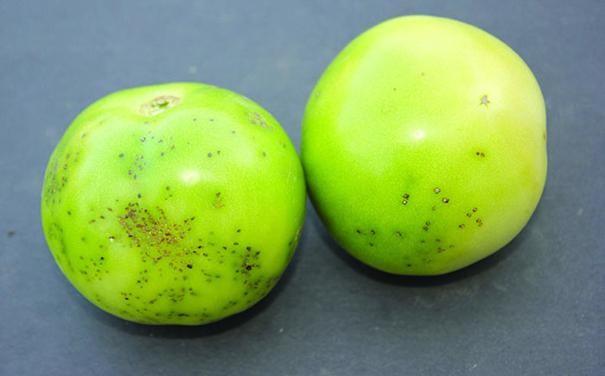
Pest and Disease Management and Control
Field Grown Tomatoes

Slide 30
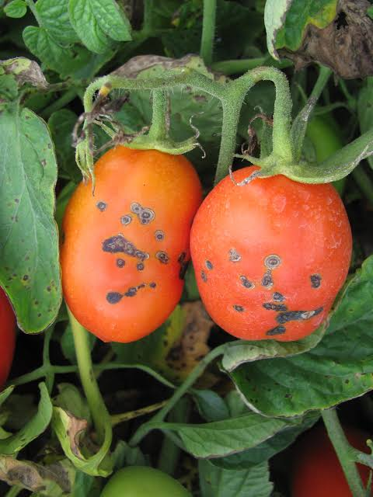
Main pests and diseases in field grown tomatoes
Major pests
Tomato-Potato Psyllid (TPP)
Tomato fruit worm
Minor pest
Thrips
Diseases
Bacterial speck
Alternaria (early Blight)
Late blight

Slide 31
Tomato Potato Psyllid (TPP)
(Bactericera cockerelli)
A small jumping insect (about 3 mm long).
First found in New Zealand in 2006.
Feeds by sucking sap from tomato plants.
Symptoms
Yellow, curled leaves.
Purple leaf colouring.
Poor plant growth (psyllid yellows).
Impact on tomatoes
Spreads bacteria that can damage plant health.
Reduces crop growth and yield.
Can lower tomato quality for processing.
Control
Monitor crops regularly.
Control weeds and remove infected plants.
Use approved insecticides when needed.

Slide 32
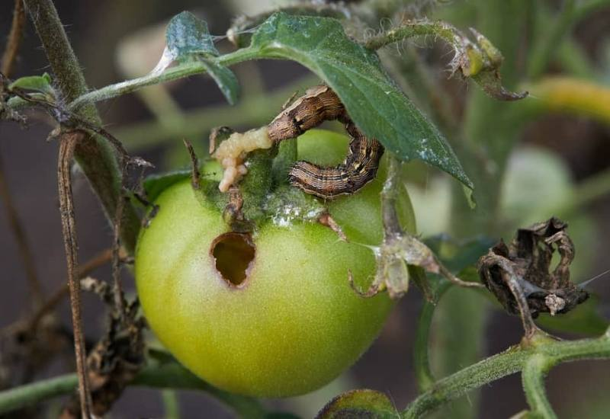
Tomato Fruit Worm
(Helicoverpa armigera conferta)
A major insect pest of field-grown tomatoes in New Zealand.
The damaging stage is the caterpillar (larva), which feeds on leaves and fruit.
Damage
Bores holes into tomatoes, usually near the stem end.
Feeding damage allows bacteria and moisture to enter, causing fruit rot.
Damaged fruit may be rejected for processing.
Can cause leaf chewing and damage to new growth.
Control
Monitor crops regularly to detect caterpillars early.
Use biological controls such as Bt (Bacillus thuringiensis) where suitable.
Apply approved insecticides when pest numbers reach damaging levels.
Follow integrated pest management (IPM) practices to protect beneficial insects.

Slide 33
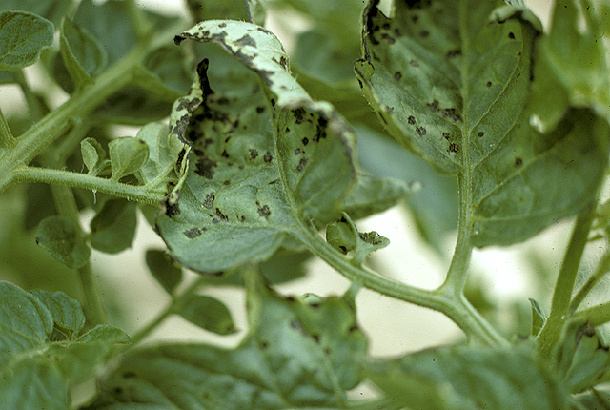
Bacterial speck of tomato
Pseudomonas syringae pv.
Caused by the bacterium Pseudomonas syringae pv. tomato.
Most common in cool, wet weather (13–24°C), especially during spring and autumn.
Symptoms
Small black or brown spots on leaves with bright yellow halos.
Severe infections can cause leaves to turn yellow and fall off.
Tiny black, slightly sunken specks (less than 2 mm wide) on fruit.
Fruit spots remain shallow and do not penetrate deeply into the flesh.
Spread
Through infected seed.
Rain and overhead irrigation splash bacteria from plant to plant.
Survives over winter in crop debris and soil.
Management and control
Rotate crops every 3–4 years.
Plant certified disease-free seed.
Apply approved copper sprays when necessary to reduce disease spread.

Slide 34
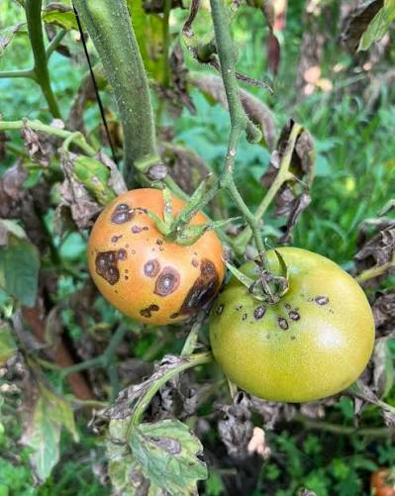
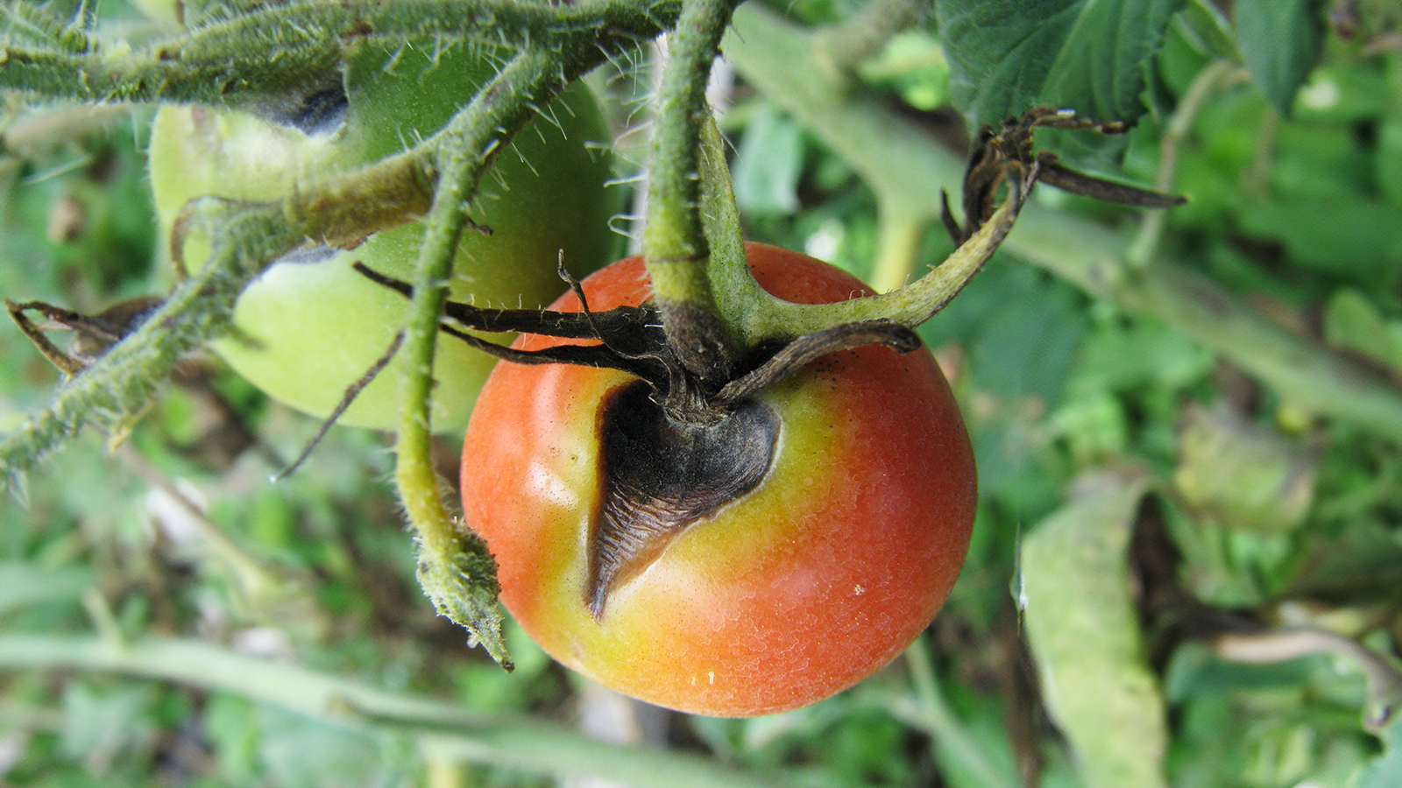
Alternaria (Early Blight)
Alternaria solani or Alternaria tomatophila
Caused by fungi Alternaria solani and Alternaria tomatophila.
Favours warm, humid conditions.
Symptoms
Dark brown circular spots on older lower leaves.
Spots form a “target” ring pattern with yellow halos.
Dark, sunken patches can appear on stems and fruit.
Spread
Spores survive in plant debris and soil.
Spread by wind, rain, and irrigation water.
Control and Management
Rotate crops (avoid tomatoes / potatoes for 2–3 years).
Improve airflow through good plant spacing.
Use approved fungicides when needed.

Slide 35
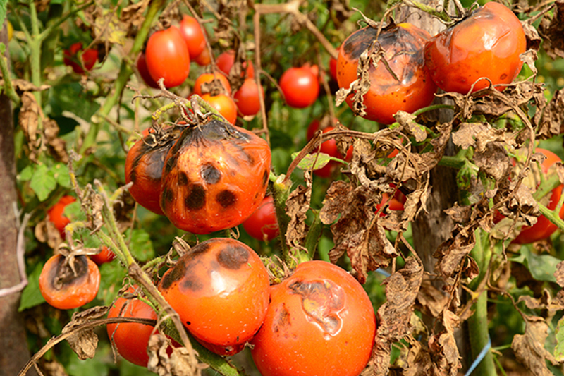
Late blight
Phytophthora infestans
Caused by fungi Phytophthora infestans.
Spreads quickly in cool, wet weather.
Can destroy a tomato crop within a few days.
Symptoms
Large, dark brown or grey patches on leaves.
White, fuzzy growth may appear underneath leaves in damp conditions.
Dark brown or black streaks and lesions on stems.
Large brown patches on fruit that become firm, leathery, and rot.
Spreads
Airborne spores carried by wind.
Rain and water splashes spread the disease.
Survives on infected tomato and potato plants.
Management and control
Apply approved fungicides (such as copper-based products) before the disease spreads.
Improve airflow by spacing
Rotate crops and avoid planting tomatoes near potatoes or other related crops.

Slide 36
Biosecurity incursions
There have been many cases of biosecurity incursions in New Zealand horticulture.
Some incursions have resulted in pest eradication, while others have not been eradicated.
These examples highlight the importance of good biosecurity management and being vigilant. Practicing good biosecurity management reduces the risk of pest or disease establishment and potential spread, that could threaten crop and vegetable production in New Zealand.

Slide 37
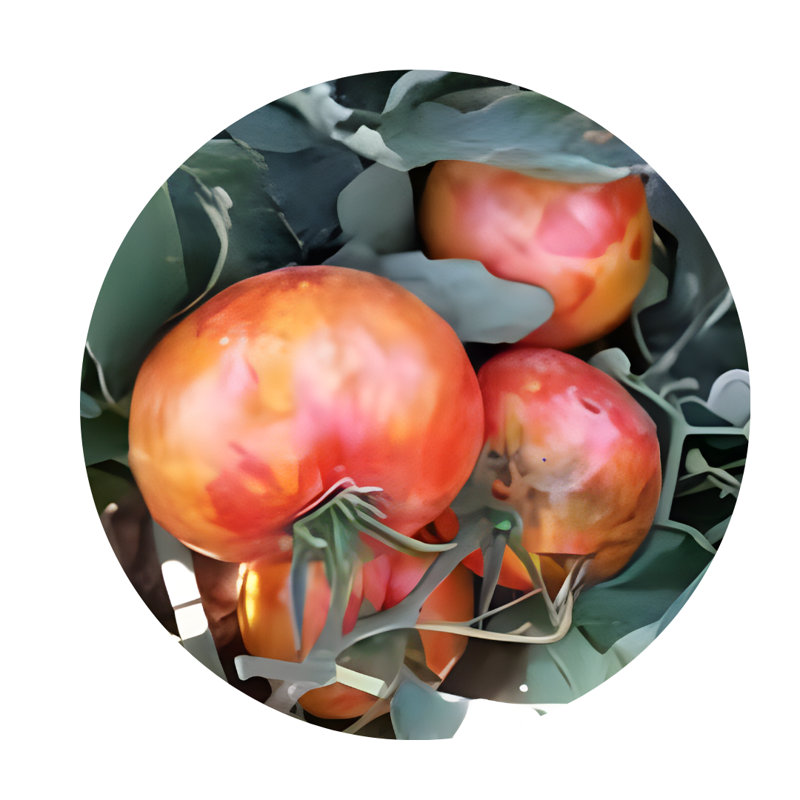
Tomato BROWN RUGOSE FRUIT VIRUS (ToBRFV)
Not In NZ
ToBRFV is a highly contagious plant virus affecting tomatoes, capsicums, and other solanaceous crops. It is a major global biosecurity concern and is closely monitored to reduce the risk of entry into New Zealand horticulture.
Symptoms
Mosaic patterns and distortion on leaves
Brown, rough, wrinkled patches on fruit
Reduced fruit quality and marketability
Plant growth may become stunted
Spread
Easily spread through contaminated tools, hands, clothing, seed, and plant material
Highly persistent and difficult to eradicate once introduced

Slide 38
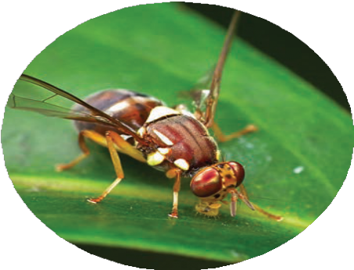
QUEENSLAND FRUIT FLY
(Bactrocera tryoni)
Not In NZ
The Queensland fruit fly is one of Australia’s most destructive horticultural pests and would pose a major risk to New Zealand’s fruit and vegetable industries if established
Why important
Many New Zealand fruit and vegetable crops are highly susceptible
Could cause major crop losses and fruit damage
Would result in loss of access to important export markets
Hundreds of millions of dollars to eradicate or control
Damage caused
Adult flies lay eggs beneath the fruit skin
Eggs hatch into larvae within 2–3 days
Larvae feed inside the fruit for 10–31 days
Feeding causes fruit breakdown and rotting
Preventing the establishment of fruit flies is critical for protecting New Zealand horticulture and export trade.

Slide 39
Impacts of biosecurity incursions on growers
Increased cost of production: control and eradication of pest and diseases once found on a property is a costly exercise.
Significant loss of yield: pest and diseases can stunt crop growth or decimate harvestable crop.
Loss of sell-able crop: a pest or disease outbreak could leave a crop unfit for human consumption.
Loss of access to markets: outbreaks of pest and diseases in New Zealand can limit international market access for not only the crop in question but also for potential host crops.
Loss of right to grow crops: in some cases, pest eradication will be attempted by banning the production of crops in a certain area. See the Pea weevil case study as an example.

Slide 40
Activity 8:
Biosecurity risk challenge
Scenario: A Queensland Fruit fly has been found.
Divide class into the following groups
  Growers
  Government
  Supermarkets or Processors
  Scientists
  Consumers
Each group explains:
What they are worried about?
What should happen next?

Slide 41
Video resources
Revitalising IPM in greenhouse tomatoes https://www.youtube.com/watch?v=mJ2Es-GDUsk&list=PLyWjTzcyS3kuOPeQllQIIqgubEoBbvVAG&index=1
Tips on dealing with spot pest https://www.youtube.com/watch?v=LGHbVJ7vW78&list=PLyWjTzcyS3kuOPeQllQIIqgubEoBbvVAG&index=2
How to Scout https://www.youtube.com/watch?v=its2VWumx00&list=PLyWjTzcyS3kuOPeQllQIIqgubEoBbvVAG&index=3
How to use Engytatus: https://www.youtube.com/watch?v=K3FMGFJm-zo&list=PLyWjTzcyS3kuOPeQllQIIqgubEoBbvVAG&index=4
TomatoesNZ Whitefly control as part of an IPM for greenhouse tomatoes https://www.youtube.com/watch?v=ofNIAH-b-8k&list=PLyWjTzcyS3kuOPeQllQIIqgubEoBbvVAG&index

Slide 42
References
Tomatoes NZ
https://www.tomatoesnz.co.nz/biosecurity/endemic-pest-fact-sheet/

