Slide 1


Slide 2
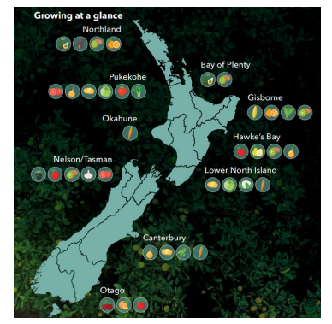
Topic 2
Location of Commercial
Vegetable Production in New Zealand
Activities

Slide 3
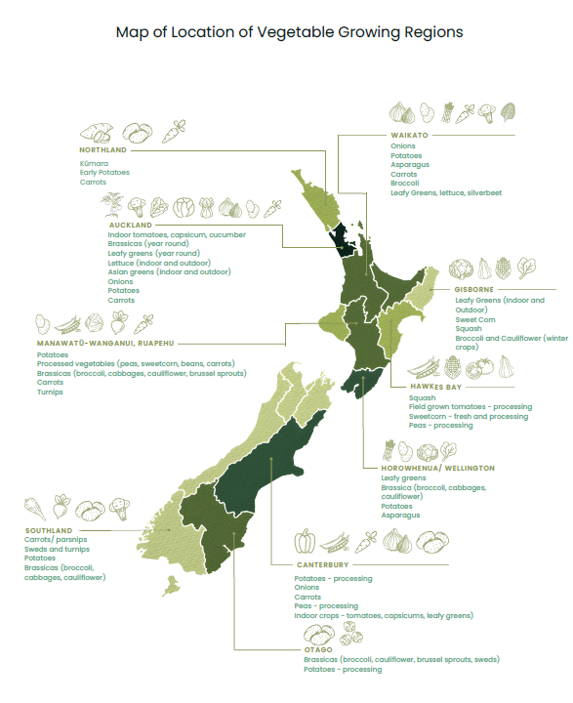

Slide 4
Activity 1: Vegetable growing regions.
Name the main vegetable crops grown in;
Northland
Pukekohe
Gisborne
Horowhenua district
Canterbury
Southland
Discussion questions
Why do some vegetables grow better in specific regions?
What vegetables are grown commercially in our region?
Why are these vegetables grown here?
How do the vegetable crops grown in our region differ from another region.
Why do growers choose different crops to grow?
Discuss the advantages and risks of having vegetable production concentrated in certain areas.
Suggest ways to reduce risk if a region experiences a severe weather event or pest outbreak.

Slide 5
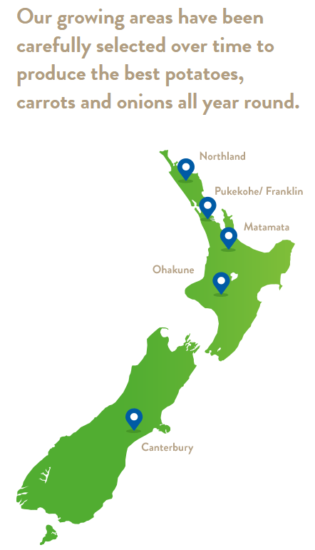
For your region
Wilcox
Write a list of vegetables grown commercially in your region.
Draw a star diagram of why these vegetables grow well in your region?

Slide 6
Activity 2:
Supply chain and year-round production analysis
Using the map to identify which regions produce specific vegetables during different months of the year.
Create a timeline or table that shows which regions produce specific vegetables during different months of the year.
Identify which vegetables rely heavily on glasshouse production and which rely on outdoor growing.
Discuss the following questions as a class or in small groups
How modern transport, refrigeration, and processing allow vegetables to reach domestic markets year-round.
The potential risks to supply if one key region is affected by extreme weather, pests, or disease.
In groups
Develop a strategy to improve food security for vegetables in New Zealand using the regional map as a reference.

