Slide 1


Slide 2
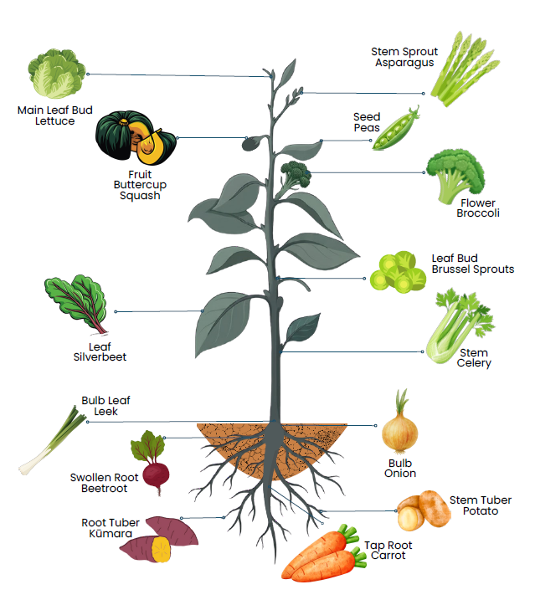
Classification of Vegetables
Parts we eat

Slide 3
Classification of Vegetables Activities
There are many ways to use slides or photos of vegetables in the classroom. Activities can be easily adapted to suit the age, experience, and learning needs of your students. These tasks are designed to build confidence in recognising and grouping vegetables.
Suggestions on how to use photos of vegetables: PowerPoint- Name these vegetables
Select photos of vegetables that are appropriate for the age group of your students. These can be printed off or used electronically. Using these images, students can engage in a range of learning activities:
Activity 2: Naming vegetables: Students name the vegetable.
Activity 3: Classifying by plant parts: Students group vegetables based on the part we eat.
Activity 4: Classifying by plant families: Students identify and group vegetables that belong to these families.
  Brassicaceae - Brassica family
  Solanaceae - Nightshade family
  Fabaceae - Legume
  Cucurbitaceae - Cucurbit family
  Amaryllidaceae - Allium family
Activity 5: AI Research
Activity 6: Dichotomous key: Students use a dichotomous key to name parts of the plant we eat.

Slide 4
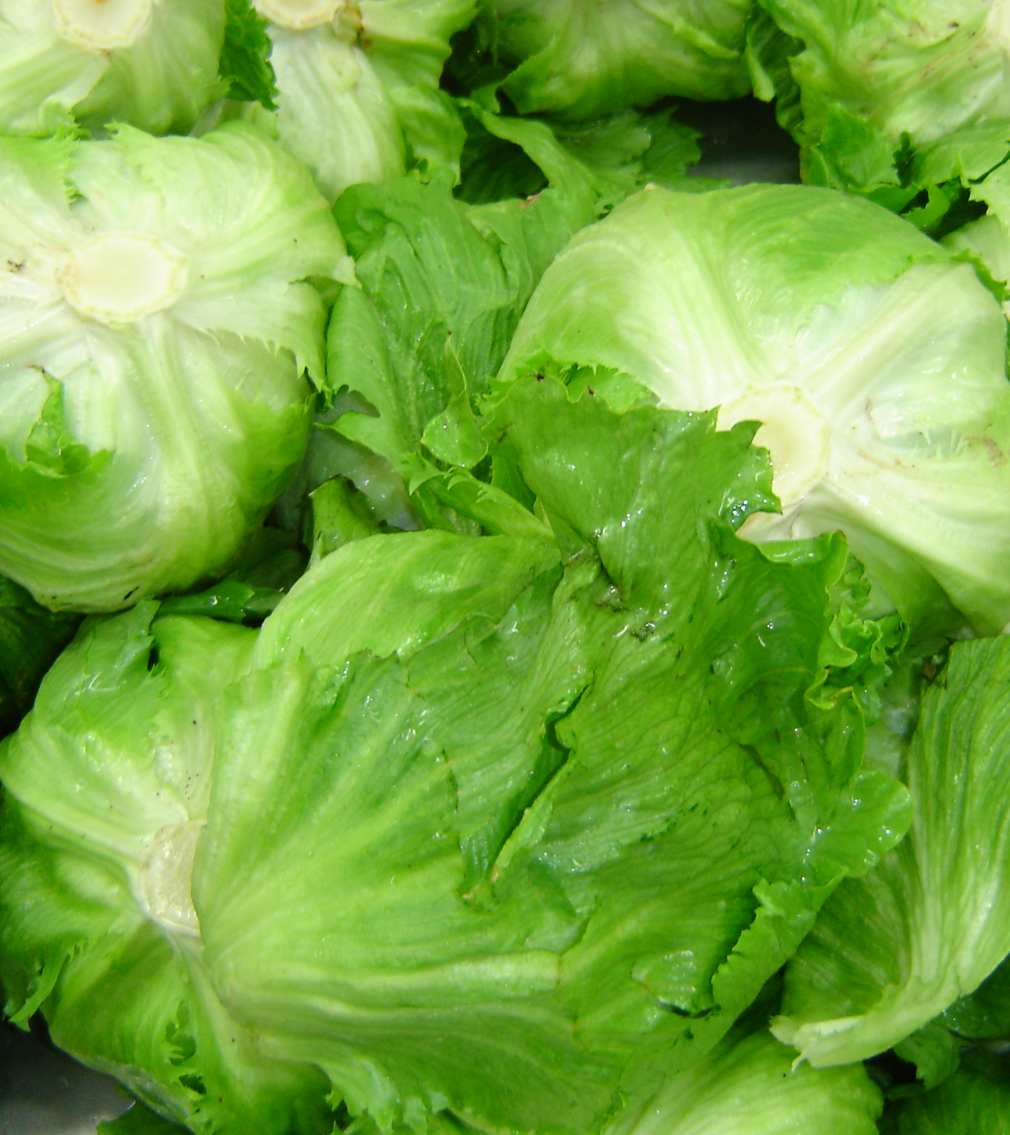
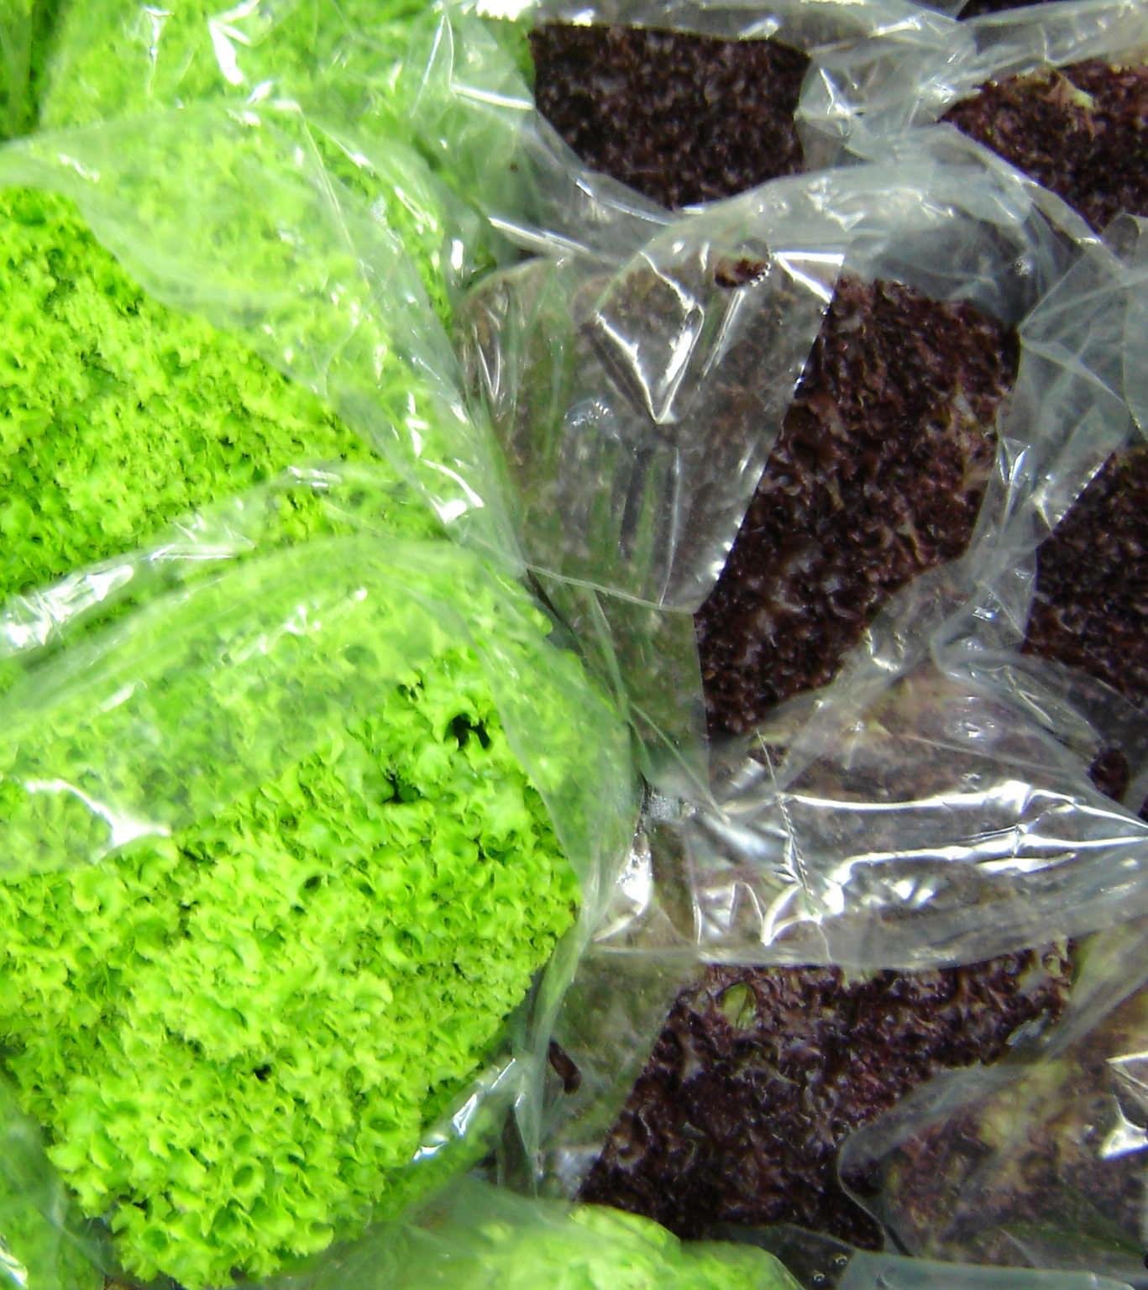

Slide 5
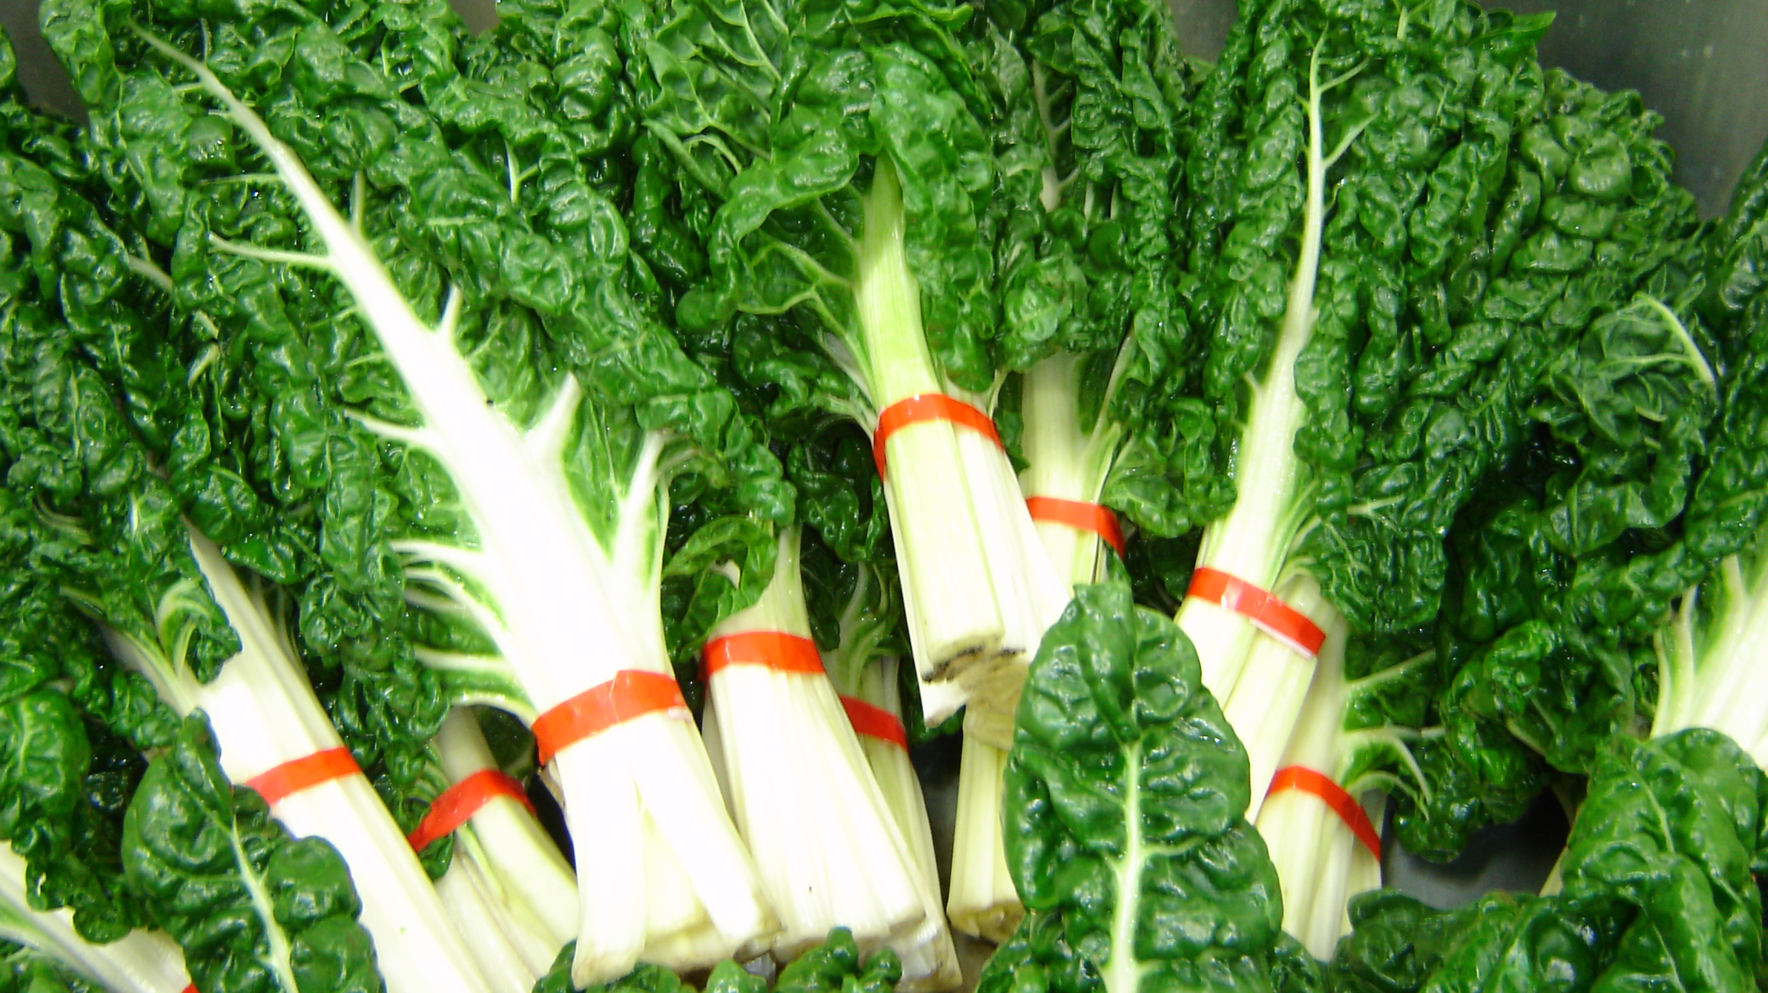

Slide 6
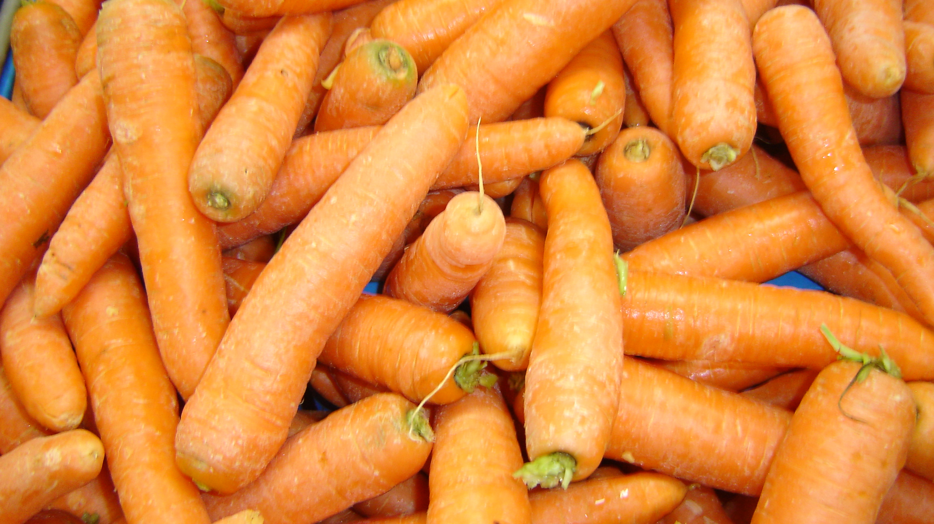

Slide 7
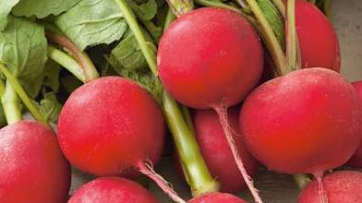

Slide 8
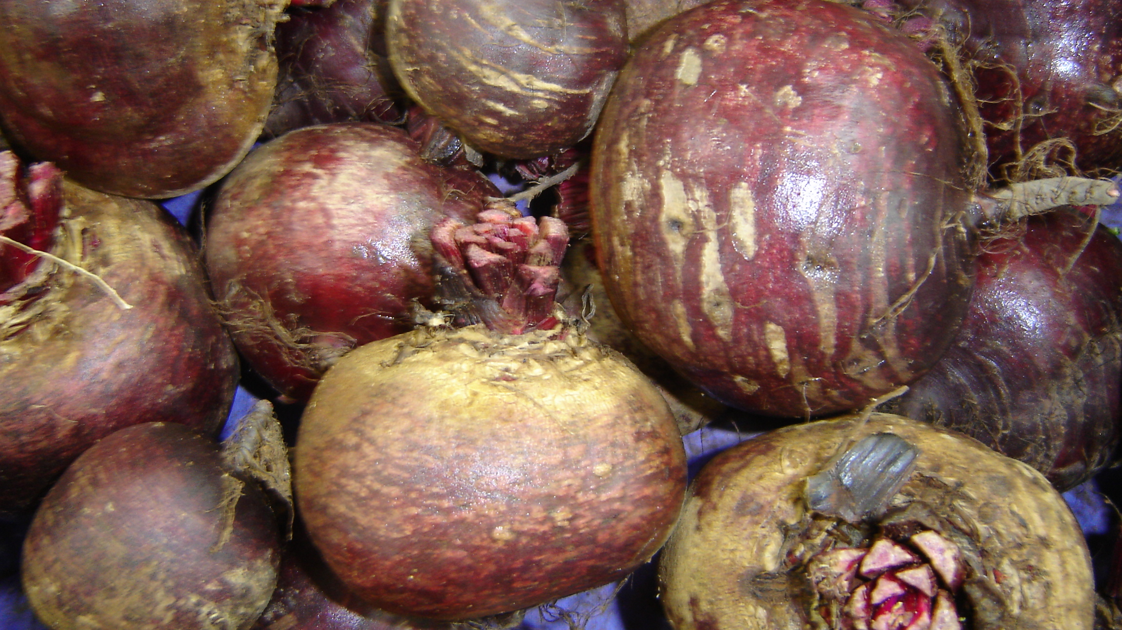

Slide 9
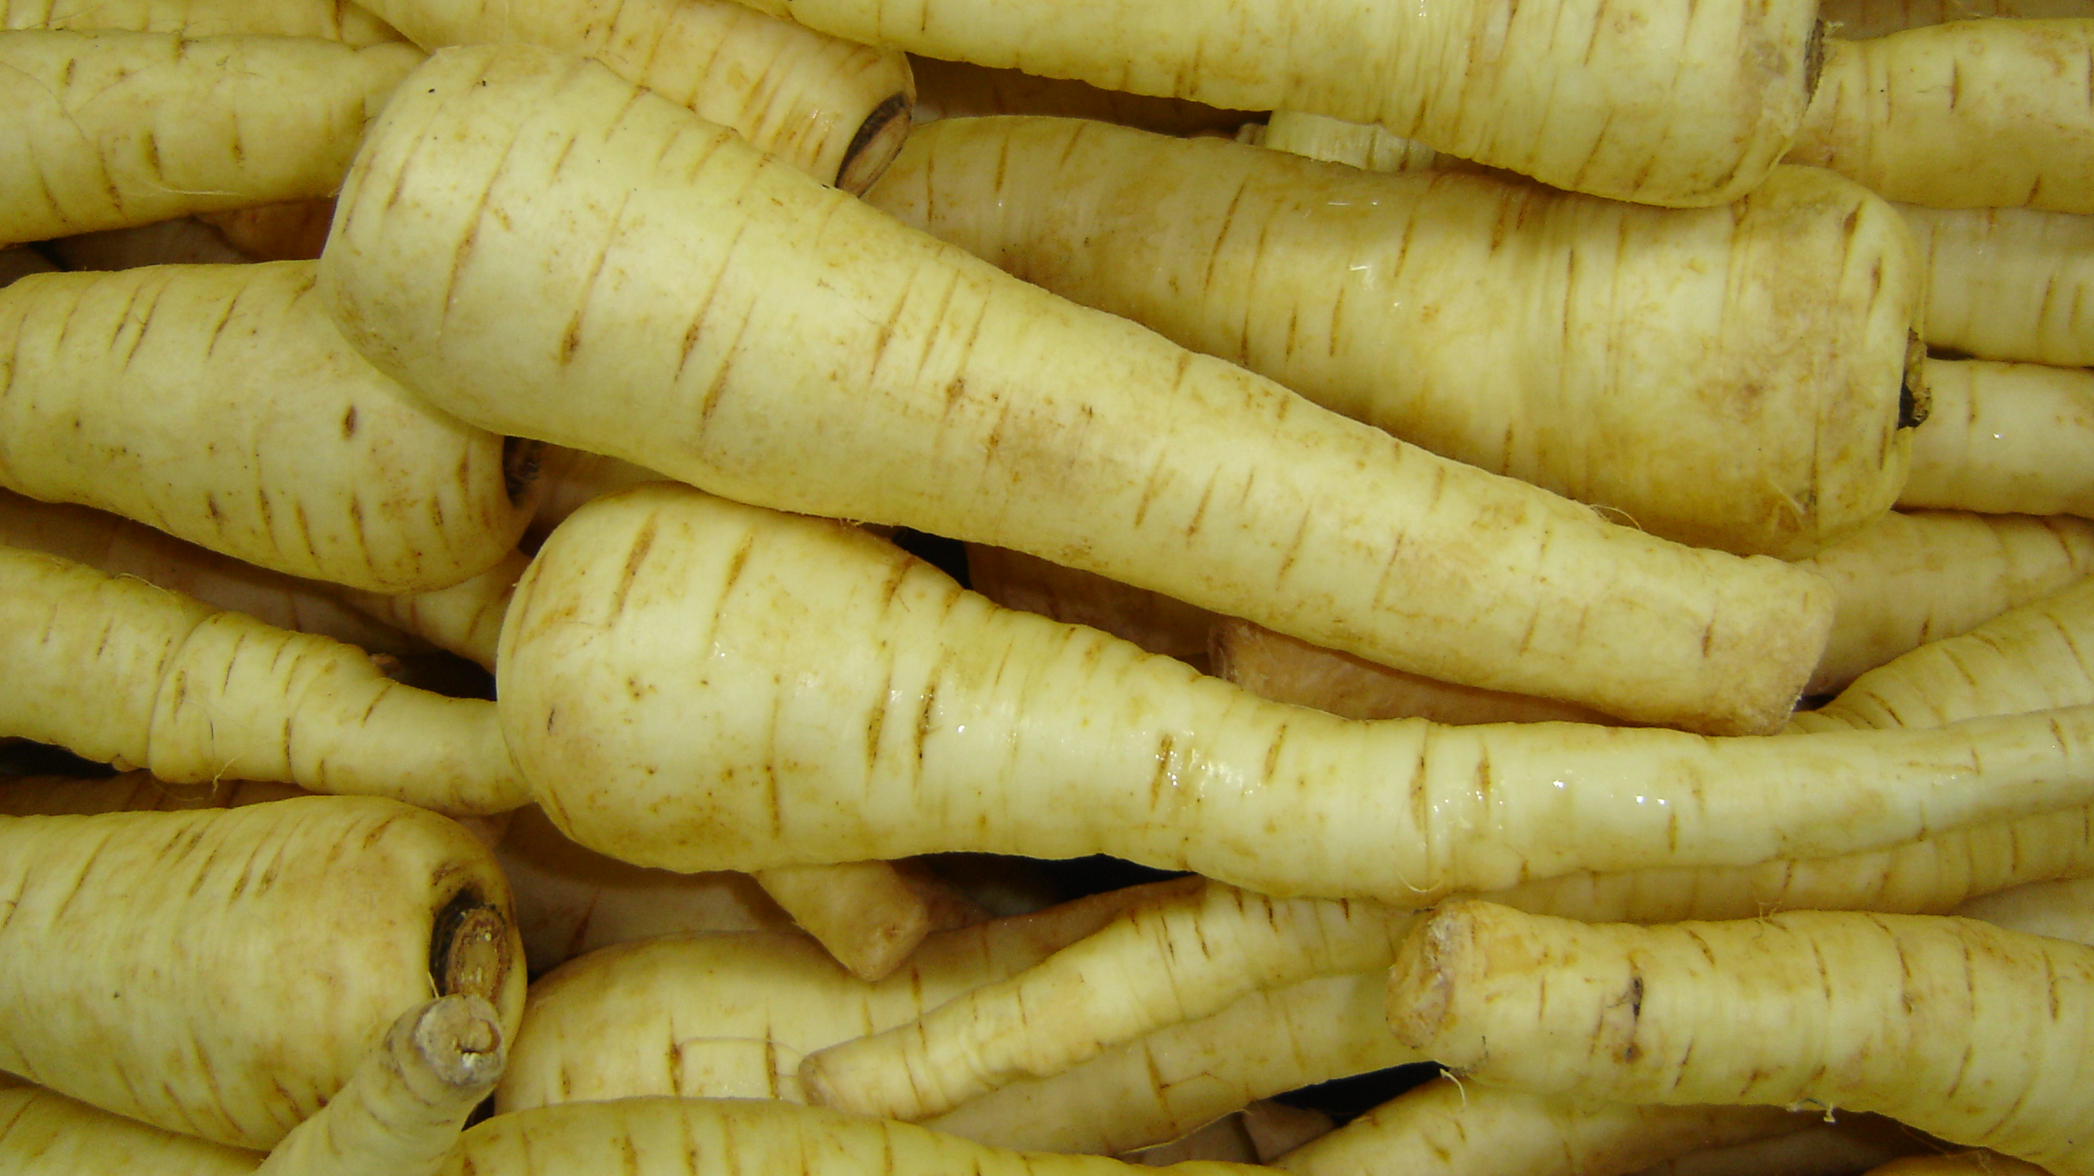

Slide 10
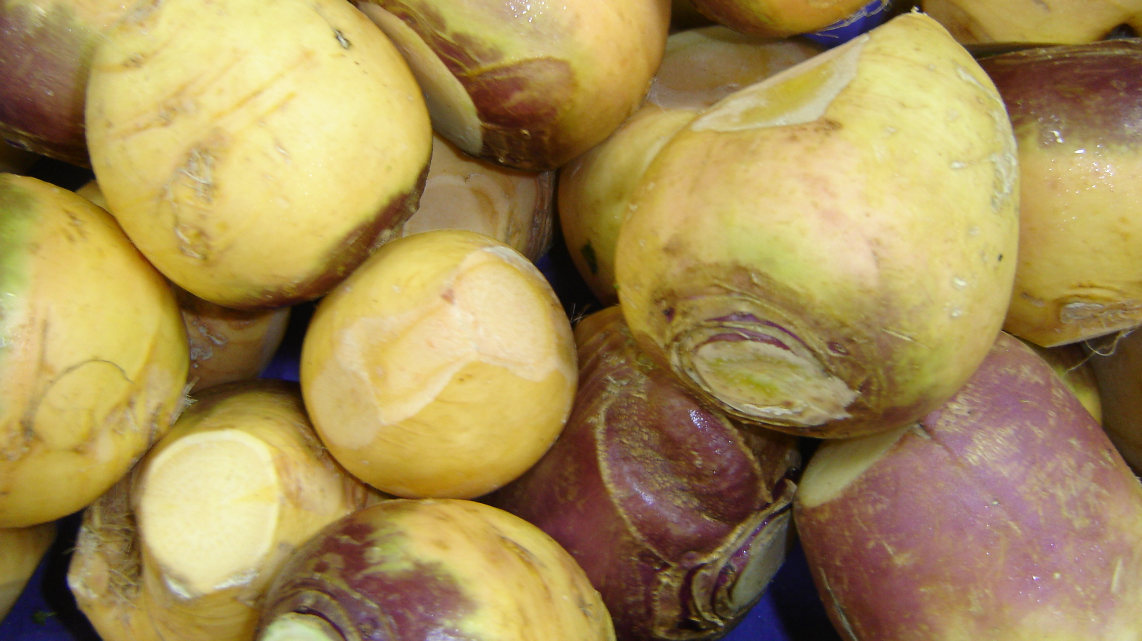

Slide 11
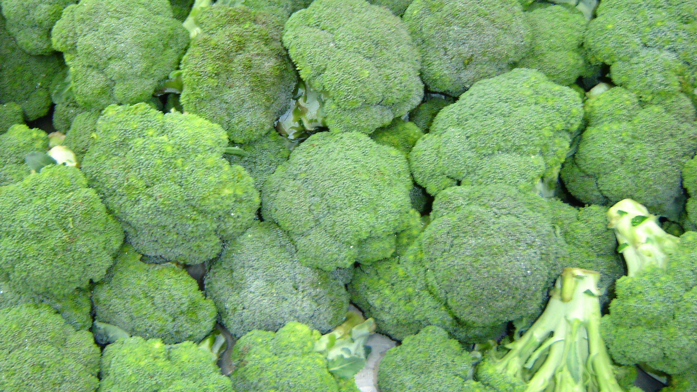

Slide 12
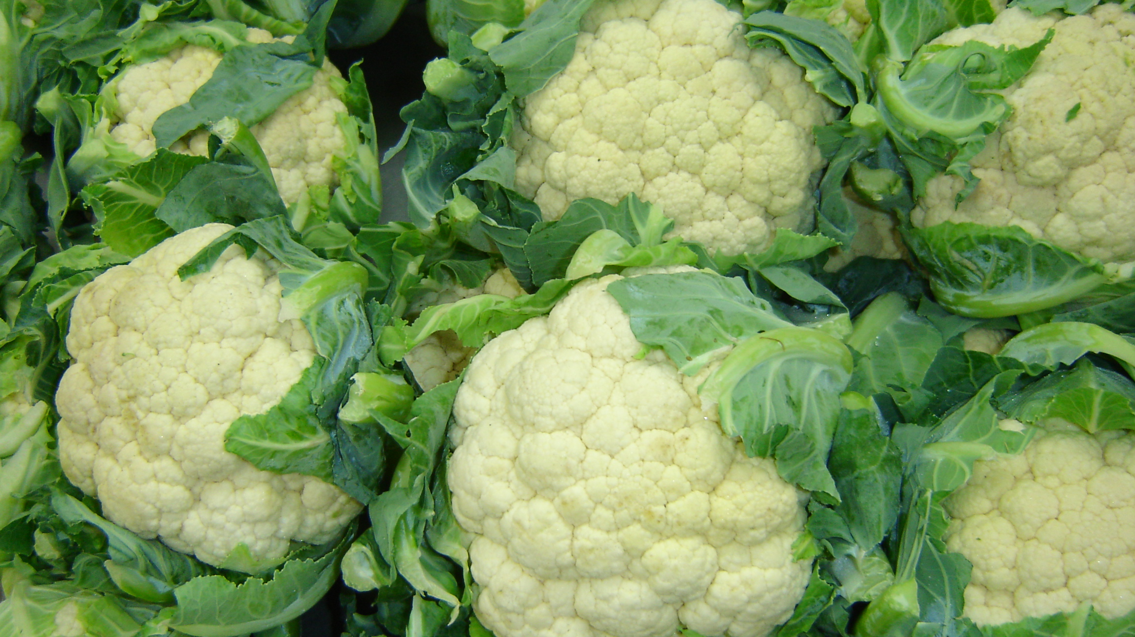

Slide 13
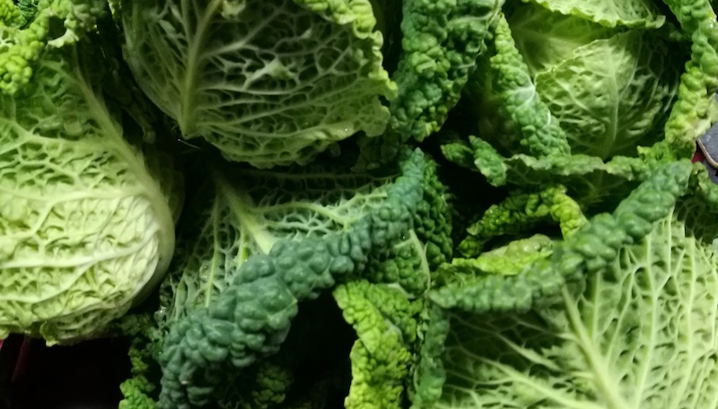
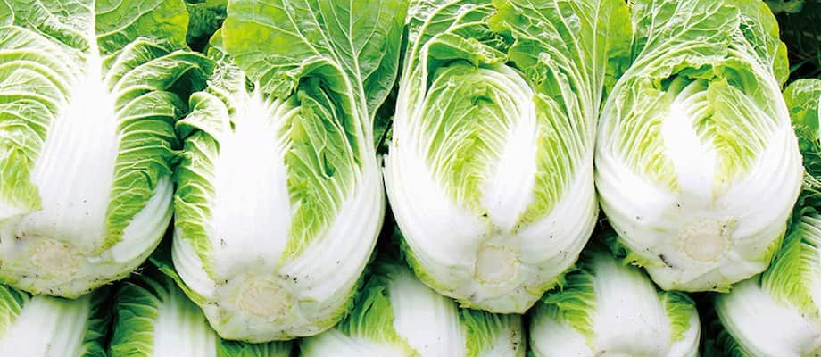
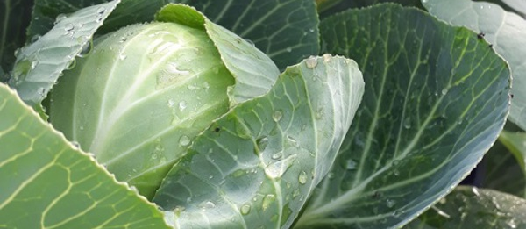
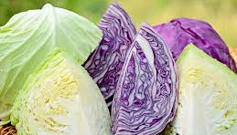

Slide 14
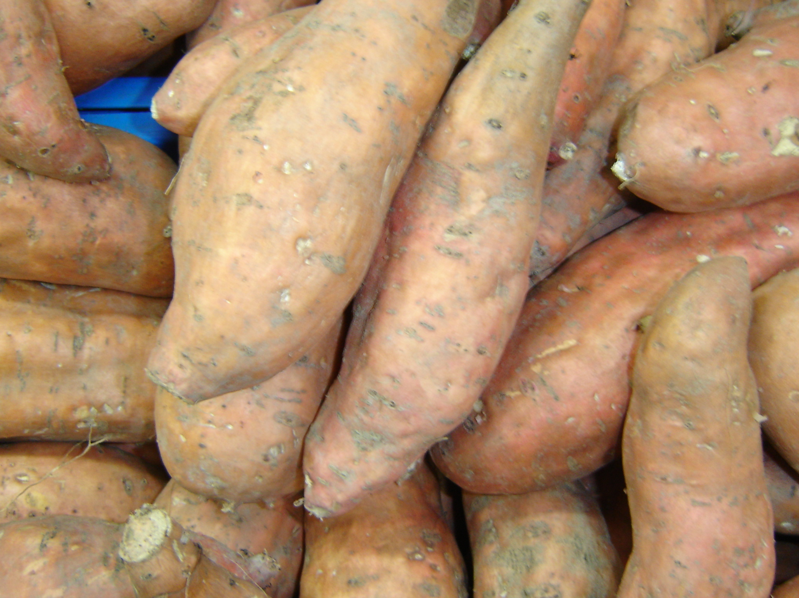
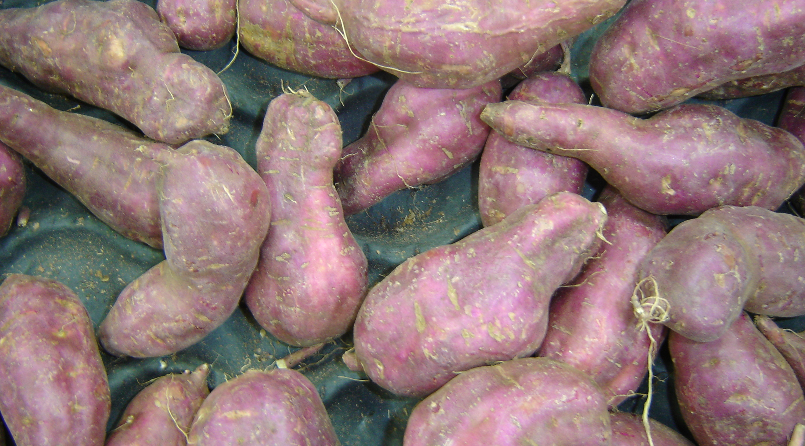
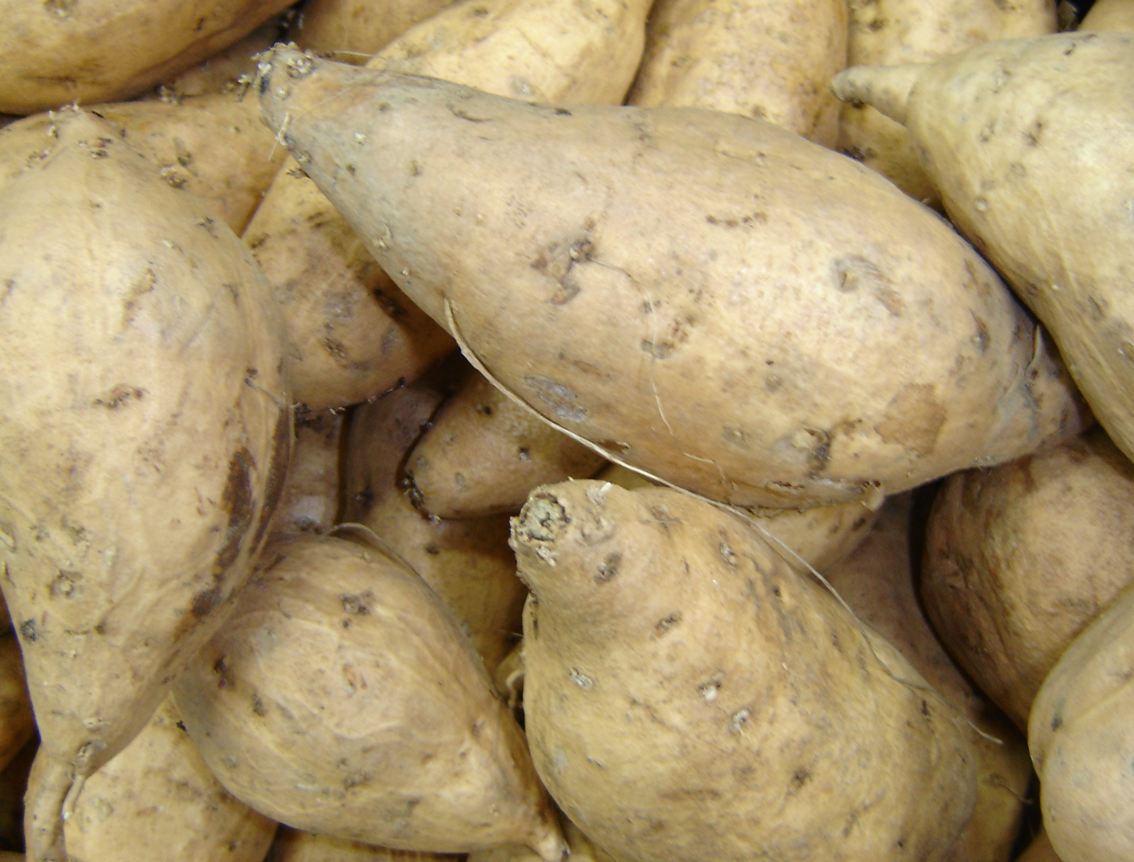

Slide 15
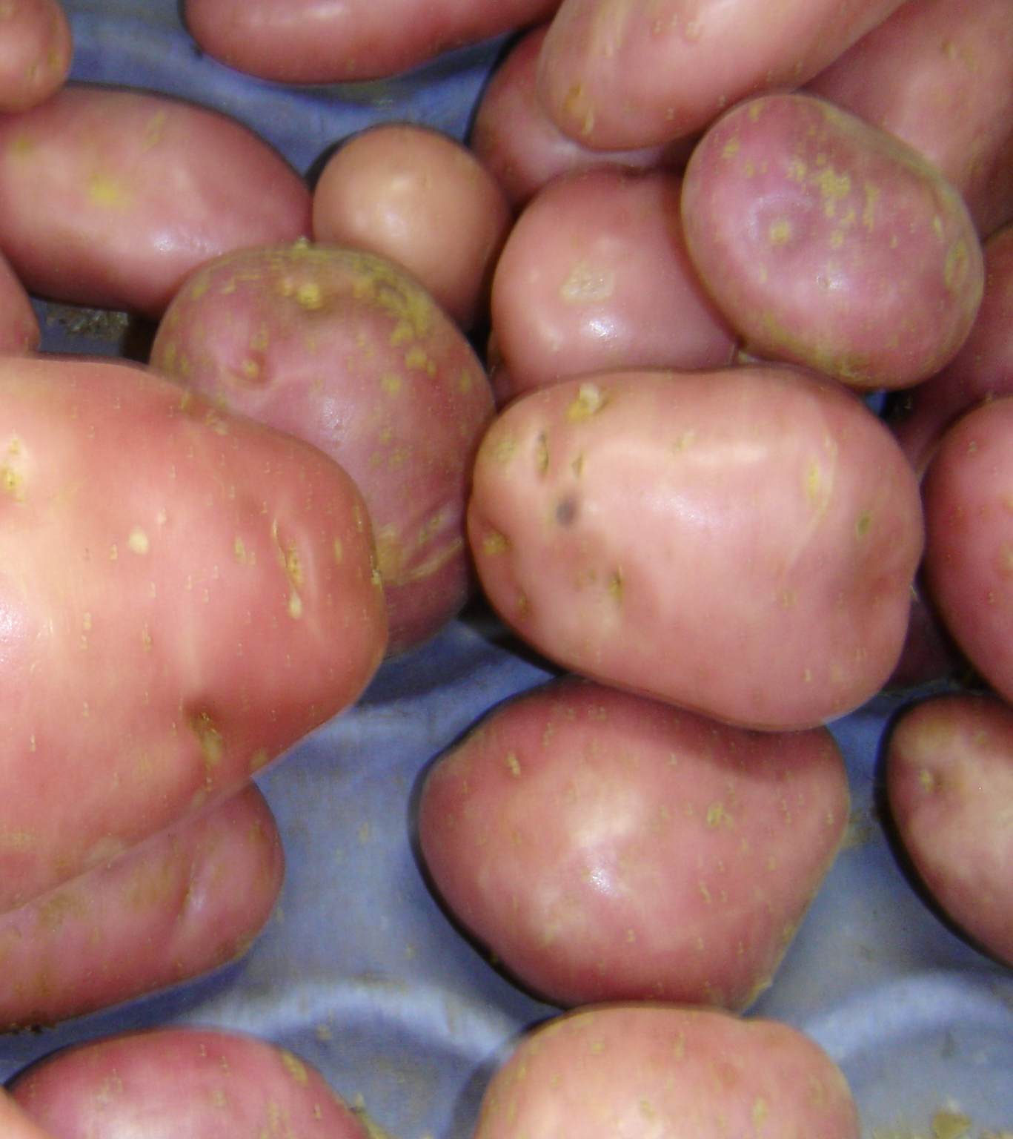
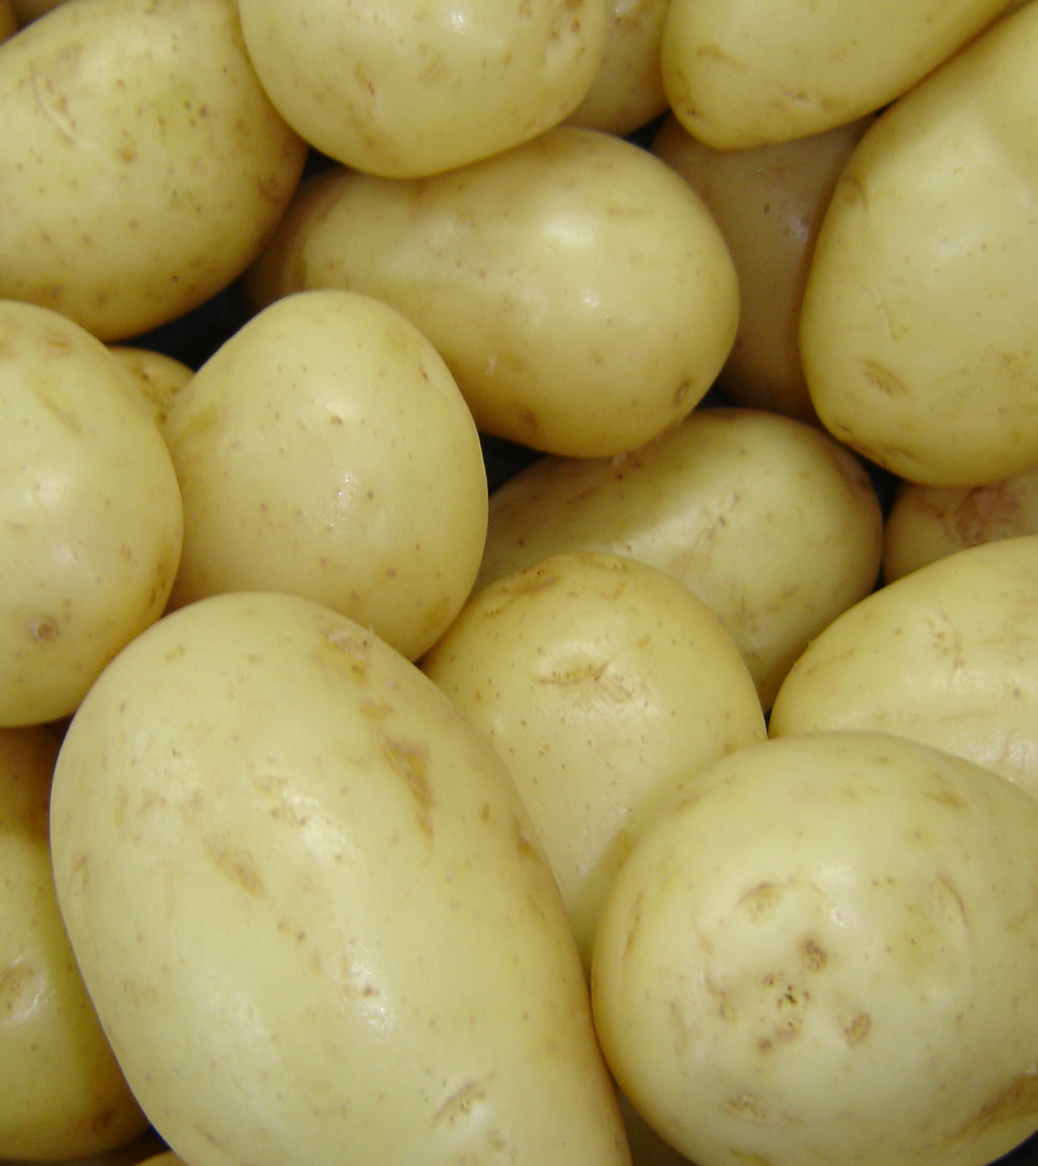

Slide 16
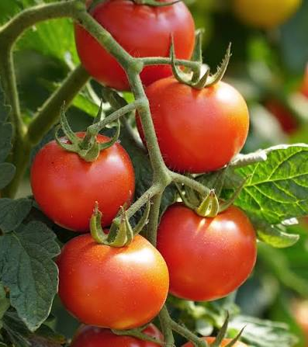
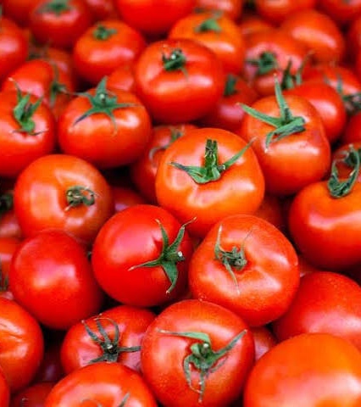

Slide 17
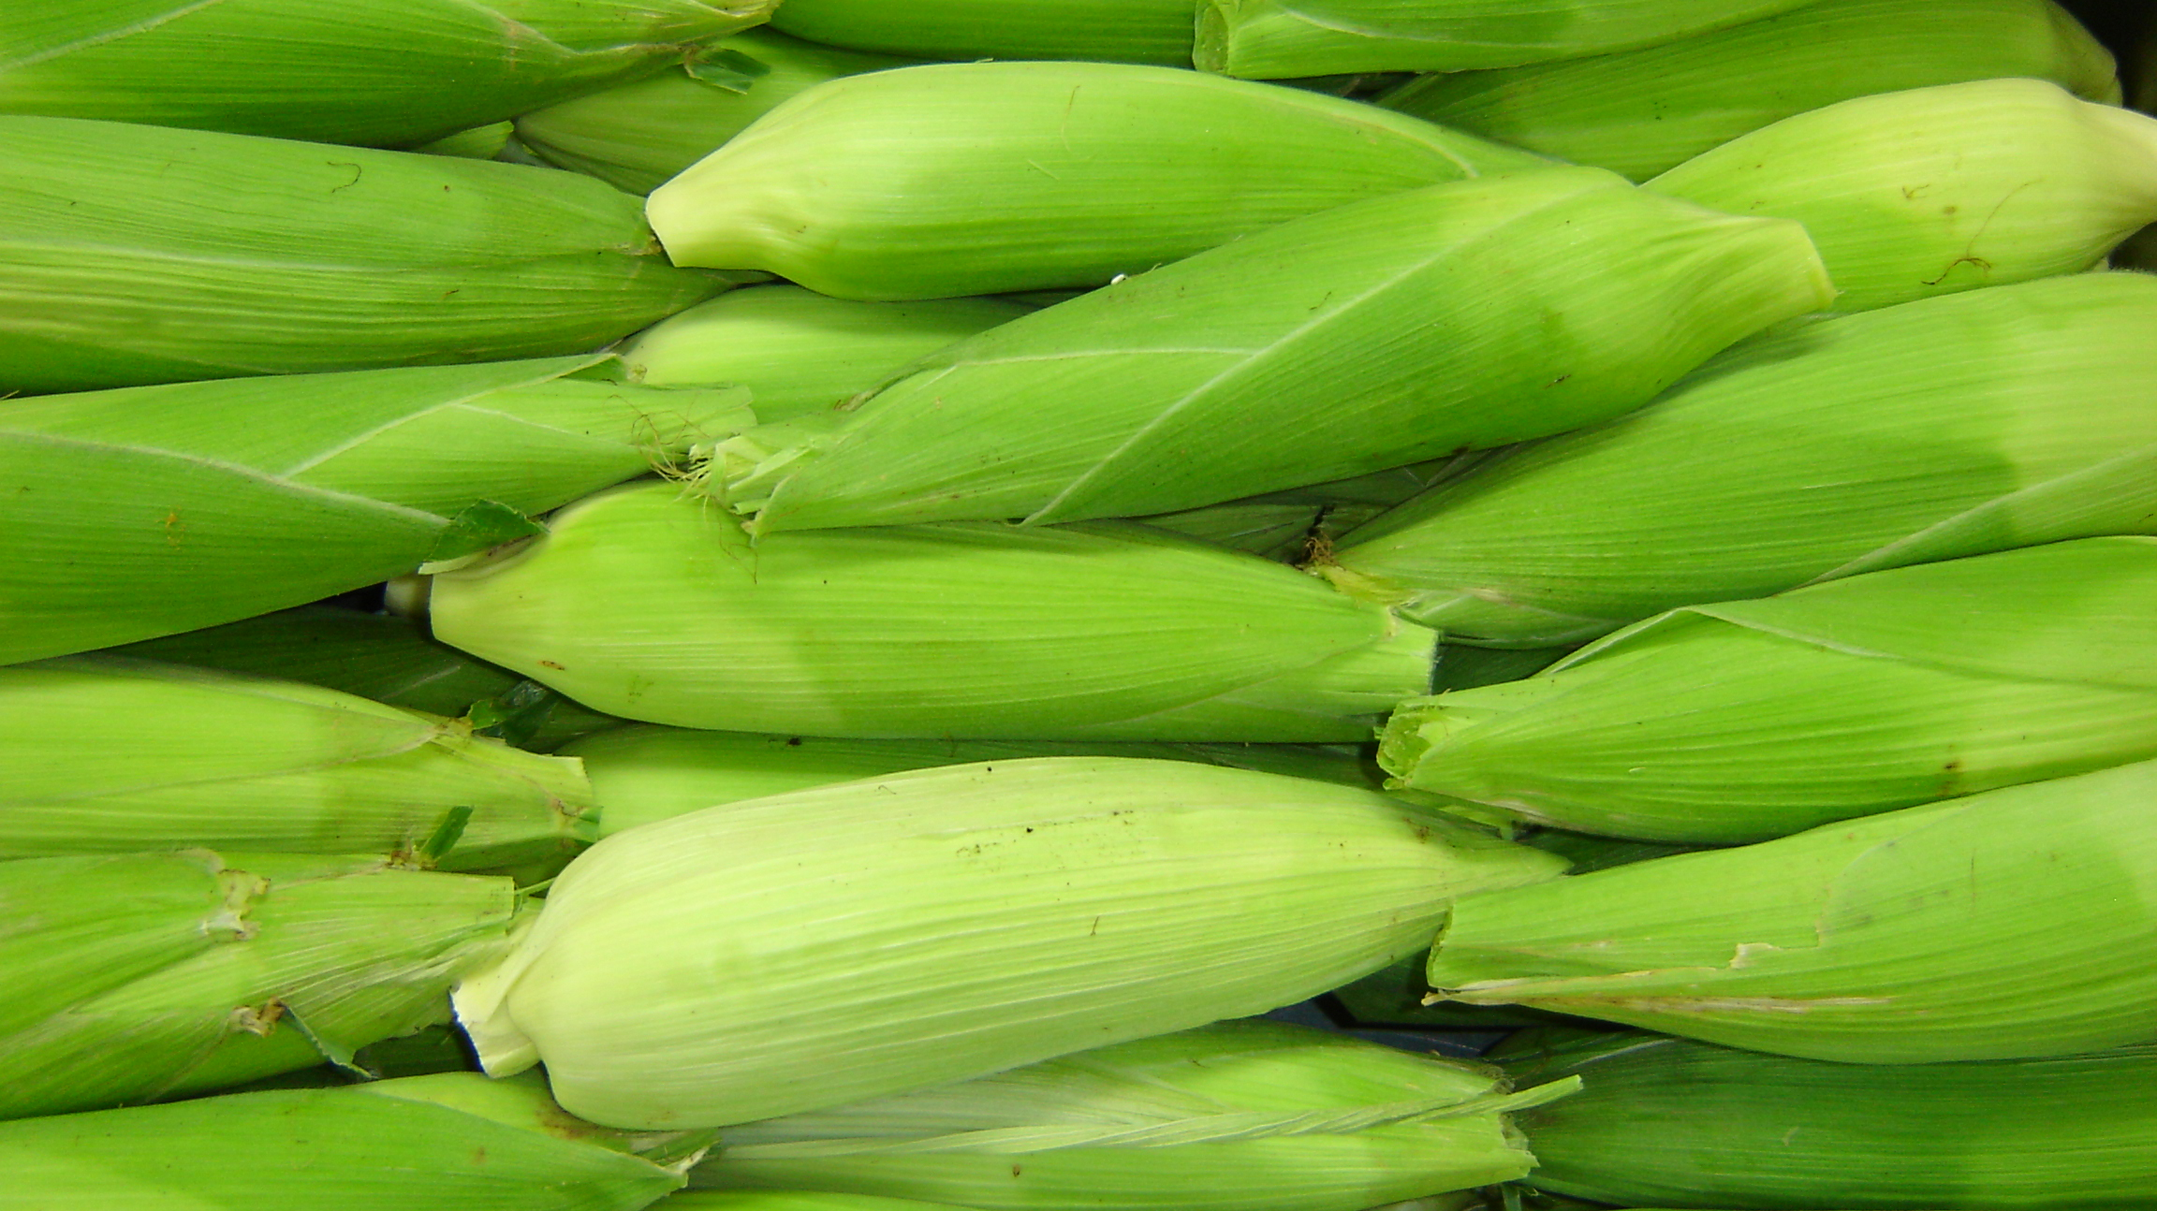

Slide 18
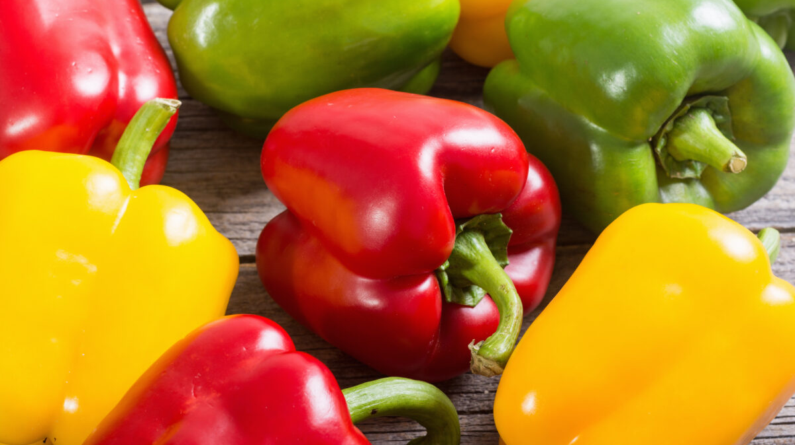

Slide 19
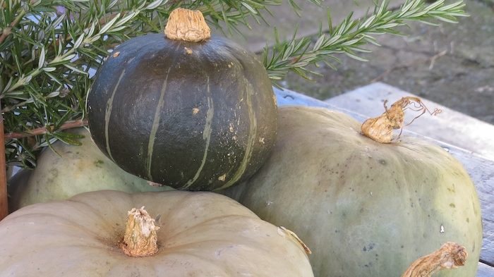

Slide 20
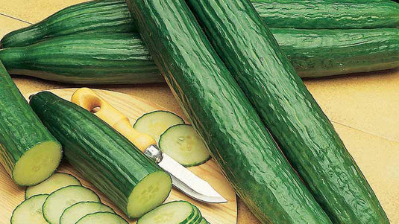

Slide 21
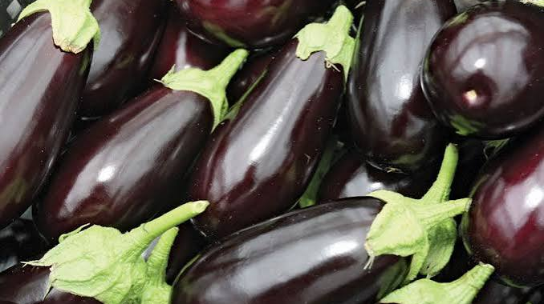

Slide 22
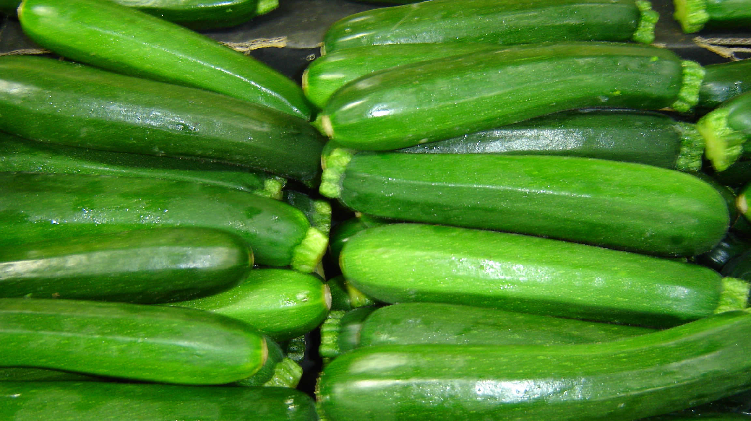

Slide 23
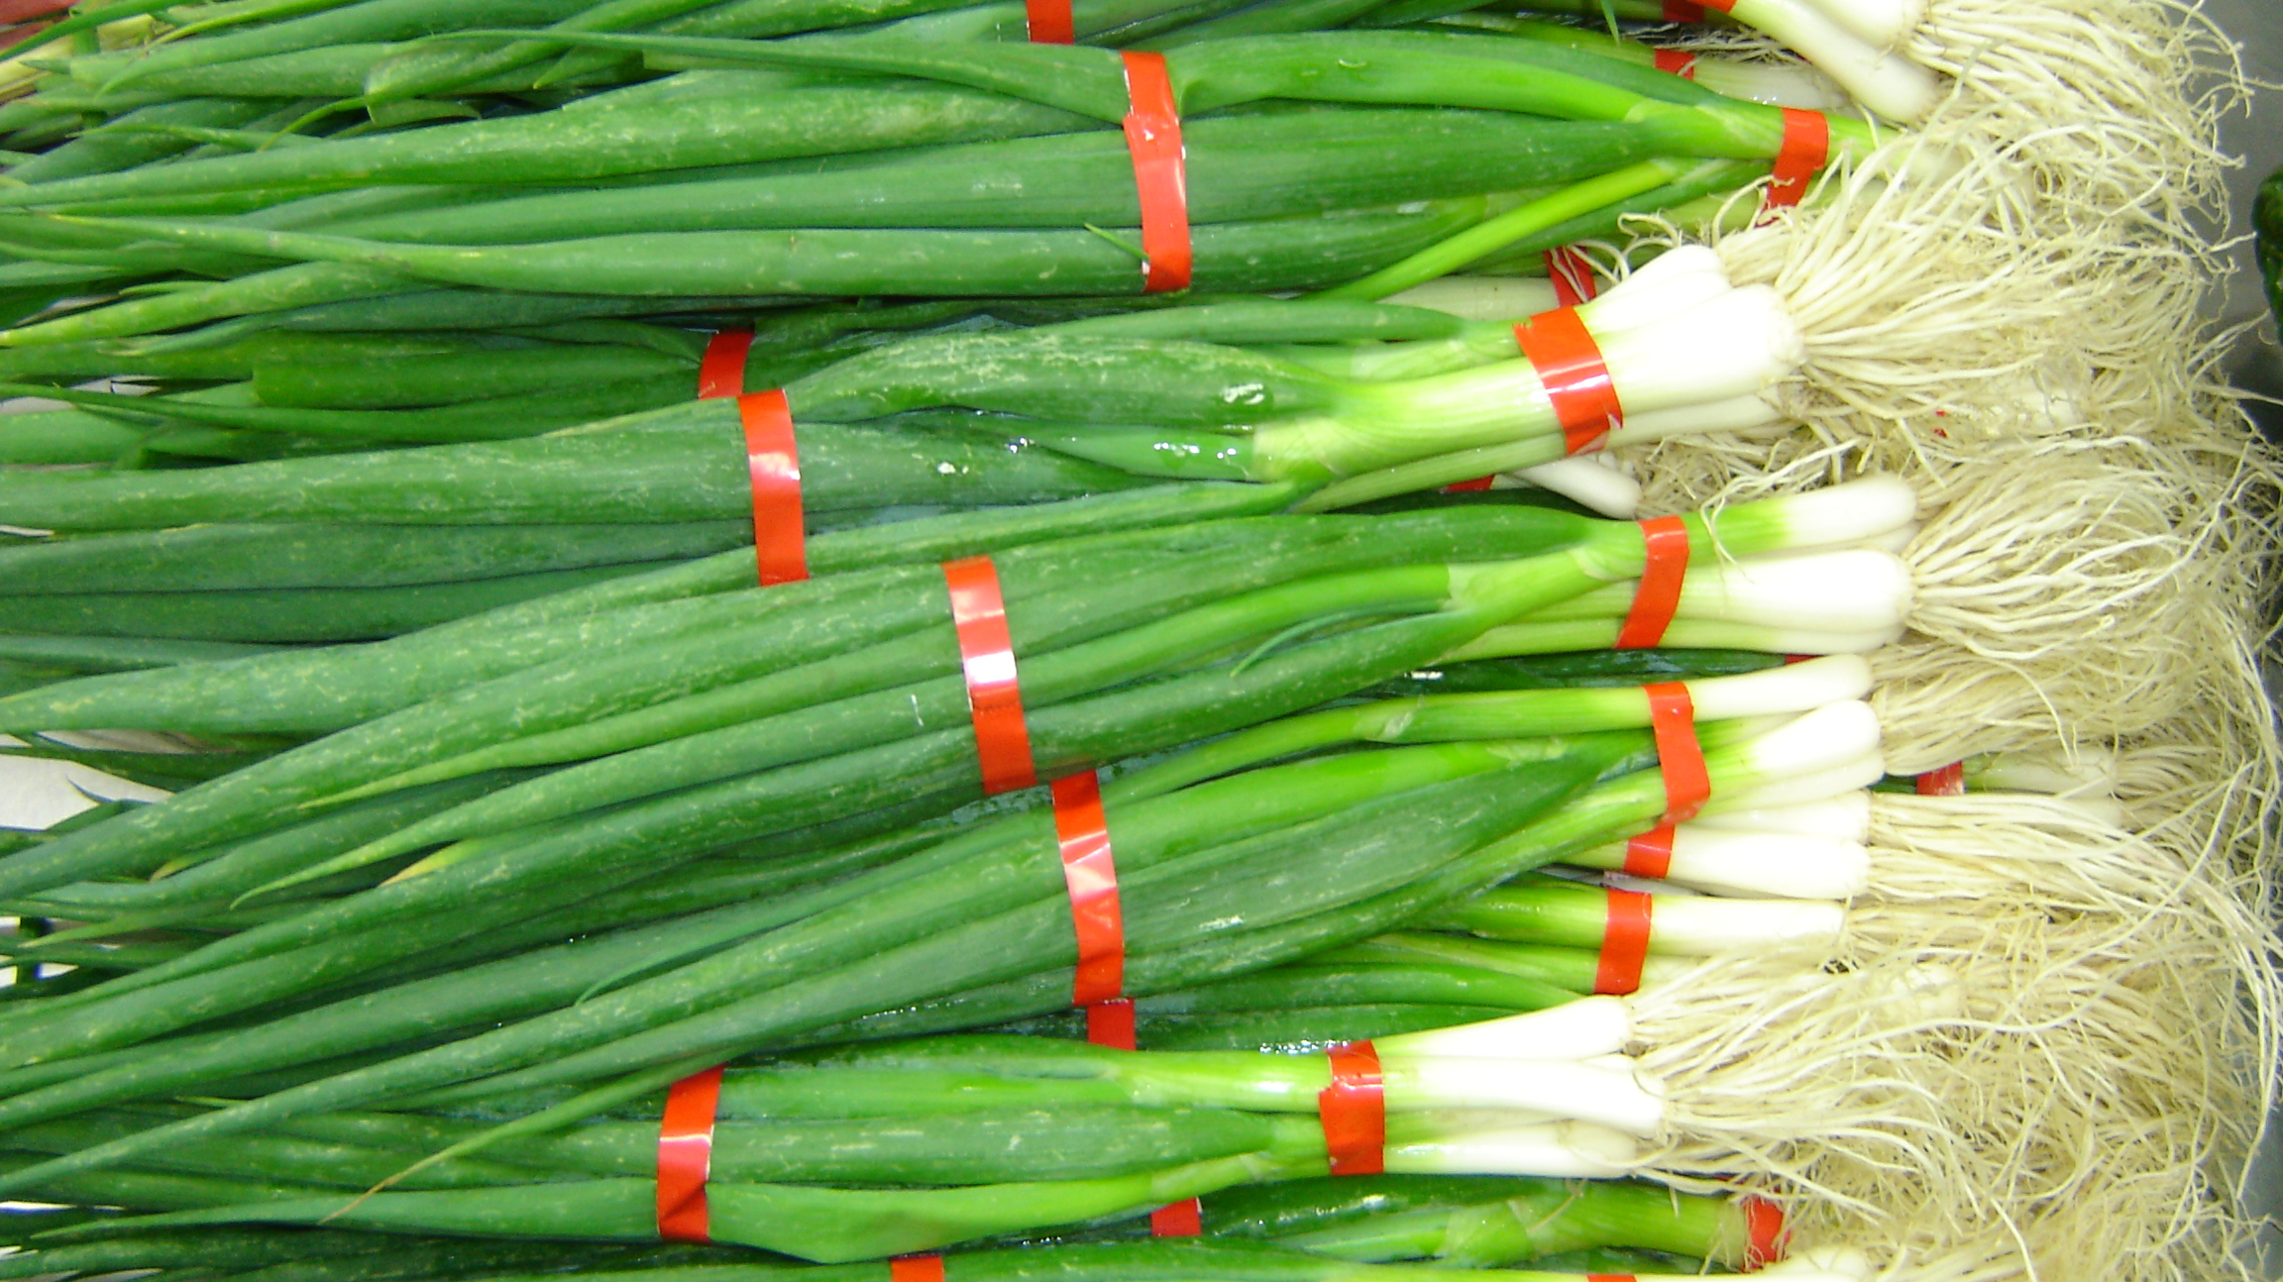

Slide 24
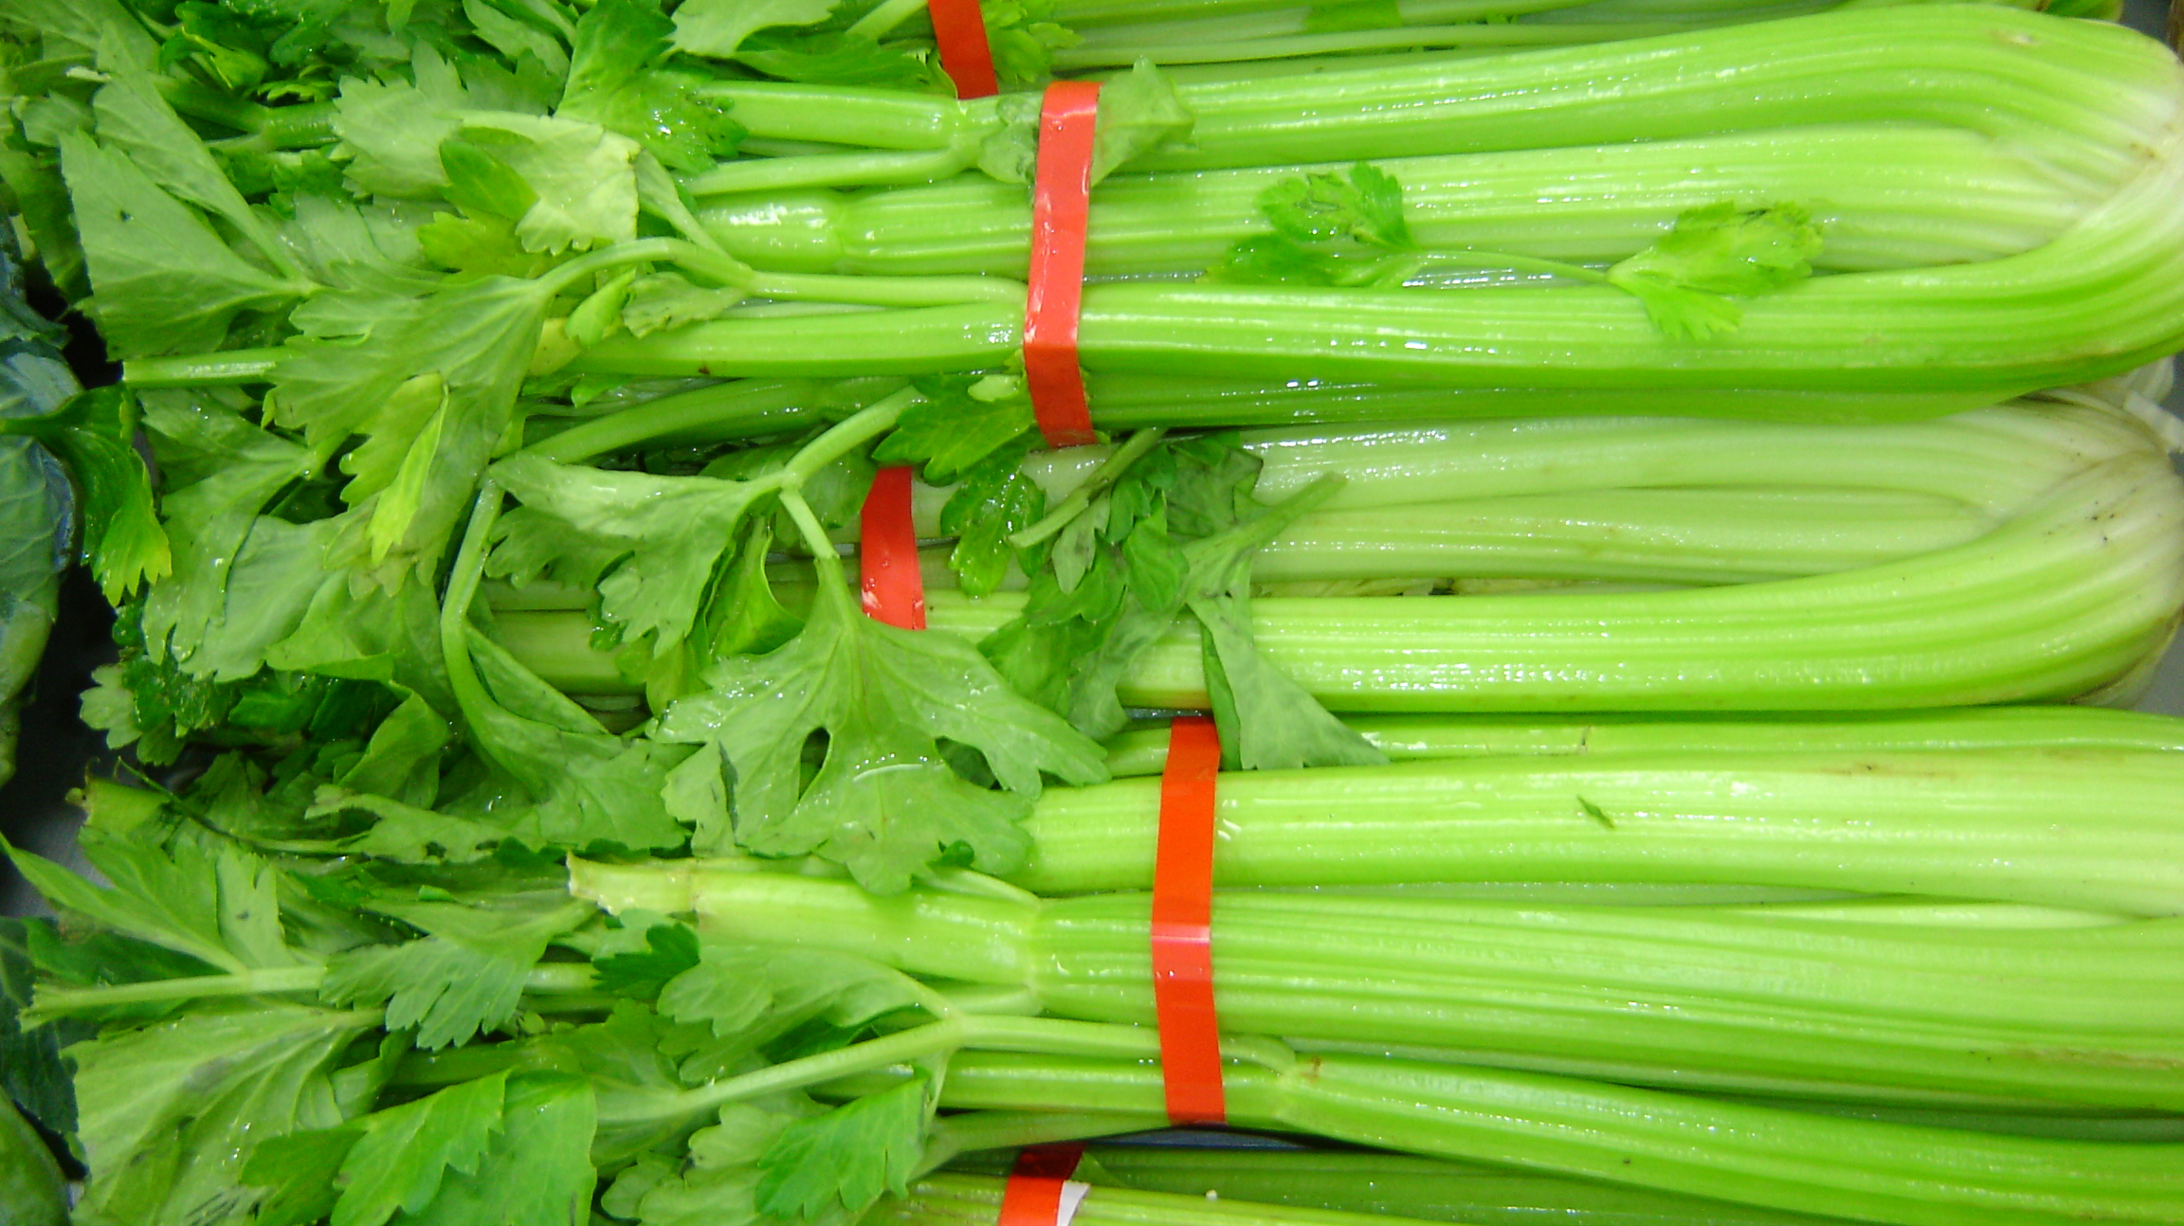

Slide 25
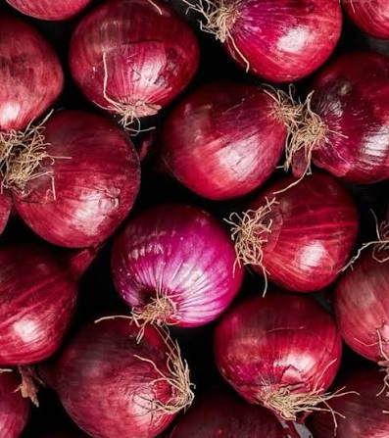
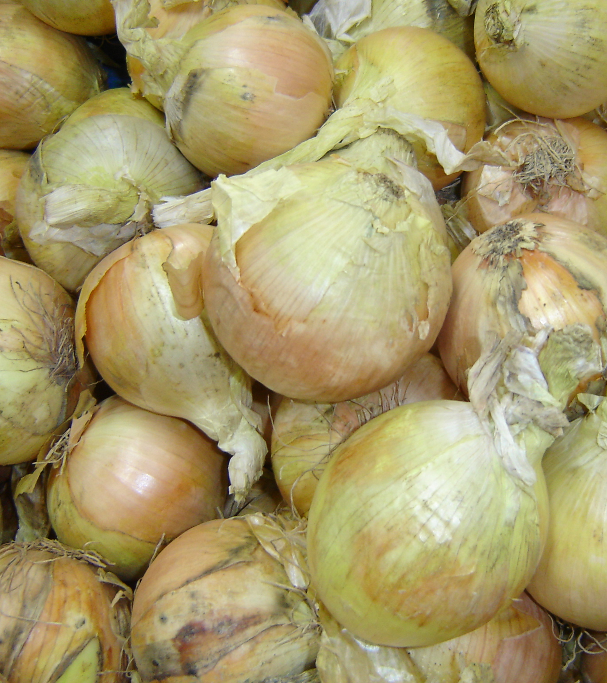

Slide 26
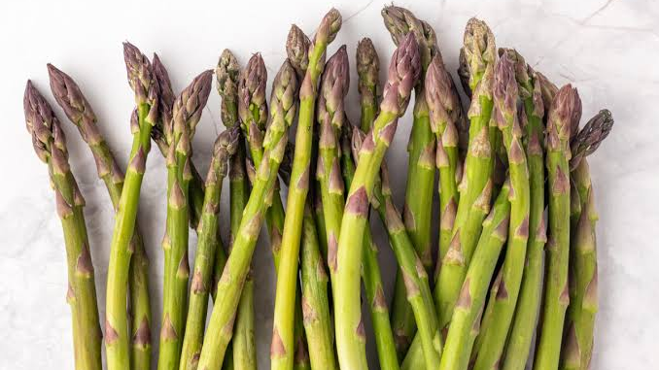

Slide 27
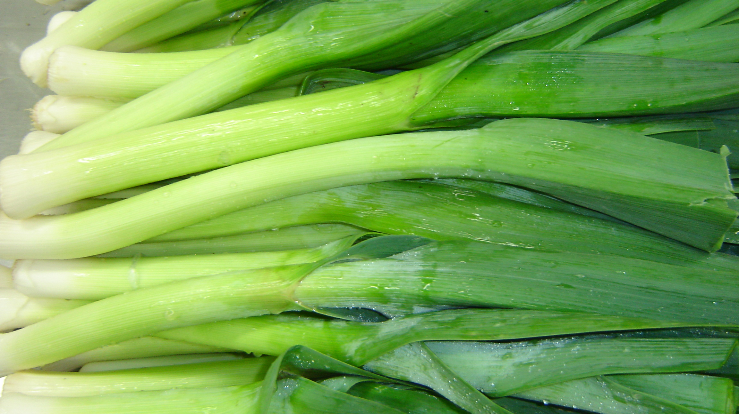

Slide 28
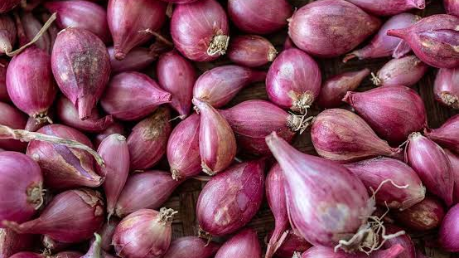

Slide 29
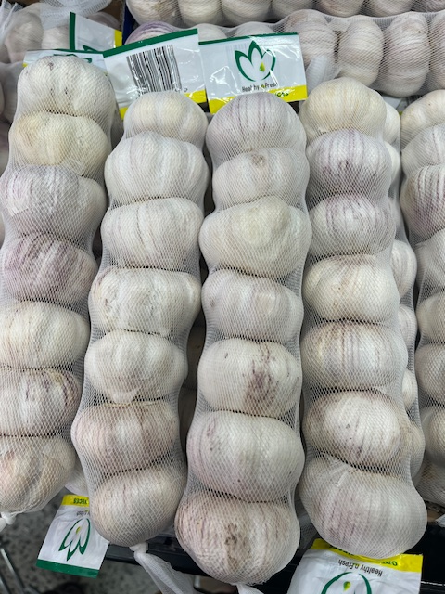

Slide 30
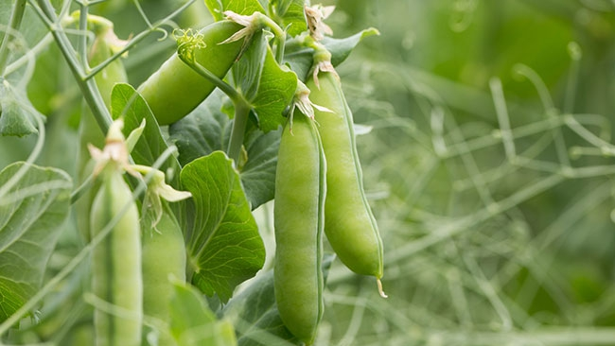

Slide 31
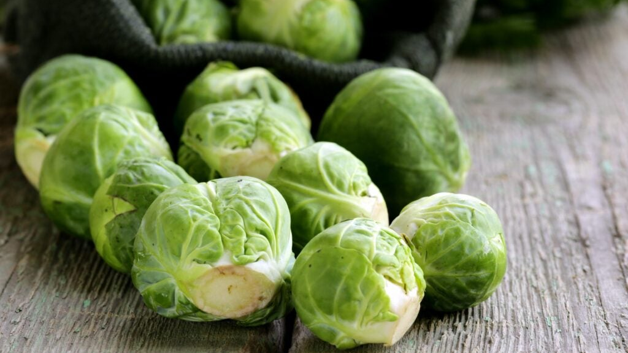

Slide 32
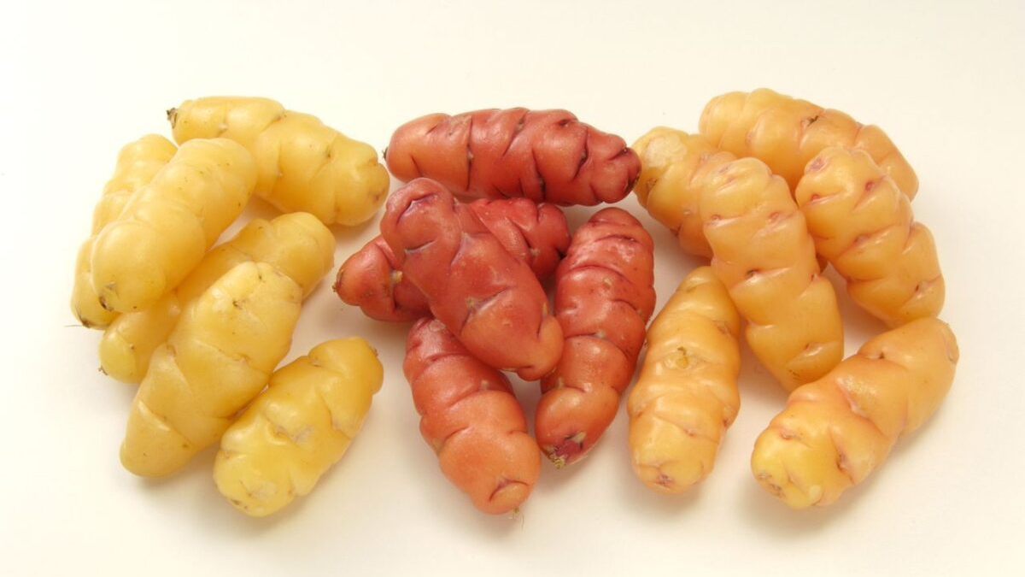

Slide 33
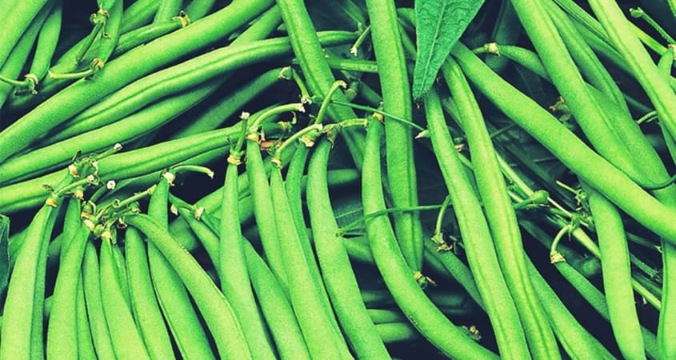

Slide 34
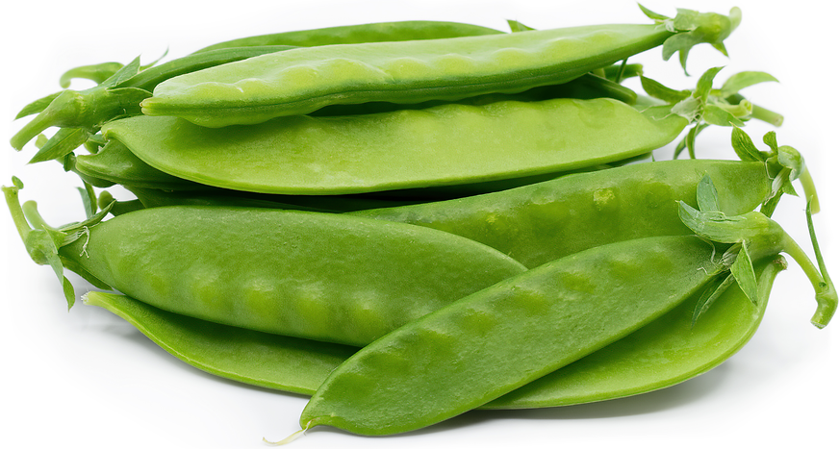

Slide 35
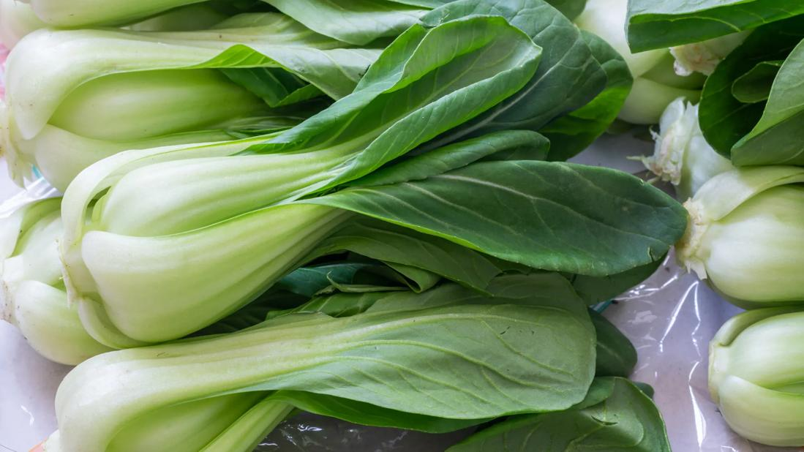

Slide 36
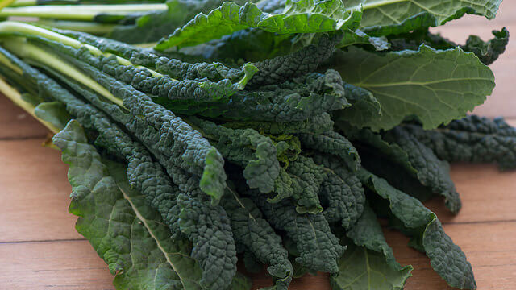

Slide 37
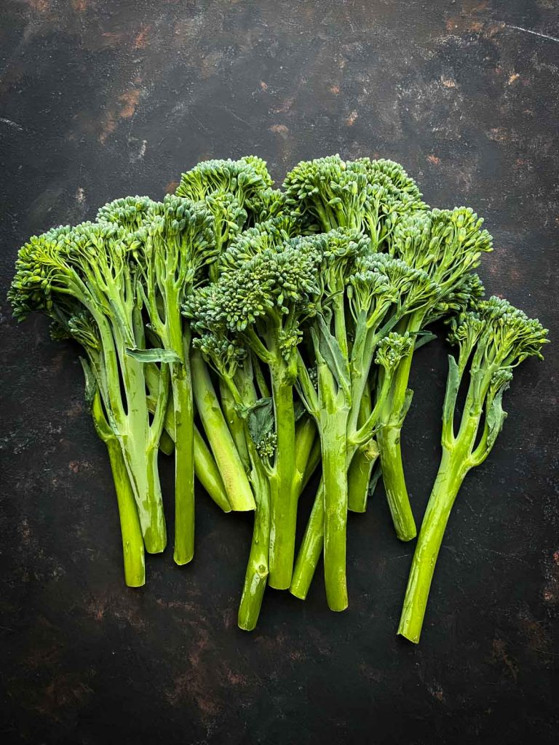

Slide 38
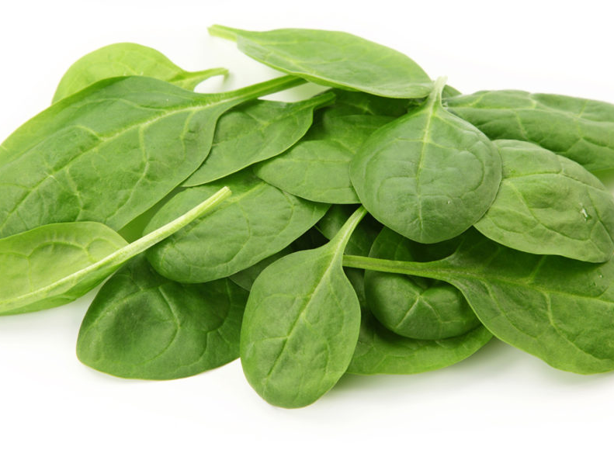
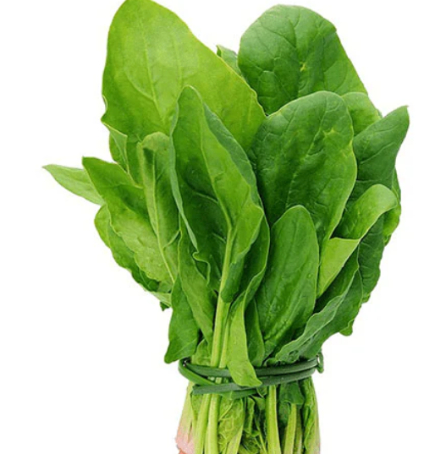

Slide 39
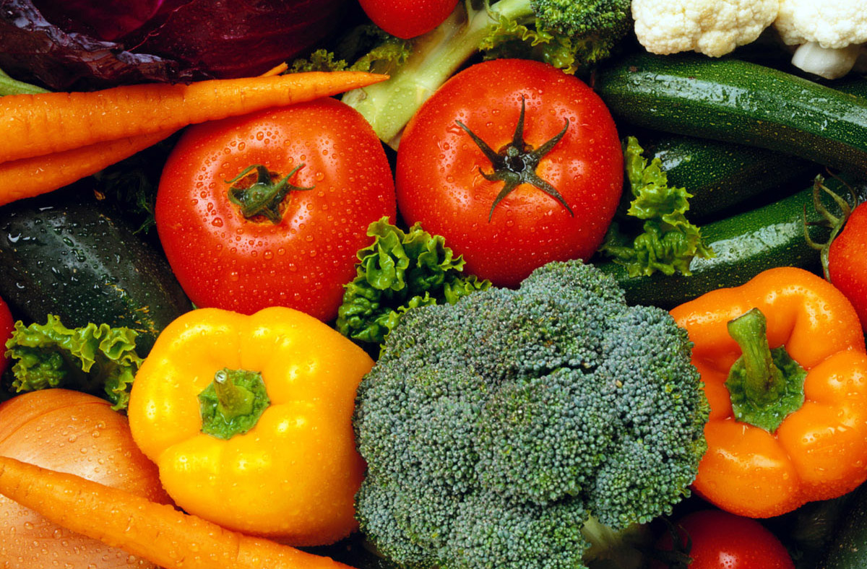
Activity 3: Classification by parts we eat
Students group vegetables based on the part of the plant we eat
Leaf
Stem
Root
Flower
Fruit
Bulb
Tuber

Slide 40
Activity 3: Classification by parts we eat Answer
Bulb | Flower | Fruit | Leaf | Seed | Root | Stem | Tuber
Onion | Broccoli | Pumpkin | Lettuce | Peas | Carrot | Asparagus | Potato
Garlic | Cauliflower | Squash | Cabbage | Beans | Beetroot | Celery | Kumara
Spring Onions | Broccolini | Eggplant | Brussel Sprouts | Sweet Corn | Radish |  | Yams
Leek |  | Capsicum | Silverbeet | Snow Peas | Parsnip
 |  | Zucchini | Spinach |  | Swede
 |  | Tomatoes | Bok Choy
 |  | Cucumber | Kale

Slide 41
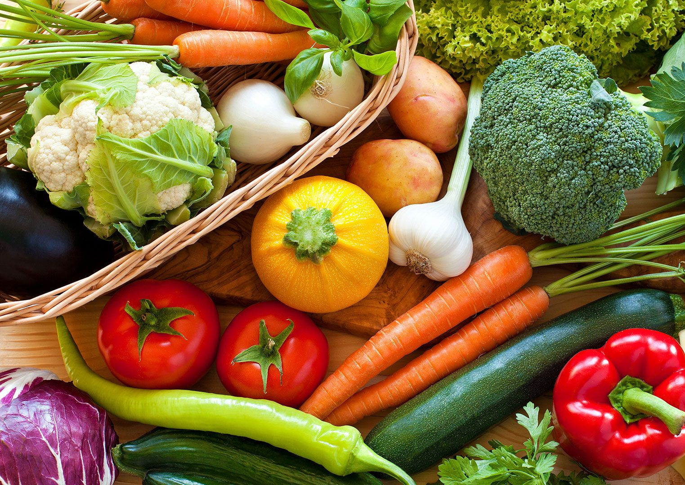
Activity 4: Classification by plant family
Students identify and group vegetables that belong these plant families
Brassicaceae - Brassica family
Solanaceae - Nightshade family
Fabaceae - Legume family
Cucurbitaceae - Cucurbit family
Amaryllidaceae- Allium family

Slide 42
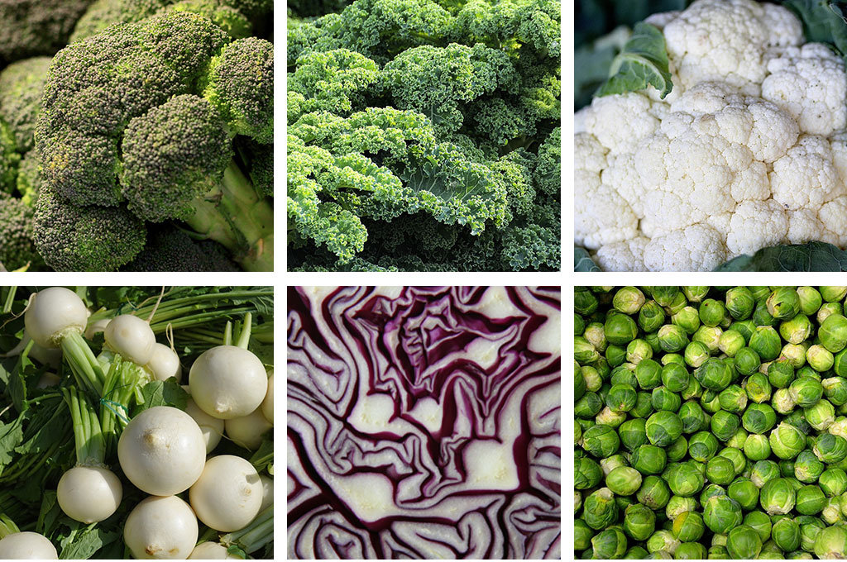
Activity 4: Classification by plant family
Answers

Slide 43
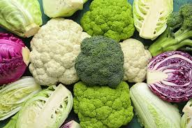
Brassicaceae - Brassica family
Cabbage
Broccoli
Cauliflower
Kale
Brussels Sprouts
Bok Choy
Swedes

Slide 44

Solanaceae - Nightshade family
Tomato
Eggplant
Capsicum
Potatoes

Slide 45

Fabaceae - Legume family
Peas
beans

Slide 46

Cucurbitaceae - Cucurbit family
Cucumber
Pumpkin
Zucchini
Squash

Slide 47

Amaryllidaceae- Allium family
Onions
Garlic
Leeks
Shallots

Slide 48
Activity 5: AI Research
1. Choose ONE research topic
  Pick one of the following and turn it into your investigation:
  Plant families and what vegetables in them have in common
  The Nightshade family and how some parts can be toxic
  Cool-season versus warm-season crops
  Why onions belong to the Amaryllidaceae family
2. AI Research question
  Write your topic as a strong AI research question.
  Example
  “How and why…?” or “To what extent…?” or “What patterns…?”
  Example questions:
  How and why do vegetables in the same plant family share similar characteristics?
  How can people safely eat vegetables from the Nightshade family even though parts of the plant are toxic?
  How does climate affect whether crops are grown as cool-season or warm-season vegetables?
  What characteristics explain why onions belong to the Amaryllidaceae family?

Slide 49
3. Guidelines for using AI
  When using AI tools (like ChatGPT or Gemini), follow these rules:
Use AI to:
  Get explanations of ideas
  Find examples
  Help organise your notes
  Check your understanding
Do NOT:
  Copy and paste answers as your own
  Use AI without checking the information
  Submit AI writing without editing it
Good practice:
  Ask follow-up questions
  Compare AI answers with other sources (books/websites)
  Rewrite information in your own words
  Keep your work accurate and clear

Slide 50
4. Record how you used AI
Include a short record of your AI use: Write at least 2–3 examples of your AI use
Example Table:
5. Apply your knowledge
Now answer this application question:
  “Using what you have learned, explain how understanding plant families or growing conditions helps growers or gardeners grow vegetables more successfully.”
  Give at least one real example
  Explain your thinking clearly
What I asked AI | What AI told me | How I used it
What is the Nightshade family? | It explained the plants and examples | Helped me understand the topic
Which parts are toxic? | Leaves and unripe fruit can be toxic | Used in my explanation

Slide 51
Activity 6:
Dichotomous key
Dichotomous key
A scientific tool used to identify organisms or objects
Works by choosing between two contrasting observable characteristics at each step
Helps narrow down options to correctly classify specimens
Used for identifying
Plants
Animals
Other objects or specimens
Can also identify vegetables based on the plant part we eat
  Roots
  Leaves
  Stems
  Flowers
  Fruits
  Seeds

Slide 52
Dichotomous key for identifying the parts of plants we eat
1a. The edible part grows below the ground → go to 2
1b. The edible part grows above the ground → go to 5
2a. The edible part is a swollen underground stem used for storing food → Tubers
2b. The edible part is not a swollen underground stem → go to 3
3a. The edible part is a swollen underground structure made of layered leaves → Bulbs
3b. The edible part is a true root growing downward into the soil → Roots
5a. The edible part contains seeds or develops from a flower → Fruits
5b. The edible part does not contain seeds → go to 6
6a. The edible part is the reproductive structure of the plant → Flowers
6b. The edible part is a vegetative part of the plant → go to 7
7a. The edible part is flat, green, and used for photosynthesis → Leaves
7b. The edible part is not flat and leafy → go to 8
8a. The edible part is the main support structure of the plant above the ground → Stems
8b. The edible part is the mature reproductive structure inside a fruit → Seeds
Steps
Look carefully at each vegetable photo. Think about which part of the plant it might come from.
Start at step 1 of the dichotomous key. Read both options (a and b) and choose the one that best describes the vegetable you are identifying.
Continue following the instructions in the key until you reach the name of the plant part (for example: root, leaf, fruit).
Write the name of the vegetable and the plant part we eat in the table

Slide 53
Table and questions
Vegetable | Part we eat
Discussion questions
Which vegetables grow above the ground?
Which vegetables grow below the ground?
Which plant part do we eat the most often?
Was the dichotomous key easy or difficult to use? Why?

Slide 54

Extension:
Students create their own dichotomous key to identify vegetables in a family e.g. The Brassicas family
  Cabbage
  Broccoli
  Cauliflower
  Kale
  Brussels Sprouts

Slide 55

Sample answer
1a. Plant forms a tight round head of leaves → Go to 2
1b. Plant does not form a tight round head of leaves → Go to 3
2a. Large single head made of tightly packed leaves → Cabbage
2b. Small round heads growing along the stem → Brussels sprouts
3a. Plant grown mainly for its flowering head → Go to 4
3b. Plant grown mainly for its leaves → Kale
4a. Flower head is green with small buds → Broccoli
4b. Flower head is white and compact → Cauliflower

