Slide 1


Slide 2
Topic 3
Plant Groups

Slide 3
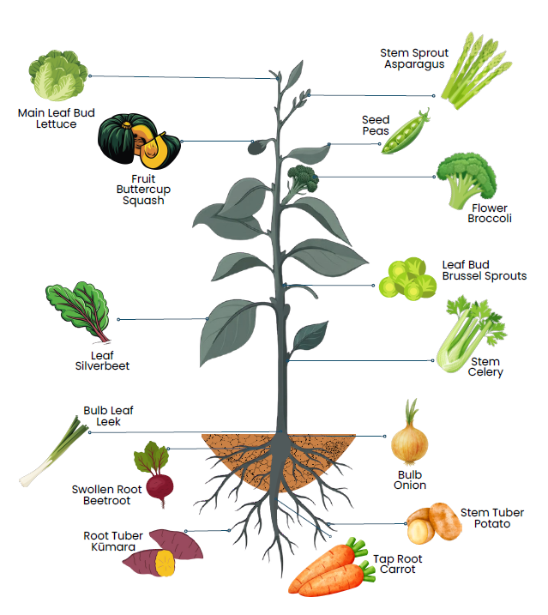
Vegetable groups
Vegetables are commonly classified according to the part of the plant that we eat:
  Roots
  Stems
  Leaves
  Flowers
  Fruits
  Seeds
  Bulbs
  Tubers

Slide 4
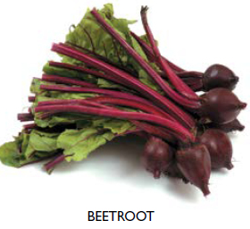
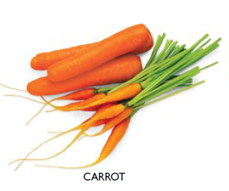
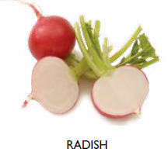
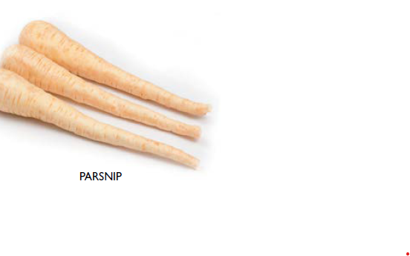
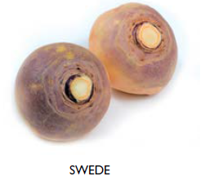
Root vegetables
Root vegetables are the underground taproots of plants. They store nutrients and energy for plant growth, making them often dense and nutritious.
They are typically long or round and can be quite hardy, storing well for extended periods.
Examples
  Carrot
  Beetroot
  Radish
  Parsnip
  Swede

Slide 5
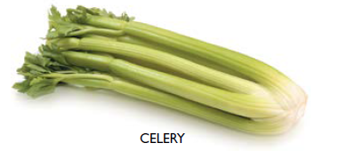
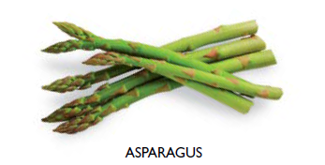
Stem vegetables
Stem vegetables are grown for their edible stalks or shoots. They often have a crisp texture and may contain fibrous strands.
Many stem vegetables are eaten raw or lightly cooked.
  Asparagus
  Celery

Slide 6
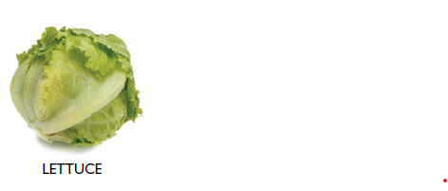
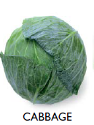
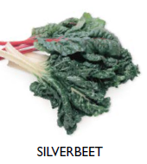
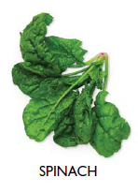
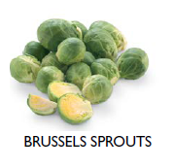
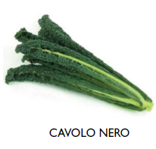
Leaf vegetables
Leaf vegetables are grown for their edible leaves. They can range in texture from crisp to tender.
Examples
  Lettuce
  Cabbage
  Brussels sprouts
  Silver beet
  Spinach
  Bok choy
  Kale

Slide 7
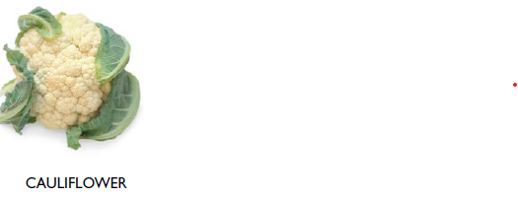
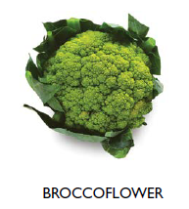
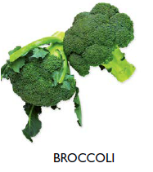
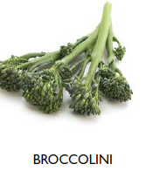
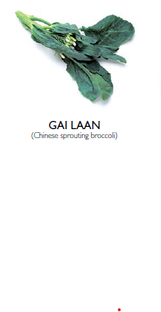
Flower vegetables
Flower vegetables are harvested before the flowers fully bloom. The edible parts are usually tightly packed flower buds or immature flowers.
Examples
  Broccoli
  Cauliflower
  Broccoflower
  Broccolini
  Gai lan

Slide 8
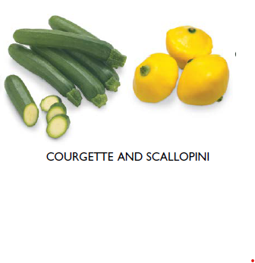
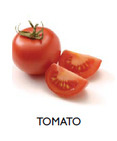
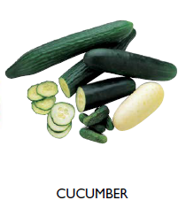
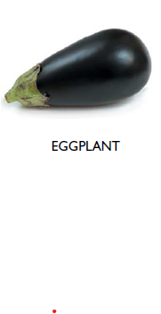
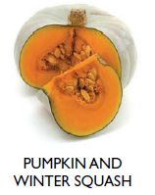
Fruit vegetables
Fruit vegetables develop from the flower of the plant and contain seeds. They are typically fleshy and come in a wide variety of shapes, sizes, colours, and flavours.
Examples
  Pumpkin
  Eggplant
  Capsicum
  Tomato
  Courgette / Zucchini
  Scallopini
  Cucumber
  Squash

Slide 9
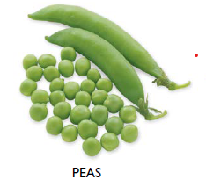
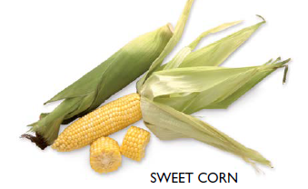
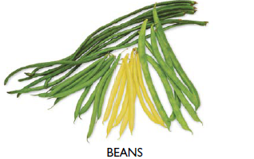
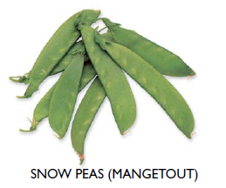
Seed vegetables
Seed vegetables grow in pods and are often harvested when the seeds are immature and tender. In some cases, both the seeds and the pod are eaten.
Examples
  Beans
  Peas
  Broad beans
  Snow peas
  Sweet corn

Slide 10
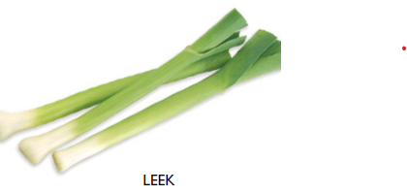
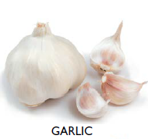
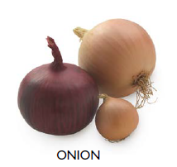
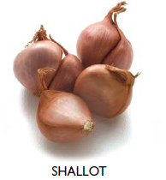
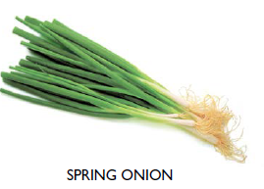
Bulb vegetables
Bulb vegetables grow just below the soil surface. They store nutrients in underground structures made of modified leaves arranged in layers. These layers protect the plant’s growing point and act as a food reserve
Examples
  Onion
  Shallot
  Garlic
  Spring onion
  Leek

Slide 11
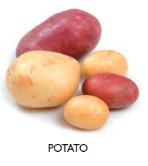
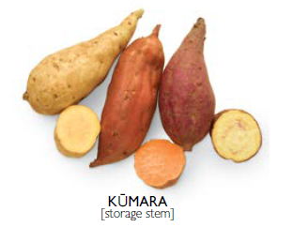
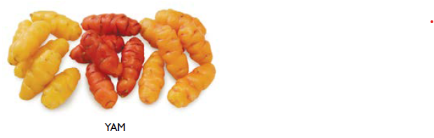
Tuber vegetables
Tubers grow underground as swollen storage organs attached to the plant’s roots. They are usually high in starch and provide significant energy.
Tubers vary widely in size, shape, and colour
Examples
  Potato
  Yam
  Kūmara (sweet potato)

Slide 12
Activity 1: Word searches
Easy
Vegetables-word-search-activity-student-copy-1
Harder
Vegetable work search.

