Slide 1


Slide 2
Topic 4
Principles of Vegetable Production in New Zealand
Activities

Slide 3
Activity 1: Summary of the Vegetable Production in New Zealand
Use the Words in the box to fill in the gaps to summarise vegetable production in New Zealand
Vegetables in New Zealand are grown using two main methods: ____________ growing and ____________-field growing.
Greenhouse vegetables are grown ____________ in special buildings called greenhouses. Growers carefully control the ____________, ____________, ____________, and nutrients.
Many glasshouse vegetables are grown without ____________ using a system called ____________. This method helps vegetables grow ____________ ____________ and protects them from bad ____________.
Some vegetables commonly grown in greenhouses include:
Open-field vegetables are grown ____________ in ____________. Growers plant vegetables in large ____________ and rely on
natural ____________, rainfall, and seasonal ____________.
Machines are often used to ____________ and ____________ crops. However, these vegetables can be affected by ____________, ____________, ____________, or ____________.
Examples of vegetables grown in open fields include:
Both growing systems help provide ____________ vegetables for people in New Zealand throughout the ____________.
fresh, harvest, fields, outdoors, hydroponics, year-round, weather, soil, sunlight, frost, wind, plant, carrots, tomatoes, broccoli, lettuce, cabbage, capsicums, cucumbers, eggplants, greenhouse, open, temperature, light, water, drought, season

Slide 4
Answer
Vegetables in New Zealand are grown using two main methods: greenhouse growing and open-field growing.
Greenhouse vegetables are grown indoors in special buildings called greenhouses. Growers carefully control the temperature, light, water, and nutrients.
Many greenhouse vegetables are grown without soil using a system called hydroponics. This method helps vegetables grow year-round and protects them from bad weather.
Some vegetables commonly grown in glasshouses include: Tomatoes. Capsicums, cucumbers, eggplants
Open-field vegetables are grown outdoors in soil. Growers plant vegetables in large fields and rely on natural sunlight, rainfall, and seasonal weather.
Machines are often used to plant and harvest crops. However, these vegetables can be affected by drought, rain, frost, or wind.
Examples of vegetables grown in open fields include: carrots, broccoli, cabbage, lettuce
Both growing systems help provide fresh vegetables for people in New Zealand throughout the year.

Slide 5
Activity 2: Crop type sorting
Drag and drop each vegetable into the correct category
Asparagus
Crop Category | Examples
Annual crops (short-term
Annual crops (long-term)
Perennial crops
Broccoli
Cauliflower
Kūmara
Lettuce
Onions
Potatoes

Slide 6
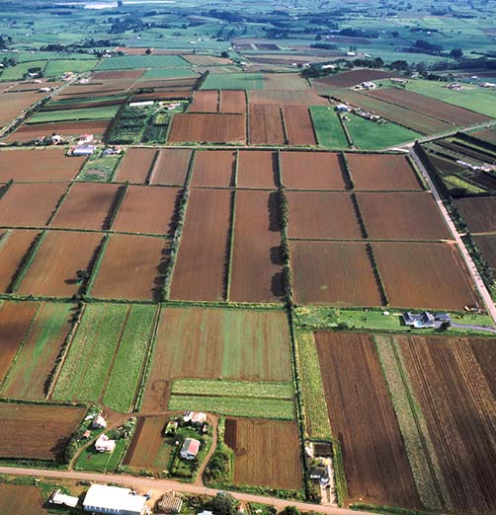
Activity 3: Designing a market garden
Scenario
You are a commercial vegetable grower planning to start a market garden in your region. Your aim is to choose crops that will grow well in your area and could be sold at local farmers markets or to supermarkets.
Choose three vegetables you want to grow in your market garden.
Explain why you chose these vegetables
Modern horticulture aims to reduce environmental impacts while maintaining productivity.
  List two sustainable management practices you would use in your market garden.
  Explain how these practices help protect the environment or improve soil health.
Draw a simple layout of your market garden showing:
  crop areas
  implement sheds
  packhouse
  irrigation

