Slide 1


Slide 2
Topic 5
Growing media in vegetable production
Activities

Slide 3
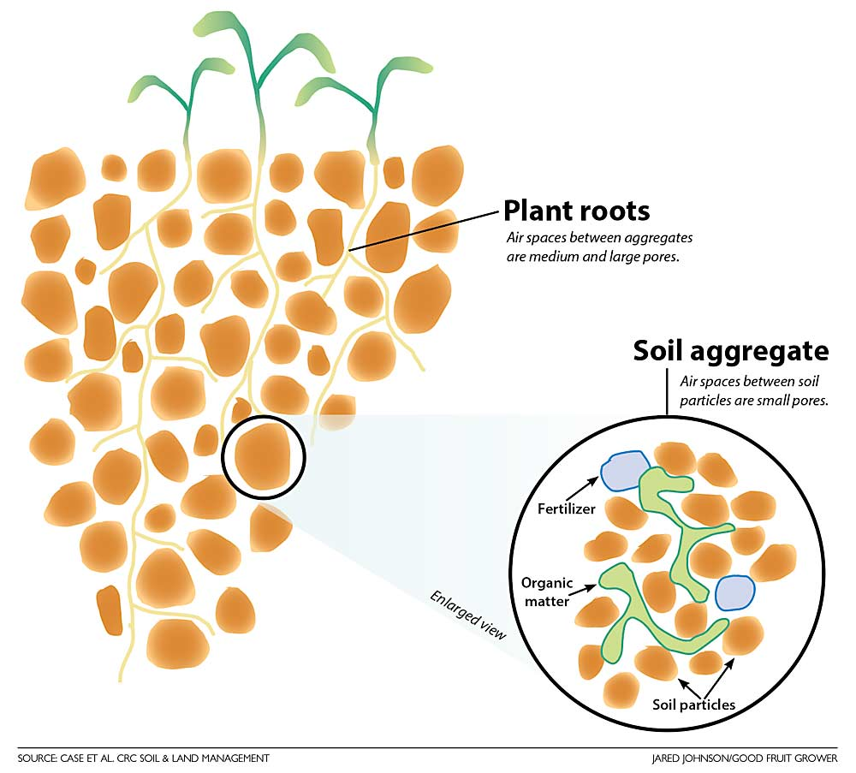
Recommendation
The junior Soil Science unit of work has more information, resources and activities. The key concepts covered in this unit are
Soil is an essential component to life
Soil composition and components
Soil investigation on soil properties
Alternative growing media

Slide 4
Activity 1: Drag and drop the term to match soil and growing media definitions
Term | Growing Media Definitions
 | Spaces in soil that hold air and water
 | A growing system where plants are grown without soil
 | Crumbly soil that is easy to work and ideal for root growth
 | Small clumps of soil particles grouped together
 | Material that does not supply nutrients on its own
 | Delivery of nutrients through irrigation water
 | A lightweight volcanic material that improves drainage
 | The arrangement of soil particles into clumps
 | A sterile growing medium with high water-holding capacity
 | Plant and animal material that improves soil fertility
 | A renewable growing medium made from coconut husks
 | When soil becomes dense and hard, reducing air spaces
Soil structure
Friable soil
Pore spaces
Soil peds
Compaction
Hydroponics
Fertigation
Inert media
Rockwool
Coconut fibre
Pumice
Organic matter

Slide 5
Activity 1: Drag and drop the term to match soil and growing media definitions
Answer
Term | Growing Media Definitions
Pore spaces | Spaces in soil that hold air and water
Hydroponics | A growing system where plants are grown without soil
Friable soil | Crumbly soil that is easy to work and ideal for root growth
Soil peds | Small clumps of soil particles grouped together
Inert media | Material that does not supply nutrients on its own
Fertigation | Delivery of nutrients through irrigation water
Pumice | A lightweight volcanic material that improves drainage
Soil structure | The arrangement of soil particles into clumps
Rockwool | A sterile growing medium with high water-holding capacity
Organic matter | Plant and animal material that improves soil fertility
Coconut fibre | A renewable growing medium made from coconut husks
Compaction | When soil becomes dense and hard, reducing air spaces

Slide 6
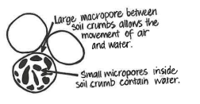
Activity 2: What makes good soil?
Which words in the box describe good soil for growing vegetables.
What does friable soil mean?
Why do plants grow better in soil with pore spaces?
Draw a picture of healthy soil.
  Label:
  soil crumbs (peds)
  plant roots
  air spaces
  water
hard, friable, fertile, dry like dust, free-draining, crumbly, holds water for plants, loose, compacted

Slide 7
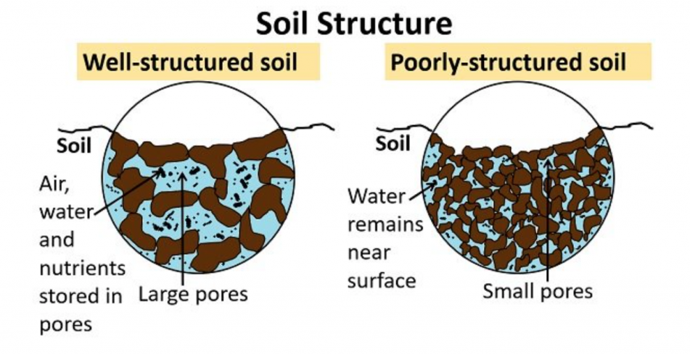
Sample answers for discussion questions.
Why might growers grow plants in coconut fibre or pumice instead of soil?
Growers use coconut fibre or pumice because they are usually sterile, and easier to control than soil. They also drain well and let growers control exactly how much water and nutrients plants get, which helps plants grow better. Soil varies in texture and structure and can contain pests, diseases, weeds and have variable nutrients which make them more difficult to manage.
Why is it important that plant roots get both water and air?
Roots need water to absorb nutrients that help the plant grow. But they also need air to carry out respiration, which releases energy for growth. If roots don’t get enough air(for example, if they are waterlogged), they can rot and the plant may die.
Which growing media is best for growing vegetables in glasshouses?
There isn’t just one “best” option, but coconut fibre is one of the most commonly used growing media for vegetables in glasshouses because it is inert, free of pests, diseases and nutrients and has good drainage and water holding capacity. Coconut fibre is biodegradable after being used, is 100% renewable and is a sustainable resource.
Why do you think this is the best growing media for growing vegetables in glasshouses?
Coconut fibre is a good choice because it holds water well but also allows plenty of air to reach the roots. It is lightweight, easy to handle, and free from most pests and diseases. It also works well with controlled feeding systems, so growers can give plants exactly the nutrients they need for fast and healthy growth.

Slide 8
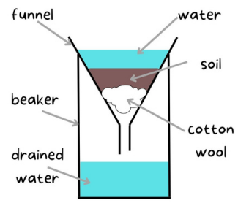
Activity 3: Growing media investigation
Learning objective: Investigate how different growing media hold water and support plant growth.
Materials for each group
3 clear funnels
4 measuring cylinders or beakers
Cotton wool
Garden soil
Coconut fibre or use potting mix
Pumice
Water

Slide 9
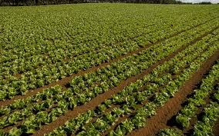
Question
Which growing material do you think holds the most water for plants?
  Garden soil
  Coconut fibre or potting mix
  Pumice

Slide 10
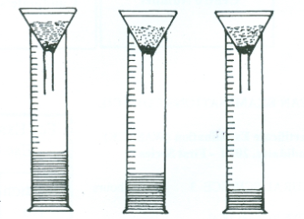
Method
Place a small piece of cotton wool into each funnel as shown in the diagram above
Place the funnels into a beaker or measuring cylinder
Fill each funnel with either soil, coconut fibre (coir) or use potting mix and pumice
Pour the same amount of water into each funnel e.g. 40ml
Observe what happens.
Measure the volume of water in the measuring cylinder after 10 mins

Slide 11
Observation and results
 | Soil | Coconut fibre or Potting mix | Pumice
Volume of water after 10 minutes
Which growing media holds the most water?
Which growing media drains the fastest?

Slide 12
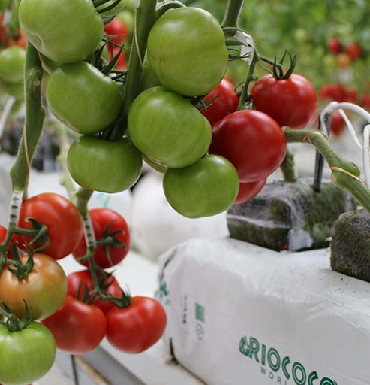
Discussion questions
Why might growers grow plants in coconut fibre or pumice instead of soil?
Why is it important that plant roots get both water and air?
Which growing media is best for growing vegetables in glasshouses?
Why do you think this is the best growing media for growing vegetables in glasshouses?

Slide 13
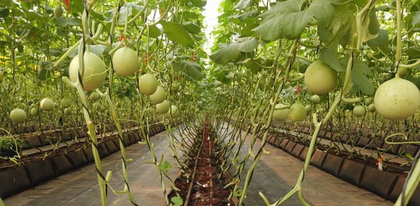
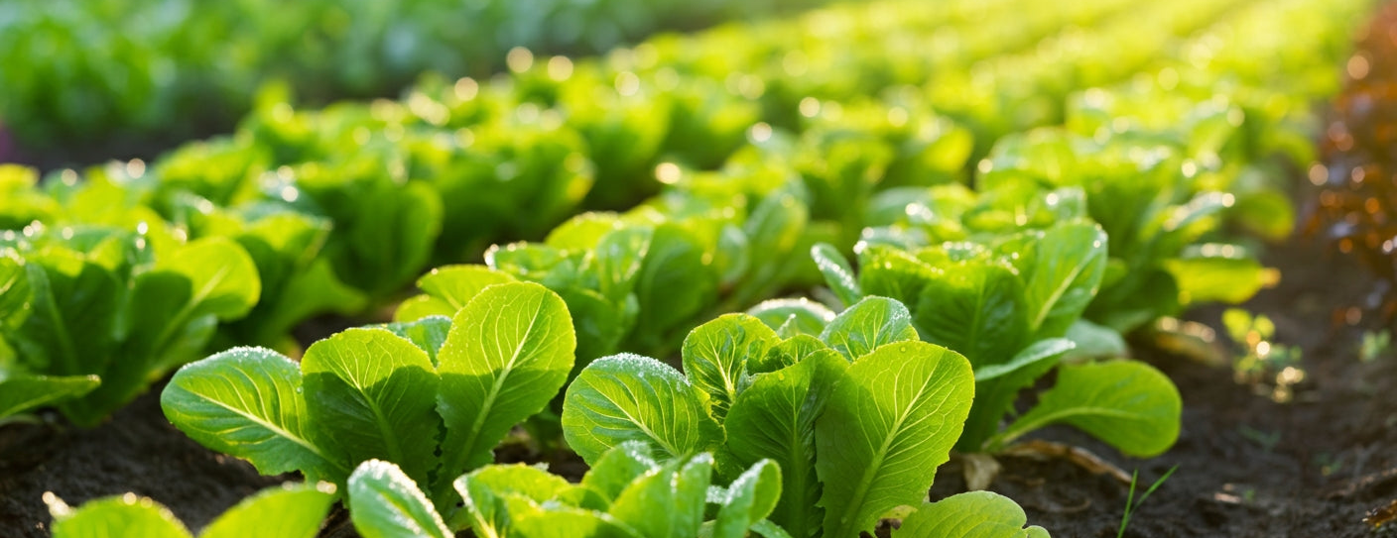
Activity 4: Test yourself questions
What is growing media, and why is it important for plant growth?
List two differences between soil-based production systems and hydroponic systems.
What are four key characteristics of good soil for vegetable production?
What is soil structure, and how does it affect plant growth?
Why is friable soil considered ideal for growing vegetables? Give two reasons.
What is hydroponics, and how are nutrients supplied to plants in this system?
Name two types of soilless growing media used in hydroponics.
Choose one soilless growing medium (rockwool, coir, or pumice) and describe one advantage and one disadvantage.

Slide 14
Answers
What is growing media, and why is it important for plant growth?
Growing media is the material in which plants grow. It is important because it provides support, water, air, and nutrients needed for plant growth and affects crop quality and yield.
List two differences between soil-based production systems and hydroponic systems.
  Soil-based systems grow plants in natural soil, while hydroponic systems use soilless media.
  In soil systems, nutrients come from the soil, while in hydroponics, nutrients are supplied through a nutrient solution (fertigation).
What are four key characteristics of good soil for vegetable production?
  Well-structured
  Friable
  Free-draining
  Fertile
  Able to hold enough water
What is soil structure, and how does it affect plant growth?
Soil structure is the way soil particles group together into small lumps called peds. Good soil structure creates pore spaces that allow air and water movement, helping roots grow easily and improving plant growth.

Slide 15
5. Why is friable soil considered ideal for growing vegetables? Give two reasons.
  It is easy for roots to grow through
  It allows good air and water movement
  Easy to cultivate
What is hydroponics, and how are nutrients supplied to plants in this system?
Hydroponics is a method of growing plants without soil using inert media. Nutrients are supplied directly to plant roots through a liquid nutrient solution, usually via a fertigation system.
7. Name two types of soilless growing media used in hydroponics.
  Rockwool
  Coconut fibre (coir)
  Pumice
Choose one soilless growing medium and describe one advantage and one
disadvantage.
Example Rockwool:
  Advantage: Holds a lot of water and provides good aeration
  Disadvantage: Difficult to dispose of

