Slide 1


Slide 2
Topic 6
Vegetable Plant Structure
Activities

Slide 3
Other supporting resources
More information, resources and activities on the structure and function of parts of a plant can be found in the junior unit of work Plant Form and Function .
The key concepts covered in this unit are
Uses of plants
Plants can be classified into groups
Plant parts have specific functions

Slide 4
Activity 1: Drag the vegetable next to the correct plant part
Plant parts | Vegetables
Root
Leaf
Stem
Flower
Fruit
Seed
Lettuce
Carrot
Celery
Broccoli
Tomato
Peas
Beetroot
Cabbage
Sweetcorn
Cauliflower
Radish

Slide 5
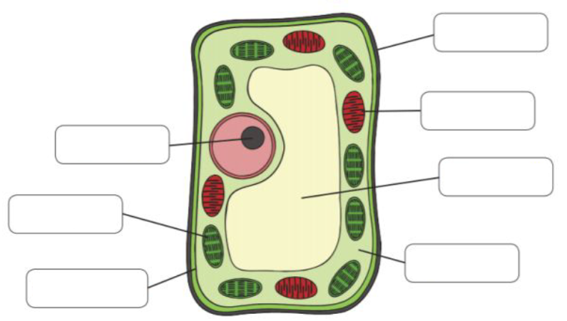
Activity 2: Inside a plant cell
Drag the words to the correct part of the plant cell
Nucleus
Cell wall
Large vacuole,
Chloroplast
Cell membrane
Cytoplasm
Mitochondria

Slide 6
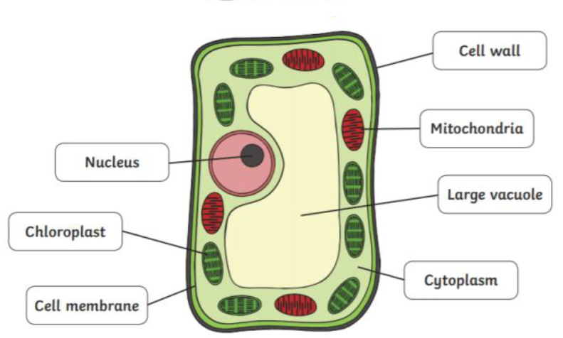
Activity 2: Inside a plant cell
Answer

Slide 7
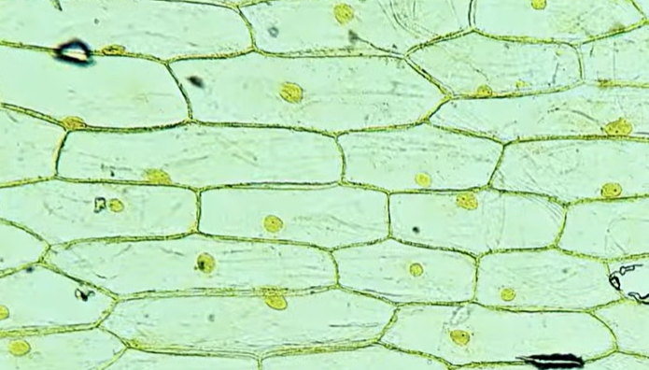
Activity 3: Looking at plant cells
Materials
Fresh vegetable e.g., onion or celery
Microscope or magnifying lens
Microscope slides and cover slips
Dropper
Water
Iodine solution (optional, to make cells easier to see)
Tweezers
How to prepare a onion cell peel slide
Watch -Onion Epidermal Cell Peel Slide Preparation Practical Experiment-Start at 1.49
https://www.youtube.com/watch?v=kjU4GXFCSig

Slide 8
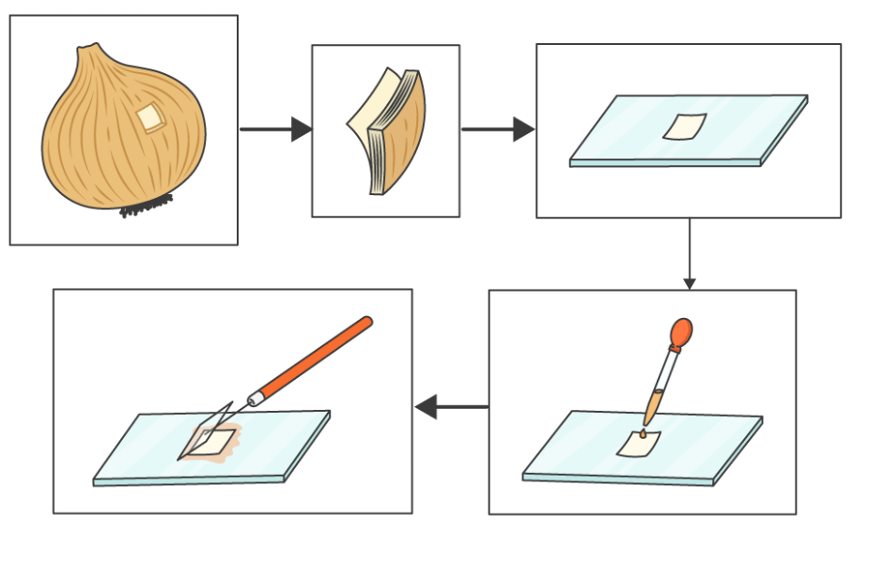
Method
Take a thin slice an onion, peel a thin layer of skin, epidermis).
Place the slice on a microscope slide.
Add a drop of water to keep it moist.
Add iodine solution to stain the cells and make them easier to see.
Carefully place a cover slip on top.
Start with low power to locate the cells.
Switch to higher power to see details.
Draw what you see and label the diagram

Slide 9
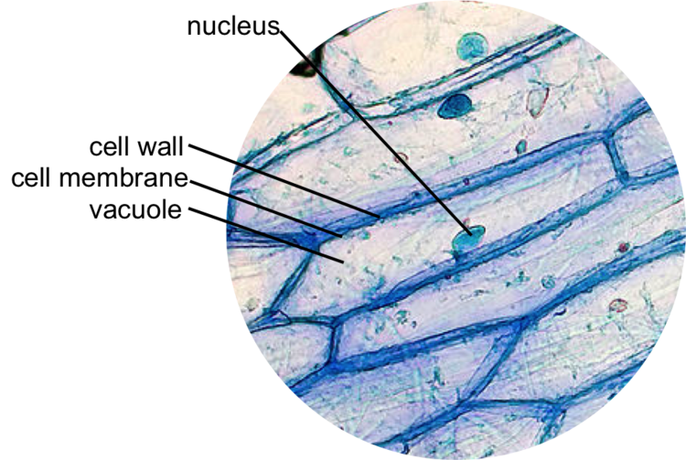
Discussion questions
Why do you think the cell wall is important for plants?
How does the vacuole help vegetables like carrots stay firm?

Slide 10
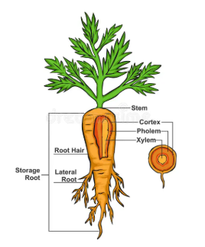
Discussion questions- Samples answers
Why do you think the cell wall is important for plants?
The cell wall is important because it gives plant cells strength and support. It helps the plant keep its shape and stand upright instead of collapsing. The cell wall also protects the cell and stops it from bursting when it takes in water.
How does the vacuole help vegetables like carrots stay firm?
The vacuole is a large space inside plant cells that stores water. When it is full of water, it pushes against the cell wall and makes the cell firm. In vegetables like carrots, this pressure keeps the cells stiff, which is why they feel crisp. If the vacuole loses water, the cells become soft and the carrot goes limp.

Slide 11
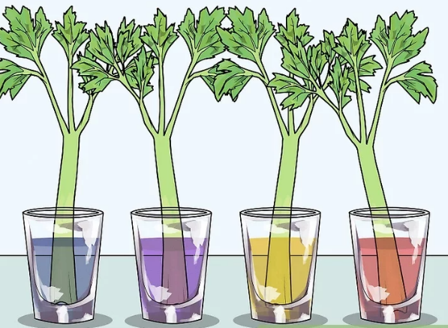
Activity 4: Exploring xylem and phloem in vegetables
Materials
Celery stalks with leaves
Water
Food colouring e.g. red, blue, yellow or green
Clear cups or jars
Knife (for teacher use only)

Slide 12
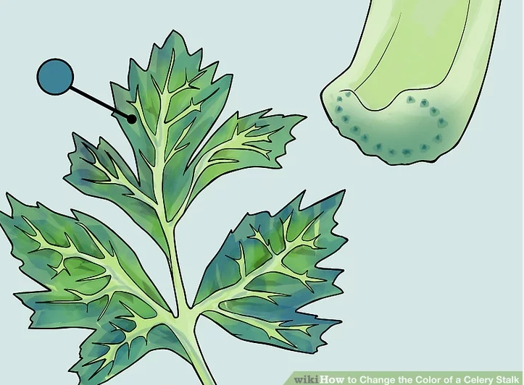
Method
Fill a clear cup, jar or beaker with water.
Add a few drops of food colouring to the water.
Trim the bottom of the celery stalk to make a fresh cut.
Place the celery in the coloured water.
Leave the celery in the coloured water for 2–4 hours or overnight for best results.
Observe what happens to the celery stalk and leaves.
Discuss
What part of the celery changes colour first?
How does the water move through the celery?

Slide 13
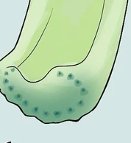
Questions
Which plant tissue carries water and minerals from the roots to the leaves?
Which plant tissue carries food (sugars) from the leaves to other parts of the plant?

Slide 14
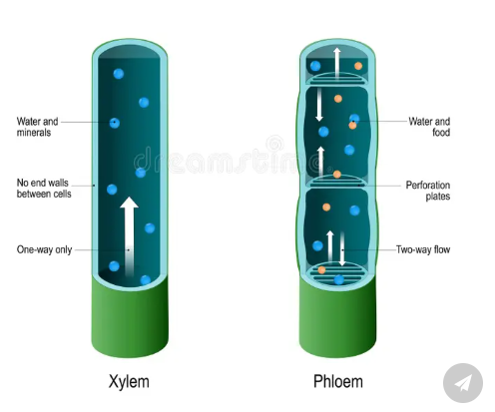
Answers
Xylem tissue moves water and dissolved minerals from the roots up through the plant to the leaves.
Phloem tissue transports sugars made in the leaves during photosynthesis to other parts of the plant where they are needed for energy and growth.

Slide 15
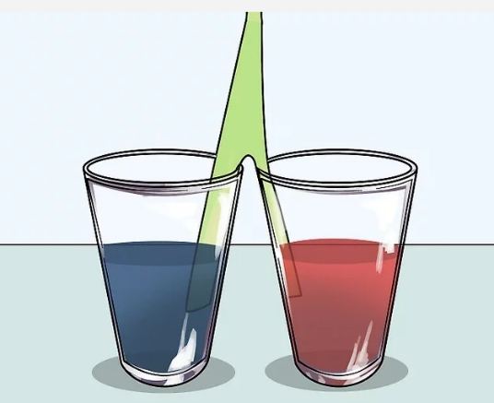
Extension: Mixing two colours with one celery stalk
Trim the bottom of the celery stalk to make a fresh cut.
Use scissors to cut stalk in half up to 3cm from the top of the leafy part
Place one half in one colour and the other half in another colour
Leave the celery in the coloured water for 2–4 hours or overnight for best results.

Slide 16
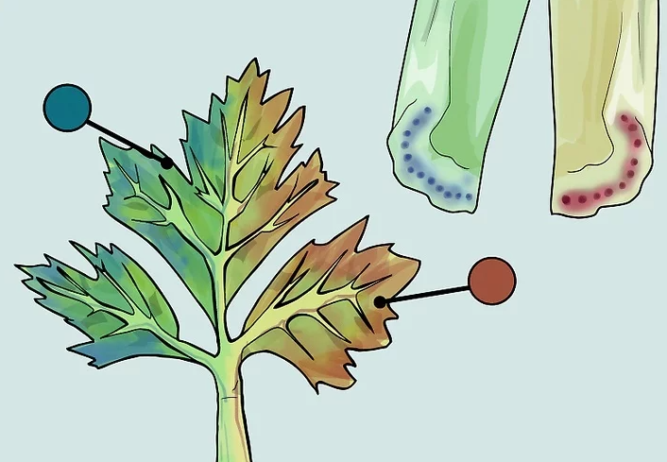
Discussion
Discuss what you think will happen
How is this experiment different than just having the whole celery stalk on one colour?

Slide 17
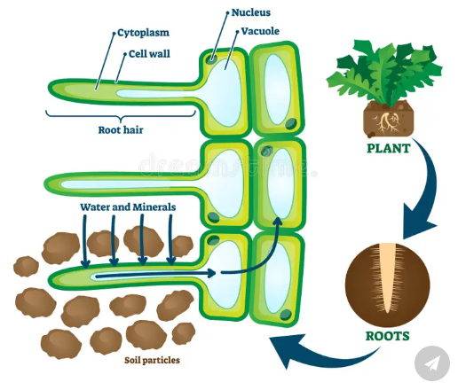
Activity 5: Summary
Drag and drop the words to complete the sentences.
Plants are made of tiny units called __________.
Groups of cells working together form __________.
Groups of tissues form plant __________ such as roots, stems, and leaves.
cells
organs
tissues

Slide 18
Activity 6: Test yourself questions
What are all plants made up of?
What is a plant organ?
Name two plant organs that we eat as vegetables.
What is the function of the cell wall in a plant cell?
What does the nucleus do in a plant cell?
Which part of the plant cell carries out photosynthesis?
What is the main function of roots in a plant?
What do xylem cells transport?
What is the difference between the shoot system and the root system?
Why are root hair cells important for plants?

Slide 19
Question answers
Plants are made up of cells, tissues, and organs.
A plant organ is a part of a plant made of different tissues that work together to do a specific job.
Examples: roots (carrot), leaves (lettuce), stems (celery), flowers (broccoli), fruits (tomato), seeds (peas). Any two
The cell wall provides support and gives the cell its shape.
The nucleus controls the activities of the cell and contains DNA.
Chloroplasts carry out photosynthesis.
Roots anchor the plant and absorb water and minerals from the soil.
Xylem cells transport water and minerals from the roots to the rest of the plant.
The shoot system is above ground and makes food; the root system is below ground and absorbs water and anchors the plant.
Root hair cells increase surface area to absorb more water and minerals from the soil.

Slide 20
Activity 7:
Multiple-Choice Quiz: Vegetable Plant Structure
1. What are all plants made up of?
A. Water and air
B. Cells, tissues, and organs
C. Leaves and roots only
D. Soil and sunlight
2. What is a plant organ?
A. A type of soil
B. A part of a plant made of tissues that do a specific job
C. A single cell
D. A type of leaf
3. Which of the following are plant organs we eat?
A. Rocks and soil
B. Roots and leaves
C. Water and sunlight
D. Air and minerals
4. What is the function of the cell wall?
A. To carry water
B. To make food
C. To give support and shape
D. To control the cell
5. What does the nucleus do?
A. Makes sugar
B. Controls the cell’s activities
C. Absorbs water
D. Transports minerals
6. Which part of the cell carries out photosynthesis?
A. Nucleus
B. Cell membrane
C. Chloroplast
D. Cytoplasm
7. What is the main function of roots?
A. To make flowers
B. To produce seeds
C. To anchor the plant and absorb water
D. To capture sunlight
8. What do xylem cells transport?
A. Sugar
B. Oxygen
C. Water and minerals
D. Carbon dioxide
9. What is the shoot system?
A. The part of the plant underground
B. The roots only
C. The above-ground parts like stems and leaves
D. The soil around the plant
10. Why are root hair cells important?
A. They make seeds
B. They help the plant grow taller
C. They increase absorption of water and minerals
D. They protect the plant from insects

Slide 21
Activity 7:
Multiple-Choice Quiz: Vegetable Plant Structure ANSWERS
1. What are all plants made up of?
A. Water and air
B. Cells, tissues, and organs
C. Leaves and roots only
D. Soil and sunlight
2. What is a plant organ?
A. A type of soil
B. A part of a plant made of tissues that do a specific job
C. A single cell
D. A type of leaf
3. Which of the following are plant organs we eat?
A. Rocks and soil
B. Roots and leaves
C. Water and sunlight
D. Air and minerals
4. What is the function of the cell wall?
A. To carry water
B. To make food
C. To give support and shape
D. To control the cell
5. What does the nucleus do?
A. Makes sugar
B. Controls the cell’s activities
C. Absorbs water
D. Transports minerals
6. Which part of the cell carries out photosynthesis?
A. Nucleus
B. Cell membrane
C. Chloroplast
D. Cytoplasm
7. What is the main function of roots?
A. To make flowers
B. To produce seeds
C. To anchor the plant and absorb water
D. To capture sunlight
8. What do xylem cells transport?
A. Sugar
B. Oxygen
C. Water and minerals
D. Carbon dioxide
9. What is the shoot system?
A. The part of the plant underground
B. The roots only
C. The above-ground parts like stems and leaves
D. The soil around the plant
10. Why are root hair cells important?
A. They make seeds
B. They help the plant grow taller
C. They increase absorption of water and minerals
D. They protect the plant from insects

