Slide 1


Slide 2
Topic 6
Vegetable Plant Structure

Slide 3
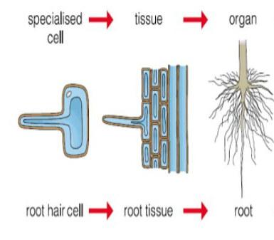
Vegetable Plant Structure
Every plant is made up of cells, tissues, and organs that work together to help it grow, develop, survive, and reproduce.

Slide 4
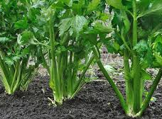
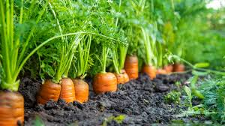
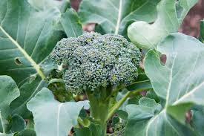
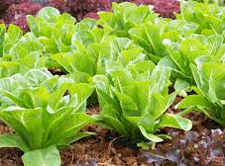
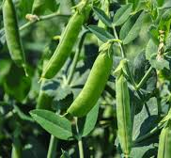
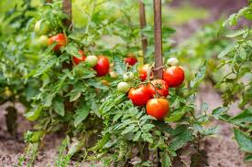
Vegetables
The vegetables we eat are actually different plant organs, such as
roots- carrots
leaves -lettuce
stems -celery
flowers -broccoli
fruits -tomatoes
seeds- peas

Slide 5
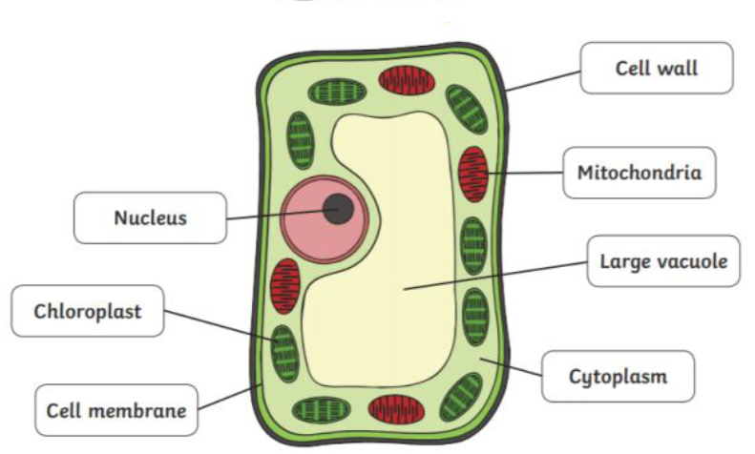
Basic plant cell structure
Cell wall – A rigid outer layer that provides support and shape.
Cell membrane – Controls what enters and leaves the cell.
Cytoplasm – A jelly-like substance that contains the cell organelles such as the nucleus and is where chemical reactions occur.
Nucleus – Contains DNA, which controls the cell’s activities.
Chloroplasts – Contain chlorophyll and carry out photosynthesis.
Large central vacuole – Stores water and helps keep the plant firm (turgid).

Slide 6
Plant cells
Watch The plant cell and its parts - Natural Science - Educational video for kids
or
All About Plant Cells for Kids | Middle School Science | Twinkl USA
Plant cells are tiny solar factories
Do
Activity 2: Inside a plant cell.
Activity 3: Looking at plant cells

Slide 7
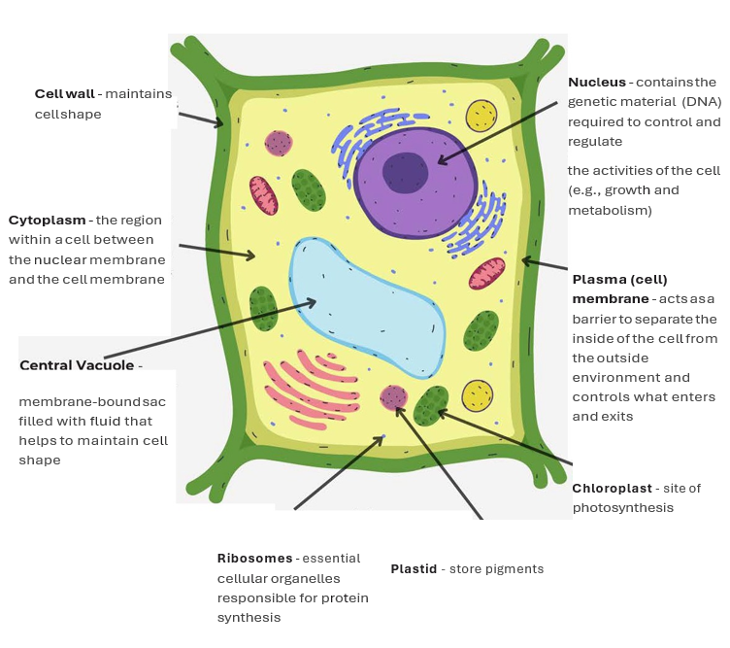
Advanced cell structure

Slide 8
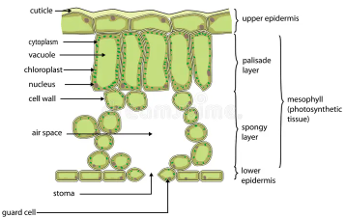
Leaf cells
Leaves contain specialised cells that carry out photosynthesis called mesophyll cells.
Mesophyll cells
are packed with chloroplasts.
is the main site of photosynthesis.
convert light energy into chemical energy (glucose)

Slide 9
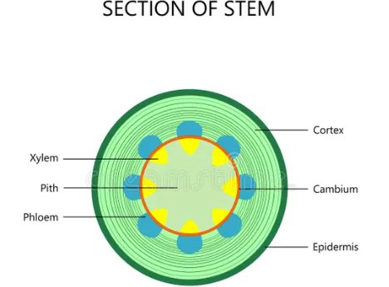
Stem cells
The stem contains specialised cells for transport and support.
Xylem cells
Carry water and minerals upward from the roots
Provide structural support due to thick lignified walls
Phloem cells
Transport sugars from the leaves to the rest of the plant
Deliver nutrients to growing tissues such as buds and roots
Parenchyma cells
Found in the cortex and pith of the stem
Store food (starch) and water
Help maintain the structure of the stem

Slide 10
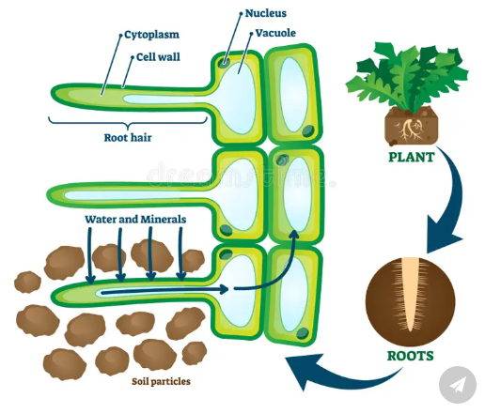
Root cells
Roots contain specialised cells that absorb water and transport substances through the plant.
Root hair cells
Have long extensions that increase surface area
Absorb water and minerals from the soil
Watch Palisade and Roots hair cell
https://www.youtube.com/watch?v=_N2raYmlmzQ

Slide 11
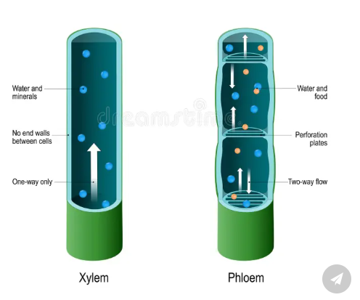
Root cells continued
Xylem cells
Transport water and minerals from the roots to the leaves.
Made of dead cells forming long, hollow tubes
Walls are strengthened with lignin for support
Phloem cells
Transport sugars made in the leaves to other parts of the plant.
Movement occurs up and down the plant supplying food to growing regions and storage organs (e.g. roots)

Slide 12
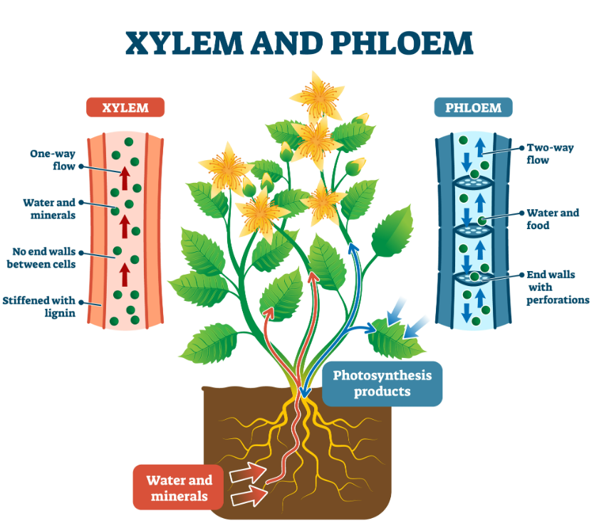

Slide 13
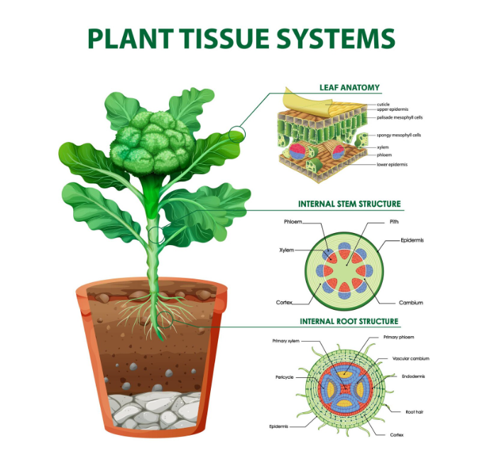
Plant tissue
Tissues are groups of similar specialised cells that work together to perform a specific function. These cells have similar structures that enable them to carry out their roles efficiently.
Watch video- suitable for senior students
Prior to showing this video to students identify the sections of the video suitable for your students
PLANT TISSUES | EASY to UNDERSTAND
Do
Activity 4: Exploring xylem and phloem in vegetables

Slide 14
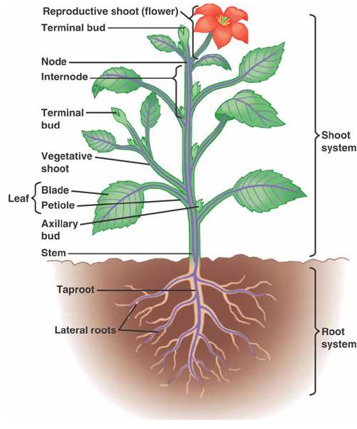
Plant organs
Plant organs are formed when different types of tissues work together to carry out a specific job. In plants like vegetables, these organs are organised into two main systems: the shoot system and the root system.
Watch video- suitable for senior students
Prior to showing this video to students identify the sections of the video suitable for your students
Plant organs | The basic structure and function of each
Do
Activity 5: Summary

Slide 15
Activity 6: Test yourself questions
What are all plants made up of?
What is a plant organ?
Name two plant organs that we eat as vegetables.
What is the function of the cell wall in a plant cell?
What does the nucleus do in a plant cell?
Which part of the plant cell carries out photosynthesis?
What is the main function of roots in a plant?
What do xylem cells transport?
What is the difference between the shoot system and the root system?
Why are root hair cells important for plants?

Slide 16
Question answers
Plants are made up of cells, tissues, and organs.
A plant organ is a part of a plant made of different tissues that work together to do a specific job.
Examples: roots (carrot), leaves (lettuce), stems (celery), flowers (broccoli), fruits (tomato), seeds (peas). Any two
The cell wall provides support and gives the cell its shape.
The nucleus controls the activities of the cell and contains DNA.
Chloroplasts carry out photosynthesis.
Roots anchor the plant and absorb water and minerals from the soil.
Xylem cells transport water and minerals from the roots to the rest of the plant.
The shoot system is above ground and makes food; the root system is below ground and absorbs water and anchors the plant.
Root hair cells increase surface area to absorb more water and minerals from the soil.

Slide 17
Activity 7:
Multiple-Choice Quiz: Vegetable Plant Structure
1. What are all plants made up of?
A. Water and air
B. Cells, tissues, and organs
C. Leaves and roots only
D. Soil and sunlight
2. What is a plant organ?
A. A type of soil
B. A part of a plant made of tissues that do a specific job
C. A single cell
D. A type of leaf
3. Which of the following are plant organs we eat?
A. Rocks and soil
B. Roots and leaves
C. Water and sunlight
D. Air and minerals
4. What is the function of the cell wall?
A. To carry water
B. To make food
C. To give support and shape
D. To control the cell
5. What does the nucleus do?
A. Makes sugar
B. Controls the cell’s activities
C. Absorbs water
D. Transports minerals
6. Which part of the cell carries out photosynthesis?
A. Nucleus
B. Cell membrane
C. Chloroplast
D. Cytoplasm
7. What is the main function of roots?
A. To make flowers
B. To produce seeds
C. To anchor the plant and absorb water
D. To capture sunlight
8. What do xylem cells transport?
A. Sugar
B. Oxygen
C. Water and minerals
D. Carbon dioxide
9. What is the shoot system?
A. The part of the plant underground
B. The roots only
C. The above-ground parts like stems and leaves
D. The soil around the plant
10. Why are root hair cells important?
A. They make seeds
B. They help the plant grow taller
C. They increase absorption of water and minerals
D. They protect the plant from insects

Slide 18
Activity 7:
Multiple-Choice Quiz: Vegetable Plant Structure ANSWERS
1. What are all plants made up of?
A. Water and air
B. Cells, tissues, and organs
C. Leaves and roots only
D. Soil and sunlight
2. What is a plant organ?
A. A type of soil
B. A part of a plant made of tissues that do a specific job
C. A single cell
D. A type of leaf
3. Which of the following are plant organs we eat?
A. Rocks and soil
B. Roots and leaves
C. Water and sunlight
D. Air and minerals
4. What is the function of the cell wall?
A. To carry water
B. To make food
C. To give support and shape
D. To control the cell
5. What does the nucleus do?
A. Makes sugar
B. Controls the cell’s activities
C. Absorbs water
D. Transports minerals
6. Which part of the cell carries out photosynthesis?
A. Nucleus
B. Cell membrane
C. Chloroplast
D. Cytoplasm
7. What is the main function of roots?
A. To make flowers
B. To produce seeds
C. To anchor the plant and absorb water
D. To capture sunlight
8. What do xylem cells transport?
A. Sugar
B. Oxygen
C. Water and minerals
D. Carbon dioxide
9. What is the shoot system?
A. The part of the plant underground
B. The roots only
C. The above-ground parts like stems and leaves
D. The soil around the plant
10. Why are root hair cells important?
A. They make seeds
B. They help the plant grow taller
C. They increase absorption of water and minerals
D. They protect the plant from insects

