Slide 1
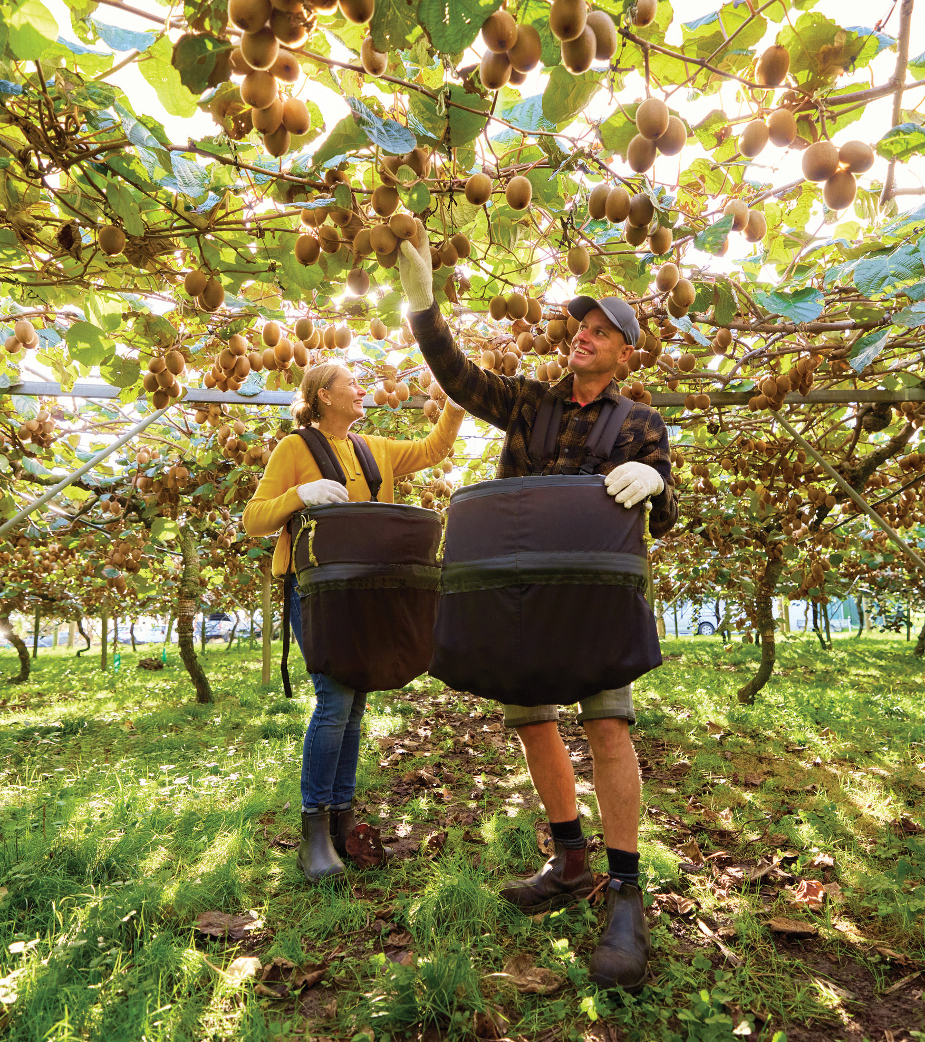

The Voice of
New Zealand’s
Kiwifruit Growers

Slide 2

Kiwifruit Growers Independent Advocate
New Zealand Kiwifruit Growers Inc. (NZKGI) works to advocate, protect and enhance the commercial and political interests of New Zealand kiwifruit growers.
Who we are
NZKGI is the government legislated Grower advocacy body representing all of New Zealand’s kiwifruit growers. NZKGI was formed in 1994 to give growers their own organisation and promote a secure and sustainable kiwifruit industry.
What we do
NZKGI is a Grower advocacy body for New Zealand’s kiwifruit Growers.
NZKGI represents kiwifruit growers, giving them their own voice in industry and government decision-making. Our work to support growers falls under six portfolios – Industry Stability, Performance & Insights, Communications, Labour & Education, Environment & Policy and Organisational Management.
The Voice of New Zealand’s Kiwifruit Growers

Slide 3

2,786
Kiwifruit
Growers
Represented by the NZKGI Forum consisting of:
15
1
8
Reps. of 12
Growing Regions
Iwi Representative
Reps of Supply Entities
The activities of which are managed and operated by:
6
7.5
Executive Members
from the Forum
FTE Staff
Members
The Voice of New Zealand’s Kiwifruit Growers

Slide 4

New Zealand’s
kiwifruit
Northland
$174m | 771 | 4.7
Auckland
$153m | 679 | 4.2
Growing regions and value
to the local economy
Bay of Plenty
$2.84b | 12,565 | 78
Waikato
$174m | 770 | 4.7
East Coast
$142m | 629 | 3.9
Key
Hawkes Bay
$41m | 180 | 1.1
Grower payments that contribute to the New Zealand economy
Lower North Island
$24m | 108 | 0.6
Producing hectares
South Island
$93m | 413 | 2.6
% of total producing hectares in NZ
The Voice of New Zealand’s Kiwifruit Growers

Slide 5
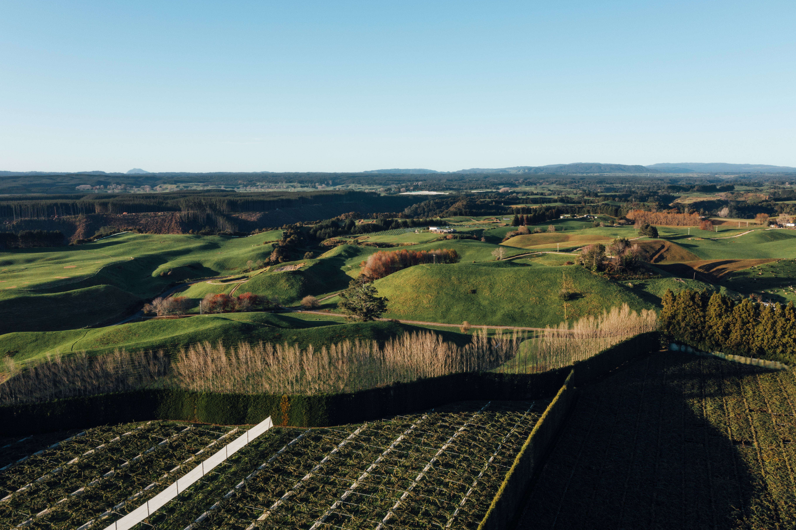
2,786 growers across 3,404 orchards
220,036,000
Submitted Trays of kiwifruit (2025/26) (New Zealand Supply)
16,115
Producing hectares
13,654
Trays per hectare
Orchard size:
Average Green
3.3ha
Average Gold
4.5ha
Average Red
2.9ha
20.2%
0-2ha
45.9%
2-5ha
24.1%
5-10ha
9.8%
10+ha
The Voice of New Zealand’s Kiwifruit Growers

Slide 6





The future
is bright
Kiwifruit is New Zealand’s largest horticultural export, accounting for
47%
of total revenue for the sector and contributing ~$4.1B to the economy
Seasonal workforce required to increase by
17,668 (2029/30*)
Strong increase in producing hectares forecast
14.5%
Global sales of New Zealand kiwifruit forecasted to rise from $4.8B (2024/25) → $6.2B by 2030 (New Zealand Supply)
10%
over the next 5 years driven by new hectares coming into production.
16,115 (2025/26)
The Voice of New Zealand’s Kiwifruit Growers
*Forecast hectare figures are indicative only and remain subject to future licence release decisions

Slide 7
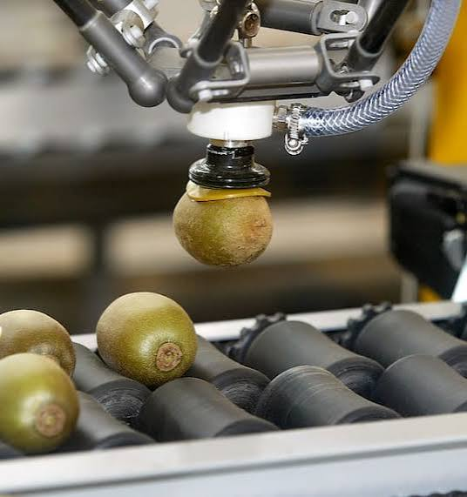
The changing landscape
Innovation, technology and global consumers are reshaping New Zealand's largest horticultural export industry​
Many people still think kiwifruit is simply growing and picking fruit.​
​
The reality is a highly sophisticated global industry driven by technology, science, sustainability and international trade.​
​
The Voice of New Zealand’s Kiwifruit Growers

Slide 8
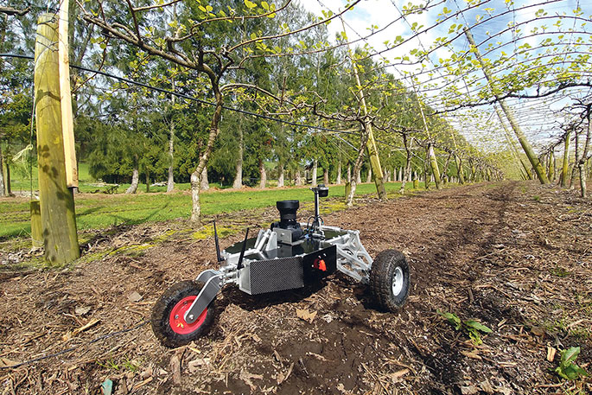
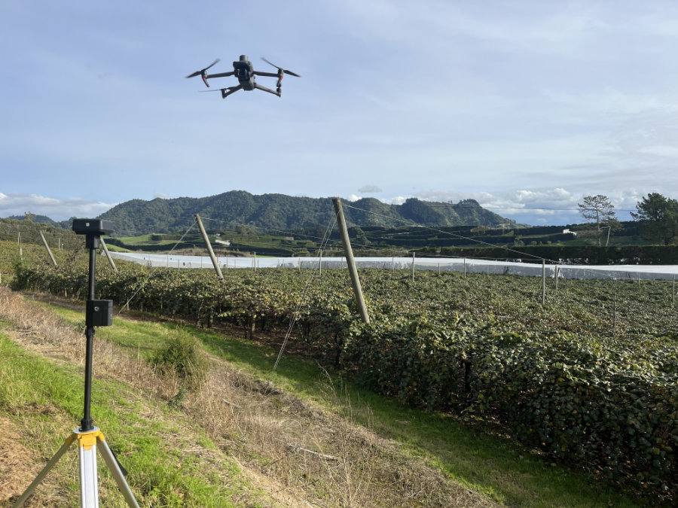
Weather stations
Irrigation monitoring
Drones
Orchard mapping technology
Growers increasingly make decisions using real-time data.
Modern orchards use technology to determine, Irrigation requirements, Pest management, Canopy management, Harvest timing, Productivity forecasting
The Orchard
of the Future
The Voice of New Zealand’s Kiwifruit Growers

Slide 9
The fastest-growing opportunities are not necessarily where people expect.
Emerging Roles
Horticultural scientists
Data analysts
GIS specialists
Agronomists
Automation technicians
Sustainability advisors
Biosecurity specialists
Supply chain professionals
Export marketers
Why this
matters for careers
The Voice of New Zealand’s Kiwifruit Growers

Slide 10
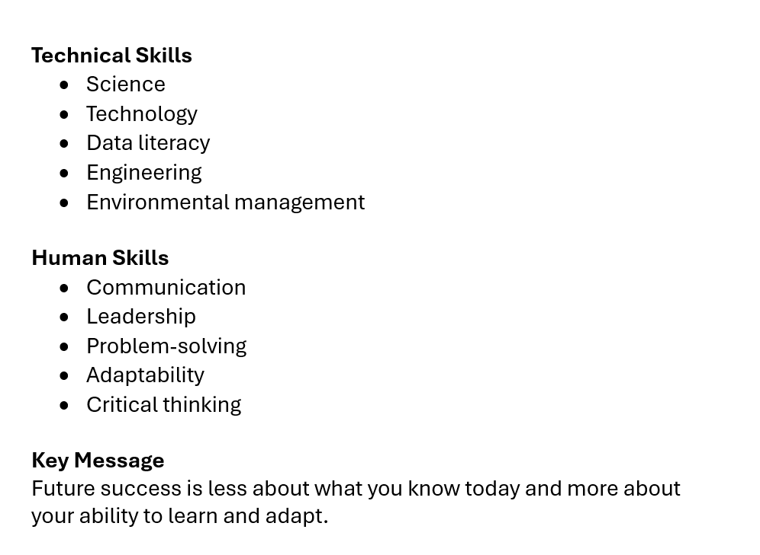
The new skills industry need
The Voice of New Zealand’s Kiwifruit Growers

Slide 11
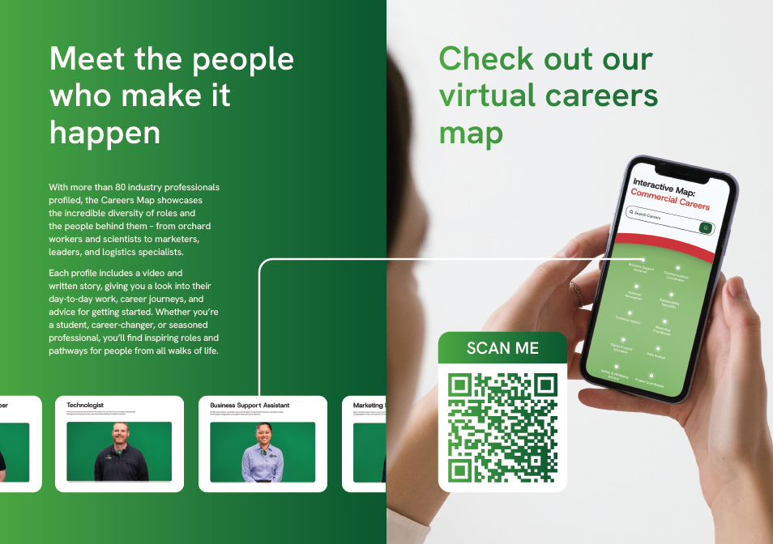
The NZKGI careers map

Slide 12
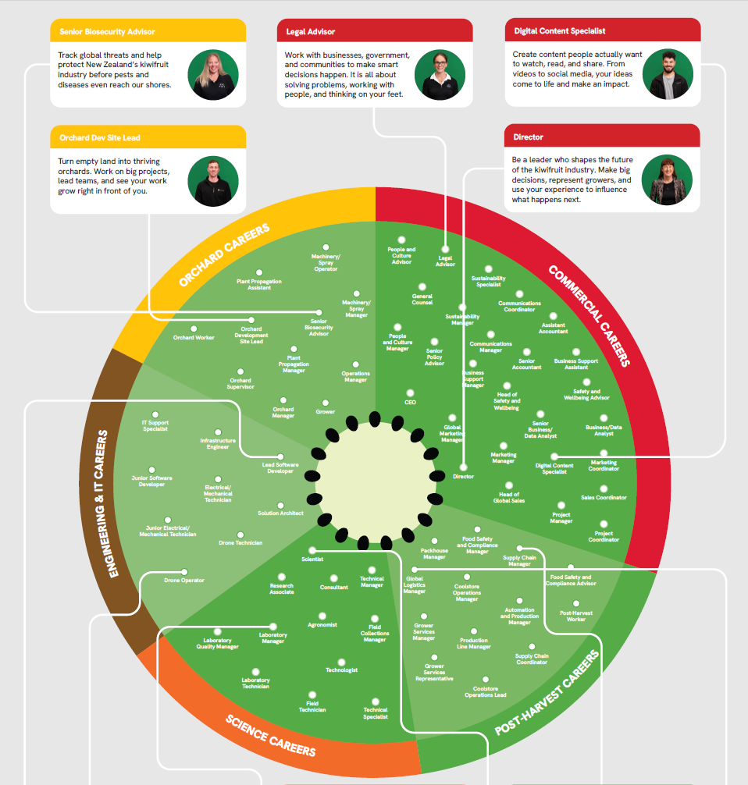
The NZKGI careers map

Slide 13
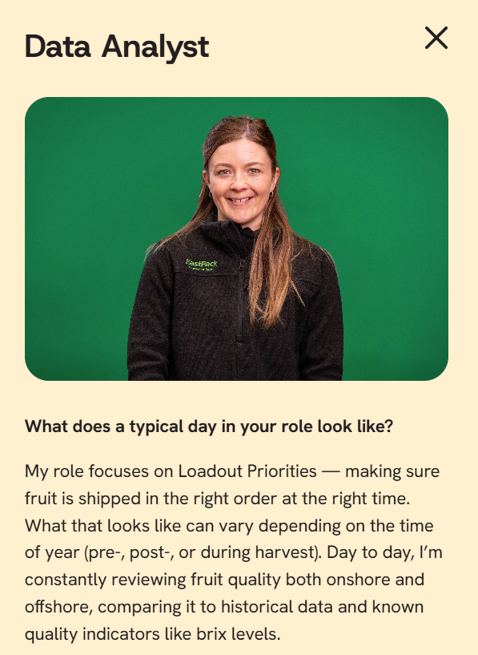
Young professionals
Scientists
Growers
Technology users
Industry leaders
Key Message
The future of kiwifruit will be
shaped by people from diverse
backgrounds, not just those
who grew up on orchards.
The people who will shape the future
The Voice of New Zealand’s Kiwifruit Growers

Slide 14
Teachers play a significant role in helping students see agriculture and horticulture differently.
The industry needs:
Scientists
Technologists
Communicators
Environmental specialists
Business leaders
Entrepreneurs
The future of horticulture will belong to people who can combine science, technology and human connection to feed a growing world.
What this means for schools
The Voice of New Zealand’s Kiwifruit Growers

Slide 15

The Kiwifruit Book
The Kiwifruit Book is currently being updated for the 2026 edition. This year, we are looking to tailor the book more specifically to students and enhance its value as a focused educational resource.
We welcome any comments, suggestions, or ideas for improvement.
Please send feedback to Mel, Kerry, or Vanessa at vanessa.malloy@nzkgi.org.nz.
The Voice of New Zealand’s Kiwifruit Growers

Slide 16
The Voice of
New Zealand’s
Kiwifruit Growers

